Slide 1
PRIVATE INVESTMENTS IN THE AUTISM SECTOR
Presented by Mark J. Macenka, Chair of the Business Law Department, Goodwin Procter LLP
February 2020

Slide 2
Private Investments in the Autism Sector – Overview
The autism treatment services sector for people 21 and under is worth approximately $15 billion
It is rapidly growing due to accelerating demand, increased prevalence and diagnosis, and expanded insurance coverage
Significant market fragmentation and high valuations related to this growth attracted increased investment from private equity groups
Acquisitions of autism treatment providers have had an unprecedented surge:
Approximately 50 M&A deals in 2019
90% were completed by private equity firms
The autism sector is made up of hundreds, if not thousands, of rapidly growing providers
Many are small operations
The primary impediment to growth for many of these companies is professional management, so well run companies are at a premium
According to John Hennegan of Shore Capital Partners
Sources: Bailey Southwell & Co; Behavioral Health Executive; Shore Capital Partners

Slide 3
Private Equity (PE) Investment
PE investment in autism services dates back to 2004 when Trimaran Capital Partners acquired Education Services of America
The market experienced a significant increase in activity over the past five years
PE involvement in the intellectual and developmental disabilities (I/DD) space spiked in 2015 –
Eight PE firms sponsored over 30 deals in a single year – a 50% increase in sector deals than the previous high
Since the uptick, PE has been increasingly interested specifically in the autism space
Recent studies show the prevalence of Autism Spectrum Disorder (ASD) is high in the U.S. – 1 in 40 children are parent-reported with an ASD diagnosis
PE backing is allowing existing providers to:
Expand their operations through partnerships and M&A with other provider organizations
Invest in technologies to improve clinical care and patient experience
Grow teams of trained clinicians to support the demand in services
Sources: Provident; Arlington Heritage Group

Slide 4
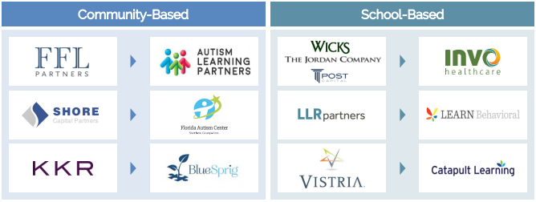
Notable Recent PE Investments
Major PE firms are now entering what has been a relatively niche investment market
August 2019: Morgan Stanley Expansion Capital fund provided funding to Alternative Behavior Strategies, a leading provider of services for children with ASD
January 2019: TA Associates acquired Behavioral Health Works, an Anaheim, CA-based company that provides School and Community-Based services in 11 states
May 2018: The Halifax Group acquired Chancelight Behavioral Health and Education, a Nashville, TN-based company offering school- and community-based services and treatment, aiming to become a national provider by growing through both organic (clinic opening) and inorganic strategies
April 2018: Blackstone Group Inc. acquired Center for Autism and Related Disorders, one of the largest treatment groups in California
Firms have been investing on both sides of the industry:
Source: BusinessWire; Bailey Southwell & Co

Slide 5
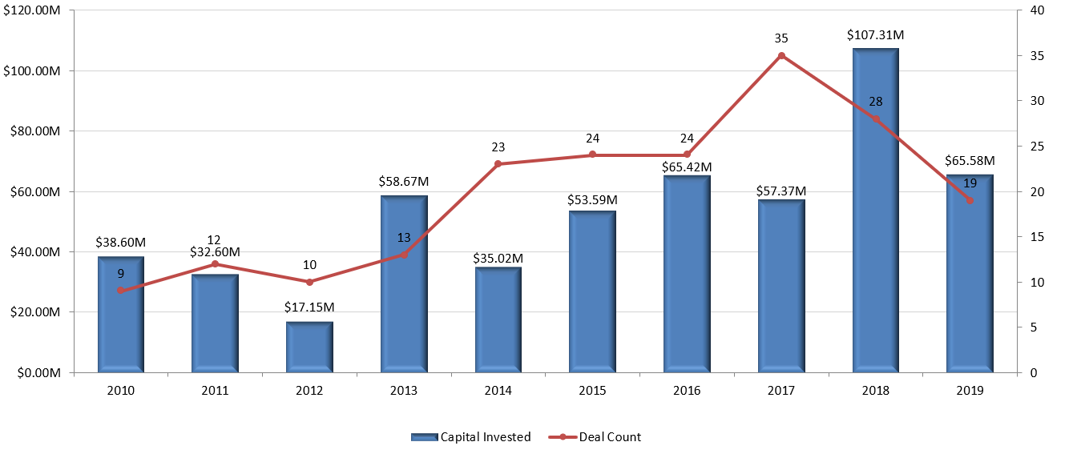
Venture Investment Trend
Though 2019 saw a regression from the spike in 2018 led by a $68 million Series C round raised by Akili Interactive, 2019 surpassed any other year in terms of Venture investment in ASD treatment companies
Note: Pitchbook does not have an industry or vertical classification for ASD-related companies. This data is based on companies involved in the space based on keyword searches of the companies’ descriptions.
Source: Pitchbook

Slide 6
What’s Next?
Other Avenues to Invest
One theme, noted by some investors, is a focus on identifying ancillary services within autism, outside the traditional delivery of therapy, such services include:
electronic records technologies, revenue cycle management, training and enterprise software all tailored to the unique needs of the space
Applied Behavior Analysis (ABA) therapy may have attributes that do not resonate with some investors, but experts believe even these more hesitant investors could increase investment in the ecosystem that supports the industry
Data Gaining More Importance
As commercial payors in the industry become more sophisticated purchasers of ABA services, tracking service-level data and outcomes is increasingly important
Investors are gravitating to providers that have the data tracking capabilities to demonstrate clinical value to payors
What About the Adult Population?
So far, nearly all the investing activity has focused on early intervention and services for children
Many experts raised the question about the unmet need for adults on the autism spectrum
Some have suggested that we will see a new wave of M&A activity involving service providers who cater to adults with alternative care models
Source: Intrepid Investment Bank

Slide 7
QUESTIONS
Presented by Mark J. Macenka, Chair of the Business Law Department, Goodwin Procter LLP
February 2020

Slide 8
Goodwin at a Glance
AmLaw Global ranked
33
Global Offices
13
Lawyers
1200+
Uniquely collaborative “one” firm culture
Highly regarded securities, white collar and IP litigation teams
5 Top Ranked Transactional Practices
Real Estate Industry
Life Sciences
Financial Institutions
Tech
Private Equity

