Slide 1
Commonwealth of Massachusetts
Community Corrections Centers
Manager’s Meeting
Probation Training Academy, Clinton MA
December 1, 2016
Alice Sweeney, Director DCS

Slide 2
AGENDA
MA WORKFORCE DEVELOPMENT SYSTEM GOVERNANCE
CURRENT LANDSCAPE OF MA WORKFORCE DEVELOPMENT SYSTEM
WORKFORCE INNOVATION AND OPPORTUNITY AND TIMELINE
PRIOR SERVICE DELIVERY STRATEGY
OUTCOMES
KEY PILLARS OF WIOA
PRIORITY POPULATIONS
COMPREHENSIVE CAREER CENTER
COMBINDED STATE PLAN

Slide 3
MA Workforce System Governance – State
GOVERNOR
MA Workforce Development Board (State Board)
(51% Private Sector Majority- Required and Membership make-up federally regulated)
EOLWD provides staff to the State Board
EXECUTIVE OFFICE
OF
LABOR AND WORKFORCE DEVELOPMENT
(EOLWD)
Appoints
STATE BOARD
DEPARTMENT
OF
LABOR STANDARDS
DEPARTMENT
OF UNEMPLOYMENT ASSISTANCE
DEPARTMENT
OF
CAREER
SERVICES
COMMONWEALTH
CORPORATION
DEPARTMENT
OF
LABOR
RELATIONS
Oversight
MA Workforce Development System
WIBs/Career Centers

Slide 4
Workforce System Governance – Local
GOVERNANCE
Chief Elected Official (CEO) (Grant Recipient)
LOCAL
WORKFORCE
DEVELOPMENT BOARD
(Local Board)
(51% Private Sector
Majority- Required Membership make-up federally regulated)
*Local Board may hire Staff for support
**CEO may appoint a fiscal agent
One-Stop Career Center
(LEAD OPERATOR)
APPOINTS
BUSINESS
Core Partners
DCS – DUA – MRC – MCB – ACLS – DTA - SCSEP
Other Local Partners
MOBD
DVS
HIGHER EDUCATION
VOCATIONAL EDUCATION
LOCAL COMMUNITY BASED ORGANIZATIONS
BUSINESS ASSOCIATIONS
Job Corp
DOC
DCS = Department of Career Services (WP, WIOA, JVSG, TAA, RESEA) DUA = Department of Unemployment Assistance (UI, RESEA, TRA )
MRC = MA) Rehabilitation Commission MCB = MA Commission for the Blind ACLS = Adult Center for Learning Services
DTA = Department of Transitional Assistance = TANF , SNAP SCSEP = Senior Community Services Employment Program
MOBD = MA Office of Business Development DVS = MA Department of Veteran Services

Slide 5
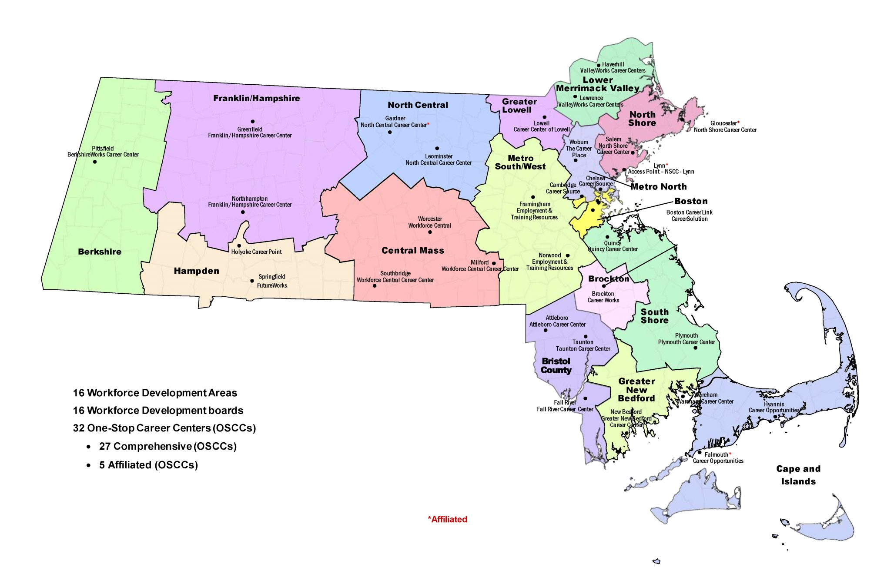
LANDSCAPE MA WORKFORCE DEVELOPMENT SYSTEM

Slide 6
PRIOR SERVICE DELIVERY STRATEGY
SUPPLY DRIVEN SYSTEM
Job Seeker
Prepare to find your next job
Explore options to upgrade your skills and/or change career
Access specialized services
Connect to community resources
Business
Post Job Openings
Conduct Job Fairs
On-site Recruitment
Access to Business Services

Slide 7
OUTCOMES
FY16 July 1, 2015 – June 30, 2016
153,883 JOB SEEKERS SERVED
94,379 UNEMPLOYMENT INSURANCE CLAIMANTS
10,603 BUSINESSES SERVED
80,785 ENTERED EMPLOYMENT
Currently no statewide reintegration programming grant however pilot programs operating in different Workforce Areas in those areas 2000 returning citizens have been served

Slide 8
WORKFORCE INNOVATION AND OPPORTUNITY ACT
(WIOA)
The Workforce Innovation and Opportunity Act (WIOA), a federal act, was signed into law on July 22, 2014. WIOA is designed to help job seekers access employment, education, training, and support services to succeed in the labor market and to match employers with the skilled workers they need to compete in the global economy. WIOA is the first legislative reform of the public workforce system in fifteen years.
WIOA Principles: The federal Act promotes an integrated, job-driven public workforce system that links diverse, talented individuals to businesses to improve employment outcomes.
WIOA Enacted
July 2014
Policy and Planning in Regional and Local Areas
November 2016 – June, 2017
Combined State Plan Draft
November 2015
Implementation Phase:
Technical Assistance & WIOA State Policy Guidance for local areas
April – July 2016
Lead Operator
In Place
Local Signed
Umbrella
MOUJuly 1, 2017
MWIB
Establishes
WIOA Steering Committee
October, 2014
Steering Committee &
Workgroups
October, 2014 – November, 2015
Final Rules
Enacted
August, 2016
Provisions
Take Effect
July 2015
*ETPL
*Eligibility
Submission of Combined State Plan
March, 3, 2016
Adjusted
April 1, 2016
DOL Final Approval
October, 2016

Slide 9
KEY PILLARS OF WIOA
One-Stop Career Centers, the foundation of the public workforce system, will provide first-rate customer service to employers and jobseekers;
The demands of businesses and workers will drive public workforce system actions; and,
Through strategic partnerships and regional coordination, the public workforce system will support a strong workforce and strong regional economies.
Continuous QUALITY improvement through evaluation, accountability, best practice identification, and data driven decision making.

Slide 10
PRIORITY POPULATIONS
WIOA requires states to connect supports and services along a continuum for priority populations that lead to long-term employment outcomes for individuals seeking services, especially those with significant challenges to employment.
Veterans
Unemployment Insurance Claimants
Youth and Adults with Disabilities
Low-Income
TANF, SNAP, homeless, and low-income individuals are a priority population across all WIOA programs.
Reentry – Returning Citizens
Older Workers
Out-of School Youth
WIOA Title I Youth funding shifts the focus on funding use from in-school to out-of-school youth.
Integrate ABE programming with core partner services to refer and co-enroll youth 16-24 and connect ABE out-of-school youth with core programs.
New referral, co-enrollment and transitional support service requirements for vocational rehabilitation.

Slide 11
COMPREHENSIVE CAREER CENTER
A comprehensive One-Stop Career Center is a physical location where jobseeker and employer customers can “access” the programs, services, and activities of all required partners.
A comprehensive one stop center must provide:
Basic Career Services
Business Services
Access to Training Services
Access to any WIOA Employment and Training Services
Access to Employment Services
Access to Workforce and Labor Market Information
Access to Core Partners Programs and Services
Access to Unemployment Insurance
All Comprehensive One-Stop Career Centers must be physically and programmatically accessible to individuals with disabilities.

Slide 12
COMBINED STATE PLAN
Submitted to the U.S. Departments of Labor, Education, and Health and Human Services.
A collaborative effort across federally funded programs that provide employment and training services for adults, dislocated workers, youth and veterans, adult education and literacy programs, vocational rehabilitation programs that assist individuals with disabilities in obtaining employment, and employment programs for those on public assistance and or with barriers to employment.
www.mass.gov/massworkforce/state-plan

Slide 13
Combined Plan: Vision Statement
All Massachusetts residents will benefit from a seamless system of education and workforce services that supports career pathways for individuals and leads to a more informed, educated, and skilled workforce, which meets the Commonwealth’s businesses’ demands and sustains a thriving economy.
To achieve this vision, Massachusetts will engage businesses to understand their needs and develop an integrated education and workforce system that supports career pathways to prepare residents with foundation, technical, professional skills and information and connections to postsecondary education and training. WIOA partners will work to:
Design career pathways across partners aligned with business demand
Improve foundation skills and transition to postsecondary education and training for individuals with barriers to employment
Assist low-income individuals and families to achieve economic self-sufficiency through support services, labor-market driven credentialing, and employment
Meet the needs of job seekers and businesses who engage in the public workforce system (including partner programs)

Slide 14
INTEGRATED SERVICE DESIGN: PERSON - CENTRIC
State and Local MOUs are designed around a “career pathway” approach based on customer perspective, not focused on the operations of funding streams.
CLASP GRAPHIC: http://www.clasp.org/resources-and-publications/publication-1/Alliance-WIOA-CP-Summary.pdf

Slide 15
Adult Job Seeker Customer Flow Model
New statewide customer flow to manage individuals from various referral sources who are triaged based on new, intensive skill assessment tools to Job Ready and Skill Building Teams within the Career Center.

Slide 16
Demand-Driven Design: Business Centric
Entry Point for Business
Assessment, Triage & Referral
Account Management
Service Delivery
Outcomes
Core Partner Agencies (Career Center, WDB, MRC, MCB, DTA, ABE)
Community College
Economic Development
Business to Business Referral
Job Fair
Job Posting
Assess business need and priorities
What are the skill needs?
Are there existing programs, resources, or capacity to meet business needs?
Are work-based training models appropriate?
Is customer eligible for Workforce Training Fund?
Account manager (agency) based on business need. Examples:
Talent sourcing & development = career center
Incumbent worker training = Workforce Training Fund
Economic incentives = MOBD
Layoff aversion
Business access to education and training resources
Referral to incentives
Successful hires
Employee retention
Repeat business/ referrals
Talent sourcing
Demand Driven “Flipping the Model”- Increase talent recruitment and hiring for business partners through business outreach, talent recruitment, matching and education and training activities that match business need

Slide 17
CROSS-AGENCY/WORKFORCE SYSTEM
COORDINATION
STATEWIDE MEMORANDUM OF UNDERSTANDING (MOU)
Articulates a coordinated vision for organizing the broadly defined public workforce system
Establishes agreement at the state level focused on designing partnerships and service delivery systems through the WIOA Core Program partners
Priority Populations (low-income, TANF/SNAP, disability, veterans, homeless, CORI, etc.)
Will establish a definition and set of shared and infrastructure costs
Will guide the establishment of local area partnerships and MOU agreements

Slide 18
CROSS-AGENCY/WORKFORCE SYSTEM
COORDINATION
LOCAL UMBRELLA MOU
The 16 Workforce Boards will convene stakeholders to:
Establish the roles of local partners in the development of an integrated education and workforce system that supports career pathways in each region to prepare residents with foundation, technical, and professional skills, and provide information and connections to postsecondary education and training
Design and develop “Umbrella” MOUs that focus on populations and service design (not funding streams)
Workforce Boards will lead partners to develop “Umbrella” MOUs and focus on demand-driven practice and integrate service design
Agree to operational costs of service delivery (shared and infrastructure costs)

Slide 19
CROSS AGENCY-COORDINATION
DEFINITION SHARED CUSTOMER
A shared customer is a job seeker or a business who is formally enrolled in services by more than one core program (at the same time or sequential) *
*If applicable a “shared” customer must meet the eligibility criteria of the partner agency providing services.

Slide 20
CROSS AGENCY – COORDINATION
Roles and Responsibilities of the
Required OSCC Partners
Each required Partner must:
Provide access to its programs or activities through the OSCC delivery system, in addition to any other appropriate locations;
Use a portion of funds made available to the partner’s programs to:
Provide applicable career services;
Work collaboratively with State and Local Boards to establish and maintain the one-stop delivery system this includes jointly funding the one-stop infrastructure through partner contributions.

Slide 21
CROSS AGENCY – COORDINATION
SHARED COSTS
DEFINITION: Cost of shared services that are provided through the Partner programs to an individual or business.
EXAMPLES INCLUDED BUT NOT LIMITED TO:
Initial Intake
Assessment
Review of Basic Skills
Identification of and Referral to Appropriate Services
Business Services
HOW ARE SHARED COSTS CALCULATED?
The federal government has not provided a consistent methodology across agencies (i.e. % of FTE, cost for % of program partner customer using OSCC, etc)
Methodology/ calculations are defined by local partners

Slide 22
CROSS AGENCY – COORDINATION
Roles and Responsibilities of the
INFRASTRUCTURE COSTS
Each required Partner must support the one-stop delivery system by jointly funding the OSCC infrastructure through Partner contributions.
Each Partner must contribute to the OSCC whether or not they are physically located in the OSCC.
DEFINITION: Infrastructure Costs are non-personnel costs that support the general operation of the One Stop Center.
EXAMPLES
Rental of Facilities
Utilities and Maintenance
Equipment including assessment – related products and assistive technology for individuals with disabilities
Technology to facilitate access to the one-stop center

Slide 23
ALSO INCLUDED IN
COMBINED PLAN
FEDERAL PERFORMANCE STANDARDS
STATE PERFORMANCE METRICS
WORKFORCE DEVELOPMENT BOARD STANDARDS
ONE STOP CAREER CENTER STANDARDS

Slide 24
STILLL TO COME
Integrated Data Systems
Competitive Selection of Lead Operator
Determining Shared & Infrastructure Costs
Staff Development Across Core Partners
Regional Planning
Annual Planning
Workforce Board Certification
Career Center Certification

Slide 25
WHERE IS COMMONWEALTH
IN IMPLEMENTATION
April 16, 2015 - Publish Notices of Proposed Rulemaking
July 1, 2015 — Majority of Provisions take effect
WIA State and local plan provisions continue to apply
Current performance accountability system remains in effect
July 1, 2015 — ETPL provisions are implemented by Governors and Boards
January 22, 20l6 - DOL, ED and HHS publish Final Rules to implement WIOA
The final regulations issued August, 2016
March 3, 20l6 - Deadline for state Combined Plan submissions
Final plan guidance may not be available until February, 2016 due date changed to April 1, 2016. The Commonwealth has submitted on time.
July 1, 2016 - Full Implementation – Program, services and activities
One-stop infrastructure cost requirements pushed out to July, 2017
Use of common One-Stop identifier must be implemented
July 1, 2017 – Lead Operator of Local One-Stops in place.

