Slide 1
Strengthening Resident and Family Councils Problem Solving in Long-Term Care: Tips for effective complaint and grievance resolution November 2017
Notes:
Welcome to this educational program, “ Problem Solving in Long Term Care : Tips for effective complaint and grievance resolution” part of an initiative on Strengthening Resident and Family Councils and Engagement.
I’m Paula Griswold, the Executive Director of the Massachusetts Coalition for the Prevention of Medical Errors.
Our Coalition was contracted by the Massachusetts Department of Public Health, sponsor of this initiative to increase resident and family engagement in Massachusetts nursing homes, and improve the quality of life for residents.
The project is funded through the federal government Center for Medicare and Medicaid Services.

Slide 2
Introduction
Goals
Engage residents and families
Partner with nursing homes on improvement
Improve quality of life for residents

Slide 3
Problem Solving in Long-Term Care: Tips for effective complaint and grievance resolution
Marci Cooley, LSW
Former Local Ombudsman Program Director

Slide 4
Problem Solving in Long-Term Care:
Tips for effective complaint and grievance resolution

Slide 5
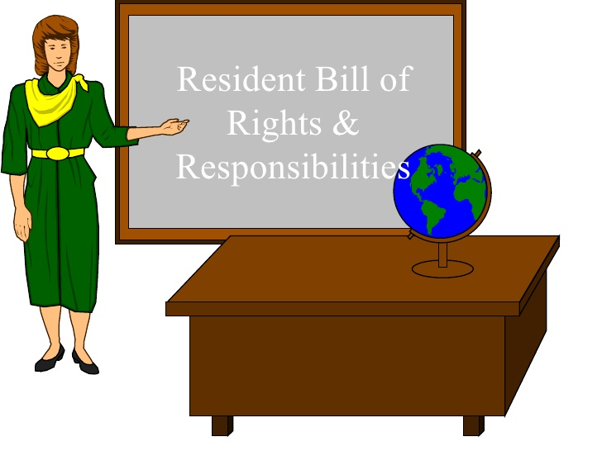
Watch the related webinar
Resident Rights

Slide 6
Choosing how to address a concern

Slide 7
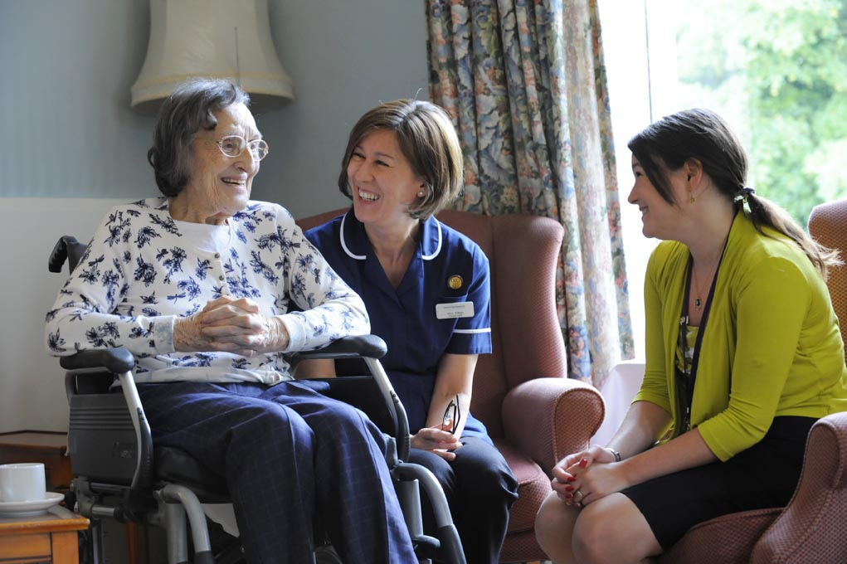
Start with facility staff

Slide 9
Resident & Family Council

Slide 10
Care Plan Meetings

Slide 11
Department of Public Health

Slide 12
Recap
Staff
Ombudsman
Resident and/or Family Council
Care Plan Meetings
The Department of Public Health

Slide 13
Contact and Resources
Staff can be found at the long-term care facility.
Massachusetts Ombudsman Program 1-800-243-4636
The Department of Public Health call: 1-800-462-5540 or fax: (617) 753-8165
Resources

