Slide 1
Profound Autism Advisory Council
Virtual Kick-Off Meeting
June 12, 2026

Slide 2
Agenda
Welcome
Ethics and Conflict of Interest Overview
Member Introductions & Expectations
Council’s Charge
Data Presentation
Next Steps

Slide 3
Ethics and Conflict of Interest Overview (1 of 2)
Conflict of Interest
All Massachusetts state, county, and municipal public employees are subject to the Massachusetts Conflict of Interest laws.
By the very nature of their service on state boards, commissions, and councils, members are considered “special state employees” and are also subject to this law.
To ensure members have familiarized themselves with the details of the Conflict of Interest laws and requirements, each of you are required to undertake the State Ethics Commission’s online Conflict of Interest training within 30 days of your appointment to the Council and every other year thereafter.
This online training is mandatory, takes roughly an hour to complete, and will walk members through the laws pertaining to conflicts of interest and the importance of filing all necessary disclosures.
Upon completion of the training, members’ certification forms should be sent directly to Council staff for their records.

Slide 4
Ethics and Conflict of Interest Overview (2 of 2)
Remember: when in doubt, contact your appointing authority or the State Ethics Commission.
Council members should view the State Ethics Commission as a resource and are encouraged to contact the State Ethics Commission with any questions or concerns related to potential conflicts of interest and any required disclosures.
Advice is confidential and cannot be provided for past conduct or for matters pertaining to a third party.
The State Ethics Commission can be contacted at (617) 371-9500
Requests for advice can also be submitted through the State Ethics Commission’s website: www.mass.gov/orgs/state-ethics-commission

Slide 5
Welcome
Ethics and Conflict of Interest Overview
Member Introductions & Expectations
Council’s Charge
Data Presentation
Next Steps

Slide 6
Member Introductions & Expectations
Allison Bovell-Ammon
Co-chair (non-voting member)
EOHHS
Amit Basak
Co-chair, Appointee of the Governor
Rosalind Baker
Appointee of the Governor
Jennifer Bertrand
Appointee of the Governor
Susan Ciccariello
MassHealth
Josh Cuddy
EOHLC
Rita Gardner
Appointee of the Governor
Sen. Robyn Kennedy
Joint Committee on Children, Families and Persons with Disabilities
Kelly Lawless
DDS
Alec Lebovitz
A&F
Rep. Jay Livingstone
Joint Committee on Children, Families and Persons with Disabilities
Liz Martineau
Appointee of the Governor
Ann Neumeyer
Appointee of the Governor
John Randall
Appointee of the Governor
Shawn Robinson
Appointee of the Governor
Fernanda Rocha
Appointee of the Governor
Amam Saleh
DMH
Maura Sullivan
Appointee of the Governor

Slide 7
Welcome
Ethics and Conflict of Interest Overview
Member Introductions & Expectations
Council’s Charge
Data Presentation
Next Steps

Slide 8
Council’s Charge (1 of 2)
Executive Order 656, signed in March 2026, established the Profound Autism Advisory Council and directs the body to develop a statewide plan that seeks to:
  Report on the prevalence of Adults with Profound Autism in Massachusetts;
  Strengthen coordination across state systems serving adults with Profound Autism, including exploring eligibility requirements across service systems;
  Promote person-centered, strengths-based approaches that recognize the needs of Adults with Profound Autism;
  Identify opportunities to improve access to stable housing, health care, community-based services, and meaningful daily activities;
  Encourage innovative residential living and service models that support safety, stability, and quality of life;
  Improve the use of data to understand population needs, service utilization, outcomes, and efficient use of state resources over time;

Slide 9
Council’s Charge (2 of 2)
Continued…
  Support a sustainable and well-trained workforce responsive to level of care and support needs; and
  Inform future policy and budget planning in a manner consistent with the Commonwealth’s long-term fiscal responsibility.
The Council may also identify innovative approaches for supporting adults with Profound Autism, including place-based or integrated models that bring together housing, services, and health care in new ways, consistent with state and federal law.
The strategy shall be presented to the Governor as a written report to inform policy and budgetary decisions regarding services and supports for Adults with Profound Autism.

Slide 10
Goals
Over the 12 months, the Council will focus on developing a statewide strategy that includes multi-dimensional aspects of services impacting adults with Profound Autism
Service delivery models
Workforce
Residential models
Cross-agency infrastructure
Health care
Turning 22 transitions
Technology
Rights and Safety
Transportation

Slide 11
Welcome
Ethics and Conflict of Interest Overview
Member Introductions
Council’s Charge
Data Presentation
Next Steps

Slide 12

Autism Services
Overview & Population Data
June 2026

Slide 13
DDS: Our Mission
To create, in partnership with others, innovative and genuine opportunities for individuals with Intellectual and Developmental Disabilities to participate fully in their communities and meaningfully engage as valued members.
Commonwealth of Massachusetts · Department of Developmental Services

Slide 14
DDS: History of Autism Services
In 2014, the Autism Omnibus Bill established the Autism Commission and expanded DDS Eligibility to include services for those with Autism Spectrum Disorder (Autism).
As a result, beginning around 2016, individuals could be found eligible for DDS Services on the basis of being diagnosed with an Intellectual or Developmental Disability, Autism, or both.
Profound Autism: In 2021, the Lancet Commission on the future of care and research in autism defined "profound autism" to refer to individuals with autism spectrum disorder who require 24-hour support and assistance due to a significant intellectual disability and limited to no language skills
In 2025, the International Society for Autism Research released a first consensus-based definition for Profound Autism, describing those with Autism and severely impaired cognitive abilities who require significant supports based on an inability to independently perform most activities of daily living.
Commonwealth of Massachusetts · Department of Developmental Services

Slide 15
DDS: Eligibility Criteria
Intellectual Disabilities
Autism Spectrum Disorder
Defined by significantly sub-average intellectual functioning existing concurrently with, and related to, significant limitations in adaptive functioning.
May relate to various developmental disabilities, including Autism.
Without co-occurring Intellectual Disability
Eligibility expanded to include Autism 'only' by the Autism Omnibus Bill (2014)
Note: Additional eligibility for Prader-Willi and Smith-Magenis Syndromes are embedded within Autism Service Eligibility
Commonwealth of Massachusetts · Department of Developmental Services

Slide 16
DDS and Profound Autism
Historically, because of the severe cognitive impairment present for those with Profound Autism, most individuals with Profound Autism receiving DDS services have been found eligible based on Intellectual Disability.
DDS eligibility determinations have historically prioritized the category providing the highest level of supports — most often Intellectual Disability — even when both ID and Autism are present. As a result, the extent to which individuals carry a dual eligibility designation may vary across the system.
Commonwealth of Massachusetts · Department of Developmental Services

Slide 17
DDS: Current Limitations of Data on Profound Autism
The challenge remains that there is no diagnostic criteria or universally accepted definition of Profound Autism.
DDS Eligibility is based on assessment and diagnosis by a qualified provider.
As of Spring 2026, there remains no single diagnostic code in the Diagnostic and Statistical Manual of Mental Disorders (DSM-5-TR) or International Classification of Diseases (ICD-10) for Profound Autism.
Individuals are often diagnosed by providers with other, related diagnoses (e.g., intellectual disability, pervasive developmental disorder, global developmental delay).
Often, individuals who may be conceptualized as having Profound Autism have difficulty accessing or engaging in full diagnostic evaluations.
Commonwealth of Massachusetts · Department of Developmental Services

Slide 18
DDS: Current Limitations of Data on Profound Autism
The following data relates to known cases of individuals in the DDS system who have Autism or Autism and a co-occurring Intellectual Disability.
For individuals diagnosed with both Autism and Intellectual Disability, Autism designation is likely undercounted in eligibility records due to the practices described below. The data below should be interpreted with these structural limitations in mind.
DDS eligibility requirements have not historically mandated dual-category designation when both Intellectual Disability and Autism are present.
In practice, eligibility has typically been assigned based on the category that unlocks the highest level of supports — most commonly Intellectual Disability. This means co-occurring Autism diagnoses may not be consistently reflected in eligibility records, particularly when the individual was found eligible prior to the expansion of services for those with Autism in 2014.
Commonwealth of Massachusetts · Department of Developmental Services

Slide 19
DDS: Current Limitations of Data on Profound Autism
As a result: Available data does not fully capture the population best understood through the emerging definition of Profound Autism. The figures presented here reflect known eligibility designations and should be interpreted with these structural data limitations in mind.
Commonwealth of Massachusetts · Department of Developmental Services

Slide 20
Summary: DDS data summarizing the number of individuals served by DDS, including those currently and actively receiving services, individuals with autism and/or Prader-Willi Syndrome currently/actively receiving services, individuals with autism and intellectual disability currently/actively receiving services, and individuals with autism broken down by age group.
Note: As the data presented during the meeting was incomplete and subject to important limitations, it is summarized here to provide appropriate context and reduce the risk of misinterpretation if shared or published separately from the meeting discussion.
Individuals Served by DDS

Slide 21
Summary: DDS data summarizing the annual growth of individuals with autism and intellectual disability eligible for DDS services from 2021 through 2026.
Note: As the data presented during the meeting was incomplete and subject to important limitations, it is summarized here to provide appropriate context and reduce the risk of misinterpretation if shared or published separately from the meeting discussion.
Annual Growth of DDS Autism and ID Population

Slide 22
Summary: Descriptions of DDS services for individuals with Profound Autism, which include employment, supports, finance, transportation, and residential services.
Note: As the data presented during the meeting was incomplete and subject to important limitations, it is summarized here to provide appropriate context and reduce the risk of misinterpretation if shared or published separately from the meeting discussion.
DDS Profound Autism Services

Slide 23
Summary: List of some of the agencies currently working with DDS to provide services for individuals with autism and intellectual disability.
Note: As the data presented during the meeting was incomplete and subject to important limitations, it is summarized here to provide appropriate context and reduce the risk of misinterpretation if shared or published separately from the meeting discussion.
Agencies Currently Providing Services
to People with Autism and Intellectual Disability

Slide 24
Summary: List of the key support services DDS is currently providing for individuals with autism and those diagnosed with autism and intellectual disability.
Note: As the data presented during the meeting was incomplete and subject to important limitations, it is summarized here to provide appropriate context and reduce the risk of misinterpretation if shared or published separately from the meeting discussion.
Autism Services — Key Supports

Slide 25
Summary: List of the day and employment services DDS is currently providing for individuals with autism and those diagnosed with autism and intellectual disability.
Note: As the data presented during the meeting was incomplete and subject to important limitations, it is summarized here to provide appropriate context and reduce the risk of misinterpretation if shared or published separately from the meeting discussion.
Autism Services — Day & Employment Overview

Slide 26
Administration &
Finance

Slide 27
DDS Historical Spending Data on ASD Population
As the primary human services provider for residents with ASD diagnoses, DDS has seen both increased caseload and spending across autism focused service accounts since the pandemic

Slide 28
DDS Historical Spending Data on ASD Population
ASD caseload has risen rapidly since 2014 Autism Omnibus passage and has become a top driver of overall DDS caseload and spending growth.
Total ASD caseload for DDS has more than doubled since 2020, while overall caseload rose by 18%
Over the same period, estimated DDS spending on ASD services increased from $41 M in FY20 to a projected $130 M in FY27, representing a 217% increase in DDS spending on ASD services since FY20
Increasing acuity and lifetime diagnoses also pose challenges for managing caseload and costs over time

Slide 29
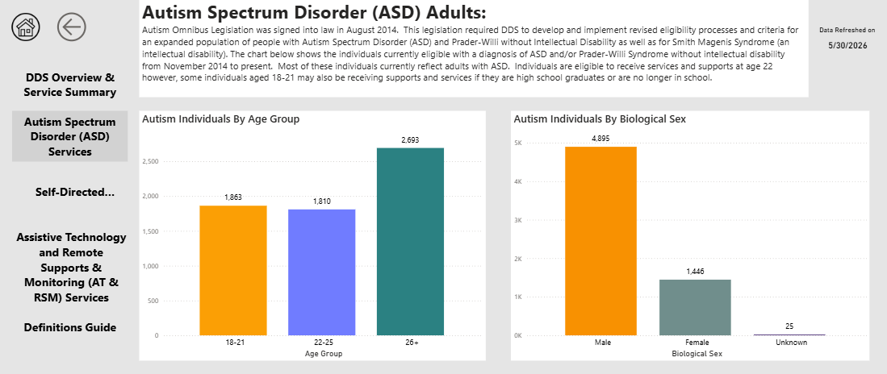
DDS Caseload Snapshot
ASD Caseload without ID snapshot:

Slide 30
Welcome
Ethics and Conflict of Interest Overview
Member Introductions & Expectations
Council’s Charge
Data Presentation
Next Steps

Slide 31
Next Steps
Monthly Council meetings (virtual)
In-person workshop (July)
Formation of a subcommittee focused on planning for innovative residential models
Public listening sessions to solicit feedback from providers and advocates, direct care workforce, and families of adults with Profound Autism

Slide 32
Council Webpage & Email Address
Webpage
Meeting notifications and summaries of materials reviewed by the Council will be posted on the Council’s Mass.gov webpage:
https://www.mass.gov/profound-autism-advisory-council
Email
Members of the public are welcome to share questions and comments directly with Council staff:
profoundautismadvisorycouncil@mass.gov

Slide 33
Thank you!

