Slide 1
MAP Advisory Group
Meeting
Massachusetts Department of Public Health
March 16, 2017
Mary Rota
DPH Clinical Reviewer,
Medication Administration Program
Drug Control Program
James Lavery, JD
Director
Bureau of Health Professions Licensure
Lauren B. Nelson, Esq.
Director of Policy and Regulatory Affairs
Bureau of Health Care Safety and Quality

Slide 2
New Location
Executive Office of Health & Human Services
Department of Public Health
Bureau of Health Professions Licensure
239 Causeway Street, Boston, MA
Drug Control Program
Medication Administration Program (MAP)

Slide 3
MAP Policy - Background
The Medication Administration Program (MAP) is authorized by chapter 94C of the General Laws, The Controlled Substance Act, pursuant to:
105 CMR 700.000, Implementation of M.G.L. c. 94C, and
The appropriate regulations of:
The Department of Mental Health in 104 CMR 28.06: Medication,
The Department of Developmental Services in 115 CMR 5.15: Medication, or
The Department of Children and Families in 110 CMR 11.00: Medical Authorizations.
MAP Registered sites must follow these regulations, statutes and the MAP Policy Manual, drafted thereunder.

Slide 4
MAP Policy - Development
Issue brought to DPH attention
Discussion MAP Administrators
Develop, modify, remove policy
Discussion/Feedback MAP Coordinators
MAP Work Group (Operational) “Help Make it Work”

Slide 5
MAP Policy - Development
Pilot (if necessary)
Feedback (tweak)
Forwarded to MAP Advisory Group for Feedback (tweak again)
Implemented
Letter Sent to Service Providers
Policy Posted to DCP/MAP Website

Slide 6
MAP Policy Proposed Revisions

Slide 7
Definitions

Slide 8
Policy 02-1(7)

Slide 9
Policy 02-1 (9)

Slide 10
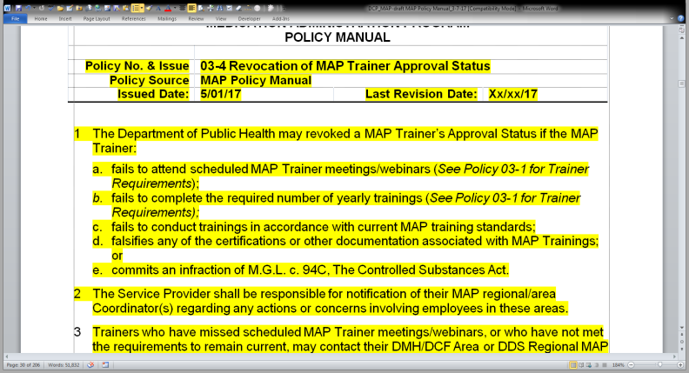
Policy 03-4 (New)

Slide 11
Policy 04-1 Advisory Ruling Number 9401

Slide 12
Policy 06-2 (1)

Slide 13
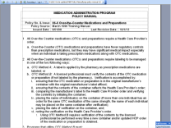
Proposed Changes
Remove Policy 06-6 Over-the-Counter Medications and Preparations
Supplement with two new Policies
06-6 Over-the-Counter Medications
06-7 Dietary Supplements

Slide 14
Policy 06-6 (Revision)

Slide 15
Proposed Changes- Over-the-Counter (OTC)
Remove ‘Preparations’ from policy
Remove OTC ‘Method B’ from policy
Require that all Over-the-Counter Medications:
Have a HCP order
Have a pharmacy label

Slide 16
Policy 06-7 (New) Dietary Supplements

Slide 17
Proposed Changes- Dietary Supplement
Dietary Supplement Policy will Require that all Dietary Supplements:
Have a HCP order
Have a pharmacy label

Slide 18
Proposed Changes- Dietary Supplement
Dietary Supplement Labeling Exemption
May be exercised if best efforts to have the dietary supplement labeled have been exhausted
When exemption in place, a Verification Procedure by a licensed professional must be completed

Slide 19
Policy 07-3 (1) (c)

Slide 20
Policy 08-2 (2)

Slide 21
Policy 08-5 (4)(b)(ii)(2)(a)

Slide 22
Policy 08-5 Sample Warfarin Medication Sheet

Slide 23
Policy 08-6 (2)(a)(ii)(1) and (4)(b)(iii) and (iv)

Slide 24
Evaluation Tool for Clozapine Therapy (5), (6), (7), (10), and (20)

Slide 25
Policy 08-6 Sample Clozapine Medication Sheet

Slide 26
Policy 08-7 (2)(a.) and (2)(a.)(i)(1.)

Slide 27
Policy 08-7

Slide 28
Policy 09-6 (9) (a.) (ii) and (iii)

Slide 29
Policy 09-7 MOR Form

Slide 30
Policy 09-7 MOR Form-Contact List

Slide 31
Policy 10-1 (3) (f)

Slide 32
Policy 10-1 (4)

Slide 33
10-2 (6) and (6) (a)

Slide 34
Policy 10-3 (1)

Slide 35
Policy 10-3 (3)

Slide 36
Policy 10-4 (3)

Slide 37
Policy 10-7 (3) (a)

Slide 38
Policy 13-2 (2)(g)(i)

Slide 39
Policy 13-5 (2)(b)

Slide 40
Policy 14-2

Slide 41
Policy 14-2 (4)(a)(iv)

Slide 42
Policy 14-2 (8)

Slide 43
Policy 14-4 Gastrostomy/Jejunostomy Registration Form

Slide 44
Policy 16-2

Slide 45
Policy 17-1

Slide 46
Section 18 MAP Advisories

Slide 47
New MAP Advisory Waiver Provision

Slide 48
Discussion

