Slide 1
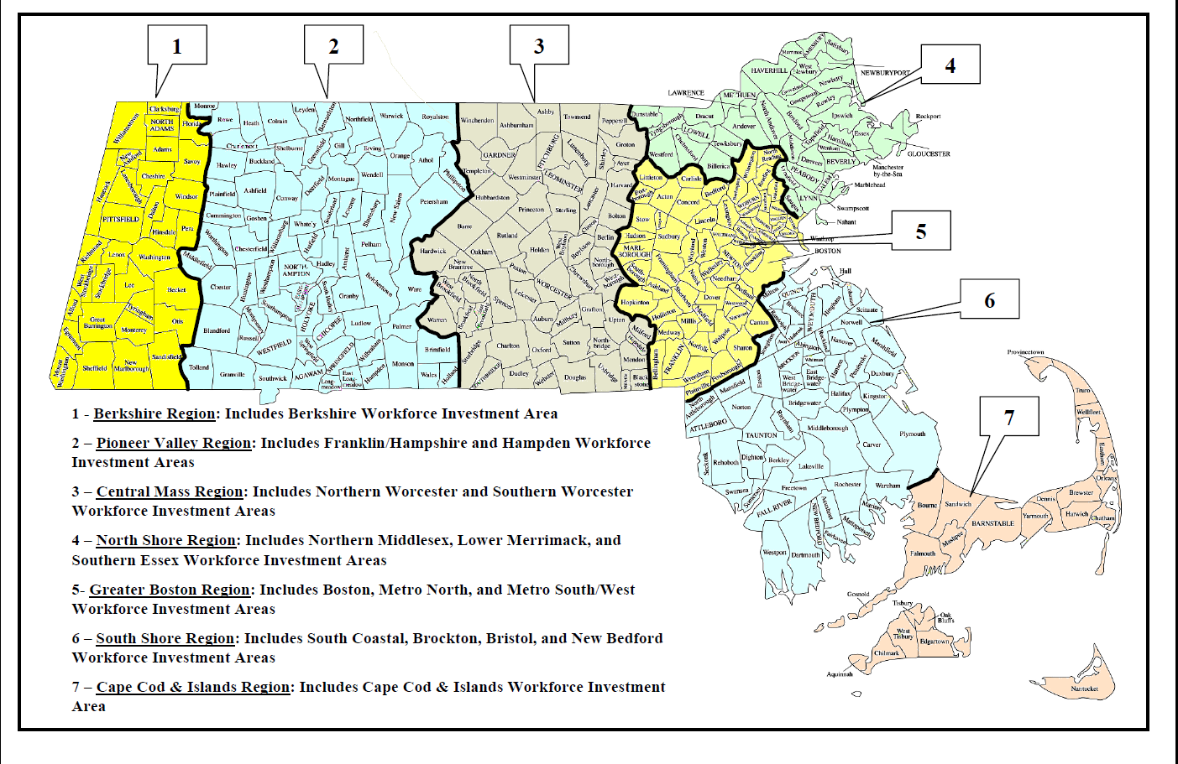
Proposed Regional Planning Areas

