Slide 1
Welcome
Provider training
Notes:
Doreet

Slide 2
Agenda
Welcome
Brief summary of CMS rule and workgroup activities
Review of strengthened and new indicators – licensure and certification
Brief discussion of Assistive technology indicator
Review of new Certification process
Certification levels
Next steps
Notes:
Doreet

Slide 3
The Community Rule
The Federal Government issued a rule for settings that provide HCBS waiver services that defines what a home and community-based setting is.
All settings must meet these definitions and requirements by March 2019
Notes:
Laney

Slide 4
It defines a community setting…
A more outcome-oriented definition of home and community-based settings
Not solely based on:
    Location
    Geography
    Physical characteristics
    Number of individuals
    Size

Slide 5
The Community Rule
CMS topics
    Respect and dignity
    Community integration
    Choice and control
Notes:
Laney

Slide 6
Community Integration and Access
Individuals have the same degree of ACCESS to the greater community as individuals who do not receive Medicaid HCBS.
The setting is INTEGRATED in the community.
Individuals within the setting are INVOLVED in community life.

Slide 7
Rights and Dignity
Individuals are treated RESPECTFULLY.
Individuals have PRIVACY.

Slide 8
Choice and Control
Individuals have choice regarding services and supports and who provides them.
Individuals have choice and control over their LIVING environment.
Individuals control their SCHEDULES.
Individuals exercise choice and control over FOOD and DINING.
Individuals are supported to optimize independence and autonomy.

Slide 9
In provider-owned and controlled settings
Each individual must have:
  privacy in their sleeping or living unit, including entrance doors lockable by the individual
  choice of roommates
  freedom to furnish and decorate their sleeping or living unit
  freedom to control their own schedules and activities, access to food at any time, able to have visitors at any time

Slide 10
In provider-owned and controlled settings
Unit or dwelling is owned, rented, or occupied under a legally enforceable agreement by the individual receiving services, including the eviction protections.
Setting must be physically accessible
Documentation in the person-centered service plan of any modifications to the requirements.

Slide 11
Workgroup on L and C changes
Workgroup convened to review licensure and certification to determine what changes were needed.
Workgroup met every other week from May until September.
The workgroup included self-advocates, family members, providers and state staff.

Slide 12
Workgroup’s tasks
Reviewed current licensing and certification indicators
Compared existing L and C indicators with new CMS requirements to determine what needs strengthening
Changed / refined certain indicators to better reflect Community Rule
Added indicators to better reflect Community Rule
For new indicators, drafted guidelines and criteria for met/ not met

Slide 13
Process of cross-checking example
CMS expectation: Individuals control their SCHEDULES.
Certification indicators:
C14: Staff support individuals to make choices regarding daily household routines and schedules.
CMS expectation: Individuals exercise choice and control over FOOD and DINING.
No indicators that address food and dining choices
Notes:
Laney ends

Slide 14
Comments from Workgroup members
One self advocate said of the process:
      “DDS and providers can hear what we are saying. So things can go more smoothly for us in the future. It's important to be out in the community so you can learn how to get where you want to go, do what you want to do and accomplish what you want in your life!”

Slide 15
The Pilot
5 pilot Providers of various sizes
Surveyed new and strengthened indicators, using co-surveyors to ensure increased consistency.
Feedback was positive regarding the process- collaborative and gracious. The Pilot experience was noted to be beneficial.
Comments on the various formats of the audits, with file review and documentation of inconsistent importance.
Some of the guidelines and criteria for met/ not met need to be clearer, more measureable and transparent.
Need to clarify criteria for met, such that the individuals’ needs and interests and support staff efforts are factored in. No exact number of community trips = met.
Notes:
Doreet

Slide 16
Comments from Pilot Providers

Slide 17
Finalization of Licensure and Certification changes
Broad stakeholder input before and after Pilot
Pilot conducted with 5 Providers – March 2016
Minor revisions to the tools made with stakeholder input
Finalization of Tools – April 2016
IT system development– Integration and testing of new indicators into DDS data management system

Slide 18
Summary of licensure changes
Strengthened/new licensure indicators:
1. Written and oral communication is respectful (L50).
2. Individuals can use communication technology (L52).
3. Individuals have privacy when taking care of personal needs and personal matters (L54).
4. Individuals and guardians have been informed of their human rights and know how to file a grievance or who to talk to if they have a concern (L49).
5. Individuals have privacy in their own space.
(L90- new)
Notes:
Begin QED

Slide 19
Licensure changes specifics
Protection from eviction added to L49
Strengthened an indicator (L49) that already looks at people’s ability to know who to go to in the event of a problem and file a grievance.
Added: have been provided with information regarding protection from eviction
L49 is rated for all services; when rating for 24/7 residential both human rights training and notification of right to be free from eviction needs to be in place.
QE will look for STATEMENT OF COMPLIANCE from Providers that there are signed agreements/ leases /documents for each person; will not be looking at specific documents directly

Slide 20
Licensure changes, cont.
L90 Privacy in bedrooms vs. L54 privacy in the bathroom and personal conversations
Added a new indicator on privacy in the bedroom
As part of this indicator, will be looking at ensuring that all individuals have a “lockable bedroom door” (unless it leads to an egress or unless documented in the ISP as contra-indicated)
L54 Strengthened privacy in bathroom and personal conversations
Ensure that information collected on privacy in the bedroom is now moved from L54 to L90
L90 Both lock on door and actions to support privacy must be present to rate met

Slide 21
Licensure changes, cont.
L50 respectful communication
increased emphasis on respectful communication WITH individuals
Examples added in tool
L52 use of communication devices, not just telephones
stressed that support to communicate should also allow for privacy in communication

Slide 22
Summary of Certification changes
A number of strengthened indicators.
Nine new indicators.
    1. Use of generic resources. (C46)
    2. Access to transportation.(C47)
    3. Individuals are part of the neighborhood.(C48)
    4. The setting blends in with other homes in the area.(C49)
    5. Individuals are part of the culture of the workplace.(C50)

Slide 23
Summary of certification changes, continued
    6. Staff/ Home providers understand people’s satisfaction with services and supports and help make changes as desired.(C51)
    7. Individuals have choice of leisure and non-scheduled activities.(C52)
    8. Individuals are supported to eat what, when, with whom they want.(C53)
    9. Individuals have assistive technology to maximize independence.(C54)

Slide 24
New Certification indicators
New indicators that apply to all services:
    1. Use of generic resources – shopping, banking, etc.
    2. Access to transportation – car, van, public transportation (applies to all services except employment)
    3. Staff/ Home providers understand people’s satisfaction with services and supports and help make changes as desired.
    4. Assistive technology to maximize independence
Residential
5. Part of Neighborhood
6. Setting
7. Choice of leisure activities
8. Food and dining choices
Work
9. Culture of work place

Slide 25
Certification strengthening
Added a domain/ topic: Access and Integration
Organizationally:
Strengthened one indicator related to the providers role in being aware of, setting the stage for changes and in actualizing CMS expectations (C4)

Slide 26
Certification strengthening, cont
Residential Service Group (24 hr Res, Placement, ABI and I H S):
Strengthened many indicators in choice and control
Strengthened indicators on relationships and skill building
Strengthened community access and integration
Employment/Day Service Group (CBDS, Employment):
Strengthened community access and integration
Notes:
End QED

Slide 27
Assistive technology overview
June 2016
Notes:
Jennifer begins

Slide 28
What is and Why assistive technology is important!
Assistive technology (AT) is any item, piece of equipment, software program, or product system that is used to increase, maintain, or improve the functional capabilities of persons with disabilities.
Paraphrasing the legal definition, assistive technologies, or “AT”, are tools (and associated supporting services) which help an individual work around the functional limitations imposed by a disability. AT for learning disabilities and learning differences includes not only computers and high-tech devices, but also innovative uses of everyday technology like voice recorders, cameras, and smart phones, and even low tech items like day planners, timers, and sticky notes.
                Information regarding what AT is and how to asses was obtained from Shelley Haven ATP, RET, website

Slide 29
Why is at important?
Overall, assistive technology aims to allow people with disabilities to "participate more fully in all aspects of life (home, work, and community)" and increases their opportunities for "education, social interactions, and potential for meaningful employment.“ It creates greater independence and control for disabled individuals.
  "Considering Assistive Technology”, Center for Parent Information and Resources". www.parentcenterhub.org.

Slide 30
AT assessment starts with asking the right questions
The most effective technology tools are those selected with these factors in mind.
The more we understand about the interaction between the PERSON, the TASK or activity they have difficulty with, and the ENVIRONMENT or context in which they perform that task -- WHO needs to do WHAT, WHERE? -- the better equipped we are to identify TOOLS (the assistive technology) to help produce the desired outcomes.

Slide 31

AT assessment is a collaborative process, not a one-time event by a specialist
Rather than a one-time
“event” conducted by a specialist,
assistive technology assessment is
best thought of as a collaborative process.
Accomplishing this relies on the collective knowledge and skills of the individual team members, each of whom has a unique perspective of the person and his/her abilities and challenges across their life (home, work, college, day supports, recreation).

Slide 32
AT assessment is a collaborative process, not a one-time event by a specialist
The inputs and involvement of the entire team are what produce successful results.
  An AT assessment always considers the perspective and inputs of the person.
Determining which AT will be effective often requires an "assessment of assistive technology needs".

Slide 33
AT assessment is a collaborative process, not a one-time event by a specialist
Depending on the expertise within the team, they may seek the services of an outside AT specialist to conduct specialized evaluation and training, recommend specific assistive technologies, and coordinate the needs assessment process.

Slide 34
Assistive technology Specialist (ATP)
Assistive Technology Specialists (ATP) – Are certified. There are two types of certification
  The Assistive Technology Certification (ATP) recognizes demonstrated competence in analyzing the needs of consumers with disabilities, assisting in the selection of appropriate assistive technology for the consumer’s needs, and providing training in the use of the selected device(s).
  Seating and Mobility Specialist Certification - The SMS certification is a specialty certification for professionals working in seating and mobility. While the ATP is a broad-based exam covering all major areas of assistive technology, the SMS exam is focused specifically on seating, positioning, and mobility.

Slide 35
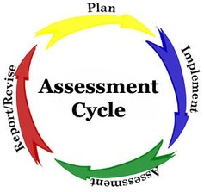
AT Assessment
Lastly, a proper AT assessment also considers necessary supporting services.
  Training for the person and/or staff
  Integration of the AT into day/work and home life
  Technical support issues
  It also provides a plan for implementation and for evaluating progress with the AT.

Slide 36
ASSISTIVE TECHNOLOGY CATEGORIES
Communication Aids
Speech and Augmentative Communication Aids
Writing and Typing Aids
Ergonomic Equipment
Hearing and Listening Aids
Computer Access Aids
Alternative Input Devices
Alternative Output Devices
Accessible Software
Universal Design
Mobility and Transportation Aids
Ambulation Aids
Scooters and Power Chairs
Wheelchairs
Vehicle Conversions
Daily Living Aids
Clothing and Dressing Aids
Eating and Cooking Aids
Home Maintenance Aids
Toileting and Bathing Aids
Prosthetics and Orthotics
Recreation and Leisure Aids
Sports Aids
Toys and Games
Travel Aids
Education and Learning Aids
Cognitive Aids
Early Intervention Aids
Seating and Positioning Aids
Environmental Aids
Environmental Controls and Switches
Home-Workplace Adaptations
Vision and Reading Aids
Services

Slide 37
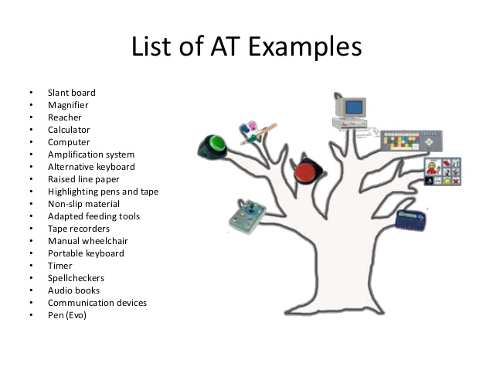
AT Examples

Slide 38
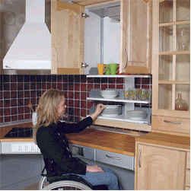
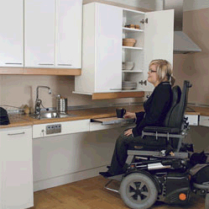

Slide 39







Technology Use – Novelty to Necessity:
No Longer Optional for Full Access to Society

Slide 40
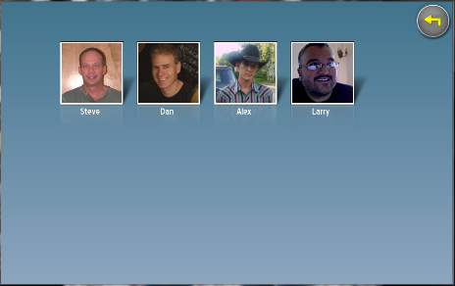
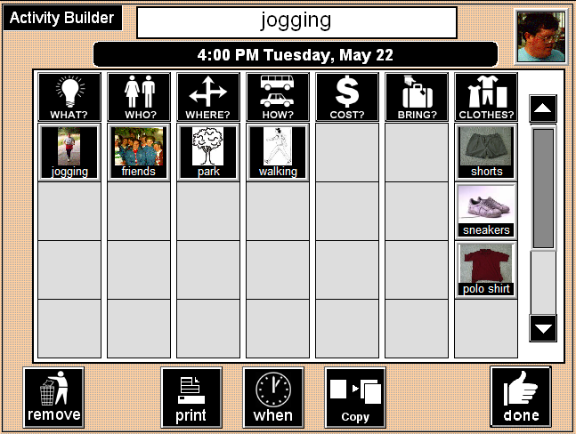
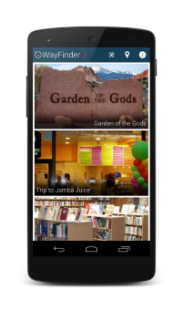

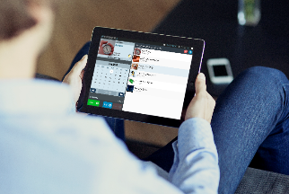
Type 1: Cognitively Accessible Everyday Technologies
Needs-based, person centered design results in everyday technologies that are simpler to use
Purpose: access core functionality of a specific everyday technology

Slide 41
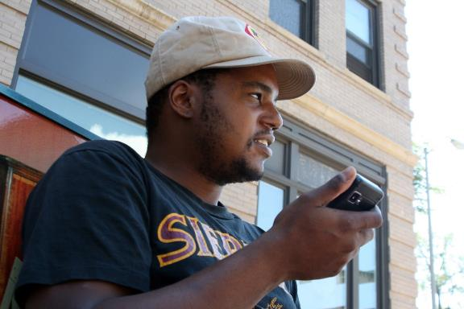
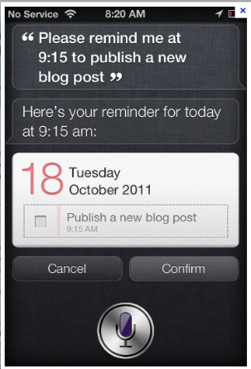

Example: Mainstream Scheduling Technologies,
Too Often Reading is Required

Slide 42
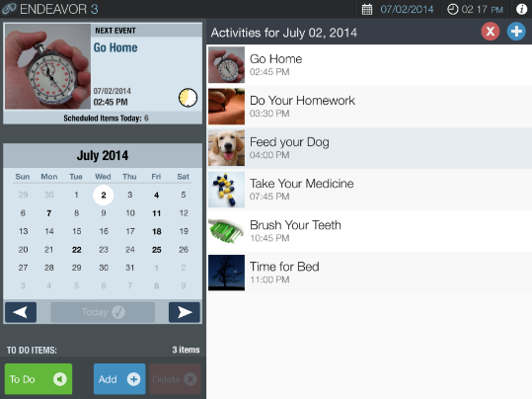

Slide 43
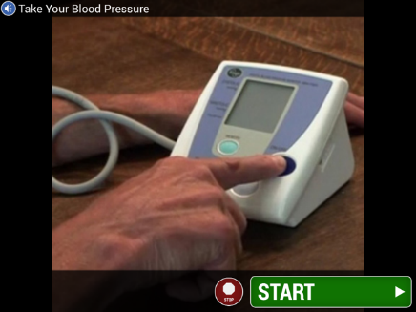
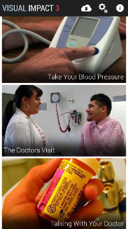
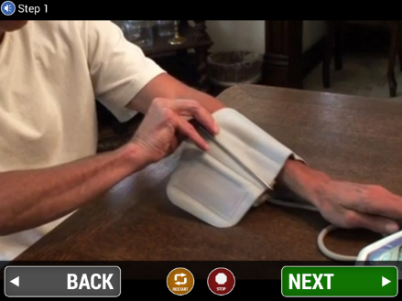
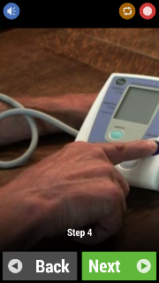





Cross-Platform, Cloud-supported Visual Task Prompting Technologies for Self-Direction, with Remote Notifications

Slide 44
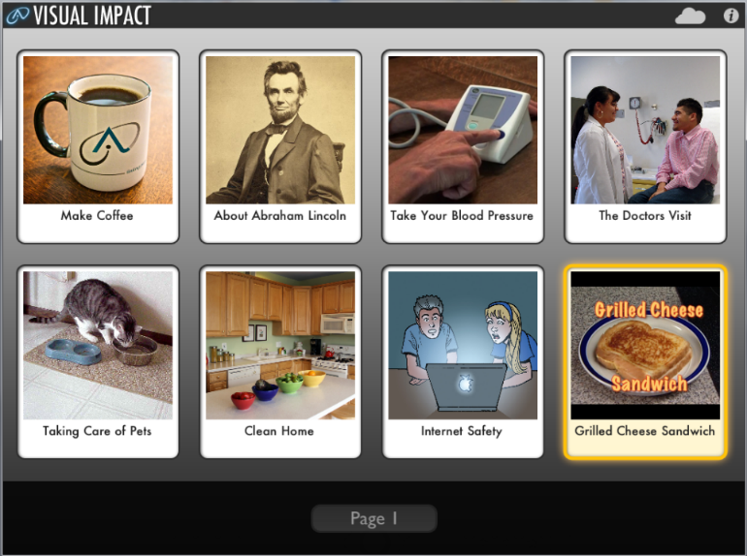

Cloud-based Activity Support System for Self-Direction
Visual Impact – Step-by-step multimedia
task instructions available in cloud-based Learning Library

Slide 45
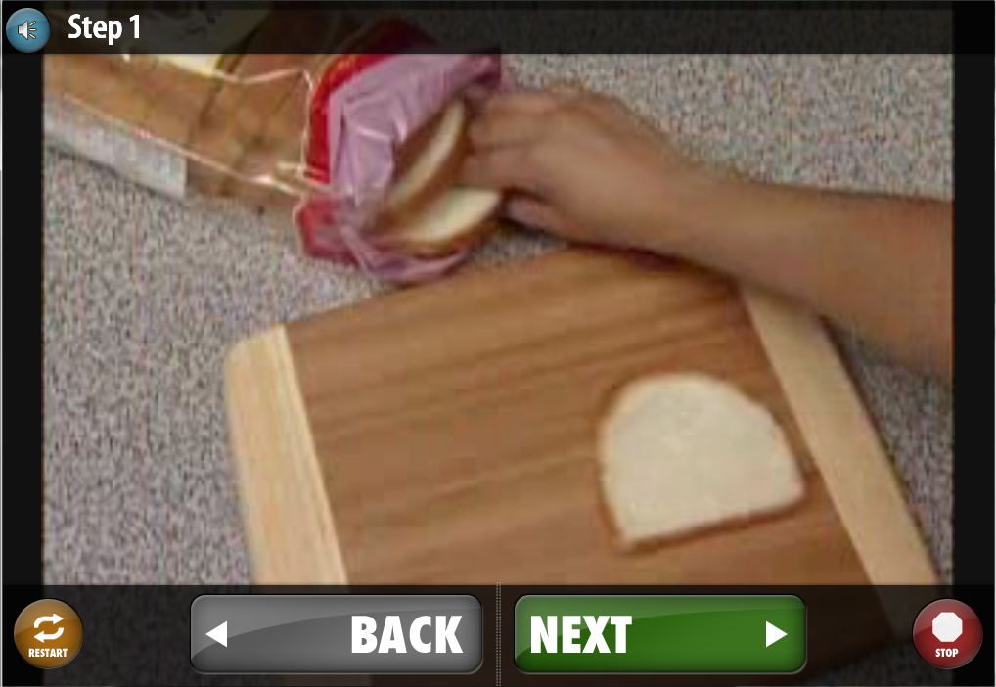
Cloud-based Activity Support System for Self-Direction
Visual Impact – Step-by-step multimedia
task instructions available in cloud-based Learning Library
Notes:
Jen ends

Slide 46
UNDERSTANDING THE SURVEY VISITS
Each survey to continue to include these components: site review, documentation review (individual, location, and agency), staff interview, individual interview and observation
Certification indicators rely more on information obtained from individual interview/ observation
Administrative Review has some additional questions
Surveys to be scheduled within current timelines

Slide 47
Survey visits and process, continued
On-going work to ensure consistency
Information collected through documentation, interviews and documentation
Collect findings, referring to guidelines, how measured and criteria for met/ not met
Consensus continue to be used to ensure that the team is rating various locations according to the same criteria
When additional guidance is needed, new interpretations will be developed
Timelines and format of the survey
Survey window will not be expanded. (remain at 5 days)
Residential surveys (audits) will continue to be scheduled for one day.
Residential audit days will be formatted slightly differently, setting the start time for later in the morning to review documentation and then staying later in the day to conduct observation / Individual interviews (about 1- 1.5 hours).

Slide 48
Certification levels
No changes to the Licensure levels or process
Certification will “roll up” and be reported by two primary service groupings, i.e. Residential/IHS and Employment/Day, rather than by each service type.
A full review of certification indicators would be conducted every two years either by DDS or through the self-assessment process.

Slide 49
Two levels of certification
  80% or more certification indicators met would be “certified”
  Less than 80% certification indicators met would be “certified with a progress report”

Slide 50
Certification level example
Residential / Individual Home Supports - Certified
20/20 24/7 residential
11/20 placement service locations
10/10 Individual Home Supports
If providing this array of services with 50 indicators rated; 41/50 were met = 82% = CERTIFIED
9 indicators not met in the provider’s placement services, will be outlined in the provider report for the provider to address. A Progress Report would not be required.

Slide 51
Certification levels, cont.
Employment/ Day Supports - Certified
22/ 25 Community Day Services
20/ 25 Employment
50 indicators rated; 42/50= 84% = Certified

Slide 52
Certification with Progress Report
There is no 60 day follow-up on certification.
The Provider completes the Progress Report one year following the survey. The Progress Report is modeled after the Provider Follow-up report.
The progress report is meant to assist providers to assess their own progress towards meeting indicators which may have presented some challenges. It should be viewed as a service improvement not a punitive process.

Slide 53
Certification with Progress Report
QE does not conduct an on-site review of any kind at this juncture.
The provider will receive a pre-populated form listing each not met certification indicator, and the area needing improvement that was noted at the time of the survey.
The Provider will briefly comment on the process utilized to correct and review each of the indicators, note the status of the indicator(s) at this one year mark, and determine if the indicator(s) is now met or remains not met.
The form is forwarded to the QE, who will forward it onto the Regional and Area Offices. There is no additional review by Operations or OQE.
Following completion of the progress report, QE will return for the next cycle’s review in one year’s time.

Slide 54
Self Assessment
Currently, Providers with a Two Year License are eligible to conduct a Self-assessment and receive a DDS targeted review.
Post August, Providers with a Two Year License will also be eligible to conduct a Self-assessment and receive a DDS targeted review.
The Provider’s self- assessment will include a review of all licensure and certification indicators. The Self-Assessment form will be pre-populated with the indicators and services to be reviewed.
DDS’s targeted review will include all critical indicators, and all not met licensure indicators, and all not met certification indicators.
For the first cycle after implementation, DDS will review all new and revised indicators.

Slide 55
Deeming (CARF)
Currently, deeming for Certification.
Post August, will continue to deem for Certification.
For the first cycle after implementation, DDS will review all new and revised certification indicators, but will continue to deem CARF for the current unchanged certification indicators.

Slide 56
Next Steps
Additional training will be offered to each provider as part of the orientation overview
Publish (electronically) all revised documents
Go live August 29 (Provider with a start date after this)

Slide 57
Thank you!
Final questions or comments?

