Slide 1
2017-2022 1115 Demonstration
Independent Evaluation Summative Report (IESR) Presentation
Public Meeting
March 13, 2026

Slide 2
Meeting Goal
The purpose of this meeting is to provide background on 1115 Demonstration Independent Evaluations, and to share findings from the 2017-2022 Independent Evaluation Summative Report and additional analyses by the Independent Evaluator.

Slide 3
Agenda
Background/Overview: 1115 Demonstration Independent Evaluation
Deep Dive: 2017-2022 Independent Evaluation Summative Report
Q&A

Slide 4
What is the 1115 Demonstration Independent Evaluation?
​Centers for Medicare & Medicaid Services (CMS) requires states with authorized 1115 Demonstrations to conduct independent evaluations of policies and programs in their Demonstrations. CMS specifies how states and their independent evaluators must evaluate demonstrations in the Special Terms and Conditions (STCs), and through additional guidance.
The Independent Evaluator (IE) for MassHealth's 2017-2022 and 2022-2027 1115 Demonstrations is ForHealth Consulting at UMass Chan Medical School (UMass Chan).​
In partnership with the State, the IE develops an Evaluation Design Document (EDD), an Independent Evaluation Interim Report (IEIR) and Independent Evaluation Summative Report (IESR) for the 1115 Demonstration.
Independent Evaluations for each 1115 Demonstration take many years to complete, as these are retrospective evaluations of each five-year demonstration. It takes time to pull together needed data, both qualitative and quantitative, allow policies and programs to mature, and conduct analyses of the various policies and programs authorized under our 1115 Demonstration.

Slide 5
MassHealth’s 2017 – 2022 1115 Demonstration: Goals and key reforms​
Demonstration Goals
Key Reforms
Enact payment and delivery system reforms that promote integrated, coordinated care and hold providers accountable for the quality and total cost of care.
Improve integration of physical, behavioral, and long-term services.
Maintain near-universal coverage.
Sustainably support safety-net providers to ensure continued access to care for Medicaid and low-income, uninsured individuals.
Address the opioid addiction crisis by expanding access to a broad spectrum of recovery-oriented Substance Use Disorder (SUD) services.
Ensure access to Medicaid services for former foster care individuals between the ages of 18 and 26, who previously resided in another state.
Ensure the long-term financial sustainability of the MassHealth program through the refinement of provisional eligibility and authorization for State Health Insurance Assistance Program (SHIP) Premium Assistance.
Accountable Care Organizations (ACOs)
Community Partners (CP) Program
Flexible Services (FS) Program
Statewide Investments (SWI)
Delivery System Reform Incentive Payment (DSRIP) Program
Various coverage and eligibility-related policies, including provisional eligibility
Certain Substance Use Disorder (SUD) services
Financial support for Safety Net Hospitals (SNH)

Slide 6
Agenda
Background/Overview: 1115 Demonstration Independent Evaluation
Deep Dive: 2017-2022 Independent Evaluation Summative Report
Q&A

Slide 7
Overview of the 1115 Independent Evaluation

Slide 8
MassHealth’s Goals for the 2017-2022 1115 Demonstration
Goals 1 and 2: Delivery System Transformation
Goal 3: Maintain near-universal coverage
Goal 4: Sustainably support safety net providers to ensure continued access to care for Medicaid and low-income uninsured individuals
Goal 5: Address the opioid addiction crisis by expanding access to a broad spectrum of recovery-oriented substance use disorder services
Goal 6: Ensure access to Medicaid services for former foster care individuals between the ages of 18 and 26, who previously resided in another state
Goal 7: Ensure the long-term financial sustainability of the MassHealth program through refinement of provisional eligibility

Slide 9

Example Logic Model — Delivery System Reform
A. Demonstration Initiatives
DSRIP Funding (ACOs, BH CPs, LTSS CPs, CSAs, SWIs) State Operations and Implementation Funding (DSRIP and other sources) Internal ACO and CP Program planning and investments
B. Activities Interventions/Programs Delivery System Changes at the Organizational Level
ACO unique actions CP unique actions ACO, MCO, and CP common actions Statewide Investments in: Community-based workforce Capacity building for ACOs and CPs (i.e., technical assistance and supporting Alternative Payment Methodology adoption) Addressing gaps in statewide care delivery (i.e., reducing Emergency Department (ED) boarding and improving accessibility for people with disabilities or for whom English is not a primary language)
C. Outputs Improved Care Processes at the Organization Level
Identifying and addressing member needs Access to care Member engagement Care plans and processes Care integration Cost management
D. Outcomes Improved Member Outcomes, Cost Trends, and Program Sustainability
Improved member outcomes Moderated cost trends Program sustainability
BASELINE
(2015-2017)
INTERIM EVALUATION
Mixed-methods design evaluating delivery system actions, preliminary changes in care delivery,
and preliminary outcomes during performance years PY0 to PY2 (07/01/2017 to 12/31/2019)
SUMMATIVE EVALUATION
Mixed-methods design evaluating delivery system actions, changes in care delivery,
and outcomes for the entire waiver period PY0 to PY5 (07/01/2017 to 03/31/2023)
Delivery System Reform Incentive Payment (DSRIP), Accountable Care Organization (ACO), Managed Care Organization (MCO), Behavioral Health Community Partners (BH CP), Long-Term Services and Supports Community Partners (LTSS CP), Community Service Agency (CSA), Statewide Investments (SWI), Program Year (PY)
9

Slide 10
Examples of Key Data Sources Used
Primary data sources include:
  Key informant interviews (e.g., State staff, ACOs, CPs, members)
  Surveys (e.g., ACO primary care providers, CP staff, practice site administrators, members)
  In-depth interviews (e.g., select ACOs, select CPs)
Secondary data sources include:
  Documents (e.g., Flexible Services (FS) Program progress reports)
  Financial and cost reports (e.g., ACO financial reconciliation reports)
  Medicaid administrative data (e.g., enrollment, claims, encounters, etc.)
  Clinical data (e.g., blood pressure measurements from Electronic Medical Records (EMRs))
  Program data
  Surveys (e.g., American Community Survey)
  Health Insurance Exchange Daily Data Extract

Slide 11
Summary of Methods
Qualitative Analyses
Document review, extraction, and synthesis
In-depth, open-ended semi-structured interviews
Systematic coding of interview transcripts
Identification of thematic patterns
Quantitative Analyses
Descriptive statistics
Trends over time
Observed-to-expected ratios
Comparative analyses (e.g., difference-in-difference)
Return on investment and cost-effectiveness analysis
COVID-19 pandemic: Qualitative analysis of interviews with stakeholders elucidated experiences and changes in care in response to the pandemic. Quantitative analyses of program effects were conducted annually so impacts could be observed in each year, and comparative analyses were adjusted for COVID-19 diagnoses.

Slide 12
Summary of Limitations
COVID-19 effects and disruptions
Limited clinical outcome data availability
Uncertain generalizability to members with short MassHealth enrollment periods
Lack of a comparison group for certain data sources (member surveys, clinical quality measures)
Possible non-response bias for surveys (those who respond are different from those who do not respond)
Potential for unmeasured differences between groups (statistical adjustments were used to attempt to mitigate confounding)

Slide 13
Select Findings from the Independent Evaluation of the Delivery System Reform

Slide 14
Goals 1 and 2: Delivery System Reform
Goal 1
Enact payment and delivery system reforms that promote integrated, coordinated care and hold providers accountable for the quality and total cost of care.
Goal 2
Improve integration of physical, behavioral, and long-term services.
Overall Findings
MassHealth reforms promoted integrated, coordinated, and accountable care. Numerous stakeholders collaborated to improve care processes at the organizational level and moderate cost growth, while generally meeting member needs, and maintaining or improving clinical quality and member outcomes.
14

Slide 15
Almost 1 Million Members Were Shifted Into ACOs At Program Launch in March 2018
>1.2 million (82% of those eligible) in ACOs (in 03/23) > 45% target from CMS

Slide 16
ACO Program Reduced Healthcare Costs and Improved Some Quality and Utilization Measures
Key Findings
Primary care utilization was higher, hospitalization rates were lower overall (but not for ambulatory care sensitive conditions), and total healthcare costs were lower among ACO enrollees in propensity-balanced comparisons vs. MCO/PCC enrollees.*
Performance on several quality measures improved over time post-implementation, while others did not improve.
Most ACOs improved blood pressure and diabetes control from the first to the second year of implementation before progress was temporarily reversed during the COVID-19 pandemic.
Estimated ACO program total costs of healthcare services (TCOC) savings were larger than the $1.47 billion in DSRIP program ACO costs.
Select Recommendations
MassHealth should continue the ACO Program and continue to study the ACO Program’s impacts to better understand how ACOs may be reducing total healthcare costs and for which enrollees, evaluate sustainability post-DSRIP, and validate the robustness of findings.
Further evaluation is needed to examine whether intermediate clinical outcomes continued to improve post-pandemic and whether downstream outcomes improve as more data become available.
Further analyses should examine the heterogeneity of performance between ACOs and primary care practices while identifying drivers of variation.
*The MCO and Primary Care Clinician (PCC) plans are longstanding MassHealth managed care plans. MCOs contract with Executive Office of Health and Human Services (EOHHS) to provide or arrange for covered services under a capitated payment agreement. Members enrolled in an MCO use that MCO’s network of providers. In a PCC plan, members select or are assigned a PCP from a network of MassHealth providers. PCC plan members utilize the MassHealth network of hospitals and specialists to receive care that is coordinated with their PCC and use the Massachusetts Behavioral Health Partnership (MBHP) network for BH services.

Slide 17
Community Partners (CP) Program
Key Findings
Communication through key contacts, strong relationships, co-location, data-sharing, and clearly defined roles promoted ACO-CP collaboration, which improved over time.
In both the BH and LTSS CP programs, quality performance generally started low but improved over time.
In comparisons of CP enrollees versus propensity balanced comparison groups:
  BH CP enrollees had more ED and hospital admissions, less ED boarding, higher outpatient BH costs, and higher TCOC.
  LTSS CP enrollees had higher outpatient care costs and higher TCOC.
Select Recommendations
States implementing healthcare partnerships with community-based organizations should calibrate program design elements to promote participation and collaboration while achieving sustainability and effectiveness of partnerships.
MassHealth should continue to offer technical assistance to CPs facing challenges with timely data access and use and should consider requiring shared electronic health record access for partnering ACOs and CPs.
Further analyses are needed to evaluate the heterogeneity of CP program impacts on cost and utilization, including by member characteristics and across varying levels of engagement.

Slide 18
Flexible Services (FS) Program
Key Findings
ACOs and Social Service Organizations partnered to launch various FS programs to provide housing and nutritional supports to MassHealth members.
FS tenancy and nutrition supports reduced rates of ED visits and inpatient admissions versus a comparison group of ACO enrollees who were FS-eligible but not enrolled.
Estimates of the net costs (program costs minus TCOC savings) per hospitalization and ED visit avoided were below commonly accepted thresholds for cost-effectiveness and cost-saving for certain subgroups.
Select Recommendations
States implementing Medicaid alternative payment models should evaluate the prevalence of health-related social needs (HRSNs) among their members and seek to increase the resources available to organizations to address prevalent HRSNs among their enrollees.
CMS and states should continue to test and evaluate nutrition and housing supports programs for Medicaid members with HRSNs.
Further analyses should explore the impacts of the FS Program on key subgroups and participants of specific program types.

Slide 19
Statewide Investments
Key Findings
The SWI Program was essential to the progress of the delivery system reforms.
Recruitment and retention of PCPs and BH specialists to work in community-based settings was challenging.
SWI programs, such as student loan repayment and recruitment incentives, were important for recruitment, training, and retention.
SWIs supported accommodations for members with physical and mobility disabilities, and for those for whom English is not their primary language.
Investments in technology and TA supported organizations in establishing new and improving existing Health Information Technology (HIT) capabilities.
Select Recommendations
In Massachusetts and other states implementing delivery system reforms, funding and technical assistance should be directed by a well-resourced design and implementation team and targeted to entities with the greatest need.
MassHealth and other state Medicaid programs implementing and sustaining integrated and accountable care models should invest in developing their community-based workforce.
States implementing integrated and accountable care models should support the development and improvement of HIT, data management, data-sharing, and analytic capabilities at healthcare and community organizations.
SWIs were designed to address gaps in the statewide delivery system and to build the capacity of community-based primary care and the behavioral health workforce to offer integrated, high-quality care for all members. The SWIs were divided into three categories of programs: 1) building and training the primary care and behavioral health workforce; 2) capacity building for ACOs, CPs, and providers; and 3) initiatives to address statewide gaps in coverage.

Slide 20
Flexible Services Program Effects on Healthcare Utilization and Costs

Slide 21
Flexible Services Enrollment Increased
Over Time

Slide 22
Nutritional Supports: Program Findings
Hospitalizations​
23% fewer among FS recipients vs. comparison group​
  Adjusted Incident Rate Ratio: 0.77 (95% Confidence Interval: 0.65, 0.90)​
ED Visits​
13% fewer among FS recipients vs. comparison group​
  Adjusted Incident Rate Ratio: 0.87 (95% Confidence Interval: 0.80, 0.95)​
Healthcare Costs​
-$712 per person​ (not statistically significant)
22

Slide 23
Nutritional Supports: Larger Impacts
After COVID-19
Years 2020-2021, N=10,409
No statistically significant differences in healthcare utilization or costs
Years 2022-2023, N=9,994
47% fewer hospitalizations
  Adjusted Incident Rate Ratio: 0.53 (95% Confidence Interval: 0.41, 0.67)
21% fewer ED visits
  Adjusted Incident Rate Ratio: 0.79 (95% Confidence Interval: 0.70, 0.90)
$1,721 per person reduction in healthcare costs
  -$1,721 (95% Confidence Interval: -3,431, -10)
23

Slide 24
Housing Supports: Program Findings*
Hospitalizations​
15% fewer among FS recipients vs. comparison group​
  Adjusted Incident Rate Ratio: 0.85 (95% Confidence Interval: 0.72, 0.99)​
ED Visits​
17% fewer among FS recipients vs. comparison group​
  Adjusted Incident Rate Ratio: 0.83 (95% Confidence Interval: 0.72, 0.99)​
Healthcare Costs​
$2,207 reduction per person​
  -$2,207 (95% Confidence Interval: -4,411; -2)
* Sample analyzed includes adults with behavioral health conditions
24

Slide 25
Housing Supports: Larger Impacts
After COVID-19*
Years 2020-2021, N=3,366
No statistically significant differences in healthcare utilization or costs
Years 2022-2023, N=3,214
24% fewer hospitalizations
  Adjusted Incident Rate Ratio: 0.76 (95% Confidence Interval: 0.59, 0.99)
25% fewer ED visits
  Adjusted Rate Ratio: 0.75 (95% Confidence Interval: 0.62, 0.91)
$4,724 per person reduction in healthcare costs
  -$4,724 (95% Confidence Interval: -7,509, -1,940)
* Sample analyzed includes adults with behavioral health conditions
25

Slide 26
Delivery System and DSRIP Program Return on Investment (ROI)

Slide 27
Objectives
Estimate the return on investment of the delivery system reforms supported by the DSRIP Program among ACO enrollees
Estimate DSRIP Program costs per ACO enrollee
Estimate the impact of the DSRIP Program on ACO enrollees’ TCOC

Slide 28
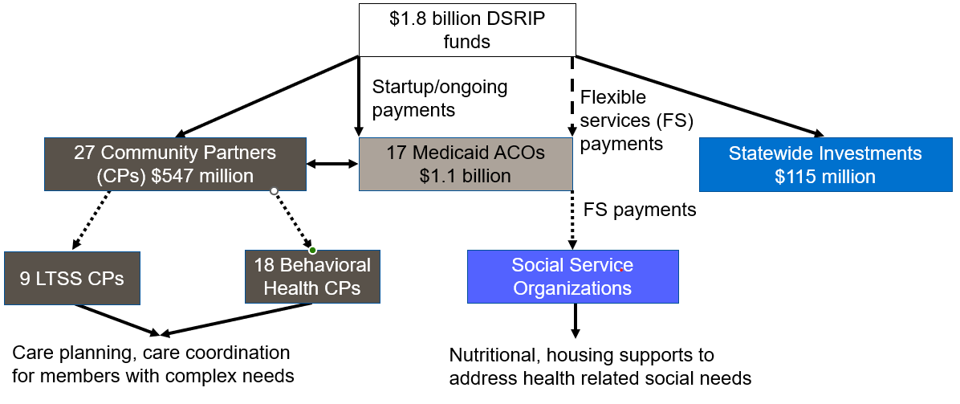
DSRIP Funding Components
Created using information from the Massachusetts DSRIP Protocol. Accessed 05/30/2019. https://www.medicaid.gov/Medicaid-CHIP-Program-Information/By-Topics/Waivers/1115/downloads/ma/MassHealth/ma-masshealth-appvd-dsrip-prtcl-20190408.pdf

Slide 29
Return on Investment
Perspective
MassHealth (Payor)
Analysis Period
March 2018 through March 2023
Unit of Analysis
An ACO enrollee
ROI
Program benefits (change in )
Program cost (Incremental cost of the DSRIP Program)
Net program benefits (Program benefits - Program cost)
Results presented in adjusted 2022$
ROI= $\frac{\text{Program} \text{Benefits}\text{ − }\text{Program} \text{Costs} }{\text{Program} \text{Costs}}$ X100

Slide 30
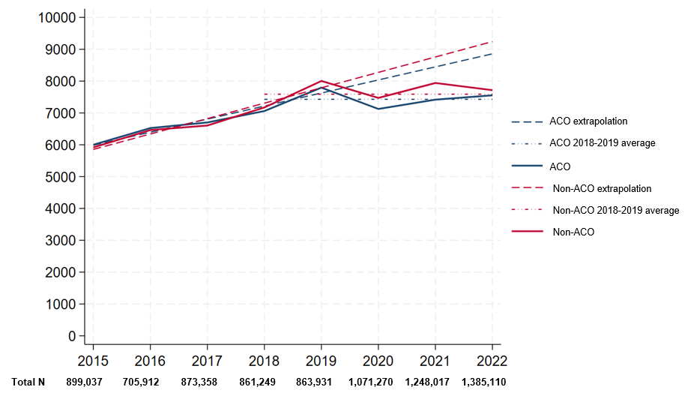
Healthcare Costs Were Reduced for ACO Versus non-ACO Enrollees
Summary
Total healthcare costs were lower for ACO enrollees versus a comparison group throughout 2018-2022.
ACO healthcare cost savings were largest in 2020-2021.
Absent COVID-19, if 2015-2019 trends continued, then ACO cost savings would have gradually grown during 2020-2022.

Slide 31
Trend in DSRIP ACO Cost per ACO Enrollee, 2022$

Slide 32
Net Savings and ROI of DSRIP Investments, in 2022$

Slide 33
DSRIP Investments in ACO Program
Overall, reforms supported by DSRIP investments produced an ROI of 35% (Confidence Bounds: 6%-64%) among ACO enrollees
The benefit-cost ratio 1.35 (Confidence bounds: 1.06,1.64) indicates that each $1 in DSRIP spending on the ACO program was associated with $0.35 (Confidence Bounds: $0.06-$0.64) in TCOC savings
Aggregate savings from DSRIP investments over the project life were $512 million (Confidence Bounds: $82 million-$942 million) among ACO enrollees

Slide 34
Results of Member Interviews

Slide 35
Member Interview Themes
Care Access and Availability
Care Coordination
Flexible Services
Quality of Care

Slide 36
Care Access and Availability
Difficulty finding an available provider, scheduling appointments, and obtaining prior authorizations were common barriers
When access to BH specialists was limited, primary care providers often addressed members’ BH needs
Patient portals supported member engagement by facilitating communication with healthcare providers
Members valued the flexibility and convenience of telemedicine appointments for improving access to care

Slide 37
Care Coordination
Member engagement in care planning and goal setting, with the help of care coordinators, improved members’ relationships with providers
Ongoing conversations about members’ healthcare goals and care plans were essential, as goals often shifted with changing life circumstances
Co-located, multidisciplinary teams enabled warm hand-offs, reduced burden of multiple appointments, and improved members’ understanding of care plans
Support from care coordinators helped members feel less alone and overwhelmed, and increased their confidence in managing their health

Slide 38
Quality of Care
Providers whom members viewed as attentive, collaborative, empathetic, and compassionate contributed to positive care experiences
Adequate time to ask questions fostered trust and made members feel heard and respected
Long-standing relationships with providers, especially those of the same gender or similar background, enhanced comfort and confidence in care
Behavioral health provider turnover disrupted care continuity, leading to treatment delays, trust issues, and disengagement

Slide 39
Flexible Services
Care coordinators and social service organization staff were very helpful in connecting members to services
Transportation issues, lack of phone access, and homelessness limited ability to participate
Some reported there weren’t enough services available to fully meet their needs
Members reported concerns they would be stigmatized for reporting their HRSNs
Staff sometimes used unfamiliar language or acronyms, leading members to be confused

Slide 40
Select Findings from Goals 3 – 7

Slide 41
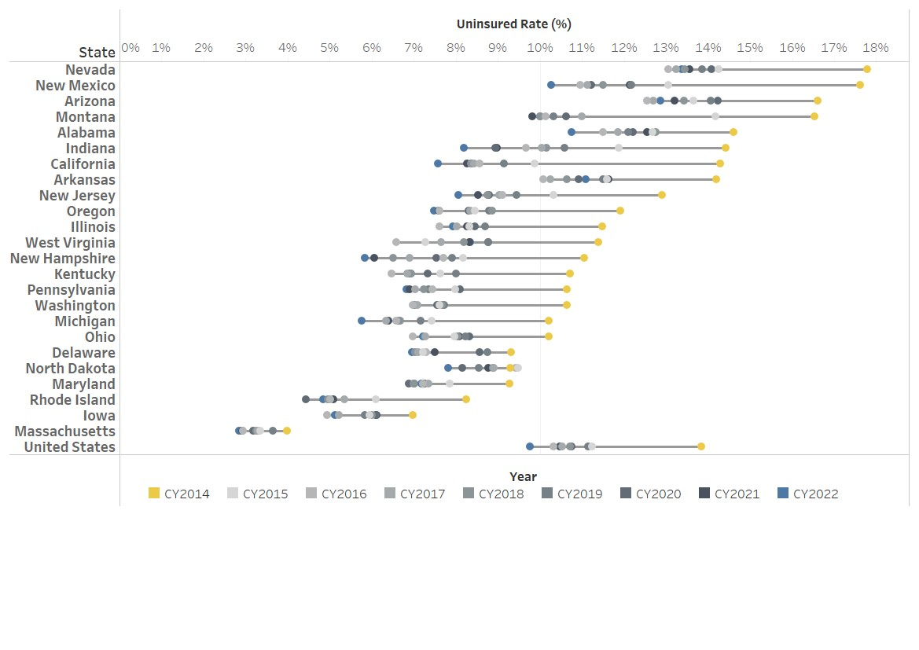
Goal 3: Uninsurance Rate of MA vs Select States
Key Findings: Massachusetts continues to lead the nation in maintaining health insurance coverage – it had and has the lowest uninsurance rate. Both long-standing programs and new or newly financed programs supported near-universal coverage for MA residents and increased access.
Note: The states selected for this comparison were based on their policy similarities with Massachusetts at the time of the evaluation design.

Slide 42
Goal 4: Sustainably Support Safety Net Providers (1)
Safety Net Hospitals (SNHs) received financial supports, part of which is tied to their partnering ACO’s performance.
Key Findings
Reduced acute unplanned acute hospitalization, all-cause ED visits, and behavioral health related ED visits
Increased the engagement rate of alcohol, opioid or other drug abuse or dependence treatment and improved antidepressant use management
Reduced annual primary care visit rate and adult access to preventive/ambulatory healthcare use
Maintained total cost of care
Recommendation
Continue investment to help SNHs sustain their quality improvement efforts

Slide 43
Goal 4: Sustainably Support Safety Net Providers (2)
After an initial decrease in uncompensated costs from FY2016–FY2019, the collective total uncompensated care cost for the 14 safety net hospitals increased annually from FY2020–FY2022.
Note: The Uncompensated Care Cost reflects the difference between Medicaid and uncompensated costs and revenue, including Medicaid shortfall. It is referred as “Available Room under Cost Limit.” The total cost is for 12 safety net hospitals. FY=Fiscal Year; CY=Calendar Year. A limitation is that the UCCR cost data are presented in fiscal year, but we applied the calendar year’s inflation rate.

Slide 44
Goal 5: Address the Opioid Addiction Crisis (1)
Key Findings
Utilization of substance use disorder services covered by MassHealth (residential rehabilitation and recovery coach services) increased through the 20 calendar quarters after implementation.
Opioid overdose among MassHealth members reduced from the demonstration baseline period, especially after the peak of the COVID-19 pandemic.

Slide 45
Goal 5: Address the Opioid Addiction Crisis (2)
Key Findings
Trends in some care quality measures improved post-implementation of expanded SUD services
    Utilization of Medication for Opioids Use Disorder (OUD) among those with OUD
    Readmission for SUD care within 90 days

Slide 46
Goal 5: Address the Opioid Addiction Crisis (4)
Discussion
External factors may impact these findings, including exacerbations of the opioid epidemic; multiple concurrent initiatives conducted at the state, local, and national level during the Demonstration to address the opioid crisis; ACO implementation; and the COVID-19 pandemic
Recommendation
Obtain insights from BH providers about findings
Ensure greater consistency among health plans in coding SUD-related services to facilitate monitoring of service use

Slide 47
Agenda
Background/Overview: 1115 Demonstration Independent Evaluation
Deep Dive: 2017-2022 Independent Evaluation Summative Report
Q&A

