Slide 1
EOHHS Quality Measurement alignment taskforce
Meeting #1
May 30, 2017

Slide 2
Agenda
Welcome and introductions
Background and rationale for alignment
Process and lessons from other states
Next steps

Slide 3
Taskforce Participants: Stakeholders
Name (*Subcommittee) | Title | Organization
Mark Alexakos, MD, MPP* | Chief Behavioral Health Officer | Lynn Community Health Center
Renee Altman Nefussy | Senior Manager of Quality Performance and Informatics | Tufts Health Plan
Richard Antonelli, MD, MS* | Medical Director, Integrated Care | Boston Children's Hospital
Arlene Ash, PhD* | Professor and Chief, Division of Biostatistics and Health Services Research | University of Massachusetts Medical School
Barrie Baker, MD, MBA | Chief Medical Officer | Tufts Health Public Plans
Dennis Heaphy, MEd, MPH* | Healthcare Advocate | Disability Policy Consortium
Lisa Iezzoni, MD, MSc* | Professor of Medicine | Massachusetts General Hospital / Harvard Medical School
Thomas Isaac, MD, MBA, MPH | Medical Director, Quality | Atrius Health
Melinda Karp, MBA* | Vice President, Consumer Centered Quality | Commonwealth Care Alliance
Holly Oh, MD* | Chief Medical Officer; Chair, Quality Committee | The Dimmock Center; Community Care Cooperative
Elisabeth Okrant, MPH* | Vice President, Quality Management | Massachusetts Behavioral Health Partnership / Beacon Health Options
Dan Olshansky, LICSW* | Vice President of Clinical Quality | Behavioral Health Network
Claire Cecile Pierre, MD* | Chief of Quality and Medical Informatics / Faculty Director of Systems Transformation | South End Community Health Center / Harvard Medical School
Michael Sherman, MD, MBA, MS | Chief Medical Officer and Senior Vice President | Harvard Pilgrim Health Care
Barbra Rabson, MPH* | President and CEO | Massachusetts Health Quality Partners
Dana Gelb Safran, ScD | Chief Performance Measurement and Improvement Officer and Senior VP, Enterprise Analytics | Blue Cross Blue Shield of Massachusetts
Robert Schreiber, MD* | Medical Director of Evidence Based Programs | Hebrew SeniorLife
Jacqueline Spain, MD | Medical Director | Health New England
Aswita Tan-McGrory, MBA, MS | Deputy Director | The Disparities Solutions Center at Massachusetts General Hospital
Neil Wagle, MD, MBA | Medical Director, Partners HealthCare: Quality, Safety, and Value (PROMs) | Partners HealthCare

Slide 4
Taskforce Participants: State Agencies
Name (*Subcommittee) | Title | Agency
Alice Moore | Undersecretary of Health | Executive Office of Health and Human Services
David Whitham | Assistant Chief Information Officer | Executive Office of Health and Human Services
Kate Fillo, PhD* | Director of Clinical Quality Improvement | Massachusetts Department of Public Health
David Tringali, MA* | Director of Quality Improvement | Massachusetts Department of Mental Health
Cristi Carman, MPH | Quality Reporting Manager | Center for Health Information and Analysis
Katie Shea Barrett, MPH | Policy Director, Accountable Care | Health Policy Commission
Linda Shaughnessy, MBA | Director, MassHealth Quality Office | MassHealth
Randi Berkowitz, MD* | Medical Director for Accountable Communities of Care | MassHealth
Gail Grossman* | Assistant Commissioner for Quality Management | Massachusetts Department of Developmental Services
Roberta Herman, MD | Executive Director | Group Insurance Commission
Kevin Beagan, MPH, MPP | Deputy Commissioner, Health Care Access Bureau | Division of Insurance

Slide 5
Agenda
Welcome and introductions
Background and rationale for alignment
Process and lessons from other states
Next steps

Slide 6
The case for advancing a coordinated quality strategy
Quality measurement is fragmented across private and public programs with few similar measures used to assess healthcare performance across all programs.
Providers do not receive a unified message on quality measurement, diluting the impact of improvement initiatives and contributing to administrative burden that is both time consuming and costly.
Policymakers in the Commonwealth currently rely on a set of mostly process measures (through the Statewide Quality Measure Set) to assess the quality of non-hospital based healthcare in the Commonwealth.
There is a growing interest in using outcome measures to more meaningfully evaluate quality. At present, outcome measures are burdensome to report for providers and payers alike in the absence of a centralized method for data collection and abstraction.
More payers and healthcare organizations are entering into Alternative Payment Models (APMs), which tie financial rewards to performance on quality measures.
Vision:
A coordinated quality strategy that focuses the improvement of healthcare quality and health outcomes for all residents of the Commonwealth and reduces the administrative burden on provider and payer organizations.

Slide 7
Quality measurement and reporting places a resource burden on providers
In December 2016, Massachusetts Health & Hospital Association (MHA) conducted a Quality Measurement and Reporting Resources Survey. 27 hospitals responded to the survey, and 22 of those provided financial estimates.
$19 million spent in quality reporting among the 22 survey respondents
All respondents reported a combined 167 FTEs
MHA estimates that over $67 million statewide is spent by provider organizations on quality measurement and reporting

Slide 8
Many different measures in use by Massachusetts payers in APMs
A total of 106 measures were included in this comparison.
Measures were included if they were identified as in use by at least one of the 5 payers/measure sets, on at least 10 APM contracts.
62 measures are unique to just one payer, and only 1 measure is used by all 5 payers
*The measure sets used in this analysis are MassHealth ACO, CMS AHIP ACO/PCMH Core Set, Harvard Pilgrim Health Care, Blue Cross Blue Shield of Massachusetts, and Tufts Health Plan.
Notes:
Merge with outcomes measures

Slide 9
Quality Measurement Taskforce and DSRIP Subcommittee Overview
The Executive Office of Health and Human Services (EOHHS) issued a Notice of Opportunity on March 17, 2017 seeking individuals with expertise in healthcare quality measurement to serve on the Taskforce and Subcommittee from the following constituencies:
Representatives from provider organizations, including medical, behavioral health, and long-term services and supports, with experience in and responsibility for quality improvement and reporting;
Representatives from commercial and Medicaid managed care health plans with experience in and responsibility for performance measurement activities related to alternative payment models;
Consumer and family/caregiver advocates; and
Representatives from academia and/or the research community with expertise in quality measurement methods and best practices.
Quality Measurement Taskforce Goals
1
Gain consensus on a quality measure set to be used going forward in alternative payment model (i.e. global budget) contracts with providers in MA
2
Identify strategic priority areas for measure development in the Commonwealth (e.g. patient reported outcomes, substance use disorder care)
DSRIP Subcommittee Goals
3
Advise MassHealth on quality measures and methodology for its Accountable Care Organizations (ACOs), Community Partners (CPs) and other DSRIP programs

Slide 10
Proposed framework
Core Measures
Limited Menu
Measures in Development
Small number of measures
To be adopted by all
Larger collection of measures
Can be selected from to meet program needs
Small collection of measures
Aligned with common priorities
Measures of clinical importance which require development or modification prior to inclusion in core or menu sets

Slide 11
Proposed phased timeline for Taskforce
Phase 1 (May-December 2017)
Phase 2 (January – December 2018)
Meetings to review candidate measures and reach consensus on a measure set
Bimonthly meetings to determine how to evolve and innovate on measures together
Taskforce Kickoff Meeting
(May 2017)
Finalize measures for use in APMs
(Dec 2017)
Maintenance of measure set
Plan for the collection of clinical/patient reported outcomes data to support measurement

Slide 12
DSRIP Subcommittee and CMS
Requirements Timeline
June 6 Subcommittee Kickoff
Intro and Specifications
Monthly or 2x month Subcommittee meetings
May-December 2017
June review ½ specifications
July review ½ specifications
August
Set benchmarks and send to CMS benchmarks and specifications
September Review policies for contracts audit, appeals, remediation plans
The DSRIP Subcommittee will be primarily responsible for advising MassHealth on quality measures and methodology for its ACO, CP and other DSRIP programs. The Subcommittee will report decisions reached to the Taskforce. Taskforce members can weigh in on but not overrule the DSRIP Subcommittee’s decisions.

Slide 13
Agenda
Welcome and introductions
Background and rationale for alignment
Process and lessons from other states
Next steps

Slide 14
Process overview
1
Set guiding principles for measure selection
2
Define the selection decision process
3
Identify performance domains and populations
4
Identify candidate measure sources
5
Identify potential data sources and operational means for acquisition
6
Select the measures
7
Estimate desired measure set size
8
Determine whether payer-specific or all-payer data should be used

Slide 15
1) Set Guiding Principles for measure selection
Purpose: Collectively establish principles to guide measure selection for the measure set and to strategically focus efforts on priority areas for the state.
Guiding principles are explicitly stated goals for the measure set that are agreed upon before measure selection.
These guiding principles will be used to inform measure selection, acting as ‘criteria’, during the shortlisting process.
Principles can relate to a range of topics, from clinical utility to technical specifications.
These principles provide an opportunity to give consideration to state priorities and strategically focus attention on them.
When considering guiding principles for measure selection, bear in mind that the intended use of this measure set is for APM contracts (i.e. global budgets) in Massachusetts, and not for public reporting or other uses.

Slide 16
Example: Rhode Island Aligned Measure Set Work Group: Measure Selection Criteria
Criteria Applied to Individual Measures
  Evidence-based and scientifically acceptable
  Has a relevant benchmark
  Not greatly influenced by patient case mix
  Consistent with the goals of the program
  Useable and relevant
  Feasible to collect
  Aligned with other measure sets
  Promotes increased value
  Presents an opportunity for performance improvement
  Transformative potential
  Sufficient denominator size

Slide 17
Example: Rhode Island Aligned Measure Set Work
Group: Measure Selection Criteria (Cont’d)
Criteria Applied to the Measure Set
  Representative of the array of services provided by the program
  Representative of the diversity of patients served by the program
  Not unreasonably burdensome to payers or providers
  Parsimonious (set is limited in number of measures)

Slide 18
Example: Washington Performance Measurement Committee
Criteria Applied to Individual Measures
  Measures are based on readily available health care insurance claims and/or clinical data.
  Preference should be given to nationally vetted measures (e.g., NQF-endorsed) and other measures currently used by state agencies.
  Measures assess overall system performance, including outcomes and cost.
  Measures should capture significant potential to improve health system performance in a way that will positively impact outcomes and reduce costs.
  Measures should be amendable to the influence of health care providers.
  Measures selected offer sufficient numerator and denominator size to ensure valid and reliable results.

Slide 19
Proposed Guiding Principles for our work
  The aligned measure set…
  Promotes alignment among payers, including Medicaid, Medicare, and private payers
  Includes NQF-endorsed measures; in the absence of NQF endorsement, measures must have been tested for validity and reliability in a manner consistent with the NQF process, where applicable
  Emphasizes outcomes whenever possible
  Assesses health care disparities and cultural competency
  Measures patient experience, person- and family-centeredness, and patient-reported outcomes as ends in themselves
For discussion:
1. Reactions to proposed guiding principles?
2. Any guiding principles that should be added?

Slide 20

2) Define the selection decision process
Proposal:
  Group consensus or majority, if needed
  Two rounds of review
  Explicit (e.g., with scoring) use of selection criteria

Slide 21
3) Identify Performance Domains and Populations
A “domain” is a category of like measures representing an aspect of performance.
Some options for performance domains include:
  Preventive Care
  Acute Care
  Chronic Illness Care
  Behavioral Health Care
  Overuse/Waste
  Patient Experience
  Cost/Efficiency
  LTSS
Proposed populations which may require different measures
Adults
Inc. those with special health needs
Children
Inc. those with special health needs
For discussion:
1. Thoughts on approaching candidate measures by domain? Then by population within each domain?
2. Are these the right domains?
3. Are there any additional subpopulations (e.g. equity) we should consider?

Slide 22
How to create an aligned measure set
The RWJF-supported Buying Value Project developed a suite of tools in 2014, titled “How to Build A Measure Set,” to assist state agencies, private purchasers, and other stakeholders in creating aligned performance measure sets.
The full suite of resources is available on the Buying Value website (www.buyingvalue.org).

Slide 23

How to create an aligned measure set (Cont’d)

Slide 24
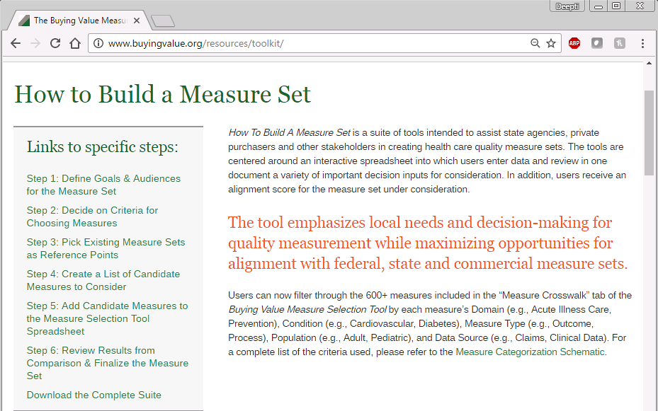
How to create an aligned measure set (Cont’d)

Slide 25
Measure sets included in the tool
Federal and National Measure Sets Included in the Tool (15)
Catalyst for Payment Reform Employer-Purchaser Measure Set
CMMI Comprehensive Primary Care Plus (CPC+)
CMMI SIM Recommended Model Performance Metrics
CMS Core Set of Children’s Health Care Quality Measures for Medicaid and CHIP (Child Core Set)
CMS Core Set of Health Care Quality Measures for Adults Enrolled in Medicaid (Medicaid Adult Core Set)
CMS Core Quality Measures Collaborative
CMS Health Home Measure Set
CMS Hospital Value-Based Purchasing
CMS Medicare Hospital Care
CMS Medicare-Medicaid Plans (MMPs) Capitated Financial Alignment Model (Duals Demonstrations)
CMS Medicare Part C & D Star Ratings Measures
CMS Medicare Shared Savings Program (MSSP) ACO
CMS Merit-based Incentive Payment System (MIPS)
CMS Physician Quality Reporting System (PQRS); CMS EP EHR Incentive Clinical Quality Measures (eCQMs); and CMS Cross Cutting Measures (CCMs)
Joint Commission Accountability Measures List
Notes:
Only removed 1 measure set: “CMMI Priority Measures for Monitoring and Evaluation”

Slide 26
Measure sets included in the tool (Cont’d)
State Measure Sets Included in the Tool
Medi-Cal P4P Measure Set
Oregon CCO Incentive Measures
Oregon CCO State Performance “Test” Measures
Rhode Island SIM Aligned Measure Set for ACOs
Vermont ACO Pilot Core Performance Measures for Payment and Reporting
Washington State Common Measure Set for Health Care Quality and Cost

Slide 27
Agenda
Welcome and introductions
Background and rationale for alignment
Process and lessons from other states
Next steps

Slide 28
Next meeting schedule and high level topics for each meeting
May | June | July | August | September | October | November | December
Meeting 1
Meetings 2-5
Meeting 6-10
  Describe current landscape
  Agree on guiding principles
  Lay groundwork for Taskforce process
  Finish laying groundwork for Taskforce process
  Discuss specific measures
  Final decisions on measure sets and how they should be used
  Begin planning for implementation, including collection of clinical data to support outcome measures
  Begin planning for priority setting around measure gaps

Slide 29
Appendix

Slide 30
Among the three largest commercial health plans, about half the measures used in APMs are different.
Notes:
Alignment drops to ~50% at best when measures used in fewer than 10 contracts are excluded.
Noteworthy that commercial insurer sets are much larger than public payer sets, so it is not surprising that there is more overlap, although sets are still not well aligned.

