Slide 1
EOHHS Quality Measurement alignment taskforce
Meeting #2
July 18, 2017

Slide 2
Agenda
Welcome
Relationship between Taskforce and DSRIP Subcommittee
Timing and Process for “Gap Filling”
Key Measure Selection Process Steps
Next Steps

Slide 3
Agenda
Welcome
Relationship between Taskforce and DSRIP Subcommittee
Timing and Process for “Gap Filling”
Key Measure Selection Process Steps
Next Steps

Slide 4
Taskforce and Subcommittee: Respective Roles
The focus of these two bodies will change over time. Their initial focus, however, is well defined.
Quality Measurement Alignment Taskforce:
Develop a multi-payer aligned measure set for use in ACO contracts
Identify where current measure gaps exist and develop a strategy to address them
DSRIP Subcommittee:
Advise MassHealth on measures and targets utilized in the DSRIP, ACO and CP measure sets
Advise MassHealth on developmental measures, including those that CMS is requiring under the terms of the 1115 waiver and DSRIP

Slide 5
What is the Role of Taskforce and Subcommittee to One Another?
Initially the two bodies have somewhat independent workstreams.
However…as the Taskforce identifies measure gaps and gap-filling strategies, it will consider the DSRIP developmental measures and whether they might fill any of the identified measure gaps.
Also, the DSRIP Subcommittee will present its MassHealth-specific recommendations to the Taskforce as time allows.

Slide 6
How Might the Roles Evolve?
The two bodies will increasingly focus on measure “gap filling” over time after a) developing the initial aligned measure set and b) meeting CMS DSRIP measure set submission requirements.
In addition, both bodies will focus on the operations of collecting and reporting outcomes measures, potentially making a recommendation around the role of a statewide clinical data repository to enhance measurement and support performance improvement.

Slide 7
Will the Aligned Measure Set Be Dynamic?
Yes! It will change for two reasons
Mandatory reason: Clinical guidelines and national measure specifications are constantly in flux.
Voluntary reason: We will want to introduce some new measures to fill current gaps.
We anticipate an annual aligned measure set review process after the set is initially established.
How much voluntary change occurs, and how often, will be a subject of discussion during future meetings of the Taskforce.

Slide 8
Agenda
Welcome
Relationship between Taskforce and DSRIP Subcommittee
Timing and Process for “Gap Filling”
Key Measure Selection Process Steps
Next Steps

Slide 9
Timing and Process for “Gap Filling”
July - August 2017
Identify measure gaps at the domain-level while reviewing candidate measures
2018
Begin gap filling/new measure development work in earnest
September – November
2017
Taskforce members and other interested parties invited to identify measures, including those in development, to fill gaps
November 2017 – February 2018
Staff synthesize information and present findings to Taskforce

Slide 10
Agenda
Welcome
Relationship between Taskforce and DSRIP Subcommittee
Timing and Process for “Gap Filling”
Key Measure Selection Process Steps
Next Steps

Slide 11
Recap: Process Overview
1
Set guiding principles for measure selection
2
Define the selection decision process
3
Identify performance domains and populations
4
Identify candidate measure sources
5
Identify potential data sources and operational means for acquisition
6
Select the measures
7
Estimate desired measure set size
8
Discuss whether payer-specific or all-payer data should be used to generate measures

Slide 12
1) Confirm Guiding Principles
Purpose: The overarching aim of the measure set is to promote multi-payer alignment in global budget alternative payment model (APM) contracts in Massachusetts. Measures do not need to satisfy all of the guiding principles in order to be selected.
Principles to be Applied to Individual Measures
Evidence-based, scientifically acceptable, nationally-endorsed and valid at the level at which it is being used (ACO).
Required data should be either readily available, not overly burdensome to collect, or, if burdensome, of demonstrable value for improving patient care.
Represents an opportunity for improvement
Is important to consumers and supports the triple aim of better care, better health and lower cost.

Slide 13
1) Confirm Guiding Principles (Cont’d)
Purpose: The overarching aim of the measure set is to promote multi-payer alignment in global budget alternative payment model (APM) contracts in Massachusetts. Measures do not need to satisfy all of the guiding principles in order to be selected.
Principles to be Applied to the Measure Set
Prioritize health outcomes, including measures sourced from clinical and patient-reported data.
Provide a largely complete and holistic view of the ACO being evaluated and the services for which it is accountable.
Strive for parsimony.
Significantly advance the delivery system toward the goals of safe, timely, effective, efficient, equitable, patient-centered (STEEEP) care.
Promote value for consumers, purchasers, and providers.

Slide 14
2) Confirm Core/Menu/Developmental Approach
The following are definitions of “core”, “menu” and “developmental” measures:
Core: measures which all payers will implement in their contracts with ACOs
Menu: measures which payers may choose to implement in contracts with ACOs
Developmental: measures that are in development, or in need of testing and validation
Note: There are likely to be some measures that are specific to Medicaid due to the service and/or population focus of the measures.
For discussion:
Does the group agree with these concepts of “core”, “menu” and “developmental”?

Slide 15
3) Identify Performance Domains and Populations
A “domain” is a category of like measures representing an aspect of performance.
Some common performance domains used in other states include:
Preventive Care
Acute Illness Care
Chronic Illness Care
Behavioral Health Care
Overuse/Avoidable Utilization
Cost/Efficiency
Patient Experience
The following domains were suggested in feedback received from Taskforce members and staff:
Disparities (e.g., disability status, race, language, gender)
Care Coordination
Integration
Patient/Provider Communication
Team-based Care
LTSS
For discussion:
Are these the right domains? Any others to adopt?

Slide 16
3) Identify Performance Domains and Populations (Cont’d)
Proposed populations which may require different measures:
Additional subpopulations (e.g., race/ethnicity, disability status, etc.) can be addressed by stratifying measures.
Adults
Including those with special health needs
Children
Including those with special health needs
For discussion:
1. Is the Taskforce comfortable organizing measures within each domain by adult and child population to ensure representativeness?

Slide 17
4) Identify Candidate Measure Sources
With which measure sets do we want to foster alignment?
Options may include:
Measures currently in use by contracted providers and payers
Measures found in national and regional measure sets
Measures that address a priority opportunity for performance improvement

Slide 18
4) Identify Candidate Measure Sources: Examples
Measures currently in use in APM contracts by providers and payers:
Harvard Pilgrim Health Care (2017)
Blue Cross Blue Shield of MA (2016)
Tufts Health Plan (2017)
Measures found in local and state measure sets:
Boston Public Health Commission (2016)
Group Insurance Collaborative: Clinical Performance Improvement Initiative
MassHealth ACO (DSRIP)
MassHealth MCO (Payment and Reporting)
Standard Quality Measure Set
Measures found in national measure sets:
CMS Core Quality Measures Collaborative (ACO/PCMH)
CMS Medicaid Child Core Set
CMS Medicaid Adult Core Set
CMS Medicare Part C & D Star Ratings Measures
CMS Merit-based Incentive Payment System (MIPS)
NCQA Health Plan Ranking
For discussion:
What additional measure sets would the group like to consider?

Slide 19
5) Identify Potential Data Sources and Operational Means for Acquisition
Data availability is often a significant constraint on measure options.
Timeliness is often a consideration, as there is often a significant time lag to obtaining claims-based measures and to obtaining data from public data sets.
Data source options include:
Clinical data – from EHRs and/or HIE (if available)
Claim data
Survey data – patient and/or provider

Slide 20
Agenda
Welcome
Relationship between Taskforce and DSRIP Subcommittee
Timing and Process for “Gap Filling”
Key Measure Selection Process Steps
Next Steps

Slide 21
Next Steps: Meeting Schedule and High Level Topics for Each Meeting
2017 |  |  |  |  |  |  |  | 2018
May | June | July | August | September | October | November | December | January | February
Meeting 1
Meeting 2
Meetings 3-9
Meetings 10-11
Describe current landscape
Agree on guiding principles
Lay groundwork for Taskforce process
Finish laying groundwork for Taskforce process
Discuss specific measures
Final decisions on measure sets and how they should be used
Solicit suggestions to fill gaps
Begin planning for implementation (specifications, performance period, etc.) and gap filling
Discuss the process for maintenance of the measure set

Slide 22
Reference Slides
The following slides may be helpful to have available for reference during today’s meeting.

Slide 23
How to Create an Aligned Measure Set
The RWJF-supported Buying Value Project developed a suite of tools in 2014, titled “How to Build A Measure Set,” to assist state agencies, private purchasers, and other stakeholders in creating aligned performance measure sets.
The full suite of resources is available on the Buying Value website (www.buyingvalue.org).

Slide 24
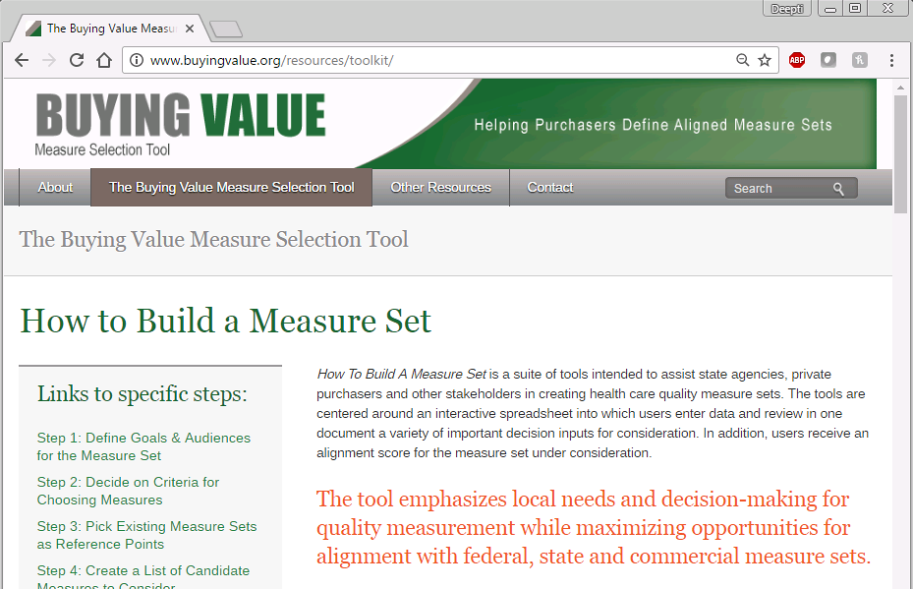
How to Create an Aligned Measure Set (Cont’d)

Slide 25
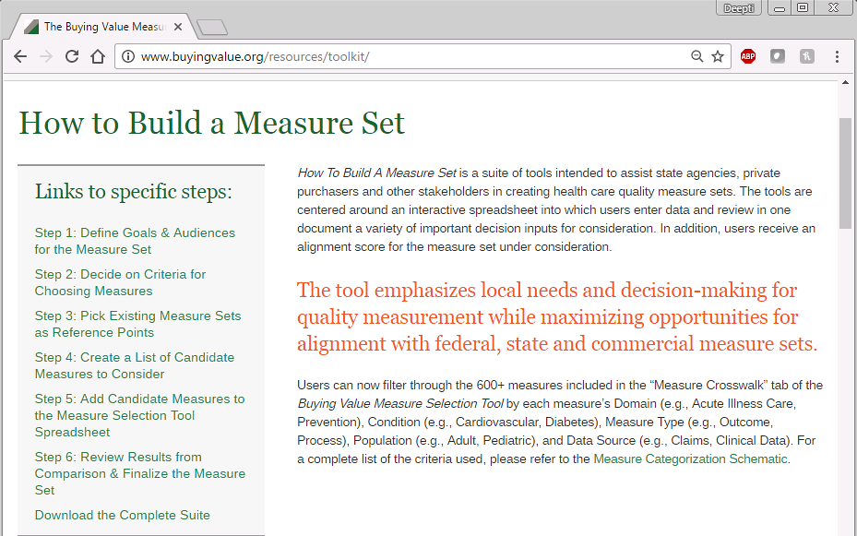
How to Create an Aligned Measure Set (Cont’d)

Slide 26
Measure Sets Included in the Tool
Federal and National Measure Sets Included in the Tool (15)
Catalyst for Payment Reform Employer-Purchaser Measure Set
CMMI Comprehensive Primary Care Plus (CPC+)
CMMI SIM Recommended Model Performance Metrics
CMS Core Set of Children’s Health Care Quality Measures for Medicaid and CHIP (Child Core Set)
CMS Core Set of Health Care Quality Measures for Adults Enrolled in Medicaid (Medicaid Adult Core Set)
CMS Core Quality Measures Collaborative
CMS Health Home Measure Set
CMS Hospital Value-Based Purchasing
CMS Medicare Hospital Care
CMS Medicare-Medicaid Plans (MMPs) Capitated Financial Alignment Model (Duals Demonstrations)
CMS Medicare Part C & D Star Ratings Measures
CMS Medicare Shared Savings Program (MSSP) ACO
CMS Merit-based Incentive Payment System (MIPS)
CMS Physician Quality Reporting System (PQRS); CMS EP EHR Incentive Clinical Quality Measures (eCQMs); and CMS Cross Cutting Measures (CCMs)
Joint Commission Accountability Measures List
Notes:
Only removed 1 measure set: “CMMI Priority Measures for Monitoring and Evaluation”

Slide 27
Measure Sets Included in the Tool (Cont’d)
State Measure Sets Included in the Tool (6)
Medi-Cal P4P Measure Set
Oregon CCO Incentive Measures
Oregon CCO State Performance “Test” Measures
Rhode Island SIM Aligned Measure Set for ACOs
Vermont ACO Pilot Core Performance Measures for Payment and Reporting
Washington State Common Measure Set for Health Care Quality and Cost

