Slide 1
EOHHS Quality Measure alignment taskforce
Meeting #34
June 9, 2020

Slide 2
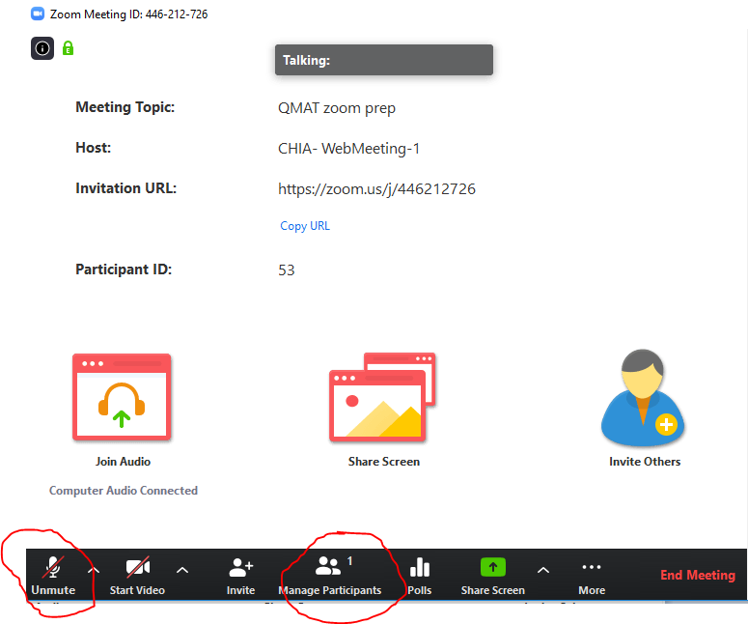
Notes on using Zoom
When you click the link in the invite and join the meeting, you will have the choice to use computer audio or telephone, and a telephone number will be provided.
You will enter the meeting muted. To unmute yourself, move your mouse in the Zoom window until a black bar appears at the bottom of the frame, and select unmute in the left corner.
You can also click Participants in this bar and a list of participants on the call will appear to the right of the screen.

Slide 3
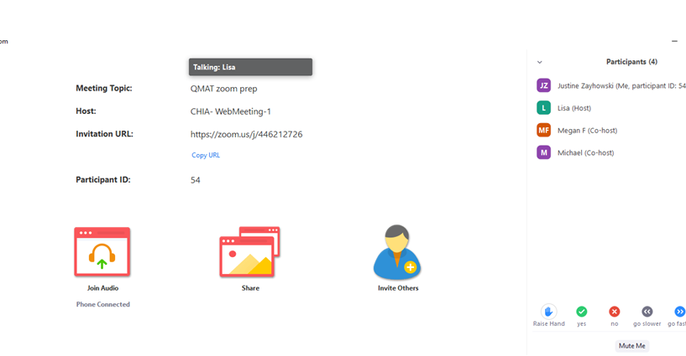
Notes on using Zoom (continued)
If you would like to speak and don’t want to interrupt, zoom has a raise hand feature that will indicate to the group that you would like to comment. It will be visible after you have opened the Participants pane (per the last slide).
Reach out to Lisa (Lisa.Ahlgren@state.ma.us) if any other questions or concerns

Slide 4
Agenda
Welcome
COVID-19 impact
Complete the annual review of the Aligned Measure Set
Preview: defining “global budget contracts”
Next steps
During this meeting, the Taskforce discussed topics 1-2 and part of topic 3.

Slide 5
Agenda
Welcome
COVID-19 impact
Complete the annual review of the Aligned Measure Set
Preview: defining “global budget contracts”
Next steps

Slide 6
COVID-19 Impact
We recognize the attention COVID-19 has been requiring of many of you, and that COVID-19 may have resulted in substantive changes in your work and current priorities.
We invite you to share your experience with COVID-19 and its impact upon you and the organization you represent.

Slide 7
COVID-19 Impact (cont’d)
We also want to take time to discuss how COVID-19 may impact the work of the Taskforce, noting the following:
Three months of cancelled meetings means that the Taskforce is behind schedule for finalizing the Aligned Measure Set for 2021, as well as considering new topics for attention.
Providers involved in COVID-19 response may be challenged to participate in Taskforce meetings and related activities.
The operational application of the Aligned Measure Set in contract negotiations for 2021 is less clear given COVID-19’s dramatic impact on care delivery.
Quality performance rates for CY2020 will not be comparable to prior year rates, which may make it difficult to determine room for improvement as we review the Aligned Measure Set for 2022.

Slide 8
COVID-19 Impact (cont’d)
In the longer term, administrative burden and provider burnout are still extremely relevant, emphasizing the importance of our continued work.
How else do you think COVID-19 will impact the work of the Taskforce?

Slide 9
Agenda
Welcome
COVID-19 impact
Complete the annual review of the Aligned Measure Set
Preview: defining “global budget contracts”
Next steps

Slide 10
Annual Review Process
Here is a summary of the status of our annual review process:
Developmental measures will be considered following the annual review process.
Step | Status
1. Background (review selection criteria and state priorities) | ✔
2. Solicit Taskforce member proposals for additions, subtractions and replacements for 2021 | ✔
3. Review the 2020 Aligned Measure Set | ✔
4. Initial review of new measures/topics | In progress
6. Revisit recommended changes to the Aligned Measure Set | Not started
5. Review feedback from the public | Not started
6. Finalize recommended changes to the Aligned Measure Set | Not started

Slide 11
Annual Review Process
Follow-up items from February
Pediatric Measures
Opioid Measures
Initiation and Engagement of Alcohol and Other Drug Abuse or Dependence Treatment
Shared Decision-making Measures

Slide 12
Aligned Measure Set Pediatric Measures
During the February Taskforce meeting, a Taskforce member asked that staff create a slide showing all measures in the Aligned Measure Set that are applicable to children.
The appendix contains slides that show Core, Menu, and Monitoring measures applicable to children and adolescents in the 2020 Aligned Measure Set.
Taskforce staff will provide updated versions of these slides following finalization of the 2021 Aligned Measure Set.

Slide 13
Appropriate Antibiotic Prophylaxis for Children with Sickle Cell Anemia
Description: The percentage of children ages 3 months to 5 years with sickle cell anemia (SCA; hemoglobin [Hb] SS or HbSβ0-thalassemia) who were dispensed appropriate antibiotic prophylaxis for at least 300 days within the measurement year. A higher proportion indicates better performance as reflected by appropriate treatment.
Numerator: The number of children ages 3 months to 5 years with SCA who were dispensed appropriate antibiotic prophylaxis for at least 300 days within the measurement year.
Denominator: The number of children ages 3 months to 5 years with SCA within the measurement year.

Slide 14
Appropriate Antibiotic Prophylaxis for Children with Sickle Cell Anemia
During the February Taskforce meeting, a Taskforce member requested information on the potential denominator size for Appropriate Antibiotic Prophylaxis for Children with Sickle Cell Anemia.
Following the meeting, one Taskforce member shared that of its MassHealth ACO pediatric population of 18,000, only 25 patients are under five with a sickle cell diagnosis (.1% of children).
Given this information, does the Taskforce recommend adding Appropriate Antibiotic Prophylaxis for Children with Sickle Cell Anemia to the Aligned Measure Set?

Slide 15
Pilot Volunteers for Three Pediatric Measures
In February, the Taskforce decided that during the March Taskforce meeting Taskforce members would share if their organizations were interested in participating in a pilot on any of the following potential Developmental measures: 1) Fluoride Varnish, 2) Tobacco Use and Help with Quitting Among Adolescents*, and 3) Developmental Screening in the First Three Years of Life.
Prior to the meeting, Taskforce staff re-distributed these specifications.
Due to time constraints we will push off this discussion to June 30th.
In the interim, please consider this question internally within your organizations if you have not yet done so.
*During this meeting, a Taskforce member also asked it Tobacco Use and Help with Quitting Among Adolescents included vaping. Following the meeting, Taskforce staff confirmed that the measure includes vaping.
Notes:
Email from CMS on 3/6: Cessation counseling/intervention for vaping would also apply to QM #402 based on the fact that E-cigarettes contain cartridges nicotine flavorings and chemicals. Additionally, as of August 2016, the U.S. Food and Drug Administration (FDA) have ruled that e-cigarettes are now considered "tobacco products" and subject to federal regulation.

Slide 16
Opioid Measures
During the February Taskforce meeting, the Taskforce decided that during the March Taskforce meeting, the Taskforce would further consider:
Appropriate Prescribing for First Fill of Opioids,
Risk of Continued Opioid Use, and
Substance Use Screening and Intervention Composite
for use in conjunction with Continuity of Pharmacotherapy for Opioid Use Disorder.
The following slides present information on each of these measures and some associated strengths and weakness. These slides were reviewed by the Taskforce during its January meeting.

Slide 17
Opioid Measures
Measure | Steward |NQF | Description | Strengths | Weaknesses
Appropriate Prescribing for First Fill Of Opioids | Health Affairs/ OptumLabs | N/A | The percentage of adults, 18 and older, who fill an initial prescription for opioid medications that does not comply with at least one of five separate measure components derived from the 2016 Centers for Disease Control (CDC) Guideline for prescribing of opioid medications that are measurable in secondary administrative claims data. (lower is better) | •Captures early prescribing patterns that lead to addiction and OUD. Is preventive in nature and requires implementation of CDC best practice for opioid prescribing and utilization management to be successful on measure. •Administrative measure | •Not NQF- endorsed and not commonly used by large purchasers

Slide 18
Opioid Measures
Measure | Steward |NQF | Description | Strengths | Weaknesses
Risk of Continued Opioid Use | NCQA *Taskforce member recommendation | The percentage of members 18 years of age and older who have a new episode of opioid use that puts them at risk for continued opioid use. Two rates are reported: 1. The percentage of members with at least 15 days of prescription opioids in a 30-day period. 2. The percentage of members with at least 31 days of prescription opioids in a 62-day period. (lower is better) | •Captures ‘new’ opioid prescribing that puts patients at risk for future OUD (prescribing is not consistent with CDC best practice). Is preventive in nature. •Administrative measure and HEDIS measure | •Not NQF- endorsed •Only 180-day look back, so may capture patients who already have OUD who were opioid free but then had relapse. Compared with #3, it has shorter lookback. •New 2019 HEDIS measure; no benchmark data yet available

Slide 19
Opioid Measures
Measure | Steward |NQF | Description | Strengths | Weaknesses
Substance Use Screening and Intervention Composite | ASAM | 2597 | Percentage of patients aged 18 years and older who were screened at least once within the last 24 months for tobacco use, unhealthy alcohol use, nonmedical prescription drug use, and illicit drug use AND who received an intervention for all positive screening results. | •One of few existing screening measures, and is comprehensive across comorbid substance use that often accompanies OUD. Addresses both screening and intervention, necessary prerequisite steps to access effective treatment. •NQF-endorsed | •Not commonly used by large purchasers •Requires EHR/chart data source

Slide 20
Opioid Measures
Measure | Steward |NQF | Description | Strengths | Weaknesses
Continuity of Pharmaco-therapy for Opioid Use Disorder | RAND Corp. | 3175 | Percentage of adults 18-64 years of age with pharmaco-therapy for opioid use disorder (OUD) who have at least 180 days of continuous treatment | •Addresses pharmacological treatment of OUD, which is often underutilized and recommended by the ASAM national clinical practice guidelines •NQF-endorsed, included in CMS Behavioral Health Medicaid Core Measure Set •Admin measure | •Low rates of starting patients with OUD on treatment to begin with, so often small denominator, and isn’t capturing the important step of initiating OUD treatment. •The ASAM national clinical practice guidelines recommend psychotherapy in combination with any pharmacological treatment of Opioid Use Disorder. Does not capture the full recommended treatment approach. •Claims data cannot differentiate patients who discontinued treatment for appropriate reasons and those who did so due to non-compliance.* •There is not sufficient evidence around the 180-day window.*

Slide 21
Opioid Measures
Which of these measures:
Appropriate Prescribing for First Fill of Opioids,
Risk of Continued Opioid Use, and
Substance Use Screening and Intervention Composite
...does the Taskforce recommend adding to the Aligned Measure Set for use in conjunction with Continuity of Pharmacotherapy for Opioid Use Disorder? Please indicate whether the measure should be placed in the Core, Menu, or Monitoring Set.

Slide 22
Agenda
Welcome
COVID-19 impact
Complete the annual review of the Aligned Measure Set
Preview: defining “global budget contracts”
Next steps

Slide 23
2020 Taskforce Goals and Developmental Priorities
During our June 30th meeting, the Taskforce will discuss how to modify its 2019 goals for 2020.
Following this meeting, Taskforce staff will distribute the 2019 Taskforce Goals.
Please review the 2019 goals in advance of the June 30th meeting and come prepared to discuss your thoughts.
During our June 30th meeting, the Taskforce will also discuss developmental measure priorities.
Following this meeting, Taskforce staff will distribute the Meeting 20 list of developmental measures and concepts.
Please review the list of developmental measures and concepts in advance of the June meeting and come prepared to discuss your thoughts.

Slide 24
Next Meeting
June 30th from 1:00-3:30pm
Complete the annual review
Defining global budget contracts
Reflect on the annual review process
Decision on including hospital measures for 2022
Pilot volunteers for three pediatric measures
Finalize NCQA letter on CDC: Blood Pressure Control
Discuss Taskforce goals for the remainder of 2020
Update on 2019 developmental measures, inclusive of 1) an update on the MNCM PRO-PM call and 2) an in-depth discussion on the health equity/stratification work
Discuss developmental priorities

Slide 25
Appendix
References slides follow.

Slide 26
Aligned Measure Set Pediatric Measures – Core Measures
# | Measure Name | Steward | Populations
03-Core | CG-CAHPS (MHQP Version) | MHQP | Children, Adolescent, Adult
04-Core | Initiation and Engagement of Alcohol and Other Drug Abuse or Dependence Treatment | NCQA | Adolescent, Adult
05a-Core | Depression Screening and Follow-Up for Adolescents and Adults | NCQA | Children, Adolescent
05b-Core | Screening for Clinical Depression and Follow-Up Plan | Centers for Medicare & Medicaid Services | Adolescent and Adult

Slide 27
Aligned Measure Set Pediatric Measures – Menu Measures
# | Measure Name | Steward | Populations
09-Menu | Childhood Immunization Status (Combo 10) | NCQA | Children
10-Menu | Immunizations for Adolescents (Combo 2) | NCQA | Adolescent
11-Menu | Influenza Immunization | AMA-PCPI | Children, Adolescent, Adult
12-Menu | Chlamydia Screening - Ages 16-24 | NCQA | Adolescent
16-Menu | Asthma Medication Ratio | NCQA | Adolescent, Adult
19-Menu | Metabolic Monitoring for Children and Adolescents on Antipsychotics | NCQA | Children
20-Menu | Child and Adolescent Major Depressive Disorder: Suicide Risk Assessment | AMA-PCPI | Children, Adolescent
21-Menu | Follow-Up After Hospitalization for Mental Illness (30-Day) | NCQA | Children, Adolescent, Adult
22-Menu | Follow-Up After Hospitalization for Mental Illness (7-Day) | NCQA | Children, Adolescent, Adult
23-Menu | Follow-up After Emergency Department Visit for Mental Health (7-Day) | NCQA | Adolescent, Adult
24-Menu | Continuity of Pharmacotherapy for Opioid Use Disorder | RAND Corporation | Children, Adolescent, Adult
25-Menu | Use of Imaging Studies for Low Back Pain | NCQA | Adolescent, Adult

Slide 28
Aligned Measure Set Pediatric Measures – Monitoring Measures
# | Measure Name | Steward | Populations
26-Monitoring | Well-Child Visits in the First 15 Months of Life | NCQA | Children
27-Monitoring | Well-Child Visits in the 3rd, 4th, 5th, and 6th Years of Life | NCQA | Children
28-Monitoring | Adolescent Well-Care Visit | NCQA | Adolescent
31-Monitoring | Contraceptive Care - Postpartum | U.S. Office of Pop. Affairs | Children, Adolescent, Adult
32-Monitoring | Prenatal & Postpartum Care - Timeliness of Prenatal Care | NCQA | Adolescent, Adult
33-Monitoring | Incidence of Episiotomy | Christiana Care Health System | Adolescent, Adult

Slide 29
Core Measure Performance
Measure | Commercial |  |  |  | Medicaid
 | 2016 | 2017 | 2018 |  | 2016 | 2017 | 2018
Comprehensive Diabetes Care: Hemoglobin A1c (HbA1c) Poor Control (>9.0%) | 21.1 | 20.8 | 22.3 |  | 32.3 | 35.0 | 31.6
Controlling High Blood Pressure | 77.2 | 74.1 | 74.3 |  | 68.4 | 66.3 | 66.7
Initiation and Engagement of Alcohol and Other Drug Abuse or Dependence Treatment- Initiation of AOD | 33.3 | 64.5 | 34.4 |  | 43.0 | 44.3 | 47.5
Initiation and Engagement of Alcohol and Other Drug Abuse or Dependence Treatment- Engagement of AOD | 12.5 | 15.7 | 12.8 |  | 17.7 | 19.5 | 18.9
Key:
<25th | 25th - 50th | 50th - 75th | 75th - 90th | ≥90th
Note: Data are not provided for: CG-CAHPS, Depression Remission and Response, Depression Remission, Depression Response, Depression Screening and Follow-up.

Slide 30
Menu Measure Performance (1 of 2)
Measure | Commercial |  |  |  | MassHealth
 | 2016 | 2017 | 2018 |  | 2016 | 2017 | 2018
Asthma Medication Ratio | 76.6 | 76.1 | 75.5 |  | 52.0 | 57.8 | 58.7
Breast Cancer Screening | 83.8 | 83.3 | 83.1 |  | 74.1 | 69.6 | 68.5
Cervical Cancer Screening | 86.1 | 85.4 | 84.2 |  | 70.6 | 71.5 | 70.8
Childhood Immunization Status (Combo 10) | 73.0 | 70.3 | 71.8 |  | 51.9 | 52.0 | 50.6
Chlamydia Screening - Ages 16-24 | 72.9 | 73.7 | 74.2 |  | 71.5 | 72.3 | 72.1
Colorectal Cancer Screening | 76.6 | 77.2 | 79.0 |  | NA - SCO only
Comprehensive Diabetes Care: Blood Pressure Control (<140/90 mm Hg) | 80.6 | 76.7 | 76.3 |  | 72.9 | 71.1 | 69.0¹
Comprehensive Diabetes Care: Eye Exam | 74.7 | 74.6 | 73.1 |  | 63.4 | 66.1 | 68.0
Follow-up After Emergency Department Visit for Mental Illness (7-Day) | No data | 70.9 | 69.7 |  | No data | 78.3 | 76.6
Key:
<25th | 25th - 50th | 50th - 75th | 75th - 90th | ≥90th
¹One MCO did not do medical record review (resulting in a rate of 0%), likely pulling down the MassHealth rate by 3-4 percentage points.
Note: Data are not provided for: Child and Adolescent Major Depressive Disorder: Suicide Risk Assessment, Continuity of Pharmacotherapy for Opioid Use Disorder, Influenza Immunization

Slide 31
Menu Measure Performance (2 of 2)
Measure | Commercial |  |  |  | MassHealth
 | 2016 | 2017 | 2018 |  | 2016 | 2017 | 2018
Follow-Up After Hospitalization for Mental Illness (30-Day) | 87.9 | 83.7 | 78.3 |  | 81.7 | 74.9 | 70.1
Follow-Up After Hospitalization for Mental Illness (7-Day) | 74.6 | 65.8 | 58.6 |  | 65.8 | 53.6 | 49.0
Immunizations for Adolescents (Combo 2) | 15.5 | 23.0 | 29.3 |  | 20.7 | 33.5 | 36.0
Metabolic Monitoring for Children and Adolescents on Antipsychotics | 39.6 | 38.7 | 40.2 |  | 37.9 | 39.0 | 37.9
Use of Imaging Studies for Low Back Pain | 81.7 | 82.2 | 82.2 |  | 77.4 | 76.8 | 76.7
Key:
<25th | 25th - 50th | 50th - 75th | 75th - 90th | ≥90th
Note: Data are not provided for: Child and Adolescent Major Depressive Disorder: Suicide Risk Assessment, Continuity of Pharmacotherapy for Opioid Use Disorder, Influenza Immunization

Slide 32
Monitoring Measure Performance
Measure | Commercial |  |  |  | MassHealth
 | 2016 | 2017 | 2018 |  | 2016 | 2017 | 2018
Adolescent Well-Care Visits | 78.0 | 77.6 | 78.3 |  | 68.5 | 67.8 | 68.6
Comprehensive Diabetes Care - HbA1c Testing | 94.6 | 94.5 | 94.6 |  | 90.9 | 90.7 | 90.3
Comprehensive Diabetes Care - Medical Attention for Nephropathy | 92.5 | 93.2 | 91.8 |  | 90.3 | 90.5 | 92.3
Prenatal and Postpartum Care - Timeliness of Prenatal Care | 93.9 | 93.6 | 95.4 |  | 87.8 | 86.5 | 86.3
Well-Child-Visits in the 3rd, 4th, 5th, and 6th Years of Life | 93.1 | 92.6 | 93.1 |  | 81.6 | 81.9 | 81.1
Well-Child Visits in the first 15 months of life (6 or more visits) | 93.8 | 94.5 | 93.9 |  | 86.9 | 83.3 | 81.6
Key:
<25th | 25th - 50th | 50th - 75th | 75th - 90th | ≥90th

Slide 33
Monitoring Measure Performance – Incidence of Episiotomy
“Incidence of Episiotomy” had a range of performance. Of the MA hospitals reporting to Leapfrog:
2017/2018* | 2018/2019
24 had a rate of <5% (Leapfrog’s target) (69%) 10 had a rate of <10% (29%) 1 had a rate of >10 (3%) | 24 had a rate of <5% (Leapfrog’s target) (65%) 13 had a rate of <10% (35%)
2017 National Average: 7.8%** | 2018 National Average: 6.9%***
* Data are for the 12 months ending 12/31/17 if the hospital submitted the Survey prior to 9/1, or it is for the 12 months ending 6/30/18 if the hospital submitted the Survey after 9/1. Same with the 2018/2019 data.
** Source: Leapfrog (2018). Castlight on Maternity Care. www.leapfroggroup.org/sites/default/files/Files/leapfrog_castlight_maternity_care_FINAL.pdf
*** Source: Leapfrog (2019). Castlight on Maternity Care. https://www.leapfroggroup.org/maternity-care-report-2019

Slide 34
Most Recent Performance on Monitoring Set Measures (cont’d)
“Contraceptive Care – Postpartum” 2016 and 2017 rates are available for MassHealth. Performance modestly improved.
Measure | 2016 | 2017 | 2018
Age 15-20
3 Days Most/Moderate | 9.0% | 8.1% | 7.8%
60 Days Most/Moderate | 49.6% | 50.7% | 49.2%
3 Days LARC | 6.8% | 5.7% | 5.2%
60 Days LARC | 25.7% | 24.5% | 23.1%
Age 21-44
3 Days Most/Moderate | 11.1% | 11.5% | 12.0%
60 Days Most/Moderate | 44.9% | 46.5% | 46.8%
3 Days LARC | 2.4% | 2.7% | 2.6%
60 Days LARC | 16.2% | 16.9% | 16.3%
“Contraceptive Care – Postpartum” measures the percentage of woman ages 15 through 44 who had a live birth that:
Were provided the most effective or moderately effective (“Most/Mod”) FDA-approved methods of contraception within 3 and 60 days of delivery
Were provided a long-acting reversible method of contraception (LARC) within three and 60 days of delivery.
Notes:
Data from Paul Kirby at MassHealth

