Slide 1
HEDIS® Digital Quality Measurement
HEDIS® is a registered trademark of the National Committee for Quality Assurance (NCQA).

Slide 2
Moving to Digital Measurement
The Need, Challenges and Principles
To fully achieve the potential of digital quality measures requires restructuring the quality measurement ecosystem to be more:
patient-centered
clinically relevant
timely
methodologically sound
broadly accepted

Slide 3
NCQA’s Vision for Quality Measurement
Better accountability at all levels
Measure harmonization across programs
Programs use better measures
Meaningful, patient-centric measures
Measures move beyond visit counts and low-bar process
Standardized electronic data
New data sources,
improved content and flow
Standardized, machine readable logic (CQL)

Slide 4
Current HEDIS Measure Framework
Differentiating Measure Format from Reporting Methodology
Measure Format
Program
Reporting Method
Quality Measures
Digital Quality Measure (dQM)
Paper Quality Measure (pQM)
CMS MIPS
NCQA HEDIS
NCQA HEDIS
Administrative
ECDS
Hybrid
CMS
Administrative

Slide 5
Electronic Clinical Data Systems (ECDS)
Reporting Standard for HEDIS
A structured method to collect and report electronic clinical data for HEDIS® quality measurement and for quality improvement
PHR
EHR
Clinical Registry
HIE
To qualify, data must use standard layouts, meet the technical specifications and be accessible by the care team upon request
Organizations report each measure component by source system of record
Case Management
Admin/
Enrollment
For more information on ECDS: http://www.ncqa.org/ecds

Slide 6
Measures available for ECDS reporting
11 measures available for ECDS reporting in Measurement Year (MY) 2019
Prenatal Immunization Status
Adult Immunization Status
Depression Screening and Follow-Up for Adolescents and Adults
Utilization of the PHQ-9 to Monitor Depression Symptoms for Adolescents and Adults
Depression Remission or Response for Adolescents and Adults
Unhealthy Alcohol Use Screening and Follow-Up
Prenatal Depression Screening and Follow-Up *new*
Postpartum Depression Screening and Follow-Up *new*
Breast Cancer Screening
Follow-Up Care for Children Prescribed ADHD Medication
Colorectal Cancer Screening
8 Measures Originally Introduced into HEDIS with ECDS Reporting
3 Traditional HEDIS Measures Newly Specified for ECDS Reporting

Slide 7
2020 Results
OBSERVATIONS FROM 2020
Overall observations from HEDIS ECDS reporting
Large increase in number of plans reporting ECDS
(total Commercial/Medicaid submissions increased from 452 in 2019 to 811 in 2020!)
Many plans reporting the immunization measures
More diverse plan types reporting
Different data source types (e.g., registry and EHR data)
Challenges exchanging behavioral health data…

Slide 8
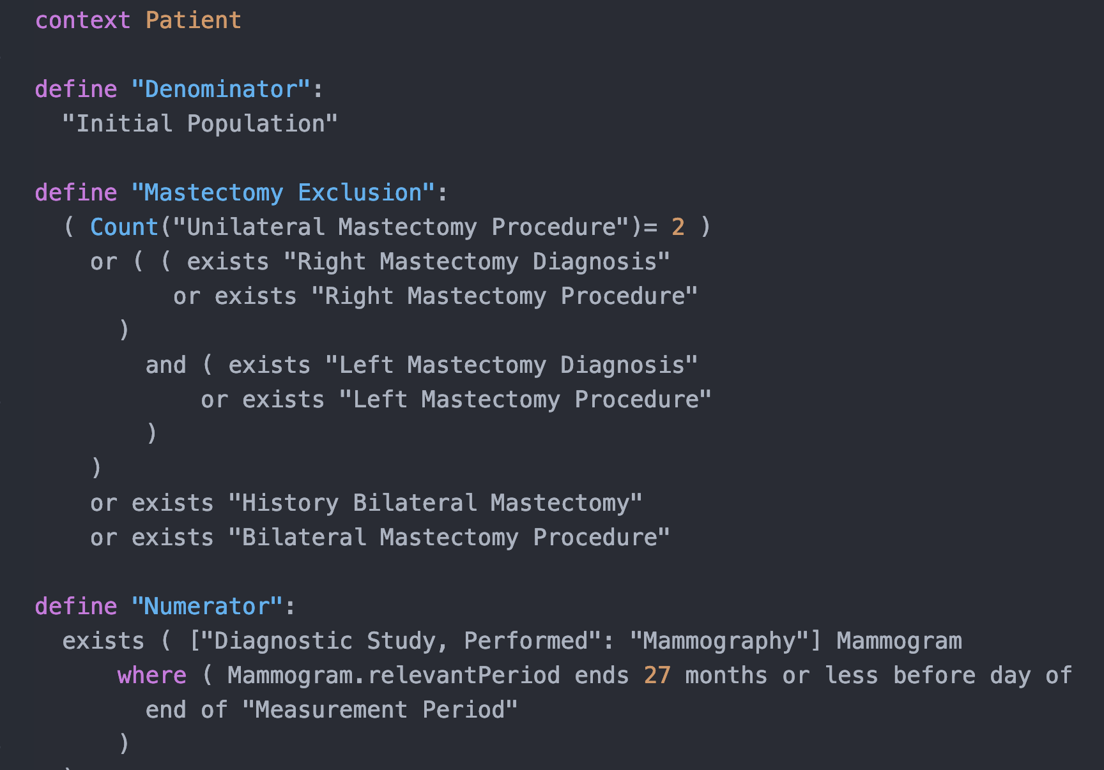
Sample “Human Readable” Measure Code
What is a Digital Quality Measure (dQM)?
digital Quality Measure
NCQA produces standardized measure code for customers
Use international standards to represent measure logic
Use U.S. standards to represent data elements
Perform the function of measure calculation
Use the same terminologies as paper specifications

Slide 9
Anatomy of a Digital Quality Measure (dQM)
Digital Quality Measure (dQM)
Data Model
Expression Logic
Structure
The abstract model that formalizes the data elements in a patient’s record into a common object structure and format
How to generate useable information from all the data elements specified in the measure
Metadata, Numerator, Denominator, Exclusions, Exceptions

Slide 10
What is FHIR®?
Latest interoperability standard
Fast Healthcare Interoperability Resources (FHIR)
HL7 standard
Enables automated data exchange through APIs
Developer friendly
Web-based technology
The Flame Design mark is the registered trademark of HL7 and is used with the permission of HL7.
FHIR® is the registered trademark of HL7 and is used with the permission of HL7. This presentation is not sponsored by HL7.

Slide 11
NCQA’s Plan To Move to FHIR
WHAT
Release a limited number of FHIR-CQL HEDIS measures for Trial Use starting in 2020
NCQA believes it is time to move to FHIR and for the first set of FHIR-CQL HEDIS measures, it is targeting Measurement Year
2022
WHY
WHEN
Proposed release of HEDIS FHIR-CQL measures for MY2022 (reported in 2023)
#1 Reduces provider burden by easing data gathering efforts
#2 Aligns with other key stakeholders (e.g., CMS)

Slide 12
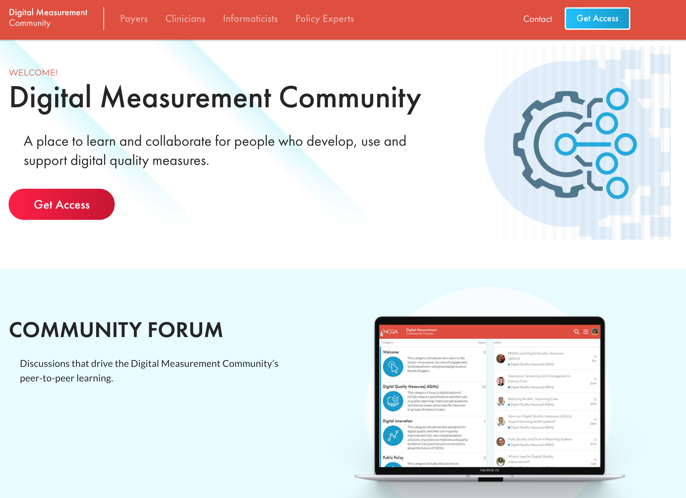
Digital Measurement Community
A NEW interactive platform for stakeholders engaged in the development and implementation of digital quality measures
Join Today!
@
digitalcommunity.ncqa.org
https://www.ncqa.org/videos/digital-measurement-community/

Slide 13
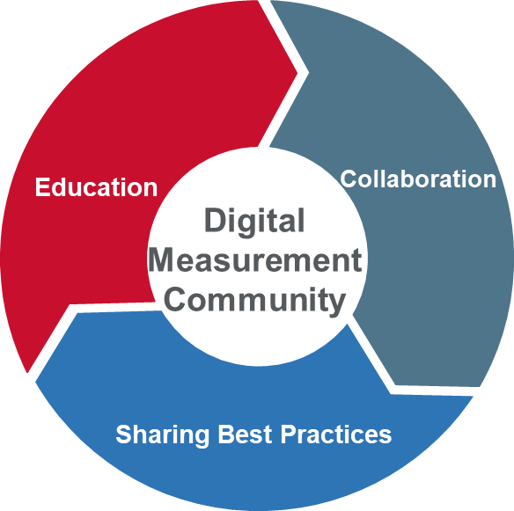
A New Interactive Digital Measurement Community
Addressing Knowledge Barriers and Lack of Coordination Across Disciplines
The Digital Measurement Community will foster collaboration around three primary areas of high impact and value:
Sharing Best Practices To promote quality and accountability in the field
Education To facilitate the adoption of digital measures and related standards
Collaboration Collaborating to build a vibrant digital measurement community

Slide 14
Appendix: DMR Roadmap for the Future

Slide 15
A Roadmap to Guide a Digital Measurement Future
Principles and Recommendations
NCQA has been working intensively with CMS, ONC and other measure developers to develop a Roadmap that will provide guidance and direction to stakeholders
Consensus process – addressing a current lack of direction in the measurement space
Seven (7) principles developed to guide stakeholders addressing:
National policy
Data interoperability
Measure formats and standards
Clinical relevance

Slide 16
Minimize Reporting Burden
7 Principles for a Digital Measure Roadmap
Use data generated in the course of planning, delivering, or paying for care
Use common measures across programs
Use common measure set for all providers

Slide 17
Strengthen Data’s Scope, Quality and Validity
7 Principles for a Digital Measure Roadmap
Use data from all suitable sources, not just payers and providers
Independently verify data quality and validity to provide info on issues and gaps
Strengthen knowledge generated using the most granular information possible
Assess all sites and care types (in part by being person-centric)

Slide 18
Establish National Systems and Data Infrastructure
7 Principles for a Digital Measure Roadmap
Maximize health IT and computable data’s potential to help providers improve
Create timely point-of-care decision support based on data from many sources
Provide community- or region-level infrastructure and support

Slide 19
Ensure Clinical Soundness
7 Principles for a Digital Measure Roadmap
Align with clinical guidelines that advance quality measurement to a continuous cycle of information supporting QI
Preserve meaningful comparison and quantifiable progress as guidelines evolve
Aid improvement through continuous measurement, intervention, assessment

Slide 20
Ensure Fairness
7 Principles for a Digital Measure Roadmap
Avoid disadvantaging providers or patient populations
Create a more inclusive QI approach that accommodates all people and groups
Standardize risk adjustment for populations
Determine population-level risk adjustment and stratification one measure at a time
Make measurement methods, data sources and results transparent

Slide 21
Align with Societal Goals
7 Principles for a Digital Measure Roadmap
Select measures for impact on cost, quality, social determinants, equity and wellbeing
Prioritize measures by anticipated benefit (value = resources used/projected benefit)
Incentivize care for complex patients based on shared savings and improving health, not on benchmarks that complex patients cannot reach
Separate patient characteristics from provider performance to avoid cherry-picking

Slide 22
Provide Timely and Targeted Analysis and Feedback
7 Principles for a Digital Measure Roadmap
Build benchmarks cautiously and include statistical results
Provide fast, actionable information from CQMs

