Slide 1
EOHHS Quality Measure alignment taskforce
Meeting #39
October 21, 2020

Slide 2
Agenda
Welcome
Finalize Guiding Principles for Use of the Aligned Measure Set in Contracts
Continue Discussing Taskforce’s Role Advancing Health Equity
Discuss Proposed Abbreviated Annual Review for 2022
Next Steps

Slide 3
The 2021 Aligned Measure Set Has Been Approved!
Secretary Sudders has approved the Taskforce’s recommended Aligned Measure Set for 2021!
Prior to the meeting, we distributed this information to members of the Taskforce as well as to our Taskforce distribution list (this includes insurers and ACOs that are not represented on the Taskforce).

Slide 4
Agenda
Welcome
Finalize Guiding Principles for Use of the Aligned Measure Set in Contracts
Continue Discussing Taskforce’s Role Advancing Health Equity
Discuss Proposed Abbreviated Annual Review for 2022
Next Steps

Slide 5
Finalize Guiding Principles for Use of the Aligned Measure Set in Contracts
During the June 30th Taskforce meeting, Taskforce members recommended creating guiding principles for implementation of the Aligned Measure Set in payer and provider contracts in areas such as denominator size and setting reasonable benchmarks.
During the August 12th and September 9th Taskforce meetings, Taskforce members provided feedback on the draft guiding principles.
Prior to today’s meeting, we distributed revised guiding principles, with the following examples italicized “Furthermore, the overall quality incentive program (through bonus payments, improvement points, or benchmarks) should not be set in a way that penalizes providers for caring for populations with higher clinical and/or social risk.”
Does the Taskforce wish to include or exclude these examples?
Does the Taskforce recommend finalizing this document?

Slide 6
Agenda
Welcome
Finalize Guiding Principles for Use of the Aligned Measure Set in Contracts
Continue Discussing Taskforce’s Role Advancing Health Equity
Discuss Proposed Abbreviated Annual Review for 2022
Next Steps

Slide 7
Continue Discussing Taskforce’s Role Advancing Health Equity
During the July 28th and September 9th Taskforce meetings, Taskforce members reviewed ideas for actions the Taskforce could take that could contribute to the reduction of health inequities in Massachusetts.
Since the September 9th meeting, Taskforce staff have discussed current work happening at various state agencies on this topic.
Today, state staff will share briefly state agency work to advance health equity:
CHIA
DPH
HPC
MassHealth

Slide 8
DPH Health Equity High Level Overview for Quality Alignment Taskforce
October 21, 2020
Sabrina Selk, Director, Office of Health Equity

Slide 9
Notes:
I always like to start with the DPH House…
This model encompasses the Commissioner’s vision of optimal health and well-being for all people of MA and which reflects “health equity” in our mission.
And we execute on this mission through these 3 pillars, by:
Using data effectively to understand what’s going on
Focusing on the social determinants of health – the conditions, especially poverty, lack of housing, and the social and built environments -- that contribute to health inequities
And we target our programs to address the disparities
OPH was established in 2017 to accelerate the use and dissemination of data to identify disparities in health outcomes, risk factors and the social determinants of health
And to facilitate organizational focus on health inequities.
Vision: Historic and persistent inequities in health and well-being are eliminated.
Mission: To achieve measurable improvements in health equity and well-being through public and private partnerships, using data, and applying a social determinants of health framework to inform and influence policies, programs and investments.

Slide 10
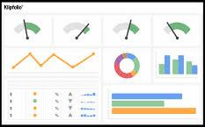
Health Equity: Key Projects
Racial Equity Movement: participate in, support, and guide RE efforts by bureaus and offices, provide an equity frame for data to inform action.
Interagency Health Equity Team (IHET): brings together senior leaders across EHS agencies to discuss how agencies use data for health equity and identify areas for strategic alignment.
Health Equity Action Dashboards: coordinating DPH-wide efforts to develop population-based health equity dashboards within PHIT.
EHS Quality Alignment Taskforce (QAT): supports EHS efforts to develop recommendations for stratifying quality measures using demographic and health-related social needs metrics.
Data Standards: ensure consistency in data collection for key populations, including defining standards and implementation of standards (e.g. RELD, SOGI, Denominators, Privacy, Rural)
Health Equity Advisory Group (HEAG): key stakeholders from communities and populations disproportionately impacted by COVID-19 to provide recommendations on DPH response.

Slide 11
Office of Health Equity: Programs
CLAS Initiative: Helps DPH programs and vendors meet CLAS standards by developing, implementing and evaluating tools and practices
Health and Disability Program: funds, trains, and guides public health staff, partners, and stakeholders to be disability inclusive. Convenes Health and Disability Partnership, a statewide advisory board
Housing Stability: align work across DPH that relates to housing instability and homelessness, with a focus on populations that experience SUD and SMI.
Interpreter Services: conducts language access assessments, provides guidance, and sets conditions to ensure health providers, including DON applicants, comply with laws and regulations.

Slide 12
DPH Data Standards: Development Update
Data Standard | At Work Group for Development or Revision | At Steering Committee for Review | At Senior Leadership for Review & Approval | Approved for Implementation | In Implementation or Piloting for Implementation
UMDI Population Denominators
Sexual Orientation and Gender Identity (SOGI)
Rural & Urban Definitions
Race, Ethnicity, & Language
People with Disabilities
Housing Instability & Homelessness
Cell Suppression | On Hold

Slide 13
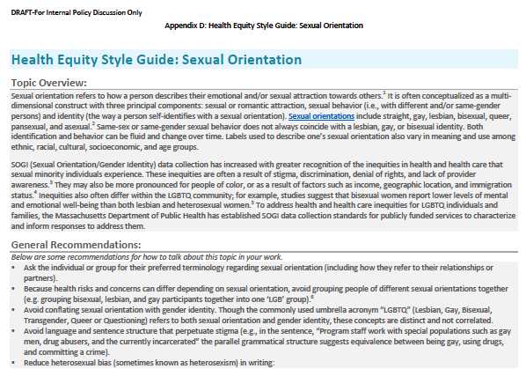
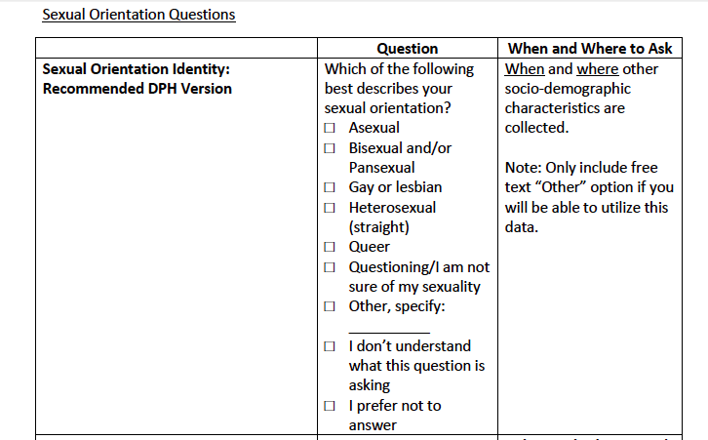
Sexual Orientation and Gender Identity: Standards
Data Standard | At Work Group for Development or Revision | At Steering Committee for Review | At Senior Leadership for Review & Approval | Approved for Implementation | In Implementation or Piloting for Implementation
SOGI
Data Standards
Two Health Equity Style Guides

Slide 15
MassHealth: Health Equity Workgroup
Proposed Vision, Mission Goal:
Vision: Everyone in Massachusetts can achieve their full potential for health and wellbeing across the lifespan
Mission: To promote, and strengthen MassHealth's efforts to integrate health equity into all programs, policies and communication to eliminate all disparities in health and healthcare
Overarching goal is to eliminate health disparities, and achieve health equity
Activity:
Provide recommendations to explicitly incorporate health equity framework into specific policies and programs for 2023-27 waiver, and
Develop a checklist for high priority workstream leaders to explicitly incorporate health equity into all of our programs, policies, practices and funding
Develop a 5-year roadmap to guide MassHealth (Enterprise)-wide efforts through a unified vision of equity to eliminate health and health care disparities with
a strategy for advancing a health equity framework in all policies and programs
a process to integrate health equity into all programs, policies and practices
MassHealth Equity
Steering Committee
Program & Policy Development
Data Strategy
Special Populations
Draft Only – For Policy Development Purposes Only

Slide 16
CHIA Work Streams Related to Health Equity
Accounting for Social Risk Factors in Public Reporting
Convened multi-stakeholder advisory group to expand risk-adjustment model to incorporate patient and community-level social risk factors into Readmissions reporting. CHIA plans to update the enhanced model by refining the data elements used and linking to additional data sources, including the APCD
Linking CaseMix to Census and ResDAC Medicare data, and exploring linking to APCD
MA Health Insurance Survey (MHIS)
Bi-annual survey of MA residents (2020 report included ~5000 responses) that includes self-reported data on race/ethnicity, education, employment, income, and other information
Collaboration with HPC to explore potential improvement to RELD data in APCD (very early exploratory discussions)
Enhanced payer reporting on the front end
Linking to more detailed geographic data that could allow for probabilistic matching

Slide 17
HPC’s current and planned health equity work relevant to the Taskforce strategies
HPC ACO Certification program (relevant to strategy 1b)
The next iteration of ACO Certification criteria is under development.
The HPC is considering a requirement that ACOs stratify by race/ethnicity or other socioeconomic factors of data collected by ACOs to
Monitor patient experiences (AC-1)
Understand the needs of patients for population health management programs (AC-4)
Supplemental information questions will gather data on ACO activities and priorities to promote health equity (e.g., data collection, program development)
Research (relevant to strategy 3)
Collaborate with CHIA to improve availability of RELD data in APCD
Pursue primary research questions related to health equity as well as subpopulation analyses
Tailor and adopt new methodologies to support equity objectives
Develop a “Best Practices” style guide to refine the ways in which we interpret, contextualize, and report on health equity findings

Slide 18
Continue Discussing Taskforce’s Role Advancing Health Equity
Given all the state efforts in this area, Taskforce staff are trying to determine the best way for the Taskforce to complement rather than duplicate existing efforts.
For the time being, we are planning on incorporating a health equity lens as part of the annual review.

Slide 19
Agenda
Welcome
Finalize Guiding Principles for Use of the Aligned Measure Set in Contracts
Continue Discussing Taskforce’s Role Advancing Health Equity
Discuss Proposed Abbreviated Annual Review for 2022
Next Steps

Slide 20
Discuss Proposed Abbreviated Annual Review for 2022
Given the prolonged review process for the 2021 set caused by COVID-19, we recommend conducting an abbreviated annual review this year, focusing on the following topics:
perform routine annual review of information such as new measure specification updates and consideration of changes to the MassHealth ACO set
conduct a substance use disorder measures scan, as previously recommended
consider any topics recommended by the Taskforce based on public feedback from the 2021 annual review
perform a health equity review of existing measures (recommended approach to be discussed next!)
Does the Taskforce agree that we should focus on the above-listed topics?

Slide 21
Discuss Proposed Abbreviated Annual Review for 2022 – Health Equity Review
To conduct our health equity review, we specifically recommend that the Taskforce:
Add consideration of health equity implications to the measure selection criteria for both individual measures and the set.
When reviewing each individual measure within the Aligned Measure Set, consider denominator eligibility by race, ethnicity, language, and disability status and discuss whether there are inequities in performance by subpopulation.
Identify measure topics for which inequities exist but for which there are no measures in the Aligned Measure Set.

Slide 22
Proposed Abbreviated Annual Review for 2022 – Health Equity Review
Add consideration of health equity implications to the measure selection criteria for both individual measures and the set.
Current criterion:
6. Represents an opportunity to improve population health at the total population and/or subpopulation level.
When reviewing individual measures, the Taskforce will examine performance stratified by race, ethnicity, language and disability status where data are available.
Proposed criterion revision:
6. Represents an opportunity to improve population health.
7. Represents an opportunity to decrease health inequities.
When reviewing individual measures, the Taskforce will examine performance stratified by race, ethnicity, language and disability status where data are available.
Taskforce staff will request stratified data from state agencies and Taskforce members and look for stratified data from other states and the research literature.
Does the Taskforce have feedback on these recommended edits?

Slide 23
Proposed Abbreviated Annual Review for 2022 – Health Equity Review
Add consideration of health equity implications to the measure selection criteria for both individual measures and the set.
Current criterion.
There is no criterion focused on health equity to be applied to the measure set as a whole.
Proposed criterion
Includes topics and measures for which there are opportunities for reduction in health inequities by race, ethnicity, language and/or disability status.
Does the Taskforce have feedback on this recommended addition?

Slide 24
Proposed Abbreviated Annual Review for 2022 – Health Equity Review
2. Consider denominator eligibility by race, ethnicity, language and disability status and discuss whether there are inequities in performance by subpopulation.
To do so, Taskforce staff ask that Taskforce member organizations share any existing and readily available data on quality performance by race, ethnicity, language, and/or disability status.
Following this meeting, we will email individual members with a formal request for such information.
Taskforce staff will also survey published health inequity reports from other states and the literature to inform this discussion.
Do Taskforce members recommend any edits to this proposed approach?

Slide 25
Proposed Abbreviated Annual Review for 2022 – Health Equity Review
3. Identify topics for which inequities exist but for which there are no measures in the Aligned Measure Set.
This conversation will be informed by members’ lived experience and by a literature review conducted by Taskforce staff.
We will also seek public comment on this topic.
Once topics are identified and prioritized, Taskforce staff will bring forth recommended measures for review and potential inclusion in the Set.
Do Taskforce members recommend any edits to this proposed approach?

Slide 26
Agenda
Welcome
Finalize Guiding Principles for Use of the Aligned Measure Set in Contracts
Continue Discussing Taskforce’s Role Advancing Health Equity
Discuss Proposed Abbreviated Annual Review for 2022
Next Steps

Slide 27
Next Meeting
November 18th from 2:30pm-4:30pm
Annual Review Topics:
Review findings from the 2020 Quality Catalogue survey
Perform routine annual review of information such as new measure specification updates and consideration of changes to the MassHealth ACO set
Begin review of the substance use disorder measure scan

