Slide 1
EOHHS Quality Measure alignment taskforce
Meeting #41
January 19, 2021

Slide 2
Agenda
Welcome
Annual review
Revisions to the annual review process
Follow-up items from November
Process for measure culling
2020 Quality Catalogue findings
Review existing measures
Next steps

Slide 3
Agenda
Welcome
Annual review
Revisions to the annual review process
Follow-up items from November
Process for measure culling
2020 Quality Catalogue findings
Review existing measures
Next steps

Slide 4
Annual Review Process – Revised to Review Existing Measures Before New Measures and Cull the Set
Step | Timing
1. Background Measure selection criteria State priorities | Meeting 40
2. Review of the existing measure set Opportunities to promote health equity Specification changes Use in contracts (through review of the Quality Catalogue) Recent performance | Meetings 41 - 43
3. Consideration of new measures New to the MSSP and Medicaid Core Sets Substance use disorder measures scan Revisit inclusion of a measure in the Core Set that requires reporting of RELD data (from October 21st meeting) Care coordination Those identified from public comment | Meetings 40, Meeting 43 - 44
4. Revisit tentatively proposed changes, consider removal of measures, and finalize the Aligned Measure Set for 2022 | Meeting 45
Notes:
We moved up the review of the existing measure set from the process shared in November.

Slide 5
Timeline for Annual Review
As a reminder, Massachusetts Aligned Measure Set for Global Budget-Based Risk Contracts 2021 Measures and Implementation Parameters state that “The Taskforce will conduct an annual review of the Massachusetts Aligned Measure Set (see details in Section IV) and finalize any recommended modifications to the measure set by 3/31 each year for the next calendar year.”
As you saw on the previous slide, Taskforce staff have decided to extend the timeline for this year’s annual review process through May due to interruptions in the annual review process caused by the pandemic.

Slide 6
Reminder: State Health Priorities
The Secretariat has identified the following as continuing state health priorities to be considered when discussing the 2022 measure set, despite the COVID-19 state of emergency:
Substance use disorders
Mental health, including pediatric mental health
Chronic disease, with a focus on cancer, heart disease, and diabetes
Housing stability/homelessness
Community tenure
Health equity

Slide 7
Follow-up Items from Last Meeting
Due to the December meeting cancelation, we have been able to gather health inequity information needed to review the existing measures within the Aligned Measure Set.
Therefore, we will pause our consideration of new measures for the time being. After reviewing the existing measures, we will return to the follow-up items from November:
Assessment of opportunity to more consistently define and collect RELD data across EOHHS agencies and programs.
Approach to engage community members in the health equity review
Consideration of new candidate substance use disorder measures
In November, Taskforce members recommended creating a work group of subject matter experts on this topic.
Please identify subject matter experts from your organizations who may be willing to participate and email Justine (jzayhowski@bailit-health.com) by 1/29.
Review of candidate social determinant of health screening measures

Slide 8
Process for Culling
During the November 18th Taskforce meeting, Taskforce members recommended incorporating a routine culling process into the annual review.
Through its measure selection criteria, the Taskforce elected to limit measures in the Core Set by setting a principle that the Core Set should not be more than five in number.
There is no parallel requirement for the Menu Set, which currently includes 21 measures, across seven domains
The largest of these domains is “Prevention/ Early Detection - Physical Health” with seven measures.
Does the Taskforce recommend establishing parameters for either the total or maximum number of measures: 1) in the Menu Set 2) in the Menu Set by domain?

Slide 9
Quality Measure Catalogue: Background
The purpose of the Quality Measure Catalogue is to capture the measures in use by payers in Massachusetts for the purposes of:
global budget-based risk contracts
tiering or limited network product methodology
consumer transparency
CHIA and the HPC have been collecting these data since 2013.

Slide 10
Quality Measure Catalogue: Background
In October 2020, the Taskforce issued a request for all Massachusetts commercial payers (N=12) to complete submissions to the Quality Measures Catalogue (QMC) by November 20, 2020.
Seven payers submitted responses to the QMC (UniCare were excluded from the analysis because they reported they do not use quality measures in their global budget contracts).
Four payers did not complete the QMC request (Aetna, Cigna, CCA, United, AllWays*).
*AllWays responded that 2021 contract negotiations were delayed due to COVID-19 so most contracts are not yet finalized. They will submit a response when they can, and Taskforce staff will share updated analysis at that time if AllWays reports use of quality measures in their global budget contracts.

Slide 11
Quality Measure Catalogue: Questions
Payers were asked to answer all of the following questions for each measure:
1. Is this measure used in global budget contracts? (Y/N)
1a. If yes, # of contracts (#)
1b. Is the measure Pay for Performance in Contracts? (Y/N)
1b. Is the measure Pay for Reporting in Contracts? (Y/N)
2. Is the measure used for tiering or limited network product methodology? (Y/N)
3. Is the measure used for consumer transparency information about provider performance (e.g., website)? (Y/N)
4. Is performance risk-adjusted for this measure? (Y/N)
5. Have you modified the externally developed specifications for this measure? (Y/N)
6. Is this measure homegrown (Y/N)?
If Payers answered “Y” to questions 5 and/or 6, they were asked to complete a supplemental form to provide detailed information about the modifications and/or homegrown measure specifications.
This process for collecting detailed information allows the HPC and CHIA to track potential Innovation measures.
Payers were asked to add any measures not included in the spreadsheet, and to respond to the questions as applicable.

Slide 12
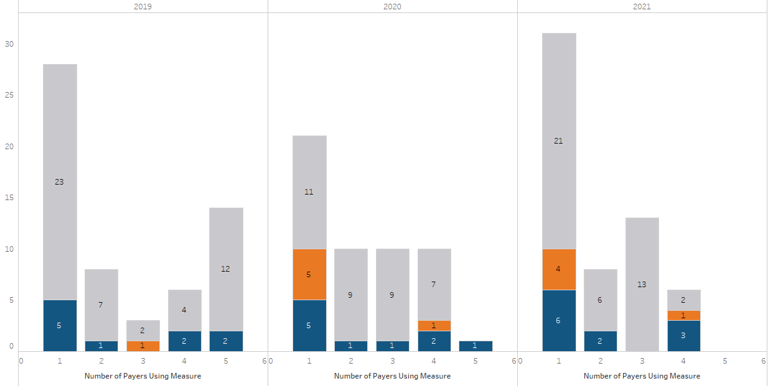
Overview of quality measures in use in any contract by MA commercial payers
Analysis only includes measures the Taskforce has considered for inclusion in the Aligned Measure Set, so hospital measures and those added by payers are not counted.
Analysis only includes the six payers who submitted this year, and who have submitted all three years.
Notable increase between 2020 and 2021 in process measures used by one payer.

Slide 13
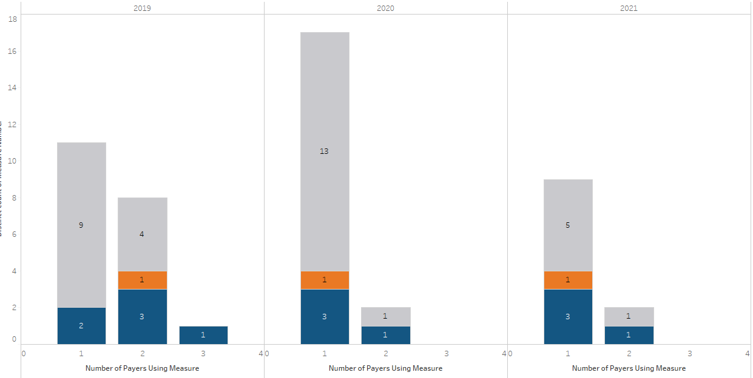
Overview of quality measures in use in at least 10 contracts by MA commercial payers
Two of the six reporting plans reported use of some measures in ≥ 10 contracts in 2021
Process measures are the most commonly used measures in ≥ 10 contracts, though fewer measures overall used in ≥ 10 contracts in 2021 than in prior years
Two measures included by both plans in ≥ 10 contracts:
Comprehensive Diabetes Care: Blood Pressure Control (<140/90 mm Hg)
Colorectal Cancer Screening

Slide 14
Plans Use of 2021 Core and Menu Measures in Any Contract
Measure Designation |  | Used in # contracts in 2021 | # contracts compared to 2020 | BCBSMA |  |  | BMC HealthNet |  |  | Fallon Health |  |  | HNE |  |  | HPHC |  |  | THP
 | Measure Name |  |  | 2019 | 2020 | 2021 | 2019 | 2020 | 2021 | 2019 | 2020 | 2021 | 2019 | 2020 | 2021 | 2019 | 2020 | 2021 | 2019 | 2020 | 2021
Core | Comprehensive Diabetes Care: Hemoglobin A1c (HbA1c) Poor Control (>9.0%) | 4 | ↑ | ● | ● | ● | ● | ● | ● | ● | ● | ● | ● | ● | ● | ● | ● | ● | ● | ● | ●
 | CG-CAHPS (MHQP Version) | 4 | = | ● | ● | ● | ● | ● | ● | ● | ● | ● | ● | ● | ● | ● | ● | ● | ● | ● | ●
 | Controlling High Blood Pressure | 4 | ↑ | ● | ● | ● | ● | ● | ● | ● | ● | ● | ● | ● | ● | ● | ● | ● | ● | ● | ●
 | Screening for Clinical Depression and Follow-Up Plan | 3 | ↑ | ● | ● | ● | ● | ● | ● | ● | ● | ● | ● | ● | ● | ● | ● | ● | ● | ● | ●
Menu | Comprehensive Diabetes Care: Blood Pressure Control (<140/90 mm Hg) | 4 | = | ● | ● | ● | ● | ● | ● | ● | ● | ● | ● | ● | ● | ● | ● | ● | ● | ● | ●
 | Immunizations for Adolescents (Combo 2) | 4 | = | ● | ● | ● | ● | ● | ● | ● | ● | ● | ● | ● | ● | ● | ● | ● | ● | ● | ●
 | Breast Cancer Screening | 3 | ↓ | ● | ● | ● | ● | ● | ● | ● | ● | ● | ● | ● | ● | ● | ● | ● | ● | ● | ●
 | Cervical Cancer Screening | 3 | ↓ | ● | ● | ● | ● | ● | ● | ● | ● | ● | ● | ● | ● | ● | ● | ● | ● | ● | ●
 | Chlamydia Screening - Ages 16-24 | 3 | ↓ | ● | ● | ● | ● | ● | ● | ● | ● | ● | ● | ● | ● | ● | ● | ● | ● | ● | ●
 | Asthma Medication Ratio | 3 | = | ● | ● | ● | ● | ● | ● | ● | ● | ● | ● | ● | ● | ● | ● | ● | ● | ● | ●
 | Use of Imaging Studies for Low Back Pain | 3 | = | ● | ● | ● | ● | ● | ● | ● | ● | ● | ● | ● | ● | ● | ● | ● | ● | ● | ●
 | Childhood Immunization Status (Combo 10) | 3 | ↑ | ● | ● | ● | ● | ● | ● | ● | ● | ● | ● | ● | ● | ● | ● | ● | ● | ● | ●
 | Colorectal Cancer Screening | 3 | = | ● | ● | ● | ● | ● | ● | ● | ● | ● | ● | ● | ● | ● | ● | ● | ● | ● | ●
 | Comprehensive Diabetes Care: Eye Exam | 3 | = | ● | ● | ● | ● | ● | ● | ● | ● | ● | ● | ● | ● | ● | ● | ● | ● | ● | ●
 | Initiation and Engagement of Alcohol and Other Drug Dependence Treatment | 4 | = | ● | ● | ● | ● | ● | ● | ● | ● | ● | ● | ● | ● | ● | ● | ● | ● | ● | ●
 | Follow-Up After Hospitalization for Mental Illness (7-Day) | 1 | ↓ | ● | ● | ● | ● | ● | ● | ● | ● | ● | ● | ● | ● | ● | ● | ● | ● | ● | ●
 | Follow-up After Emergency Department Visit for Mental Health (7-Day) | 1 | = | ● | ● | ● | ● | ● | ● | ● | ● | ● | ● | ● | ● | ● | ● | ● | ● | ● | ●
 | Influenza Immunization | 1 | = | ● | ● | ● | ● | ● | ● | ● | ● | ● | ● | ● | ● | ● | ● | ● | ● | ● | ●
 | Metabolic Monitoring for Children and Adolescents on Antipsychotics | 1 | = | ● | ● | ● | ● | ● | ● | ● | ● | ● | ● | ● | ● | ● | ● | ● | ● | ● | ●
 | Continuity of Pharmacotherapy for Opioid Use Disorder | 1 | = | ● | ● | ● | ● | ● | ● | ● | ● | ● | ● | ● | ● | ● | ● | ● | ● | ● | ●
 | Follow-Up After Hospitalization for Mental Illness (30-Day) | 1 | ↑ | ● | ● | ● | ● | ● | ● | ● | ● | ● | ● | ● | ● | ● | ● | ● | ● | ● | ●
 | Child and Adolescent Major Depressive Disorder: Suicide Risk Assessment | 0 | = | ● | ● | ● | ● | ● | ● | ● | ● | ● | ● | ● | ● | ● | ● | ● | ● | ● | ●
 | Informed, Patient-Centered Hip and Knee Replacement | 0 | N/A |  |  | ● |  |  | ● |  |  | ● |  |  | ● |  |  | ● |  |  | ●
 | Risk of Continued Opioid Use | 0 | N/A |  |  | ● |  |  | ● |  |  | ● |  |  | ● |  |  | ● |  |  | ●
 | Shared Decision-Making Process | 0 | N/A |  |  | ● |  |  | ● |  |  | ● |  |  | ● |  |  | ● |  |  | ●
See chart comments on next slide

Slide 15
Plans Use of 2021 Core and Menu Measures in Any Contract
The chart on the previous slide reflects use of the 2021 Aligned Measure Set in global budget contracts.
There are some notable caveats:
Measures that were removed from the set during the 2020 measure review are not included here. The removed measures are:
1. Depression Remission and Response for Adolescents and Adults
2. Depression Remission at Six or Twelve Months
3. Depression Remission at 6 or 12 Months – Progress Towards Remission
4. Depression Screening and Follow-up for Adolescents and Adults
BMC HealthNet is using Controlling Blood Pressure in contracts, but has not yet adopted the 2021 specifications, so it was not counted as the core measure for this chart.
Initiation and Engagement of Alcohol and Other Drug Dependence Treatment moved from Core to Menu in 2021, so it is only listed in Menu here but use is tracked across years.

Slide 16
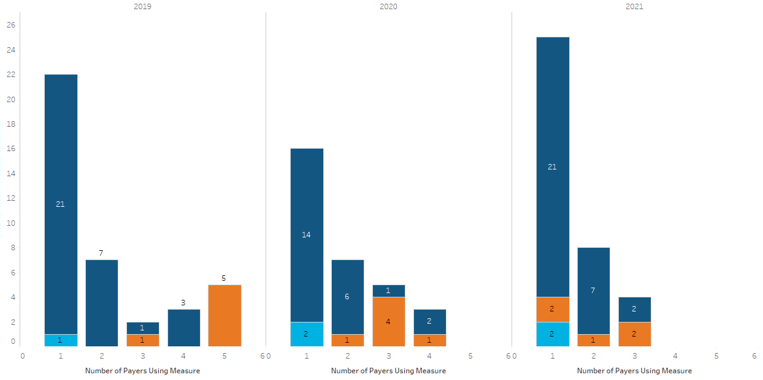
Plans report continued use of non-endorsed quality measures and developmental/monitoring measures in contracts
Many non-aligned measures continue to be included in global budget based contracts, increasing from 31 in 2020 to 37 in 2021.
30 non-endorsed measures are in use in contracts in 2021 (up from 23 in 2020), and 21 by only a single payer (up from 14 in 2020)
Developmental measures include: Community Tenure, and Depression Remission or Response for Adolescents and Adults (2020 and 2021)

Slide 17
Impact of COVID-19 on Quality Measurement in MA Global Budget-Based Risk Contracts
As part of this year’s Quality Measure Catalogue submission, payers were asked targeted questions on the impact of the pandemic on quality measurement in their global budget-based risk contracts for 2020 and 2021.
Examples:
Additions (e.g., included “non-measure” options to receive incentive)
Modifications (e.g., adjustments to benchmarks, data sources, or measure calculation approach)
Subtractions (e.g., removing preventive or patient experience measures)
No payer reported that they had eliminated quality measure-based incentives for 2020 altogether in response to the pandemic.

Slide 18
Impact of COVID-19 on Quality Measurement in MA Global Budget-Based Risk Contracts (Cont.)

Slide 19
Review of Existing Measures
The focus of today’s meeting is to begin review of the measures within the 2021 Aligned Measure Set.
To do so, we will walk sequentially through each measure, beginning with Core measures, then Menu, then Monitoring. For each measure we will consider the following:
Opportunities to promote health equity
External measure set composition and specification changes
Recent performance
Prior to this meeting, you were provided with the 2021 Aligned Measure Set Crosswalk which provides a more detailed information, including domain, condition, population, data source, previous Taskforce discussions, and performance over time.

Slide 20
Sources for “Opportunities to Promote Health Equity”
DPH 2019 Literature Review of Quality Measure Perf. Disparities
Taskforce member organization stratified data (solicited 12/14/20)
MGH, Annual Report on Equity in Health Care Quality (AREHQ) 2018-2019
Community Care Cooperative Race, Ethnicity and Language Data January 2021 (full set of slides in appendix)
UMass Memorial Ambulatory Health Equity Quality Dashboard. 12/21/20 (full set of slides in appendix)
UMass had a lot of information; we are only sharing the difference in performance between the highest performance race/ethnicity and the lowest
Boston Children's Hospital ACO. EOHHS Quality Measure Alignment Taskforce Health Equity Subcommittee Pilot Data Collection. BCH and PPOC Jan-Dec 2018 EHR data (we compared lowest to highest performing subpopulations).
“How States Can Use Measurement as a Foundation for Tackling Health Disparities in Medicaid Managed Care”
State Disparities Research conducted by Bailit Health
CA’s Medi-Cal Managed Care External Quality Review Technical Report
MI’s Medicaid Health Equity Project Year 7 Report
MN’s 2017 Health Care Disparities Report
Notes:
Additional sources were considered in selected instances, but a comprehensive literature review was not performed for each measure.

Slide 21
Sources for “Opportunities to Promote Health Equity”
Buying Value Tool: Disparities-Sensitive Measures
National Healthcare Quality and Disparities Report 2018
Public comments (solicited through 12/14/20 request) – no relevant responses received
Disparities by Disability Status Literature Search: The sources above focused primarily on race, ethnicity, and language without attention to disability status. Therefore, we supplemented the above work by searching for data on inequities by disability status by measure. Sources by measure can be found within the Crosswalk.
Not all results are displayed on each slide. All information can be found in the Disparities Research tab of the Crosswalk.
Thank you to the organizations that shared their data with us!
Notes:
Additional sources were considered in selected instances, but a comprehensive literature review was not performed for each measure.

Slide 22
Sources for Other Considerations
Measure set changes
HEDIS – no changes since last annual review
MassHealth – no changes reported by MassHealth
Medicaid Core Sets – CMS 2021 Updates to the Child and Adult Core Health Care Quality Measurement – no changes to measures in our Set
MSSP – MSSP Quality Measure Benchmarks for the 2020/2021 Performance Years – no changes; CMS List of Measures under Consideration for December 21, 2020
Specification changes
We are not aware of any major specification changes at this time; we welcome you to share any major specification changes you know of for Taskforce consideration.
HEDIS – no changes since last annual review
Medicaid Core Sets – updated technical specifications to be released in the spring

Slide 23
Sources for Other Considerations
Recent performance
MassHealth data from Paul Kirby (12/1/20) for HEDIS 2020, including PCC and MCO performance. NCQA HEDIS 2020 national Medicaid HMO percentile benchmarks were used to assess opportunity for improvement.
Commercial population performance, weighted by enrollment for BCBSMA (HMO/POS), BCBSMA (PPO), HPHC (HMO/POS), THP (HMO/POS/EPO). Compared to National ALOB percentiles for each year.
Prior year performance data were collected as part of prior annual review processes.
We have noted if performance has improved, declined, or is roughly the same (within one percentage point) from prior years.
Key:
<25th | Between 25th and 50th | Between 50th and 75th | Between 75th and 90th | ≥90th

Slide 24
CG-CAHPS (MHQP Version) (Core)
Race/Ethnicity | Language | Disability Status
MGH performance: All racial/ethnic minorities lower than Whites on: Care Coordination, Provider Communication, and Provider Rating Asians had lower patient experience on all ambulatory composite B.1 MGH, Annual Report on Equity in Health Care Quality (AREHQ) 2018-2019 | MGH performance: Non-English-speaking more likely to recommend their provider Non-English-speaking lower patient experience scores in the areas of Care Coordination, Provider Communication, and Provider Rating. B.1 MGH, Annual Report on Equity in Health Care Quality (AREHQ) 2018-2019 | Dual eligible beneficiaries with a disability were more likely to report being unable to get needed health care compared to beneficiaries without a disability (14% versus 10%). H. Disparities by Disability Status Literature Search https://www.cms.gov/About-CMS/Agency-Information/OMH/Downloads/Data-Highlight_How-Does-Disability-Affect-Access-to-Health-Care-for-Dual-Eligible-Beneficiaries.pdf
Set/Specification Change | Commercial Performance | MassHealth Performance
No | 2019 data provided in the 2021 crosswalk | 2018 data provided in the 2021 crosswalk

Slide 25
Comprehensive Diabetes Care: Hemoglobin A1c (HbA1c) Poor Control (>9.0%) (Core)
NQF has identified this to be a “disparities-sensitive measure.”
Race/Ethnicity | Disability Status
UMass performance showed highest control for Asians (75%) and lowest for Blacks or African Americans (65%) Prevalence of diabetes 77% higher among Blacks and 66% higher among Hispanics than Whites. B3. UMass Memorial Ambulatory Health Equity Quality Dashboard. 12/21/20. A. DPH Literature Review on Quality Measure Performance Disparities, Piccolo, Rebecca et al. (2016). | Diabetes: Age-Adjusted Prevalence Rates (per 1000): No disability group (3.7%); Cognitive limitations group (18%); Physical disability group (15%). H. Disparities by Disability Status Literature Search https://pubmed.ncbi.nlm.nih.gov/21419369/
Set/Specification Change | Commercial Performance | MassHealth Performance
No | 22.3 Performance has declined since 2016 by 1.2 percentage pts | 35.8 Performance has declined since 2016 by 3.5 percentage pts

Slide 26
Controlling High Blood Pressure (Core)
NQF has identified this to be a “disparities-sensitive measure.”
Race/Ethnicity | Disability Status
C3 performance showed lower levels of BP control among Black or African American patients (45%) than White (50%). CA and MN Medicaid programs also reported Black patients faring worse on control of high blood pressure. B2. Community Care Cooperative Race, Ethnicity and Language Data January 2021 D. State Disparities Research | Compared to adults without disability, those with physical disabilities and those with cognitive limitations experienced more high blood pressure. High Blood Pressure: Age-Adjusted Prevalence Rates (per 1000) : No disability group (16.1%); Cognitive limitations group (27.5%); Physical disability group (67.3%). H. Disparities by Disability Status Literature Search https://pubmed.ncbi.nlm.nih.gov/21419369/
Set/Specification Change | Commercial Performance | MassHealth Performance
No | 74.3 Performance remained the same 2018-2019 | 68.4 Performance improved 1.7 percentage points since 2018

Slide 27
Screening for Clinical Depression and Follow-Up Plan (Core)
NQF has identified this to be a “disparities-sensitive measure.”
Race/Ethnicity | Language | Disability Status
Medicaid-covered Latinx, Asian/Pacific Islander, and Black youth were less likely to have a depression diagnosis than white counterparts. After a new diagnosis, Native American and Latinx youth were less likely than white youth to have received an antidepressant or a mental health specialty visit.¹ Black and Asian adults were less likely to be screened for depression than white adults. Latinx adults were more likely to be screened for depression. Post-screening, Black adults, Latino males, and Asian adults were less likely to receive mental health care than their white counterparts² |  | The estimated prevalence of depression in adults with disability (24.9-41%) is higher than that of adults without disability (22.8-27.5%) Individuals with physical disability reported more pain, depression, and anxiety and a lower quality of life. H. Disparities by Disability Status Literature Search https://pubmed.ncbi.nlm.nih.gov/28362849/
Set/Specification Change | Commercial Performance | MassHealth Performance
No | No data | 42.9
¹https://jamanetwork.com/journals/jamapediatrics/fullarticle/481451
²https://www.ncbi.nlm.nih.gov/pmc/articles/PMC4408551/

Slide 28
Asthma Medication Ratio (Menu)
Race/Ethnicity | Disability Status | Housing/Income
In 2016, 1 in 12 children ages 0-17 had asthma. Among them, asthma disproportionately affected males, non-Hispanic Black children, and children from low-income households. F. National Healthcare Quality and Disparities Report 2019 | Adults with physical disabilities and/or cognitive limitations experienced more asthma than adults without disability. Age-Adjusted Prevalence Rates (per 1000) Asthma: No disability group (7.6%); Cognitive limitations group (17%); Physical disability group (71%). H. Disparities by Disability Status Literature Search https://pubmed.ncbi.nlm.nih.gov/21419369/ | Substandard housing conditions have been associated with poor health outcomes related to asthma. Even after controlling for other traditional measures of socioeconomic status, children are more likely to have asthma the closer their family is to the federal poverty line. A. DPH's Literature Review on Quality Measure Performance Disparities. Taylor, Lauren. (2018). .
Set/Specification Change | Commercial Performance | MassHealth Performance
No | 75.2 Performance declined from 2017 by 1.1 percentage points | 55.6 Performance declined from 2017 by 2.2 percentage points
Notes:
MA performance for commercial and MassHealth was below the 50th percentile in 2016.

Slide 29
Breast Cancer Screening (Menu)
NQF has identified this to be a “disparities-sensitive measure.”
Race/Ethnicity | Disability Status
UMass performance showed higher screening rate for White (77%) than other race/multi-racial patients (67%) The Medicaid managed care breast cancer screening rate is 2.6 percentage points higher for Whites than for Blacks in Michigan, and 6 percentage points higher in Minnesota. B3. UMass Memorial Ambulatory Health Equity Quality Dashboard. 12/21/20. D. State Disparities Research | Mammography rates for women aged 50+ were higher for women without disability (74%) than for women with basic actions difficulty (67%) or complex activity limitation (61%). The lowest mammography rates among women aged 50+ were seen in those with cognitive difficulties (52%) and those with ADL or IADL limitations (51%). H. Disparities by Disability Status Literature Search https://www.cdc.gov/nchs/data/misc/disability2001-2005.pdf
Set/Specification Change | Commercial Performance | MassHealth Performance
No | 83.1 Performance roughly the same as prior years | 69.4 Performance roughly the same as prior years

Slide 30
Agenda
Welcome
Annual review
Revisions to the annual review process
Follow-up items from November
Process for measure culling
2020 Quality Catalogue findings
Review existing measures
Next steps

Slide 31
Next Steps and Meeting 42
Next Steps
Meeting 42 (Feb. 23rd) Annual Review Topics:
Finish review of the measures in the existing Aligned Measure Set
Continue the consideration of new measures
Follow-up items from the November Taskforce meeting

