Slide 1
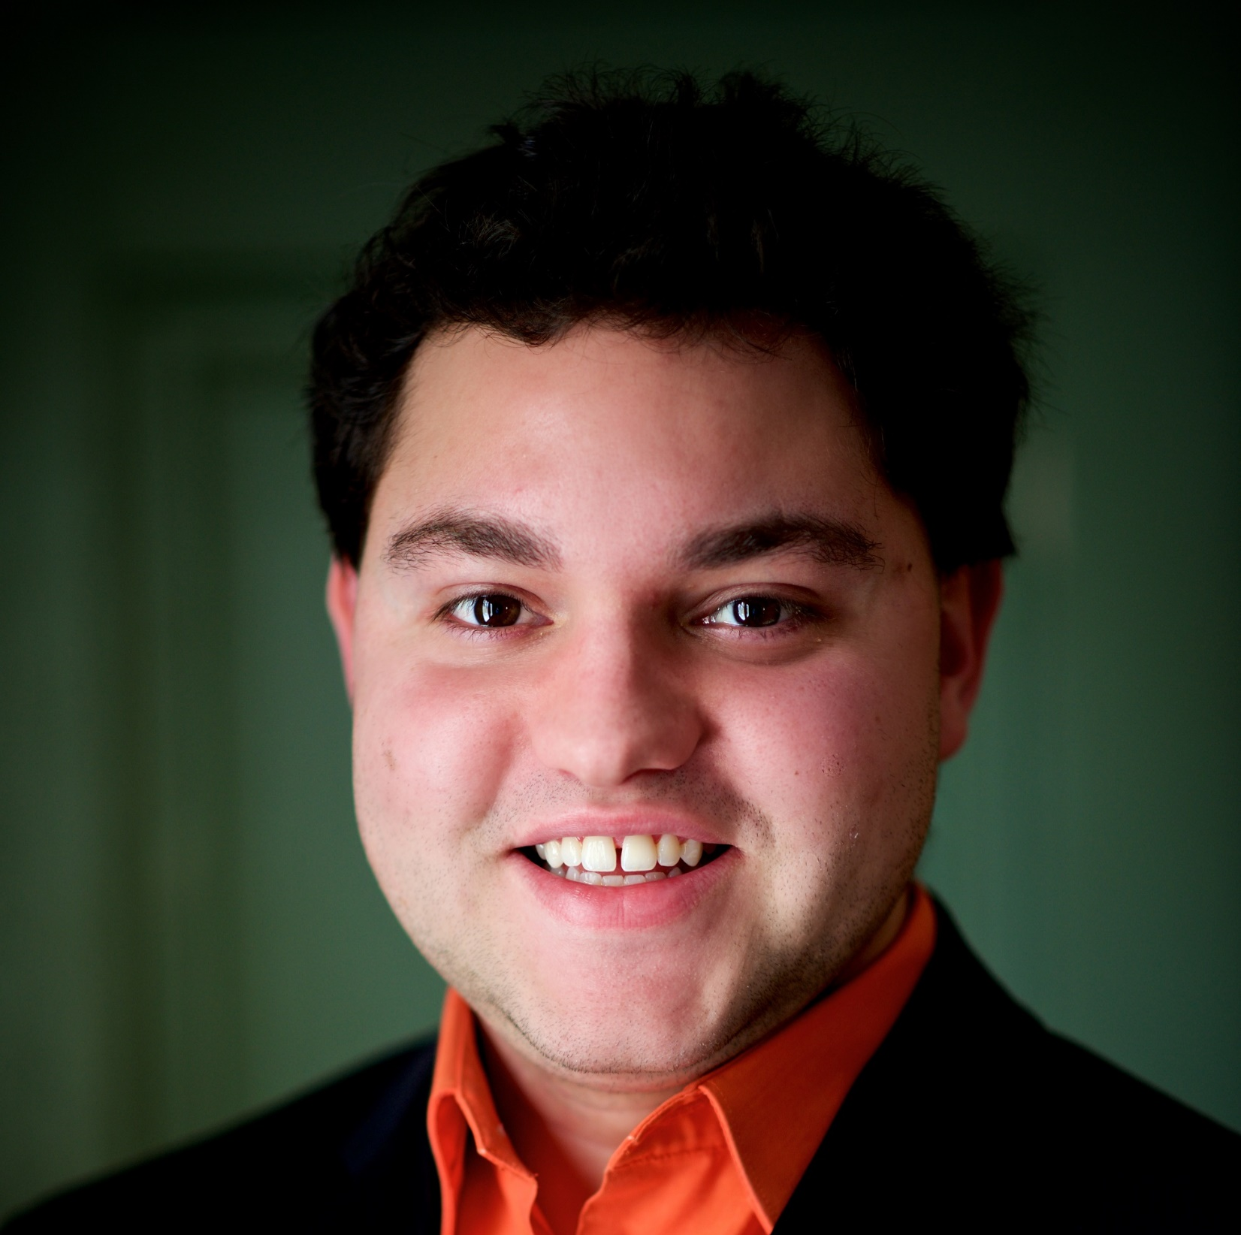
Community Services Division Quarterly Reporting Tutorial
Filipe Zamborlini
Community Grants Coordinator
Filipe.Zamborlini@mass.gov

Slide 2
Quarterly Report Requirements
Quarterly Reports Due Dates
15th of the month following the end of the quarter for each Fiscal Year of your grant.
January 15
April 15
July 15
October 15

Slide 3
Quarterly Report Requirements
Information to Submit
Amount spent per line item each quarter
Narrative if no funds are spent in quarter
Project highlights (optional)

Slide 4
Community Services Division Quarterly Reporting Tutorial
Filipe Zamborlini
Community Grants Coordinator
Filipe.Zamborlini@mass.gov

