Slide 1
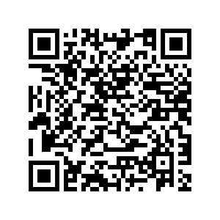
Quincy Route 3A/Hancock Street Transportation Improvements Study Public Information Meeting #2
What is happening?
MassDOT will hold a second Public Information Meeting for the Quincy Route 3A/Hancock Street Transportation Improvements Study on Tuesday, March 4, 2025, at 6:00 p.m., virtually via Zoom. At this meeting, the study team will provide an overview of the data collected, proposed alternatives, and intersection treatments. There will also be an opportunity for public comment. Accessibility accommodations and language services will be provided free of charge, upon request, as available.
The Quincy Route 3A/Hancock Street Transportation Improvements Study is a conceptual planning study of the northern Hancock Street section of Route 3A. MassDOT will evaluate congestion and gaps in the multimodal transportation network and work with stakeholders to develop recommendations for future improvements in the corridor.
To register for the meeting use the QR code or click below:
When Where
https://us06web.zoom.us/webinar/register/WN_iLFOqUqqRn6ZUFo-DiPqiw
Tuesday March 4, 2025
6:00 – 7:00 p.m.
Virtually, via Zoom
Visit https://www.mass.gov/quincy-route-3ahancock-street-transportation-improvements-study for more information.
This meeting is accessible to people with disabilities and those with limited English proficiency. MassDOT provides reasonable accommodations and/or language assistance free of charge upon request, as appropriate. To request accommodation or language assistance, please contact MassDOT’s Chief Diversity and Civil Rights Officer by phone (857) 368-8580, fax (857) 368-0602, relay 7-1-1, or by email to MassDOT.CivilRights@dot.state.ma.us. Requests should be made as soon as possible prior to the meeting, and for more difficult to arrange services including sign- language, CART or language translation or interpretation, requests should be made at least ten
(10) business days before the meeting.

