Slide 1
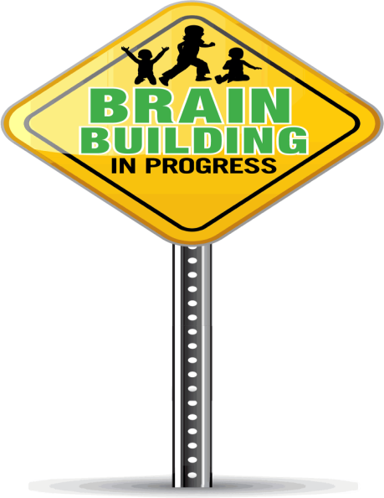
EEC Board Meeting
April 8, 2014
Race to the Top Early Learning Challenge Grant (RTT-ELC)

Slide 2
RTT-ELC Grant Overview
The US Departments of Education and Health and Human Services objectives for RTT-ELC:
Successful State Systems built on broad-based stakeholder participation and effective governance structures.
High-Quality Accountable Programs based on a common set of standards aligning Head Start, CCDF, IDEA, Title I of the ESEA, state-funded preschools, and similar programs to create a unified statewide system of early learning and development.
Promoting Early Learning and Development Outcomes for Children through the implementation of common statewide standards for young children, comprehensive assessments aligned to those standards across a range of domains, and clear guidelines for improving the quality of programs and services that promote health and engage families in the care and education of young children.
A Great Early Childhood Education Workforce that is supported through professional development, career advancement opportunities, differentiated compensation, and incentives to improve knowledge, skills, and abilities to promote the learning and development of young children.
Measuring Outcomes and Progress through the collection, organization, and understanding of evidence of young children’s progress across a range of domains, as well as implementing comprehensive data systems and using data to improve instruction, practices, services, and policies.

Slide 3
Current Status of RTT-ELC in Massachusetts
Expanded infrastructure
  EEC staff
  Early Childhood Information System (ECIS)
  Strengthened alignment along the birth to third grade continuum
  Early childhood and kindergarten learning standards
  MKEA
  Local grants
  Increased program and provider quality
  Strengthening QRIS
  Expanding professional development
  Improved grant management
  Project and budget amendments to ensure effective and efficient use of funds

Slide 4
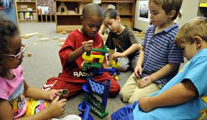
2013 RTT-ELC Highlights
Program Quality
A total of 631 programs received QRIS Program Improvement Grants to increase quality.
Completion of the MA Alignment Study with clear recommendations on how the state can improve its early learning standards.
Completion of guidelines for Early English Language Development Standards.

Slide 5
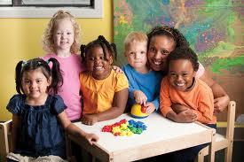
2013 RTT-ELC Highlights
Educator Quality
Launch of the Resources for Early Learning website, the state's first digital hub of early education resources for families and educators.
The first cohort of 13 students in the Post Master's Certificate Program graduated in December 2013.
151 individuals from across the state participated in the 2012-2013 Early Educators Fellowship Initiative.

Slide 6

2013 RTT-ELC Highlights
Family and Community Engagement
Massachusetts has received national recognition for its RTT-ELC initiative to engage statewide museums and libraries in STEM early education.
Over $800K was awarded to local communities to support evidence-based literacy programs and over 7,000 families received evidence based literacy programming in 2013.
Over 1,200 families have received financial literacy education to improve their financial skills.

Slide 7
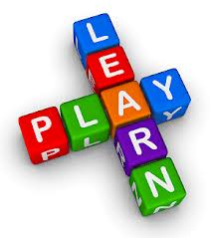
2013 RTT-ELC Highlights
Screening and Assessment
1,160 children across the state have received a developmental screening through the Ages and Stages Questionnaire (ASQ).
There are 77 school districts participating in MA Kindergarten Entry Assessment (MKEA), an increase of 74% from 2012.
Over 400 public school kindergarten teachers and administrators attended a MA Kindergarten Entry Assessment (MKEA) conference in October 2013 to learn more about the importance of formative assessment in early childhood settings.

Slide 8

2013 RTT-ELC Highlights
Infrastructure
Boston, Springfield, Lowell, Pittsfield, and Somerville are the recipients of the Birth to Third grade grant and are executing strategic plans to improve their infrastructure so that children receive high quality early education.
Interagency partners (DCF, DMH, DPH, DHCD and ORI) are fully staffed and have provided statewide trainings that have reached over 1,100 individuals that include agency staff and early education providers.
The Early Childhood Information System (ECIS) went live in July 2013 with real time data to inform policy.
EEC hired a RTT fiscal staff member and actively interviewed for additional RTT staff to manage projects.

Slide 9
RTT-ELC Budget Update
Overall spending to date: $15,235,528 (30% of total grant)
Spending Breakdown by Project
Proj. | Program | Year 1 | Year 2 | Year 3 | Total Expenditures
1 | Systems Infrastructure | $ 516,801 | $ 1,146,363 | $ 152,374 | $ 1,815,538
2 | Tiered Quality, Rating, and Improvement System (QRIS) | $ 928,883 | $ 2,631,240 | $ - | $ 3,560,123
3 | Massachusetts Early Learning and Development Assessment System (MELD) | $ 974,804 | $ 303,296 | $ - | $ 1,278,100
4 | Family Engagement Evidence Based Practice | $ 243,921 | $ 768,167 | $ 1,474 | $ 1,013,562
5 | Sustaining Program Effects in the Early Elementary Grades | $ 247,174 | $ 1,086,901 | $ 23,231 | $ 1,357,307
6 | Standards: Validation and Alignment | $ 538,773 | $ 677,546 | $ 20,634 | $ 1,236,953
7 | Interagency Partnerships | $ 181,785 | $ 977,092 | $ 163,577 | $ 1,322,455
8 | Ensuring Competency through Workforce Knowledge, Skills, and Practice-Based Support | $ 322,896 | $ 1,301,443 | $ 7,988 | $ 1,632,327
9 | Common Measure for Kindergarten Entry Assessment | $ 157,659 | $ 74,867 | $ - | $ 232,527
10 | Early Childhood Information System | $ 92,092 | $ 206,172 | $ 56,481 | $ 354,745
11 | Pre-K to Grade Three Communications | $ 67,322 | $ 166,727 | $ - | $ 234,049
12 | Pre-K to Grade Three Alignment Content Based Media Partnership | $ 266,208 | $ 931,635 | $ - | $ 1,197,843
 |  | $ 4,538,320 | $ 10,271,449 | $ 425,760 | $ 15,235,528

Slide 10
RTT-ELC Budget Update
Unspent Year 1 & 2 funds have been transferred to priority areas for Years 3 & 4

Slide 11

RTT-ELC Lessons Learned in 2013
Lessons Learned
Findings from the MA Alignment Study emphasize the need to address the state's early learning standards in the area of social and emotional development and approaches to learning and play domains. MA will prioritize revising its preschool standards to incorporate these domains in the coming year.
Kindergarten teachers should be provided more professional development opportunities to fully understand the value of formative assessment.

Slide 12

RTT-ELC Next Steps
Continue fiscal and programmatic monitoring of projects and vendors to ensure compliance with Federal requirements through the duration of the grant.
Develop sustainability plans for successful projects that enhance EEC’s strategic focus areas.
Develop communication campaign to inform and foster partnerships with internal and external stakeholders.

