Slide 1
An Introduction to NORD
Massachusetts RDAC Meeting
Annissa Reed- State Policy Manager, Eastern Region
December 9th, 2021

Slide 3
OUR STAKEHOLDERS
PATIENTS & FAMILIES
PATIENT ORGANIZATIONS
Undiagnosed
Newly Diagnosed
Caregivers
Research Foundations
Disease-Specific Advocacy Organizations
Support Groups
MEDICAL PROFESSIONALS
REGULATORS
INDUSTRY
Food and Drug Administration (FDA)
National Institutes of Health (NIH)
Centers for Medicaid and Medicare (CMS)
Social Security Administration (SSA)
Biotechnology
Pharmaceutical
Research Organizations
Service Providers

Slide 4
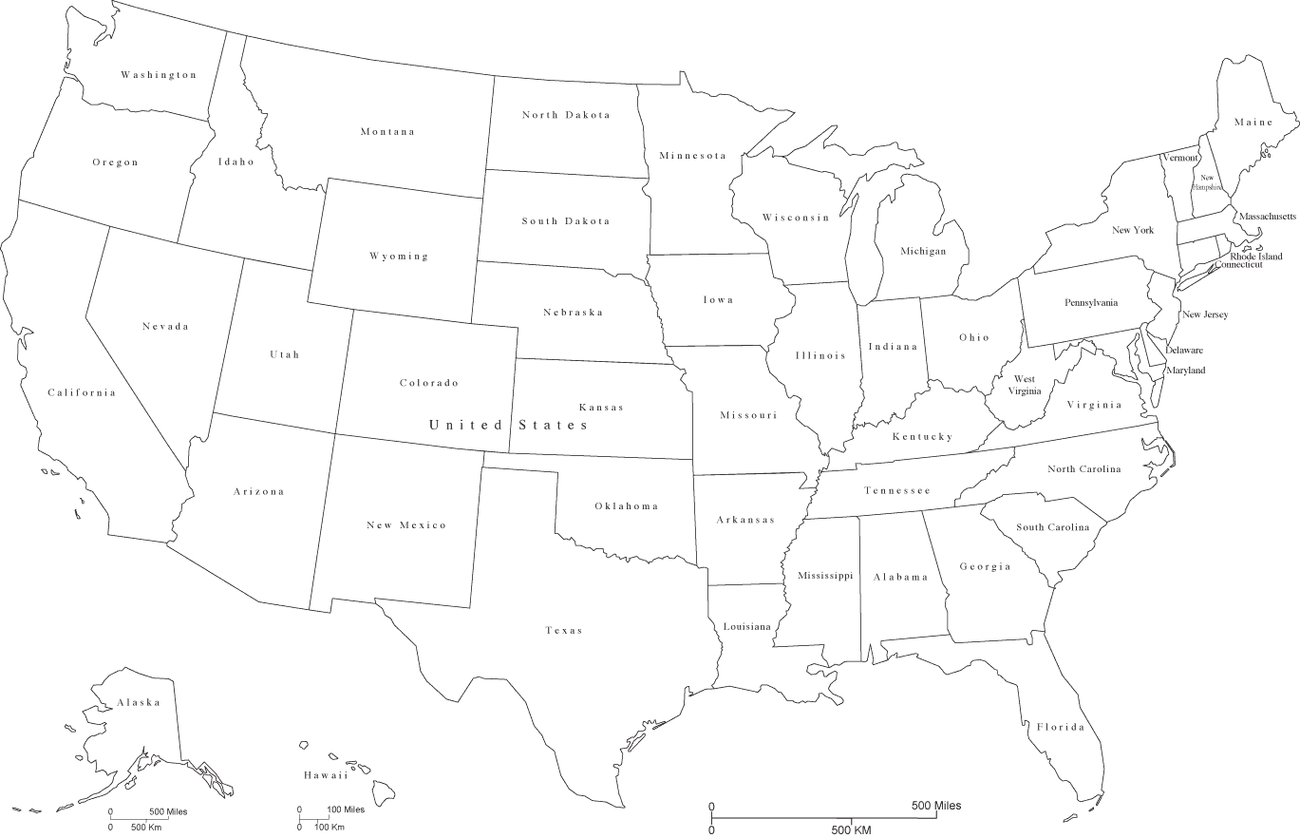
MEMBERSHIP ORGANIZATIONS
3
4
5
8
26
1
1
7
15
3
8
1
18
1
20
12
27
2
4
10
16
3
1
5
330 Members
1,200 PAGs
7,000 Rare Diseases
1
5
11
1
4
7
3
3
1
11
1
1
7
1
1
14

Slide 5
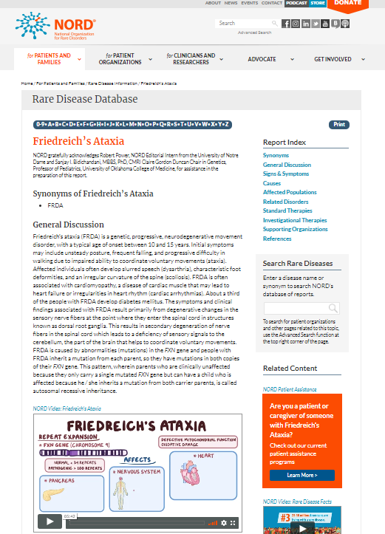
RARE DISEASE DATABASE
Rare Disease Database
1,300+ reports
Integrated videos
In 2021
Updated reports: 44
New reports added: 9

Slide 6
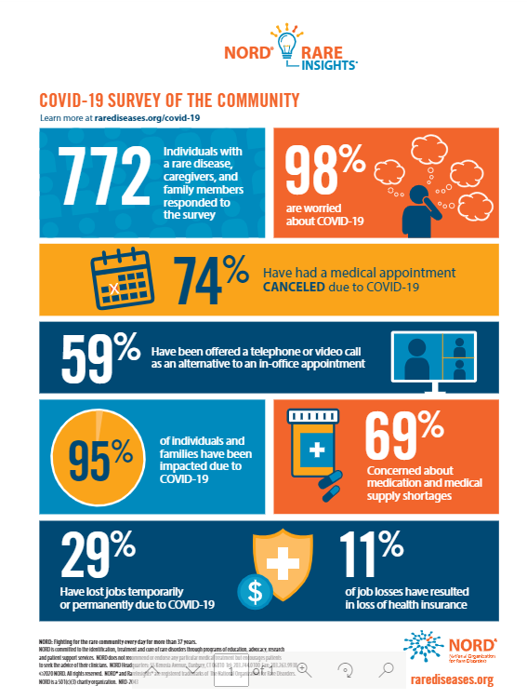

Slide 7
NORD Patient Assistance Programs
https://rarediseases.org or 800.999.6673
NORD is well-recognized and universally regarded as the expert in navigating the complex rare disease landscape.

Slide 8
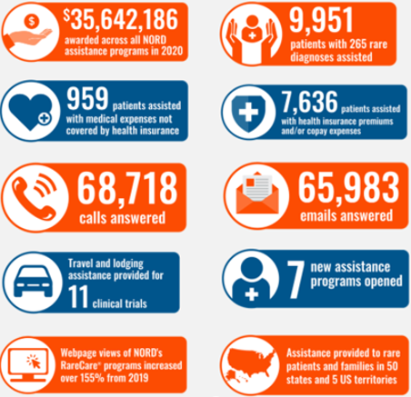
Patient Services Impact
Dedicated Patient Services and Information Services Team
Communication Center:
Mon-Thurs 8:30am-7:00pm
Fri 8:30am-6:00pm EST

Slide 9
PROJECT RDAC
GOAL: Optimize existing rare disease advisory councils (RDACs) and increase the number of RDACs across the country
Organize diverse coalitions of rare disease community stakeholders in support of establishing new RDACs
Create opportunities for existing RDACs to collaborate with each other
Develop resources to guide RDACs at every step of the process:
Model Language
Webinars/Workshops
Toolkits
Legislator Engagement

Slide 10
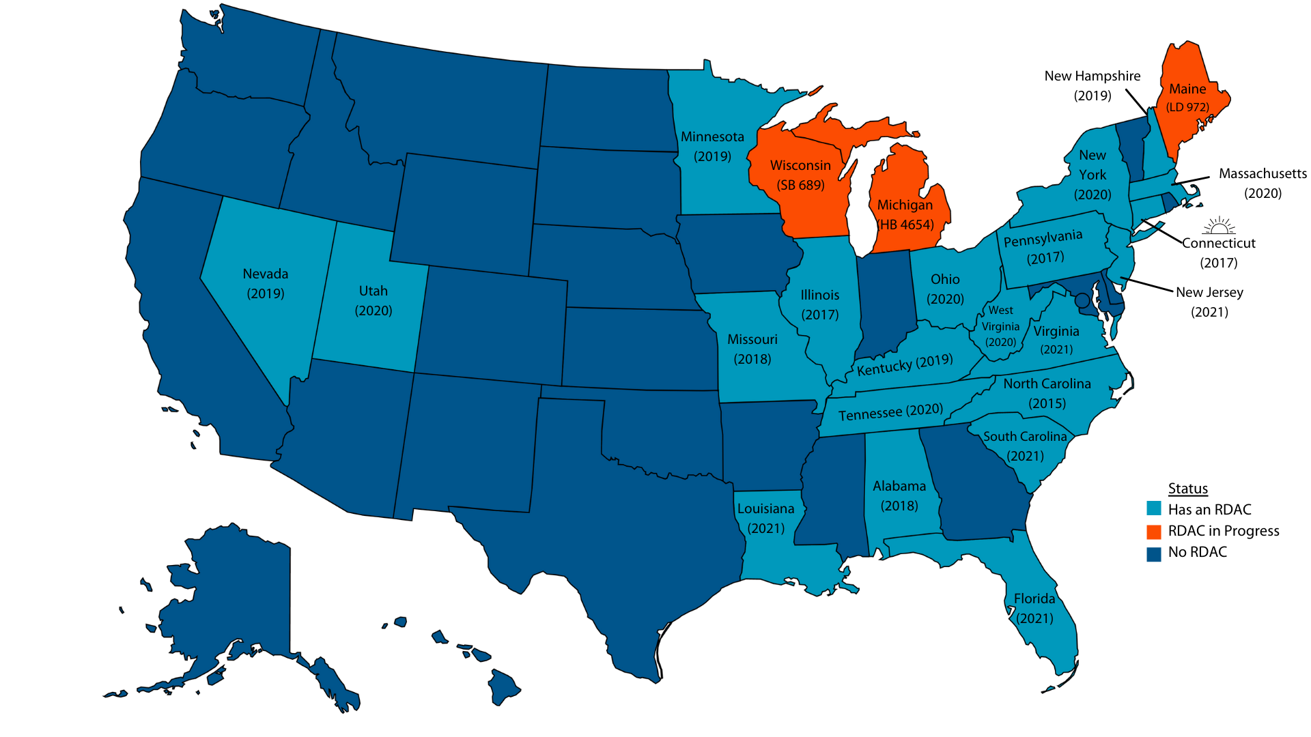
RARE DISEASE ADVISORY COUNCILS
Since the launch of Project RDAC:
7 states have passed RDAC legislation into law (OH, MA, VA, FL, LA, NJ, SC)
3 states have pending RDAC legislation (ME, MI, and WI)
8 states had active RDAC engagement (CA, TX, GA, MD, MS, AR, IN, WA)
21 states have passed RDAC legislation!

Slide 11
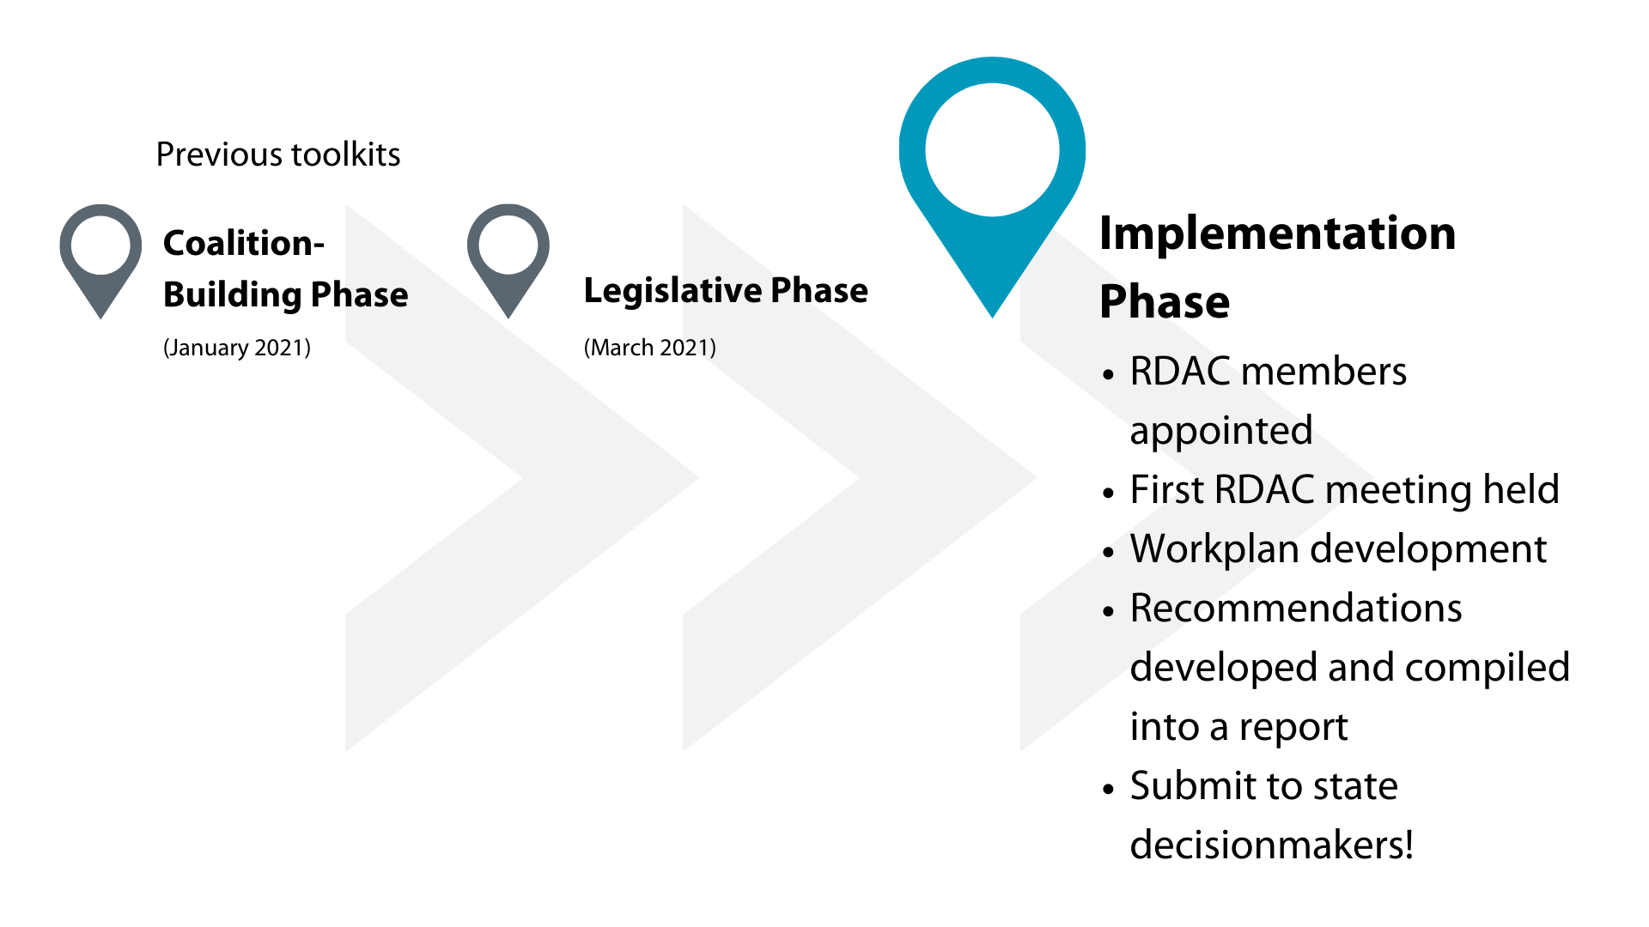
LIFECYCLE OF AN RDAC
Access toolkits at: https://rarediseases.org/projectrdac/

Slide 12
OPERATIONALIZING THE RDAC AS THE CHAIR/VICE-CHAIR

Slide 13
NORD RDAC RESOURCES
Examples of resources contained in the implementation toolkit:
Criteria for a strong application process
Sample email to advertise open RDAC positions
Sample agenda for first meeting
Template slides on rare diseases
Criteria for a strong website
Template social media posts
Sample email to invite a guest speaker
Sample presentation for legislators
Letter from an RDAC to state agencies

Slide 14
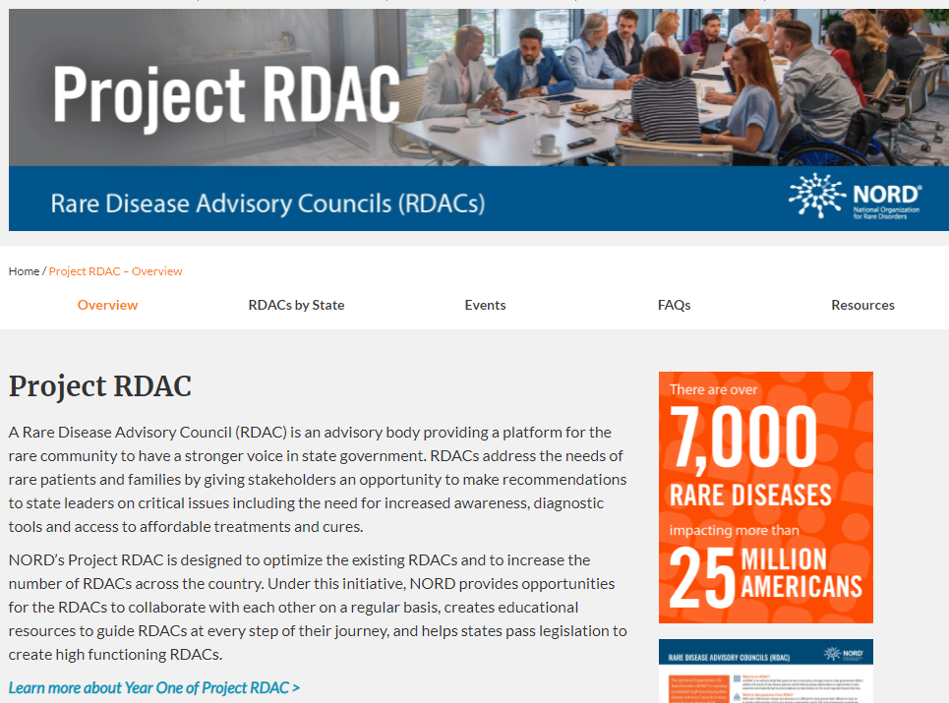
HOW TO REQUEST THE TOOLKIT
VISIT THE PROJECT RDAC WEBSITE
rarediseases.org/projectrdac

