Slide 1
Real Estate Services Technical Assistance Guidance Webinar
Community One Stop for Growth

Slide 2
Webinar Road Map
What is the Community One Stop for Growth?
Where does this program fit in the One Stop?
Important program parameters.
How to be competitive.
Examples of successful applications.
Completing the application.
Key dates and information.

Slide 3
What is the Community One Stop for Growth?
The Community One Stop for Growth is the main driver of economic development in the Commonwealth.
The One Stop is a single application portal and collaborative review process designed to streamline the experience for the applicant and better coordinate economic development programs and staff on engagement and grant making.

Slide 4
What is the Community One Stop for Growth?
Executive Office of Economic Development | MassDevelopment Finance Agency | Executive Office of Housing and Livable Communities
Mass Works Infrastructure Program Rural & Small Town Development Fund Urban Agenda Grant Program Massachusetts Downtown Initiative | Underutilized Properties Program Site Readiness Program Collaborative Workspaces Program Brownfields Redevelopment Fund Real Estate Services Technical Assistance | HousingWorks Infrastructure Program Housing Choice Grant Program Community Planning Grants Program

Slide 5
Real Estate Services Technical Assistance Program Overview
MassDevelopment
MassDevelopment is the state’s development finance agency and land bank, working with businesses, nonprofits, banks, and municipalities to stimulate economic growth across the Commonwealth.
What We Offer
Finance
Bond Financing
Grants
Loans & Guarantees
Tax Credits
PACE Financing
The Commonwealth’s Land Bank
As a land bank, we help smaller and under-resourced communities address vacant properties; help address larger or more complex properties or projects across the state; and administer and distribute funding.
Real Estate
Development Projects
Technical Assistance
Site Readiness Program

Slide 6
Real Estate Service Technical Assistance Program Overview
Program Staff
Ben Murphy
Vice President, Real Estate
Email: bwmurphy@massdevelopment.com
Purpose of the program
To address site-specific and/or district-wide economic development challenges as part of MassDevelopment’s Land Bank mission to redevelop vacant and underutilized property, which helps facilitate larger development down the line.
Who’s eligible?
Municipality
Municipal agency (Redevelopment Authority, Economic Development Industrial Corporation, Housing Authority)
Other public entities

Slide 7
Where Does Real Estate Services Technical Assistance Fit in the One Stop?
Preparing for Growth |  |  | Catalyzing Specific Projects
Community Activation & Placemaking | Planning & Zoning | Site Preparation | Building | Infrastructure
Technical Assistance for Downtowns Downtown Design Consultant Services Downtown Mobility/Parking Consultant Services Downtown Wayfinding/Branding Consultant Services Economics of Downtown Consultant Services Pedestrian Orientation/Placemaking Consultant Services Small Business Support/E-commerce Consultant Services Forming a Downtown Management District Equitable Workforce and Business Development Programming Entrepreneurship and Small Business Development Workforce Development and Training Initiatives Community Organizing and Leadership Development | Community Plan Master Plan Neighborhood Plan Downtown Plan Urban Renewal Plan Housing Production Plan Regional Plan Corridor Plan Zoning Revision Zoning Revision to Comply with Section 3A of MGL c.40A Comprehensive Zoning Review & Revision Planning for Housing Housing Feasibility Plan Housing Site Master Plan Housing Infrastructure Plan Housing Site Design Plan District Redevelopment Technical Assistance Planning for Growth in a Commercial/Industrial or Mixed-Use District | Brownfield Site Clean Up Brownfields Site Assessment Brownfields Remediation Site Improvements to Unlock Development Site Readiness Pre-Construction Site Readiness Construction Municipal Surplus Property Disposition Municipal Surplus Property Disposition Study | Underutilized Property Rehabilitation Underutilized Property Pre-Construction Underutilized Property Construction Creating Collaborative Workspace Collaborative Workspace Feasibility Study Collaborative Workspace Fit-Out or Equipment Community Lead Housing Production Support Housing Production Support Housing Rehabilitation Support Housing Preservation | Public Infrastructure to Support Housing Growth (Residential Only) Pre-construction - Design / Engineering Documents Only Construction Public Infrastructure to Support Mixed-Use and Commercial/Industrial Growth Pre-construction - Design / Engineering Documents Only Construction Small Town Road Improvements to Enhance Public Safety (STRAP) Construction of Road Improvements to Enhance Public Safety

Slide 8
Project Parameters
Project Budget | Awards of up to $50,000 for technical assistance
Project Timeline Requirements | Projects need to be completed by June 30, 2025
Eligible Use of Funds | Public Surplus Property Reuse: Site Concept Plans, Market Feasibility Studies, Request for Proposals/Qualifications District Redevelopment Technical Assistance District Redevelopment Strategies, Corridor Studies, District Improvement Financing (DIF)
Key Core Parameters | For Surplus Property projects, future municipal use planning, such as for town offices, community centers, parks, etc. is not eligible. For District Redevelopment Technical Assistance, a district should have public surplus property and/or underutilized properties within the area.

Slide 9
How to be Competitive
What is the key information that program reviewers take into consideration?
Will the project accomplish one or more of the program objectives?
Attract or retain jobs
Create housing opportunities
Assist historically disadvantaged communities
Advance smart growth
Advance planning and predevelopment activities to a point where the private sector is compelled to invest in the project area
Result in the redevelopment of surplus public property
Are there any particularly important questions?
Has the community already produced any studies or planning documents related to the surplus property or district?
What attachments should applicants be prepared to include in their applications?
If available: site plans, building plans, maps, photos

Slide 10
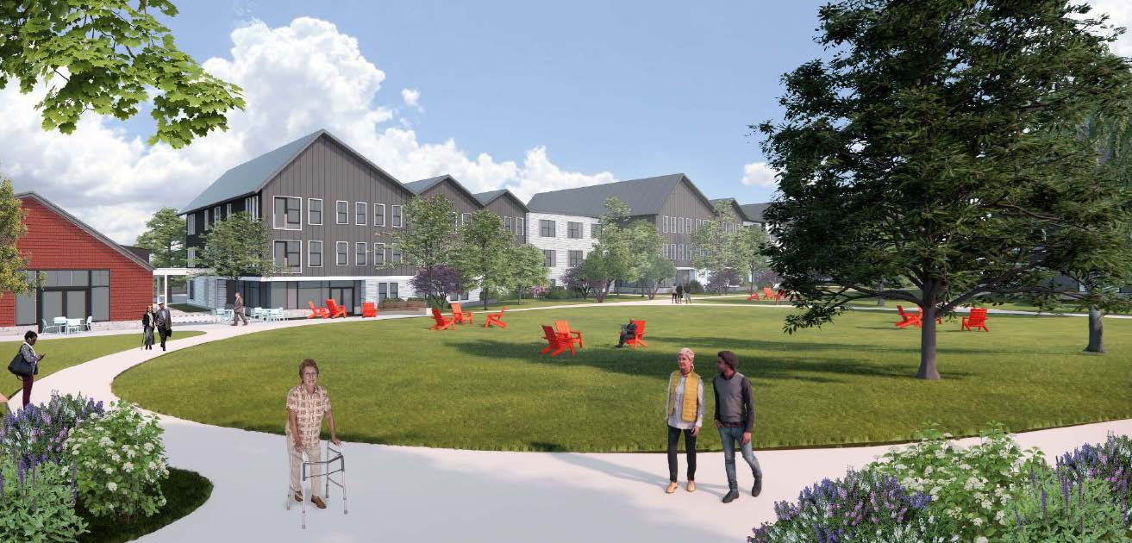
Successful Application Example #1
Applicant: | Foxborough Housing Authority Public Surplus Property Project
Project description: | The Foxborough Housing Authority (FHA) accepted a vacant parcel of state land for affordable housing but did not have the capacity to develop the parcel. MassDevelopment’s consultant developed an RFP to find a qualified developer for the site and assisted the FHA in their selection of a development team. The project will create 200 affordable senior housing units.
What made the project successful? | Project planned to accomplish creating affordable housing on vacant and underutilized former state surplus property.

Slide 11
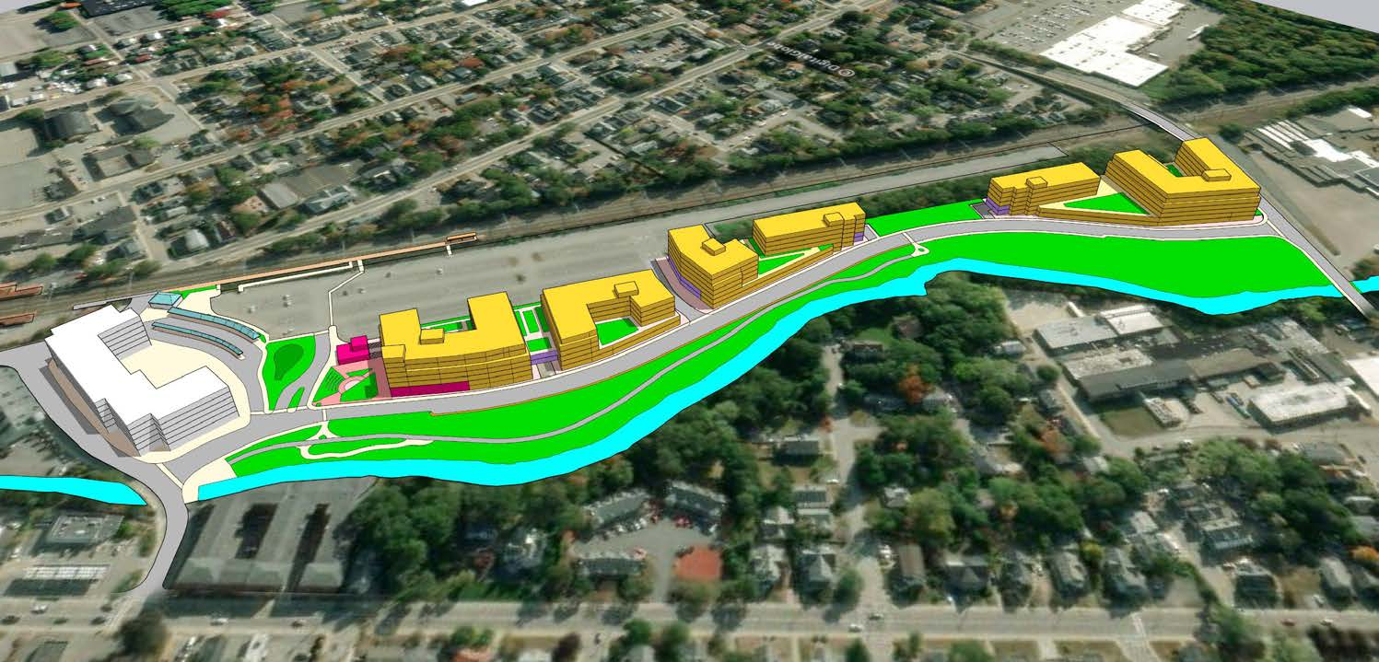
Successful Application Example #2
Applicant: | City of Attleboro District Planning Project
Project description: | The City of Attleboro expected new development to occur in their Transit-Oriented Development District (TOD) and saw the potential in utilizing District Investment Financing (DIF) to further encourage improvements in the district. New mixed-use developments in the district will complement the already completed development of 136 new housing units. The most conservative estimates call for the construction of 650 units of market rate and mixed income housing. MassDevelopment’s consultant helped the city through the process to create the DIF.
What made the project successful? | Project planned to accomplish attracting new development to underutilized property close to a transit hub.

Slide 12
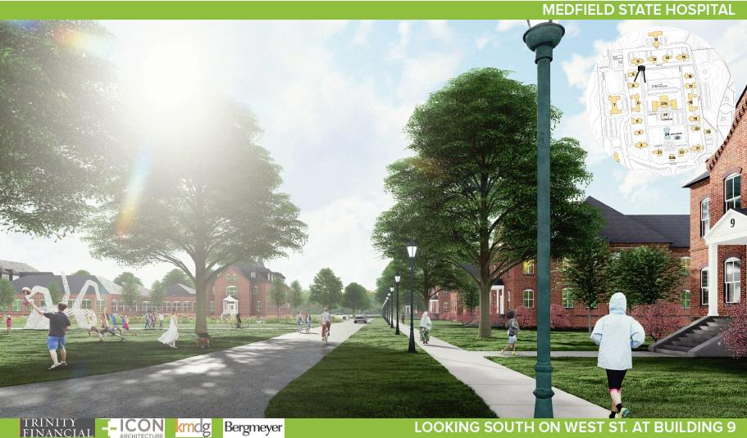
Successful Application Example #3
Applicant: | Town of Medfield Public Surplus Property Project
Project description: | The Town of Medfield saw the potential of redeveloping the former Medfield State Hospital into a mixed-used development with affordable housing. MassDevelopment’s consultant assisted the Town in identifying potential developers and establishing terms with the preferred developer. The project is expected to produce 334 new apartments (25% of which will be affordable) and a mix of commercial and community spaces while retaining and restoring much of the historic buildings on the site.
What made the project successful? | Project planned to accomplish attracting redevelopment to former state owned surplus and underutilized property.

Slide 13
Completing the Full Application
Key Question: In Section 2 of the Full Application, applicants are asked to indicate the Project Category. To be reviewed by the Real Estate Services Technical Assistance Program, applicants should make the following selections in question 2.4:
Visit www.mass.gov/onestop to view: One Stop Webinar 2: Application Guidance
 | Public Surplus Property Reuse Projects
Development Continuum: | Site Preparation
Project Type: | Municipal Surplus Property Disposition
Project Focus: | Municipal Surplus Property Disposition Study

Slide 14
Completing the Full Application
Key Question: In Section 2 of the Full Application, applicants are asked to indicate the Project Category. To be reviewed by the Real Estate Services Technical Assistance Program, applicants should make the following selections in question 2.4:
Visit www.mass.gov/onestop to view: One Stop Webinar 2: Application Guidance
 | District Redevelopment TA Projects
Development Continuum: | Planning & Zoning
Project Type: | District Redevelopment Technical Assistance
Project Focus: | Planning for Growth in a Commercial/Industrial or Mixed-Use District

Slide 15
FY25 Round Timeline
Jan.
Full Application and Expression of Interest Open (January) – The Full Application is the official form for submitting all funding requests. Applicants may now begin to work on applications in the IGX system, however applications will only be accepted during the submission period.
One Stop Guidance Phase (January – May) – A series of webinars will be hosted be both the One Stop Team and staff from each program within the One Stop. In addition, office hours will be hosted to answer applicant questions. Visit www.mass.gov/onestop for the full schedule of webinars and office hours.
Full Application Submission Period (May-June) – Applicants may submit their Full Application(s) beginning May 6, 2024. All applications must be submitted by the Full Application deadline of 11:59 p.m. on Wednesday, June 5.
Review and Evaluation (July – August) – All complete and eligible Full Applications submitted by the deadline will be reviewed and evaluated by the corresponding program managers at each state agency. The One Stop team will also conduct joint application reviews across agencies. Based on the program’s criteria, each program will prepare its list of applications recommended for funding, to be further reviewed and approved by agency and Secretariat leadership.
Notification of Grant Decisions (September) – Once final recommendation have been approved, applicants will be notified of grant decisions in writing, and announcement events will be scheduled.
Sept.

Slide 16
Opportunities for Guidance
Visit www.mass.gov/onestop for more information on:
Expression of Interest
Complete an Expression of Interest to see if your project(s) is eligible for funding through the One Stop and get tips for preparing your application.
One Stop and Program Webinars
Recordings of all One Stop webinars are now available on the One Stop website.
Office Hours
One Stop General Guidance Office Hours – One Stop staff will hold office hours to discuss general One Stop process and technology questions.
Program Office Hours – Staff from each program will hold an office hour to answer applicant questions related to the program.
Office hours: Thursday, February 29th at 10AM

