Slide 1
Recovery Coach Commission
Executive Office of Health & Human Services
Marylou Sudders, Secretary
March 18, 2019
3:00-5:00pm
One Ashburton Place
Boston, MA

Slide 2
Agenda
Welcome
Approval of 01/23/19 Meeting Minutes
Commission Timeline
Listening Sessions
Presentation
Recovery Coach Workforce Scan
Panels
Consumers of Recovery Coach Services
Employers of Recovery Coaches
Next Steps

Slide 3
Commission Timeline
Jan
Feb
Mar
Apr
May
Jun
Jul
Aug
01/23
02/04
03/18
04/01
4/29
05/06
05/20
06/03
06/17
07/15
August 9th
Report Due
January 23, 2019 3-5PM | Commission Meeting 3 Presentations: “Level set” from BSAS, MBSACC, and RIZE Panel: Recovery coach & recovery coach supervisors
February 07, 2019 2-4PM | Listening Session #1 hosted by Representative Carole Fiola in Fall River
March 18, 2019 3-5PM | Commission Meeting Presentation: DMA Health Strategies Workforce Scan Panel: Consumers of recovery coach services Panel: Employers of recovery coaches
April 02, 2019 4-6PM | Listening Session #2 hosted by Siu Ping Chin Feman in Worcester
April 30, 2019 4:30-6:30PM | Listening Session #3 hosted by Mayor Fiorentini in Haverhill
May 09, 2019 4-6PM | Listening Session #4 hosted by Haner Hernández in Greenfield
May 20, 2019 3-5PM | Commission Meeting 2 Presentations: Contracting and payer perspective from BSAS & MH Commission will discuss standards for credentialing
June 03, 2019 TBD | Listening Session #5 hosted by Barnstable County Department of Human Services in Cape Cod
June 17, 2019 3-5PM | Commission Meeting Commission will discuss recommendations
July 15, 2019 3-5PM | Commission Meeting Review draft of final deliverable
Commission Meeting
Listening Session

Slide 4
Listening Sessions
Jan
Feb
Mar
Apr
May
Jun
Jul
Aug
01/23
02/04
03/18
04/01
4/29
05/06
05/20
06/03
06/17
07/15
August 9th
Report Due
Geographic Region | Date/Time/Location | Host
Listening Session #1: Fall River | February 07, 2019 2-4PM Bristol Community College | Representative Carole Fiola
Listening Session #2: Worcester | April 02, 2019 4-6PM Family Health Center of Worcester | Siu Ping Chin Feman Medical Director, Gavin Foundation
Listening Session #3: Haverhill | April 30, 2019 4:30-6:30PM Hunking School | City of Haverhill Mayor Fiorentini
Listening Session #4: Greenfield | May 09, 2019 4-6PM Greenfield Community College | Haner Hernández Executive Director, Behavioral Health Workforce Leadership Development Institute, Inc.
Listening Session #5: Cape Cod | June 03, 2019 Time TBD Cape Cod Community College | Barnstable County Department of Human Services

Slide 5
Recovery Coach Workforce Scan Fiscal Year 2018 Recovery Coach Commission Meeting March 18, 2019 Julia Ojeda, RSS Coordinator, BSAS Deborah Strod, Sr. Associate, DMA Health Strategies Jinna Halperin, Sr. Associate, DMA Health Strategies

Slide 6
DMA RC Scan Overview
DPH/BSAS Recovery Support Services contracted DMA Health Strategies to create a snapshot of RC services in the Commonwealth.
Phase I (DPH/BSAS):
Census of BSAS funded and/or contracted programs offering RC Services (33 programs)
Phase II (non-DPH/BSAS):
Point in time illustration of non-DPH/BSAS funded and/or contracted RC Services (20 programs)

Slide 7
DMA RC Scan Respondents
Phase I (DPH/BSAS)
Outpatient Providers
Massachusetts Access to Recovery Programs (ATR)
Emergency Department RC Pilot Programs
Moms Do Care Programs
Opioid Urgent Care Centers
Phase II (non-DPH/BSAS)
Community health providers
Nonprofit/community organizations
Hospitals/health care systems
Emergency departments
Community/regional coalitions
Police departments

Slide 8
DMA RC Scan Summary Findings: DPH/BSAS & Non-DPH/BSAS RC Services
Rapid expansion
Demand exceeds capacity
Not enough trained RC Supervisors
Need for provider readiness
Wide variation in compensation
Wide variation in role definition and titles
No system for tracking RCs and RCSs
Service data not always available

Slide 9
DMA RC Scan Methods
Phase I (DPH/BSAS):
Key informant interviews
Phone-administered surveys
SurveyMonkey survey to collect Q4 data
BSAS Ambulatory (outpatient) funding reports
Provider RC service reimbursement data
Phase II (non-DPH/BSAS):
Semi-structured interviews

Slide 10
DMA Health Strategy’s FINDINGS

Slide 11
DMA RC Scan Interviewees Reported - RC Role: Across All Settings
Connect to wrap-around services and supports
Identify culturally and linguistically sensitive services
Navigate criminal justice system
Attend some appointments
Prevent relapse
Identify goals
Build healthy relationships
Encourage hope and motivation
Foster life and coping skills
Build rapport
Serve as role model
Support family
Share personal story
Wellness Planning
Social and Emotional Support
Service Navigation
Recovery
Coach
Community Outreach and Advocacy
Resource Sharing and Linkage
Engagement in Treatment
Public face of RC services
Increase awareness of RC services
Service team member
Multi-agency engagement
Fight stigma
Support employment
Serve as gateway to larger recovery community
Foster positive social network
Facilitate access to education
Engage appropriate level of care
Support relationships with providers
Facilitate membership in recovery centers

Slide 12
DMA RC Scan Interviewees Reported - RC Role: Setting-specific Support
Opioid Urgent Care Centers
Secure detox bed
Harm reduction information
Moms Do Care Program
Pre-natal support
Six months postpartum support
Support groups for breastfeeding and for trauma
Resources for mom and baby
Home-based support
Outpatient Providers
Wellness planning
Emergency Department
Crisis management
Post-overdose support
Naloxone education
Post-discharge follow-up
Motivation to stay alive and enter treatment
Recovery
Coach
Police Departments
Crisis intervention
Rapid placement into treatment
Risk-based outreach
Naloxone education and distribution
Post-jail planning
Overdose follow-up
Home visits
Family and friends support
Recovery trainings for police
Coalitions
Crisis management
Post-overdose support
Food and housing resources
Appointment reminders
Transportation
Harm reduction strategies
Treatment program connection
Community engagement trainings
Drug Courts
Court hearings
Access to Recovery Program
Clearing warrants

Slide 13
DMA RC Scan Interviewees Reported - RC Role: Benefits and Challenges
Benefits:
Engage and retain recoverees
Shift how providers treat and view recoverees
Improve community relations and build trust
Reduce stigma
Share lived experience
Challenges:
Provider readiness impacts role integration
Lack of role clarity
Asked to perform tasks inconsistent with role
Not enough trained RC Supervisors

Slide 14
DMA RC Scan Interviewees Reported – RC Sustainability Affected by Inconsistent Hours and Wages
Hourly Rate and Hours vary greatly
DPH/BSAS annual $25k-$47k
non-DPH/BSAS annual unpaid - $45k
Couple of hours - part time - full time
Many RCs working in multiple programs
Non-DPH BSAS programs reported
57% used only part-time RCs
41% paid salaries with benefits
43% of RCs were unpaid volunteers

Slide 15
Concerns and Needs Reported by DMA RC Scan Interviewees
Concerns:
Manageable caseload
Pay and benefits
Secondary trauma
Fidelity (case management tasks, clinical, etc.)
RC services increased over FY18 in DPH/BSAS outpatient programs
Demand exceeds capacity (waitlists)
Needs:
Support network and resources for self-care
Dedicated non-clinical supervisors and established supervisory structure
Learning Community network and RC Registry
Career path options
Job and workforce readiness support
Geographically accessible trainings

Slide 16
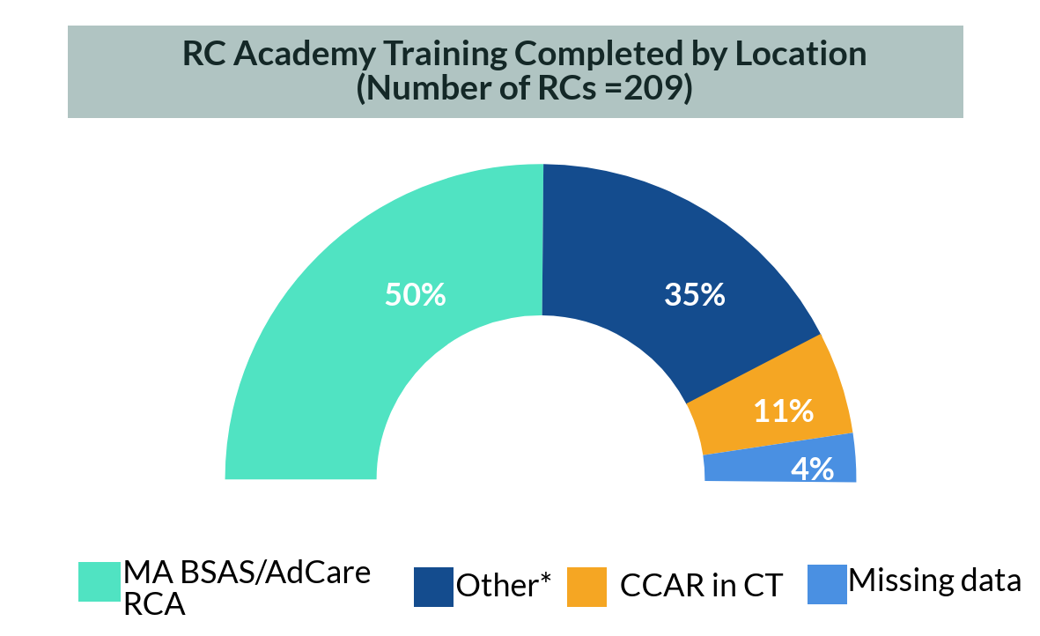
Survey Results: FY18 RC Training Location and Certification Plans – DPH/BSAS
Of 209 RCs in DPH/BSAS funded and/or contracted programs in FY18:
95% completed RC Academy
76% of the RCs were Certified Addiction Recovery Coach (CARC)-certified or taking classes toward CARC
* Other locations included in-house trainings or trainings at High Point Treatment Center, New England School for Addiction Studies, Westfield State University, RECOVER Project, Tipping Point Inc., or in New Hampshire and Vermont. This is not an exhaustive list of all non-BSAS RC training locations available.

Slide 17
Surveys Results: RC Supervision Highlights
90% of the 51 DPH/BSAS RC Supervisors completed the DPH/BSAS RC Supervisor Training
Increasing demand based on MassHealth requirement
DPH/BSAS and MassHealth require RCs to be supervised by a trained RC Supervisor
Trained RC Supervisor required for RC certification
RC Supervisor training and RC Supervision are not funded or reimbursable

Slide 18
DMA RC Scan Interviewees Reported - RC Funding Sustainability
Funding is a universal concern
Current rates may not sufficiently cover RC service costs, including administration, supervision, and Supervisor training
Grant funding ends, programs end
half the programs surveyed used grants
continuity and sustainability impacted

Slide 19
DMA RC Scan Interviewees Reported - RC Services Dependent on Provider Readiness
To implement RC services with fidelity, providers need:
Organization-wide training on the RC role and training on integrating RCs into treatment teams
Infrastructure and policies to support RC service delivery
Organization and payer support for RC flexibility in meeting needs of individual recoverees
Training on how to bill payers

Slide 20
Considerations based on DMA RC Scan
Create a Recovery Coach Registry to monitor workforce and centralize access to RC services
Provide a consistent system for RC service quality regardless of payer
Offer technical assistance for provider readiness
Support the RC/RCS Learning Communities
Offer provider support for third party reimbursement
Increase availability of trained RC Supervisors

Slide 21
Questions/Comments
Thank you to all of the respondents who shared their perspectives, experiences, and data!
The RC Workforce Scan Team:
BSAS Recovery Support Services
Julia Ojeda
DMA Health Strategies
Jinna Halperin
Deborah Strod
Talia Hahn
Ali Ireland

Slide 22
Consumers of Recovery Coach Services Panel
Lisa Atkins
Anissa Booker
Christian Jacques

Slide 23
Employers of Recovery Coaches Panel
Kim Hanton, North Suffolk Mental Health Services
Danny Ginivan, Eliot Community Human Services
Ginny Mercure, Gandara Mental Health Services
Keith Scott, Advocates
Chuck Weinstein, Massachusetts General Hospital

Slide 24
Next Steps
Jan
Feb
Mar
Apr
May
Jun
Jul
Aug
01/23
02/04
03/18
04/01
4/29
05/06
05/20
06/03
06/17
07/15
August 9th
Report Due
January 23, 2019 3-5PM | Commission Meeting 3 Presentations: “Level set” from BSAS, MBSACC, and RIZE Panel: Recovery coach & recovery coach supervisors
February 07, 2019 2-4PM | Listening Session #1 hosted by Representative Carole Fiola in Fall River
March 18, 2019 3-5PM | Commission Meeting Presentation: DMA Health Strategies Workforce Scan Panel: Consumers of recovery coach services Panel: Employers of recovery coaches
April 02, 2019 4-6PM | Listening Session #2 hosted by Siu Ping Chin Feman in Worcester
April 30, 2019 4:30-6:30PM | Listening Session #3 hosted by Mayor Fiorentini in Haverhill
May 09, 2019 4-6PM | Listening Session #4 hosted by Haner Hernández in Greenfield
May 20, 2019 3-5PM | Commission Meeting 2 Presentations: Contracting and payer perspective from BSAS & MH Commission will discuss standards for credentialing
June 03, 2019 TBD | Listening Session #5 hosted by Barnstable County Department of Human Services in Cape Cod
June 17, 2019 3-5PM | Commission Meeting Commission will discuss recommendations
July 15, 2019 3-5PM | Commission Meeting Review draft of final deliverable
Commission Meeting
Listening Session

Slide 25
Commission Staff Contact
Please direct any questions and materials to:
Anny Domercant
Anny.Domercant@MassMail.State.MA.US
Vivian Pham
Vivian.Pham@MassMail.State.MA.US
General Public Comments and Questions
EHSRecoveryCoachCommission@MassMail.State.MA.US

