Slide 1

Recreational Risk Management of Surface Waterbodies: Cyanobacteria Surveillance in Massachusetts
Michael Celona*, Vanessa Curran, Irena Draksic,
Michael Beattie, Rachel Wilson, & Marc Nascarella
*Presenting Author:
Chief, Water Toxics Unit
617-624-5757
mike.celona@state.ma.us
Environmental Toxicology Program
Bureau of Environmental Health
Massachusetts Department of Public Health

Slide 2
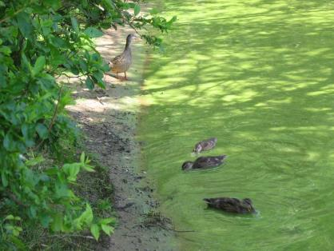
Outline
Harmful Algae Blooms
MDPH Guidelines
Environmental Monitoring Program
Lessons Learned
Future Efforts

Slide 3
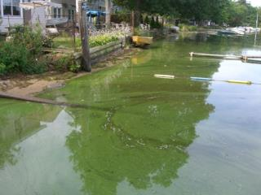
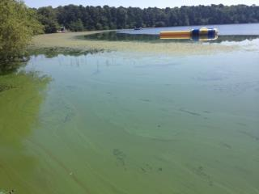
Harmful Algae Blooms
Blue-green algae/cyanobacteria occur in aquatic ecosystems
Highly concentrated in water: harmful algae bloom (HAB)
Ability to produce toxins
Human and animal health concerns

Slide 4
MDPH Guidelines
Established cyanobacteria guidelines in 2008
MDPH recommends an advisory when:
  A cyanobacteria scum is present
  A cell count exceeds 70,000 cells per milliliter of water
  A microcystin level exceeds 14 parts per billion
Advisories remain in place until levels remain below guidelines

Slide 5
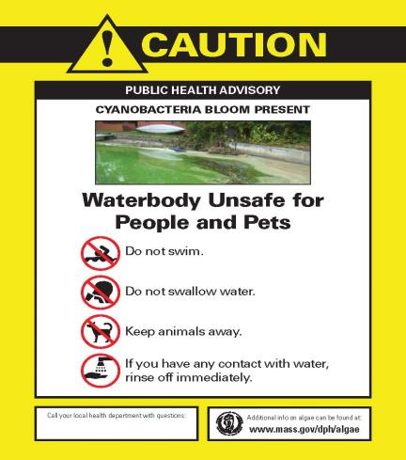
MDPH Guidelines

Slide 6
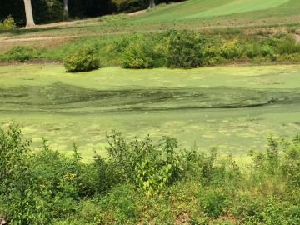
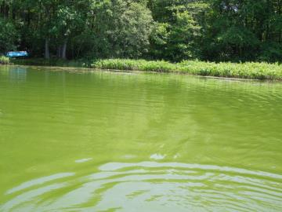
Environmental Monitoring
MDPH established an environmental monitoring program for recreational waterbodies:
  Monitoring strategy
  Sampling and analysis protocol
  Data evaluation
  Recommendations

Slide 7
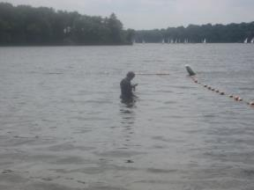
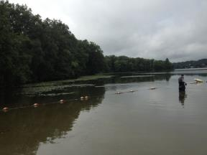
Monitoring Strategy
Two types of HAB monitoring:
  Routine
  Response
Once detected, samples collected weekly until advisory rescinded

Slide 8

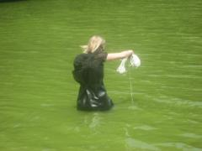
Sampling and Analysis
Sample collection:
  Chose location based on likelihood of exposure
  Fill 1L amber bottle at a location 6 inches below the water surface, in 3 feet of water
Water quality parameters collected in the field included:
Air and water temp. | Salinity
Secchi disk depth | pH
Dissolved oxygen | Turbidity

Slide 9
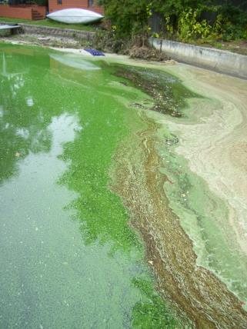
Sampling and Analysis
Photographs are taken to record surface water observations
Samples are shipped to a private laboratory for analyses:
  Genera identification
  Genera cell count
  Microcystin level

Slide 10
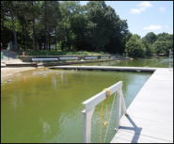
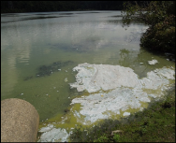
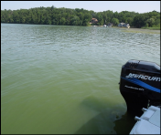
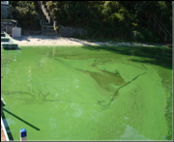
Results
From 2009-2014, 1,075 samples were collected from 75 waterbodies in 58 municipalities
One-third of samples exceeded the cell count guideline
The dominant genera in the exceeding samples were primarily Anabaena, Aphanizomenon, and Microcystis
Less than 1% exceeded the microcystin guideline
Anabaena Blooms
Microcystis Blooms

Slide 11
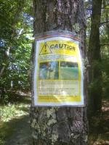
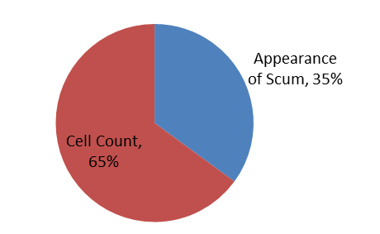
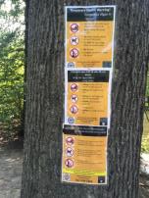
Advisories
MDPH recommended a total of 97 public health advisories

Slide 12
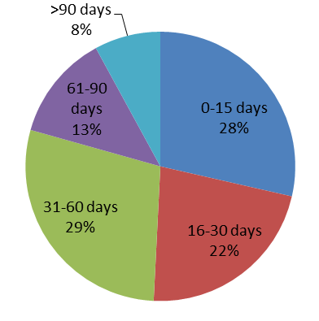
Advisory Length
In general, these advisories lasted less than 60 days

Slide 13
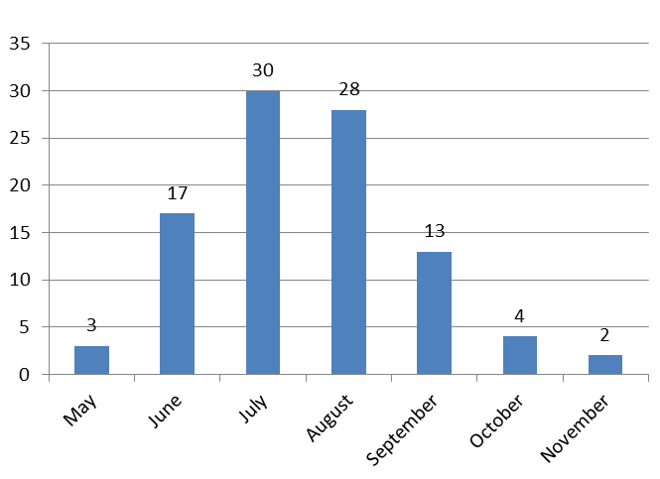
Advisory Issuance by Month
Majority of advisories issued in July and August

Slide 14
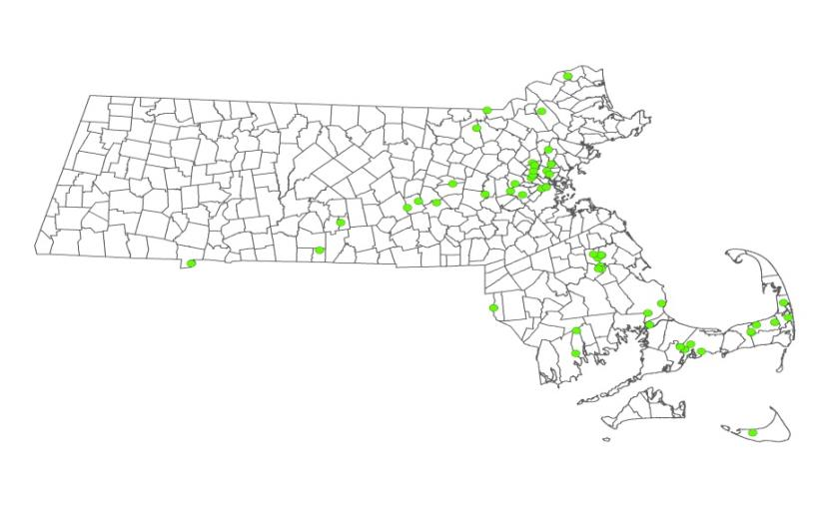
Advisory Locations
Locations tend to be in Eastern Massachusetts

Slide 15
Lessons Learned
HABs are a common in Massachusetts
  Tend to be concentrated in eastern Massachusetts
  Most frequently occur in the summer months
  May continue into the fall
Mutual reliance
  MDPH relies on local officials/residents to report blooms
  Local officials rely on MDPH to provide technical and analytical support
Monitoring is resource intensive

Slide 16
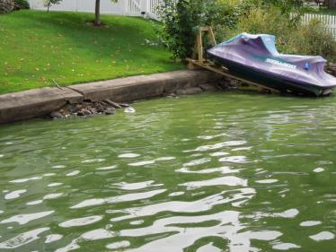
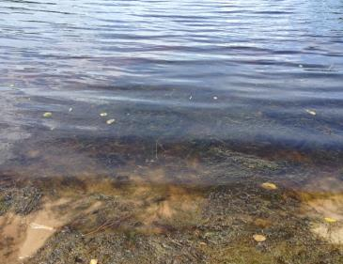
Lessons Learned
Photographs are important!
  A significant number of blooms are identified by photographed scums
  Helps to limit responding to issues that are clearly not HAB-related
Likely a HAB
Not Likely a HAB

Slide 17
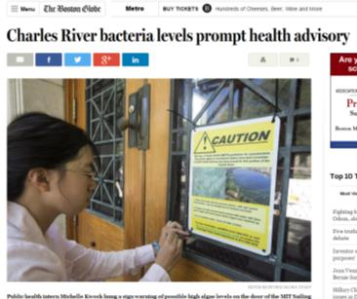
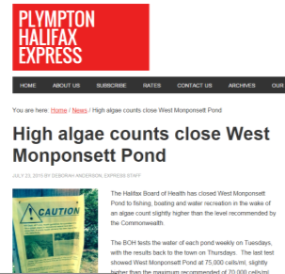
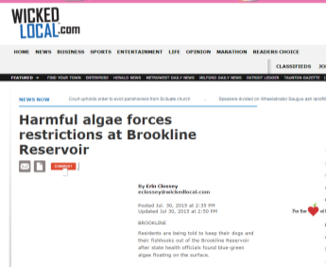
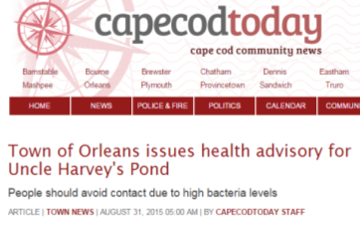
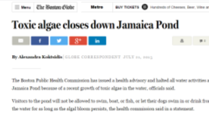

Lessons Learned
Great deal of public interest in this issue
Sampling of media reports from 2015:

Slide 18
Future Efforts
Harmonize MDPH guidelines with evolving federal guidance
Use data for development of predictive models
Continue to provide analytical and technical assistance to local health officials, requesting agencies, and others

Slide 19
Acknowledgments
This work was partially supported by a US Centers for Disease Control and Prevention cooperative agreement and a US Environmental Protection Agency BEACH grant.
The content of this presentation and the views expressed by the authors do not necessarily reflect the official views of our federal partners.
State partners: MA Department of Environmental Protection, MA Department of Conservation and Recreation, local health officials, and watershed organizations

