Slide 1
Redesigned Business Services in Central MA
Notes:
JEFF
Welcome all, Introduce Janice and Jennithan

Slide 2
Central MA Workforce Area
Notes:
JEFF
Highlight Geographic context – and note two career centers

Slide 3
Theory of Action
With greater emphasis upon serving employers, we will open greater direct access to employment opportunities for our job seeking customers, ultimately, providing both customer groups with greater value. Achieving this greater value will in turn help drive greater demand and support for our services.
https://www.youtube.com/watch?v=bh1eULtwfVQ
Notes:
JEFF
Review rationale for redesign….play video

Slide 4
Redesign Goals
An increase in the number and depth of employer relationships:
increased placement opportunities for WCCC referred candidates
increased usage of employer resources such as HITG, WTFP, and Apprenticeship.
Job Seekers moving through assessment, career action planning, and remediation of career readiness, technical, and academic skills – and then into employment
Alignment of the ACT/Career Ready 101 system with job openings and job seeker assessments
Development of new trainings offered to address the skill gaps identified through the new demand-facing model.
Notes:
Jeff
Review The goals for our redesign come down this….
Increasing our employer relationships
Revising our job seeker service flow
And using our employer feedback to identify and fill gaps in our local workforce

Slide 5
Redesign Team Working Groups:
New Job Seeker Services Flow
Job Seeker Online Services Portal
Staff Training
Staff Structure
What Services offered to whom & When
Member tools for job search, planning, and readiness
How many staff assigned for each function & how are they organized
Training for all staff on redesign, portal, and teamwork; training for business staff
Notes:
JEFF
Note the work divided into four teams

Slide 6
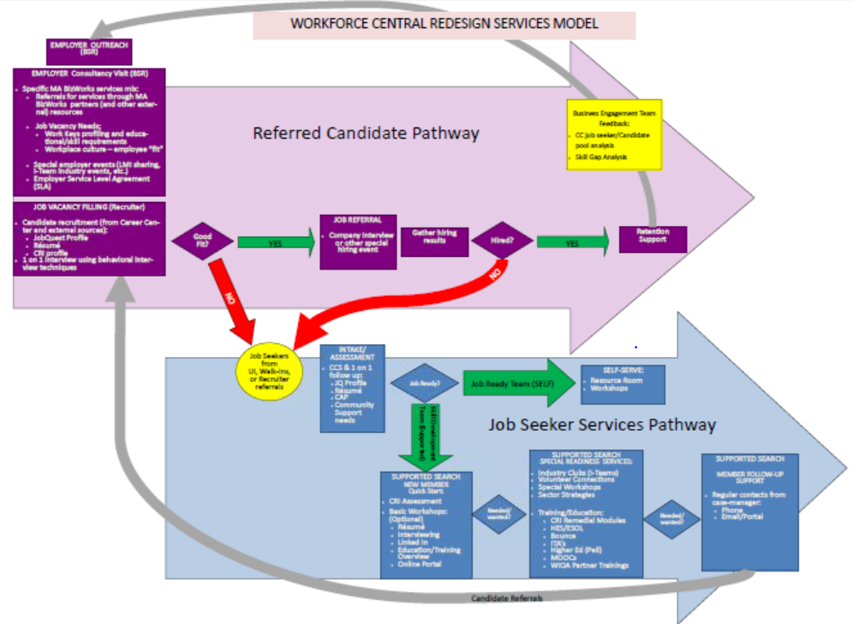
Customer Flow
Notes:
Jeff
Here’s the overview of our customer flow…
We’ll get into more details now – turn it over to Janice

Slide 7
Job Seeker Services
JOBSEEKERS
Job Ready?
Self-Serve
Intake / Assessment
YES
NO
Supported Search
& RESEA
Notes:
Janice
First a bit about the job seeker flow –
Customers come in, the go through a Career Center Seminar and we work to assess if they want/need additional readiness and RESEA status

Slide 8
Job Seeker Services
JOBSEEKERS
Intake & Assessment: Career Center Seminar (CCS)
IAI or JSSA (assessment)
CAP or IEP
JobQuest
Resume
Support needs
RESEA Review/Meeting with Counselor
Notes:
Janice
Following the CCS, job seekers meet with a counselor to do a basic assessment of where they’re at and what they want to go – this forms the basis of their Career Action Plan (also known as an Individual Plan for Employment)

Slide 9
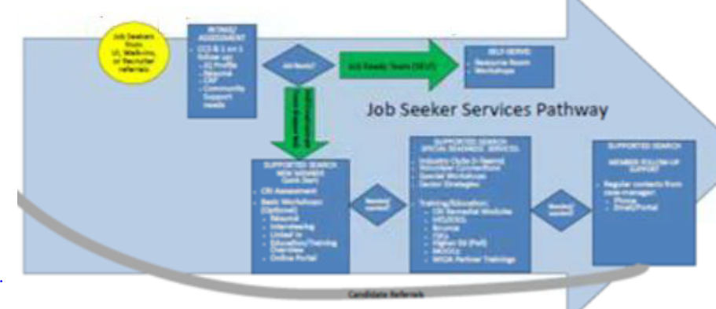
SELF-SERVE
Resource Room
Workshops
Fast Track Consult
Professor Teaches
Volunteer Connections
CareerHub (online portal)
JOBSEEKERS
Notes:
Janice
Customers that are “job ready” still have access to a variety of tools
Note that many of our customers are mandated under RESEA to complete multiple steps, including a follow visit with their counselor, so while they may be “job ready”, they’ll still require some continued staff assistance

Slide 10
Supported Search
AND
Readiness Services
JOBSEEKERS
Notes:
Janice
Those needing additional help can access more tools…GO TO NEXT SLIDE

Slide 11
Job Seeker Services
JOBSEEKERS
SUPPORTED SEARCH
Career Ready Initiative: Assessment & Online Learning
Basic Workshops
Résumé Writing
Interviewing Skills
LinkedIn
CareerHub Online Portal
Notes:
Janice
…these include the Career Ready Assessment, basic workshops such as Résumé Writing, Interviewing Skills and LinkedIn and access to the online portal.

Slide 12
Job Seeker Services
JOBSEEKERS
READINESS SERVICES
Specialty Workshops
Sector Strategies
Career Ready Assessment
Bounce Readiness
Training / Education
(OJT, Pre-apprentice, etc.)
ITA’s/TABE
ABE / HSE / ESOL
Higher Ed/QCC Navigator
Online training
Partner Trainings
Notes:
Janice
We also offer a variety of special readiness services…and training assistance through our partners [read through boxes]…

Slide 13
Job Seeker Services
JOBSEEKERS
FOLLOW UP SUPPORT
Job retention support
Counselor contacts:
Email
Phone
Text Messaging (Computer to text)
Notes:
Janice
…And then counseling staff stay in contact with them in a variety of ways…note the use of computer to text

Slide 14
Business Services
Customer Flow
Notes:
Janice
Let’s get more into the business services flow process..
Introduce Jennithan to talk more about this

Slide 15
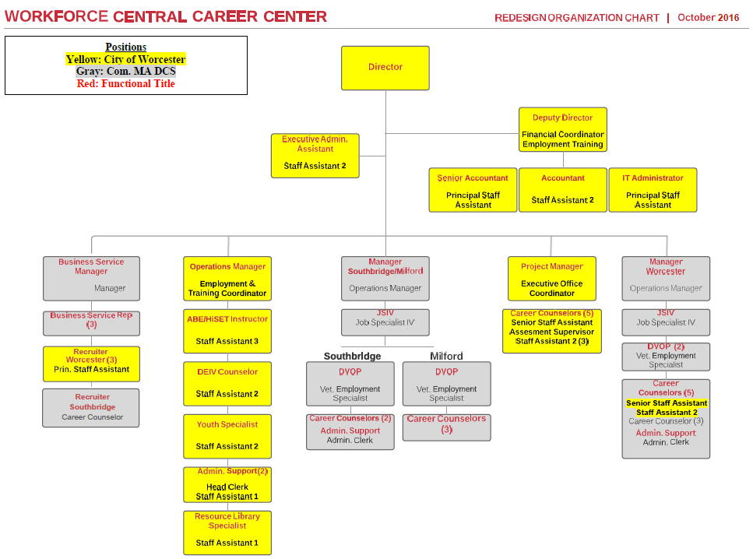
Business Engagement Solutions Team (BEST)
Notes:
Jennithan
First, note that staffing structure/org chart was changed to create a separate business unit (the BEST) which includes manager (me) as well as recruiters and business services reps – maybe note also that the specific numbers of these staff are in flux as we deal with budget

Slide 16
Referred
Candidate
Mass BizWorks
Business Needs?
Special Events
Vacancy
Notes:
Jenn
BSR’s get connected wity employers a variety of ways;
Contact by business
Inquiries to / from MA BizWorks
Internal targeted business outreach requests from counselors
Regardless of whether the business engagement is initiated by the employer or is the result of outreach, the BSR makes the determination on what is the best way to service them based on the request or business needs.
There are three primary options the BSR will offer:
Mass BizWorks resources
Special Events
And assistance with filling open jobs
TRANSITION: Mass BizWorks resources will be recommended if…

Slide 17
Referred
Candidate
Mass BizWorks
Business Needs?
Training & Consultation
Layoff Aversion & Management
Business Development / Partnerships
Important Websites
Notes:
Jenn
Mass BizWorks services referrals include… [READ Box]

Slide 18
Referred
Candidate
Special Events
LMI sharing
Industry events
Job fairs / recruitments
Mass BizWorks information sessions
Business Needs?
Special Events
Notes:
Jenn
special events, such as
LMI sharing
Industry events
Job fairs / recruitments
Mass BizWorks information sessions
TRANSITION: Finally, the BSR’s will…

Slide 19
Referred
Candidate
VACANCY
“Standard” job orders (basic member outreach)
“Premium” referral services (vetted candidate recruitment, i.e. Recruitment Solutions Initiative (RSI))
Business Needs?
Vacancy
Notes:
Jenn
Or, the BSR can assist employers with filling their open positions.
Based on the request or business needs, the BEST will make a decision on which vacancies will be handled as standard job ads and which will be done using our vetted recruitment referral services
TRANSITION: When recruitment referral services will be used…

Slide 20
Referred
Candidate
Standard Job orders
Complete job posting on MA JobQuest
Run WCCC member match
Contact matches with “blind” lead notice – seek replies
Review/confirm respondent’s background & readiness status
Share job lead information – member contacts company
Send list of referred names to company
Notes:
Jenn,
Here’s the basic steps we follow in our standard job order process….[read steps]

Slide 21
Referred
Candidate
Premium Recruitment services
Gather detailed job/company information
Complete Career Ready job profile
Determine company’s preferred referral process
Secure Service Level Agreement with the company
Create - enter a confidential job order
Recruiter(s) run WCCC member match & contact external networks
Interview and screen candidates
Vetted candidates sent to company
Notes:
Jenn
In our premium process, here’s the steps we follow ….[read steps]

Slide 22
Business
Engagement
Solutions
Team
Feedback / Debrief Process:
Track hiring demand trends
Identify hard to fill – labor “gaps” to share with CMWIB, WCCC, and Mass BizWorks partners
Notes:
Jenn
BET feedback process between the recruiters and BSRs to assess the job seeker / candidate pool in order to determine the possibility of future skills training grants or to pursue job development with employers.
TRANSITION: Jeff’s going to come back now to talk more about how the BEST efforts help align with the other parts of our system…

Slide 23
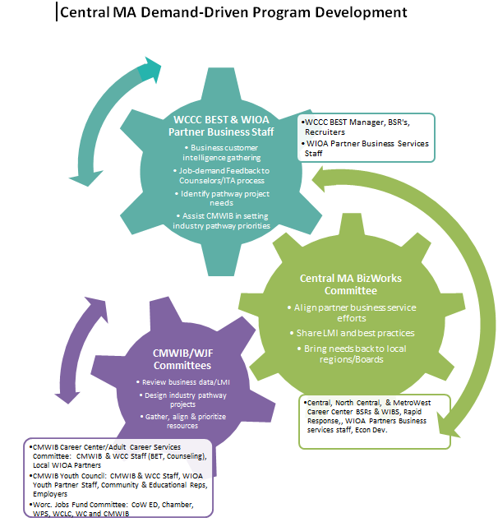
Notes:
Jeff
So this is a bit of how we’re thinking of roles between the career center’s business services team (or really any individual partner that has business staff for that matter)…
NOTE what the BEST does…they then share this with our multi-regional area BizWorks group to compare notes; this group also –
The next step is to bring it back locally to our region’s Career Center/Adult Career Services Committee – which will include WIOA Partner reps….this group then looks to rally the various resources available to fill the gaps which are identified….
And note the arrows work both ways – the groups may bring to the BET’s attention an issue that they may wish to help solve or bring to their business customers.

Slide 24
Central MA WIOA Partners planning
June 29, 2016
Notes:
Jeff
Note this is also part of our WIOA regional Partner ship….here’s a slide showing our local partners…

Slide 25
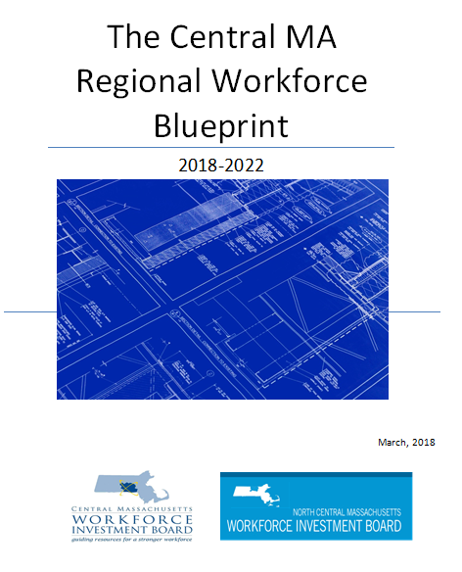
Central Region
Workforce Blueprint
Sets shared long term vision for region
Identifies priority industries/occupations
Aligns efforts of MA Education, Economic Development, and Workforce Development
Notes:
Jeff
Discuss blueprint

Slide 26
Notes:
Jeff
Ask if there are any questions….all answer as appropriate

Slide 27
Thank You!

