Slide 1
State Trauma Committee Region II Report
Trauma Service
UMass Memorial Medical Center
Timothy A. Emhoff, MD
Chief, Trauma and Surgical Critical Care

Slide 2
State Trauma Committee: Region II Report
Region overview
Demographics and Trends in Trauma Care: Last 5 years
Pre-Hospital: notification and EMS feedback
Transferring Hospitals: criteria, pre-notification, feedback
Post Trauma Care: resources and barriers
Prevention and Access

Slide 3
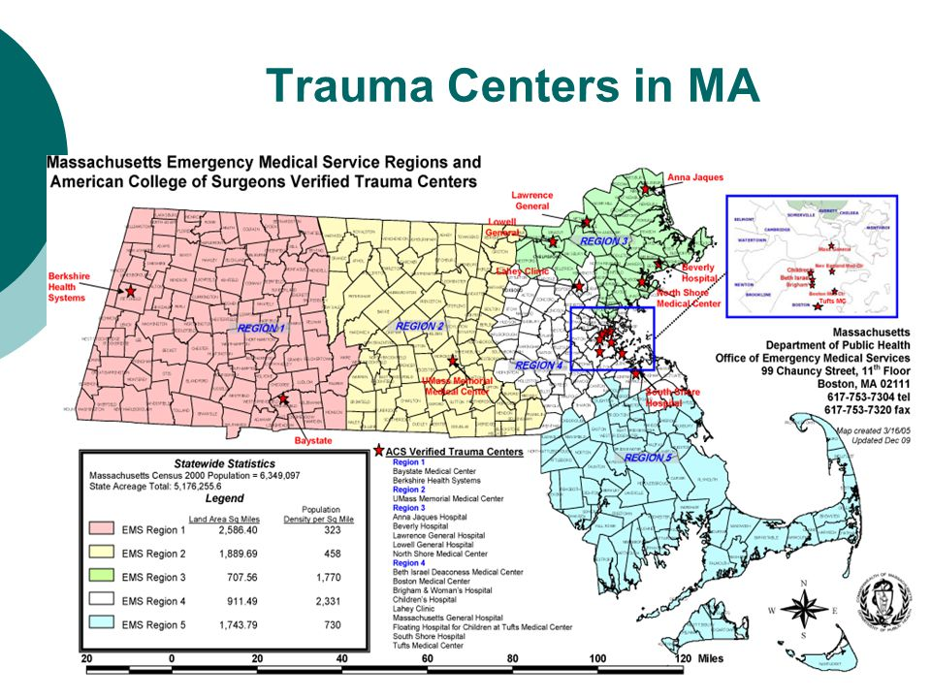

Slide 4
Falls: Central Massachusetts 1989 - 2010

Slide 5
Region II: Trauma Activations

Slide 6
Region II: Mechanisms of Injury

Slide 7
Region II: Age Ranges

Slide 8
Region II: Mortality Rate

Slide 9
Trauma Deaths: Impact of the Elderly (> 70 years)

Slide 10
Region II: Transfers vs Scene Activations
41%
38%
37%
36%
41%

Slide 11
Region II: Prevention and Access
As Region II’s only Level I Trauma Center:
Hospital (UMass University): NEVER on Trauma Diversion
During “high census”:
Transfers reviewed by on-call trauma surgeon to insure the need for tertiary care
List of approximately 180 transfer “refusals” reviewed monthly by TPM and TMD to insure those patients with traumatic injuries were not refused
Transfers out:
Patient request: receive care at other tertiary care centers
>50% BSA burns

Slide 12
Notifications and Feedback to EMS Services
Notification: CMED and through our “TrACs” system (Transfer and Access)
Worcester EMS: 80% of scene transfers: “Levels” patients (1 or 2), calls TrACS or Lifeflight or CMED, paged out as a “template” (Level, mechanism, VS, Airway, etc, ETA)
Hospital transfers (40% of activations): called to and paged out through the “TrACs” system (calls are recorded).
Feedback:
Weekly Trauma M&M: over/under triage, prolonged scene times, significant change in P_{s} from pre-hospital to hospital
Monthly Trauma ED/EMS meeting: over/under triage; issues with care, transport, triage
All transfers (from ER’s, hospitals) receive a letter enumerating injuries and outcome
Weekly Monthly, Quarterly, Yearly: conferences, grand rounds, bedside rounds with EMS

Slide 13
Region II: Transferring Hospital: Criteria for Transfer; Process for Notification
No other ACS designated Trauma Centers (any level): all are “points of entry”
No hospital has a formal “plan” of decision tree as to what stays and what is transferred
One hospital actually HAS a plan: but not followed
Decision –to-transfer largely driven by:
Admitting physicians (Hospitalists, etc) “not comfortable” with trauma (however minor)
Admitting specialist: no “back up” if something goes wrong
Specialist is available to care for the injury, but “doesn’t do trauma”

Slide 14
Region II: Resources for Post – Trauma Care; Barriers
TBI patients with underlying psychiatric illness
Transfers from OOS with no insurance: difficult to “refer back”
Elderly with minor injuries requiring “3 midnights”
Nights, weekends, holidays:
awaiting insurance approval
Facilities not willing to “use up days” with weekend/holiday transfers
Patients requiring staged surgical procedures with no home to go to
No “UMass” rehab capabilities
Two local inpatient rehab facilities
No local pediatric rehab capability

Slide 15
Region II: Prevention and Access
Injury Prevention Initiatives:
Teen DRIVE: Driving simulator to > 15 high schools/year
Teen RIDE: full day of education (hospital) for first time offenders < 18 years
Car Passenger safety (Car Seats): provides car seats > 300 families/year
Population Health Clerkship: 2nd year MS: two weeks of PH/IP immersion
Goods for Guns: Local, Regional, National
Stop the Bleed Campaign
Geriatric Falls
5-10 health/safety fairs or public events each year
All with ONE FTE!!! (a program weakness recognized by the ACS)

