Slide 1
State Trauma Committee Region III Report
Jonathan Drake, MD, Lowell General Hospital
Lorrie Willett, RN, North Shore Medical Center
Cynthia Paolillo, RN, Lowell General Hospital
Christina Jahl, RN, Anna Jacques Hospital
Beth Pahigian, RN, Lawrence General Hospital
Denise Buckley, RN, Beverly Hospital

Slide 2
State Trauma Committee: Region II Report
Region overview
Demographics and Trends in Trauma Care: Last 3 years
Pre-Hospital: notification and EMS feedback
Transferring Hospitals: criteria, pre-notification, feedback
Post Trauma Care: resources and barriers
Prevention and Access

Slide 3
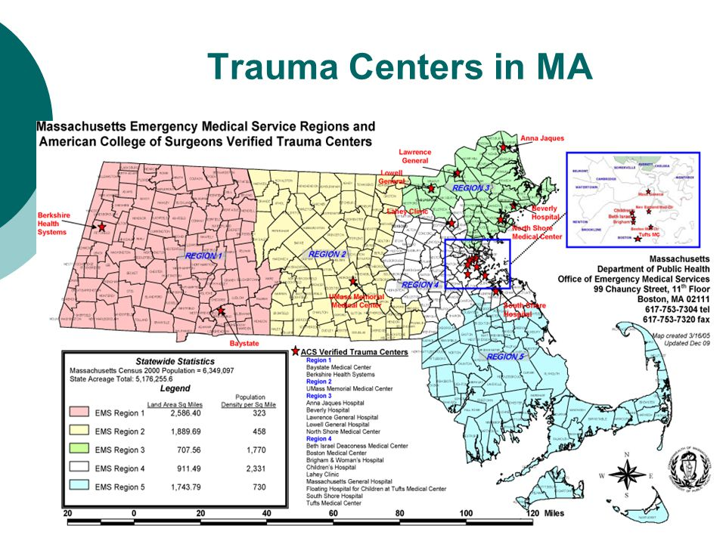

Slide 4
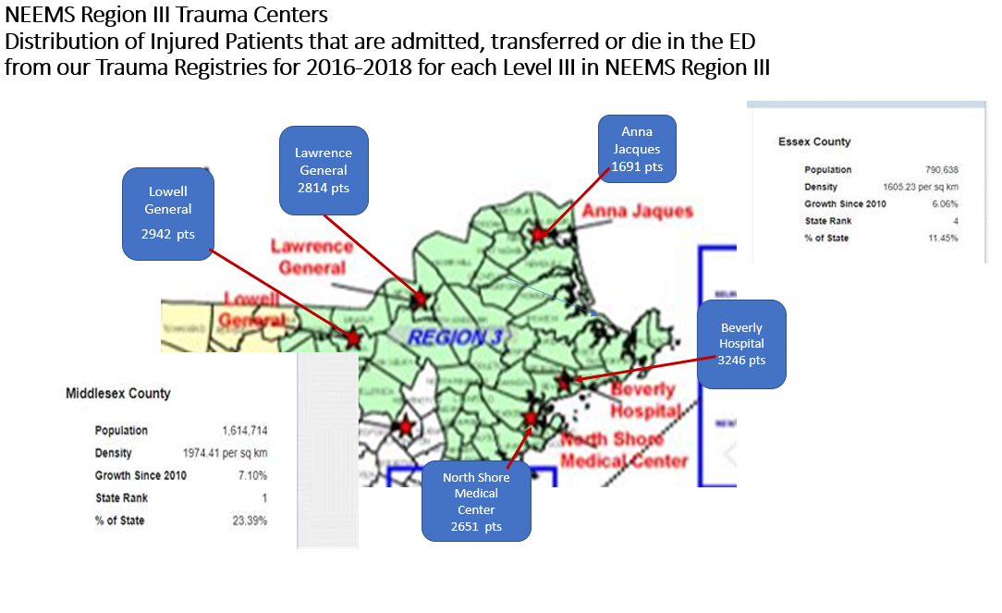
Region III consists of Essex and Middlesex Counties with a census of 2,405,352 people (2nd after Region IV)
Growth rate
Essex and Middlesex Counties make up Region III and are considered to have grown considerably since 2010. Middlesex is ranked 1st and Essex is ranked 4th for population growth
>>Do these Level III Trauma Centers contribute to quality Trauma Care in Massachusetts?
>>Does Region III need 5 verified Level III Trauma Centers?
>>Or should the question be: Should we encourage the development of more Level III Trauma Centers in other parts of the State? Would this take some burden off of the Level I and II trauma centers?
Massachusetts Population 2019 (Demographics, Maps, Graphs)worldpopulationreview.com/states/massachusetts-population
Can we answer these questions?
Notes:
Region III is 2nd in population to Region IV as well as the smallest in size of all the Regions

Slide 5
Trauma Activations
Level I Activations
All 5 Level III TCs utilize the minimum ACS criteria for Level I Activations but most add additional criteria (e.g. fall > 20 ft, ED physician discretion)
Level II Activations
Each TC looks at their patient population, ISS scores and over/undertriage rates
This data along with multidisciplinary chart review each TC determines which injuries require a Level II activation
Enhances better use of resources and decreases the overtriage rate considerably

Slide 6
Trauma Activations and Interface with EMS
Notification:
CMED or recorded Land-line (consistent throughout all TCs)
Each TC interacts with different EMS services
Some TCs provide Medical Direction for EMS and some do not– this makes a difference for QA/QI
EMS agencies call in a Trauma Alert for appropriate patients
Some TCs will activate a level I or II response based on the EMS report and others do not until the patient arrives to the ED
No Level III TC goes on diversion for trauma UNLESS of a Code Black

Slide 7
Percent of Trauma Patient Population that meet criteria for a trauma activation 2016-2018 data all 5 trauma centers N = 13,173 patients
Notes:
Only Lowell has no Level II Activation criteria or activations– for Lowell we make the consult level the Level II activation.

Slide 8
NEEMS Region III Trauma Centers: Percentage of Mechanisms of Injury N= 13,133 injured pts
Notes:
Total patients in registries from 2016-2018 = 13,173
Total GLFs+ 7421
Total MVC 1370
“Other”
Burns, Plastics, Hand/UE tendon and arterial injury/ genitourinary, some thoracic and lumbar spine fxs

Slide 9
Age Distribution of Injured Patients in NEEMS Region III Trauma Centers n=13,231 injured pts from 5 Level III TCs

Slide 10
Percentage of Ground Level Falls w/ Age > 70

Slide 11
Mortality Rate in 5 Level III Trauma Centers in NEEMS Region III
Of all deaths in Region III 45 % of mortalities occurred in patients ages 70 and above

Slide 12
NEEMS Region III: Transfer of Patients to Higher Level of Care
5 Points of Entry for trauma patients
Does this confuse EMS?--Each hospital is responsible for working closely with their EMS providers to ensure that injured patients are brought to the trauma center best suited to treat the patient
Level IIIs are often looked at as a place to stabilize a patient and then transfer
However, some Level IIIs keep critical trauma patients after damage control surgery and others transfer them to higher level of care
Each Level III TC has formal transfer guidelines
Guidelines are developed individually by each trauma center (ACS requirement)
Transfer guidelines vary depending on the available specialties at each individual TC
ACS trauma verification assists with keeping more patients in the community
Each transfer is reviewed via the trauma PI process for appropriateness and timeliness of the transfer
Every Level III TC has an affiliation agreement and a formal PI process with a Level I TC

Slide 13
NEEMS Region III: Transfer of Patients to Higher Level of Care
Level III trauma affiliations
Anna Jacques Hospital – Beth Israel Lahey Health
Beverly Hospital – Beth Israel Lahey Health
North Shore Medical Center – Massachusetts General Hospital/Brigham & Women’s Hospital
Lawrence General Hospital – Beth Israel Hospital/Tufts Medical Center
Lowell General Hospital – Tufts Medical Center
Trauma transfers from a Level III to a Level I TC
Aeromedical
Critical care ground
ALS

Slide 14
Injured Patients Transferred to Higher Levels of Care in Region III data is taken from 4 of the 5 Level IIIs in Region III

Slide 15
What types of trauma are usually transferred? Data from 3 Level III TCs in Region III N= 2409 transfers

Slide 16
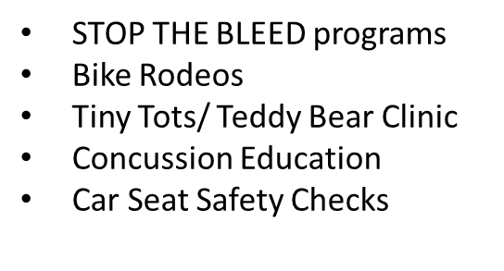
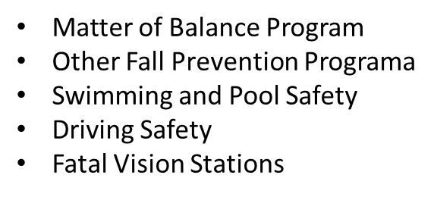
No Level III trauma center has a dedicated 1FTE position for injury prevention
The Trauma Program Managers must perform the IP themselves or set up volunteer teams to help them
ACS requirement to provide IP (criterion deficiency if not provided)
The following are IP programs offered in Region III:

Slide 17
Additional facts about Region III TCs
While most of the Level III Trauma Centers in Region III enter between 900 to 1500 patients per year into their registries:
Some Level III TCs do not have a full time TPM
Not all Level IIIs have a full time trauma registrar for every 500-750 trauma patients entered into the trauma registry each year.
No Level III TC has help with Injury Prevention
No Level III TC has a PI Coordinator

