Slide 1
Commonwealth of Massachusetts
Trauma Systems Committee
Region IV Report
November 20th, 2019

Slide 2
Region IV Report
Region Overview
Prevention and Access
Pre-Hospital: Notification and EMS Feedback
Transferring Hospitals: criteria, pre-notification, feedback
Post Trauma Care: resources and barriers

Slide 3
Region Overview
7 Adult Trauma Centers
6 Level One Trauma Centers
BWH, MGH, BIDMC, BMC, Tufts, Lahey
1 Level Two Trauma Center
SSH
4 Pediatric Trauma Centers
3 Level One Trauma Centers
BCH, MGH, Tufts
1 Level Two Trauma Center
BMC

Slide 4
Region IV Overview
Adult Trauma Centers

Slide 5
Beth Israel Deaconess Medical Center Profile CY18
N = 2242
Percent of patients meeting activation criteria = 36%(Stat/Basic)
63% (Stat/Basic/Consult)
Percent of trauma transfers = 56%
Top 3 mechanisms of injury =
1. Falls
2. MVC
3. Pedal Cycle
Percent of patients 65yo and older = 51%
Percent of patients 70yo and older with ground level falls = 27%
Mortality rate = 2.45%

Slide 6
Boston Medical Center Profile CY18
N = 1727
Percent of patients meeting activation criteria = 85%
Percent of trauma transfers = 22% (transfers into BMC),
Top 3 mechanisms of injury =
1. Falls -> 690/40%
2. Interpersonal Violence -> 450/26%
3. MVC -> 202/12%
Percent of patients 65yo and older = 23%
Percent of patients 70yo and older with ground level falls = 12%
Mortality rate = 2% (inpatient only) 4% (including DOA)

Slide 7
Brigham and Women’s Profile CY18
N = 1740
Percent of patients meeting activation criteria =
Percent of trauma transfers = 63%
Top 3 mechanisms of injury =
1. Falls
2. MVC
3. Assault
Percent of patients 65yo and older = 53%
Percent of patients 70yo and older with ground level falls = 45%
Mortality rate = 3.8%

Slide 8
Lahey Hospital & Medical Center Profile CY18
N = 1703
Percent of patients meeting activation criteria = 49%
Percent of trauma transfers = 35%
Top 3 mechanisms of injury =
1. Ground level falls
2. Fall from stairs
3. MVC
Percent of patients 65yo and older = 70%
Percent of patients 70yo and older with ground level falls = 64%
Mortality rate = 3%

Slide 9
Massachusetts General Hospital Profile CY18
N =
Percent of patients meeting activation criteria = 27%
Percent of trauma transfers = 40%
Top 3 mechanisms of injury =
1. Falls
2. MVC/ MCC
3. Pedestrian Struck
Percent of patients 65yo and older = 48%
Percent of patients 70yo and older with ground level falls = 16%
Mortality rate = 4.3%

Slide 10
Tufts Medical Center Profile CY18
N =
Percent of patients meeting activation criteria = 75%
Percent of trauma transfers = 48%
Top 3 mechanisms of injury =
1. Fall
2. MVC
3. Assault
Percent of patients 65yo and older = 45%
Percent of patients 70yo and older with ground level falls = 25%
Mortality rate = 5%

Slide 11
South Shore Hospital Profile CY18
N = 1842 admissions
Percent of patients meeting activation criteria = 37%
Percent of trauma transfers = 12% (Adult 8%, Pedi 4%)
Top 3 mechanisms of injury =
1. Falls (all heights)
2. MVC
3. Pedestrian struck
Percent of patients 65yo and older = 51%
Percent of patients 70yo and older with ground level falls = 28%
Mortality rate = 3%

Slide 12
Region IV Overview
Pediatric Trauma Centers

Slide 13
Boston Children’s Hospital Profile CY18
N =
Percent of patients meeting activation criteria = 22%
Percent of trauma transfers in = 53%
Top 3 mechanisms of injury =
1. Falls
2. Motor vehicle/bicycle related
3. Sports
Percent of patients 65yo and older = 0%
Percent of patients 70yo and older with ground level falls = 0%
Mortality Rate = 0%

Slide 14
Massachusetts General Hospital Pediatric Profile CY18
N =
Percent of patients meeting activation criteria = 26%
Percent of trauma transfers = 49%
Top 3 mechanisms of injury =
1. Falls
2. Sports related
3. MVC / Pedestrian
Percent of patients 65yo and older =
Percent of patients 70yo and older with ground level falls =
Mortality rate = 1.8%

Slide 15
Tufts Medical Center Pediatric Profile CY18
N =
Percent of patients meeting activation criteria = 93%
Percent of trauma transfers = 78%
Top 3 mechanisms of injury =
1. Falls
2. MVC
3. Sports
Mortality rate = 0

Slide 16
Prevention and Access

Slide 17
Prevention and Access
Injury Prevention Initiatives
Stop the Bleed
Gun Violence Prevention
Distracted Driving Education
SBIRT
Geriatric Falls Prevention
AARP Automotive Courses
Government Advocacy

Slide 18
Prevention and Access (cont.)
Injury Prevention Initiatives
Safe Kids Initiatives (medication safety, pedestrian safety)
Child Passenger Safety events and checkpoints
Safe Shelter Program (child-proofing family homeless shelters)
Think First (brain and spinal cord injury prevention education)

Slide 19
Pre-Hospital: Notification and EMS Feedback

Slide 20
Pre-Hospital: Notification and EMS Feedback
Notification:
Boston Central Medical Emergency Direction (CMED) radio
Ring Down Phone – recorded line from EMS turret; utilized for sensitive patient information, SA, high profile events/patients
Access Centers (each institution with own process)
Feedback
EMS participation/attendance at institution Peer Review
Review of scene time, transport, care rendered
EMS Liaisons – direct communication with Pre-hospital Providers

Slide 21
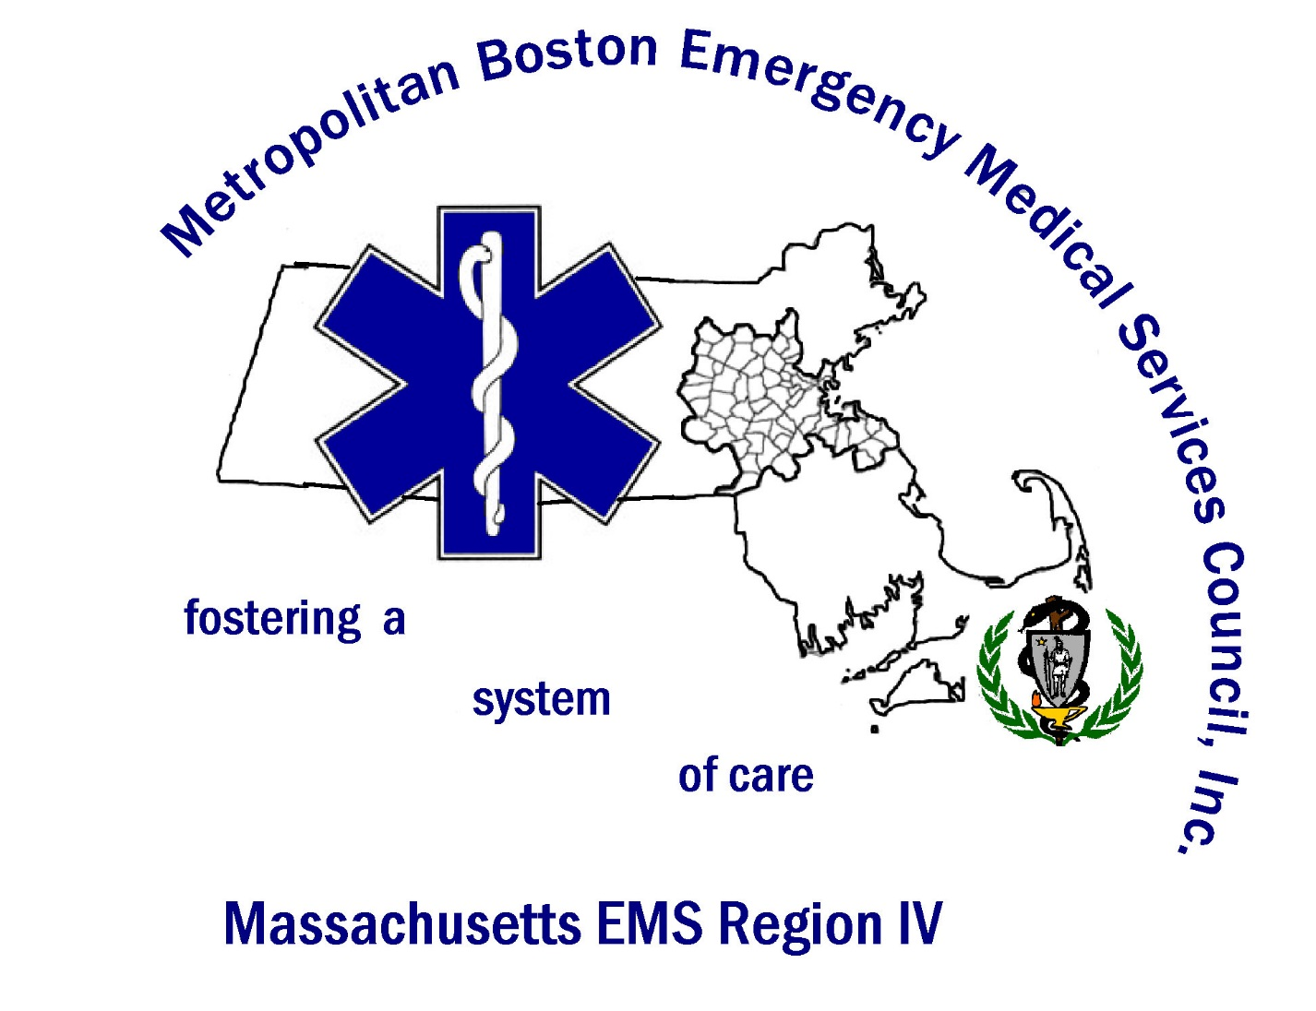

Slide 22
Metropolitan Boston EMS Council, Inc
The delivery of emergency medical services in the Commonwealth of Massachusetts is regulated by the Massachusetts Department of Public Health (DPH) Office of Emergency Medical Services. M.G.L. Chapter 111c, the enabling legislation, empowers DPH to create and enforce the Commonwealth's EMS regulations, 105 CMR 170.000.
The Metropolitan Boston Emergency Medical Services Council, Inc. (MBEMSC), EMS Region IV, is the agency designated by the DPH to coordinate the delivery of emergency medical services, as defined by 105 CMR 170.100 - 170.106, within the sixty-one cities and towns comprising the Metropolitan Boston Area.
coordinates, maintains and improves the EMS system within those sixty-one communities;
oversees EMS activities focusing on quality patient care;
reviews and recommends continuing education programs for ambulance service providers;
provides information and educational resources to the public;
coordinates the Metro Boston CMED radio and communication system;
assists in statewide EMS treatment protocol development;
disaster response and communications.

Slide 23
Mission of Region IV
The Regional Board of Directors supports, strengthens, and promotes the quality of EMS by fostering a system of care, furthering public and professional education, and encouraging research.
Region IV's goal is to ensure that timely access to appropriate emergency medical care is available to all residents and visitors. In addition, we work to increase public recognition and understanding of the EMS system.
We strive to promote:
the availability and quality of emergency care by developing clinical and system performance standards
inter-agency coordination and collaboration
efforts to strengthen and expand professional education
MBEMSC works to develop a database and methodologies to evaluate EMS system performance, as well as to develop funding resources sufficient to support program initiatives.

Slide 24
Governance
The council is governed by a Board of Directors consisting of local and state government officials, emergency medical technicians (EMTs), nurses, doctors, ambulance service providers, fire, police, hospitals, and citizens representing the 61 communities of Metropolitan Boston and the surrounding area.
Licensed Physicians with regular and frequent involvement in the provision of emergency care (representing 2 OBTH and 2 non‑COBTH hospitals; 1 Physician shall be a Surgeon with regular and frequent involvement in the provision of emergency care who represents a Level I or Level II Trauma Center)
Hospital Administrators (representing COBTH and non‑COBTH hospitals)
Emergency Nurses
Emergency Medical Technician, Advanced, or Paramedic, (2 shall be non-officers or non-managers)
Prehospital ALS Manager/Directors, with 1 representing each of the following geographic areas covered by the Representative’s service: COBTH area, Northwest Suburban area, North Suburban area, South Middlesex area, Southwest Suburban area, and South Suburban area. (No service shall have more than one Representative in this category.)
Consumers
Law Enforcement Representative
Fire Service Representatives (1 shall be a Chief of Department, 1 shall be a non-Fire Chief)
Licensed Ambulance Service Representatives (1 individual shall represent a municipally-funded ambulance service)
Representative of the municipally designated primary EMS provider of the City of Boston
State Representative/Senator or Senior Staff Person
Local Government Representative
Licensed EFR Service Representative (This category shall exclude all licensed ambulance services)
At‑Large Members

Slide 25
ORGANIZATIONAL CHART
METROPOLITAN BOSTON EMERGENCY MEDICAL SERVICES COUNCIL, INC.
Chair, Board of Directors
Patrick Sean Tyler
Chair, Executive Committee
Patrick Sean Tyler
Vice Chair
Jason Cavallaro
Executive Director
Derrick Congdon
Medical Director
William Tollefsen, MD
Assistant Director
Emily McDonald
Social Media Manager
Jill White
Administrative
Assistant
Betty Ericksen
Medical Control
Committee
Frank Friedman, MD.
Membership Committee
Gibson McCullough
Pre-Hospital System
Coordination Committee
William Porcaro, MD
Public Information and Education
Resource Committee
Alice King
Trauma Systems
Committee
Michael Murphy, M.D
11/19

Slide 26
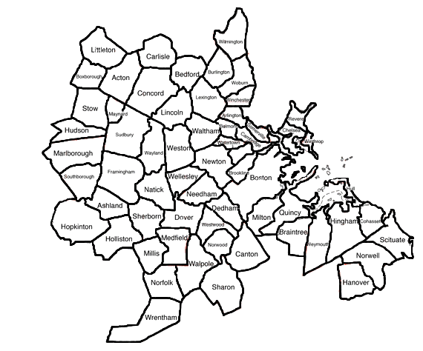
The Region
The Region, which extends north as far as Wilmington and Littleton, west as far as Marlborough and Hopkinton, and south as far as Wrentham and Hanover, serves as residence to over 2 million people, and accounts for close to 1 million emergency department visits in the Region's hospitals each year.

Slide 27
Hospitals
Beth Israel-Deaconess Hospital - Milton Beth Israel Deaconess Hospital - Needham Beth Israel Deaconess Medical Center- East and West Campuses Boston Children's Hospital Boston Medical Center Brigham and Women's Hospital Brigham and Women's Faulkner Hospital Cambridge Health Alliance Carney Hospital Dana-Farber Cancer Institute Emerson Hospital Lahey Hospital and Medical Center Massachusetts Eye and Ear Infirmary Massachusetts General Hospital
MetroWest Medical Center (Framingham and Natick) Mount Auburn Hospital Newton Wellesley Hospital Norwood Hospital Shriner's Hospital for Children - Boston Somerville Hospital (a campus of Cambridge Health Alliance) South Shore Hospital St. Elizabeth's Medical Center Steward Satellite ER Facility-Quincy (a satellite location of Carney Hospital) Tufts Medical Center UMASS/Memorial Medical Center - Marlborough Hospital Campus VA Boston Healthcare System Winchester Hospital

Slide 28
Services
There are 70 ambulance services that reside in Region IV with several others that operate in and around the area.
They consist of a mix of BLS and ALS services form several different areas:
Municipal
Private
3rd Service
Air
Call/Volunteer
Hospital Based
College Based

Slide 29
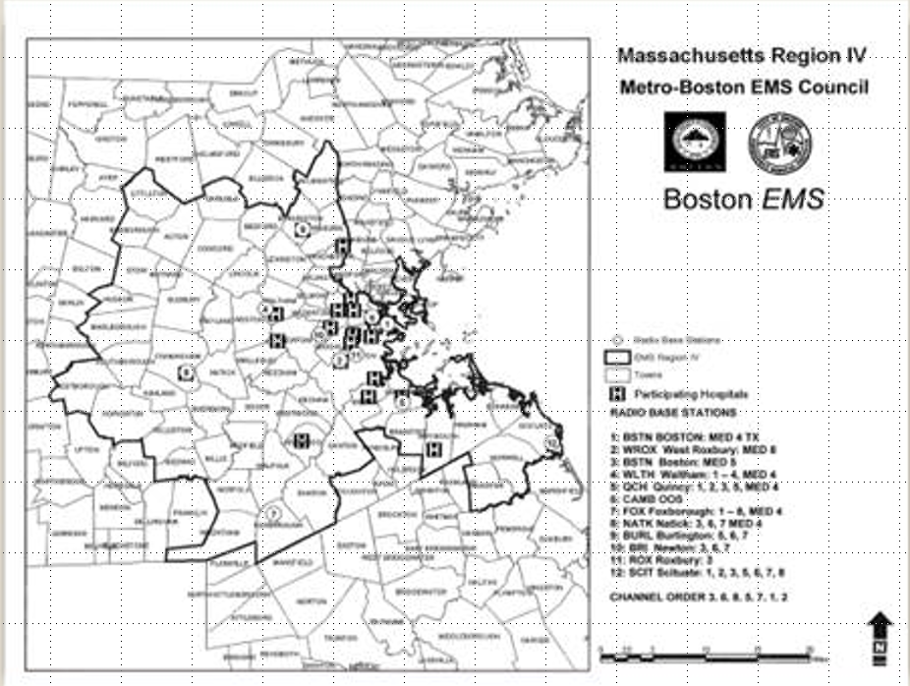

Slide 30
Massachusetts EMS Region IV
Region IV consists of 62 cities and towns surrounding and including the city of Boston
Region IV consists of 911 square miles and a population density of 2331 persons per square mile
CMED services approximately 100 ambulance services. They include municipal, private, hospital based, and aeromedical units

Slide 31
CMED’s Responsibilities
Routine ambulance to hospital communications
Daily testing of system
Prompt notification of MCI/disaster with timely updates as available
Coordination of EMS resources
Appropriate distribution of patients from scene to hospital
Tracking care capabilities of individual hospitals: RED/ YELLOW/ GREEN

Slide 32
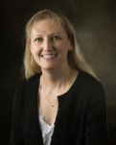
Boston EMS Department Overview CY18
Bureau of the Boston Public Health Commission
401 FTE
Two tiered system
21 BLS/ 5 ALS (peak)
126,419 incidents
154,417 responses
> 400 calls per day
> 85, 897 transports annually
James Hooley
Chief
Sophia Dyer, MD
Medical Director

Slide 33
Trauma Stats*
Incidents By Type | Number | Percentage
Injury (lacerations, fractures, etc.) | 15,952 | 12.62%
Motor Vehicle Collision (MVA, Ped, Bike/Scooter) | 5,652 | 4.27%
Trauma (Penetrating, Long Fall, etc.) | 1,096 | 0.87%
Fire/Hazmat/Standby | 2,237 | 1.77%
TOTAL | 24,937 | 19.53%
*https://www.boston.gov/sites/default/files/document-file-04-2019/2018_boston_ems_vital_stats.pdf

Slide 34
BEMS - System Assets
BLS - Basic Life Support
ALS - Advance Life Support
Tango Trucks - Logistics / Support
T10 MERV- Mobile Emergency Response Vehicle - 15+ patient capacity
Jake Units - Gator (golf cart) Teams
X-Ray Units - Bicycle Teams
Harbor Unit - Marine unit in partnership with BPD marine boats
Squad 80 CAT unit - Community Assistance Teams
Critical Incident Support Management- Peer Support / CISM Teams
Partnerships
BAMA- Boston Ambulance Mutual Aid
BFD
Law Enforcement Organizations (LEO)- BPD/MSP/MBTA Transit/Park Rangers
Boston Trauma Response Team - SMART Team*
https://jri.org/services/behavioral-health-and-trauma/boston-trauma?gclid=Cj0KCQiAn8nuBRCzARIsAJcdIfNOWn9w4OoKjMMBF9nvbFsgjBFfQZSaOBBkTu8eDtsOOuDP-uxYPEgaAhwBEALw_wcB

Slide 35
Prevention Programs
Car Seat Program
https://www.boston.gov/departments/emergency-medical-services/how-schedule-car-seat-check
Senior Safety Presentations
https://www.boston.gov/departments/emergency-medical-services
CPR Training
https://www.boston.gov/departments/emergency-medical-services/cpr-training

Slide 36
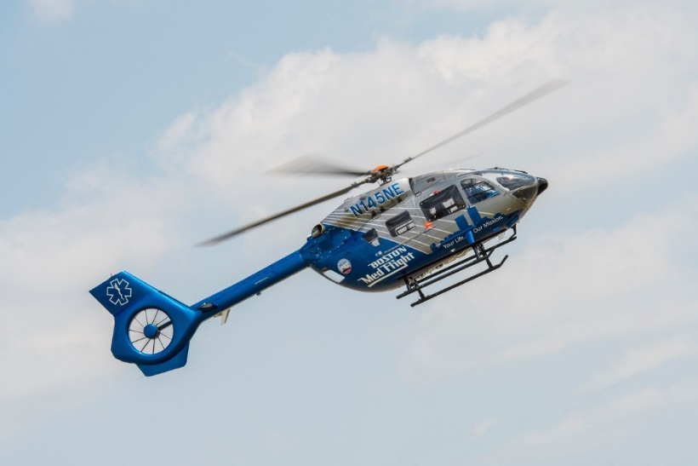
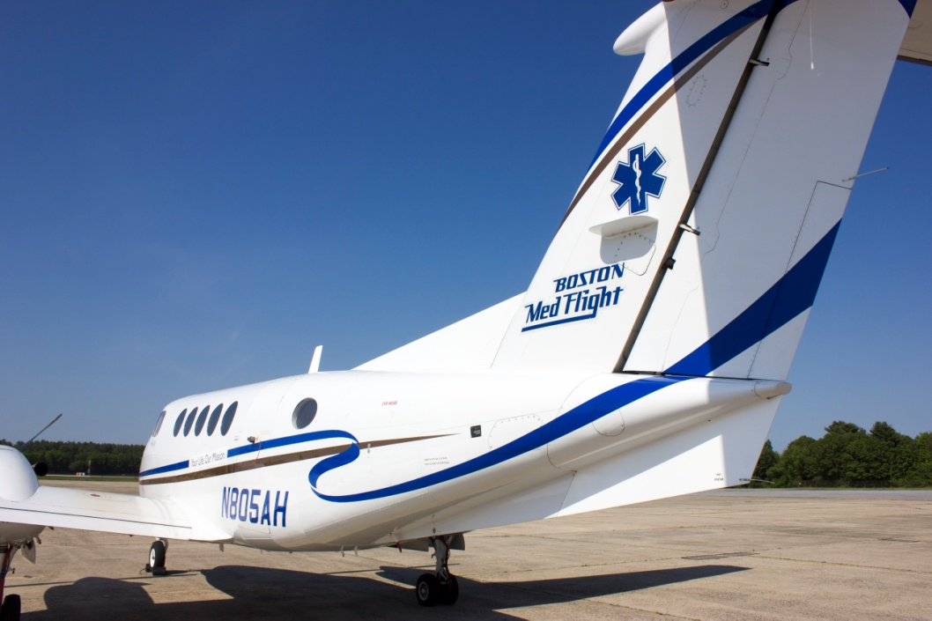
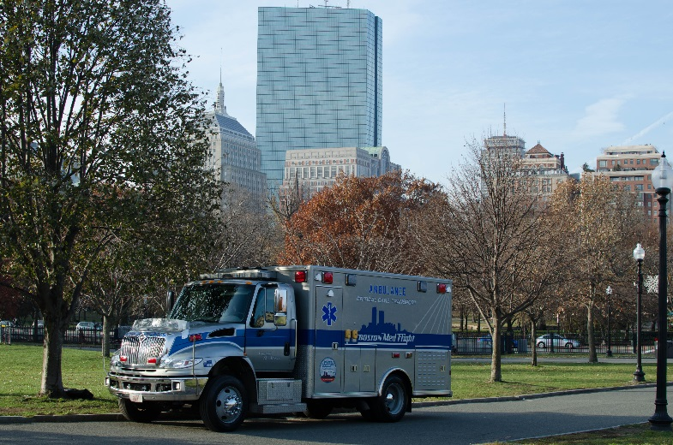
BOSTON MEDFLIGHT
Your Life. Our Mission.

Slide 37
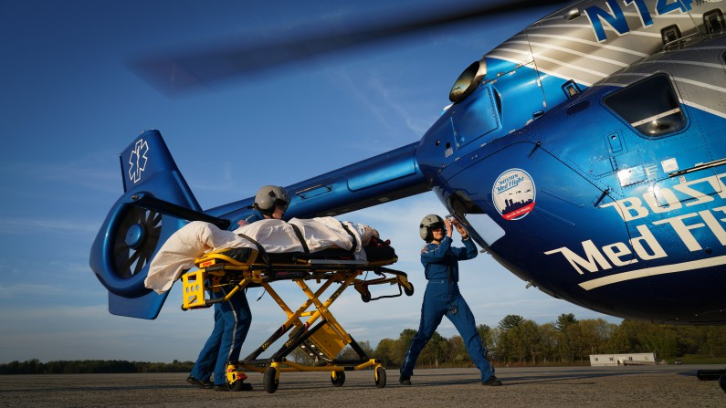
Boston MedFlight History
Nonprofit consortium formed in 1985
Founded by six academic medical centers, seventh added in 2017
Boston Medical Center
Beth Israel Deaconess Medical Center
Brigham & Women’s Hospital
Boston Children’s Hospital
Lahey Hospital and Medical Center
Massachusetts General Hospital
Tufts Medical Center

Slide 38
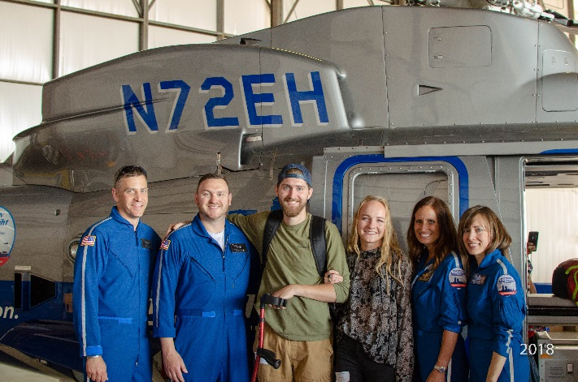
Boston MedFlight Philosophy
Nonprofit, put patient needs first
Right patient, right vehicle, right time – using the most appropriate vehicle for patient needs
Consortium hospitals expect us to be an extension of their care – we are their transport team
“High end” critical care – we care for patients other services cannot (including other air services)

Slide 39
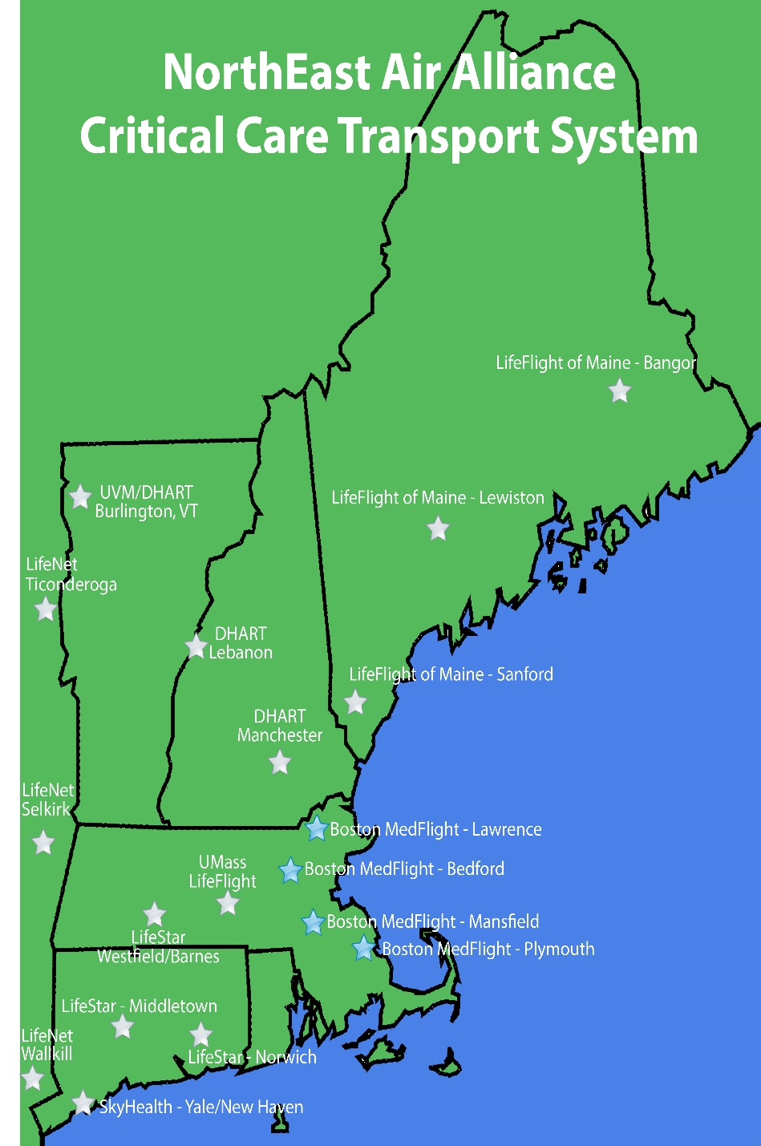
Boston MedFlight’s Operation
4 Bases operating out of Lawrence (12hr), Bedford (24hr), Mansfield (12hr), and Plymouth (24hr).
Lawrence to become a 24hr base in March 2020.
Helicopter/Ground services from all bases; Fixed Wing services from Bedford Base.
Additional resources available from cooperative relationship with regional partners.

Slide 40
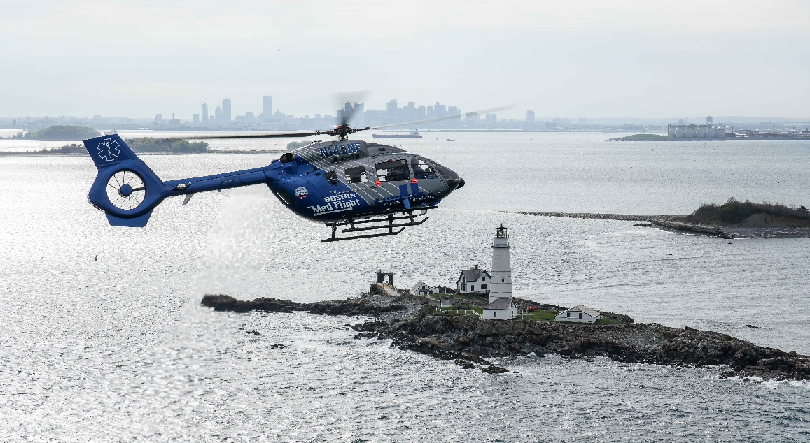
Boston MedFlight’s Volume
Total Transports in FY 2019 : 4780 patients
Trauma is 17% of the overall volume.
Transport requests consist of :
Scene 12%
Interfacility 88%
Adult 78%
Pediatric 12%
Neonate 10%
Significant increase this year in ECMO and iEPO transports and will soon be routinely carrying blood products on our vehicles.
Natural evolution of our program

Slide 41
Transferring Hospital

Slide 42
Transferring Hospital
Criteria for transfer
Patient need outweighs sending facility’s ability, resources
In need of damage control surgery, neurosurgery, microvascular or reimplantation
High risk patients (pregnant, significant co-morbidities with high injury burden)
Formal/informal transfer agreements
ACS criteria for trauma transfer
Process for Notification
CMED – scene trauma, transfer update
Undesignated MedFlight
BMF selects transfer destination based on rotation, ICU bed availability
Access Centers
Report called, information provided to ED and Trauma service

Slide 43
Resources/Barriers for Post Trauma Care

Slide 44
Resources/Barriers for Post Trauma Care
Resources
Rehab facilities within enterprise (ex. Spaulding under Partners umbrella, Franciscan Children’s Hospital)
Value beds (beds “rented” by hospital to facilitate placement)
Barriers
Lack of mental health beds, facilities that have capability to care for concomitant injury and psychiatric illness
Under insured
Medicare/Medicaid limits to rehab days/care
Insurance approval
Repatriation for out of state patients
Uninsured and difficult to place

