Slide 1






Massachusetts Region V Trauma Overview
August 28, 2019

Slide 2
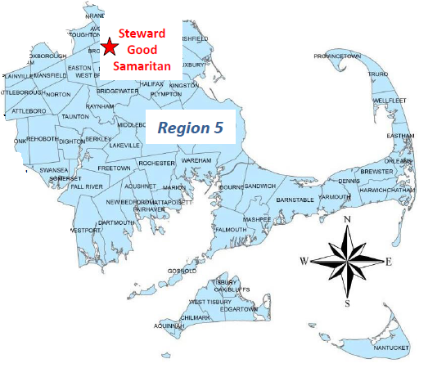
ACS Verified Trauma Centers in Region V

Slide 3
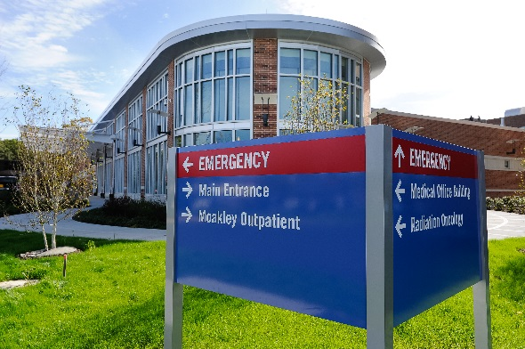
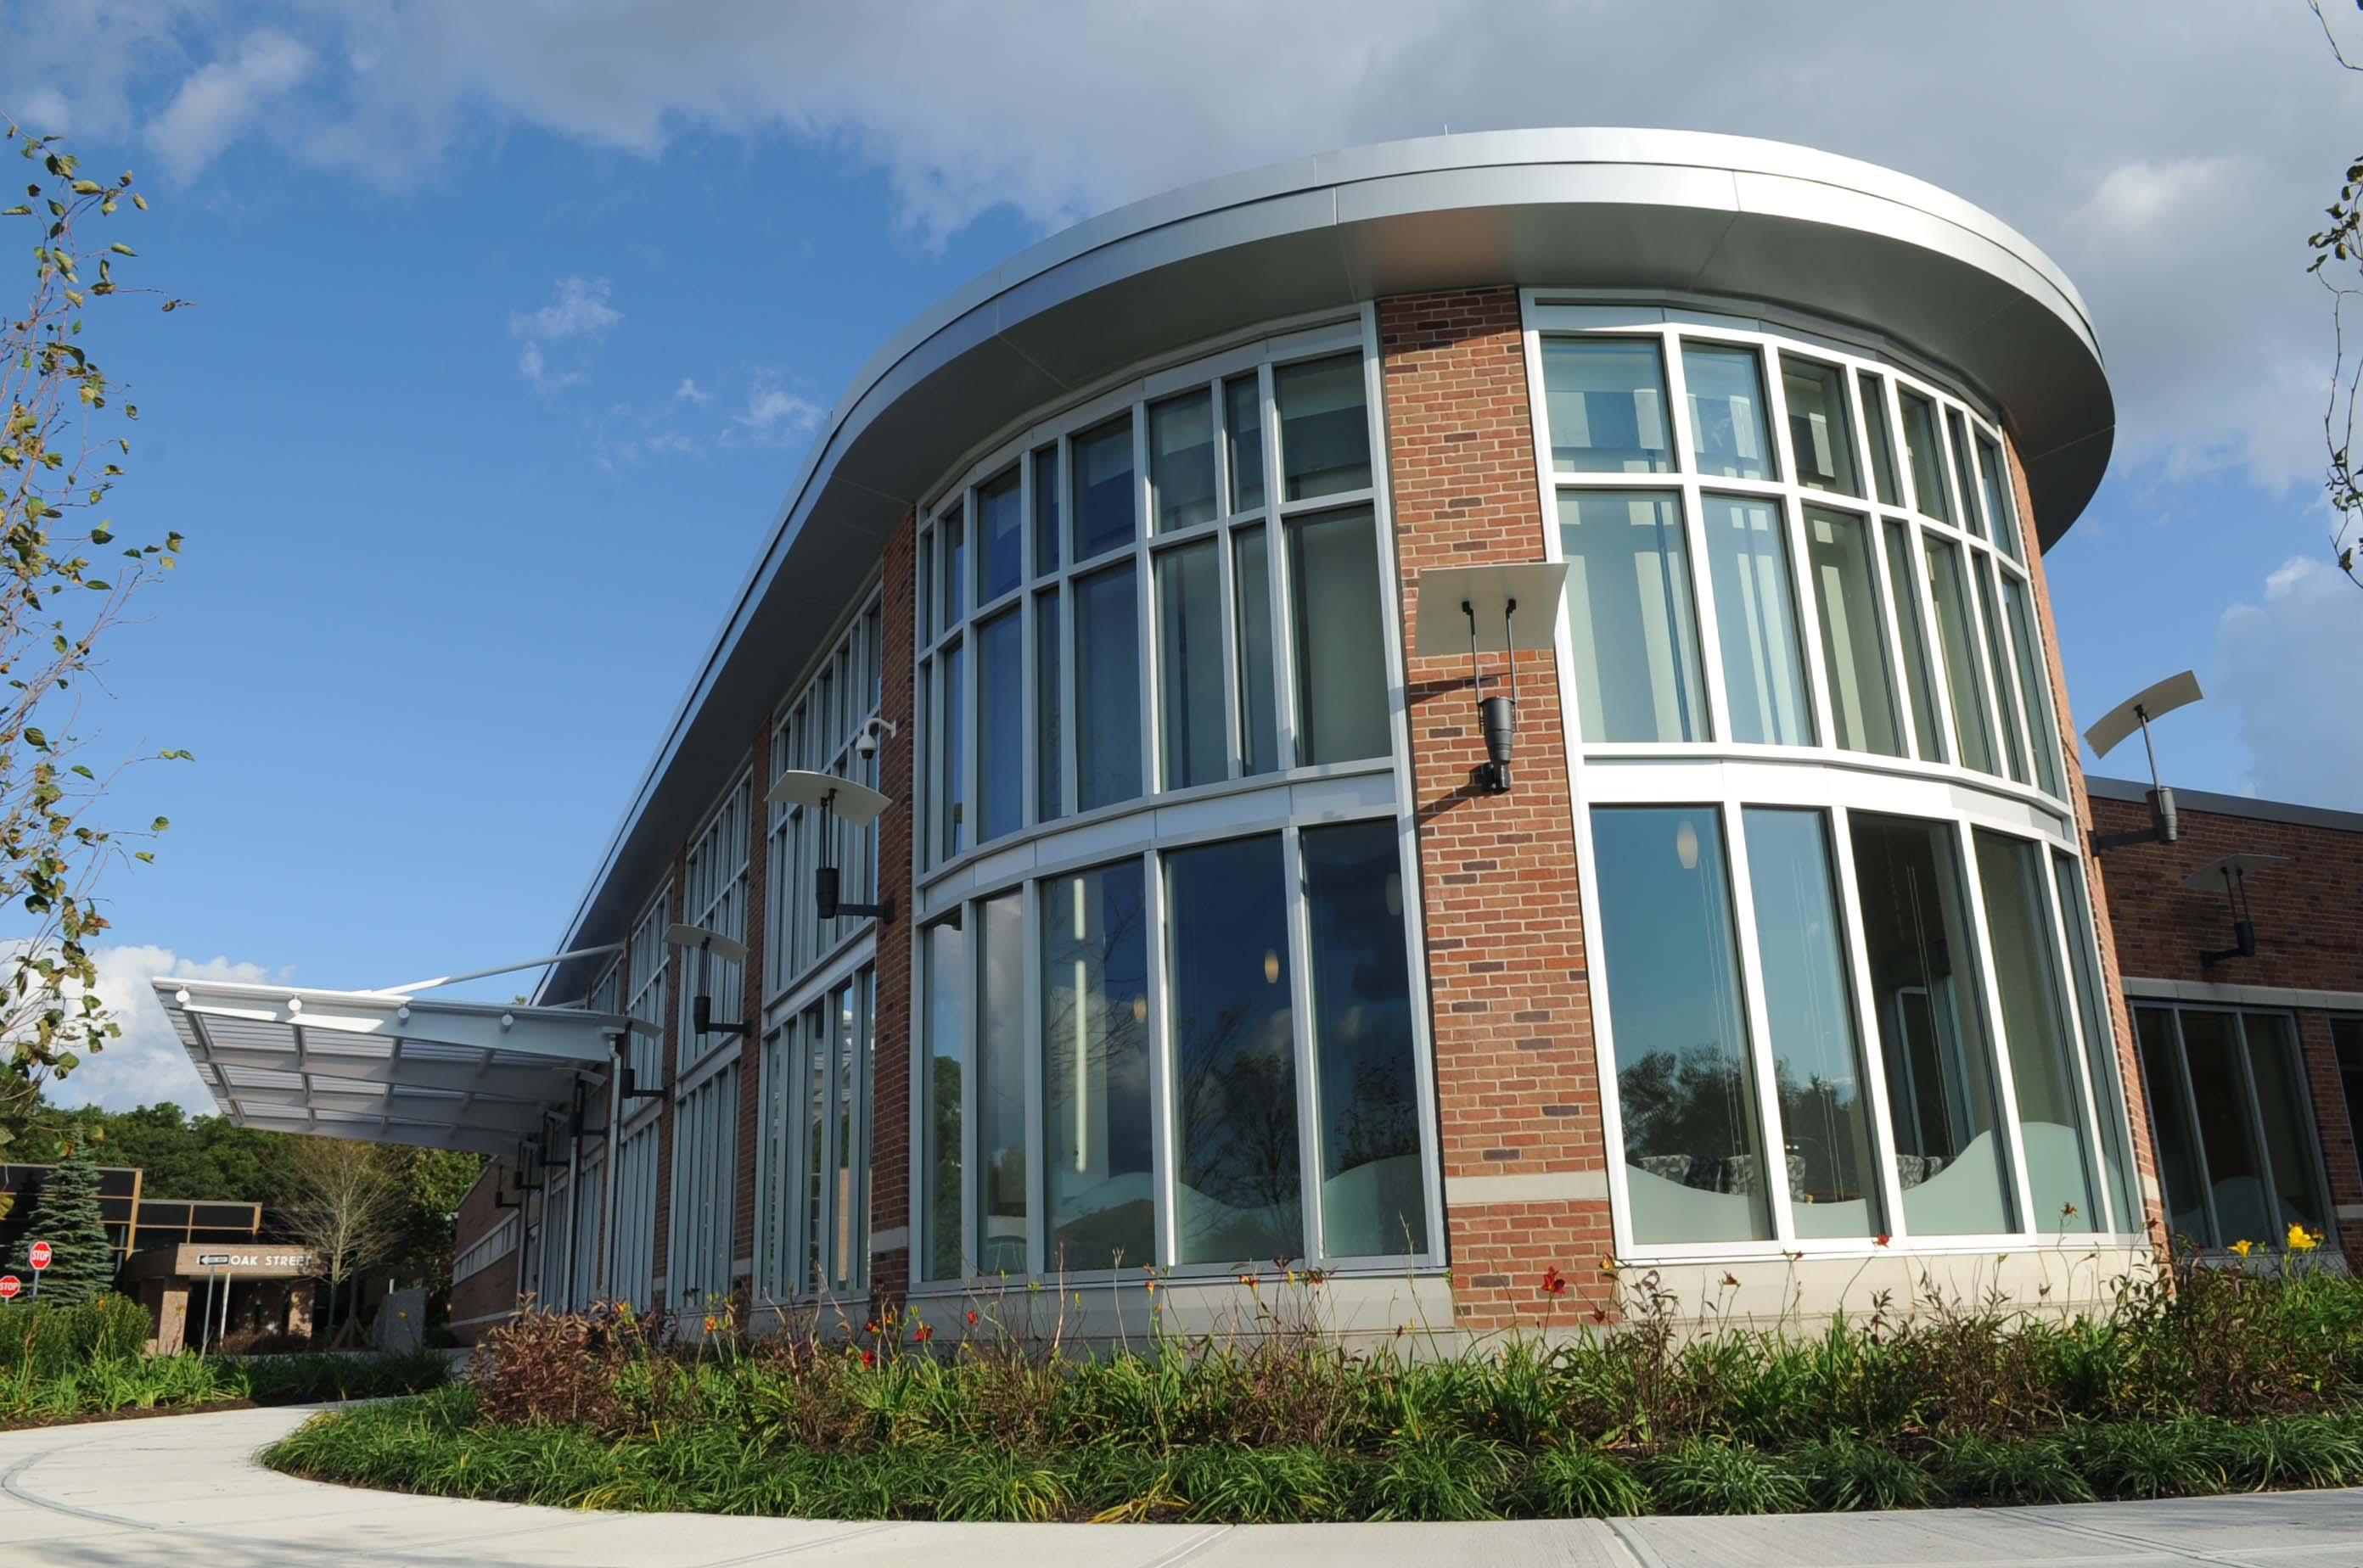
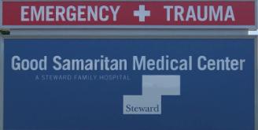
Hospital Trauma Profiles

Slide 4
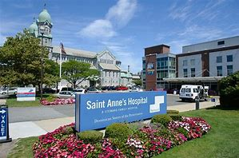
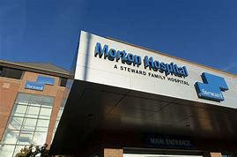
Hospital Trauma Profiles

Slide 5
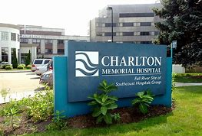
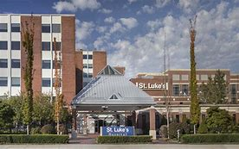
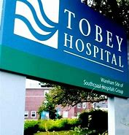
Hospital Trauma Profiles
Hospitals | Trauma Center? | Pre Hospital Notification | In Hospital-Transfers | Post Trauma | Prevention and Access
Southcoast Hospitals- Charlton, Tobey, and St. Luke's | N | At Southcoast we do not have designated trauma services (yet). Southcoast does see severe trauma, including trauma cases that self-present or are dropped off by the public, trauma cases with unstable airways or other indications to come to the nearest hospital first, and trauma cases that may have been under-triaged. Cases called in via CMED or phone. Southcoast has a robust EMS QA system. ED physicians refer trauma cases brought in by EMS to EMS Med Director for review, especially if they have questions or concerns, and he provide feedback back to the EMS systems involved. | We transfer most major trauma cases after ED stabilization, usually to RIH. The exceptions have been traumas where, after a thorough ED evaluation, there is found to be only one serious injury -- i.e., isolated orthopedic injuries or neurosurgical injuries -- that can be handled by a single speciality service, such as orthopedics or neurosurgery. We can access most trauma specialty services via transfer to Boston or Providence. | The main issue with post-trauma care and resources is that our patients are often taken out of state, to Rhode Island, and then when they return home they have serious insurance barriers and provider followup barriers to establishing post-trauma care in Massachusetts. | We feel that there is a severe need for trauma care for our region, a need we hope to fill by establishing St. Luke's Hospital in New Bedford as a Level II trauma center.

Slide 6
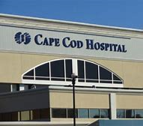
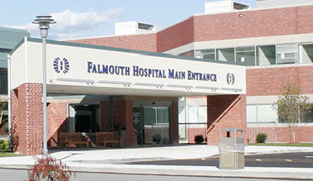
Hospital Trauma Profiles

Slide 7
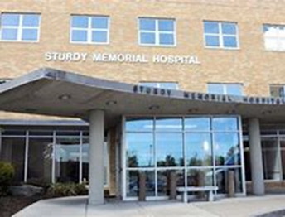
Hospital Trauma Profiles
Hospitals | Trauma Center? | Pre Hospital Notification | In Hospital-Transfers | Post Trauma | Prevention and Access
Sturdy Memorial Hospital | N | We utilize Twiage/CMED/recorded phone line for pre-notification of trauma patients that are transported to Sturdy. Based on EMS protocols most major trauma is transported directly to Rhode Island Hospital. Feedback is provided to EMS when requested by the transporting service. Additionally, all trauma cases are reviewed by the EMS QA director and feedback is provided to the departments as needed. Cases may also be discussed during monthly rounds. | Any patients with acute intra-abdominal, thoracic, neurosurgical trauma related injuries are transferred to a trauma center. Some isolated orthopedic injuries are managed at Sturdy. Complicated orthopedic injuries are transferred to trauma center after discussion with orthopedics. Facial and ophthalmologic trauma is transferred to trauma center. We do not have neurosurgery, ENT/OMFS/Plastics available at Sturdy. | Patients with orthopedic injuries that don’t require admission will follow up with orthopedics as an outpatient. We do not have a trauma clinic. Barriers for transfer is when hospitals are at capacity and are not taking any transfers. Another barrier is insurance coverage for patients transferred to RIH as their insurance will often not cover their post trauma follow up at RIH. | Our primary referral center is RIH which usually is able to meet our needs and there hasn’t been any significant issue with getting our patients the necessary trauma care. We do provide Stop the Bleed education.

Slide 8
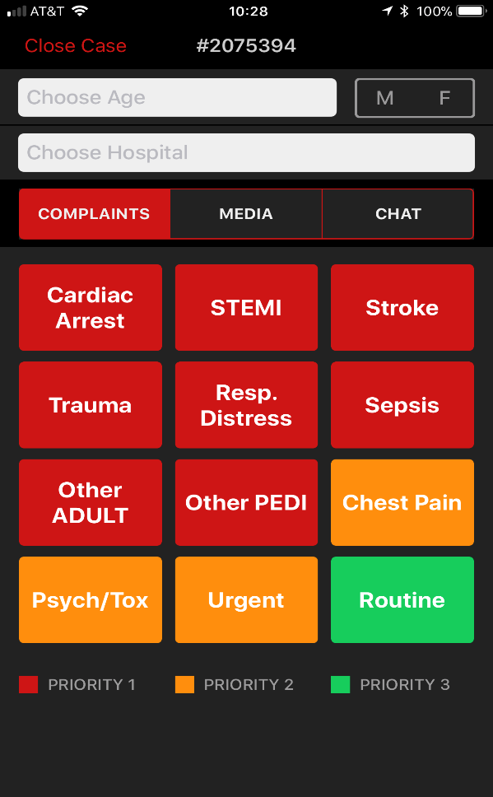
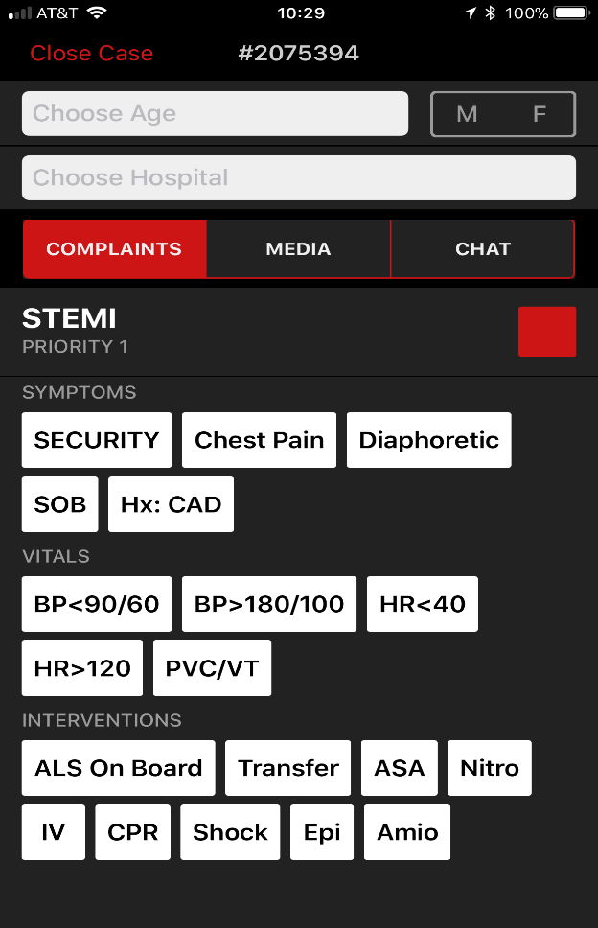
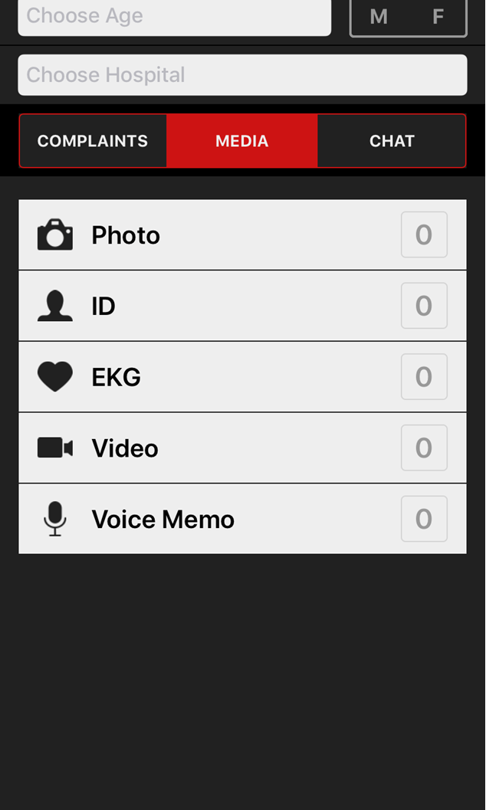
Twiage EMS-facing Mobile App

Slide 9
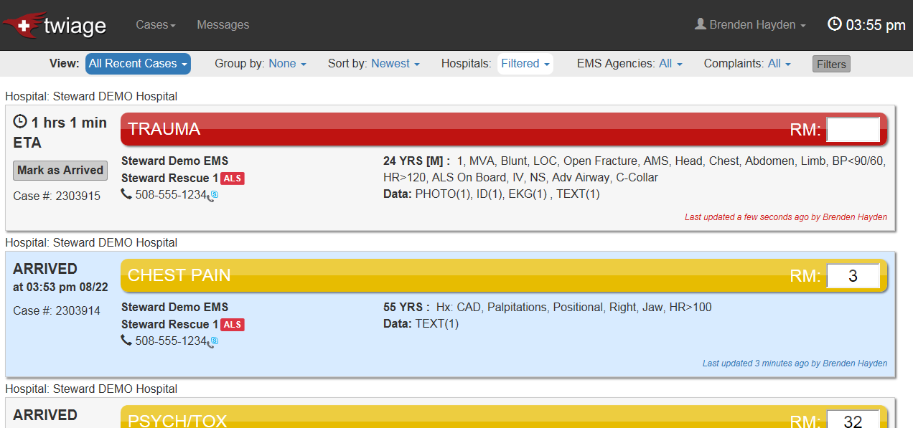
Twiage Hospital Dashboard

Slide 10
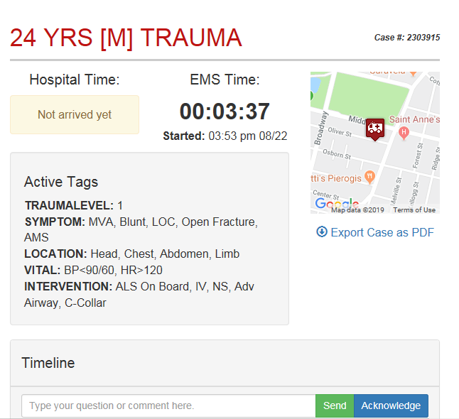

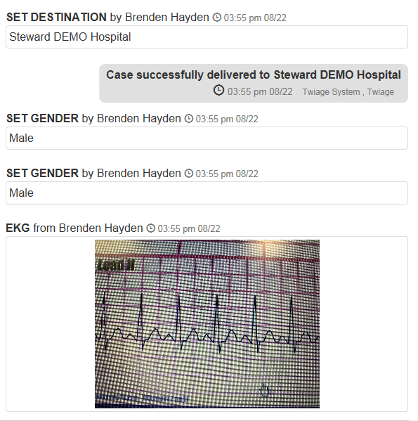

Slide 11

Questions?

