Slide 1
State 911 Department
Regional Development Grant Guidance

Slide 2
WHAT’S NEW
Added requirement for information for proposed projects
Language added relative to responses for clarification and/or additional documentation
Updated funding priorities
Clarify language regarding budget modifications
Application deadline is Wednesday, April 15, 2026
Language added relative to documents required for application
Updated language relative to amended applications
Updated language relative to quarterly reporting
Timeline for response clarified

Slide 3
WHAT’S NEW continued
Budget modification processing timeline extended to 15 business days
Language added for consistency with other grant programs
Reimbursement processing timeline extended to 45 business days
Language addressing missing documentation has been updated
Disbursement language added for personnel costs at a new Regional PSAP or RECC prior to go-live
Language regarding payment notification has been updated
Language added relative to electronic signature
Clarification added to reimbursement for expenses incurred language
“District” added to reimbursement section

Slide 4

Application Checklist
Completed Budget Worksheet
Completed Prioritized List of Requested Items
Completed Detailed Project Narrative
Detailed Quotes/Statement(s) of Work Attached
Completed Signed ICIP form for Radio Projects/Consoles, if applicable
Fully Executed Commonwealth of Massachusetts Contractor Authorized Signatory Listing Form signed by Board Chair or City or Town Official AND each listed signatory must sign next to their name on the form
Completed the Highlighted Sections of the Commonwealth Standard Contract Form, Signed and Dated by an Authorized Signatory
Signed and Dated Development Grant Application Cover Page

Slide 5
Application Checklist continued
All required documentation/ reports/ quotes shall be provided with the
Proposed Regionals/RECCs Letters of Attestation
Most Recent Approved Audit Report
grant application. The State 911 Department may decline to consider
incomplete submissions and may return incomplete applications to the
applicant. The State 911 Department reserves the right to request
clarification and/or additional information from the applicant. All
responses to request for clarification and/or additional information shall
be provided within the timeline noted in the Department’s request.
Failure to respond to any and all requests within the noted timeline may result in a funding request and/or the application being given no further consideration.
Regional & RECC: Intermunicipal Agreements/Governing Document

Slide 6
Reminders
Priorities:
Expansion of existing regional PSAPs or RECCs through the addition of one (1) or more PSAPS to an existing regional PSAP or RECC, with an executed IMA
Upgrade of existing regional PSAPs and RECCS
Development of new regional PSAPs and RECCs or new expansion of existing regional PSAPs or RECCs through the addition of one (1) or more PSAPs to an existing regional PSAP or RECC, with letters of attestation only
Development/expansion of regional secondary PSAPs
Development of new regional PSAPs or RECCs with an executed IMA previously funded under this grant program
Development of new regional PSAPs or RECCS with an executed IMA

Slide 7
Reminders
Guidelines & Application available at www.mass.gov/e911 or www.commbuys.com
(1) Original single-sided, unbound or 3-hole punched application including all supporting documentation
3. The State 911 Department may, in its sole discretion, permit an applicant to amend and/or supplement a grant application to provide additional information and/or clarification regarding the project(s) being requested prior to contract award. Such information/clarification may include but not be limited to, quotes received after the application deadline, IMA executed after the application deadline, additional letters of attestation executed after the application, modified priority list with justification for said modification. Applicants shall not be allowed to supplement its application with documentation that was required upon submission or to modify its application proposing new projects, unless in the State 911 Department’s sole discretion, it determines such request documents a strong and clear case that to allow such modification does not cause harm to other applicants and/or is in the best interest of the Department and its regionalization efforts to allow such modification.

Slide 8
Reminders
4. All required documentation /reports/quotes shall be provided with the grant application. The State 911 Department may decline to consider incomplete submissions and may return incomplete applications to the applicant. The State 911 Department reserves the right to request clarification and/or additional information from the applicant.
5. All responses to request for clarification and/or additional information shall be provided within two (2) business days or the timeline noted in the Department’s request. Failure to respond to any and all requests within the noted timeline may result in a funding request and/or the application being given no further consideration.
6. Ensure everything on the completed application checklist applicable to your application is included with the submission.

Slide 9
Purpose
Development and Start-up of Regional PSAPs, Regional Secondary PSAPs or RECCs
Expansion or Upgrade of existing Regional PSAPs, Regional Secondary PSAPs and RECCs

Slide 10
Use of Funding
CPE (Regional Secondary PSAPs ONLY)
Professional Services (not to exceed $75,000)
Operational
Staffing
Technical
Project Management Services
Governance
Cyber Security Assessment (may exceed threshold)

Slide 11
Use of Funding
Transition Expenses
Personnel Costs - PSAP Director/PSAP Deputy Director
Key Support Positions
Certified Telecommunicators (proposed centers)
Training Costs (proposed centers)
Security Measures
On-site Temporary Relocation Expenses
Transition Award

Slide 12
Example of Transition Award
Anytown PSAP joins Everywhere Regional Emergency Communications Center on July 1, 2026. The annual assessment to Anytown is $150,000. Below is a depiction of what the Development Grant may support through multiple funding cycles.
Year 1 (FY27) 100% | Year 2 (FY28) 100% | Year 3 (FY29) 100% | Year 4 (FY30) 50% | Year 5 (FY31) 25%
$150,000 | $150,000 | $150,000 | $75,000 | $37,500

Slide 13
Use of Funding
Construction
Purchase of a Building
Architectural & Engineering Services
Leasing of a PSAP Facility
Ancillary Expenses
Equipment

Slide 14
Application Structure
Section 1: Project Overview
Section 2: Funding Request
Section 5: Forms
Section 3: Priority
Section 4: Supporting Documentation

Slide 15
Application
Section 1: Project Overview
Proposed Project
Project Timeline
Positive impact on regional/multi-community public safety
Address other applicable funding sources (911, federal, state)
Address other Regional PSAPs, Regional Secondary PSAPs, and/or RECCs in your geographical area
Compliance with guideline requirements, ADA guidelines, forms, worksheets
Wireless Direct Plan
Emergency Medical Dispatch
Status and Completion Date of Active Development Grant Award(s)

Slide 16
Application
Section 2: Funding Request
Detailed description and cost, including quantity for requested items under each Category
Identify if the requested item is a replacement of an existing item
Narrative description and Budget Worksheet should easily reconcile

Slide 17
Application
Section 3: Priority
Priority by Category
Completion of Form is REQUIRED
Prioritized List of Requested Items Form
Within Each Category

Slide 18
FISCAL YEAR 20XX STATE 911 DEPARTMENT REGIONAL PSAP AND REGIONAL SECONDARY PSAP AND RECC DEVELOPMENT GRANT
PRIORITIZED LIST OF REQUESTED ITEMS
REQUIREMENT FOR EVERY APPLICANT
Section 3: Priorities – Every applicant must list each requested item by the applicant’s priority, the funding category it falls under, include the vendor, vendor quote # and the amount.
PRIORITY | FUNDING CATEGORY | ITEM, QUANTITY, VENDOR NAME & VENDOR QUOTE # | AMOUNT
# 1 | D | Assessments for Communities A, B, and C | $ 1,500,000.00
# 2 | D | Director's Salary | $ 95,000.00
# 3 | D | Deputy Director's Salary | $ 79,000.00
# 4 | G | (6) Position Console Workstations Upgrade, Vendor Name, #********* | $ 325,000.00
# 5 | G | (6) Position Radio Console Upgrade, Vendor Name, #************ | $ 208,000.00
# 6 | D | Security Measures Upgrade, Community A, Vendor Name, #********* | $ 34,000.00
# 7 | B | Cyber Security Assessment | $ 83,000.00
# 8 | G | (20) MDT’s, Vendor Name, #******* | $ 245,800.00
# 9 | D | Administrative/Finance Support Salary | $ 68,000.00
# 10 | D | IT Manager's Salary | $ 76,000.00
 |  | TOTAL AMOUNT REQUESTED | $ 2,713,800.00

Slide 19
Application
Application
Section 4: Supporting Documentation
Detailed project narrative
Statement of Work
Vendor Contract(s)
Current Inter-municipal Agreement / District Agreement
Current Letter(s) of Attestation
Most recent approved Audit Report
Detailed Quotes
Budget Worksheet
Prioritized list of requested items
NOTE: If applying under a municipality, submit the summary section of the audit report and the detailed section for ONLY your regional/RECC

Slide 20

Application
Signed and Dated Development Grant Application Cover Page
Fully Executed Commonwealth of Massachusetts Contractor Authorized Signatory Listing Form signed by Board Chair or City or Town Official AND each listed signatory must sign next to their name on the form
Commonwealth Standard Contract Form Completed Highlighted Sections, Signed and Dated by an Authorized Signatory
Interoperable Communications Investment Proposal (ICIP) Template, if applicable

Slide 21
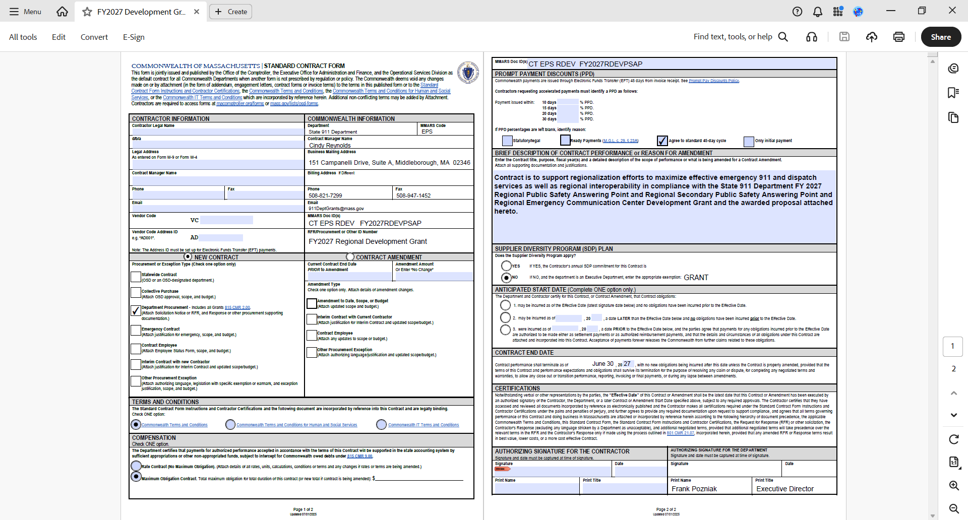
NEW STANDARD CONTRACT FORM NOW 2 PAGES

Slide 22
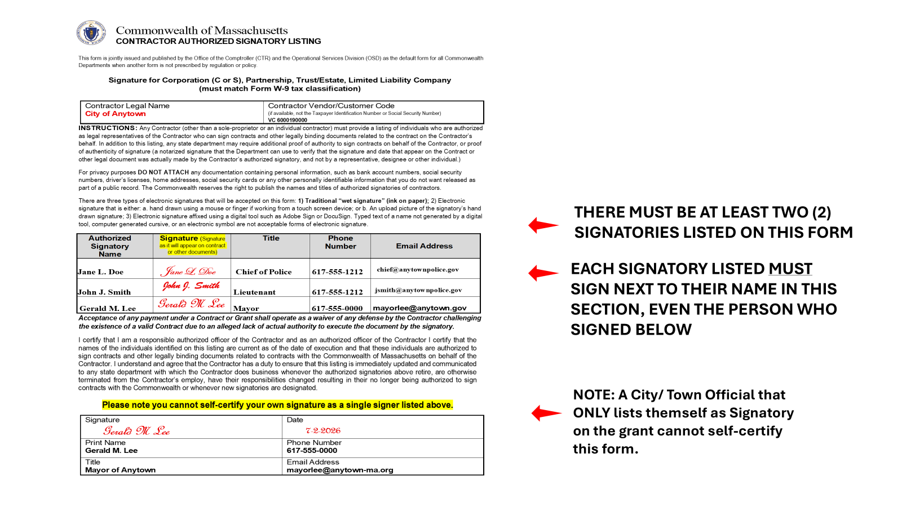

Slide 23
Overview of Form
Investment Summary
Communications Interoperability Problem
Background Information/Detailed Investment
Expected Outcomes
SCIP Goals
Ownership
Usage Plan
Disciplines
Multi-Jurisdictional Interoperability
Special Conditions
ICIP TEMPLATE

Slide 24
Interoperable Communications Investment Proposal (ICIP)
Please complete all sections except for SIEC Review Section.
The completed ICIP form must be emailed with your grant application to:
Agency Name
Email Address
For equipment purchases, a vendor price quote that includes the equipment make, model and specifications must be submitted with this form. Please identify the quote number(s) or other identification code(s) associated with this proposal in the requesting cell below so the correct quote is tied to the ICIP during review.
Community Name
Project Point of Contact
Phone # |  | Email
FFY / Program |  | Project Costs
Project Start Date |  | Project End Date
Investment Name
Vendor Quote #
Investment Summary (describe your project)
Communications Interoperability Problem Description
Background Information / Detailed Investment Description

Slide 25
Expected Outcomes- Describe the communications interoperability gaps that will be addressed
SCIP Goals- Identify each SCIP goal (check the box) that this investment will support and describe how that support will be accomplished. The current Massachuetts SCIP can be found here: www.mass.gov/doc/massachusetts-statewide-communication-interoperability-plan-scip-2020
Goal |  | Describe support
 | Governance
 | SOP
 | Technology
 | Training & Exercise
Ownership - Identify the proposed owners of all assets procured with this investment.
Organization |  |  | Asset Description
Usage Plan - Describe the usage plan for the equipment / project

Slide 26
Disciplines- Identify each responder discipline that will enhance its communications interoperability from this investment and describe the interoperability enhancement
Please use the following abbreviations to represent the corresponding discipline: LE - Law Enforcement; EMS - Emergency Medical Services; EMA - Emergency Management Agency; FS - Fire Service; HZ – HAZMAT; PW - Public Works; PH - Public Health; GA – Governmental Administrative; PSC - Public Safety Communications; HC - Health Care; O-Other
Discipline | Enhancement
Multi-Jurisdictional Interoperability - All investments must provide interoperability between two or more jurisdictions. Identify each jurisdiction that will achieve interoperability from this investment.
Following Section will be completed by SIEC:
REVIEW STATUS |  | APPROVE | AMEND | DENY
Statewide Interoperability Coordinator (SWIC) Recommendation
Executive Management Committee (EMC) Recommendation
Statewide Interoperability Executive Committee (SIEC) Recommendation
Applicant notified of Recommendation
SIEC Member Signature / Date
The attached Special Condition must be signed and submitted with your completed ICIP form. ICIP forms submitted without the signed Special Conditions will not be reviewed.

Slide 27
Applicants must include in their application (narrative and budget) the costs – that are allowable under the respective grant program - associated with meeting the following five (5) general requirements to contribute data to the applicable system or repository.
Assign internal resources and/or hire resources to develop, test, and implement the functional and technical requirements;
Procure the required software and hardware;
Conduct acceptance testing;
Sign-off on acceptance testing; and
Assign internal resources and/or hire resources to maintain the technical environment.
Contact the Executive Office of Technology Services and Security (EOTSS) if additional information is required.
National Information Exchange Model (NIEM) Conformance. Applicants applying for grant funds to develop new data exchanges must commit to developing these exchanges incorporating the NIEM data exchange standards. Applicants must include in the narrative of the grant application a description of how the project will achieve NIEM conformance. For additional information on NIEM, please visit www.niem.gov
Security Policies and Standards. Applicants will abide by any of the following policies and standards that apply to the project.
Commonwealth of Massachusetts Enterprise Information Security (EIS) Policy and Standards. State agencies or organizations under the Executive Branch must comply with the latest published EIS standards as applicable. These standards may be accessed at https://www.mass.gov/handbook/enterprise-information-security-policies-and-standards.
Commonwealth of Massachusetts Web Accessibility Standards. Grant applications that propose to implement Internet or Intranet based web-browser interfaces must conform to the Commonwealth’s Web Accessibility Standards. These standards may be accessed at https://www.mass.gov/guides/web-accessibility-standards.
Security Policies and Standards. If an information sharing or data exchange project proposes the
sharing or exchanging of Criminal Offender Record Information (CORI) data as defined in Massachusetts General Law Chapter 6 Section 168-172, the applicant and all participants within the project must ensure that all systems conform to the standards set forth in the current version of the FBI’s CJIS Security Policy.
c.
As the duly authorized representative of the applicant, I hereby certify that the applicant will comply with the above conditions.
Print Project Name
Authorized Signature |  | Date
Print Name
Print Title

Slide 28
Not Required For:
Batteries
Cameras – Unless the project included backhaul infrastructure to be used for information/data sharing
Computer Aided Dispatch (CAD)/Records Management System (RMS) Software
Computers, general purpose – Unless used for information/data sharing
GPS units
Microphones (including collar/throat microphones)
Multi-channel recorders
Netclocks
Warranties/Maintenance
Wireless air cards
Wireless IP routers
ICIP TEMPLATE

Slide 29
Bulletin #20-1 Public Safety Agency Encryption
Purchasing Guidelines
Minimum encryption type of AES-256
Prohibit use of CKR/SLN #’s 1 – 20
Support more than one encryption key
Each KID/LID should be a randomly generated hexadecimal code between 0001-FFFF or agency may choose to use the CKR/SLN #
Contact SWIC for CKR/SLN Assignments
Consider use of common encryption keys
Channel Programming
“Strapped” encrypted channels/zones recommended
Ensure LMR equipment has zones/banks that include/conform explicitly with MTCP
CKR/SLN and KID/LID Assignments

Slide 30
CoMIRS Radio Feature Requirements
Required
700/800 MHz Operation
Portable radio output power 1-3 watts
Mobile radio output power 10-35 watts
Minimum 1,000 mode capability
Minimum 14-character backlit display
Zone programming with 16 modes per zone
Operation on Convention Systems
Operation on Motorola SmartZone Type II Trunking Systems
Operation of Project 25 Digital Trunking Systems
Project 25 Radio Authentication
Base radio output power 10-35 watts
*As of May 1, 2021, all radios submitted for provisioning on CoMIRS must include the required features noted here.

Slide 32
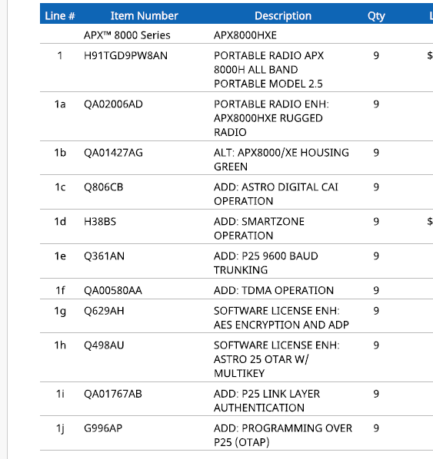

Sample Vendor Breakdown “Vendor Quote”
*Not an endorsement or product recommendation. Demonstration purposes only.

Slide 33
ICIP Template
  https://www.mass.gov/doc/icip-form-with-conditions/download?_ga=2.217334166.1288377473.1607959209-1195923342.1562698534
Statewide Communications Interoperability Plan
  http://www.mass.gov/doc/massachusetts-statewide-communication-interoperability-plan-scip-2020
Meet Applicable SAFECOM P25 Guidance
  https://www.cisa.gov/publication/emergency-communications-grant-guidance-documents
RESOURCES FOR RADIO PROJECTS

Slide 34
Additional Guidance on Encryption: Guidance Bulletin 20-1
  https://www.mass.gov/doc/public-safety-encryption-guidance-bulletin
  Best Practice Guidelines
  https://www.mass.gov/doc/interoperable-emergency-communications-best-practices-guidance-bulletin-22-1/download
Subscriber Units must be programmed with the Massachusetts Tactical Channel Plan (MTCP) (This document is for public safety official use only. Email MA.SWIC@Mass.gov for a copy.)
Statewide Contract PSE01 was awarded on 1/1/2022 and covers radios and radio systems.
RESOURCES FOR RADIO PROJECTS

Slide 35
COMMBUYS
Information Needed for Registration
Tax ID
Address
E-mail
Phone Number
Business Structure
Business Type (Non-Profit/ For Profit)
UNSPSCs: *00-00-00 (commodity code used for grants)
Vendor Registration takes about 10 minutes.

Slide 36
OSD’s Best Practices
Best Practices
Read posting in its entirety; including all attachments
Create a Bid Specific Folder
Follow instructions included in the RFR
Review All Documents before uploading
Know the Bid Opening Date (submission deadline)

Slide 37
OSD Resources & Contacts
Training
Email: osdtraining@mass.gov
Job Aids
Website: mass.gov/vendor training
How to Create a Quote in COMMBUYS
Using the Q&A Tab Within a COMMBUYS Bid
How to Withdraw, Reopen, and Resubmit a Quote
Basic COMMBUYS Navigation and Searching for the Seller Role
How to Create a Quote in COMMBUYS
Webcast – Video
Webinars – Live Training
How to Locate & Respond to Bids in COMMBUYS
COMMBUYS Essentials for the Seller Role
Operational Services Division
617-720-3300
www.mass.gov/osd

Slide 38
Examples of Non-Eligible Expenses
Contingencies/Escalation Fees
Legal Fees
Operational costs
Monthly recurring fees
Maintenance/Warranty Costs/Annual Subscriptions/Service Plans, except noted in Category J: Ancillary Expenses and tied to Equipment requested in Category G of current application
Community Notification System
Personnel training costs for existing centers
Microsoft Office Suite
MDT Law Enforcement Scanners, Mobile Printers, Thermal Cameras
Travel Expenses, Mileage Stipend for Directors
Allowances (including Site Work Allowances)
Owner’s indirect costs
Payments not tied to deliverables (e.g., payment due at contract signing; progress billing)
Salary does not include lump sum payments, stipends, buy-outs, extended leave, jury duty, active duty, or attendance at conferences/ meetings/ trainings

Slide 39
Post Award Considerations
Ensure all award requirements are met prior to incurring costs. Costs incurred prior to contract start date are not eligible
Ensure contract(s) structure aligns with grant structure to avoid delay in reimbursement
Ensure goods and services being purchased, including quantities, align with grant award
Reimbursement versus Disbursement
Deliverables/commodities/services align with executed contracts with vendors/contractors
Notification to 911 of project meetings
Notification of additional grant awards that provide funding to the overall project
File Quarterly Reports on Time
Align funding for approved projects requiring ICIP, noted at time of ICIP approval. Do not move forward until ICIP approved

Slide 40
Resources
Located on our website: www.mass.gov\e911
  Development Grant guidelines and reimbursement forms
  Development Grant application
  State 911 Department Regional Development Grant Guidance PowerPoint presentation

Slide 41
Contact Information
STATE 911 DEPARTMENT
151 CAMPANELLI DRIVE, SUITE A
MIDDLEBOROUGH, MA 02346
508-828-2911
www.mass.gov/e911
Angela Pilling, Grant Manager 508-821-7305 / Angela.Pilling@mass.gov
Cindy Reynolds, Grants Specialist 508-821-7299 / 911DeptGrants@mass.gov
Karen Robitaille, Finance Director 508-821-7221 / Karen.Robitaille@mass.gov
Janelle Menard, Fiscal Specialist 508-821-7267 / Janelle.L.Menard@mass.gov
Richard Fiske, Director of Public Safety Communications & Interoperability
Statewide Interoperability Coordinator (SWIC) 617-620-3607 / Richard.Fiske@mass.gov
Peter Woodford, Division of Capital Asset Management & Maintenance 857-204-1347/ Peter.Woodford@mass.gov
COMMBUYS Helpdesk: 1-888-627-8283 / OSDHELPDESK@mass.gov

