Slide 1
Regional Planning in Massachusetts An Initiative of the Workforce Skills Cabinet
Attachment C

Slide 2
Executive Summary
The regional planning process, an initiative of the Workforce Skills Cabinet, will bring together regional partners in…
…in order to collectively determine high priority regional career pathways and craft collaborative solutions to meet the Commonwealth’s jobseeker and employer needs.
Education
Community Colleges, Voc-Tech, State Universities
Economic Development
MOBD Offices,
REDO, RPA
Workforce
Workforce Development Boards

Slide 3
Background
Created by Executive Order No. 560, the Workforce Skills Cabinet brings together the Secretaries of Education, Labor and Workforce Development, and Housing and Economic Development.
The WSC is tasked with building collaborative solutions and aligning economic, workforce and education systems in Massachusetts with the skill needs of regional economies.

Slide 4
Status Quo
EOLWD
WDBs
EOHED
MOBD
REDO
RPA
EOE
Community Colleges
State Universities
Voc-Techs

Slide 5
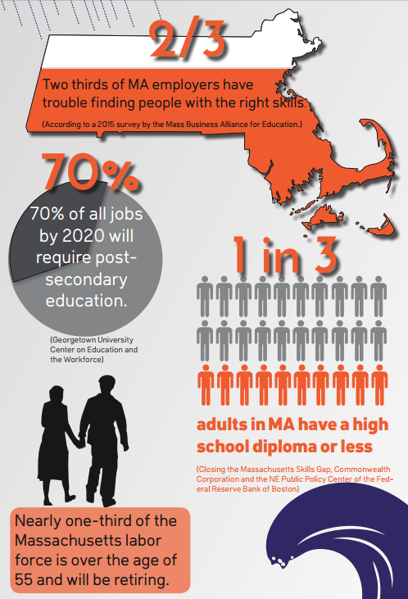
Impact Model
TEAMS IDENTIFY:
-- Employer demand / LMI trends
-- High-job growth industries/ occupations
-- Gaps between “demand” and “supply (regional blue prints)
TEAMS ALIGN:
-- Strategies & action steps
-- Resources (federal and state fund)
-- Outcomes of “supply side” programs to meet demand (curriculum, seat capacity at community college, voc tech, OSCC etc.)
TEAM IMPACTS:
Employment
Business Hiring & Expansion
Economic
growth
TEAM OUTCOMES:
-- More graduates with in-demand skills
-- Employers find workers
-- Individuals get jobs, advance career ladders
WSC REGIONAL TEAMS Business, Education, Workforce Systems
Challenges
WSC Process/Outcomes
Intended Results

Slide 6
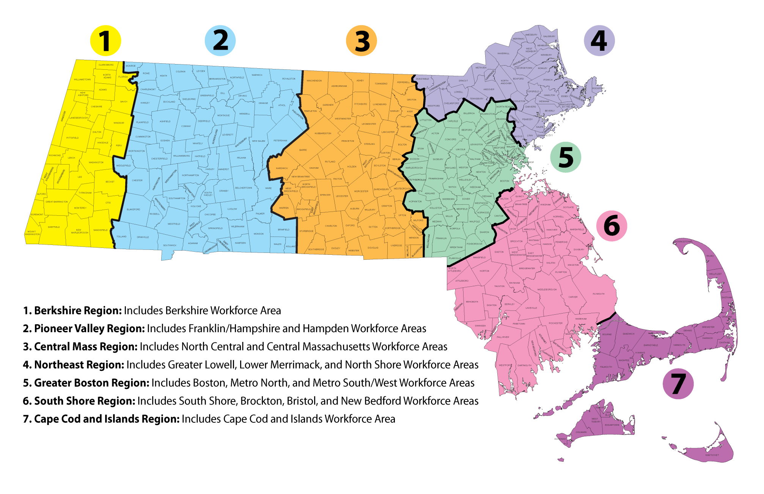
WSC Regions

Slide 7
Outcome Breakdown
Current Regional Environment | Expected Regional Planning Outcome
No mechanism to convene systems. No process exists to bring together Workforce, Education, Economic organizations. 16 Workforce Development Boards MOBD and REDO organization regions (not aligned with Boards) No existing convening mechanism to convene P-16 education partners in a region (technical education, community college, 4 years, funded programs). | Seven multi-system regional WSC teams. Teams are established via a joint policy communication from EOLWD, EOE, EOHED and represent workforce, economic development, and education partners.
Lack of alignment and consensus across systems on key trends / talent demand. Each system conducts labor market analysis in a silo, without influence over multiple systems. | Collectively driven: Review of standardized, consistent labor market information highlighting regional talent needs. SWOT analysis of the labor market trends. Confirm high priority list of career pathways for the region. Labor market blueprint for the region.
Lack of collective accountability across systems for producing a pipeline of skilled and credentialed workers. | Collectively formulated goals and collective accountability to meet talent needs in priority career pathways. Goals are quantified and shared across sectors.
Lack of consistent, aligned process through which state, regional and local actors can prioritize investments and planning across systems. Each system receives information only from its own regional representatives. | WSC Regional Teams utilize priority list of career pathways to: Pursue federal, state, and private funding opportunities (All) Develop sector partnerships and expanded education and training (All) Set curriculum and seat capacity within education systems, and connect to job training (Ed) Outreach to business to work with One Stop Career Centers to develop new referrals for hiring candidates (EconDev, Workforce) Coordinate additional programs and resources State Workforce Skills Cabinet uses regional blueprint developed by WSC Regional Leadership teams to inform funding decisions at a state level and apply for federal grant resources.

Slide 8
Outcomes - Continued
Labor market blueprints and priority career pathways developed by regional planning teams will inform, at a minimum…
EOLWD | Workforce Competitiveness Trust Fund/Economic Opportunity Fund Workforce Training Fund WDB Required Regional Planning
EOHED | Urban Agenda Grant Program Manufacturing Training Program Workforce Housing Proposals
EOE | Capital Skills Grants Chapter 74/Perkins Approval Capital Planning STEM Pipeline Programs College and Career Pathways

Slide 9
Regional WSC Leadership Teams
Education
Community Colleges, Voc-Tech, State Universities
Economic Development
MOBD Offices,
REDO, RPA
Workforce
Workforce Development Boards
Teams range from 5-20 in size
Teams are convened by Workforce Development Boards
Representation on the Teams includes the leadership (President, Director etc) from Education (Voc Tech, 2YR, 4YR), Economic Development (MOBD, REDO, RPA), and Workforce Board

Slide 10
Composition of Regional Teams – Organizational Leads, Workforce Development
Region | WDBs | State WDB Representation
Berkshire | Berkshire WDB | Beth Mitchell, General Dynamics Mission Systems Optional: Gerard Burke, Hillcrest Educational Centers, Inc.
Pioneer Valley | Franklin Hampshire WDB Hampden County WBD | Joanne Berwald, Mestek, Inc. Tricia Canavan, United Personnel Services Eric Hagopian, Massachusetts Center for Advanced Design and Manufacturing Optional: Joseph Wagner, Legislature
Central Mass | North Central WDB Central MA WDB | Sue Mailman, Coghlin Electrical Contractors Optional: Eileen Donoghue, Legislature
Northeast Region | Lowell WBD North Shore WDB Merrimack Valley WDB | Ray Wrobel, Align Credit Union Optional: Kim Driscoll, City of Salem Optional: Dan Rivera, City of Lawrence
Greater Boston | Metro North WDB Metro Southwest WDB Boston Private Industry Council WDB | Driscoll DoCanto, Merill Lynch Joanne Pokaski, Beth Israel Deaconess Medical Center Beth Williams, Roxbury Technology Corporation Sherry Dong, Tufts Medical Center Optional: Pam Eddinger, Bunker Hill CC Optional: Carol Grady, JVS Optional: Cassius Johnson, Year Up
South Shore | South Shore WDB Brockton WDB Bristol WDB New Bedford WDB | Anne Broholm, Ahead LLC Juliette Mayers, Inspiration Zone LLC Jesse Brown, Heidrea Communications
Cape Cod and the Islands | Cape Cod WDB | Kristin Broadley, Centerville Pie Co., Inc.
TBD, works statewide:
Donna Cupelo, Verizon
James Cassetta, WORK, Inc.
Kathy Cullen-Cote, PTC
Aixa Beauchamp, Beauchamp and Associates
Assigned statewide, optional attendance:
John Mann, NAGE Unit One
Warren Pepicelli, New England Joint Board / Unite Here
Elizabeth Skidmore, Carpenters Union

Slide 11
Composition of Regional Teams – Organizational Leads, Economic Development
Region | MOBD Office | RPA | REDO
Berkshire | Western Region | Berkshire Regional Planning Commission | 1Berkshire Strategic Alliance
Pioneer Valley | Western Region | Franklin Regional Council of Governments Pioneer Valley Planning Commission | Economic Development Council of Western Mass
Central Mass | Central MA Region | Montachusett Regional Planning Commission Central Mass Regional Planning Commission | Central Regional EDA Partnership North Central Mass Development Corporation
Northeast Region | Northeast Region MetroWest & Merrimack Valley Region | Northeast Middlesex Council of Governments Merrimack Valley Planning Commission | North Shore Alliance for Economic Development
Greater Boston | Greater Boston Region | Metropolitan Area Planning Council | 495 MetroWest Partnership
South Shore | Southeast Region | Old Colony Planning Council Southeastern Regional Planning and Economic Development District | Metro South Chamber of Commerce South Coast Development Partnership
Cape Cod and the Islands | Southeast Region | Cape Cod Commission Martha’s Vineyard Commission Nantucket Planning and Economic Development Commission | Cape Cod EDC Partnership

Slide 12
Composition of Regional Teams – Organizational Leads, Education
In progress: Each region will nominate and the identify four participants (state university, community college, vocational school, district superintendent)

Slide 13
Participant Roles
Partner Roles | WDBs | MOBD Office and REDO | Community College | State Universities | Career Techs
Bring resources to the table to support WSC Leadership Team | √ | √ | √ | √ | √
Analyze labor market data and business and community feedback to build consensus on priority regional career pathways | √ | √ | √ | √ | √
Bring industry voice and needs to dialogue | √ | √
Identify existing education and training capacity for high demand career pathways for region | √ |  | √ | √ | √
Utilize high demand career pathways priorities for region to:
Collaboratively develop partnerships to support expanded education and training | √ | √ | √ | √ | √
Prioritize grant requests | √ | √ | √ | √ | √
Develop curriculum and credentialing pathways |  |  | √ | √ | √
Outreach to business to provide input on voc-tech and community college curriculum | √ | √ | √ |  | √
Outreach to business to work with One Stop Career Centers to develop new referrals for hiring candidates | √ | √

Slide 14
Regional WSC Teams Timeline
Month | Event | Purpose | Who
March 2017 | WSC State Leaders Kick-Off Event | Provide state and regional leaders with overview of regional planning process and goals | State organizes, regional partners attend
April 2017 | Face-to-Face Regional Sessions (1 per seven regions) | Convene WSC Regional Teams to review LMI and form consensus agenda on priority skill needs and industry/occupational growth in region, create initial Supply and Demand Blueprint | WDBs organize in regions, regional WSC teams attend, State/consultant supports with LMI
May – July 2017 | N/A | Gather input from regional business partners via state developed survey tool | MOBD develops, regional teams customize/implement
Aug – Oct 2017 | Regional Meetings (3 per seven regions) | Review survey results, finalize/update supply and demand blueprints, discuss and provide feedback on regional implementation of Blueprint | Workforce Development Boards organize, regional WSC teams attend
Nov 2017 | N/A | Submit regional blueprint to the State; State compiles state-wide Blueprint | WDBs, with input from regional WSC teams
 | Annual Review | Evaluate last year’s planning process and performance | WDBs organize, regional WSC teams attend

Slide 15
Regional WSC Teams – Process Summary
1 State-level kick-off event
Regional planning events convened by WDBs (within 7 regions)
1st planning event is supported by State/consultants
Business survey for feedback
Deliverable: Regional Supply and Demand Blueprint for Action
Priority career pathways and occupations
Strategies / Action steps to address talent gaps
Blueprints will be used to align regional and state activities for NSFY, grant-making (e.g. Capital Skills Grant Program and WCTF), economic development regional activities, WIOA, and more.

Slide 16
WSC State & Regional Planning Phases
Secretariat State Plan Alignment |  |  |  |  |  |  |  | WSC Regional Teams (LMI, Planning, Blue Prints)
Jan-16 | Mar-16 | May - August 2016 | Sep-16 |  | Oct-16 | Nov-16 | Dec-16 | March-17 | April-17 | May-17 | Jun-17 | July-17 | Aug-17 | Sept-Jul | Oct-17 | Nov-17
Creation of (7) Regional Skill Gap Analyses
Opportunities for All (Econ State Plan) |  |  |  |  | Economic Development Summit (Regional Planning Messaging) |  |  | WSC Statewide Kick Off Event for Regional Planning | WSC Team Regional Sessions | Direct Survey of Business / Analysis |  |  | Prioritization of Regional High Demand Career Pathways/ Strategies to Reduce Talent Gaps |  |  | Final WSC Regional Blue Print (Priority Career Pathways and Action Plan)
 | WIOA State Plan Submitted (Workforce State Plan) |  |  | Final WIOA State Plan Approved (regional planning included) |  | WIOA Conference (Regional Planning Messaging)
 |  | EOE Capital Planning Process |  |  |  | Regional Events for Capital Planning Process (WSC Regional Planning Messaging)
Align Award and Investment of Federal / State Resources with Regional Blue Prints

Slide 17
Questions and Discussion

