Slide 1
Reporting Year 2024
TURA Information Release
Lillian Zemba
MassDEP
Notes:
1

Slide 2
Accessibility
2024 Information release has been updated to meet new accessibility requirements.
This means that some data is presented in a new format.

Slide 3
Reporting Year 2024
2007 Core Group Progress
Production Adjusted Total Use--71% reduction
Notes:
3

Slide 4
Reporting Year 2024
2007 Core Group Progress
Production Adjusted Byproduct--59% reduction
Notes:
4

Slide 5
Reporting Year 2024
2007 Core Group Progress
Production Adjusted On-site Releases--84% reduction
Notes:
5

Slide 6
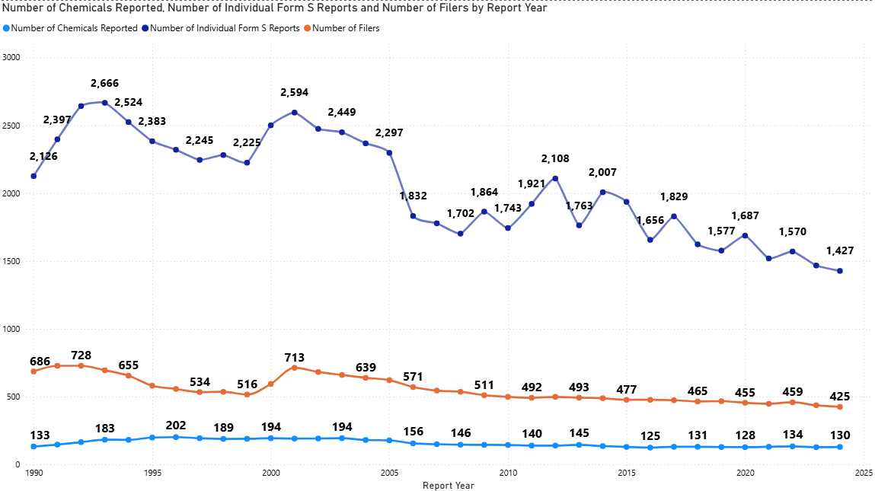
Reporting Year 2024
Toxics Use Reduction Information Release
Filer Trends
Notes:
6

Slide 7
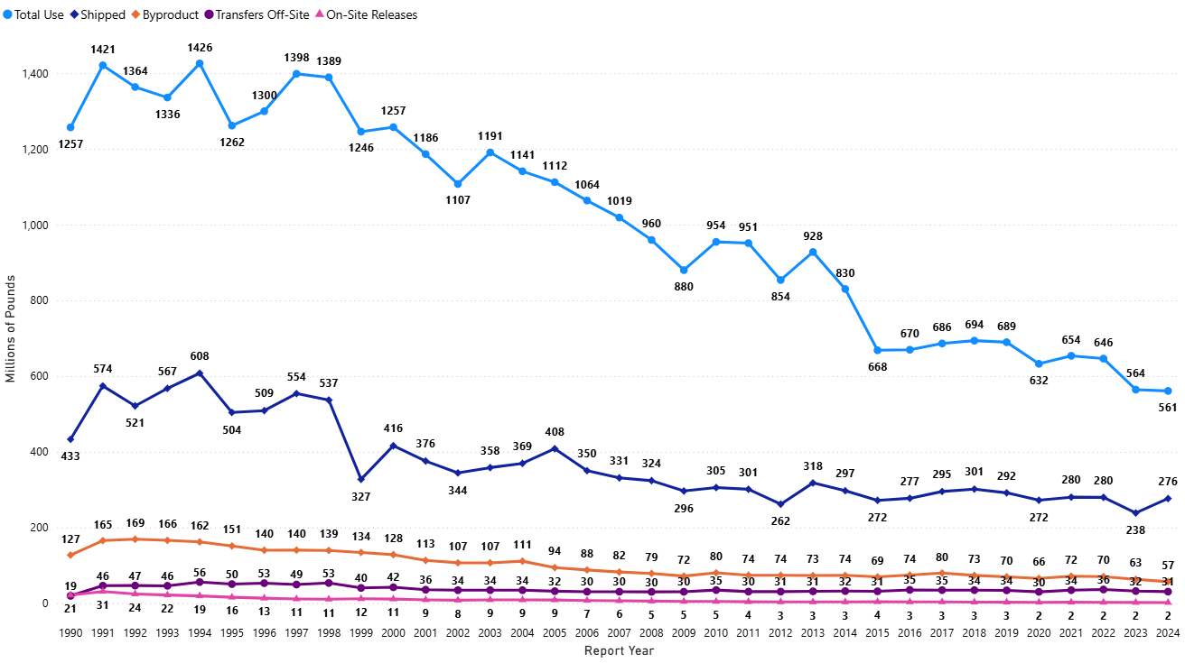
Reporting Year 2024
Raw Reported Data
Notes:
7

Slide 8
2024 Number of Facilities by Industrial Sector
Total Number of Facilities = 425 (Includes Trade Secret Data)
Sector | Percent of Total
Chemical Manufacturing | 19.3%
Fabricated Metal Product Manufacturing | 13.9%
Nonmetallic Mineral Product Manufacturing | 9.9%
Computer/Electronic Product Manufacturing | 6.1%
Paper Manufacturing | 6.1%
Food Manufacturing | 5.2%
Utilities | 4.2%
Electrical Equipment Manufacturing | 4.0%
Miscellaneous Manufacturing | 4.0%
Personal and Laundry Services | 3.8%
Plastics and Rubber Products Manufacturing | 3.3%
Chemical Distributors | 2.8%
Primary Metal Manufacturing | 2.8%
Textile Mills | 2.8%
Machinery Manufacturing | 2.1%
Petroleum and Coal Products Manufacturing | 2.1%
Waste Management and Remediation Services | 2.1%
Beverage and Tobacco Product Manufacturing | 1.4%
Transportation Equipment Manufacturing | 1.2%
Other | 2.8%
Notes:
8

Slide 9
Reporting Year 2024
Toxics Use Reduction Information Release
The complete Information Release can be viewed online on the MassDEP TURA Data and Results Webpage.
Notes:
9

