Slide 1
Rest Home Task Force
Bureau of Health Care Safety & Quality
Judy Bernice MBA, FACHE, Licensure Unit Manager
Katherine C. Saunders, MS, Director, Division of Quality Improvement
January 10, 2025
1

Slide 2
Rest Home Licensing, Reporting Structure, and Existing Data
Section 27 of Chapter 197 of the Acts of 2024 requires the Rest Home Task Force to examine the following:
the licensing, regulatory and reporting structure for rest homes;
an inventory of licensed rest homes and licensed rest home beds;
the location and service areas of existing rest homes;
a review of rest home closures since 2015

Slide 3
Facilities applicable to the Rest Home Task Force
Rest Home
A facility that provides Level IV care in a supervised supportive and protective living environment and support services incident to old age for residents having difficulty in caring for themselves and who are ambulatory and do not require Level II or III nursing care or other medically related services on a routine basis.
Resident Care Facilities
A unit within a Long-Term Care Facility that provides Level IV care in a supervised supportive and protective living environment and support services incident to old age for residents having difficulty in caring for themselves and who are ambulatory and do not require Level II or III nursing care or other medically related services on a routine basis.

Slide 4
The licensing structure for the operation of Level IV (Rest Home) Long Term Care Facilities
Licensing of Level IV (Rest Homes) Long Term Care Facilities
Initial licensure and any renovations afterwards requires Plan Review for Health Care Facilities | Mass.gov.
Plan Review includes the architectural review of the physical plant to determine compliance with F.G.I. Guidelines.
Initial licensure/Change of Ownership (CHOW) requires Health care facility initial licensure and change of ownership | Mass.gov as a long-term care facility for the provision of Level IV services.
This includes an initial licensure application, suitability (the review of information to determine acceptable or right for ownership), and CORI checks, along with other application documentation such as local municipality approval, and a fee.
For a brand-new rest home, Determination of Need approval may also be required, which supports the development of innovative health delivery methods and population health strategies within the health care delivery system; and to ensure that resources will be made reasonably and equitably
Licensure renewal is required every two years. A renewal application will be mailed to the facility approximately 90 days prior to expiration, along with a letter detailing the required documentation for submitting the application.

Slide 5
The regulatory requirements for the operation of Level IV (Rest Home) Long Term Care Facilities
Regulatory requirements for the operation of Level IV Long Term Care Facilities
105 CMR 150.00: Standards for long-term care facilities | Mass.gov
105 CMR 153.00: Licensure procedure and suitability requirements for long-term care facilities | Mass.gov
105 CMR 155.00: Patient and resident abuse prevention, reporting, investigation, penalties and registry | Mass.gov

Slide 6
The reporting structures for the operations of Level IV (Rest Home) Long Term Care Facilities
The Health Care Facility Reporting System (HCFRS) is a web-based system that health care facilities must use to report incidents and allegations of abuse, neglect, and misappropriation. How to set up initial access to the HCFRS | Mass.gov
Complaint Unit: File a complaint regarding a nursing home or other health care facility | Mass.gov
Complaints can be submitted by printing and completing the Consumer/Resident/Patient Complaint Form and faxing the completed form to (617) 753-8165 or mailing it to 67 Forest Street, Marlborough, MA 01752
Massachusetts rest homes must annually report aggregate HCP COVID-19 and influenza data through Virtual Gateway’s Health Care Facility Reporting System (HCFRS). Health Care Personnel COVID & Influenza Vaccination References and Resources | Mass.gov

Slide 7
Inventory of Licensed Rest Homes and Licensed Rest Home Beds
Number of RHs and total bed counts by year​
There are currently 58 DPH-licensed RHs , 16 (22%) have closed since 2015 (16 out of 74) ​
Currently we have a total of 2,002 beds in DPH-licensed RHs, reduced from 2,404 beds since 2015, 17% reduction​
Year​ | # RHs ​ | Total beds​ | #closures​
2015​ | 74​ | 2,404 ​ | 1​
2016​ | 73​ | 2,378 ​ | 5​
2017​ | 68​ | 2,266 ​ | 1​
2018​ | 67​ | 2,250 ​ | 1​
2019​ | 66​ | 2,214 ​ | 3​
2020​ | 63​ | 2,144 ​ | 1​
2021​ | 62​ | 2,104 ​ | 2​
2022​ | 60​ | 2,066 ​ | 2​
2023​ | 58​ | 2,022 ​ | 0​
2024​ | 58​ | 2,002 ​ | 0​

Slide 8
Service Area Definition, as Operationalized for this Analysis
Typically, the term "service area," when used in the context of the health care system, is defined by the home address of a patient panel for a given health care facility or service or based on the hospital location where a patient is treated.
By definition, a rest home is the home address for its residents, therefore, this definition cannot be applied to a panel of patients or residents occupying a rest home. DPH does not have or collect home addresses for residents prior to their admission to a rest home.
Moreover, selection of a rest home location may be influenced by the home address of family members rather than the prior address of the resident.
Therefore, for the purposes of this analysis we have applied the EOHHS regional definitions (N = 6) as a proxy for Rest Home Service Area.

Slide 9
The Location of Existing Rest Homes
58 currently DPH-licensed RHs
Boston = 7
Central = 14
Metro West = 7
Northeast = 11
Southeast = 11
Western = 8

Slide 10
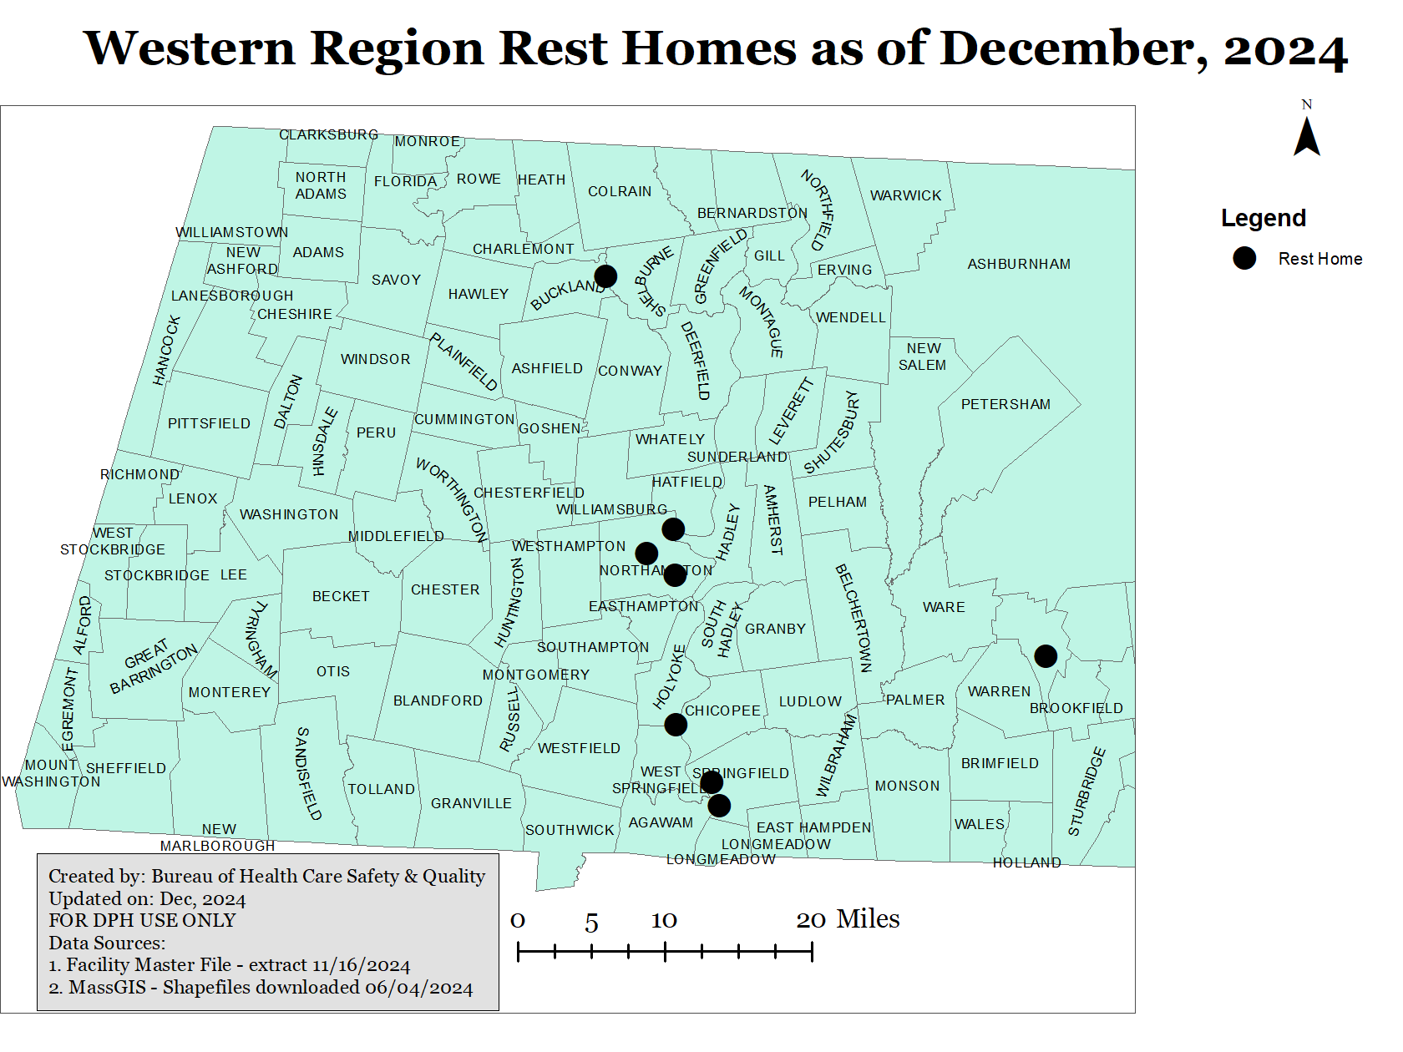
Rest Home Name | City
BEAVEN KELLY HOME | HOLYOKE
LATHROP HOME | NORTHAMPTON
ELLEN RICE REST HOME, INC. | SPRINGFIELD
ST LUKE'S HOME | SPRINGFIELD
ROCKRIDGE AT LAUREL PARK | NORTHAMPTON
LABELLES REST HOME | SHELBURNE
RIVER VALLEY REST HOME | FLORENCE
APPLEWOOD HOME FOR ELDERS | ATHOL

Slide 11
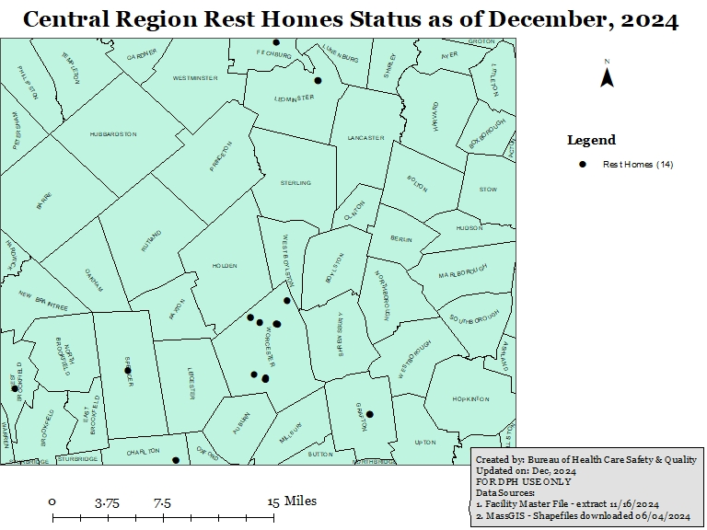
Rest Home Name | City
CHARLTON MANOR REST HOME | CHARLTON
VILLAGE REST HOME | LEOMINSTER
BROOKHAVEN ASSISTED CARE | WEST BROOKFIELD
PLEASANT ACRES ASSISTED CARE, LLC | WORCESTER
DALTON REST HOME | WORCESTER
HOMESTEAD HALL | WORCESTER
DODGE PARK REST HOME | WORCESTER
WINTER HILL REST HOME | WORCESTER
DONNA KAY REST HOME | WORCESTER
PENNY LANE ASSISTED CARE | FITCHBURG
LINCOLN HILL MANOR | SPENCER
CRESCENT MANOR ASSISTED CARE, LLC. | GRAFTON
THE OASIS AT DODGE PARK | WORCESTER
The WILLOWS AT WORCESTER | WORCESTER

Slide 12
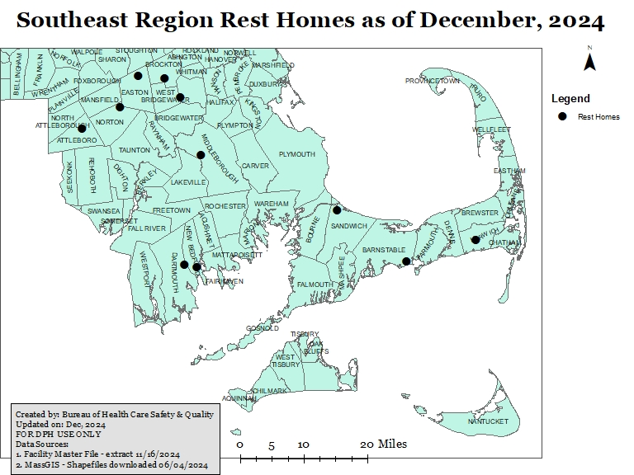
Rest Home Name | City
PLEASANT STREET ASSISTED CARE | ATTLEBORO
VILLAGE REST HOME II OF BROCKTON | BROCKTON
WESTVIEW REST HOME | EAST BRIDGEWATER
ROSEWOOD MANOR REST HOME | HARWICH
HAVENWOOD ASSISTED CARE LLC | NEW BEDFORD
DAGGETT-CRANDALL-NEWCOMB HOME | NORTON
VILLAGE REST HOME | EASTON
DARTMOUTH MANOR REST HOME | NORTH DARTMOUTH
SERENITY REST HOME LLC | MIDDLEBORO
CAPE WINDS REST HOME OF SANDWICH | SANDWICH
CAPE WINDS REST HOME OF HYANNIS | HYANNIS

Slide 13
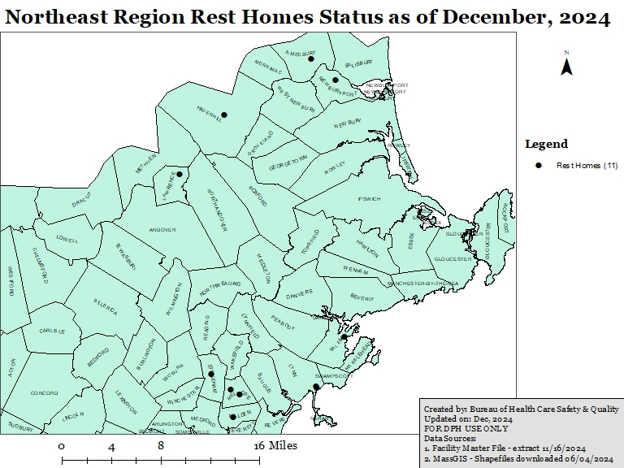
Rest Home Name | City
IVY HILL ASSISTED CARE, LLC | HAVERHILL
THE GERMAN HOME | LAWRENCE
LYNN HOME FOR ELDERLY PERSONS | LYNN
DAVENPORT MEMORIAL HOME | MALDEN
OOSTERMAN'S REST HOME | MELROSE
NEWBURYPORT SOCIETY OF AGED MEN | NEWBURYPORT
BROOKHOUSE HOME FOR AGED WOMEN IN SALEM | SALEM
FULLER HOUSE OF STONEHAM REST HOME | STONEHAM
LYNN SHORE REST HOME | LYNN
THE FITCH HOME, INC. | MELROSE
HILLSIDE REST HOME | AMESBURY

Slide 14
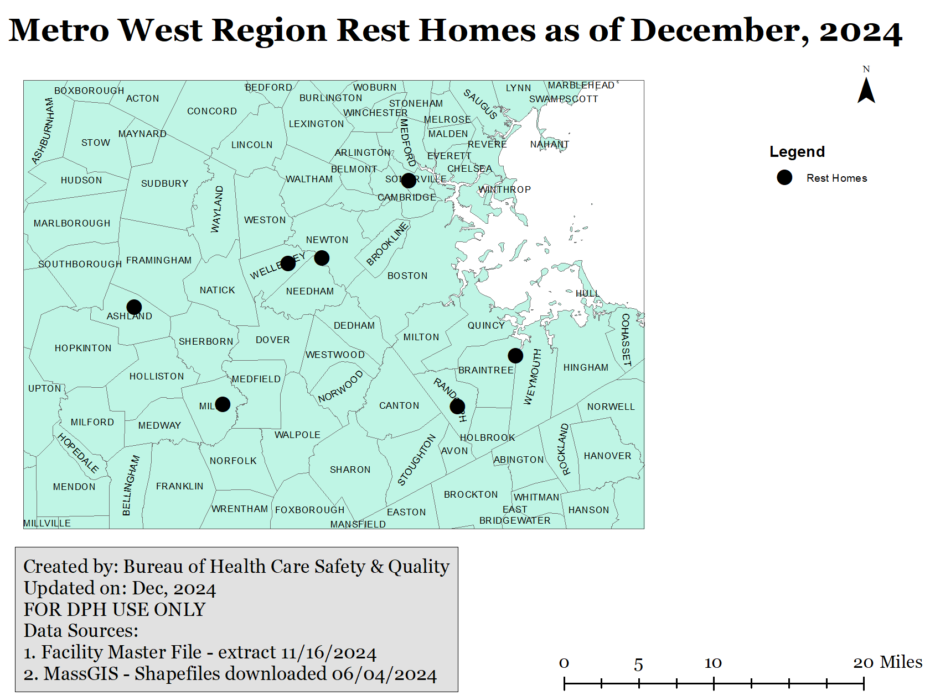
Rest Home Name | City
MILL POND ASSISTED CARE LLC | ASHLAND
WILLOWBROOK MANOR REST HOME | MILLIS
PETTEE HOUSE | NEWTON UPPER FALLS
SETH MANN 2ND HME FOR AGED/INFI WOM | RANDOLPH
ELIZABETH CATHERINE REST HOME LLC | WEYMOUTH
vna senior living - Highland Avenue Campus | SOMERVILLE
MARILLAC RESIDENCE | WELLESLEY HILLS

Slide 15
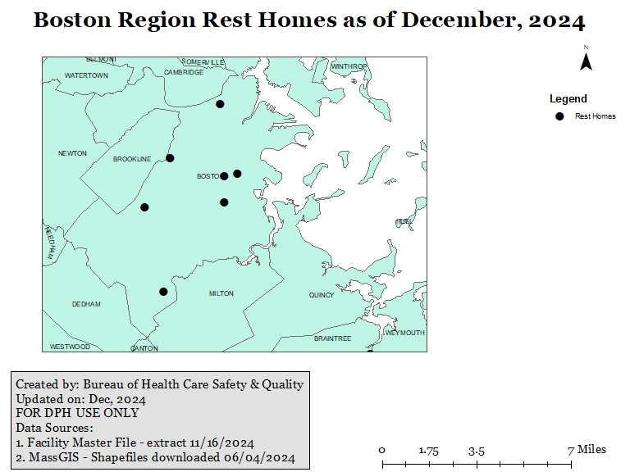
Rest Home Name | City
ANN'S REST HOME | BOSTON
BURGOYNE REST HOME | DORCHESTER
MT PLEASANT HOME | BOSTON
HALE HOUSE | BOSTON
SOPHIA SNOW HOUSE | WEST ROXBURY
FAIRMOUNT REST HOME, INC. | BOSTON
CUSHING MANOR HOME, INC | BOSTON

Slide 16
The Location of Existing Rest Homes and Bed Counts
EOHHS ​REGION | # Open RHs​ | Total Beds​
Boston ​ | 7​ | 248​
Central ​ | 14​ | 530​
Metro West ​ | 7​ | 278​
Northeast ​ | 11​ | 287​
Southeast ​ | 11​ | 320​
Western ​ | 8​ | 339​
Total​ | 58​ | 2,002 ​

Slide 17
The Location of Existing Level IV Beds within a Nursing Home
NURSING HOME NAME | TOWN | REGION
OVERLOOK MASONIC HEALTH CENTER | CHARLTON | Central
LUTHERAN REHABILITATION AND SKILLED CARE CENTER | WORCESTER | Central
CARLETON-WILLARD VILLAGE RETIREMENT & NURSING CTR | BEDFORD | Metro West
ALLIANCE HEALTH AT DOOLITTLE | FOXBOROUGH | Metro West
BETHANY SKILLED NURSING FACILITY | FRAMINGHAM | Metro West
LINDEN PONDS | HINGHAM | Metro West
ALLIANCE HEALTH AT MARIE ESTHER | MARLBOROUGH | Metro West
CAMPION HEALTH & WELLNESS, INC | WESTON | Metro West
POND HOME | WRENTHAM | Metro West
NEW ENGLAND HOMES FOR THE DEAF, INC | DANVERS | Northeast
LAKEVIEW HOUSE SKLD NRSG AND RESIDENTIAL CARE FAC | HAVERHILL | Northeast
THE BERKELEY RETIREMENT HOME | LAWRENCE | Northeast
CONTINUING CARE AT BROOKSBY VILLAGE | PEABODY | Northeast
ROYAL MEGANSETT NURSING & REHABILITATION | FALMOUTH | Southeast
HANNAH B G SHAW HOME | MIDDLEBOROUGH | Southeast
WINDEMERE NURSING & REHABILITATION CENTER | OAK BLUFFS | Southeast

Slide 18
The Location of Existing Level IV beds within a Nursing Home
EOHHS REGION | # NHs with L4 Beds​ | Total beds​
Western | 0 | 0
Central ​ | 2​ | 85​
Southeast | 3 | 72
Northeast ​ | 4​ | 185​
Metro West ​ | 7​ | 282​
Boston | 0 | 0
Total​ | 16​ | 624​

Slide 19
Closures of Level IV beds within Nursing Homes 2015-2024
EOHHS Region | NH w/ L4 beds Closures​ | Total beds​
Boston ​ | 1​ | 23​
Southeast ​ | 1​ | 35​
Total | 2 | 58

Slide 20
A Review of Rest Home Closures Since 2015
EOHHS Region | Rest Home Name | City | Closure
Central | WESTBROOK HEIGHTS REST HOME | WEST BROOKFIELD | 2015
Central | PRESENTATION HEALTH CARE CENTER INC | LEOMINSTER | 2016
Central | ST JOSEPHS ABBEY RESIDENT CARE FACI | SPENCER | 2016
Central | BURNCOAT PLAINS REST HOME | WORCESTER | 2019
Central | CALDWELL HOME - EXTENDED CARE | FITCHBURG | 2022
Metro West | GOOD SHEPHERD CENTER | MARLBOROUGH | 2016
Metro West | ST CHRETIENNE RETIREMENT RESIDENCE | MARLBOROUGH | 2016
Metro West | TIDD HOME | WOBURN | 2017
Metro West | WHITTAKER REST HOME | SOUTH WEYMOUTH | 2018
Metro West | THE LELAND HOME | WALTHAM | 2020
Metro West | MT IDA REST HOME, INC. | NEWTON | 2021
Northeast | ST JULIE BILLIART RESID CARE CTR | IPSWICH | 2016
Northeast | OOSTERMAN'S REST HOME, INC. | WAKEFIELD | 2019
Northeast | HALCYON HOUSE | METHUEN | 2021
Southeast | TIFFANY II REST & RETIREMENT HOME | ROCKLAND | 2019
Southeast | THE CHILTON HOUSE REST HOME | PLYMOUTH | 2022

Slide 21
A Review of Rest Home Closures Since 2015
EOHHS ​ | # of RH Closures​ | Total Beds​
Central ​ | 5​ | 112​
Metro West ​ | 6​ | 145​
Northeast ​ | 3​ | 93​
Southeast ​ | 2​ | 52​
TOTAL​ | 16​ | 402​
A total of 16 RHs have closed (402 beds)
11 closed between 2015-2019 and ​
5 closed between 2020-2022 ​
No closures observed in 2023 & 2024​

Slide 22
