Slide 1
Massachusetts
Rest Home Task Force
Established by Section 27 of Chapter 197 of the Acts of 2024
Submitted:
April 1, 2025

Slide 2
Table of Contents
Task Force Overview
Background
Key Definitions
Oversight of Rest Home Quality / Resident Experience
Task Force’s Findings by Charge
Task Force’s Recommendations
Appendices
Appendix A – Legislative Mandate
Appendix B – List of Task Force Members
Appendix C – Summary of Meetings and Input Provided to the Task Force
Appendix D – Resources Reviewed by the Task Force
Appendix E – Written Comments Received from Members Regarding the Draft Report
2

Slide 3
Task Force Overview
The Rest Home Task Force was established in 2024 with the enactment of Section 27 of Chapter 197 of the Acts of 2024, An Act to Improve Quality and Oversight of Long-term Care, and was charged with evaluating the governance and regulatory structure of rest homes in the Commonwealth.
The Task Force was chaired by Executive Office of Health and Human Services Undersecretary for Health, Kiame Mahaniah, acting as the designee of the Secretary of Health and Human Services, and was comprised of a diverse panel of lawmakers, public health professionals, industry stakeholders, rest home administrators, and experts in health care administration and finance (see full list in Appendix B).
The Task Force met five times from January to March 2025 and was required to submit its recommendations to the Clerks of the House of Representatives and Senate and the House and Senate Committees on Ways and Means, not later than April 1, 2025.
All meetings were subject to the Open Meeting Law and minutes were taken and approved for each meeting. Appendix C outlines the meetings and input provided, including the individuals who presented. All materials considered by the Task Force as well as minutes of the Task Force’s meetings were posted on a publicly-available webpage: https://www.mass.gov/rest-home-task-force
Note: With the new federal administration and rapidly changing landscape for federal funding, it remains uncertain the extent to which policies and funding from the U.S. Department of Health and Human Services (HHS) and Centers for Medicare and Medicaid Services (CMS) will change and, if so, how those changes may impact rest home services.
3

Slide 4
Background – Key Definitions
Rest Home: a residential care facility that provides 24-hour supervision and supportive services for aged, infirm, and at times indigent populations, who may have difficulty in caring for themselves, but do not routinely require nursing care. Rest homes provide housing, meals, activities, and arrange and coordinate medical services for individuals who need a supportive living arrangement. Rest homes are licensed by the Massachusetts Department of Public Health (DPH).
Some rest home beds, classified as “Level IV” beds, are located within skilled nursing facilities (SNFs), which are considered “multi-level” or “hybrid” facilities (see map and table on Slide 18).
Per 105 CMR 150.00 Standards for Long Term Care Facilities, religious order homes do not require a license from DPH to operate. These homes must meet all local health and safety requirements.
Nursing Facility: alternatively known as “skilled nursing facilities” (SNFs), nursing facilities are supportive living environments for aged or infirm residents that provides a wide range of health and personal care services. Services at nursing facilities focus more on medical care than most rest home or assisted living facilities, and may include rehabilitation services, such as physical, occupational, and speech therapy. Similar to rest homes, nursing facilities are licensed by DPH.
Assisted Living Residence: private residences that offer housing, meals, and personal care services to aging adults who live independently. Assisted living residences (ALRs) are certified by the Executive Office of Aging & Independence (AGE) and are designed for adults who can live independently in a home-like environment but may need help with daily activities such as housekeeping, meal preparation, bathing, dressing, and/or medication assistance. ALRs do not provide medical or nursing services and are not designed for people who need serious medical care. Most assisted living residents pay fees privately, and the cost for each ALR can vary depending on the size, services, and location of the residence.
4

Slide 5
Background – Key Definitions (cont.)
RCC-Q: the Resident Care Cost Quotient (RCC-Q) is a methodology for tracking spending across rest homes, including investments in direct care staff, infection control, and other resident care related expenditures that have a direct and meaningful impact on overall resident quality of life, health, and well-being. The RCC-Q serves as a mechanism to strengthen resident quality of care by holding rest homes financially accountable for managing their revenue and investing in resident care related costs, including direct care staffing.
To increase and incentivize greater expenditure in these areas, EOHHS required residential care facilities to begin reporting resident care expenditures and revenue in September 2023 for the purposes of calculating the RCC-Q.
EOHHS conducts audits of RCC-Q reports for five rest homes each year, selected based on their RCC-Q score (>80%), size of the facility (to represent a distribution across the industry), and whether the facility was audited in the prior year.
Please refer to the detailed overview included in the Rest Home Payment and Rate Overview presentation from the Task Force’s 1/24/2025 meeting for additional information.
DCC-Q: similar to the RCC-Q for rest homes, the Direct Care Cost Quotient (DCC-Q) is a methodology for tracking spending at nursing facilities, the key difference being that nursing facilities are not permitted to include the salaries for administrators, executive directors, and responsible parties (RPs) in their reporting as direct care staff.
Since October 2023, all nursing facilities participating in the Massachusetts Medicaid (“MassHealth”) program are required to complete the DCC-Q, as part of a series of reforms to promote a higher standard of care and improved infection control.
5

Slide 6
Background – Oversight of Rest Home Quality / Resident Experience
EOHHS provides oversight of rest homes and ensures the quality of residents’ experience through the following:
1. Long-Term Care (LTC) Ombudsperson Program – rest home-specific activities​
The LTC Ombudsperson acts as an advocate and independent mediator to resolve problems between residents and rest homes as they relate to the health, welfare, and rights of those they serve.​
Independently investigates any issues that are reported by residents, family members, or resident advocates, visiting facilities on a regular basis and allowing residents to voice their complaints and work toward resolutions with staff before issues can escalate.​
In 2024, the three largest categories of complaints included: 1) Residents’ Autonomy, Choice, Rights; 2) Admissions, Transfers, Discharges, Evictions; and 3) Environment.​
2. DPH Bureau of Health Care Safety and Quality (BHCSQ)
The DPH BHCSQ conducts unannounced visits to all DPH-licensed facilities on a bi-annual basis, or ad-hoc when specific licensure complaints are raised. The BHCSQ team consults with the local LTC Ombudsperson prior to visits, as appropriate.​
Surveys are conducted by BHCSQ licensure surveyors who survey all types of licensed healthcare facilities. The full list of the relevant regulations are reviewed with administrators, including census, capacity, prior incident reports, any medical records, personnel files, vaccination reporting, and all policies and procedures.
When onsite, surveyors ask whether any residents wish to speak with them, offering to converse with them privately out of earshot of staff. Surveyors also make efforts to seek out residents who may have submitted a complaint or been involved in a reported incident.
6

Slide 7
Background – Oversight of Rest Home Quality / Resident Experience (cont.)
3. DPH Complaint Unit​
The DPH Complaint Unit follows up on resident complaints and consults with the appropriate LTC Ombudsperson as part of its investigation/review.​ Complaints are sorted into two distinct categories: facility-reported incidents and resident complaints.
Facility-reported incidents
Current regulations require that facility administrators notify the DPH Complaint Unit directly when certain incidents of a serious nature occur. These incidents may include allegations of abuse, falls with injury, elopements, death, criminal acts, resident rights, medication incidents, etc.​
In 2024, DPH received 300 facility reports. None of these reports resulted in the facility being deemed in immediate jeopardy, but were instead indications of facility owners’ adherence to their regulatory requirements and diligent oversight of their operations.
Resident complaints
As with the LTC Ombudsperson Program, resident complaints may be submitted directly to the DPH Complaint Unit.​ These complaints are triaged by the DPH Complaint Unit and investigated.
Examples of resident complaints may include falls/injuries, elopements, resident rights, quality of care, environment, billing, etc.​
In 2024, DPH received 115 resident complaint reports​. In many cases, these reports were duplicative of self-reported incidents also reported by facilities.
7

Slide 8
Task Force’s Findings by Charge
8

Slide 9
Task Force’s Findings by Charge
Charge
The Task Force was charged with evaluating the governance and regulatory structure of rest homes in the Commonwealth, including an examination of the following:
the licensing, regulatory and reporting structure for rest homes;
an inventory of licensed rest homes and licensed rest home beds;
the location and service areas of existing rest homes;
a review of rest home closures since 2015;
a review of the recommendations implemented from the Nursing Facility Task Force report issued pursuant to Section 91 of Chapter 41 of the Acts of 2019;
the feasibility of receiving federal reimbursement for rest home expenses; and
a review of the current rate structure for rest homes compared to the actual cost of care to residents.
The Task Force was required to submit its findings, including any recommendations, or proposed legislation necessary to carry out its recommendations, to the Clerks of the House of Representatives and the Senate and to the House and Senate Committees on Ways and Means, not later than April 1, 2025.
The full text of the legislation establishing the Task Force is available: Chapter 197, Section 27 of the Acts of 2024
On the following slides are the Task Force’s overall findings, as well as individual findings based on each aspect of the Task Force’s charge.
9

Slide 10
Task Force’s Findings by Charge
Overall Findings
Over the course of its deliberations, the Task Force considered each aspect of its charge, dedicating specific meetings to discussing payment and rate structures, regulatory oversight of rest homes, past efforts at reform, as well as the real-world experiences of administrators of both small and large rest homes.
From its earliest meetings, members noted that for various reasons, rest homes appear to be less well-understood than other residential services for the aging community, such as assisted living residences or skilled nursing facilities.
Presentations and testimony provided to the Task Force during these meetings illustrated the variety of settings and types of services offered across the rest home industry, the complexities of the licensing and regulatory structure surrounding rest homes, and the desire of the industry for a renewed commitment to reform.
What emerged in the Task Force’s discussions was an appreciation for the critical role that these residences play in ensuring that aging populations across the Commonwealth have access to housing and supportive services in environments which foster dignity and respect.
10

Slide 11
Task Force’s Findings – Charge (i)
Charge
Examine the licensing, regulatory and reporting structure for rest homes
Findings
Several state agencies support rate setting, payment, licensure and patient care responsibilities, including:
The Center for Health Information and Analysis (CHIA) – Reviews cost reports and develops rate methodology options to present to EOHHS.
MassHealth / Office of Long-Term Services and Supports (OLTSS) – Makes direct payments to rest homes with funds from DTA to make up the difference between the combined federal and state SSI/SSP benefits and the actual cost of rest home care.
The Department of Transitional Assistance (DTA) – Serves as payer using State Supplemental Program (SSP) and Emergency Aid to Elderly, Disabled, and Children (EAEDC).
The Department of Public Health (DPH) – Oversees licensing, regulates, inspects, and quality assurance (complaint unit and inspections) for rest homes.
UMass Medical School – Oversees submission of SSI/SSP and RCC-Q data and administers the SSP payments under agreements with OLTSS and DTA.
EOHHS Ombudsman Program – Works to resolve problems between residents and rest homes, as they relate to the health, welfare, and rights of those served.
The following slides outline the licensing, regulatory and reporting structure for rest homes in more detail.
11

Slide 12
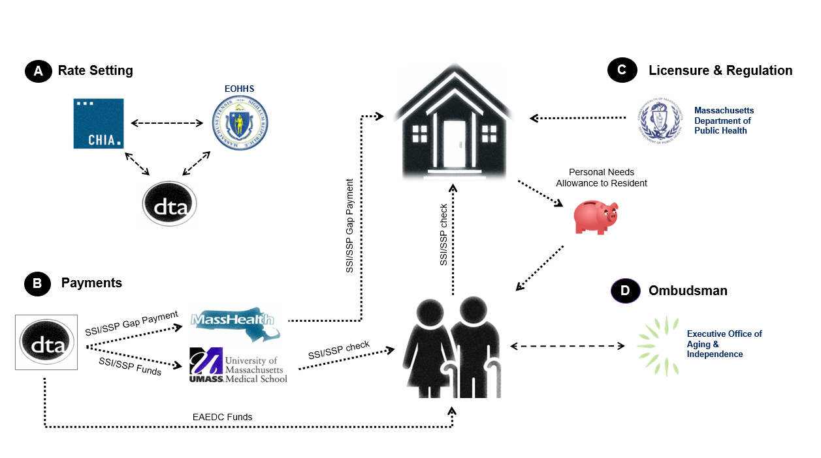
Task Force’s Findings – Charge (i) (cont.)
Findings (cont.)
Several state agencies support rate setting, payment, licensure and patient care responsibilities.
12

Slide 13
Task Force’s Findings – Charge (i) (cont.)
Charge
Examine the licensing, regulatory and reporting structure for rest homes
Findings – Licensing
DPH holds licensing authority over rest homes in the Commonwealth, requiring licensure renewal every two years.
Initial licensure of rest homes and any renovations afterwards require completion of a Plan Review for Health Care Facilities. Plan Review includes the architectural review of the physical plant to determine compliance with Facility Guidelines Institute (FGI) guidelines.
Initial licensure/Change of Ownership (CHOW) requires Health care facility initial licensure and change of ownership | Mass.gov as a LTC facility for the provision of Level IV services.
This includes an initial licensure application, suitability (the review of information to determine acceptable or right for ownership), and CORI checks, along with other application documentation such as local municipality approval, and a fee.
For a brand-new rest home, “Determination of Need” approval may also be required, which supports the development of innovative health delivery methods and population health strategies within the health care delivery system; and to ensure that resources will be made reasonably and equitably.
For licensure renewals, DPH mails applications to facilities approximately 90 days prior to expiration, along with a letter detailing the required documentation for submitting the application.
13

Slide 14
Task Force’s Findings – Charge (i) (cont.)
Charge
Examine the licensing, regulatory and reporting structure for rest homes
Findings – Regulatory and Reporting Structure
The Bureau of Health Care Safety and Quality (BHCSQ) at DPH oversees regulatory requirements for the operation of rest homes (Level IV Long Term Care Facilities), outlined in the following standards:
105 CMR 150.00: Standards for long-term care facilities | Mass.gov
105 CMR 153.00: Licensure procedure and suitability requirements for long-term care facilities | Mass.gov
105 CMR 155.00: Patient and resident abuse prevention, reporting, investigation, penalties and registry | Mass.gov
The Health Care Facility Reporting System (HCFRS) is a web-based system overseen by BHCSQ that health care facilities must use to report incidents and allegations of abuse, neglect, and misappropriation.
Complaints can be submitted via the Consumer/Resident/Patient Complaint Form available on the webpage of the Division of Health Care Facility Licensure and Certification Complaint Unit, which investigates each complaint.
Massachusetts rest homes must also report annually aggregate Health Care Personnel COVID-19 and influenza data through the HCFRS: Health Care Personnel COVID & Influenza Vaccination References and Resources
14

Slide 15
Task Force’s Findings – Charges (ii) & (iii)
Charge
Examine an inventory of licensed rest homes and licensed rest home beds
Examine the location and service areas of existing rest homes
Findings – Inventory of Rest Homes and Rest Home Beds
There are currently 74 DPH-licensed rest homes operating in the Commonwealth:
58 freestanding rest homes with a total of 2,002 beds (see map and table on Slide 17).
16 skilled nursing facilities (SNFs) have rest home (Level IV) beds and are known as multi-level or hybrid facilities, with a total of 624 Level IV beds (see map and table on Slide 18).
In addition, there are a handful of religious rest homes that are not licensed and tracked by DPH. Per 105 CMR 150.00 Standards for Long Term Care Facilities, religious order homes do not require a license from DPH to operate and are not included in the count. However, these homes must meet all local health and safety requirements.
Of the 58 freestanding rest homes referenced above, 31 are private/for-profit, 21 are non-profit. The financial status of the remaining 6 rest homes is not tracked by DPH, as these facilities do not admit public residents and are therefore not required to submit annual cost reports.
15

Slide 16
Task Force’s Findings – Charges (ii) & (iii) (cont.)
Charge
Examine an inventory of licensed rest homes and licensed rest home beds
Examine the location and service areas of existing rest homes
Findings – Service Areas
Typically, the term “service area,” when used in the context of the health care system, is defined by the home address of a patient for a given health care facility or service or based on the hospital location where a patient is treated. By definition, a rest home is the home address for its residents, therefore, this definition cannot be applied to patients or residents occupying a rest home. DPH does not have or collect home addresses for residents prior to their admission to a rest home. Moreover, selection of a rest home location may be influenced by the home address of family members rather than the prior address of the resident.
For the purposes of this report, DPH has applied the six EOHHS regional definitions as a proxy for “service areas” of existing rest homes: Boston, Central, Metro West, Northeast, Southeast, and Western Massachusetts (see map and table on the following slide).
16

Slide 17
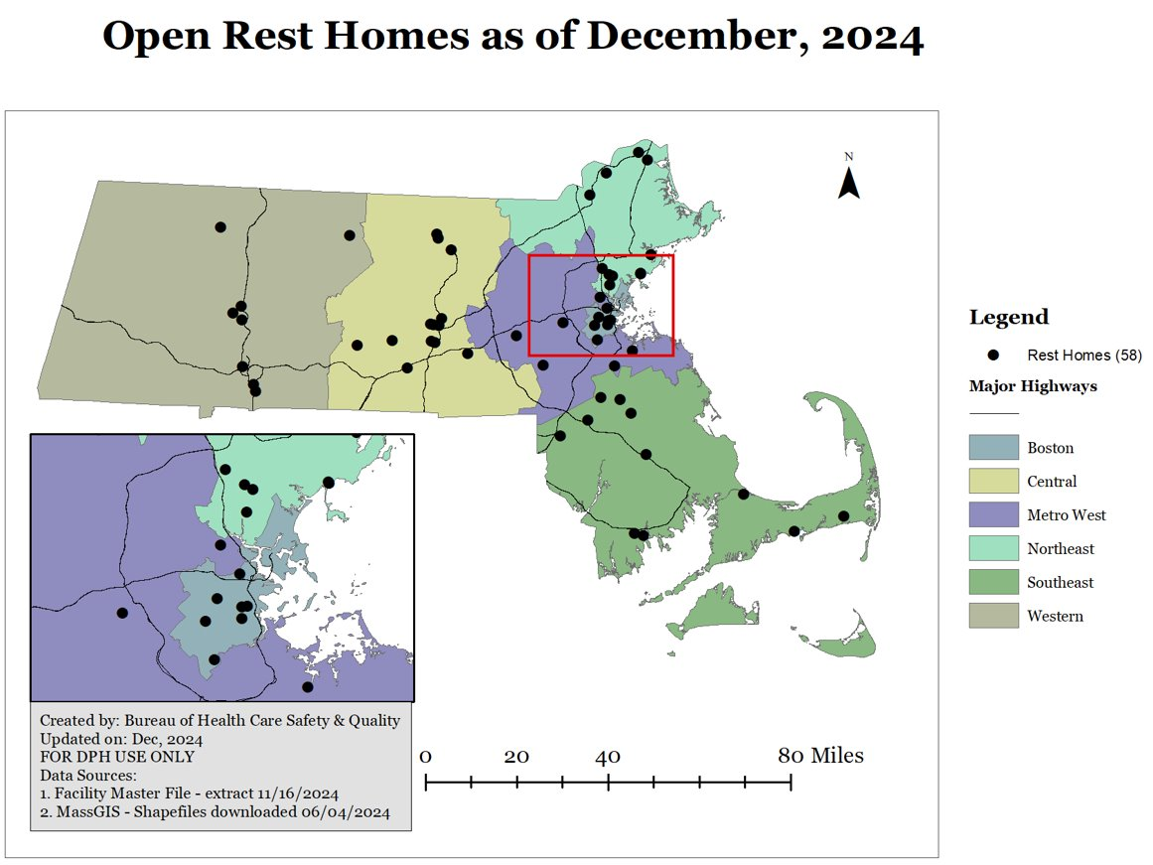
Task Force’s Findings – Charges (ii) & (iii) (cont.)
EOHHS Region | Free-standing RHs​ | Total Beds​
Boston ​ | 7​ | 248​
Central ​ | 14​ | 530​
Metro West ​ | 7​ | 278​
Northeast ​ | 11​ | 287​
Southeast ​ | 11​ | 320​
Western ​ | 8​ | 339​
Total​ | 58​ | 2,002 ​
Please refer to the Bureau of Health Care Safety & Quality Data Summary presentation from the Task Force’s 1/10/2025 meeting for additional information.
17

Slide 18
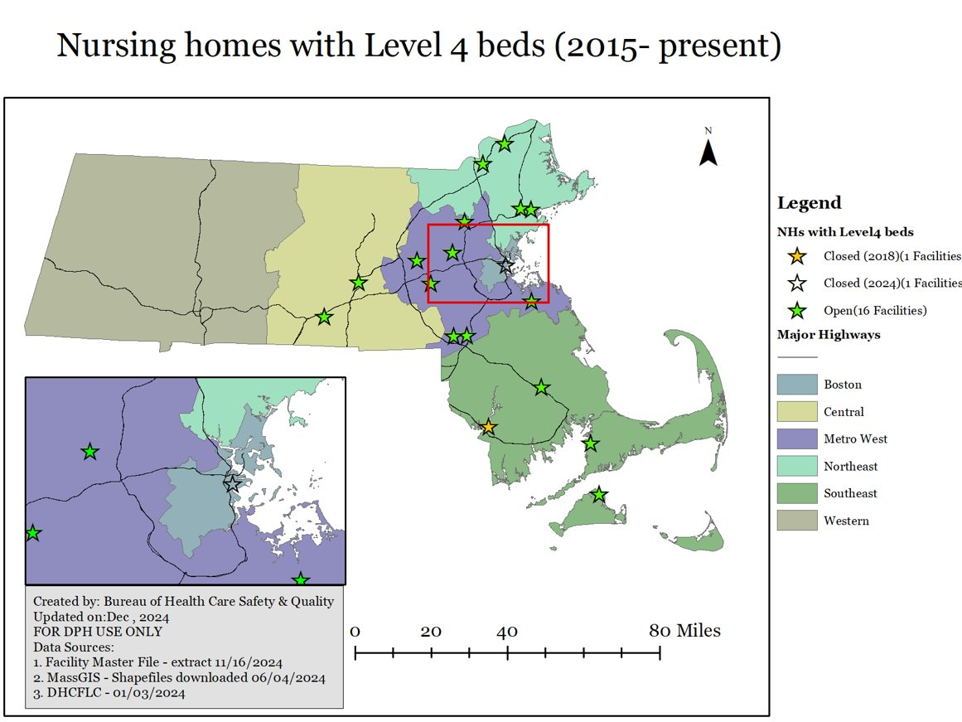
Task Force’s Findings – Charges (ii) & (iii) (cont.)
EOHHS Region | SNFs with Level IV beds​ | Total Beds​
Boston ​ | 0 | 0
Central ​ | 2​ | 85
Metro West ​ | 7​ | 282
Northeast ​ | 4​ | 185
Southeast ​ | 3​ | 72
Western​ | 0 | 0
Total​ | 16​ | 624​
Please refer to the Bureau of Health Care Safety & Quality Data Summary presentation from the Task Force’s 1/10/2025 meeting for additional information.
18

Slide 19
Task Force’s Findings – Charge (iv)
Charge
Review rest home closures since 2015
Findings
Since 2015, a total of 16 of 74 (22%) DPH-licensed rest homes operating in the Commonwealth have closed. Of these 16 facilities, 11 closed between 2015-2019 and ​5 closed between 2020-2022​. No rest home closures were observed in 2023 or 2024.​
Closures of these facilities resulted in a 17% reduction in beds from 2,404 beds in 2015 to 2,002 beds in 2024​ (last available data).
The Task Force discussed that while outside the scope of their specific charge, the period from 1998 to 2015 saw a larger number of facility closures.
Testimony provided to the Task Force during its meetings touched on some of the reasons why facilities such as rest homes close, which include financial challenges and the retirement or passing of the owner or administrator of a private/for-profit rest home.
Region ​ | RH Closures (since 2015​) | Total Beds​
Central ​ | 5​ | 112​
Metro West ​ | 6​ | 145​
Northeast ​ | 3​ | 93​
Southeast ​ | 2​ | 52​
TOTAL​ | 16​ | 402​
Please refer to the Bureau of Health Care Safety & Quality Data Summary presentation from the Task Force’s 1/10/2025 meeting for additional information.
19

Slide 20
Task Force’s Findings – Charge (iv) (cont.)
Please refer to the Bureau of Health Care Safety & Quality Data Summary presentation from the Task Force’s 1/10/2025 meeting for additional information.
20

Slide 21
Task Force’s Findings – Charge (v)
Charge
Review the recommendations implemented from the Nursing Facility Task Force report issued pursuant to Section 91 of Chapter 41 of the Acts of 2019
Findings
The Nursing Facility Task Force was established through the Acts of 2019 and convened six times from September 2019 through January 2020, charged with evaluating ways to ensure the financial stability of skilled nursing facilities, considering the role of skilled nursing facilities within the continuum of elder care services, and addressing current workforce challenges.
While there was some discussion of rest homes, the majority of the Nursing Facility Task Force's work focused on the nursing facility industry.
Through its deliberations, the Task Force reached consensus on 19 “points of agreement,” summarized in the group’s final report submitted to the Legislature on 1/31/2020. As referenced by the MARCH representative during the Rest Home Task Force’s deliberations, during the 1/10/2020 meeting of the Nursing Facility Task Force, MARCH proposed a number of recommendations related to rest homes that were not ultimately adopted.
These 19 points of agreement were distilled by the Nursing Facility Task Force into four “policy goals,” each with their own “policy proposals” (see following slides for additional details).
The full Nursing Facility Task Force report is available at: https://www.mass.gov/doc/nursing-facility-task-force-final-report/download
21

Slide 22
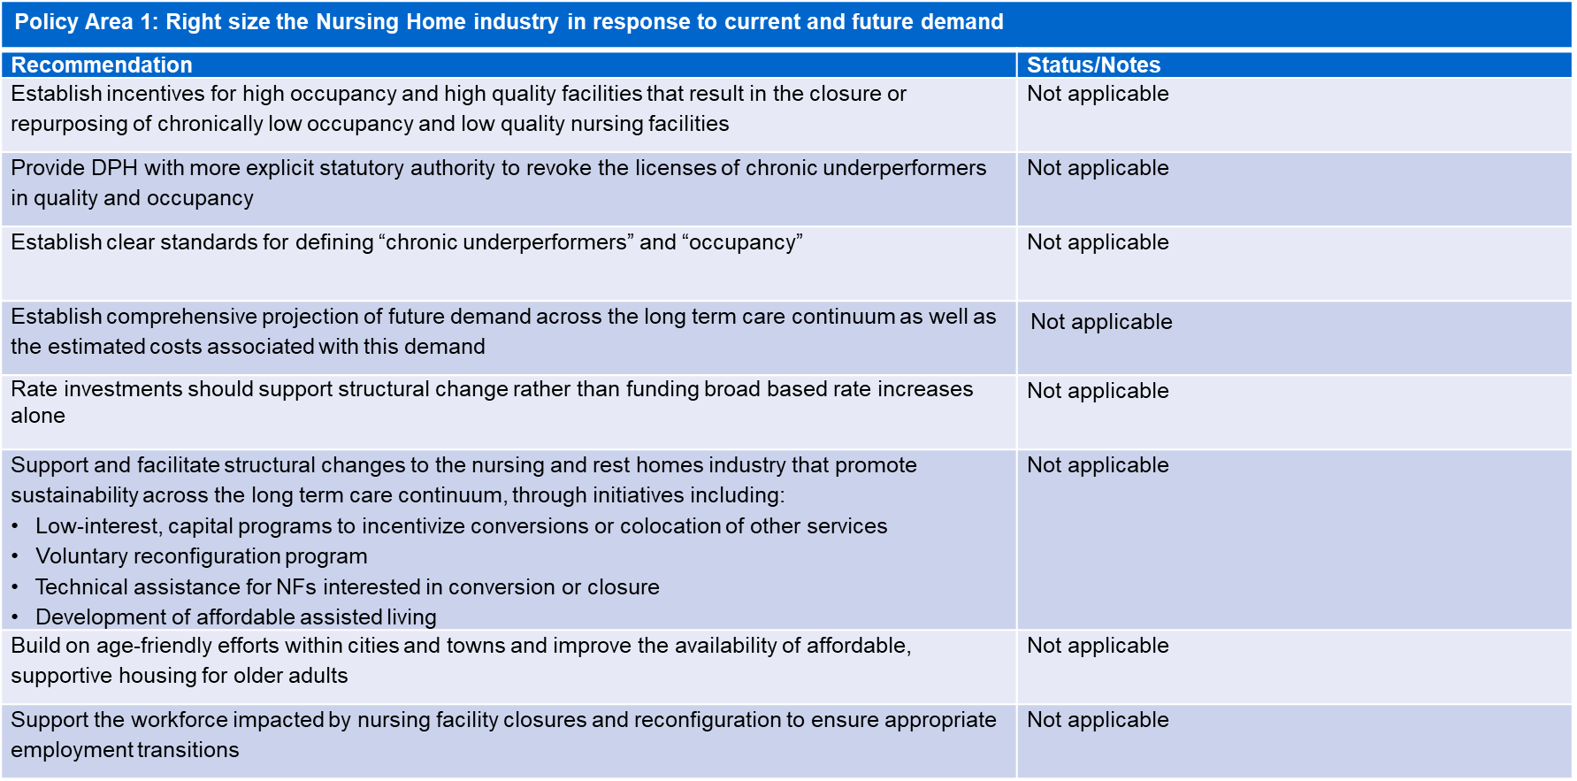
Task Force’s Findings – Charge (v) (cont.)
22

Slide 23
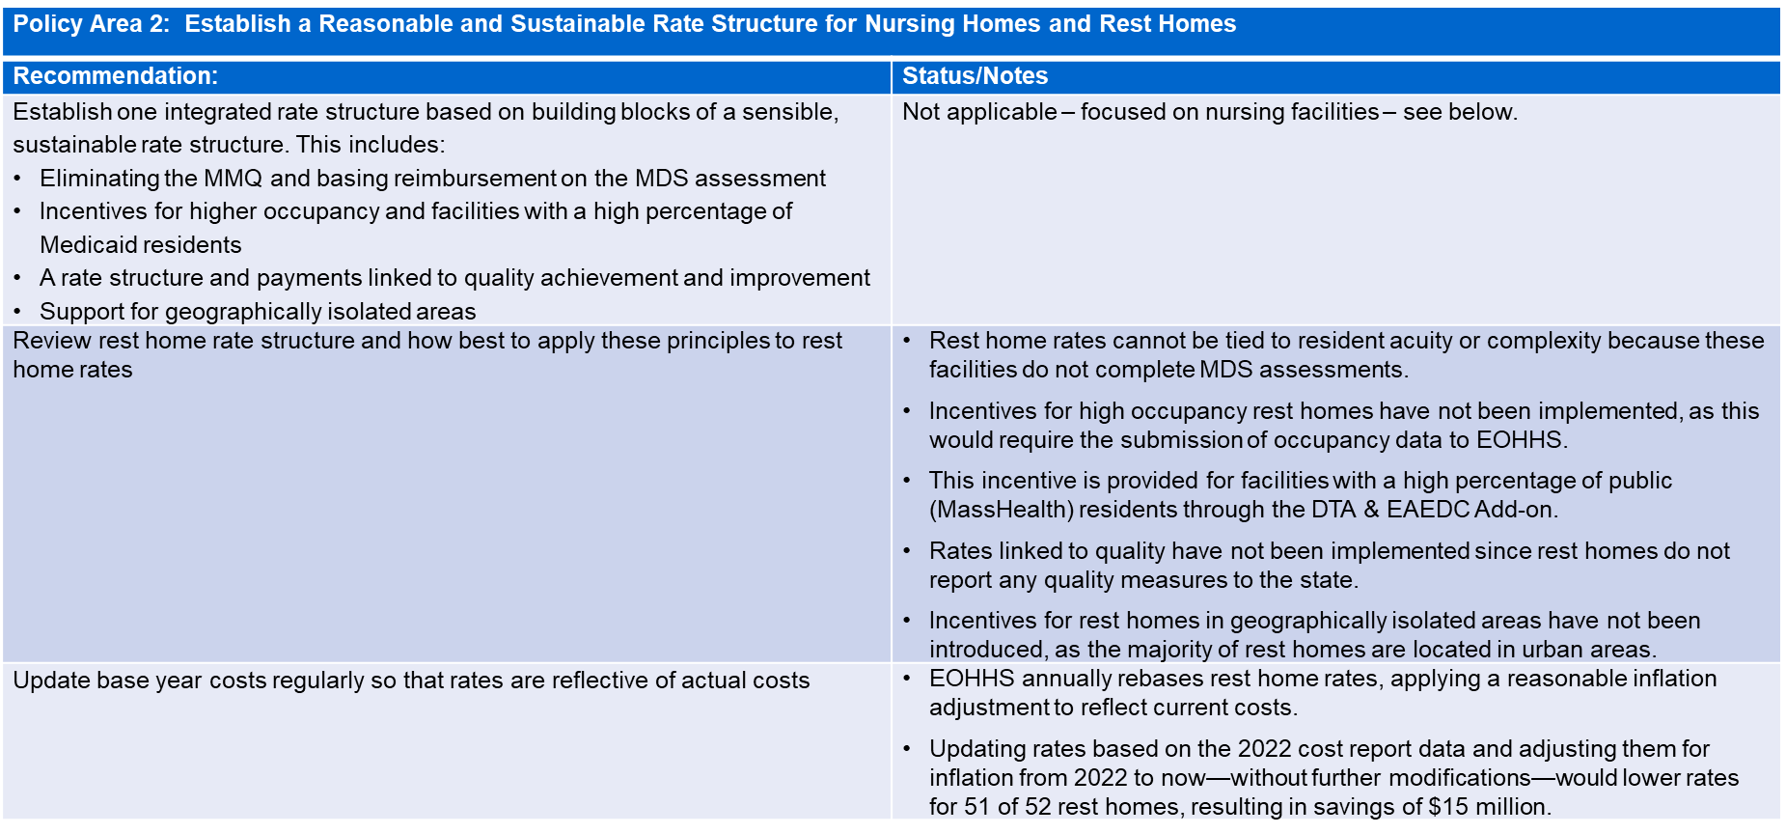
Task Force’s Findings – Charge (v) (cont.)
23

Slide 24
Task Force’s Findings – Charge (v) (cont.)
24

Slide 25
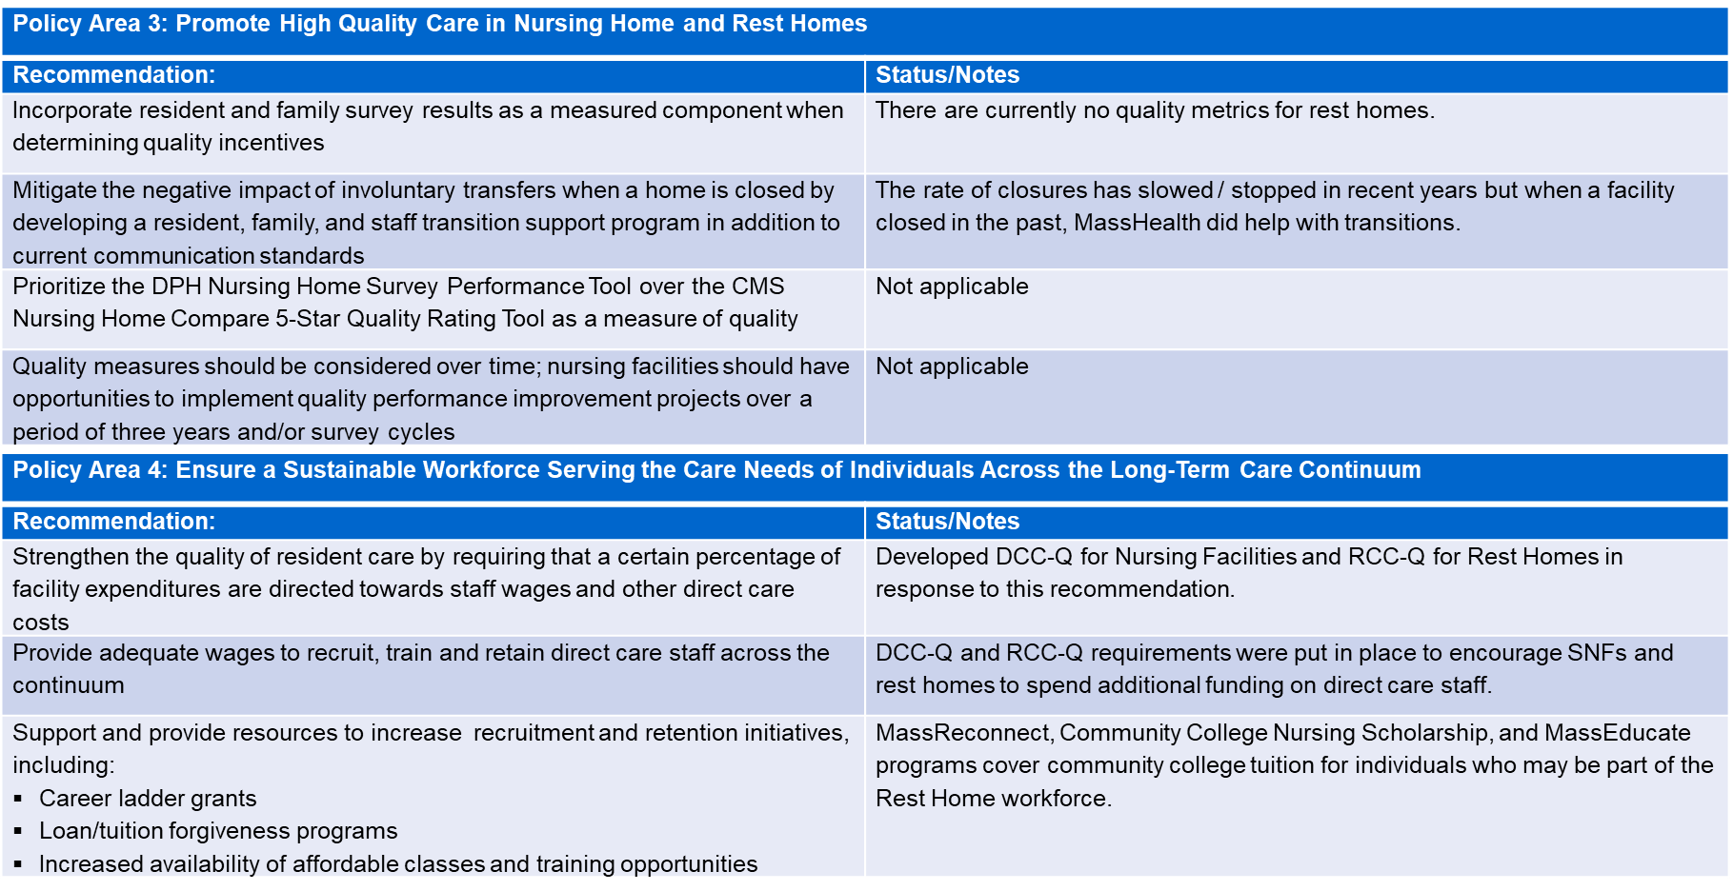
Task Force’s Findings – Charge (v) (cont.)
25

Slide 26
Task Force’s Findings – Charge (v) (cont.)
26

Slide 27
Task Force’s Findings – Charge (vi)
Charge
Examine the feasibility of receiving federal reimbursement for rest home expenses
Findings
With the new federal administration and rapidly changing landscape for federal funding, it remains uncertain the extent to which policies and funding from the U.S. Department of Health and Human Services (HHS) and Centers for Medicare and Medicaid Services (CMS) will change and, if so, how those changes may impact rest home services.
Rest home services are currently ineligible for federal reimbursement through Federal Medical Assistance Percentage (FMAP), as they are not included in the list of Medicaid services approved by CMS.
Public rest home residents often have MassHealth coverage, but they are not required to be on MassHealth to access rest home services. However, some residents with MassHealth coverage, such as those on MassHealth Standard, may qualify for certain Long-Term Services and Supports (LTSS) services. Many residents already receive LTSS services, including Adult Day Health (ADH), Day Habilitation, and Home Health, for which MassHealth receives federal matching funds.
Given that rest homes are institutional settings, under the current CMS rules, obtaining a waiver to cover certain services provided by rest homes would be challenging. Furthermore, even if CMS were to approve such a waiver, rest homes would then be subject to specific Medicaid requirements for service provision. Additionally, all residents receiving these services would need to be MassHealth members.
27

Slide 28
Task Force’s Findings – Charge (vii)
Charge
Review the current rate structure for rest homes compared to the actual cost of care to residents
Findings
Several state agencies support rate setting and payments: EOHHS, CHIA, and DTA evaluate costs, revenues and budget constraints yearly to determine rates. These rates are required to be promulgated annually.
The following information is compiled and analyzed to determine rest home rates:
Please refer to the detailed overview included in the Rest Home Payment and Rate Overview presentation from the Task Force’s 1/24/2025 meeting for additional information.
Cost Reports | Submitted to CHIA annually by rest homes (due by June). Analysis typically completed by CHIA in a 6-8 month timeframe. Required data includes assets, liabilities, revenues, expenses, bed counts, resident days, and mortgage/loan information.
Resident Care Cost Quotient (RCC-Q) Filings | Submitted twice a year to EOHHS by rest homes (due on March 1st and September 1st). Required data includes resident care expenses on direct care staff and revenues.
Budget Appropriation | Additional funding earmarked by the Legislature.
28

Slide 29
Task Force’s Recommendations
29

Slide 30
Task Force’s Recommendations
Recommendations:
Based on the information, resources, and testimony presented to the Task Force, a set of long-term strategies were developed that fall under the following five broad categories:
Update regulatory requirements to ensure standard expectations of care and distribution of funding across rest homes.
Enhance financial reporting requirements to increase transparency and best identify impacts of costs on rest homes.
Increases in data collection to improve access to data related to quality of care, patient demographics, and geographic trends in occupancy.
Increase engagement among regulatory and industry stakeholders.
Increase rest home industry’s access to capital funding.
Under each category, various proposals were developed, prioritizing both the long-term sustainability of the rest home industry and the current realities of the federal landscape and specifically the priorities of the incoming federal administration.
Members discussed the draft proposals during the 2/28/2025 and 3/14/2025 Task Force meetings.
30

Slide 31
Task Force’s Recommendations (cont.)
1 | Update regulatory requirements to ensure standard expectations of care and distribution of funding across rest homes
A | Collaborate with the rest home industry to review and propose updates to the rest home regulations to both streamline and modernize the current regulations for licensed rest homes and ensure high quality of care for rest home residents, including exploring establishing reasonable staffing requirements for rest homes. As part of considerations of staffing requirements, conduct an analysis of current staffing levels, standards of care. Components would include staffing levels, turnover rates and impact on quality of care. Explore feasibility of client related quality measures such as survey responses on care, environment and experience, family communication (especially where they go when a rest home is closed) and autonomy of clients.
B | Conduct an analysis to report on the viability of receiving federal approval to receive Federal Medical Assistance Percentages (FMAP) for rest home services and identify any necessary changes to current law or regulatory requirements that would facilitate rest homes being eligible for FMAP.
31

Slide 32
Task Force’s Recommendations (cont.)
1 | Update regulatory requirements to ensure standard expectations of care and distribution of funding across rest homes
C | In the instance where additional funding is allocated to rest homes, consider the following rate adjustments: Lower the occupancy standard from 90% and increase the cap on variable costs from 85% Use alternative inflation forecasting data (e.g., Massachusetts CPI) for updating rates Adjust the methodology for determining capital rates Combine the two existing add-ons, the DTA/EAEDC and Resident Care add-ons, into a single DTA add-on, structured to benefit rest homes that have a larger percentage of residents receiving DTA benefits. Provide staffing add-ons for rest homes with higher use of nursing staff, reflecting higher acuity needs of residents.
D | Increase the Personal Needs Allowance (PNA) for rest home residents that receive public subsidy, to enhance the dignity of residents and address the current PNA of $72.80.
32

Slide 33
Task Force’s Recommendations (cont.)
2 | Enhance financial reporting requirements to increase transparency and best identify impacts of costs on rest homes
A | Strengthen cost report data submissions by requiring rest homes to submit financial statements with cost reports and identifying any existing redundancies relative to reporting requirements in an effort to streamline those requirements.
B | Update the RCC-Q report submission process, allowing rest homes to petition EOHHS for a temporary “waiver” if a rest home was below the RCC-Q threshold because the costs incurred by the rest home to make physical plant improvements were more than 10% of the rest home’s annual revenue in the reporting year.
C | Ensure transparency and accountability in the RCC-Q submissions by annually publishing the RCC-Q scores on the EOHHS website, in the manner it is currently done for the DCC-Q scores for nursing facilities.
33

Slide 34
Task Force’s Recommendations (cont.)
3 | Increase data collection to improve access to data related to quality of care, patient demographics and geographic trends in occupancy
A | Monitor the Commonwealth’s needs for rest home services in all geographic areas by collecting staffing and occupancy data from rest homes on a regular basis in a manner which does not impose significant administrative burden on rest homes. Explore the feasibility of conducting a detailed analysis of geographic disparities in rest home services and occupancy rates with the goal of developing strategies to address these disparities.
B | Improve hospitals and other providers’ awareness of rest homes by publishing a dedicated page containing information about rest home services, an interactive map of rest homes, and their contact information.
34

Slide 35
Task Force’s Recommendations (cont.)
4 | Increase engagement among regulatory and industry stakeholders
A | DPH holds annual meetings with rest home providers to share important information, including common survey findings and best practices, and to engage in Q&A with providers, with the aim of improving care for rest home residents.
B | Establish an internal EOHHS working group to explore the topics raised during the deliberations of the Rest Home Task Force, with regular engagement from the rest home industry.
C | EOHHS, DTA, DPH and MassHealth meet with the Joint Committee on Aging and Independence on a quarterly basis to discuss the implementation of recommendations included in the Rest Home Task Force report.
35

Slide 36
Task Force’s Recommendations (cont.)
5 | Increase rest home industry’s access to capital funding
A | Spend the $10 million for capital projects at rest homes authorized by the Legislature in the 2024 Economic Development Bill (Chapter 238, Acts of 2024, An Act Relative to Strengthening Massachusetts’ Economic Leadership). See note below.
Note: Task Force members discussed the need for additional capital funding for the rest home industry. However, for a capital earmark in a bond bill to be funded, it must be included in the Governor’s annual capital investment plan (CIP), published in the spring each year. The Administration is aware of the authorization and will consider this program in the context of all other funding requests received, all capital needs across the Commonwealth, the amount of capital spending that the Commonwealth can prudently afford, and whether the request is eligible for tax-exempt bond financing per federal tax law.
36

Slide 37
Task Force’s Recommendations (cont.)
Recommendations on Which the Task Force Was Unable to Reach Clear Agreement
Establish a requirement for a 5-year Strategic Plan outlining agency and industry roles, timelines, as well as anticipated outcomes, to serve as a framework for this collaboration and allow the incorporation of any recommendations that may come from the other groups, such as the Viability and Sustainability of Long-Term Care Facilities Task Force, as well as the Senior Housing Commission.
Change the use and methodology of the RCC-Q, including:
Align the current RCC-Q requirements for rest homes with the DCC-Q requirements for nursing facilities by lowering the RCC-Q threshold to 75% and prorating the self-reported costs related to the rest homes ED/CEO/owner(s) and staff not providing direct care services.
Eliminate the RCC-Q, establishing an alternative rating system focused on quality-of-care.
Allow Administrator and Responsible Person Cost
Conduct an independent analysis of the relevant allowable costs, goals, criteria and outcomes of the RCC-Q, and the impact of including private revenue and revenue from endowments.
Conduct an independent analysis of rate adequacy and cost reporting that would inform any regulatory revision related to costs associated with minimum staffing levels and recommend any new or updated financial reporting requirements.
37

Slide 38
Task Force’s Recommendations (cont.)
Recommendations on Which the Task Force Was Unable to Reach Clear Agreement (cont.)
Address the capital needs of rest homes across the state through a number of possible mechanisms:
Conduct a capital needs assessment for all facilities;
Ensure that rest homes with Level IV Nursing Homes are eligible for funds from the Long-Term Care Workforce and Capital Fund in the 2024 Long Term Care bill (Chapter 197 of the Acts of 2024, An Act to Improve Quality And Oversight of Long-term Care);
Explore whether supportive housing funds in the 2024 Economic Development bond bill (Chapter 238, Acts of 2024, An Act Relative to Strengthening Massachusetts’ Economic Leadership) could be used for rest homes; and
Amend the construction standards for rest homes to allow rest homes to be renovated in accordance with residential building codes similar to those allowed for Assisted Living Residences. Current regulations require rest homes to comply with health care facility regulations, subject to plan review at DPH, and Determination of Need requirements. All of these requirements make it extremely challenging and costly to renovate and update rest homes.
Explore whether DPH regulations and licensing applications could include questions regarding previous ownership of rest homes (as part of suitability criteria).
38

Slide 39
Appendices
39

Slide 40
Appendix A – Legislative Mandate
Full text of the legislation: https://malegislature.gov/Laws/SessionLaws/Acts/2024/Chapter197
Chapter 197, Section 27 of the Acts of 2024
(a) There shall be a task force to evaluate the governance and regulatory structure of rest homes in the commonwealth. The task force shall include, but shall not be limited to, an examination of the following: (i) the licensing, regulatory and reporting structure for rest homes; (ii) an inventory of licensed rest homes and licensed rest home beds; (iii) the location and service areas of existing rest homes; (iv) a review of rest home closures since 2015; (v) a review of the recommendations implemented from the nursing facility task force report issued pursuant to section 91 of chapter 41 of the acts of 2019; (vi) the feasibility of receiving federal reimbursement for rest home expenses; and (vii) a review of the current rate structure for rest homes compared to the actual cost of care to residents.
(b) The task force shall consist of the secretary of health and human services, or their designee, who shall serve as chair; the secretary of elder affairs, or their designee; the commissioner of public health, or their designee; the assistant secretary for MassHealth, or their designee; the commissioner of the department of mental health, or their designee; the commissioner of the department of transitional assistance, or their designee; the chairs of the joint committee on elder affairs, or their designees; 1 person to be appointed by the minority leader of the house of representatives; 1 person to be appointed by the minority leader of the senate; and 5 members to be appointed by the governor, 1 of whom shall be a representative from the Massachusetts Association of Residential Care Homes, Inc., 1 of whom shall be a representative of LeadingAge Massachusetts, Inc., 1 of whom shall be a representative of Massachusetts Senior Action Council, Inc., 1 of whom shall have direct care giver experience and 1 of whom shall have experience in health care administration and finance.
(c) The task force shall submit a report of its findings, including any recommendations or proposed legislation necessary to carry out its recommendations, to the clerks of the house of representatives and the senate and to the house and senate committees on ways and means, not later than April 1, 2025.
40

Slide 41
Appendix B – List of Task Force Members
Name / Affiliation | Task Force Seat
Kiame Mahaniah Executive Office of Health and Human Services (chair) | Designee of the Secretary of Health and Human Services (who shall serve as chair)
Judy Bernice Bureau of Health Care Safety and Quality, Department of Public Health (DPH) | Designee of the DPH Commissioner
Scune Carrington Private practitioner, BennuCare | Appointee of the Governor, representative with direct care giver experience
Kim Clougherty Department of Mental Health (DMH) | DMH Commissioner or their designee
Emily Cooper Executive Office of Aging & Independence (AGE) | AGE Secretary or their designee
Tracey Cravedi Hale House | Appointee of the Governor, representative of LeadingAge Massachusetts, Inc.
41

Slide 42
Appendix B – List of Task Force Members (cont.)
Name / Affiliation | Task Force Seat
Moses Dixon Senior Connection | Appointee of the Governor, representative with experience in health care administration and finance
Pamela Edwards Massachusetts Senior Action Council | Appointee of the Governor, representative of Massachusetts Senior Action Council
Patricia Jehlen Massachusetts Senate, Joint Committee on Aging and Independence | Co-chair of the Joint Committee on Aging and Independence or their designee
Mathew Muratore Former Member of the House of Representatives | Appointee of the Minority Leader of the House of Representatives
Megan Nicholls Department of Transitional Assistance (DTA) | Designee of the DTA Commissioner
Patrick O’Connor Massachusetts Senate | Appointee of the Minority Leader of the Senate
42

Slide 43
Appendix B – List of Task Force Members (cont.)
Name / Affiliation | Task Force Seat
Ron Pawelski Massachusetts Association of Residential Care Homes (MARCH) | Appointee of the Governor, representative from MARCH
Thomas Stanley Massachusetts House of Representatives, Joint Committee on Aging and Independence | Co-chair of the Joint Committee on Aging and Independence or their designee
Pavel Terpelets Office of Long-Term Services and Supports (OLTSS), MassHealth | Designee of the Assistant Secretary for MassHealth
43

Slide 44
Appendix C – Summary of Meetings and Input Provided to the Task Force
Presenters | Topics Discussed | Resources and Supporting Documents
January 10, 2025
Kiame Mahaniah (chair) Undersecretary for Health Designee of the Executive Office of Health and Human Services Secretary | Discussion of the Task Force’s charge and proposed meeting schedule | Task Force Presentation
Lauren Cleary Associate General Counsel Executive Office of Health and Human Services | Overview of the Open Meeting Law (OML) | OML Guide
David Giannotti Public Education and Communications Division Chief, State Ethics Commission | Overview of members’ Ethics and Conflict of Interest requirements | Ethics and Conflict of Interest Overview
Judy Bernice Licensure Unit Manager Bureau of Health Care Safety and Quality, DPH Kate Saunders Director, Division of Quality Improvement Bureau of Health Care Safety and Quality, DPH | Overview of rest home licensing, reporting structures, and existing data collected for DPH-licensed rest homes in the Commonwealth | Bureau of Health Care Safety & Quality Data Summary
44

Slide 45
Appendix C – Summary of Meetings and Input Provided to the Task Force (cont.)
Presenters | Topics Discussed | Resources and Supporting Documents
January 10, 2025 (cont.)
Ron Pawelski President, Massachusetts Association of Residential Care Homes (MARCH) | Expectations for the Task Force’s work | MARCH Statement
January 24, 2025
Pavel Terpelets Director of Institutional Programs Office of Long Term Services and Supports (OLTSS), MassHealth | Overview of the rate structure and payment mechanisms for rest home in the Commonwealth | Rest Home Payment & Rate Overview
45

Slide 46
Appendix C – Summary of Meetings and Input Provided to the Task Force (cont.)
Presenters | Topics Discussed | Resources and Supporting Documents
February 7, 2025
Ron Pawelski President, MARCH | Overview of the role of rest homes in Massachusetts, including the financial and regulatory challenges their industry faces | MARCH Presentation
Condase Weekes-Best Owner and operator, Wellspring Homecare, Ann’s Rest Home and Burgoyne’s Rest Home | Overview of Ms. Weekes-Best’s experience as an owner and administrator of two small rest homes | Condase Weekes-Best Presentation
Pavel Terpelets Director of Institutional Programs OLTSS, MassHealth | Summary of the recommendations from the Nursing Facility Task Force | Nursing Facility Task Force Recommendations
46

Slide 47
Appendix C – Summary of Meetings and Input Provided to the Task Force (cont.)
Presenters | Topics Discussed | Resources and Supporting Documents
February 28, 2025
Micha Shalev Owner, Dodge Park | Overview of Mr. Shalev’s experience as an owner and administrator of a large rest home | Micha Shalev Presentation
Dayva Briand Deputy Director, OLTSS, MassHealth | Discussion of the Task Force’s proposed recommendations | Proposed Recommendations
March 14, 2025
Kiame Mahaniah Undersecretary for Health, EOHHS | Discussion of the Task Force’s draft report and proposed recommendations | Draft Report
47

Slide 48
Appendix D – Resources Reviewed by the Task Force
Copies of all meeting materials are available on the Task Force’s Mass.gov webpage: https://www.mass.gov/info-details/rest-home-task-force-meeting-materials
January 10, 2025
Approved 1/10/2025 Meeting Minutes
Task Force Presentation
Task Force Statute
Bureau of Health Care Safety & Quality Data Summary
MARCH Statement
January 24, 2025
Approved 1/24/2025 Meeting Minutes
Rest Home Payment & Rate Overview
Rest Home Task Force Revised Calendar
48

Slide 49
Appendix D – Resources Reviewed by the Task Force (cont.)
February 7, 2025
Approved 2/7/2025 Meeting Minutes
MARCH Presentation
Condase Weekes-Best Presentation
Nursing Facility Task Force Recommendations
February 28, 2025
Approved 2/28/2025 Meeting Minutes
Proposed Recommendations
March 14, 2025
Approved 3/14/2025 Meeting Minutes
Draft Report
49

Slide 50
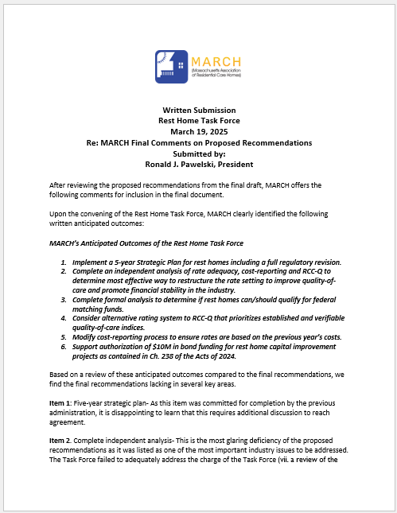
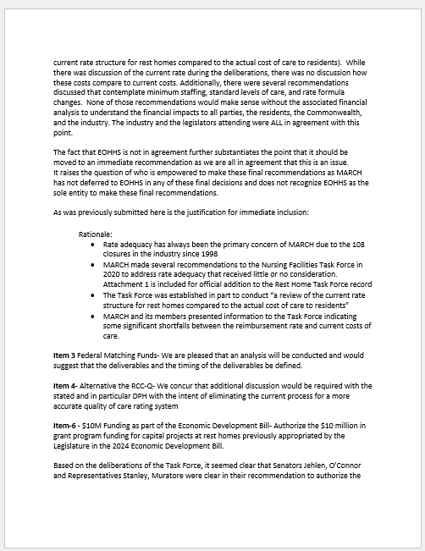
Appendix E – Written Comments Received from Members Regarding the Draft Report
50

Slide 51
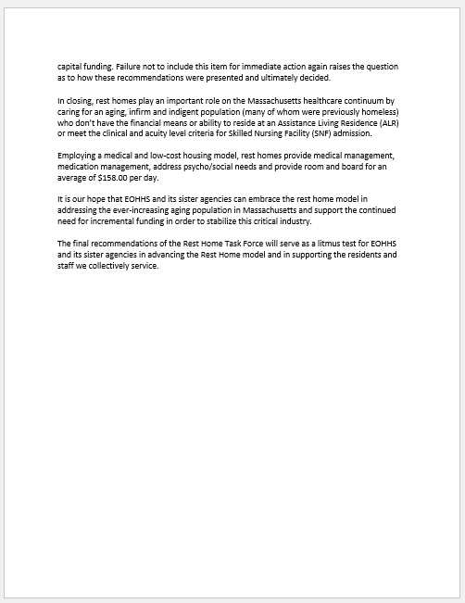
Appendix E – Written Comments Received from Members Regarding the Draft Report
51

Slide 52
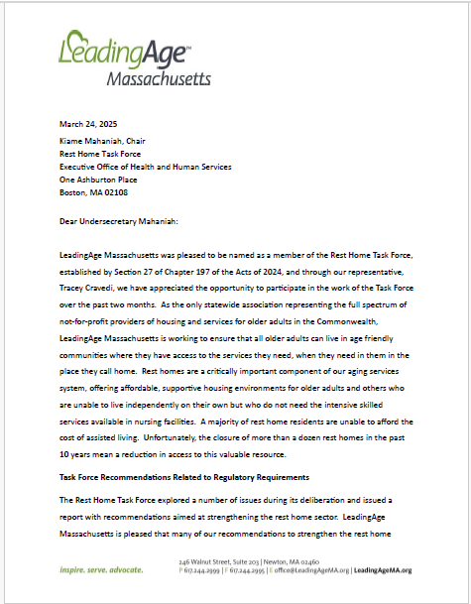
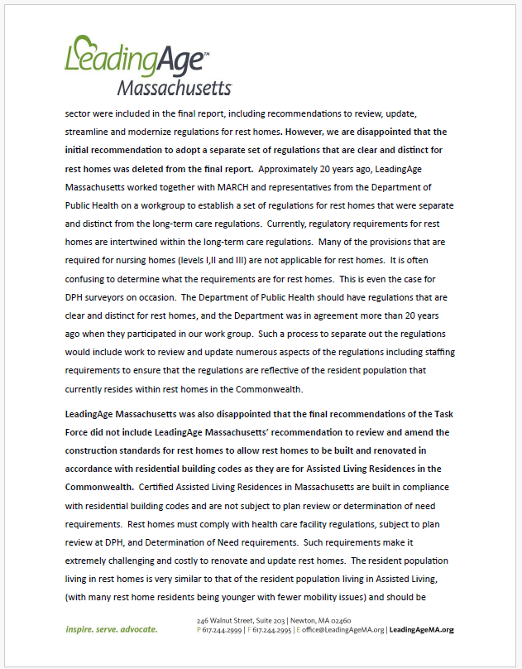
Appendix E – Written Comments Received from Members Regarding the Draft Report
52

Slide 53
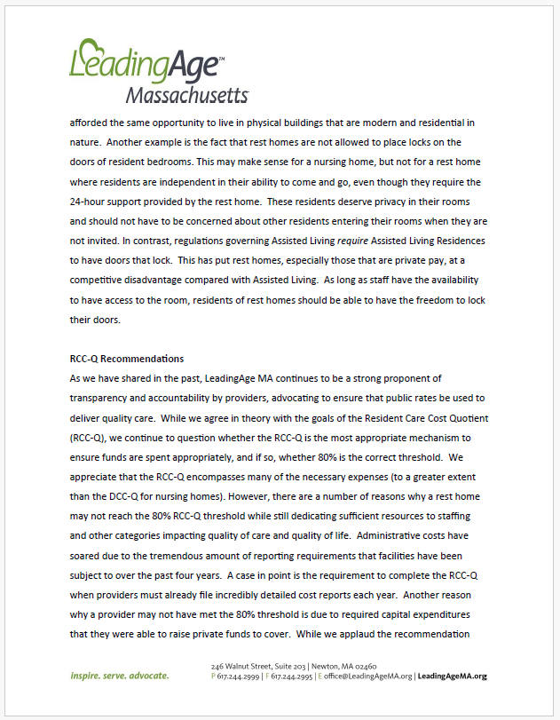
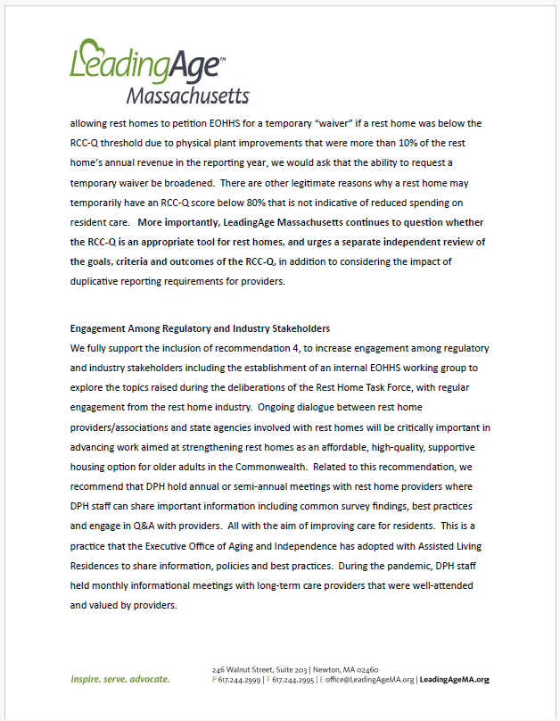
Appendix E – Written Comments Received from Members Regarding the Draft Report
53

Slide 54
Appendix E – Written Comments Received from Members Regarding the Draft Report
54

