Slide 1
Presentation to the Rest Home Task Force: The Urgent Need for Adequate Reimbursement to Support Residents, Staff, and Facilities
Micha Shalev MHA CDP CDCM CCADDCT

Slide 2
Agenda
History of Dodge Park
Sample Cost increases from 2020 to 2024
Consequences of the increases
What we are asking for from you

Slide 3
Introduction
Dear distinguished members of the Massachusetts Rest Homes Task Force,
Thank you for the opportunity to address you today.
My name is Micha Shalev, and I am the co-owner of Dodge Park Rest Home.
I am here to discuss a critical issue that affects not only our operation but the well-being of the residents who rely on us for care, the employees working for us, and the families they support:
The underfunding of rest homes in Massachusetts and
its financial impact on our ability to provide quality services.

Slide 4
Our History
Dodge Park established in 1967
Ben Herlinger and Micha Shalev purchased Dodge Park in 2007 after running 7 facilities in California for 18+ years.
Part of our community:
Designated Dodge Park as the neighborhood polling center pre-COVID.
Free monthly support group for dementia caregivers
Emergency shelter for community during ice storms
Dodge Park is recognized as one of the best facilities in MA
We have earned the Caring Star award by Caring.com every single year since 2015 (when the award started).
Despite their importance, rest homes like Dodge Park are facing unprecedented financial challenges due to chronic underfunding.

Slide 5
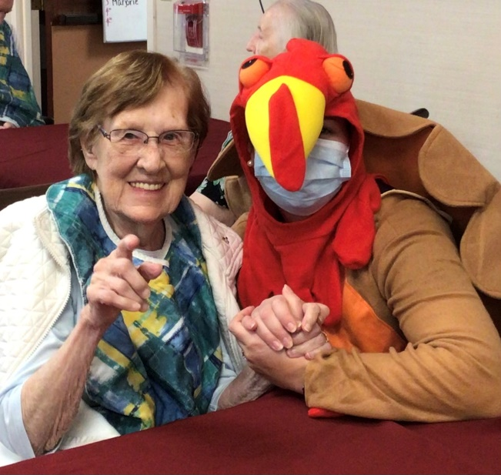
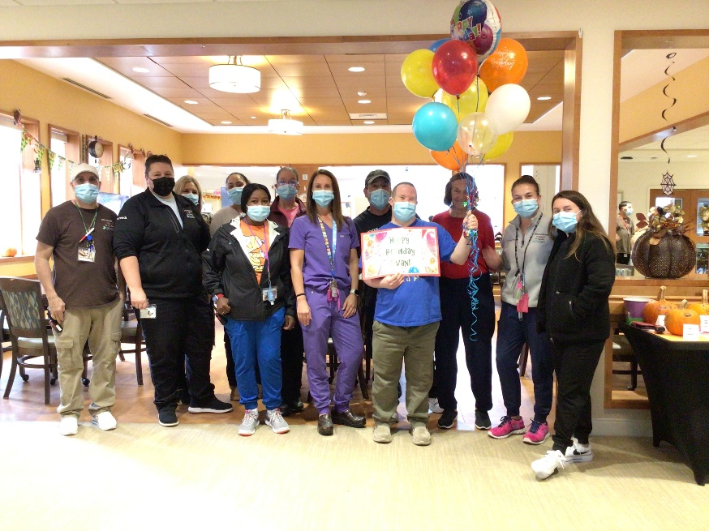
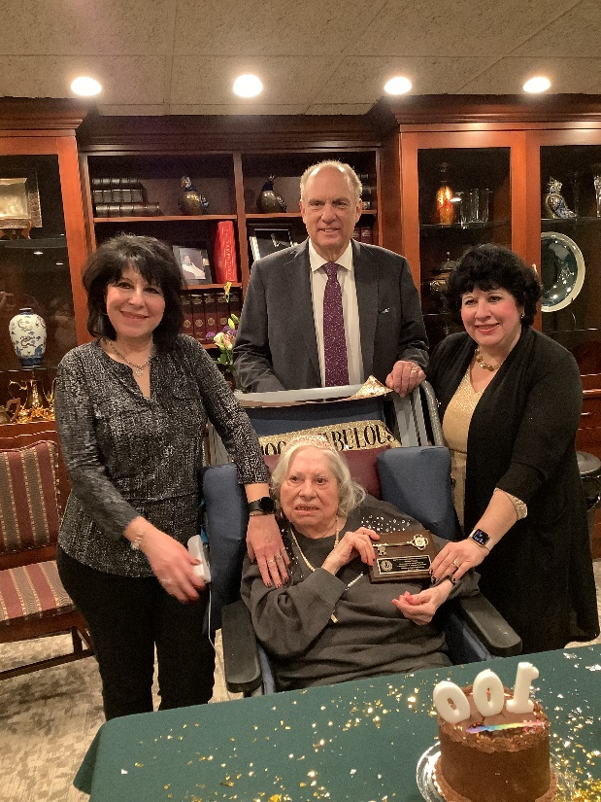
The Dodge Park Difference
From 2020, we transitioned leadership staffing from RPs to LPNs (nurses) on all shifts
All family members have the owners personal cell numbers, and we are always available
High staff to resident ratio
Resident retention is high
We have many residents with us for over 10 years, and some for over 20 years
Leadership and key personnel retention is high
Many staff have been part of our family for 15-20 years

Slide 6
Audited Financials Showing the Unreimbursed Expenses Per Resident Day from 2021-2023 (2024 Was Not Yet Audited by Our CPA)
 | TOTAL EXPENSE | ALLOWED EXPENSE | TOTAL EXPENSE | ALLOWED EXPENSE | TOTAL EXPENSE | ALLOWED EXPENSE | TOTAL EXPENSE | ALLOWED EXPENSE | TOTAL EXPENSE | ALLOWED EXPENSE
 | 2020 | 2020 | 2021 | 2021 | 2022 | 2022 | 2023 | 2023 | 2024 | 2024
TOTAL EXPENSES | $ 5,321,252 | $ 4,527,536 | $ 5,207,493 | $ 4,457,612 | $ 6,221,635 | $ 5,270,528 | $ 6,498,165 | $ 5,562,927 | NA | NA
TOTAL RESIDENT DAYS | 19,809 | 19,809 | 18,704 | 18,704 | 19,887 | 19,887 | 20,156 | 20,156 | NA | NA
COST PER RESIDENT DAY | $268.63 | $228.56 | $278.42 | $238.32 | $312.85 | $265.02 | $322.39 | $275.99 | NA | NA
MASSSHEALTH REIMBURSEMENT RATE | $127.84 | $127.84 | $148.02 | $148.02 | $154.82 | $154.82 | $182.90 | $182.90 | $207.95 | $207.95
PERCENTAGE INCREASE FROM 2020 |  |  | 15.79% |  | 21.10% |  | 43.07% |  | 62.66%
UNREIMBURSED EXPENSE PER RESIDENT DAY | $140.79 | $100.72 | $130.40 | $90.30 | $158.03 | $110.20 | $139.49 | $93.09 | NA | NA
UNREIMBURSED EXPENSE AS A PERCENTAGE OF COST | 52.41% | 44.07% | 46.83% | 37.89% | 50.51% | 41.58% | 43.27% | 33.73% | NA | NA

Slide 7
Rates of Payment to Dodge Park have increased since 2020, after a decade of no or minimal increase, a positive development, but it is insufficient to properly treat the Commonwealth’s elderly population residing in Rest Homes.
Facilities like Dodge Park are being forced by the state government to bear an enormous percentage of the cost of caring for the elderly population of Massachusetts. There have indeed been increases to the annual rate, but these increases come against corresponding increases in the expense of providing services to our residents.
As of 12.31.23, despite recent increases, my company’s loss per public-pay resident, per day, is virtually unchanged ($140.79 in 2020, $139.49 in 2023).
The reimbursement rates were and are sorely insufficient to an alarming degree, and facilities like Dodge Park are not made whole on the cost of providing for these residents.
For the four-year period of 2020-2023, my company paid the shortfall between the cost of care and the reimbursement rate to $130.40 and $158.03 per public-pay resident per day. My company is forced to subsidize the care of the Commonwealth’s responsibility, its elderly residents, with our private pay residents.

Slide 8
The Paradox of the State’s Claim of Reimbursement vs The Actual Problem
The state must recognize that there is a discrepancy between the reimbursement and the actual operation cost as clearly demonstrated in my CPA’s report. The state continues claiming that “we already increased resident public daily rate by XY %” without seeing the whole picture.
What we need:
Immediately adjust the pay to rest homes based on the allowable expenses as per cost report
As you noticed on my CPA report -we do not get reimbursed properly based on the allowable expenses
Immediately start discussions about other expenses that rest homes should be allowed to include in the cost report that will be recognized by the state
This is extremely critical and will require immediate open discussions between the state, MARCH, and facility owners.
Consider different tiers of care & staffing that different facilities provide and consider this in the reimbursement
Match workforce reimbursement benefits paid for workforce hiring and training
When minimum wage increased to $15 an hour, nursing homes received incremental funding to support and hiring staff members. Rest Homes were excluded. And this is just one example.
The goal is to provide quality care, retain and hire good staff and by the end save money to the state.

Slide 9
RCC-Q Challenge
As you are aware, the current RCC-Q threshold for rest homes is set at 80%.
This threshold is higher than the 75% threshold required for nursing homes.
The discrepancy places an undue financial and operational burden on rest homes, which already operate with limited resources and face substantial challenges due to underfunding and rising operational costs.
Financial support to SNF since 2020 was much more significant than to rest homes even though rest homes share the same load of the care.
Facilities like Dodge Park are required to file annual cost reports and the new RCC-Q, which unfairly and capriciously disallows expenses vital to our ongoing functionality. The annual Rates of Payment to Dodge Park and other Rest Home Facilities are SUPPOSE to be based upon these reduced expenses and produce a fraction of this recomputed cost without showing the true picture.
Lowering the RCC-Q threshold for rest homes from 80% to 75%, in alignment with the requirement for nursing homes, would provide much-needed relief to the industry. This adjustment would:
Ensure Financial Sustainability: A lower threshold would increase access to state reimbursements, enabling rest homes to better manage rising costs while maintaining quality care for residents without placing facilities in difficult situations like rate reductions.
Promote Equity: Aligning the RCC-Q requirements for rest homes with those for nursing homes ensures fair and consistent standards across similar care settings.

Slide 10
The Financial Impact of Underfunding
Inadequate Reimbursement Rates
Many facilities are operating at a deficit, relying on limited reserves to stay afloat.
Staffing Challenges
Licensed Nursing Staff Add Significant Cost
Retaining staff year over year (Every $1 increase per staff member=$3200 for employer on annual base). If we have 74 Full-Time Staff Members, we all can calculate the actual annual cost increase.
Deferred Maintenance and Facility Upgrades
Underfunding limits our ability to invest in necessary maintenance and upgrades, leading to outdated facilities that do not meet modern standards.
Deferred maintenance poses safety risks and diminishes the quality of life for residents.
It also poses significant challenges in complying with Life Safety Inspections.
Increased Reliance on Private Funding
This reliance creates inequities and reduces the accessibility of care for lower-income residents.

Slide 11
Consequences for Residents
Compromised Quality of Care
Staffing shortages and financial constraints lead to reduced attention and care for residents.
Limited Access
Financially vulnerable individuals may be unable to find affordable care due to the closing of rest homes.
Mental and Physical Well-being
The stress of financial instability within facilities can trickle down, impacting the mental and physical health of residents.

Slide 12
The Case for Increased Funding
Cost-Effectiveness
Rest homes provide a more affordable care solution compared to hospitals and nursing homes. Increased funding would ensure these cost-effective services remain available.
Workforce Stabilization
Competitive wages and benefits funded through higher reimbursement rates would reduce turnover and improve quality of care.
Facility Modernization
With adequate funding, rest homes can invest in necessary upgrades, ensuring safety and comfort for residents.
Public Health Impact
Stable rest homes reduce the burden on the healthcare system by providing essential preventive and long-term care services.
Allow placement directly from hospital to release the current bottleneck in the healthcare system

Slide 13
Recommendations
Increase Reimbursement Rates
Advocate for a systematic review and adjustment of reimbursement rates to align with current operational costs.
Increase rates for facilities that provide licensed nursing care on site and care for more challenging residents (dementia, behavior, etc)
Establish Emergency Funding
Create a fund to support rest homes in financial distress to prevent closures and ensure continuity of care.
Workforce Development Programs
Allocate resources for training and professional development to build a robust workforce.
When SNF received rate increases for direct care costs, rest homes were excluded. Include rest homes in SNF designations and prove rest homes the same opportunities.
Capital Investment Grants
Provide grants for facilities to undertake necessary upgrades and modernizations.

Slide 14
Conclusion
Underfunding is not just a financial issue.
It is a moral and societal challenge that affects some of the most vulnerable members of our community.
Addressing this issue requires immediate action to ensure that rest homes like Dodge Park remain a viable and essential component of our healthcare system.
I urge the Task Force to prioritize increasing funding and to advocate for the systemic changes needed to support rest homes and aging in place.
Thank you for your time and dedication to this critical issue.
I am happy to answer any questions or provide additional information.

