Slide 1
Restrictive Housing Systems Study:
Program Validation and Best Practices Recommendations
Rick Raemisch
Senior Expert
Scott Semple
Senior Expert
Robin Timme, Psy.D., ABPP, CCHP-MH
Project Manager
Senior Expert & Vice President
Presentation to the Massachusetts Restrictive Housing Oversight Committee
9.24.2020

Slide 2
Introduction and Agenda
Scope of Consultation
Consulting Team
Assessment and Methodology
Capturing the Current System
General Impressions
Next Steps
Report Delivery
Implementation Plan
Discussion and Questions

Slide 3
Scope of Consultation
Independent assessment
All agree that change is good – question of best practices and logistics
Capture current Restrictive Housing system
Compare with evolving practices
Identify strengths
Identify tweaks
Recommend evolution to current model
Additional recommendations as indicated

Slide 4
Consultant Team
Robin Timme, Psy.D., ABPP, CCHP-MH
Project Manager
Senior Expert & Vice President
Rick Raemisch
Senior Expert
Elizabeth Falcon, Psy.D., MBA, CCHP-MH
CEO & Founder
Scott Semple
Senior Expert
David J. Stephens, Psy.D.
Senior Expert
Marc D. Richman, PhD
Senior Expert

Slide 5
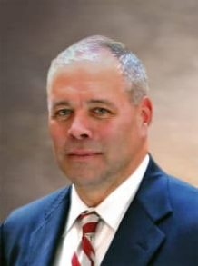
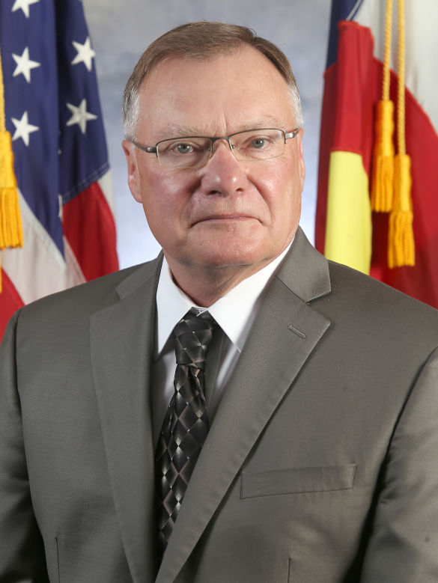
Today’s Team
MDCR TEAM
Scott Semple
Former Commissioner of Corrections (CT)
30+ Years of Experience
European Models
Progressive Programs
Attended all site visits
Rick Raemisch
Former Director of Corrections (CO & WI)
Former Sheriff and Attorney for USDOJ
Restrictive Housing Reforms
International Recognition for Reforms
Robin Timme, Psy.D., ABPP, CCHP-MH
Board-Certified in Forensic Psychology
Temporary License as Psychologist
Specialized Practice in Corrections
Healthcare Delivery in Prisons
Attended all Site Visits

Slide 6
Guiding Principles
Restrictive Housing Definition:
103 CMR 425.05
A placement that requires:
Confinement to cell > 22 Hours Per Day
Does Not Include:
Ordered by Healthcare Provider
HSU, Hospitalization, Suicide Watch
Consistent with ACA and other Standards
Condition of Confinement, Not a Place
The Purpose of Restrictive Housing
Deterrence
Incapacitation
Rehabilitation
Retribution
Effectiveness
Least Restrictive Doctrine
Programming and assumption of clinical or criminogenic need

Slide 7
Sources to Date
Pre-Kickoff Teleconference
Data Request #1
Kickoff and First Workshops
Core Working Group
Legal, Policy and Classification
Treatment and Programming
Release, Systems Issues, and Follow-up
Data Request #2
Small Focus Groups by Theme
Programming
Staffing and Training
Security Operations
Prisoners’ Legal Services
Mental Health System Overview
Data
Healthcare Operations (Wellpath)

Slide 8
Sources to Date
Summary of Stakeholder Involvement
45 Individuals
5 Organizations/Agencies Including DOC
5 Facilities Represented in Meetings
14 Correctional and Healthcare Line Staff
Undersecretary
Commissioner
All Deputy Commissioners
Mid-Point Workshop

Slide 9
Site Visits – Protocol
COVID-19 Precautions
Opening and Closing Meetings
Superintendent and Designees
Regional and Site Mental Health Leadership
Specific Escorts Requested
Interviews
Formal and Informal
Consents
Incarcerated Persons
Inmate-Patients
DOC Staff
Wellpath Staff
Consultation with Mental Health

Slide 10
Site Visits
Day One [8/18/2020]
Souza-Baranowski Correctional Center
Secure Treatment Program (STP)
Restrictive Housing Unit (RHU)
North Side General Population
Health Services Unit (HSU)
Residential Treatment Unit (RTU)
MCI – Shirley
Health Services Unit (HSU)
Clinical Stabilization Unit
Nursing Care Unit
Restrictive Housing Unit (RHU)
A-2 General Population
MCI – Concord
Secure Adjustment Unit (SAU)

Slide 11
Site Visits
Day Two [8/19/2020]
MCI - Cedar Junction
Department Disciplinary Unit (DDU)
Limited Privileges Unit (LPU)
DDU – SMI Contraindicated
Behavior Management Unit (BMU)
Young Fathers [Future]
Old Colony Correctional Center
Bridgewater State Hospital Sentenced Units
Intensive Stabilization & Observation Unit
Recovery Unit
Residential Treatment Unit (RTU)

Slide 12
Mapping the System

Slide 13
Current Restrictive Housing Process
General Population
Health Services Unit
DDU Referral
Restrictive
Housing Unit
Medium Security
Hearing
SMI
Repeat
Residential
Treatment Unit
Behavior Management Unit
Department Disciplinary Unit
Structured Treatment Units
(MAX)
Secure
Adjustment Unit
Residential
Treatment Unit
Secure Treatment Program
SMI
Repeat
General Population
Maximum Security
Hearing
Health Services Unit
Restrictive
Housing Unit
DDU Referral
Source: DRAFT Falcon, Inc. 9.3.2020

Slide 14
Preliminary Impressions

Slide 15
Next Steps

Slide 16
Additional Information and Report Delivery
This Meeting of the RHOC
Your input and questions
Data Request #3 is Under Way
Specific population studies
Assessing Effectiveness
Recidivism Rates
Special Populations
Serious Mental Illness
Substance Use Disorders
Additional Focus Groups
Former Mental Health Clinicians
Formerly-Incarcerated Persons
Legislators
Considerations
Implementation
Planned DDU Move – Opportunity
Culture and Buy-in
Goal: Mid-October Report

Slide 17
Questions & Discussion
Thank You

