Slide 1
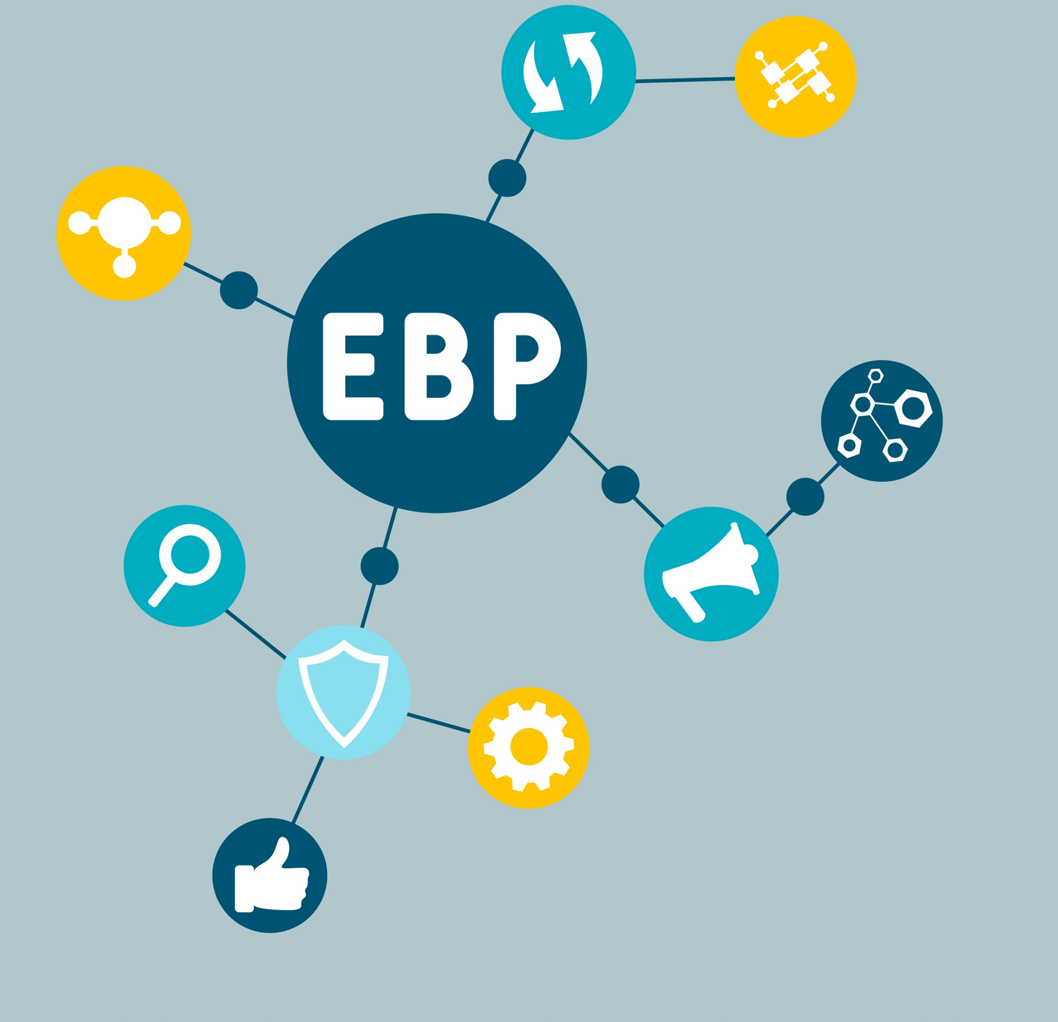
Risk Management
ACCS Principles
Notes:
Introduce Trainers

Slide 2
Learning Objectives
During this module you will:
01
Practice
identifying risk factors
02
Learn
3 key steps to effective risk management
03
Understand
which screening & assessment tools are used in ACCS
Notes:
Explain:
During this module you will:
Practice identifying risk factors
Learn three key steps to effective risk management
Understand which screening and assessment tools are used in ACCS

Slide 3
Introduction
There are three primary clinical risks to assess, monitor and prevent for our ACCS persons served. These risks are ongoing and fluid, and require frequent status checks and potential adjustment of treatment and risk management plans every 90-days:
Suicide Risk
Substance Use Risk
Violence Risk
Notes:
Explain:
The purpose of this module is to give an overview of the importance working with persons served to effectively identify and manage their clinical risks. The details covered here are essential components of the ACCS model that differ from prior models of service delivery you may have used before.
There are three primary clinical risks to assess, monitor and prevent for our ACCS persons served. These risks are ongoing and fluid, and require frequent status checks and potential adjustment of treatment and risk management plans every 90-days:
Suicide risk
Substance use risk, and
Violence risk
We will briefly discuss each of these

Slide 4
Step 1: Identifying Risks
Get a reliable and accurate judgment regarding whether the risk is present for the person served, and, if so, how high is the risk.
Start this process by identifying within the first 45 days of enrollment whether the person served has risk factors.
Risk Factor: Any factor or characteristic that increases the likelihood someone will experience an undesirable outcome
Notes:
Explain:
The first step is always to get a reliable and accurate judgment regarding whether the risk is present for the person served, and, if so, how high is the risk. We start this process by identifying whether the person served has risk factors within the first 45 days of enrollment or within 72 hours of discharge from a hospital
Risk factors are defined as any factor/characteristic that increases the likelihood that someone will experience the undesirable outcome in question.
Facilitator Notes: Examples of undesirable outcomes include attempting suicide, using alcohol to excess, hurting oneself, hurting someone else.
e outcomes include attempting suicide, using alcohol to excess, hurting oneself, hurting someone else.

Slide 5
Risks Factors
Activity
What are some risk factors for heart disease?
People at elevated risk may need some prevention strategies in their treatment plans to reduce the likelihood that they will experience the undesirable outcome. They may never actually experience the outcome because it can be prevented.
What are warning signs that you may be having a heart attack?
Notes:
Ask:
What are some examples of risk factors for heart disease?
(Participants can give examples aloud or write in the chat)
After they give examples, advance slide and explain:
People at elevated risk may need some prevention strategies in their treatment plans to reduce the likelihood that they will experience the undesirable outcome. They may never actually experience the outcome because it can be prevented.
FACILITATOR NOTES: For example, someone who is at high risk of heart disease may need to start a regular exercise regime to decrease their risk. In the mental health context, a person served who is at elevated risk for harming others (violence), for example, may be in need of extra monitoring and supports, anger management or CBT-related treatment, etc.
Then there are ‘warning signs’ which may indicate the individual now needs a more significant intervention to manage the risk.
Advance Slide & Ask:
What are the warning signs someone may be having a heart attack? (Participants can give examples aloud or write in the chat)

Slide 6
Static risk factors
Historical factors that have been demonstrated to relate to risk for suicide. They are non-changeable aspects of the individual’s identity, history, or experience.
Dynamic risk factors
Factors that are potentially changeable or responsive to treatment.
Notes:
FACILITATOR NOTES:
Use the example of identifying risk factors for heart disease to cover static vs. dynamic risk factors.
Explain: There are two types of risk factors. Read the definitions from the slide.
An example of a static risk factor might be family history and an example of a dynamic factor would be high blood pressure, obesity, etc.
The dynamic factors are those that become targets for prevention or intervention.
Ask: What are some examples of dynamic risk factors for heart disease? (Participants can write in the chat or state aloud)
After this introduction, facilitators explain:
Just as there are known risk factors for heart disease, there are known risk factors for suicide, severe substance use and violence.
Just as there are known ways to lower one’s risk of having a heart attack, there are known ways to lower one’s risk for suicide, severe substance use and violence.
Just as there are warning signs that one is having a heart attack, there are warning signs that someone is at imminent risk for attempting suicide, relapse or harming someone.
There are dynamic vs static risk factors for each of these types of risks as well.

Slide 7
Recall the Differences Between Screening and Assessment…
Screened
in
Screening
Assessment
Screened out
Doesn’t have the risk in question
Has the risk in question
Notes:
xplain:
We use valid screening and assessment instruments to identify whether clinical risks are present for any of our ACCS persons served (e.g., suicide, substance use, violence).
Recall from our module about evidence-based practices, that there is a difference between screening and assessment instruments.
Screening instruments are short, generally require minimal training and do not require credentials, and are used as a method for sorting individuals into categories – those who ‘screen out’ do not have the risk in question, and those who ‘screen in’ might have the risk in question
Assessments are more comprehensive and are conducted by specialized staff (clinicians) with individuals who ‘screen in’ as potentially having the concern/risk in question.
Assessments determine the severity of the risk or concern and help guide the best course of action/treatment plans.
Also recall from our module about evidence-based practices, that it is important to use screening and assessment instruments that have evidence as to their accuracy when used with individuals from the cultural backgrounds we serve (e.g., Latinx, Black). In other words, we want to ensure our tools are culturally relevant and valid.

Slide 8
STEP 1: Identifying Risk -Screening
Screening
Low scorers – “Screen out”, do not have the risk in question
High scorers - ”Screen in”, might have the risk in question. Move onto assessment
Screening
Assessment
Assessment
Conduct a full assessment of risks for which our persons served screen high.
Treatment
Plan
Treatment Plan
Design treatment plans, tailored to the person served
The clinician and integrated treatment teams are to review these plans every 90-days.
Notes:
Explain:
The first step to identify risk factors is to conduct screening using valid, evidence-based, screening tools. The value of using EB screening tools is to:
Improve accuracy
Ensure consistency across staff
Minimize any biases
A standard and valid screening process involves administering the screening tool to all persons served at the same time point. Every screening tool we will cover is intended to be administered by clinicians to all persons served at their first intake, within 45-days of enrollment or 72 hours from discharge.

Slide 9
Activity
Have you used or administered screening tools before?
Which tools have you used?
Notes:
Activity:
Ask:
“Have you used or administered screening tools before? Which tools have you used?” (Participants can give examples aloud or write in the chat.)
Facilitator Note:
Ask them about their experience with some of these tools to gauge whether they are familiar with the screening concept.
Explain there are specific screening requirements for ACCS persons served, which will be reviewed briefly in the next slides.

Slide 10
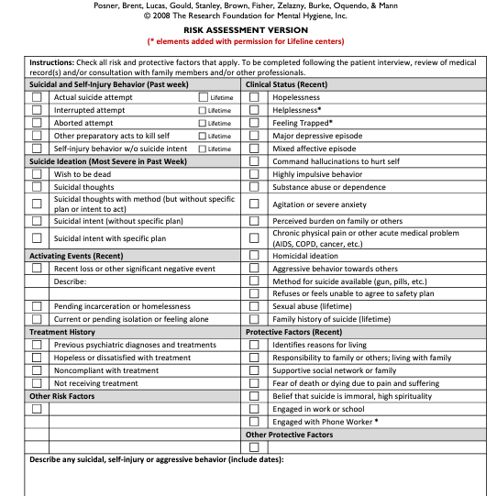
Suicide Risk
Columbia-Suicide Severity Rating Scale (C-SSRS)
Notes:
Explain:
The C-SSRS is a valid screening tool for suicide risk and is required to be used by all ACCS providers.
It is completed based on a brief interview with the person served, a review of their medical history, and possibly consultation with family members or other providers.
It asks about recent (in the past week) and lifetime risk factors, such as suicidal and self-injury behaviors and suicidal thoughts.
It also asks about other risk factors associated with suicide, such as recent feelings (e.g., hopelessness, agitation) and behaviors (e.g., aggressive behavior towards others, substance abuse).
The C-SSRS is available in multiple languages (over 40) and has evidence of its validity with different ages and some cultural groups; mainly Latinx populations (e.g., Argentinian, Mexican, Spanish).

Slide 11
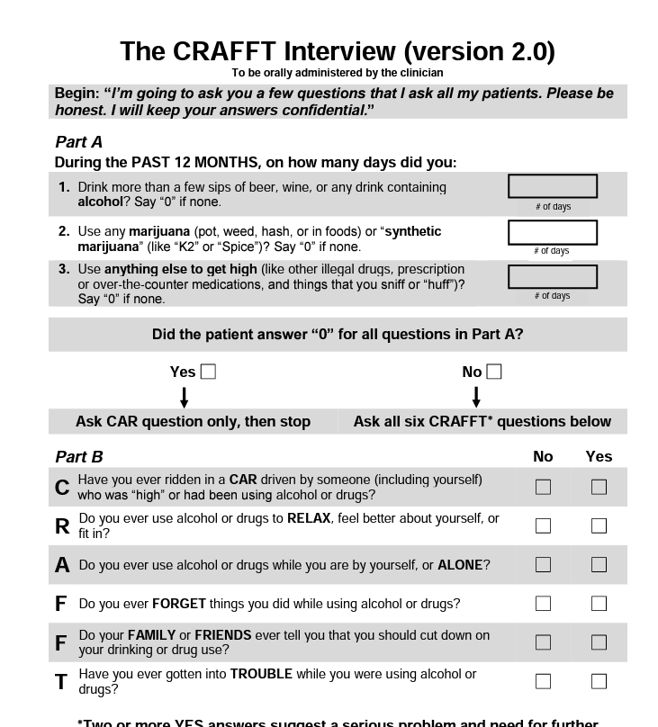
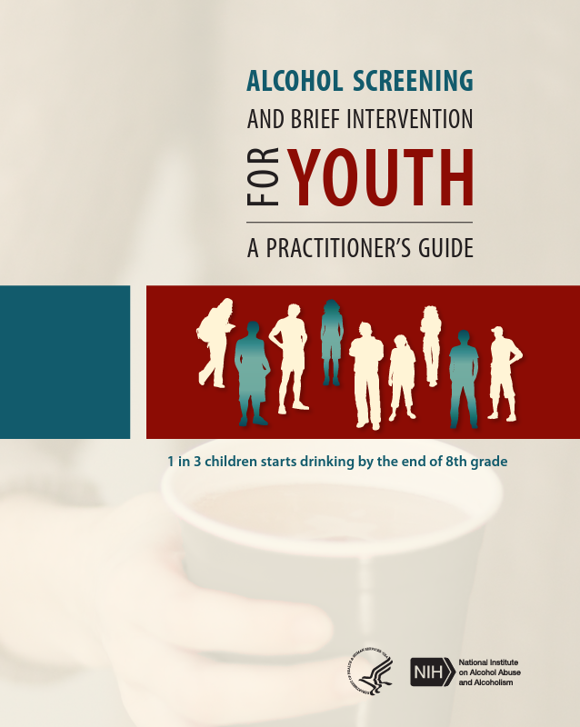
Substance Use Risk
Agencies choose a validated screening tool:
CAGE
CRAFFT
NIAA
Notes:
Explain:
All persons served are also to be screened for risk for substance use.
The slide contains examples of valid substance use screening tools. At this agency we use the…... [insert name of tool]. The ___ has __(#) questions and screens for………[alcohol use/misuse, drug use, etc]
If your agency uses the CAGE or CRAFFT, state the relevant point about its cultural validity below:
The CRAFFT is a brief interview that is administered by a clinician (usually). It has cross-cultural applicability in that it has been translated into almost 30 languages and validated for use with multiple Latinx populations, Native Americans and Alaskan Natives
The CAGE is a questionnaire that contains four questions about alcoholism. It has been translated into at least six languages and has been used with Black & Latinx individuals. However, there is some evidence it may not be very sensitive for Latinx patients.
Facilitator NOTES:
When you describe your agency’s tool, note that SBIRT is not a screening tool – it is an approach for identification to referral to treatment. The SBIRT developers provide a few different screening tool recommendations that can be used as part of this approach (the ‘S’ in SBIRT stands for screening), but there is no such thing as an “SBIRT screening tool”.

Slide 12
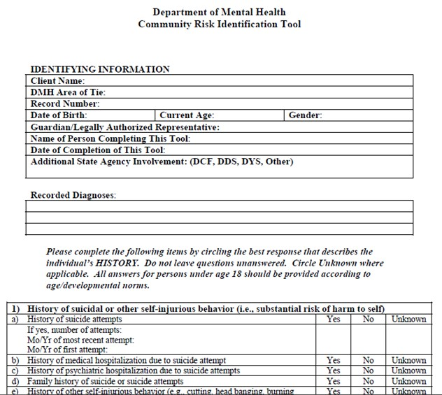
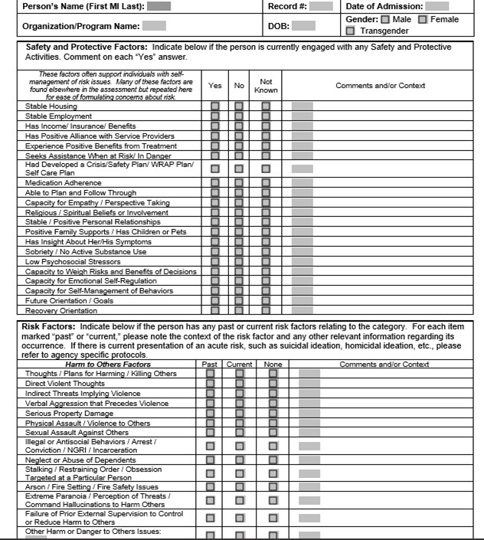
Violence Risk
MSDP
CRIT
MSDP
CRIT
Notes:
Violence risk [agencies should customize this slide as needed]
Facilitator Note:
We ‘screen’ for violence risk by reviewing results of the Community Risk Identification Tool (CRIT) if available, and by conducting a MSDP Comprehensive Assessment for all persons served. These tools gather a lot of historical information about various risks. Violence risk is just one of them.

Slide 13
Screening is portable and should be conducted whenever there is cause for concern.
Clinicians also administer screening tools within 45-days of enrollment and within 72 hours of a discharge from a hospital, detox facility, or jail.
All staff persons should be trained how to screen for suicide risk using the C-SSRS when there is a cause for concern.
Notes:
Explain:
Screening is portable and should be conducted whenever there is cause for concern.
Clinicians also administer these screening tools to our persons served within 45-days of enrollment and within 72 hours of discharge from any facility.
The most important point is to conduct screening whenever there is cause for concern.
Clinicians also may administer screens at each review for checks and balances.
DMH strongly advocates for all staff to be trained in the C-SSRS in order to administer it when there is cause for concern.

Slide 14
STEP 2: Identifying Risk - Assessment
Screening
Portable and should be conducted whenever there is cause for concern
Clinicians also re-administer these screening tools to our persons served at every review
Screening
Assessment
Assessment
Conduct a full assessment of risks for which our persons served “screen in”.
Treatment plan
Treatment Plan
Design treatment plans, tailored to the person served
The clinician and integrated treatment teams are to review these plans every 90-days.
Notes:
Step 2: Assessment
Explain:
The second step in our process for identifying risks is to conduct a full assessment of risks for which our persons served screen high.
It is the assessment that tells us whether the risk is truly present, how severe it is, and what we may need to do to manage their risk and prevent suicide, serious substance use, or violence.
Assessments are used for final decisions related to the extent of risk and treatment planning and are completed by trained clinicians.
(continued on next slide)

Slide 15
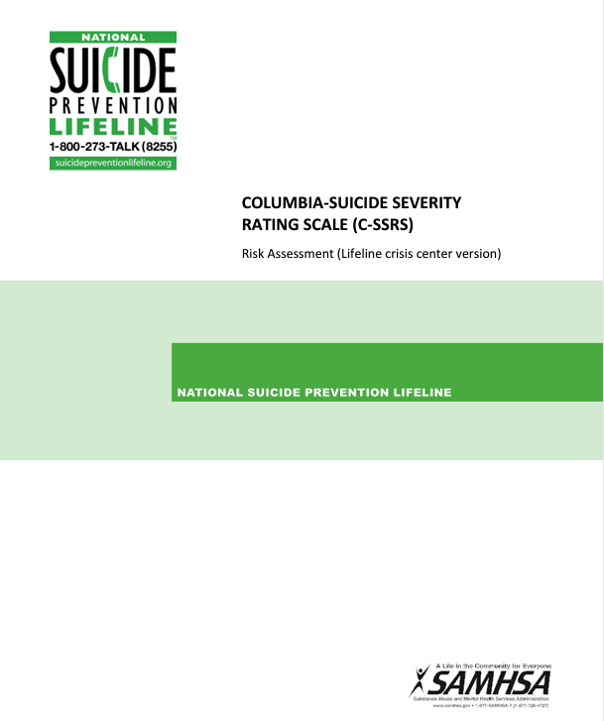
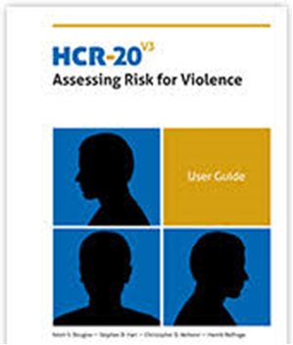
Required Assessments
Columbia full assessment for suicide risk
HCR-20 for violence risk
Substance Use Assessment - selected by agency
Notes:
Clinicians do this by using:
The Columbia full assessment for suicide risk
The [insert agency tool into slide] for substance use risk
The HCR-20 for violence risk
Note that whether an HCR-20 is needed is not based on a clear-cut screening criteria (like a cutoff score).
Rather it is a clinical determination based on the comprehensive assessment as to whether the person served might have a risk of harming others.
Clinicians make the final determination about the need for this assessment after seeking consultation from the Integrated Treatment Team and with DMH as needed.
The HCR-20 has been validated for different racial/ethnic groups, including Black, Hawaiian, and Asian.
For persons served who are identified as definitely having any of these risks in their assessment, clinicians will readminister the assessments whenever a person’s needs change (e.g., change in residence, death of loved one) or annually, at a minimum.

Slide 16
Assessing Functioning and Quality of Life: Self-Sufficiency Matrix
Clinicians complete the Self-Sufficiency Matrix (SSM) with every person served within 45-days of enrollment and every 90-days to identify areas of supports needed
improve access to benefits and resources
increase independence
improve quality of life.
The SSM is used to identify and prioritize functional areas to be addressed in goals and objectives in the treatment plan using a person-centered approach
Notes:
Explain:
In addition to identification of clinical risks, another critical assessment conducted with all ACCS persons served focuses on recovery and areas of well-being, known as Social Determinants of Health (e.g., access to transportation, food security).
Our goal is to help the persons served build resiliency and live independently in the community.
Clinicians complete the Self-Sufficiency Matrix (SSM) with every person served within 45-days of enrollment and every 90-days to identify areas of supports needed to improve access to benefits and resources, to increase independence and improve quality of life. The SSM is completed in a person-centered manner with the persons served identifying areas in which they would like to focus and their goals.
The SSM is used to identify and prioritize functional areas to be addressed in goals and objectives in the treatment plan using a person-centered approach

Slide 17
Activity
What are some examples of areas of functioning or quality of life you think would be important to assess among ACCS persons served?
Notes:
Ask: What are some examples of areas of functioning we might want to assess for ACCS persons served that affect quality of life? Ask them to comment or write in the chat
Facilitator Note:
If needed, provide some examples of functional domains in the SSM: Housing, Employment, Income, Food, substance use and mental health, life skills, disability and physical health, and other functional areas

Slide 18
STEP 3: Treatment Planning
Screening
Portable and should be conducted whenever there is cause for concern
Clinicians also re-administer these screening tools to our persons served at every review
Screening
Assessment
Assessment
Conduct a full assessment of risks for which our persons served screen high.
Treatment
Plan
Treatment Plan
Design treatment plans, tailored to the person served
The clinician and integrated treatment teams are to review these plans every 90-days.
Notes:
Explain:
The third step is to design treatment plans, tailored to the person served, that will manage these risks and prevent negative outcomes from occurring. Development of the treatment plan is a collaborative effort between the person served, clinician, and other members of the team.
The clinician and integrated treatment teams are to review these plans every 90-days.

Slide 19
Elements of the Treatment Plan
The beginning of each treatment plan includes an overall summary of the screening and assessment findings, known as the clinical formulation.
This should include the results of each screen, whether the risks were present or not, and provide the results of any of the assessments and what the person needs to manage these risks.
For individuals with any of these risks present, the treatment plans must include goals and objectives for managing or treating those risks, in language that resonates with the client.
Plans should include goals and objectives related to functional areas of focus identified in the SSM to increase resilience and independence
Notes:
Facilitator Note: Drive the point home that the risks need to be included in the treatment plan when they exist. The exercise later should assist with this.
Explain:
The beginning of each treatment plan includes an overall summary of the screening and assessment findings. This should include the results of each screen, whether the risks were present or not, and provide the results of any of the assessments and what the person needs in place to manage these risks.
For individuals with any of these risks present, the treatment plans must include goals and objectives for managing or treating those risks, in language that resonates with the person served. The management plan is created in a person-centered manner using the approach described earlier.
Plans also should include goals and objectives related to functional areas of focus identified in the SSM to increase resilience and independence
The plan is developed with the persons served and integrated treatment team, which greatly improves the quality of care and ensures a person-centered and recovery-oriented approach

Slide 20
Tips for ensuring good case management:
Every member of the individual’s treatment team should have the person’s current treatment plan, attended integrated treatment team meetings, and be aware of the person’s risks
The SSM should be shared with the whole integrated treatment team
All members of integrated teams should be trained how to use motivational interviewing and engagement techniques to incorporate strategies for managing risks into the treatment plan in a way that is person-centered and recovery-oriented
Notes:
Explain:
Every member of the individual’s treatment team should have the person’s current treatment plan, attend integrated treatment team meetings, and be aware of the person’s risks. This will help to continually reinforce and consistently move towards the person’s served goals.
The SSM should be shared with the whole integrated treatment team.
All members of integrated teams should be trained how to use motivational interviewing and engagement techniques to incorporate strategies for managing risks into the treatment plan in a way that is person-centered and recovery-oriented.

Slide 21
Activity
How do the case management tips affect your role?
What do you think you could do to help prevent undesirable outcomes, such as suicide risk or aggression?
How might you help persons served to achieve their functional goals?
Notes:
Explain that even though they have limited experience at this point, you would like them to start thinking about their role and what they can do to provide the person served with the best care.
Ask:
How do the case management tips affect your role?
What do you think you could do to help prevent undesirable outcomes, such as suicide risk or aggression?
How might you help persons served to achieve their functional goals?
Facilitator notes: Some potential answers:
Every staff should have basic skills in motivational interviewing and how to have difficult conversations with persons served who are risky
Every ITT member should know results of the SSM and risk screens, and the treatment plan and strategy
Every member should be trained in the C-SSRS and know when to conduct if needed
Treatment team members, particular peer specialists and recovery coaches, help improve resiliency by modeling and coaching (e.g., attending community-based, peer-led groups, riding public transportation together until confidence is achieved)

Slide 22
Activity
How to talk about risks with persons served to motivate them to include these in their treatment plan goals
Notes:
Explain: In this video, we will review an example of how to talk about risks with persons served to motivate them to include these in their treatment plan goals (e.g., MI, harm reduction).

Slide 23
Activity
Notes:
Slide 23: Video
(5 minute video)
Show video example related to substance use, then ask for their reactions.
https://www.aamc.org/what-we-do/equity-diversity-inclusion/lgbt-health-resources/clinical-vignettes/substance-use-history

Slide 24
In the remaining sections we will discuss briefly:
Motivational interviewing techniques
Strategies for suicide prevention
Strategies working with persons served with severe substance use histories
Notes:
Explain:
In the remaining sections we will discuss briefly:
Motivational interviewing techniques
Strategies for suicide prevention
Strategies working with persons served with severe substance use histories

