Slide 1
Energy Affordability Overview: Landscape of Energy Burden & Reform Options
June 24, 2024

Slide 2



About Us
RMI (formerly the Rocky Mountain Institute) is a nonprofit organization working with public utilities commissions, advocates, and other stakeholders to advance affordable and equitable decarbonization across the United States.
Rachel Gold
Principal
Maria Castillo
Senior Associate
Carina Rosenbach
Senior Associate

Slide 3
Objectives
Propose a framework through which to understand the causes of energy burden and the regulatory options to mitigate it
Present an overview of the energy affordability landscape in MA and reforms under consideration in this docket to support the stakeholder discussion to follow
Share examples of energy affordability reforms around the U.S. for stakeholder and Department consideration

Slide 4
Table Setting on Energy Burden

Slide 5
What is energy burden?
Energy burden
Energy costs
household income
Consumption (kwh, therms, gallons)
Energy price ($/kwh, therm, gal)
(+ customer, demand costs)
Usage behavior
Energy efficiency (EE)
Rate components
Rate design
Behavioral EE
Active demand response
EE programs
Codes & standards
Rate base * return on equity (ROE) = return
Operating Expenses
Taxes
Notes:
Definition is energy costs/house hold income
Household income is largely out of the control of economic regulation for energy – so we’ll set that aside for now, although it is important to note that there are ways in which energy programs and protections can support areas like workforce development
When we think about energy costs – a very simplified way to break that down is price * consumption – how much energy costs times how much you use it (recognizing there are also some fixed elements to many bills). Let’s take each in turn.
Consumption – what we can do here is reduce and shift energy needs
We have a range of tools to influence usage behavior – like active demand response programs, time-varying rates, and behavioral energy efficiency – and we should make sure customers have those tools available. However, that can only go so far since we know that some customers deprive themselves of
When we think about the opportunity here in Massachusetts, it’s about 1) ensuring these programs work for the most energy burdened customers and 2) making sure
Price
What’s in scope for the conversation today are a series of interventions or policies designed to make bills more affordable for the customers that are most energy burdened.
Others like arrearage management plans help to reduce debt and support regular payment
And disconnection policies help to protect energy access
That’s a great place to start, but it’s the top of the iceberg, and misses the opportunities Massachusetts has to reduce bills for all customers. Those may be more appropriately covered in the context of other proceedings

Slide 6
Making bills more affordable for the most energy burdened customers
Protect energy access
Reduce debt and support regular payment
Reduce energy needs
Make bills more affordable
Low-income energy efficiency programs
Protections from utilty shutoffs and disconnections
Debt forgiveness and payment plans
Rate designs with a discount or arrearages forgiveness
Notes:
LI EE
Opportunities to scale
Stacking
Enrollment, verification considerations
LI DR and PIPPs
Opportunity: consider new offerings and updated designs to better meet needs

Slide 7



Making bills more affordable for all supports the most energy-burdened customers
Across U.S., concerns about spending surge to address climate risks, replace aging infrastructure, address fossil fuel volatility, accelerate energy transition across sectors
The solution? Regulatory reforms designed to address local cost drivers.
Fuel volatility? Fuel cost sharing, transparency policies
Poor cost containment? Multi-year revenue plans with revenue caps, shared savings mechanisms, performance incentive mechanisms, more careful use of cost trackers
Capex bias? Capex-opex equalization
Inflated ROE? ROE reforms to match reasonable risk premiums
New technologies and grid capabilities offer the promise of addressing these challenges through a portfolio strategy across demand, storage, clean supply
But an imperfect, outdated regulatory model creates problematic incentives – for capex bias, gold plating, etc. that stymie an affordable transition
Notes:
Why it matters now more than ever
Expected spending surge + need to keep rates affordable through it
Why it’s more achievable now than ever
New technologies/grid capabilities (e.g., GETs, AMI, demand flexibility)
Why the existing regulatory system falls short of achieving it
Imperfect, outdated regulatory model that creates problematic incentives

Slide 8
Landscape of Energy Affordability in US & MA

Slide 9
Everyone has an energy burden, not everyone is energy burdened
Energy burden | Household classification
< 4% | Non energy burdened
4-6% | Energy stressed
7-10% | Energy burdened
10%+ | Energy impoverished
Source: Brown, et al High energy burden and low-income energy affordability: conclusions from a literature review (2020)
Source: Cook and Shah, Reducing energy burden with solar: Colorado's strategy and roadmap for states National Renewable Energy Laboratory (2018)
Notes:
NREL, Cook and Shah
Tee up energy insecurity

Slide 10
Low-income households in MA spend 4.5x more of their income on energy than non-low-income households
Source: US Department of Energy, LEAD Tool (2020)*
* Data values are for 2018
Notes:
LIHEAP eligibility in MA, one of multiple AMP criteria, is 0-60% SMI

Slide 11
The lowest income households in MA by FPL spend a fifth of their income on energy bills
Source: US Department of Energy, LEAD Tool (2020)*
* Data values are for 2018
Notes:
Eversource provides a 42% bill discount1 for those <200% Federal Poverty Limit (FPL)
FPL range household numbers:
0-100%: 246,021
100-150%: 167, 879
150-200%: 158, 130
200-400%: 597, 287
400%+: 1,477, 263

Slide 12
While owners have higher energy expenditures than renters, low-income renters and owners have highest energy burden
Source: US Department of Energy, LEAD Tool (2020)*
* Data values are for 2018
Notes:
DOE LEAD Tool1q

Slide 13
In Massachusetts, over a million households reported facing a form of energy insecurity in the last year
Energy insecurity is the inability of a household to meet its basic household energy needs.
25% of households forwent expenses, such as food or healthcare, to pay energy bill
18% leave home at an unsafe or unhealthy temperature
20% unable to pay their energy bill in full
1.3
million
987k
917k
Nearly ¼ of families that forewent expenses had to do so nearly every month.
Source: US Census Bureau, Census Household Pulse Survey (2024)

Slide 14
Energy “shutoffs”/disconnections back on the rise after temporary COVID-19 protections
Source: Utility Disconnections Dashboard, Indiana University (2024)

Slide 15




Disconnecting a household’s electricity deeply destabilizes vulnerable households
Higher likelihood of sickness, hospitalization, developmental delays, and medical emergencies; life threatening for those on medical devices that require electricity
Health
“I went without electricity for 2 days. I used candles so I could see at night... I ended up having to take out a payday loan. I felt bad and frustrated that I couldn’t pay for something that, to me, is a basic necessity.” – Marcela, San Diego
Finances
Potential to jeopardize a child’s healthy living environment; may lead to eviction or foreclosure and unconventional, potentially unsafe means of lighting, heating, and cooling
Safety
Source: Living without Power – Health Impacts of Utility Shutoffs in California, The Utility Reform Network (2018);
Surviving a Shut-Off: U.S. Households at Greatest Risk of Utility Disconnections and How They Cope, American Behavioral Scientist (2021)
Notes:
https://energyrights.info/content/living-without-power-health-impacts-utility-shutoffs-California
https://housingmatters.urban.org/research-summary/which-americans-face-greatest-risk-utility-shut-offs-and-how-do-they-cope
Since 2009, shutoffs have resulted in the deaths of at least 11 California residents due to fires caused by candles, extension cords or carbon monoxide poisoning from portable heaters.9

Slide 16
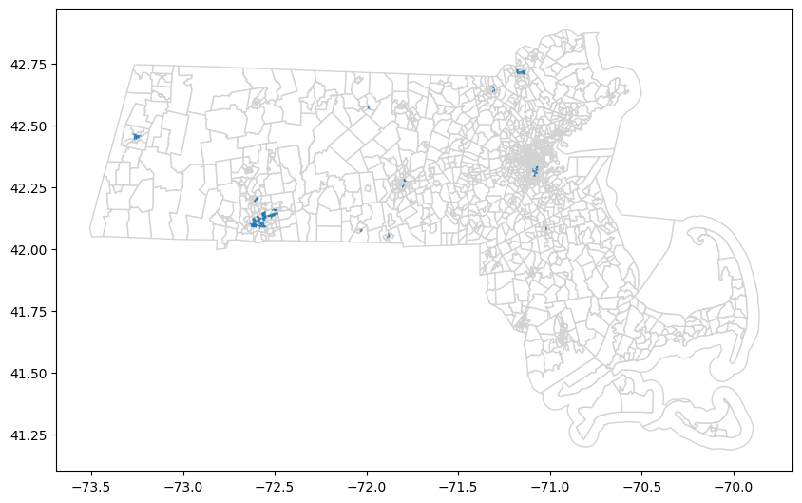
Fifty-four communities in MA identified as “disadvantaged” qualify due to their high energy burden
A ”disadvantaged” community is a designation for a census tract that is overburdened by environmental, climate, and socioeconomic factors and/or historically underserved.
Justice40, a federal government initiative, seeks to deliver 40% of the overall benefits of investments in climate, clean energy, and related areas to disadvantaged communities.
Notes:
Other lenses - burden

Slide 17
Fifty-four communities in MA identified as “disadvantaged” qualify due to their high energy burden
A ”disadvantaged” community is a designation for a census tract that is overburdened by environmental, climate, and socioeconomic factors and/or historically underserved.
Essex County:
- 95% Latino
- In 90th percentile for energy burden and linguistic isolation (~35% of population)
Hampden County:
- Significant minority population, 30% Black and 45% Latino
- In 90th percentile for energy burden, diesel PM pollution exposure
Justice40, a federal government initiative, seeks to deliver 40% of the overall benefits of investments in climate, clean energy, and related areas to disadvantaged communities.
Plymouth County:
- Diverse population: 40% white, 24% Latino, and 11% Black
- In 90th percentile for energy burden, high unemployment rate, housing burden

Slide 18
Policy opportunities for addressing energy burdened population in MA
Low-income households are most in need of solutions that systematically manage their energy burden and keep them out of the energy poverty cycle.
Low-income energy burden is 4.5x higher than for non-low income households
The lowest income households in (0-150% FPL) spend up to 20% on energy expenditures
Low-income renters and home-owners have highest energy burden across other income/owner groups
1 out of every 4 households in MA reported not being able to pay their energy bill in full
Debt management and forgiveness program
Tailored bill assistance
Low-income energy efficiency
Protections from utility ”shutoffs”/disconnections

Slide 19
Landscape of Energy Affordability Solutions

Slide 20



Most states offer at least one of these programs and policies to support low-income customers, while MA offers several
Low-Income Discount Rates – 12+ states
Percentage of Income Payment Plans (PIPPs) – 9+ states
Cap energy bills as a percentage of household income (e.g., 6% of monthly household income)
Arrearage Management Plans – 10+ states
Low-Income Energy Efficiency Programs – Most states
Disconnection Protections – Most states offer some protection
Target energy efficiency benefits to low-income customers (e.g., weatherization, more efficient appliance deployment, and/or improved controls)
Protect customers from shutoffs for nonpayment, typically on a temporary basis or under certain conditions (e.g., cold-based protections, protections for vulnerable customers, etc.)
Provide energy at a discounted price, which can be flat (e.g., 30% discount on the utility’s kWh rate) or tiered (e.g., the discount varies by income group).
Provide a payment plan for customers in arrears to pay down their debt over time, with debt forgiveness for timely payments (e.g., 1/12 of debt forgiven for each timely payment)
LEGEND
MA has the policy
MA does not have the policy
Notes:
Sources:
•Discount rate: https://www.cga.ct.gov/2018/rpt/pdf/2018-R-0051.pdf
•PIPP: internal research
•AMP: https://www.utilitydive.com/news/utility-exec-and-consumer-advocate-arrearage-management-programs-are-a-win/579357/
•EE: https://database.aceee.org/state/guidelines-low-income-programs
•Disconnection protections: https://energyjustice.indiana.edu/disconnection-dashboard/index.html

Slide 21
Each program and policy has its benefits and drawbacks, depending on design
Low-Income Discount Rates
Benefit: Can provide relief to energy burdened customers
PIPPs
Benefit: Can directly reduce energy burden, including for customers who are severely burdened, and protect against rising rates
Arrearage Management Plans
Benefit: Can help customers more manageably reduce their debt and avoid disconnection, while reducing the cost of bad debt for utilities and all ratepayers
Low-Income Energy Efficiency Programs
Disconnection Protections
Drawback: A flat discount rate may not significantly improve energy burden for the most severely burdened customers
Drawback: May change customer’s marginal incentive to save energy
Benefit: Can reduce energy burden by helping customers to lower their consumption, thus lowering overall bills
Drawback: Health and safety issues in housing stock may mean that additional efforts are needed to achieve desired savings
Benefit: Can help maintain critical basic energy services for energy burdened and/or vulnerable customers who are unable to pay their bills
Drawback: Without a robust portfolio of protections in place, may fail to protect access for certain customers
Drawback: Unless paired with bill assistance, may not address underlying causes of financial hardship, leading to recurring debt problems

Slide 22
Most states have taken a patchwork approach to disconnection protection, including MA
Protection | Landscape overview
Requirements for the number of days post-bill before disconnect
In-person/phone notification requirements | Attempt in-person notice: 12 states (including MA) Attempt notice by phone: 22 states (including MA) Written notice: 49 states (including MA)
Minimum arrearage before disconnect requirements
Weather-based disconnection protection | 41 states offer cold-based protection (including MA) 20 states offer heat-based protection (not including MA)
Protections for vulnerable customers | MA is 1of only 3 states that protects financial hardship households with baby < 12 months MA also delays disconnection up to 3 months for low-income customers with medical conditions (1 of 45 states) MA restricts disconnections for households with elderly customers > 65 (1 of 14 states) Unlike a handful of states, MA does not extend protections to customers with disabilities
HI
CA
MA
NH
0 days
15
19
30
48
60
HI, MA, CA
UT
CO, etc⁴
NH, MD
NJ
AZ, RI
$0
$25
$50
$100
$200
$300
Notes:
1. Utility Disconnections Dashboard: Utility Disconnections Dashboard (exosphere.app), 2. In some states (e.g., NH), the utility is required to delay disconnection if they cannot reach the customer. This is not required in HI. 3. There are various caveats to these minimum arrearages by state. 4. Colorado, Nevada, Vermont, Idaho, and Maine.

Slide 23
MA can consider a number of complementary strategies to scale participation across programs
SIMPLIFIED ENROLLMENT – Streamline the application and enrollment process as much as possible, including by taking an automatic enrollment or self-certification approach to income verification. Allow automatic renewals.
AGENCY DATA SHARING – Identify and enroll eligible customers through information sharing and collaboration between utilities and state agencies (e.g., cross-enroll customers in nutrition assistance and energy assistance programs).
UTILITY DATA – Direct utilities to leverage AMI data and any purchased data (e.g., from a third party) for customer targeting and enrollment in low-income assistance programs.
INCREASED INCOME ELIGIBILITY – Consider extending program eligibility to moderate income customers beyond 200% of the Federal Poverty Limit (FPL) to reach more customers in need. This may require statutory support.
MARKETING & OUTREACH – In addition to traditional channels such as bill inserts and marketing campaigns, consider partnering with local community-based organizations to support program marketing and outreach to customers in need.

Slide 24
Tiered low-income discount rates and PIPPs are closely related and can be designed to work similarly to reduce energy burden
Feature | Tiered-Discount Rate | PIPP
Energy Burden Impact | With a larger number of tiers, the rate can more directly address energy burden for different income groups Ex: NH’s discount rate includes 8 tiers | PIPPs tie the level of assistance directly to a household’s income, ensuring a direct reduction in energy burden.
Protection Against Rising Rates | The discount can be calculated using a pre-determined energy burden level and recalculated as rates increase Ex: CT’s discount rate is designed to achieve 6% energy burden and will be reviewed biennially | By definition, PIPPs cap bills at a certain energy burden level, therefore protecting against rising rates.
Bill Stability | The discount rate can be paired with fixed billing to provide level bills month-to-month Ex: NY’s discount rate customers are automatically enrolled in the state’s budget billing program | PIPP bills remain even month-to-month, given that they are capped at a certain income level
Energy Efficiency | Discount rates have an inherent conservation incentive given that bills vary with usage, but discount rate customers can also be encouraged to enroll in energy efficiency programs. | PIPPs can incentivize or mandate energy efficiency Ex: VA’s PIPP customers are required to participate in energy efficiency and weatherization programs

Slide 25



In a rare instance of broad disconnection reform, the Los Angeles Department of Water and Power (LADWP) has ended disconnections for low-income and elderly customers
 | Context | The lowest-income households,¹ as well as majority-Black and majority Latino communities, were more than 2x as likely to be shut off from power and water compared to higher income households and white households
 | Why it’s innovative | The reform responds to LADWP data showing that shutoffs are not an effective collections tactic
 | Evidence base | Shutoff protection does not lead to free ridership: The majority – 63% of EZ-SAVE customers and 78% of Lifeline customers – remained current on their bills during the COVID-19 shutoff moratorium. These groups paid their bills at the same rate or higher than all customers.¹
“
The fact that these customers — when they have the opportunity, when they can – do pay, really does remove, from my perspective, the power of [the free rider argument], and tells us that their lack of payment isn’t a lack of responsibility... It’s a result of their actual inability to pay the bill.
- LADWP Commission President Cynthia McClain-Hill⁴
”
1. Making under $50K/year: Board of Commissioners Meeting - Sep 27th, 2022 (granicus.com). 2. EZ-SAVE is the low-income discount, Lifeline is for those with a disability and/or over 62 years, 3. Shutoffs motion: https://ladwp-jtti.s3.us-west-2.amazonaws.com/wp-content/uploads/sites/3/2022/11/15133047/N.17-Shutoffs-Motion.pdf, 4. https://www.latimes.com/cali fornia/story/2022-11-16/l-a-to-end-water-and-power-shutoffs-for-low-income-customers-who-cant-pay

Slide 26
MA stakeholders can consider the following reforms to current low-income programs and policies to address energy burden
Modifications to existing programs & policies
Low-income discount rate – A tiered low-income discount rate that varies by income group could more directly reduce energy burden
New programs & policies
PIPP – PIPPs provide the most direct solution for mitigating energy burden. Pairing a PIPP with an energy efficiency program requirements can ensure additional value for the customer, the utility, and the grid.
Scaling customer participation across programs – Streamlined enrollment, use of utility AMI data, expanded marketing and outreach, and increased eligibility can help the state reach more customers in need.
Disconnection protections – Heat-based protections, protections for people with disabilities, and minimum arrearage requirements can help energy burdened & vulnerable customers retain energy access. More broad reform may protect additional customers.

Slide 27
Appendix

Slide 28
All states have access to federal Low-Income Home Energy Assistance Program (LIHEAP) funds, but participation varies
LIHEAP by the Numbers in MA
Household participation
18.5% of eligible households enrolled in LIHEAP in 2023
668k households eligible for LIHEAP did not receive assistance
Energy burden addressed through LIHEAP
2% of total energy burden covered through LIHEAP assistance in MA
Assistance received in 2023
152k households received heating assistance
13,229 received winter or year round crisis assistance
8,042 households received weatherization assistance
Notes:
MA crisis definition:
Crisis Definition:
The crisis intervention component of Massachusetts’ LIHEAP is a FastTrack system, integrated into the heating assistance program, for prioritizing and expediting services to households experiencing heating emergencies. The purpose of this FastTrack system is to provide swift response to heating emergencies, while steering applicants into the mainstream heating assistance component with full benefits. Emergency
applications are given priority at all intake and processing steps. LAAs are required to provide for emergency response within 24 hours or 18 hours of the eligible household’s application or request, in accordance with the statute and corresponding procedures outlined in the Fiscal Year 2023 Administrative Guidance.
Life-threatening Crisis Definition:
A life threatening crisis includes no heat for any reason such as out of fuel, utilities disconnected or heating system failure. When an applicant notifies the Subgrantee of their emergency, the Subgrantee reviews the application and requests any documentation still required to complete the application. The emergency application is given certification priority. If eligible, the vendor will be authorized to make a delivery, or guaranteed a payment in cases of eviction or utility disconnection.
Eligibility/Priority: 60% SMI
BenefitsWinter: $1,600

Slide 29

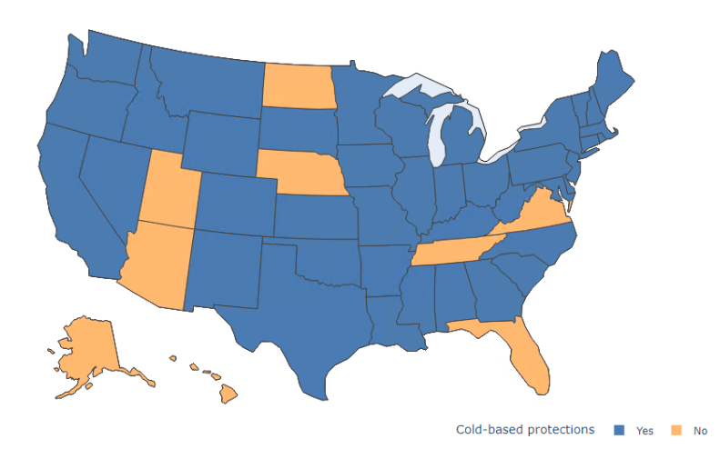
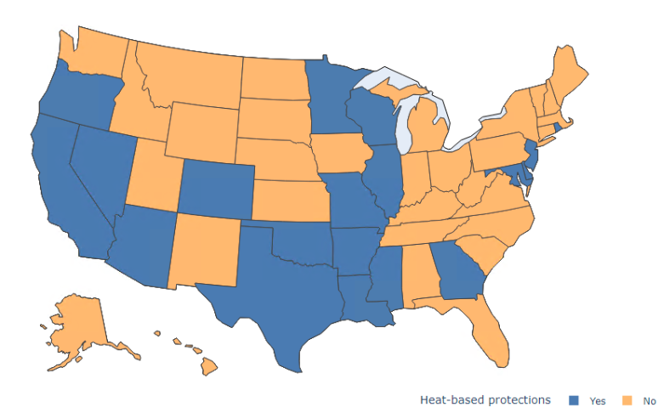

Weather-related disconnection protections
These narrower reforms prevent utilities from disconnecting customers during times of extreme cold or heat. They aim to ensure customers retain access to essential heating and cooling.
Cold-based protections (41 states)¹
Heat-based protections (20 states)¹
Protection below 32°F
No protection
Heatwave protection
No protection
Legend:
Has protection
Doesn’t have protection
1. University of Indiana Energy Justice Lab: Utility Disconnections Dashboard: https://http-149-165-173-211-80.proxy-js2-iu.exosphere.app/, 2. States with the highest average high and low temps are Florida, Hawaii, Texas, and Louisiana: Extreme Weather Watch

Slide 30

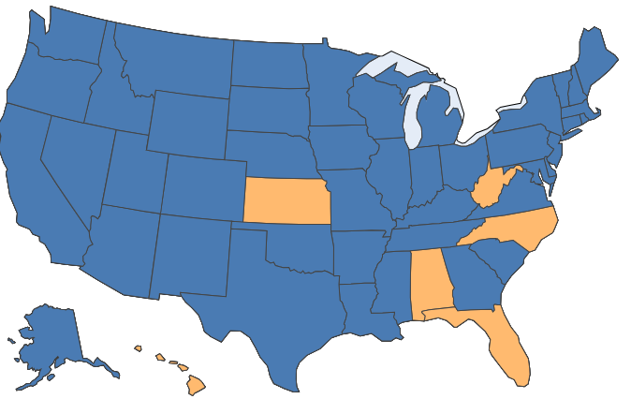
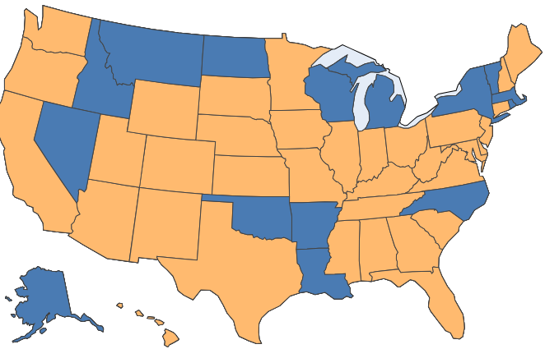
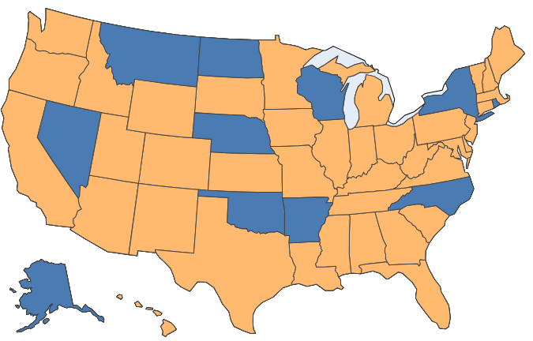
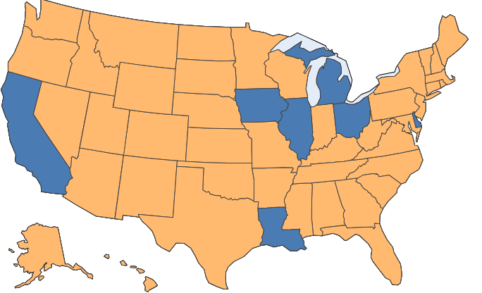
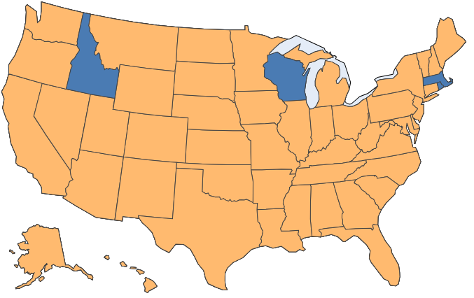
Disconnection protections for certain customer groups
These narrower reforms protect vulnerable customer segments – including the medically vulnerable, the elderly, people with disabilities, military personnel, and households with young children – from disconnection, typically on a temporary basis.
 |  | Examples
Protection |  | CA | MA | NH
Medical (45 states) |  | Physician’s certificate required, payment plan required | Physician’s certificate required, disconnection deferred 3 months (6 months if chronic illness)¹, financial hardship customers only² | Physician’s certificate required, disconnection deferred up to 1 year
Elderly (14 states) |  | No protection | Utility must gain written approval from DPU to terminate service if all adults 65+ years and presence of financial hardship | Presence of 65+ considered when utility requests to disconnect a household
Disabilities (11 states)
 |  | No protection | No protection | No protection
Military (7 states) |  | 180 day disconnection delay, payment plan required | No protection | No protection
Young (4 states) |  | No protection | <12 months old and presence of financial hardship | Utility must request permission from Commission to disconnect customers & include info on presence of children <5 years
Notes:
Notes: University of Indiana Energy Justice Lab: Utility Disconnections Dashboard: https://http-149-165-173-211-80.proxy-js2-iu.exosphere.app/ . 1. Terms around deferring disconnection vary by state. Certificates must be renewed periodically. 2. Protections only apply to financial hardship customers (LIHEAP-eligible customers)

Slide 31
California’s highly utilized LI rate (“CARE”) model vastly improves energy affordability for very low-income customers
In MA, Eversource provides a 42% flat discount
Discount & Eligibility
For decades, CARE has provided a 30-35% bill discount for those <200% FPL. A separate program, FERA, has provided an 18% discount for those <250% FPL
Same eligibility threshold for MA program
Benefits
High utilization rate for CARE: 91%+¹
Impact: Utility affordability is improved significantly for customers in vulnerable areas. Very low-income households spending 16-92% of their disposable income on electricity before CARE are now spending 10-55%²
All ratepayers except CARE participants contribute to CARE and other programs through the Public Purpose Program Charge (PPPC), which constitutes ~5% of customer’s bills³
CARE specifically corresponds to a ~$3-5 surcharge for applicable residential customers⁴
MA program utilization rate is ~32%
Cost Recovery
MA program is funded through RAAF (~$2.80/month surcharge)
1. ESA CARE Annual Reports 2022, Summary Highlights Tab, Enrollment Rate; Total Enrolled, Participants, Actual. CARE: 90% enrollment goal consistently met. FERA: D.21-06-015 established 50% enrollment goal by 2023 and a 70% by 2026. 2 Affordability ratio (electricity costs/disposable income) measured for households at the 20th percentile of the local income distribution. 2020-annual-affordability-report.pdf (ca.gov). 3. PG&E Electric and Gas Rates Fact Sheet 2022 - 3-29-22.pdf. Includes C&I customers. 4. ESA CARE Annual Reports 2022, CARE Table 10, Electric. Surcharge % varies by utility: PG&E: $5.18, 4.4%; SCE: 3.1%; SDG&E: $3.70, 2.6%. These are for CARE only

Slide 32
New Hampshire and Connecticut provide example structures for tiered LI rate design
State | New Hampshire | Connecticut
Name of Program | Electric Assistance Program (“EAP”) | Low-Income Discount Rate (“LIDR”)
Discount | Discount rate is sliding scale between 5% to 86% depending on household income | Tier 1: 10% Discount Rate Tier 2: 50% Discount Rate
Eligibility | Households <200% of the FPL | Tier 1: Households <60% state median income Tier 2: Households <160% FPL
Cost Recovery | Funded through System Benefits Charge on monthly customer utility bills | Funded through System Benefits Charge on monthly customer utility bills
Additional Features | Monthly usage cap at 750 kWh of consumption Statewide program for all 4 utilities in the state, meaning that cost recovery is distributed more widely across customers of all service territories | Monthly usage caps of 800 kWh (Tier 1) and 1,200 kWh (Tier 2) Program designed with explicit policy goal of limiting household energy costs at 6%
Notes:
New Hampshire’s LMI rate recognizes that very low-income households need significantly higher levels of support, thus a discount of 76% is possible for households at less than 75% of the federal poverty guideline.
• New Hampshire’s LMI program is statewide, so it coordinates across service territories for a consistent state-wide approach.
• New Hampshire’s LMI program distributes the cost across all NH utility ratepayers, which tends to even out any disproportionate impact of one utility serving relatively higher numbers of LMI customers than others.
• New Hampshire’s LMI program provides more certainty for LMI ratepayers who move from one utility service area to another

Slide 33
California and Virginia provide example structures for PIPP design
State | California | Virginia
Name of Program | Percentage of Income Payment Plan Pilot | Percentage of Income Payment Program
Cap | 4% of household income | 6% of household income for those with non-electric heating 10% of household income for those with electric heating
Eligibility | CARE customers who are either located in one of the zip codes with the highest rates of disconnections, or who have experienced 2+ disconnections during the year prior to the moratorium | <150% of the FPL
Cost Recovery | PPPC. Estimated total bill subsidy costs of $23 million and administrative costs of $15 million. | Universal service fee on non-participating customers’ bills (~79¢ monthly surcharge)
Additional Features | The pilot, launched in 2021, aims to enroll 15,000 participants across CA’s major IOUs | Requires reduction in energy consumption through weatherization or energy efficiency programs
Notes:
New Hampshire’s LMI rate recognizes that very low-income households need significantly higher levels of support, thus a discount of 76% is possible for households at less than 75% of the federal poverty guideline.
• New Hampshire’s LMI program is statewide, so it coordinates across service territories for a consistent state-wide approach.
• New Hampshire’s LMI program distributes the cost across all NH utility ratepayers, which tends to even out any disproportionate impact of one utility serving relatively higher numbers of LMI customers than others.
• New Hampshire’s LMI program provides more certainty for LMI ratepayers who move from one utility service area to another

Slide 34
The lowest income households in MA have the second lowest energy burden across similar income households in the Northeast
Source: US Department of Energy, LEAD Tool (2020)*
* Data values are for 2018
Notes:
Note about other fuel expenditures showing up in other states

Slide 35
Across income groups, share of energy expenditures by fuel remains consistent
Source: US Department of Energy, LEAD Tool (2020)*
* Data values are for 2018
Notes:
DOE LEAD

Slide 36
Households residing in smaller multi-family units and mobile homes have a higher energy burden on average
Source: US Department of Energy, LEAD Tool (2020)*
* Data values are for 2018
Notes:
DOE LEAD

