Slide 1
Rural Development Fund Guidance Webinar
Community One Stop for Growth

Slide 2
Road Map
What is the Community One Stop for Growth?
Program Overview
Where does the Program Fit in the One Stop?
Important Program Parameters
How to Be Competitive
Examples of Successful Applications
Completing the Full Application
Key Dates and Opportunities to Get Guidance

Slide 3
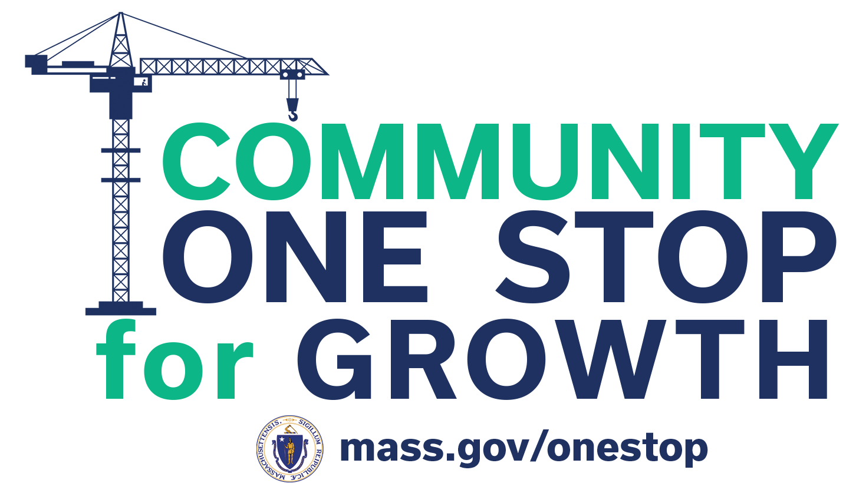
What is the Community One Stop for Growth?
The Community One Stop for Growth is the main driver of economic development in the Commonwealth.
The One Stop is a single application portal and collaborative review process designed to streamline the experience for the applicant and better coordinate economic development programs and staff on engagement and grant making.
Executive Office of Economic Development | MassDevelopment Finance Agency | Executive Office of Housing and Livable Communities
MassWorks Infrastructure Program Rural Development Fund Urban Agenda Grant Program Massachusetts Downtown Initiative | Underutilized Properties Program Site Readiness Program Collaborative Workspaces Program Brownfields Redevelopment Fund Real Estate Services Technical Assistance | HousingWorks Infrastructure Program Housing Choice Grant Program Community Planning Grants Program

Slide 4
Rural Development Fund Overview
Program Staff | Anne Gobi, Director of Rural Affairs (Anne.Gobi3@mass.gov) Mallory Sullivan, Rural Programs Manager (Mallory.Sullivan@mass.gov)
What is the Purpose of the Program? | The Rural Development Fund provides funding for capital and community planning projects in Towns with populations less than 7,000 or with a population density of less than 500 persons per square mile. This competitive grant program awards funds based on the project’s nexus with housing, transportation, infrastructure, economic development, and community development, and strategies important to rural and small towns.
Who is Eligible? | Municipal governments, from any Massachusetts town that meets the definition of a Rural Community and/or a Small Town (having fewer than 500 persons per square mile and/or having a total population of 7,000 or fewer persons) Other public entities (Public Housing Authority, Redevelopment Authority, Water/Sewer District, Economic Development Industrial Corporation, a public body created by legislative act, etc.) Regional Planning Agencies A lead applicant may submit a joint application in partnership with one or more other eligible applicant(s).

Slide 5
Where Does the Rural Development Fund Fit in the One Stop?
Preparing for Growth |  |  | Catalyzing Specific Projects
Community Activation & Placemaking | Planning & Zoning | Site Preparation | Building | Infrastructure
Technical Assistance for Downtowns Downtown Design Consultant Services Downtown Mobility/Parking Consultant Services Downtown Wayfinding/Branding Consultant Services Economics of Downtown Consultant Services Pedestrian Orientation/Placemaking Consultant Services Small Business Support/E-commerce Consultant Services Forming a Downtown Management District Equitable Workforce and Business Development Programming Entrepreneurship and Small Business Development Workforce Development and Training Initiatives Community Organizing and Leadership Development | Community Plan Master Plan Neighborhood Plan Downtown Plan Urban Renewal Plan Housing Production Plan Regional Plan Corridor Plan Zoning Revision Zoning Revision to Comply with Section 3A of MGL c.40A Comprehensive Zoning Review & Revision Planning for Housing Housing Feasibility Plan Housing Site Master Plan Housing Infrastructure Plan Housing Site Design Plan District Redevelopment Technical Assistance Planning for Growth in a Commercial/Industrial District | Brownfield Site Clean Up Brownfields Site Assessment Brownfields Remediation Site Improvements to Unlock Development Site Readiness Pre-Construction Site Readiness Construction Municipal Surplus Property Disposition Municipal Surplus Property Disposition Study | Underutilized Property Rehabilitation Underutilized Property Pre-Construction Underutilized Property Construction Creating Collaborative Workspace Collaborative Workspace Feasibility Study Collaborative Workspace Fit-Out or Equipment Community Lead Housing Production Support Housing Production Support Housing Rehabilitation Support Housing Preservation | Public Infrastructure to Support Housing Growth (Residential Only) Pre-construction - Design / Engineering Documents Only Construction Public Infrastructure to Support Mixed-Use and Commercial/Industrial Growth Pre-construction - Design / Engineering Documents Only Construction Small Town Road Improvements to Enhance Public Safety (STRAP) Construction of Road Improvements to Enhance Public Safety

Slide 6
Important Project Parameters
Project Budget | Grants will likely be in the $50,000-$500,000 range. Planning and Zoning projects will be limited to $100,000. Grants in all other categories will be limited to $500,000. Match funds are not required, but make applications more competitive.
Project Timeline Requirements | FY25 grants are expected to be awarded in the fall of 2024. Awarded projects must be completed by June 30, 2026.
Eligible Use of Funds | Grants will generally reimburse for any costs related to consultants, architect/engineering firms, and/or general contractors, as applicable.
Funding Restrictions | Applicant must be a small or rural community (population under 7,000 and/or population density of under 500 residents per square mile) Private entities are not eligible applicants. Projects in all categories of the development continuum are eligible for the Rural Development Fund, except for the Community Activation & Placemaking category.

Slide 7
How To Be Competitive
What is the key information that program reviewers take into consideration?
Project Plan and Need: Does the project respond to clearly defined local priorities and describe how targeted populations will be served by the outcomes of the project?
Leadership and Capacity to Succeed: Is appropriate leadership with the requisite experience and ability to execute the project in place? Does the project have a reasonable timeline that considers all necessary tasks?
Project Readiness: Is the project ready to proceed? Are cost estimates reasonable? Is there a cash match?
Rural Focus Areas: Does the project address priorities of the 2019 Rural Policy Advisory Commission Plan?
What attachments should applicants be prepared to include in their applications?
Project Location Map
Cost Estimates
Site Plan/Construction Drawing
Climate Resilience Design Standard Report
Site Images
Letters of Support

Slide 8
Successful Application Example #1
Applicant: | Town of Warren
Project Description: | The Town of Warren will implement the Prospect Street Improvement Project by replacing 870 feet of water main and installing fire hydrants, water service connections, substantial storm drainage piping, two storm drainage structures, two new precast concrete storm drainage structures, and temporary trench repair.
What Made the Project Successful: | Project Plan and Need: Shared how project contributed to overarching neighborhood revitalization goals. Made strong ties between project outcomes and economic development strategy implementation. Leadership & Ability to Execute: Provided examples of successful prior infrastructure grant implementation. Identified specific community engagement and inclusivity efforts.
Insert Image of Project Site/Area

Slide 9
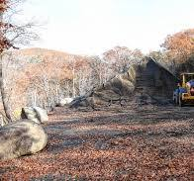
Successful Application Example #2
Applicant: | Town of Buckland
Project Description: | The Town of Buckland will create a community wood bank to provide fuel assistance to residents with limited, fixed income and no access to other fuel sources. Funding will cover the startup costs for equipment and site work to enable the town to maintain a sustainable fuel assistance program.
What Made the Project Successful: | Project Plan and Need: Described a unique local need and local solution. Described widespread support from residents. Project Readiness: Shared that a site had been identified and terms of use were in development. Shared extensive collaboration with DCR.

Slide 10
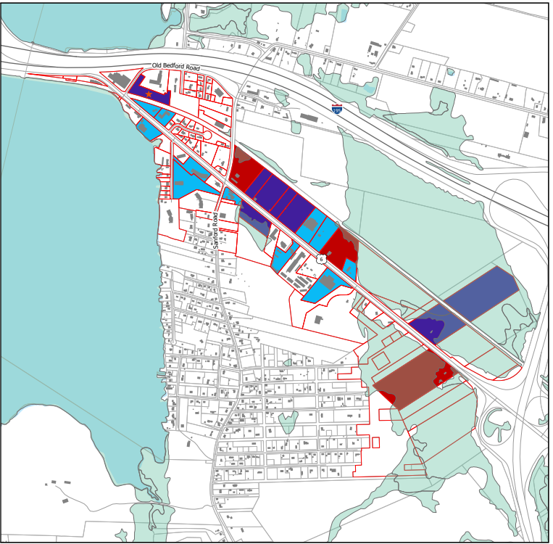
Successful Application Example #3
Applicant: | Town of Westport
Project Description: | This project is for Route 6 sewer system design and permitting. The design will allow for the construction to take place in phases. The design will also provide for future expansion into the abutting residential neighborhoods and provide capacity for future development.
What Made the Project Successful: | Project Plan and Need: Made strong case that existing infrastructure was primary impediment to commercial and residential development. Identified project as a priority in multiple town plans. Project Readiness: Town had recently completed preliminary design for project.
Insert Image of Project Site/Area

Slide 11
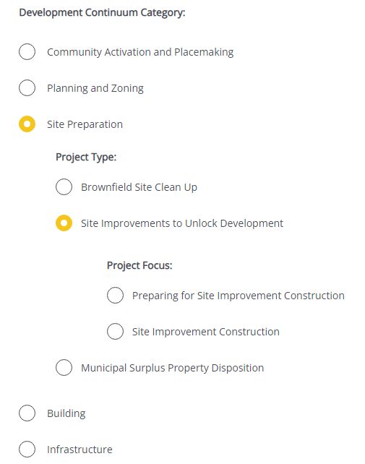
Completing the Full Application
Key Question: In Section 2 of the Full Application, applicants are asked to indicate the Project Category. To be reviewed by the Rural Development Fund, applicants should make the following selections in question 2.4:
For more information on completing the Full Application, visit www.mass.gov/onestop to view One Stop Webinar 2: Application Guidance
Development Continuum: | Planning & Zoning Site Preparation Building Infrastructure
Project Type: | Select the most appropriate Project Focus option for your application
Project Focus: | Select the most appropriate Project Focus option for your application
Example: Development Continuum selection

Slide 12
FY25 Round Timeline
JAN
Jan.
Full Application and Expression of Interest Open (January) – The Full Application is the official form for submitting all funding requests. Applicants may now begin to work on applications in the IGX system, however applications will only be accepted during the submission period.
One Stop Guidance Phase (January – May) – A series of webinars will be hosted be both the One Stop Team and staff from each program within the One Stop. In addition, office hours will be hosted to answer applicant questions. Visit www.mass.gov/onestop for the full schedule of webinars and office hours.
Full Application Submission Period (May-June) – Applicants may submit their Full Application(s) beginning May 6, 2024. All applications must be submitted by the Full Application deadline of 11:59 p.m. on Wednesday, June 5.
Review and Evaluation (July – August) – All complete and eligible Full Applications submitted by the deadline will be reviewed and evaluated by the corresponding program managers at each state agency. The One Stop team will also conduct joint application reviews across agencies. Based on the program’s criteria, each program will prepare its list of applications recommended for funding, to be further reviewed and approved by agency and Secretariat leadership.
Notification of Grant Decisions (September) – Once final recommendation have been approved, applicants will be notified of grant decisions in writing, and announcement events will be scheduled.
Sept.

Slide 13
Opportunities for Guidance
Visit www.mass.gov/onestop for more information on:
Expression of Interest
Complete an Expression of Interest form to see if your project(s) is eligible for funding through the One Stop and get tips for preparing your application
One Stop and Program Webinars
Recordings of all One Stop webinars are now available on the One Stop website
Office Hours
One Stop General Guidance Office Hours – One Stop staff will hold office hours to discuss general One Stop process and technology questions
Program Office Hours – Staff from each program will hold an office hour to answer applicant questions related to the program
The Rural Program Team’s office hours will be held on Wednesday, March 20th at 10:00 a.m.

