Slide 2
Massachusetts Commission for the Deaf and Hard of Hearing Statewide Advisory Council November 17, 2022

Slide 3
Commissioner Sotonwa
Updates from Dr. Opeoluwa Sotonwa
Commissioner at MCDHH
Noteworthy Retirements, Citations & Recognition of Awards
Governor Transition Plan
Division and Departmental Updates
HR Liaison
Social Services Department
Communication Access Services Division

Slide 4
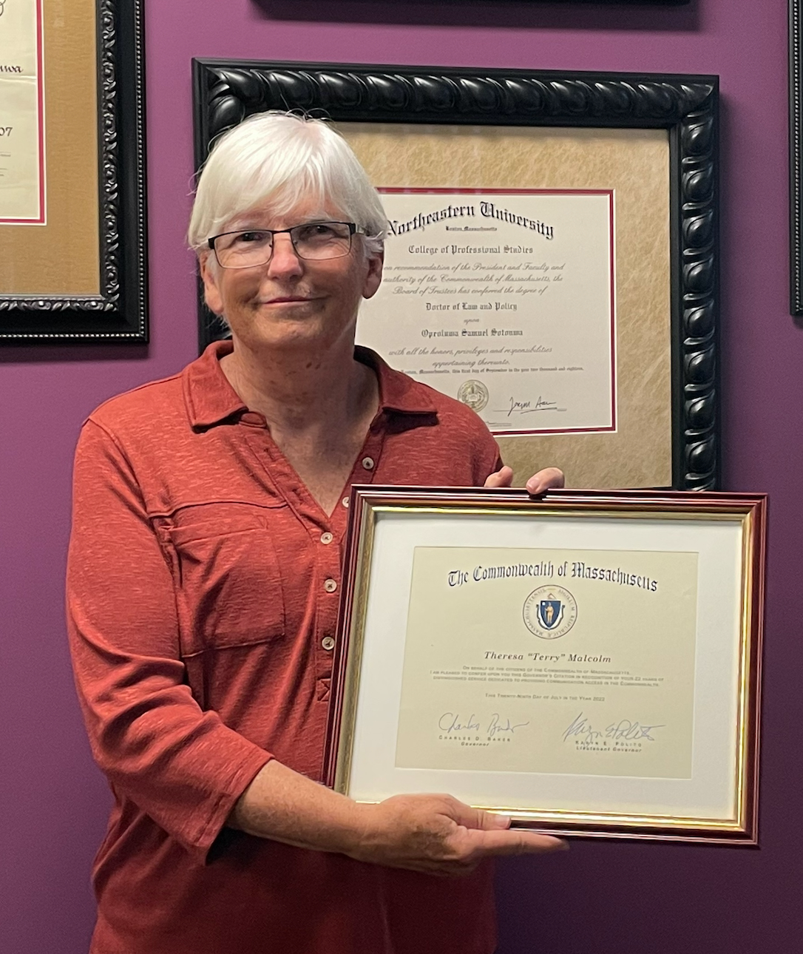
Noteworthy Recognitions (slide 1 of 5)
Recent Retirements: Let’s extend our thanks to Terry Malcolm
Terry is with us tonight!
Let us offer her our individual sentiments!
You know, looking back over 22 years, I am so blessed to have been here. And I know MCDHH is the bedrock of the Deaf Community and I'm always happy to remain in partnership with you.
So, please know I'm your ambassador. I always tell people of the community to look to MCDHH as I will, too. Thank you all so much.
- Terry Malcolm

Slide 5
Noteworthy Recognitions (slide 2 of 5)
MCDHH Celebrates Diana L’Heureux Batch
Diana recently retired and we want to share that Diana has been a valued colleague at MCDHH; she worked in State service for 28 years! For the entirety of Diana’s career, she served with distinction and worked tirelessly at MCDHH and contributed significantly to work within the court and legal systems for decades. Diana also contributed to legal trainings and served as a mentor.
“As a person raised by Deaf parents, working for MCDHH felt like a natural process for me. Interpreting 28 years as a staff of MCDHH has given me the tools to be successful in providing professional quality interpreting services for the community in which we serve. Communicating and being around Deaf and Hard of hearing people was like home to me.”
-Diana L'Heureux Batch

Slide 6
Noteworthy Recognitions (slide 3 of 5)
Our State Government’s
Performance Recognition Award
in the group category is awarded to:
MCDHH’s 35th Anniversary team
The 35th Anniversary Committee members are:
Hana Hanigan Karin Eddy
Anthony Harrison Aurora Wilber
Lori Novak Terry Malcolm
Jonathan O’Dell Zoe RajBhandary
CONGRATULATIONS team!!

Slide 7
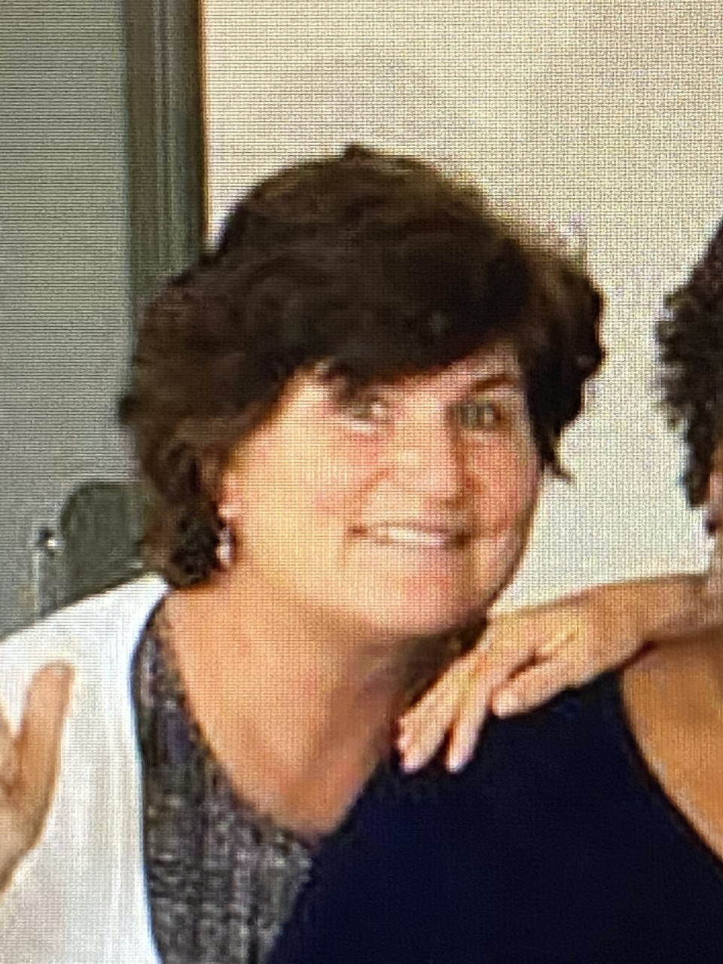
Noteworthy Recognitions (slide 4 of 5)
Our State Government’s
Performance Recognition Award
in the individual category is awarded to:
Carol Menton
Our heartfelt thanks to Carol for her incredible leadership
as interim director of the Social Services Department.
Congratulations, Carol!!

Slide 8
Noteworthy Recognitions (slide 5 of 5)
Honoree for the Governor Paul Cellucci
Leadership & Mentorship Award
Jonathan O’Dell
During the pandemic, Jonathan played a vital role in preparing the Commonwealth's Workforce of Tomorrow by serving as a subject matter expert, providing valuable technical support on numerous high-profile programs to make them accessible such as The Vaccine Equity Initiative, Future of Work Initiative, and IT Accessibility Road Map.
Jonathan's relentless pursuits of advancing MCDHH goals to create a fully accessible Commonwealth have ensured that the Deaf and Hard of Hearing Communities’ needs received prominent attention from the upper echelons of our state government. It is gratifying to see that Jonathan—for his numerous contributions to our great Commonwealth—is lauded as the true public servant we should all aspire to be.
- Commissioner Sotonwa

Slide 9
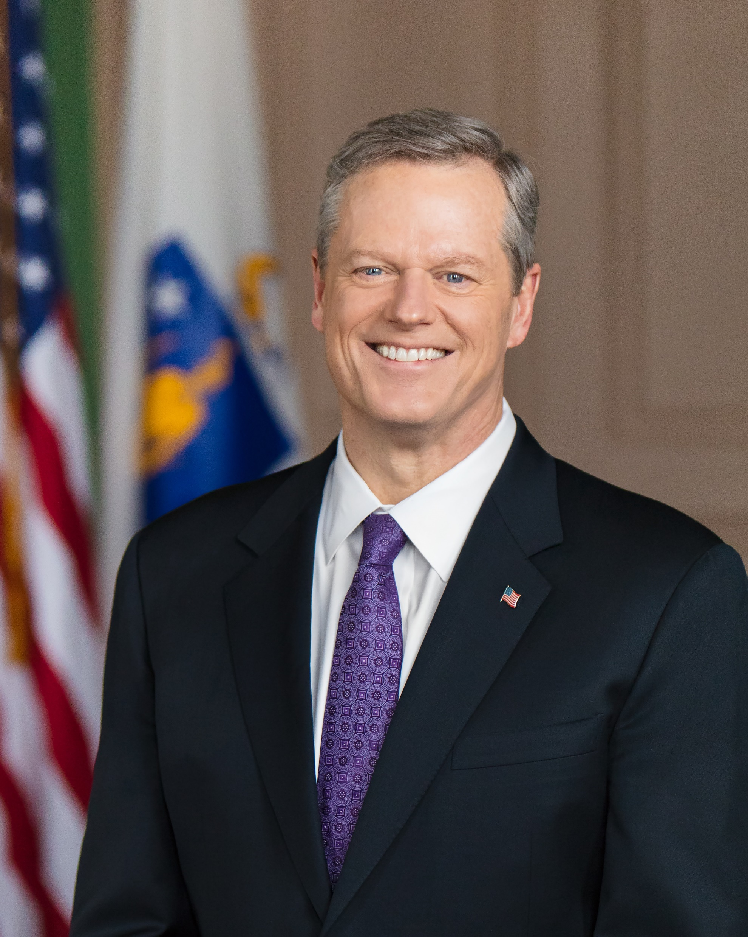
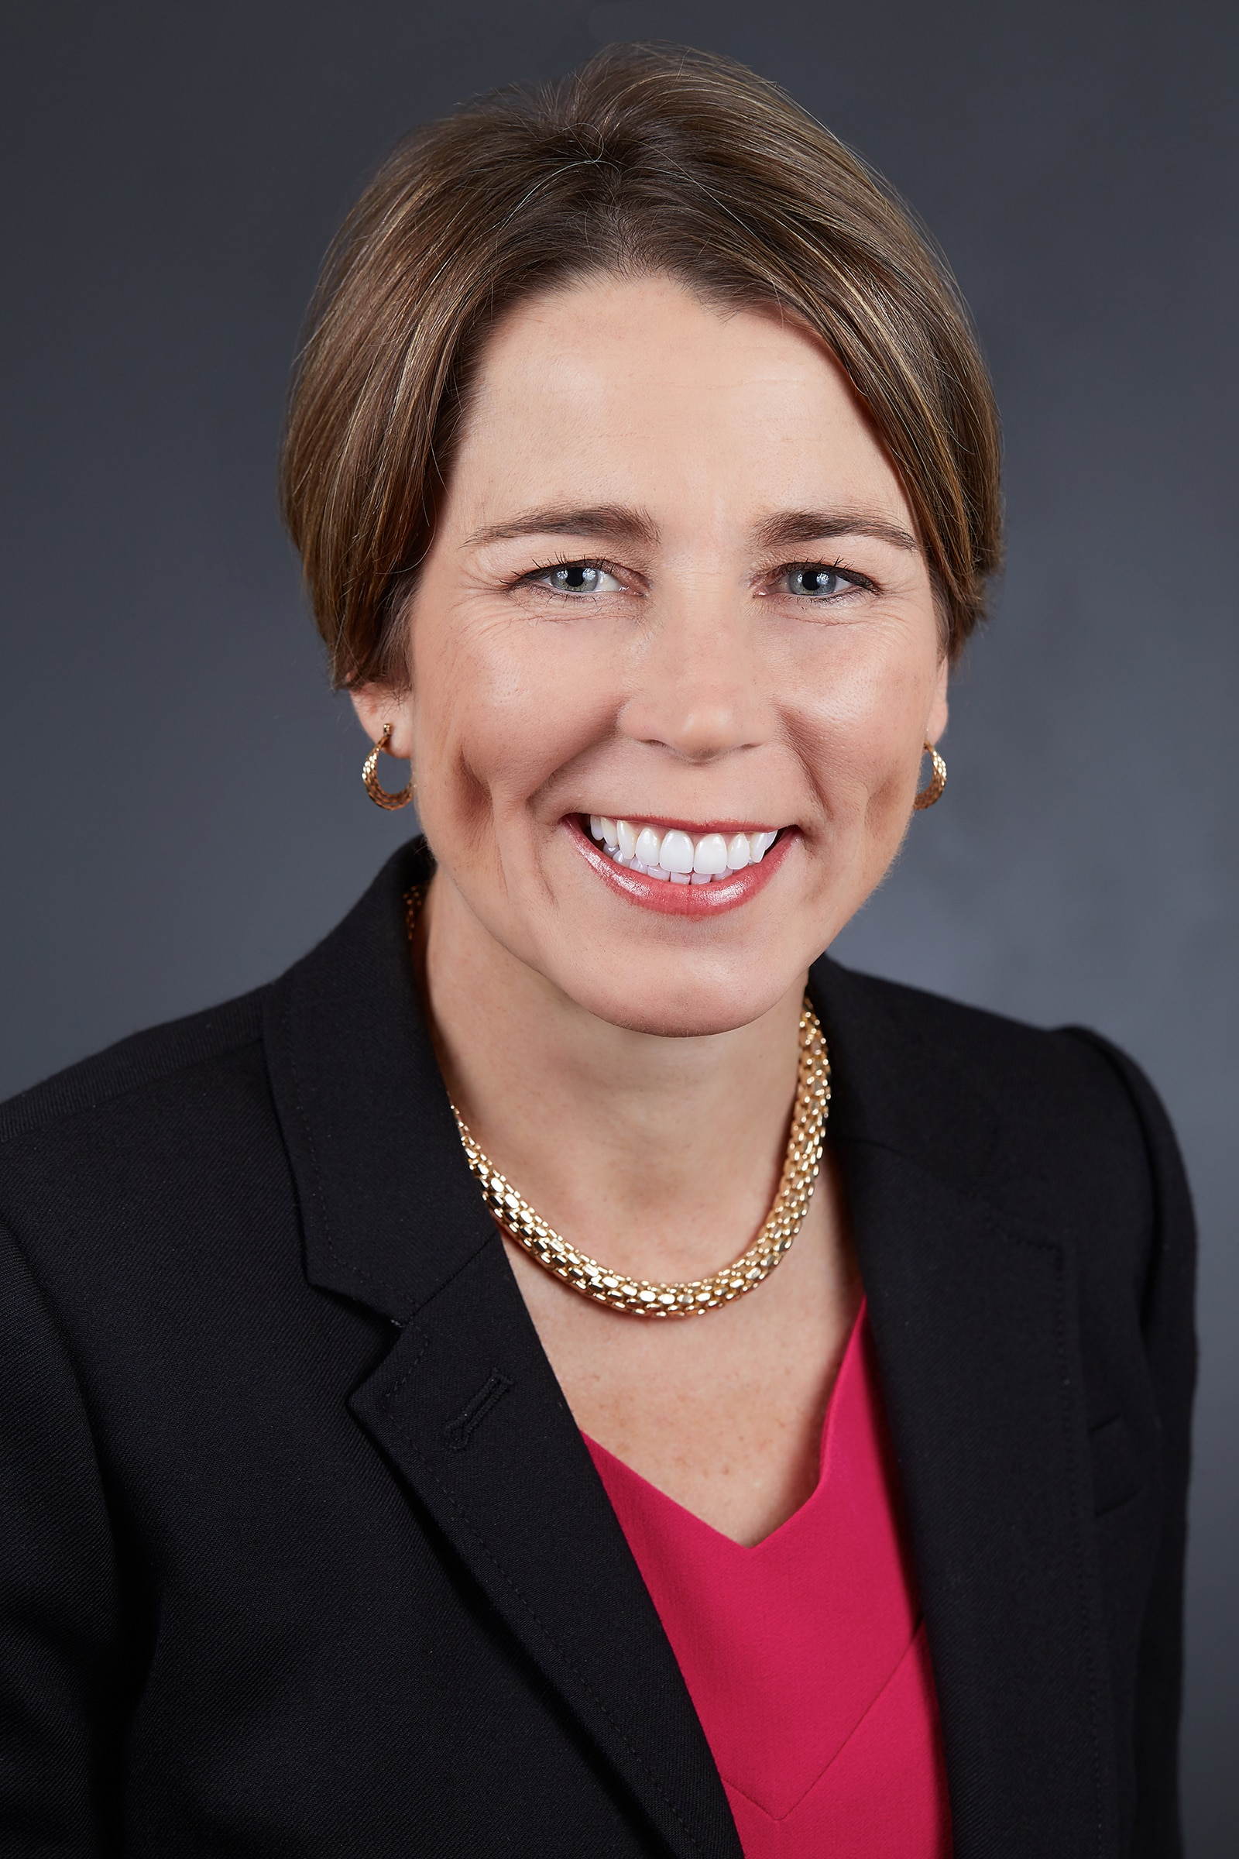
Transition plan for Governorship
January 5, 2023

Slide 10
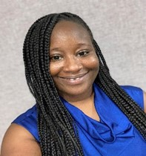
Division and Departmental Updates: Human Resources
Updates on behalf of Janay Mitchell
Human Resources Liaison
MCDHH has hired 2 part-time ASL SUD Interpreters
Tracey Baptiste (Western MA)
Desiree Weems (Eastern MA)
Active Searches
Vacancies
Janay Mitchell
HR Liaison

Slide 11
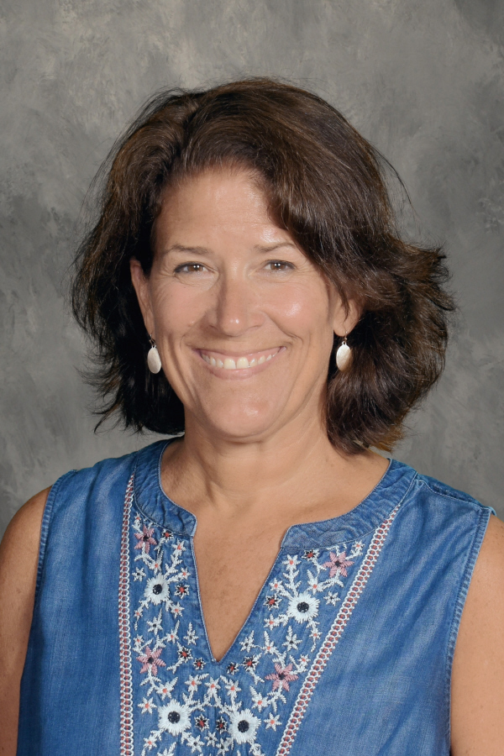
Division and Departmental Updates: Social Services Department
Updates on behalf of Peggy Lee
Director of Social Services Department (SSD)
April Smith, Adult Case Manager, transferred from Boston to the Southeast/Cape/Islands region.
We will be posting for Boston soon.
SSD staff represented MCDHH at the following events:
MOD Summit
Lawrence Disability Fair
Western MA State Association for the Deaf
Peggy Lee, Director
Social Services Department

Slide 12
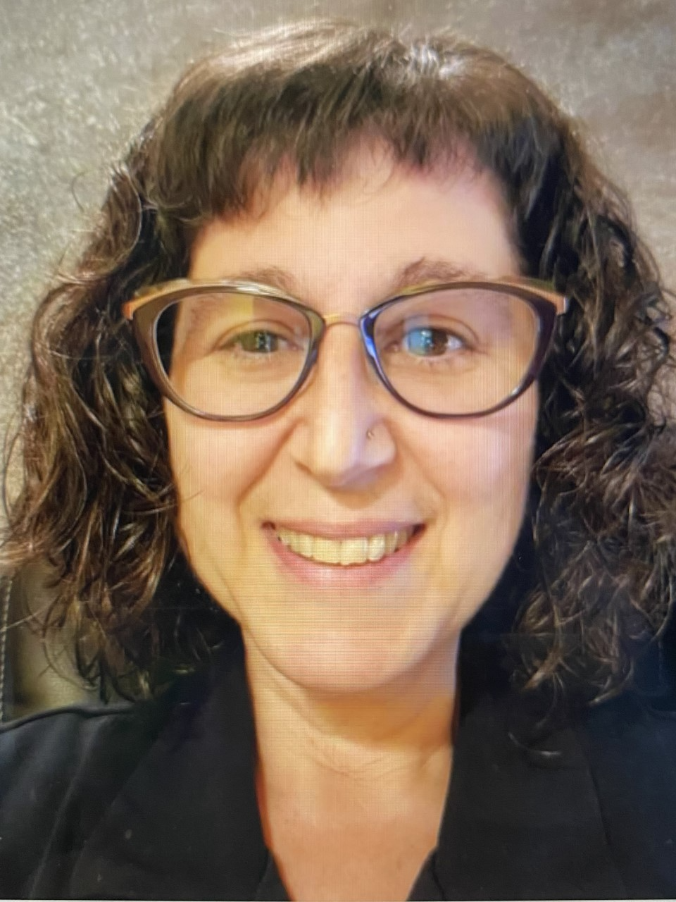
Division and Departmental Updates: CAS Overview (CAS slide 1 of 6)
Updates on behalf of Cat Dvar, Director
Communication Access Services Division
Screening​
Interpreters​
Referral​ Service
Workforce Development
After-hours Emergency Service (AHE)
Cat Dvar
Director of CAS Division

Slide 13
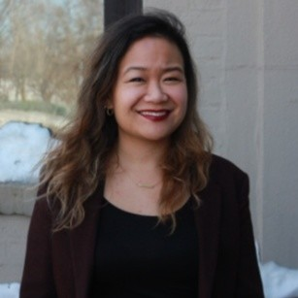
Division and Departmental Updates: CAS Screening (CAS slide 2 of 6)
The Screening Redesign Request for Information (RFI) is in process; we anticipate sending the RFI to researchers in the field of ASL interpreter testing by end of 2022
Using the information collected via the RFI, we’ll then create a robust Request for Responses (RFR) to be disseminated in FY24
Our fully redesigned—new and inclusive--Screening Program will hopefully launch sometime in FY26 or FY27
The Screening Coordinator, Crystal Eusebio, has been working collaboratively with Denise Martinez, the Interpreter Supervisor and Training Coordinator. They are creating a robust series of trainings for new Screening Evaluators coming onto our contract. These trainings will be completed by the end of January 2023. At that time, our pool of Screening Evaluators will be significantly increased in both size and diversity. We hope this will create an inclusive testing environment for all the diverse candidates who take our Screenings.​
Crystal Eusebio
Screening Coordinator

Slide 14
Division and Departmental Updates: CAS Interpreters (CAS slide 3 of 6)
MCDHH Staff Interpreters and progress in talent acquisition
Our staff interpreters continue to work tirelessly to provide the highest quality services for our staff and for the community both on-site and remotely ​
We are currently interviewing for our full-time Staff Deaf Interpreter position​
We will be interviewing soon for our part-time Legal Deaf Interpreter position​
Our 2 ASL/spoken English Legal Interpreter part-time positions will be posted shortly

Slide 15
Division and Departmental Updates: CAS Referral (CAS slide 4 of 6)
Our Referral Team is hard at work
Our Referral Team has been working tirelessly to meet the communication access needs of Deaf, late-deafened, Deaf/Blind, hard of hearing and Oral Deaf constituents across the Commonwealth​
Our Referral Department continues to offer 24/7 Standby Press Conference coverage for the Governor’s requests statewide and the Boston Mayor’s office​
MCDHH has been working closely with KMBS on the Referral Modernization Project, meeting twice a week leading into the transition from our current interim software system to the Final System. We anticipate that transition from the current interim Referral Software System to the Final Fully Modernized System to be sometime in the spring.​

Slide 16
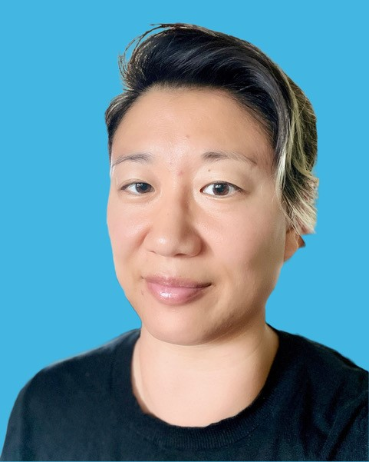
CAS Division Updates: Workforce Development (CAS slide 5 of 6)
Programs that will run under WFD:​
Subject Matter Expert Consultant Groups (SMEC): diversity, equity and inclusion as a primary driver
ASL Interpreter SMEC: this diverse group of external SMEs will work intensively for 3 months from January through March of 2023 to create an action plan for MCDHH. This SMEC will address every step along the interpreter pipeline from first exposure to the field all the way to 10 years job satisfaction.
CART SMEC: – focuses on CART recruitment, training, mentorship, retention, longevity and diversity. The RFR for this SMEC will be going out shortly. We anticipate work to be completed before the end of FY23.​
Outreach – creating outreach presentations to draw young people statewide into the fields of communication access starting in middle and high schools​
ASL Interpreter and CART Mentorship Programs​
Court and Legal Training for ASL and Deaf interpreters​
Deaf Interpreter Training and Mentorship​
Outreach/Education Programs for our Sister Agencies​
Holly Pearson WFD Coordinator

Slide 17
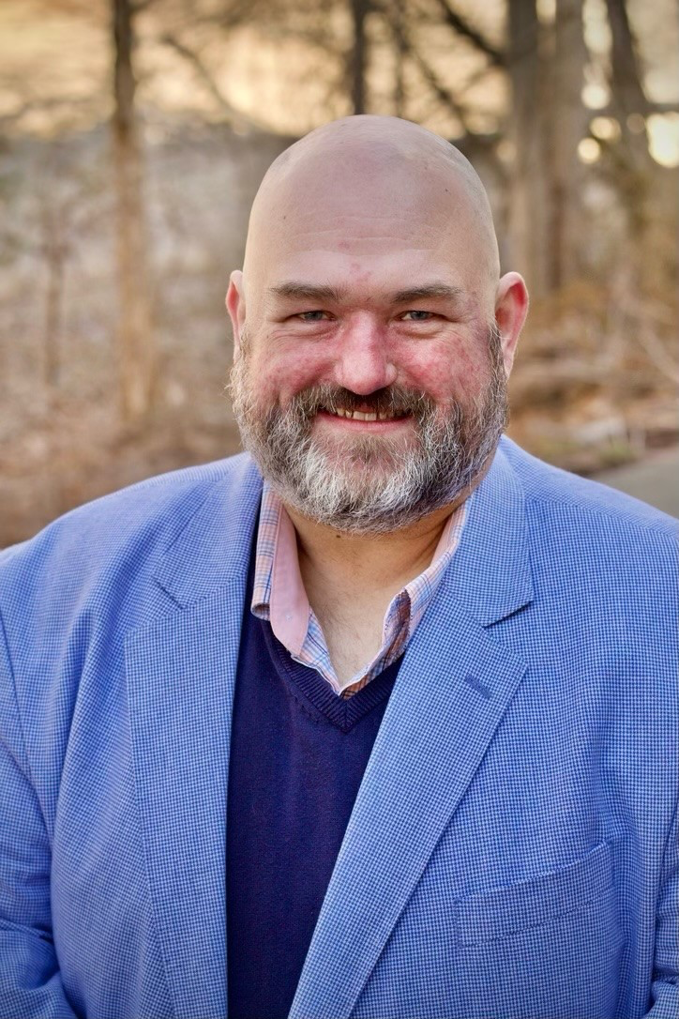
Division and Departmental Updates: CAS AHE (CAS slide 6 of 6)
After Hours Emergency Program
Andy Veith is our Interim AHE Coordinator
Andy has been busy with the following:
filling after-hours emergencies
working closely with our Referral Staff to fill emergencies that come in late in the day and roll over into the evening
supporting the work of Referral.
Gathering, tracking and analyzing AHE data to help determine if a permanent program is warranted​
Since the pilot program started, we have seen an uptick in the both (a) the number of requests for emergency services and (b) the number of successfully filled assignments.
Andy Veith
AHE Interim Coordinator

Slide 18
Thank you!

