Slide 1
EEC Safe Sleep Campaign
Reducing the risk of Sudden Infant Death Syndrome (SIDS) by working to ensure that every sleep is
a safe sleep.
Notes:
We are not going to teach you about SIDS or SUID. We are going to talk about what we are doing to reduce the risk of it.
As we do in the trainings offered in Region 3. I’m going to take a moment to allow anyone for whom this topic is especially poignant, or painful, to feel free to leave the room….at least for a few moments while we talk about what led us to begin a campaign to reduce the risk of SIDS.

Slide 2
SIDS
Sudden Infant Death Syndrome (SIDS) is the sudden death of an infant younger than 1 year of age that remains unexplained after a thorough case investigation that includes a complete autopsy.
From the Safe to Sleep® Public Education Campaign, available at: http://www.nichd.nih.gov/sts/Pages/default.aspx
Notes:
In Massachusetts, SIDS is the third leading cause of death among children less than one year of age. (Source: MA Child Fatality Review Program 2009-2012).

Slide 3
Data on SIDS
SIDS is the leading cause of death in babies 1 month to 1 year of age.
Most SIDS deaths happen when babies are between 1 month and 4 months of age.
Each year, about 4,000 infants die unexpectedly during sleep time, from SIDS, accidental suffocation, or unknown causes.
SIDS is not a risk for babies 1 year or older.
From the Safe to Sleep® Public Education Campaign, available at: http://www.nichd.nih.gov/sts/Pages/default.aspx
Notes:
We can’t prevent SIDS. It can just happen even in ideal circumstances. But we know that we can help to reduce the risk. Since the Back to Sleep Campaign started, the incidence of SIDS has dropped in half nationwide.
The intake, investigation and management of the death of a child is devastating to the whole regional office. For ourselves, for children, for educators and the families - we had to do something to make a change.
So, we started a campaign.

Slide 4
The Safe Sleep Campaign:
Public Awareness
Training for ourselves, and
In-person training for FCC Educators
Policy Development
System Development/Collaboration with DPH
And a new message:

Slide 5
The Message:
The first weeks that an infant is enrolled in child care is a critically important time to ensure that all safe sleep policies and practices are followed.
We have developed a PSA to help spread this message (in 4 languages)
Notes:
Many thanks to Bea, Ginny at Comcast, the families and the fcc educator that helped us with this (twice!).
This PSA has been sent out to all local cable access stations in our region.
Play PSA

Slide 6
The “Perfect Storm” of Risk Factors
During the first weeks of child care, the following risk factors can combine:
The infant is 3-4 months in age (maternity/paternity leave is over.)
Baby catches its first upper respiratory infection (via exposure to other children for the first time)
The baby experiences stress (due to first real separation from parents.)
There is a new sleep environment
There might be a change in sleep position
Notes:
The message we created is critical because this “perfect storm” of risk factors comes together at the time a new baby enters care. Most SIDS messages are geared towards parents alone – we realized that a message needed to be developed for caregivers as well.

Slide 7
The Training
Staff volunteered to offer a 2-hour Safe Sleep training at our office, after hours, at least 1x/month.
Over the past year, training has been offered:
In person via an interactive method,
To over 300 FCC educators and assistants and recently to staff of group programs,
in English, Spanish, Portuguese and Khmer,
To anyone cited for not following EEC regulations related to safe napping of infants,
In a manner that yields outstanding reviews from participants:
Notes:
The help of the McKays has had an impact on many. All participants read out loud and sign a safe sleep pledge before they leave.

Slide 8
Concepts that Surprise our Students:
The trachea is above the esophagus when a baby lays on its back. Babies wont choke on spit up.
It is just fine, better even, if a baby doesn’t sleep soundly,
A bare crib is best,
Its ok to say “no” to a family that asks you to sleep a child in a manner that is not safe.

Slide 9
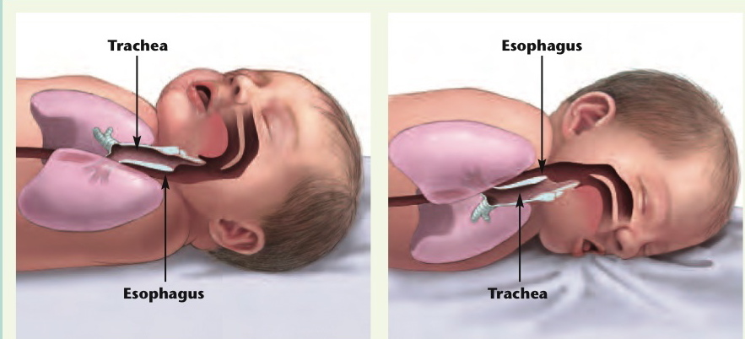
Supine Sleep and Fear of Choking
When the baby is laying on their back, the baby’s breathing tube (trachea) lies on top of the swallowing tube (esophagus). If the baby throws up, it will go back down the swallowing tube (remember gravity).
When a baby is sleeping on their tummy, if they throw up it will pool at the opening of the breathing tube. This makes it easier for the baby to have food go down into their lungs and choke them.
9

Slide 10
In Their Own Words:
“In person training hits home more than on line…this training should be every year.”
“I will not allow myself to get complacent”
“One way I will change my behavior in the future is that the infant has to sleep in a crib on their backs all the time and nothing can be inside the crib.”
“I will change how I communicate with parents.”
“Encontre util la ensenanza y aprendi que no debo acostar el bebe boca abajo.” (I found the training useful and learned that I should not face a baby down to sleep.)

Slide 11
Moving Forward: Going State-Wide:
New Policy Development:
Training at renewal, not just initial licensure.
Parent notification of safe sleep citations.
Training for all FCC licensors on 4/11/14.
EEC/DPH Collaboration on Training Development
Request for Qualifications
State-wide access to in-person training with the early education message.
Expansion of training across all EEC Regions.

