Slide 1
Massachusetts Board of Registration in Medicine Quality & Patient Safety Division
Deconstructing SQR Reports
Dorothy Doweiko, MHA, BSN, RN
Erin C. Long, MSN, RN, Quality Analyst
Trinh Ly-Lucas, MSN, AGNP-BC, Quality Analyst
Daniela Brown, MSN, RN, CIC, Director

Slide 2
Disclaimer
This slide deck was presented by the Quality and Patient Safety Division in December of 2022. We have since transitioned to online/electronic reporting. The elements in the presented reports are the same elements required in the online/electronic reporting platform.

Slide 3
Before We Begin…
We are available for a private presentation for your PCA Committee/QAPI Committee as well as private meetings to answer any questions you may have about the PCA program or electronic reporting.
The submissions of SQR Reports is a regulatory requirement, however it is a healthcare facility’s governing body that is responsible for the Patient Care Assessment program. There should be a process for certain events to reach the PCA Committee and/or a quality subcommittee of the governing body. This report is for them too!

Slide 4
Annual Reports (AR) Semiannual Reports (SAR) As of 9/1/23 there is now an option for a single, annual PCA-QA report in lieu of the above-mentioned reports. Safety & Quality Review (SQR) Reports
To ensure that the facility’s PCA program is working, the QPSD requires three (option for two types as of 9/1/23) types of reports

Slide 5
Identification of an event as any one of the four types of major incidents does not necessarily indicate either that the outcome was preventable or that it resulted from substandard medical practice.
Safety & Quality Review (SQR) Reports
Type I
Type II
Type III
Type IV
Deaths in the course or Resulting from Ambulatory Surgery
All Maternal Deaths Related to Delivery
Wrong site surgery on an organ, extremity, or body part
All Deaths or Major or Permanent Impairment of Bodily functions that are not ordinarily expected as a result of the patient’s condition on presentation

Slide 6
Confidentiality
Information and records necessary to comply with the Board’s risk management and quality assurance programs; and necessary to the work product of medical peer review committees, including major incident reports required to be submitted to the Board, are afforded statutory confidentiality protections.
M.G.L. c. 111, § 204(a) & 205(b)

Slide 7
Case Study 1
SQR Review Form

Slide 8
Safety and Quality Review Reports
As you go through the case studies, please note that there are important points on the right side of the slide in the SQR form.
When you get to the attachments section, the LEFT side of the slide will give some details of the event. The RIGHT side of the slide provides better details and represents a more comprehensive report.

Slide 9
Safety and Quality Review Form
I. Report Identification
Please check off initial report unless it is a follow up report
II. Reporting Healthcare Facility
Include your name, title, and contact information.
Please sign the report.
III. Date and Location of Event
IV. Patient(s) Involved in Event
Fill in required fields

Slide 10
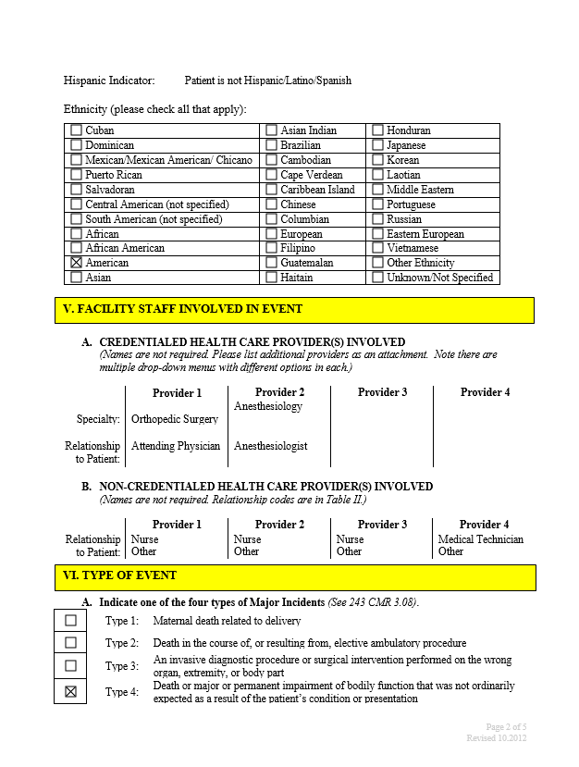
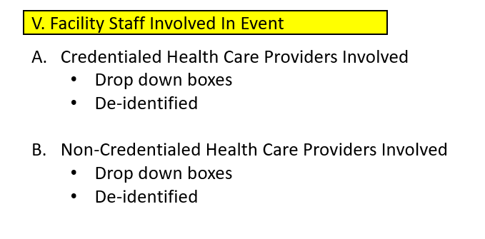

Slide 11
VI. Type of Event
Indicate one of the four types of Major Incidents
Type 1: Maternal death related to delivery
Type 2: Death, in the course of, or resulting from ambulatory surgery
Type 3: An invasive diagnostic procedure or surgical intervention performed on the wrong organ, extremity or body part
Type 4: Death or major or permanent impairment of bodily function that was not ordinarily expected as a result of the patient’s condition or presentation
A. For either Type 3 or 4 Major Incident, indicate one of the following:
Major Impairment/Temporary
Major Impairment/Permanent
Death
Other (please explain)
B. Indicate if the event was reported as an SRE to DPH.

Slide 12
VII. Nature of Incident
Codes:
There is a guide to help you identify the codes.
You may opt not to include them
B. Summary of the Event
The summary is a brief overview of what happened.
It does not take the place of the detailed summary
C. Detailed Narrative of the Event.
Please attach the detailed narrative to the report.

Slide 13
VIII. Internal Review
A. Include date review completed
B. Committees or individuals that reviewed the event
Titles not names
Pertinent people and committees are key to a thorough investigation into the event
C. Results of Internal Review
Identify factors that may have contributed to the event
Description of Results of Internal Review
Please attach the internal review to the report.
IX. Safety and Quality Improvement Measures
A. Safety and Quality Improvement Measures or Corrective Actions Taken
Including but not limited to these types of actions
Remember that staff education is considered a weak intervention and may not be enough to address identified issues.
Consider if stronger actions may be indicated
Description of Quality Improvement Measures or Corrective Actions

Slide 14
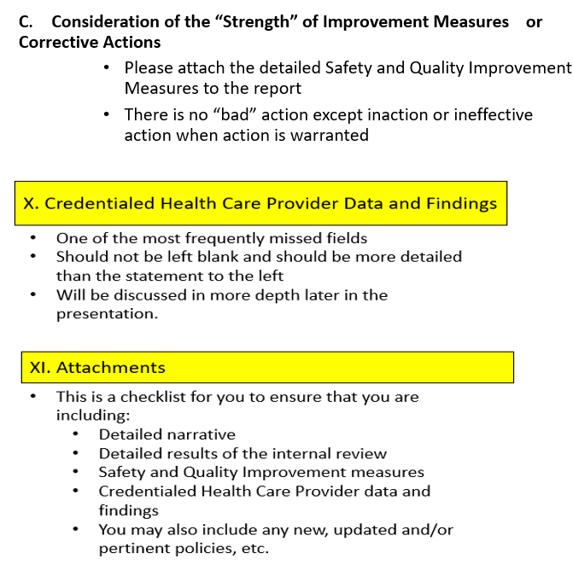

Slide 15
VII. Nature of Incident
C. Detailed Narrative of the Event
14-year-old white female who was brought to the OR on 4/22/22 for an ORIF of her comminuted L radius/ulna fracture. Pt with a past medical history of atopic dermatitis and allergic rhinitis. Pt had been jumping on a trampoline when she jumped into a handstand and sustained a fracture to the left arm. Pt was sedated, a left brachial plexus block was administered by anesthesia followed by induction of general anesthesia. The ORIF was lengthy and complicated by muscle tissue found between the fracture sites and a complicated re-alignment with intramedullary nail placement. At the conclusion of the surgery, the skin was sutured, and a cast was being placed as the surgical count occurred. During count it was noted that part of a scalpel blade was missing.
Timeline of events:
0800 Pt brought to the OR
0810 Left brachial plexus block administered
0815 Induction of anesthesia
0818 ORIF began
0945 Skin closure
1000 Cast placed
1010 Xray of L radius/ulna
1000-1015 OR team completing counts and checklists recognize that part of the scalpel blade is missing and bring this to the attention of the surgeon.
1015 Surgeon views post-op film. Notes that there appears to be a small metal object noted in the tissue of the incision site.
1020 Cast cutter obtained, cast removed, incision opened, site explored. A small metal fragment was retrieved. Object was found to be the missing scalpel blade. Patient re-casted. Surgeon left the OR immediately after the case.
1045 Patient to recovery room. Disclosure was made to the child’s mother with f/u planned for 1 week.
C. Detailed Narrative of the Event
14-year-old white female who was brought to the OR on 04/22/22 for an ORIF of her comminuted L radius/ulna fracture.
Timeline of events:
0800 Pt brought to the OR
0818 ORIF began
0945 Skin closure
1000 Cast placed
1010 Xray of L radius/ulna
Surgeon views post-op film. Notes that there appears to be a small metal object in the tissue at one of the incision sites.
1020 Cast cutter obtained, cast removed, incision opened, and metal fragment was retrieved.
1045 Patient to recovery room.

Slide 16
VIII. Internal Review
D. Description of Internal Review
A RCA was completed with the OR Chief of Staff, the surgeon, nurses, OR tech and anesthesia.
The findings were as follows:
It was felt that the patient was appropriately prepped, and anesthesia was given in a timely manner. The skin was opened using a #10 scalpel. While the sharp was thought to have been intact, a piece of the scalpel was later found to have broken off.
Due to the nature of the fracture and difficulty with rod placement, there were several people assisting in the surgery and the metal object was not noticed. Additionally, the child was starting to wake up at the end of the case and required more sedation. This was thought to be a distractor.
During count it was noted that part of the scalpel blade was missing. This was brought to the attention of the surgeon who did not respond. The surgeon was felt to be rushed and dismissive to staff. The surgeon was behind due to the complicated surgery and was getting ready to go into the next case. The staff reported that they were hesitant to approach the physician with concerns as he was “curt and dismissive to the staff”.
When the post-op films were completed and the object was noted on the film, the staff reported that the surgeon “appeared angry and his manner of speech hostile”. The surgeon removed the cast, opened the incision, located and removed the object, and then reclosed the wound. The surgeon then re-applied the cast and left the OR.
Anesthesia reviewed the case for concerns of the child waking up towards the end of surgery. Dosing was reviewed with pharmacy and was appropriate for age/weight. Timing of dosing appropriate. No additional recommendations or findings.
D. Description of Internal Review
A RCA was completed
The findings were as follows:
It was felt that the patient was appropriately prepped, and anesthesia was given in a timely manner.
Due to the nature of the fracture and difficulty with rod placement, there were several people assisting in the surgery, holding the arm while the rods were being placed.
During count it was noted that part of the scalpel blade was missing. This was brought to the attention of the surgeon who was not concerned. The staff reported that the surgeon was felt to be rushed and dismissive to staff.
When the post-op films were completed and the object was noted on the film, the staff reported that the surgeon appeared “angry and his manner of speech hostile”.

Slide 17
IX. Safety and Quality Improvement Measures
Several opportunities were identified from this case.
It was found that the scalpel was not inspected for integrity after use. The post-surgery OR count policy was revised with specific wording to address inspection of instruments and sharps post use. Education was completed on updated policy.
TeamSTEPPS training will be initiated in the OR as this is known to be a high-risk setting and teamwork and communication is key to patient safety. Training to start 8/1/22.
Support was provided to staff members who were involved in this incident. This support is ongoing for staff members involved in events with poor outcomes and/or patient safety events that occur.
Policy developed: Stop the Line for Patient Safety including the manner in which to escalate events when staff do not feel they are being heard. Policy education completed and policy in effect 5/30/22.
Several opportunities were identified from this case.
Policy revision.
Education was completed.
Policy developed: Stop the Line for Patient Safety.

Slide 18
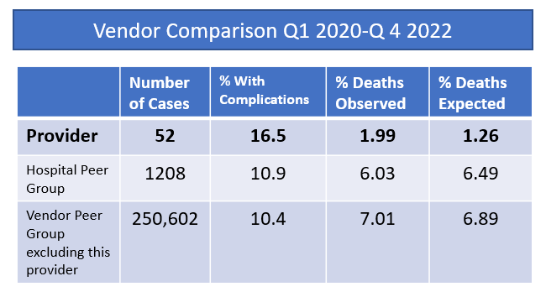
X. Credentialed Heath Care Provider Data and Findings
The surgeon in this case has a higher % of complications but a lower % of deaths compared to internal and external peer groups.
The surgeon has a higher surgical site infection (SSI) rate compared to their peers which is trending downward. There is plan in place to address this metric. The surgeon is being supported by Infection Prevention and Control and the Chief of Surgery. SSI rate has decreased from 3.5 in Q1 2022 to 1.9 in Q4 of 2022.
A trend was identified regarding the provider. It was noted that there were two previous complaints of inappropriate behavior from the OR staff in a two-year period. The surgeon was placed on a focused professional practice evaluation (FPPE) for the behavioral concerns and peer support was offered and accepted.
and/or metrics with any noted trends and follow-up plan included
The provider involved does not have any care concerns, is not an outlier and is in good standing with the hospital.
De-identified please

Slide 19
Who is reviewing these SQR reports??? Why are they asking for more information???

Slide 20
SQR Review
Receive SQR Report
Reviewed by Nurse Quality Analyst
Close event OR if incomplete or questions, reviewed at weekly QPSD Meeting
Response may be requested OR referred to QPS Committee
Committee member(s) reviews event with RN
Discussed at Monthly QPS Committee meeting
Request information or close event
If additional questions, request meeting
“Thank you for your visit this morning. I can speak for many of us based at X hospital, the meeting was just as you said it would be: it was collaborative, supportive, collegial, and compassionate.
We appreciated the chance to learn from your team and are grateful for the time and effort invested in your visit. We look forward to hearing from you in follow-up…”.
-CMO, Acute Care Hospital 2022

Slide 21
What is missing from some reports?
Credentialed Heath Care Provider Data and Findings No primary source (core) peer review documents. All information and data is to be DE-IDENTIFIED. Providing the results of a review does not compromise peer review protections and is consistent with the intent of the M.G.L. c. 111, § 205(b) provisions. (243 CMR 3.07(3)(l) and 243 CMR 3.08(3)). Often should include data to support “there are no care concerns”. Examples provided in case studies. If there are concerns and/or the provider is an outlier, what is being done to support the provider and address the concerns?

Slide 22
What is missing from some reports?
The Internal Review is not inclusive of possible contributing factors and/or aligned with corrective measures. What were possible contributing factors? Medicine Nursing Systems issues Device-related Pharmacy-related Environment-related Communication Transfers of care and handoffs Electronic medical record Is there a plan of correction to address your determinations/findings?

Slide 23
What is missing from some reports?
Strength of Corrective Measures Pair several “weak” measures and/or “moderate” measures for improved plan of correction. “Weak” measures can be good actions, but often alone will be insufficient. “Strong” measures are wonderful, but not always indicated or feasible due to expense, scope, and time. Education alone will likely not effect change.

Slide 24
Evaluation of Corrective Measures
STRONGER ACTIONS SYSTEM-FOCUSED | Resilient system solutions that make the behavior contributors (Human error and choices ) inconsequential Effective automation Forcing functions Architectural plan improvements Elimination of universal adaptors for medical equipment such as IV tubing/connectors
MODERATE ACTIONS SYSTEM/BEHAVIORS FOCUSED | Strengthened systems solutions combined with improved perception of risk and behavioral choices Eliminate /reduce distractions Checklist /cognitive aides Standardization of equipment and processes (IV pumps, bar code scanning) Education with simulation/drills (challenge how to include all staff/MDs, etc.) Double independent checks Standardized communication tools (read backs, IPASS, SBAR hand off)
WEAKER ACTIONS BEHAVIOR –FOCUSED | Behavior-Focused attempts to manage risk solely through rule compliance, education, or the addition of procedural steps without strengthening system Education Additional documentation Warnings, signs Review and/or implement new procedures /polices

Slide 25
SQR-Type IV Events
243 CMR 3.08(2)(d)
On the reporting form, check the box for the appropriate "type" of “major incident” that took place. If the event is either a Type 3 or Type 4 Event, indicate whether the patient died, or suffered a major impairment (temporary or permanent) of bodily function. We define “major impairment” as a significant change in the patient’s functional status, either physically or mentally. If none of these three choices apply, indicate "other" and provide a brief explanation. You should base your selection on what you know about the patient’s condition at the time you are completing the report.
BORIM SQR Instruction Sheet P. 3

Slide 26
DPH Definition of Serious Injury
The definition of serious injury shall include:
Physical or mental damage that substantially limits or results in loss of one or more of the major life activities (e.g., breathing; dressing/undressing; drinking; eating; eliminating waste products; getting into or out of bed, chair, etc.; hearing; seeing; sitting; sleeping; walking; and working) of an individual in the short term, which may become a disability if extended long term. A serious injury can result in death, loss of a body part, long or short-term disability, loss of bodily function, or require a major intervention for correction (e.g., higher level of care, surgery, and dialysis). Serious injury includes a substantial change in the patient’s risk status such that care or monitoring, based on national accepted standards, whether provided or not, is required that was not required before the event.
Examples include but are not limited to:
The patient’s discharge status or discharge plan was changed as a result of the serious injury
As a result of the incident, there was a change in the treatment plan that required a change in the level of care provided to the patient
Any incident requiring major intervention, such as resuscitation, surgical intervention in the OR, new dialysis treatment, a higher
level of care, e.g., transfer to critical care unit, for correction
The patient’s length of stay was extended, either at the hospital or at their post-acute placement to address the serious injury
Bone fractures including wrist and rib fractures. Excludes hairline fractures and fractures of the fingers, toes, thumbs and nose
Loss of a body part
Permanent or temporary loss or substantial limitation of bodily function
Any potential exposure to blood borne pathogens (e.g., Hepatitis or HIV) through reuse or improper repurposing of medical
equipment, e.g., endoscopy tubes, syringes, regardless of whether or not the patient is actually infected
Laceration that requires repair by suture or staple
Second-degree or more severe burn
DPH 2012 SRE Reporting Guidance P.13 Appendix I

Slide 27
Severity of Impairment (Harm/Injury) Reported *excludes patient falls and pressure injuries

Slide 28
Case Study 2
SQR Review Form

Slide 29
Safety and Quality Review Form
I. Report Identification
Please check off initial report unless it is a follow up report
II. Reporting Healthcare Facility
Include your name, title, and contact information.
Please sign the report.
III. Date and Location of Event
IV. Patient(s) Involved in Event
Fill in required fields

Slide 30
V. Facility Staff Involved In Event
Credentialed Health Care Providers Involved
Drop down boxes
De-identified
Non-Credentialed Health Care Providers Involved
Drop down boxes
De-identified

Slide 31
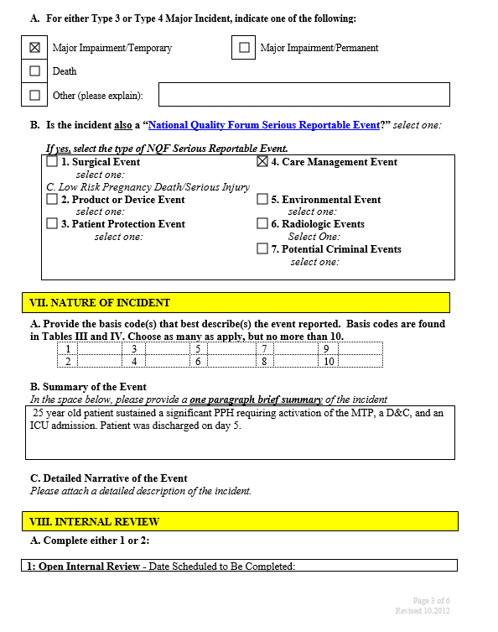
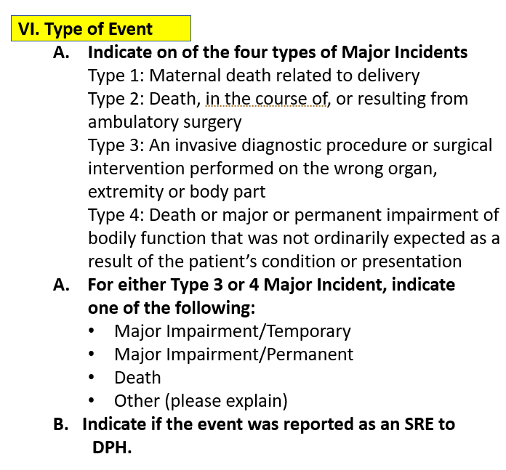

Slide 33
VIII. Internal Review
A. Include date review completed
B. Committees or individuals that reviewed the event
Titles not names
Pertinent people and committees are key to a thorough investigation into the event
C. Results of Internal Review
Identify factors that may have contributed to the event
Description of Results of Internal Review
Please attach the internal review to the report.
IX. Safety and Quality Improvement Measures
A. Safety and Quality Improvement Measures or Corrective Actions Taken
Including but not limited to these types of actions
Remember that staff education is considered a weak intervention and may not be enough to address identified issues.
Consider if stronger actions may be indicated
Description of Quality Improvement Measures or Corrective Actions

Slide 35
VII. Nature of Incident
Detailed Narrative:
The patient is a 25-year-old G1P0 at 36 3/7 weeks who presented to L&D at 7:15 am on 5/6/22 reporting spontaneous rupture of membranes (SROM) of clear fluid at approximately 6 am with contractions every 2-3 minutes in the past hour. Pregnancy was complicated by hyperemesis gravidarum. Medications included PNV and iron supplementation. PMH included asthma.
Timeline:
7:20am-Patient was placed on the EFM with noted FHR 130-140s, moderate variability, no accelerations, no decelerations, contractions noted every two-three minutes.
7:35am- Initial sterile vaginal examination (SVE) performed by RN was 6/100%/0 (dilation/effacement/station) with vertex presentation. Patient was assessed at low risk for hemorrhage. VS 98-102-20 BP 110/62. Pain was rated 10/10 with contractions. The RN informed the Certified Nurse Midwife (CNM) of the patient’s arrival and of her assessment. The patient was well known to the CNM as she had cared for the patient in the prenatal period.
7:50am- The patient complained of needing to push. The CNM had arrived at the bedside and performed a SVE at 7:55am which showed the patient to be 10/100/+3. The RN called for assistance for imminent delivery.
8:02am- A vigorous 2.7 kg male infant was delivered with Apgar’s of 8/9.
8:07am-Placenta was delivered without difficulty and initially was reported to be intact. Immediately after delivery of the placenta, the uterus was noted to be boggy with brisk vaginal bleeding. Fundal massage was performed.
8:12am- The patient did not have intravenous access. Oxytocin 10 units IM was administered. HR 106 BP 100/62.
8:16am- Misoprostol (Cytotec) 800 mcg was administered sublingually. The patient continued to experience brisk vaginal bleeding and the uterus remained boggy despite uterotonics and fundal massage.
8:23am-Manual removal of retained products was accomplished with later inspection of the placenta revealing it to not be intact. The Quantitative Blood Loss (QBL) was noted to be 650mL. Patient’s temp was 96.3 HR 116-125 BP 92/54. The CNM opted to not insert intravenous line and provide IVF as the patient was able to tolerate PO fluids and bleeding appeared to have stopped.
9am-The patient was assisted to BR to void whereby patient had a syncopal episode with brief LOC. She was assisted to back to bed. BP 80/45 HR 126. The CNM was informed. Patient was asked to drink additional fluids.
9:15am- HR 114 BP 96/52. Patient reported feeling better. Uterus was reported to be firm with moderate vaginal bleeding noted.
9:30am-Patient was transferred to post-partum unit. HR 114 BP 98/56.
Detailed Narrative:
The patient is a 25-year-old G1P0 at 36 3/7 weeks who presented to L&D at 7:15 am on 5/6/22 reporting spontaneous rupture of membranes (SROM) of clear fluid at approximately 6 am with contractions every 2-3 minutes in the past hour.
Timeline-
7:20am-Patient was placed on the EFM with noted FHR 130-140s
7:35am- Patient was assessed at low risk for hemorrhage. The RN informed the Certified Nurse Midwife (CNM) of the patient’s arrival and of her assessment. The patient was well known to the CNM as she had cared for the patient in the prenatal period.
7:50am- The patient complained of needing to push.
8:02am- A vigorous 2.7 kg male infant was delivered with Apgar’s of 8/8
8:07am-Placenta was delivered without difficulty. Fundal massage was performed.
8:12am-Oxytocin 10 units IM was administered
8:16am- Misoprostol (Cytotec) 800 mcg was administered sublingually.
8:23am-Manual removal of retained products was accomplished. The CNM opted to not insert intravenous line and provide IVF as the patient was able to tolerate PO fluids and bleeding appeared to have stopped.
9am-The patient was assisted to BR to void whereby patient had a syncopal episode with brief LOC.
9:30am-Patient was transferred to post-partum unit

Slide 36
Detailed Narrative Continued:
10:05am-The post-partum RN arrived to greet and assess the patient. Brisk vaginal bleeding was noted, and the uterus was boggy.
10:10am- Medications were administered and two L&D RNs arrived for additional assistance. Fundal massage continued.
10:15am- The patient was awake but drowsy and confused to place and time. Oxytocin and LR were administered intravenously.
10:18am- The anesthesiologist arrived HR 136 BP 72/60, temperature was 95.9 F
10:22am-Vaginal bleeding continued to be brisk.
10:28am- The patient arrived in the OR. The physician performed a D&C and evacuation of placental fragments with resolution of bleeding.
11:20am- Surgery ends. QBL in the OR was 1.2L.
12:30pm- A total of 4u PRBC, 2u FFP, I unit Cryoprecipitate, TXA was administered in the OR and during first hour of recovery in ICU.
Patient was extubated.
Patient was able to be discharge to home on hospital day five.
Detailed Narrative Continued:
10:05am-The post-partum RN arrived to greet and assess the patient. Brisk vaginal bleeding was noted, and the uterus was boggy. BP 82/54 with HR 130. The RN requested that the L&D RN return while performing fundal massage. The on call CNM was paged but was attending another birth. The Laborist and back-up obstetrician were unable to immediately respond as they were performing a cesarean section. Oxytocin 10 units IM and Methergine 0.2 mg IM were ordered.
10:10am- Medications were administered and two L&D RNs arrived for additional assistance. Fundal massage continued. The L&D RN started a large bore intravenous line and initiated IVF wide open. The patient was catheterized for 90mL of urine.
10:15am-The patient’s uterus remained boggy with brisk bleeding observed. BP 72/58 HR 136. The patient was awake but drowsy and confused to place and time. The L&D nurse called for the MTP to be initiated. An OB-RRT was called and a request for a General Surgeon was made to assist in the OR to relieve the backup obstetrician. The IV therapist arrived and started a second large bore intravenous line and obtained labs. Oxytocin and LR were administered intravenously.
10:18am- The anesthesiologist arrived HR 136 BP 72/60, temperature was 95.9 F. Pre-operative anesthesia consent obtained from the patient’s spouse.
10:22am-Vaginal bleeding continued to be brisk. The backup obstetrician arrived and verbally consented the spouse for a D&C. The patient was taken to the OR. HR 132 BP 74/58. Estimated blood loss (EBL) in post-partum was 1 L.
10:28am- The patient arrived in the OR. Anesthesia provided GETA and utilized warm IV fluids and upper extremity warming blanket. In the OR, the physician performed a D&C and evacuation of placental fragments with resolution of bleeding. Uterus was noted to be firm. Lab results from postpartum unit returned with H&H 6.2/23 (prenatal Hgb was 10.5 and HCT was 33) plat 98, fibrinogen 140 INR 1.9.
11:20am- Surgery ends. QBL in the OR was 1.2L. Patient transferred to the ICU for recovery and observation. VS 102/58, HR 114. Uterus firm with light to moderate vaginal bleeding noted.
12:30pm- A total of 4u PRBC, 2u FFP, I unit Cryoprecipitate, TXA was administered in the OR and during first hour of recovery in ICU. VS 100/54 HR 118, temperature 97.6. Labs: Repeat labs: WBC 16.3 H& H 7.8/28 plat 96 INR 1.6. Fibrinogen 178. Lactate 1.5. While in ICU, additional blood products were administered for a total of 6u PRBC, 4U FFP, I unit cryo, and I unit platelets with calcium and electrolyte replacement over the next 12 hours. ABG upon arrival to ICU ABGs were 7.23/30/88/17. Uterus remained firm at umbilicus with light to moderate vaginal bleeding noted.
Patient was extubated and serial labs showed improvement with H&H 9.5/31 plat 124, INR 1.2 fibrinogen 245 upon discharge from the ICU on day 2.
Patient was able to be discharge to home on hospital day five.

Slide 37
VIII. Internal Review
Internal Review:
1. The specialty specific reviewer (OB/GYN) reviewed the case on 5/27/22. Concerns were identified regarding the management of the second stage of labor.
Hemorrhage risk assessment was not performed at the start of the second stage. Patient had a precipitous delivery with a preterm infant which increased her risk of post-partum hemorrhage (PPH). A type and screen and baseline CBC would have been indicated.
There was no attempt to initiate an intravenous line after delivery and provide both fluid resuscitation and intravenous oxytocin. The reviewer noted this as a variance as the patient was clearly orthostatic with vital signs trending in the wrong direction. This may have been better identified if an early warning system had been in place.
Misoprostol was given as a second line drug rather than methylergonovine IM.
Type and screen was not ordered. The initial QBL of 650mL warranted increased surveillance and response readiness which was not appreciated. The placenta was inspected by the CNM and found to be intact. The reviewer questioned if there were any thoughts of using ultrasound to ensure complete uterine evacuation. Pathology and exam in the OR later revealed that there were placental fragments missing.
In interview, the CNM reported that she had been on for over 24 hours and very busy during the overnight shift. She was scheduled to complete her shift at 7:30am. She chose to remain and care of the patient as the patient was well known to her. The CNM endorsed fatigue and a bias regarding her observations of an intact placenta and the patient’s previously expressed preferences for a “low intervention” birth as explanation for not appreciating the condition of the placenta and not initiating an intravenous line and intravenous oxytocin. The CNM also reported that in hindsight, she should not have stayed and cared for the patient as she had been on call for greater than 24 hours during a very busy time and had been extremely fatigued.
Given the patient’s initial hemorrhage, it would have been prudent for the Laborist to have been updated regarding the patient prior to her transfer to the postpartum unit. The process and policy for backup Obstetrical support was reviewed and no issues were identified. There was a high volume and high acuity on the unit which resulted in the Laborist and back-up obstetrician being immediately unavailable. The Laborist appropriately contacted the in-house general surgeon who was able to immediately respond. Alternatively, the Chief of Obstetrics may have been contacted. Please see policy for Contingency (Back-up) Obstetrical Support.
Internal Review:
The specialty specific reviewer (OB/GYN) reviewed the case on 5/27/22. Concerns were identified regarding the management of the second stage of labor.
Hemorrhage risk assessment was not performed at the start of the second stage.
There was no attempt to initiate an intravenous line after delivery.
Misoprostol was given as a second line drug
Type and screen was not ordered.
In interview, the CNM reported that she had been on for over 24 hours and very busy during the overnight shift. She was scheduled to complete her shift at 7:30am. She chose to remain and care of the patient as the patient was well known to her.
Given the patient’s initial hemorrhage, it would have been prudent for the Laborist to have been updated regarding the patient prior to her transfer to the postpartum unit.

Slide 38
VIII. Internal Review continued
2. The specialty specific reviewer (Anesthesia) reviewed the case on 6/10/2022.
3. Nursing review was completed on 5/22/22. Opportunities were identified in the following areas:
The post-partum hemorrhage (PPH) protocol for a vaginal QBL > 500mL was not followed
Risk assessment was indicated at the beginning of the second stage but not documented. The nurse did not recall the assessment.
There was insufficient hand off by nursing.
No hemorrhage cart on post-partum unit.
There was no ability to perform QBL on the post-partum unit due to lack of education, equipment, and supplies. Therefore, EBL was performed while the patient was in postpartum which may have been underestimated.
There have been poorly attended semiannual drills in L&D.
The L&D RN appropriately called for the MTP and OB-RRT.
4. The case underwent additional reviews by OB/GYN and Anesthesia Department Chiefs. No additional concerns were identified.
5. The Board Quality Committee reviewed the event on 7/28/2022. Findings were accepted.
2. The specialty specific reviewer (Anesthesia) reviewed the case on 6/10/2022. The Anesthesiologist responded quickly when called and there were no care concerns identified. The process and policy for backup Anesthesia support was reviewed and no issues were identified. Please see policy for Contingency (Back-up)Anesthesia Support. Given the patient’s initial hemorrhage, it may have been prudent for the anesthesiologist to have been updated regarding the patient prior to her transfer to the postpartum unit.
3. Nursing review was completed on 5/22/22. Opportunities were identified in the following areas:
The post-partum hemorrhage (PPH) protocol for a vaginal QBL > 500mL was not followed. Labs were not drawn. The patient was transferred to the post-partum unit soon after delivery due to a very busy L&D unit with patients waiting to be admitted. The patient had a significant blood loss and subsequent syncopal episode. The patient’s agreement that she “felt better” provided a false sense of reassurance and the acuity and high volume of patients on the unit contributed to a drift from protocol.
Risk assessment was indicated at the beginning of the second stage but not documented. The nurse did not recall the assessment. The precipitous birth and gestational age increased the risk of hemorrhage which was not appreciated.
There was insufficient hand off by nursing. The original L&D nurse taking care of the patient had assumed care of another patient. The new nurse recovering the patient did not convey the severity of the initial hemorrhage or the subsequent syncopal episode to the postpartum nurse.
No hemorrhage cart on post-partum unit. The only cart is located in L&D.
There was no ability to perform QBL on the post-partum unit due to lack of education, equipment, and supplies. Therefore, EBL was performed while the patient was in postpartum which may have been underestimated.
No PPH drills in the postpartum unit. There have been poorly attended semiannual drills in L&D.
The L&D RN appropriately called for the MTP and OB-RRT.
4. The case underwent additional reviews by OB/GYN and Anesthesia Department Chiefs. No additional concerns were identified. The process and polices for backup obstetrician and general surgeon support were reviewed. No concerns were identified. The Laborist and backup obstetrician involved in this event appropriately contacted the on call General Surgeon who was in house and quickly responded to the L&D allowing the backup obstetrician to respond to the patient in the postpartum unit. Please see attached policy. Findings were accepted.
5. The multidisciplinary Professional Practice Evaluation Committee reviewed the case on 7/21/2022 and accepted the specialty specific review findings.
6. The Board Quality Committee reviewed the event on 7/28/2022. Findings were accepted.

Slide 39
IX. Safety and Quality Improvement Measures
Corrective Measures:
CNM provider: CME on post-partum hemorrhage.
Education
Implementation of an Early Warning System (EWS)
Policies reviewed and amended.
Addition of a hemorrhage cart in post-partum unit.
Corrective Measures:
CNM provider: CME on post-partum hemorrhage. Collegial Intervention accepted.
Increase frequency of mandatory PPH simulation drills to monthly for the next six months including the postpartum staff and off shift times in the rotation. Will then hold quarterly drills. See attached educational materials.
Implementation of an Early Warning System (EWS) to highlight abnormal vital signs and assessments in labor & delivery and post-partum unit. Education for nurses and credentialed providers occurred prior to initiation.
Hemorrhage Risk Assessment policy reviewed and amended to include frequency of assessment and actions to take with each level of risk. Nurse Manager will monitor for compliance for a three-month period and report compliance rates at department and staff meetings.
Review of policy regarding criteria for transfer and hand-off from L&D to the post-partum unit. Include policy attestation for all L&D and post-partum employees. Will incorporate handoffs in drills and simulation. See policy attached.
Addition of a hemorrhage cart in post-partum unit.
Inclusion of post-partum nursing staff in education and resources provided to postpartum unit regarding assessment of QBL. To be completed by November 30, 2022.

Slide 40
X. Credentialed Heath Care Provider Data and Findings
Credentialed Provider Data and Findings:
The Certified Nurse Midwife (CNM) joined the ABC Medical Center Staff in 2018. The CNM has met expectations in Ongoing Professional Practice Evaluation (OPPE), compares as expected, and is not an outlier compared to her peers during the period Q1 2020-Q4 2021. Metrics include volume, complications, post-partum infections, cesarean sections, admission to NICU, maternal and neonatal mortality, and breastfeeding rates.
From Q1 2020 through Q4 2021, the Department of Obstetrics and Gynecology has had 35 events subjected to peer review. Volume of deliveries for this time was 3,082. Of the events subjected to peer review, 8 were attributed to Certified Nurse Midwives and only the current event is attributed to this CNM.
This provider has no record of disciplinary actions by ABC Medical Center.
The provider has not been previously involved in any case submitted as a SQR report.
The Chair of Obstetrics and Gynecology and the Director of Midwifery Services have no concerns about this provider.

Slide 41
SQR Reporting Takeaways
Consider if your internal review and corrective measures includes a system-level perspective and approach.
QPSD is primarily focused on your review and response of an event rather than the event outcome. Specifically, we are interested that you conducted a comprehensive internal review and implemented appropriate corrective measures, if applicable.
Ensure internal review findings align with your corrective measures. Consider the strength of your corrective measures.
Preventability should not impact reporting. Whether an event is determined to be preventable or non-preventable, opportunities for improvement may be identified.
The reporting of near-miss events to the QPSD is not required, however, if the near-miss events resulted in a significant process improvement, be proud and share your facility’s achievement in promoting patient safety.
If it is uncertain whether a case should be reported as a Type IV Event, guidance may be obtained from QPSD Analysts.

