Slide 1
Open Meeting Law: Balancing Government Transparency with Government Efficiency
Special Commission on State Institutions
September 6, 2023

Slide 2
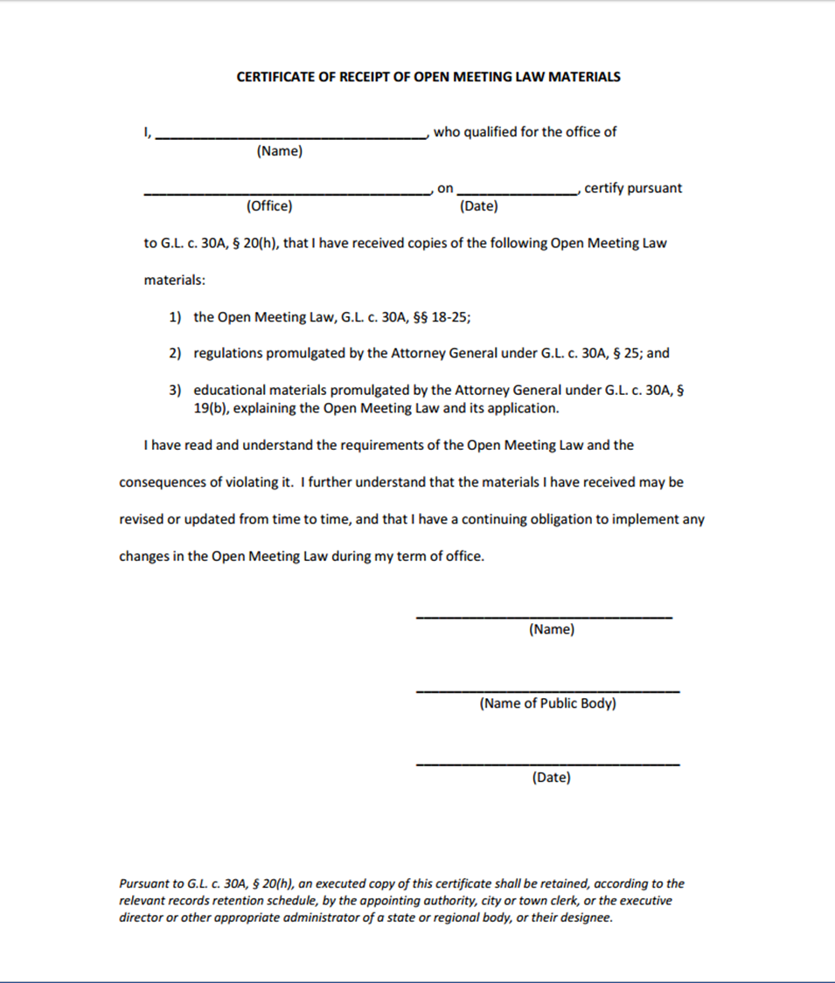
Certification
Members must sign certification within two weeks of receipt:
Read and understand requirements of the law and consequences for violating it
Educational Materials:
OML Guide Book
Last 5 Years of OML Determinations
©2023 Office of Attorney General. Permission granted to reproduce for personal and educational use, only.

Slide 3
Open Meeting Law Basics
Notice of meetings must be posted
Meetings must be open to the public
Minutes must be kept
Complaint process

Slide 4
Public Body
Definition
A multi-member board, commission, committee or sub-committee … however created, elected, appointed or otherwise constituted, established to serve a public purpose … subcommittee shall include any multiple-member body created to advise or make recommendations to a public body.
Subcommittees
Subcommittees are themselves public bodies, and must comply with all provisions of the Open Meeting Law

Slide 5
Quorum and Deliberation
Quorum: a simple majority of the members of a public body, unless otherwise provided.
Deliberation: an oral or written communication through any medium, including
e-mail, between or among a quorum of a public body on any public business within its jurisdiction.
“Deliberation” includes almost all communications, with limited exceptions for administrative matters such as scheduling meetings, and is not limited to decision-making or opinion communications.
😐
😐
😐
😐
😐

Slide 6
Deliberation
Not deliberation:
Agenda
Reports or
documents
Scheduling
Subquorum, but not subcommittee

Slide 7
Meeting
Definition: Deliberation by public body with respect to any matter within the body’s jurisdiction
Includes:
Regular board meetings
Special meetings
Retreats
Workshops

Slide 8
Accessibility
Adequate, alternative access: Ability to clearly follow the proceedings of the public body while they are occurring
Reasonable efforts to accommodate crowds
Accessible to the disabled
Americans with Disabilities Act, federal Rehabilitation Act of 1973, state constitutional provisions
The Attorney General’s Civil Rights Division can assist -
Contact the Civil Rights Division at (617) 963-2939
Notes:
If utilizing the provision in the March 12, 2020, Executive Order to provide “adequate, alternative means of public access,” the method utilized must enable the public to clearly follow the proceedings of the public body while they are occurring.
Reasonable efforts to accommodate crowds
Accessible to the disabled
Americans with Disabilities Act, federal Rehabilitation Act of 1973, state constitutional provisions
Civil Rights Division of the Attorney General’s Office can assist
Contact the Civil Rights Division at (617) 963-2939
Security policies

Slide 9
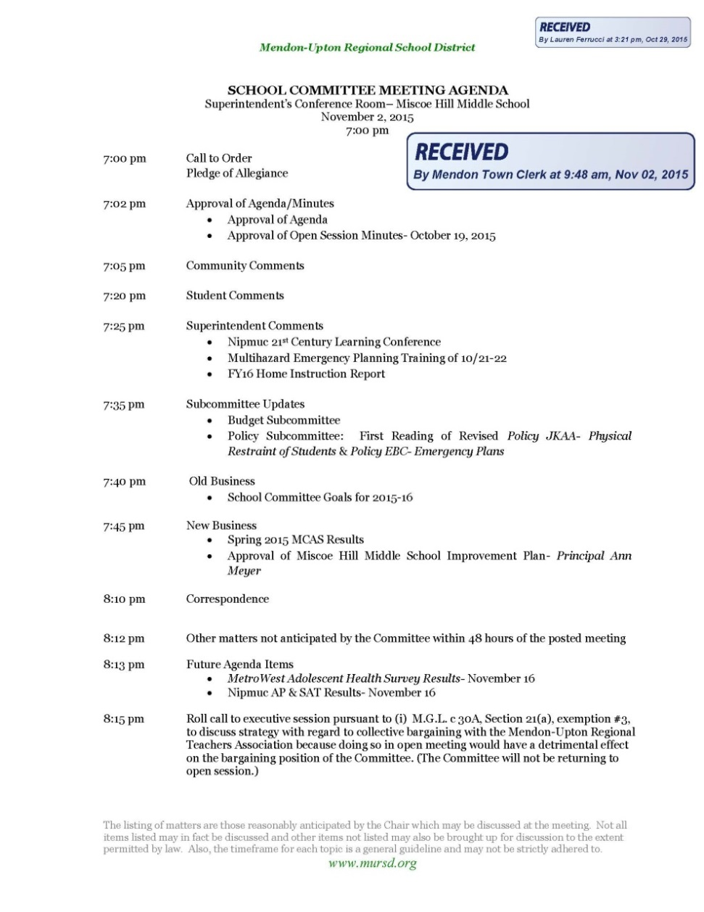
Meeting Notices
Date of meeting
Time of meeting
Place of meeting
List of topics reasonably anticipated
Date and time of notice posting
©2023 Office of Attorney General. Permission granted to reproduce for personal and educational use, only.
Notes:
Except in an emergency, a public body must post notice of meeting at least 48 hours in advance, excluding Saturdays, Sundays, and legal holidays
Notice must include:
Date of meeting
Time of meeting
Place of meeting
List of topics chair reasonably anticipates will be discussed at meeting
Topics should give enough specificity so that the public will understand what will be discussed.
Date and time notice was posted
If the notice is revised, the revised notice must record the date and time the original notice was posted, as well as the date and time of the revision

Slide 10
Executive Session
Procedural requirements for entering executive session
Convene open session
State purpose
Take roll call vote
Reconvene?
Remote participants
All votes by roll call
Notes:
OML allows public bodies to conduct closed, or executive, meetings in certain circumstances
Public bodies must follow OML requirements for executive session:
Convene open session prior to going into executive session
State publicly the purpose(s) for the executive session
Conduct roll call vote to enter executive session and obtain a majority of members
Announce whether open session will reconvene after
Statement by remote participant(s) that no other person is present / able to hear discussion at remote location, unless approved by body
Maintain minutes of and documents from executive session
Discuss only matters for which executive session is lawfully called
Conduct roll call votes of all votes taken during executive session

Slide 11
Meeting Minutes
Minutes must state the date, time, place of the meeting, and list of members present or absent
Minutes must include:
A summary of discussion of each topic
Decisions made and actions taken, including a record of all votes - Secret ballots prohibited; roll call votes recorded accordingly
List of documents and other exhibits used by the body at the meeting, including by remote participants
Notes:
Minutes must state the date, time, place of the meeting, and list of members present or absent
Minutes must include:
A summary of discussion of each topic
Decisions made and actions taken, including a record of all votes
Secret ballots are explicitly prohibited
List of documents and other exhibits used by the body at the meeting, including by remote participants
Name(s) of any member who participated remotely.

Slide 12
Resources
Attorney General’s Open Meeting Law Website
http://www.mass.gov/ago/openmeeting
Open Meeting Law: G.L. c. 30A, §§ 18-25
Regulations: 940 CMR 29.00
Guide
FAQs
Checklists
Determination Letters

Slide 13
Contact Information
Office of Attorney General
Division of Open Government
One Ashburton Place
Boston, Massachusetts 02108
openmeeting@mass.gov
(617) 963-2540

