Slide 1
Commonwealth of Massachusetts
Seal, Flag, and Motto Advisory Commission
Round 2 Selections

Slide 2
Seal Selections (23)

Slide 3

Slide #171, 777
(3)
(2)

Slide 4

Slide #344
(2)

Slide 5

Slide #981
(1)

Slide 6

Slide #551
(1)
(2)

Slide 7

Slide #691
(1)

Slide 8
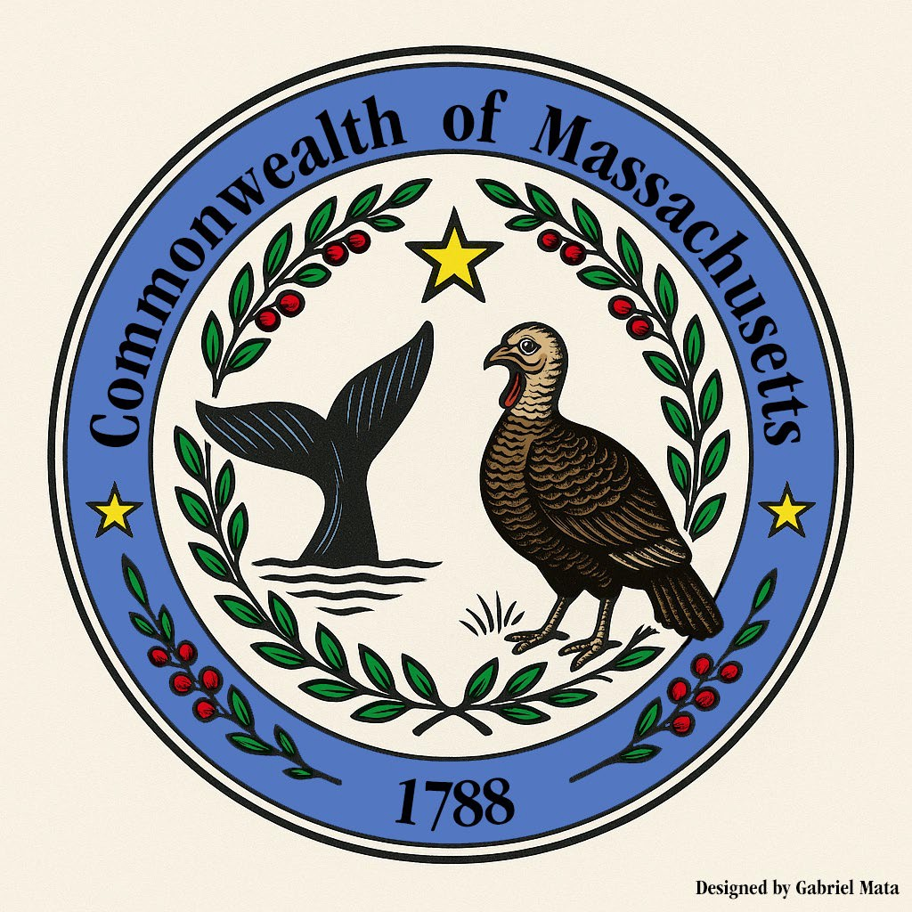
Slide #730
(1)

Slide 9

Slide #898
(2)

Slide 10
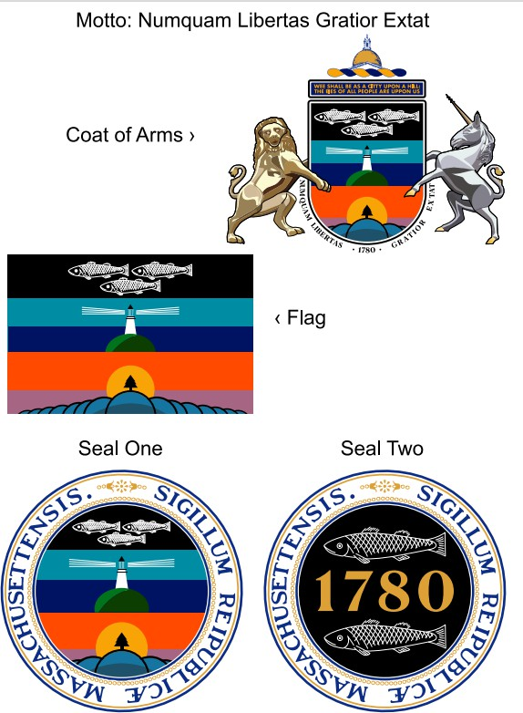
Slide #929
(1)

Slide 11

Slide #30
(2)

Slide 12

Slide #250
(1)

Slide 13

Slide #300
(1)

Slide 14

Slide #888
(1)

Slide 15
Slide #898
(1)

Slide 16

Slide #982
(1)

Slide 17
Slide #123
(1)
Keep the flag and seal as is but make one change: Remove the arm and sword over the Native American. Preserve the beauty of this simple white flag.

Slide 18

Slide #146
(1)

Slide 19


Slide #543
(1)

Slide 20

Slide #1027
(1)

Slide 21

Slide #1004
(1)

Slide 22
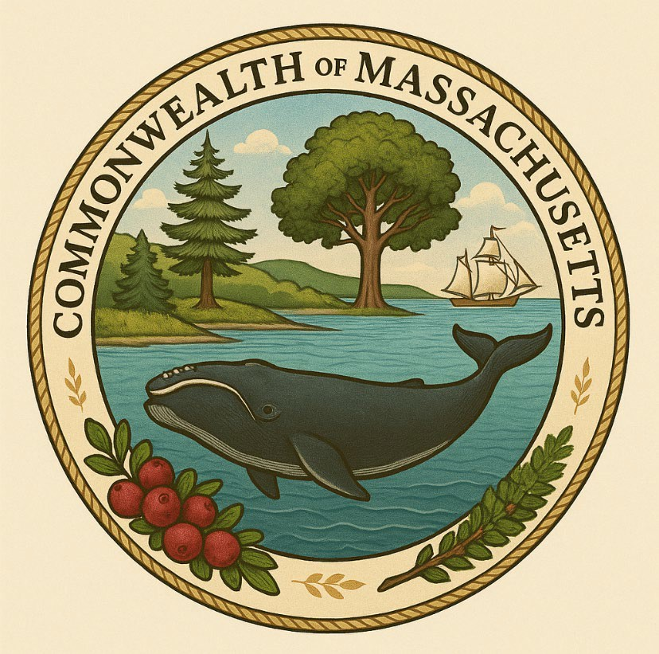
Slide #4
(2)

Slide 23
Slide #30
(2)

Slide 24


Slide #33/116
(2)

Slide 25

Slide #1133
(2)

Slide 26
Flag Selections (48)

Slide 27
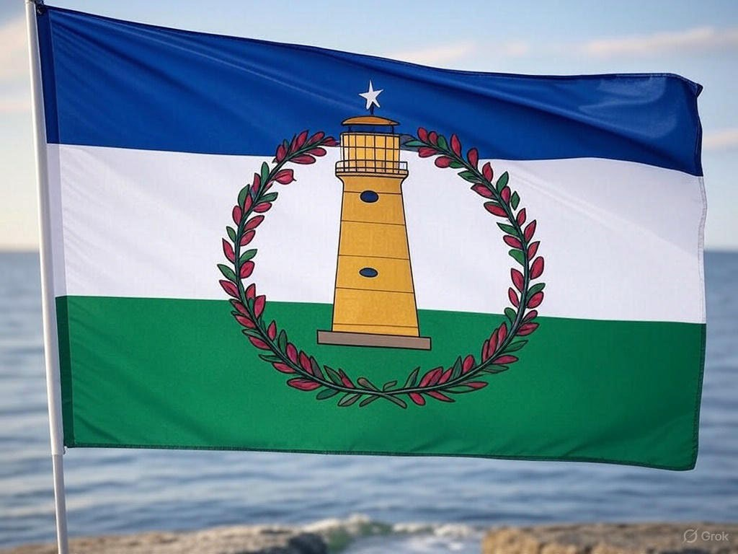
Slide #10
(1)

Slide 28

Slide #297
(2)

Slide 29

Slide #70
(1)

Slide 30

Slide #105
(1)

Slide 31

Slide #171, 777
(1)

Slide 32

Slide #252
(1)

Slide 33

Slide #317
(1)

Slide 34

Slide #784, option 8
(1)

Slide 35

Slide #804
(1)

Slide 36

Slide #917
(1)

Slide 37

Slide #1151
(1)

Slide 38

Slide #3
(1)

Slide 39

Slide #38
(1)

Slide 40

Slide #110
(1)

Slide 41

Slide #119
(1)

Slide 42

Slide #193
(1)

Slide 43

Slide #272
(1)

Slide 44

Slide #349
(1)

Slide 45

Slide #571
(1)

Slide 46

Slide #734
(1)

Slide 47

Slide #788
(1)

Slide 48

Slide #793
(1)

Slide 49

Slide #816
(1)

Slide 50

Slide #858
(1)

Slide 51

Slide #908
(1)

Slide 52

Slide #918
(1)

Slide 53

Slide #1022
(1)

Slide 54
Slide #146
(1)

Slide 55

Slide #231
(1)

Slide 56

Slide #354
(1)

Slide 57

Slide #566
(1)

Slide 58

Slide #666
(1)

Slide 59

Slide #176
(1)

Slide 60

Slide #815
(1)

Slide 61

Slide #1141
(1)

Slide 62

Slide #1074
(1)

Slide 63

Slide #1056
(1)

Slide 64

Slide #1018
(1)

Slide 65

Slide #928
(1)

Slide 66

Slide #518
(1)

Slide 67

Slide #130
(1)

Slide 68

Slide #29
(2)

Slide 69

Slide #58
(2)

Slide 70

Slide #105
(3)

Slide 71

Slide #542
(2)

Slide 72

Slide #837
(2)

Slide 73

Slide #863
(2)

Slide 74

Slide #865
(2)

Slide 75
Motto Selections (32)

Slide 76
Slide #31
(2)
Aequalitas. Diversitas. Libertas.
These are the latin words for the ideals we uphold in our Commonwealth; equality, diversity, and freedom. If we recite these ideals, we may continue to embed them into our communities.

Slide 77
Slide #90
(2)
Given the current political environment, I support keeping the state motto as-is. However, there is one change I'd be very supportive of. Our motto is thematically similar to the much more well-known "Live Free or Die" of our neighbors. My proposed change could be making it more succinct, truncating it to "Peace only under liberty", which I think captures the easy- to-grasp feeling of our neighbor's slogan again. At a minimum, the motto should be displayed/circulated more in English rather than in Latin. It's a good motto with strong historical roots, but a mostly dead language is not the best way to convey that

Slide 78
Slide #192
(1)
(2)
The Beverly Public Library has a bronze seal in its floor that has a motto originally written by Benjamin O Peirce. It says: Bono publico laetamur. That translates to, "we rejoice in the public good." Ever since I read that on a Beverly Public Library instagram post, I've thought it was such a perfect motto for any public entity. I'd like to submit it as a possibility for the state's motto. It expresses a hopefulness and joy about building things for communal benefit, which I think captures the best of Massachusetts.

Slide 79
Motto: Be Revolutionary
Slide #154
(1)

Slide 80
Motto: We the people, for the people
(1)
Slide #256

Slide 81

Motto: The Spirit of America
(1)
Slide #539

Slide 82
Slide #124
(1)
Current Latin motto on the flag- Ense petit placidam sub libertate quietem- By the sword we seek peace, but peace only under liberty. Forget the Latin motto and use the Massachusetts Native Language out of respect for original inhabitants. Source- Natick Dictionary, Trumbull 1903, pp.264 under the word definition for "Free" is the questionSunnummatta Nut-chippinninnuoo - Am Not I Free?
Sunnummatta Nut-chippinninnuoo Am I not free? It's a simple question all people in Massachusetts have asked and will continue to ask. New Motto- Sunnummatta Nut-chippinninnuoo

Slide 83

Slide #251
(2)

Slide 84
(2)
Slide #30

Slide 85
(1)
Slide #344

Slide 86
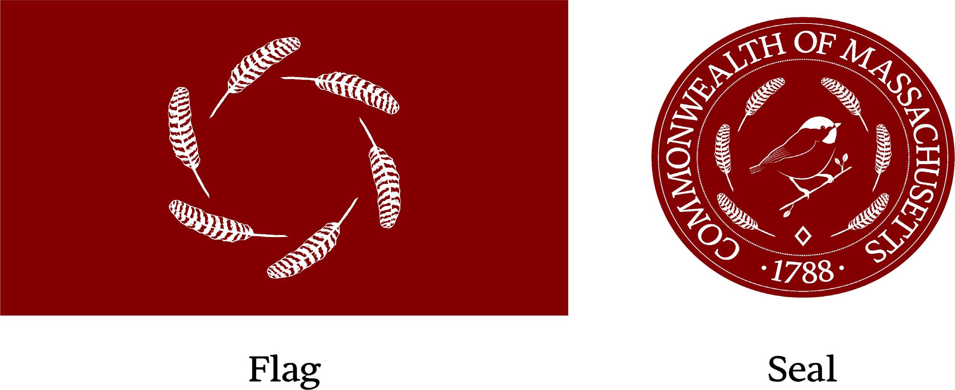
Slide #: 171, 777
(1)
Motto: We are one and free.

Slide 87
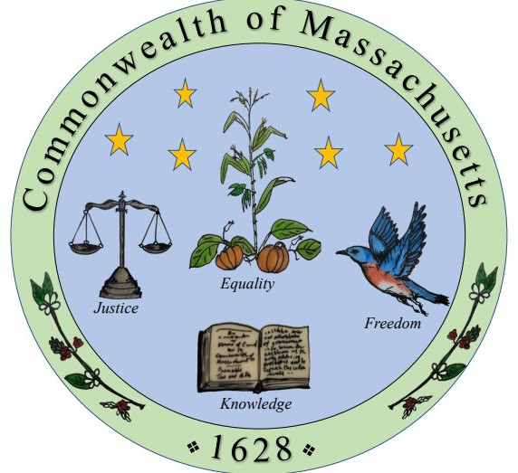
(1)
Slide #505

Slide 88

(1)
Slide #521
Motto: Shining a Light Forward

Slide 89

(1)
Slide #568

Slide 90
Slide #785
(1)
Ingenio et Animo: Celebrates Massachusetts' distinctive blend of world-class innovation and the grit to pursue it. (Latin: "By Talent and Courage")
Fortitudo et Scientia: Affirms that resilient people empowered by knowledge drive progress. (Latin: "Strength and Knowledge")
Lux et Libertas: Portrays Massachusetts as a beacon of knowledge, freedom, and enlightened progress, reflecting our intellectual traditions and foundational commitment to individual rights. (Latin: "Light and Liberty")
Liberty and Union: Drawn from the historic Taunton "Liberty and Union" flag, this motto connects Massachusetts' revolutionary roots to its enduring dedication to national unity.
Spirit of Inquiry, Heart of Progress: Explicitly communicates Massachusetts' ongoing dedication to curiosity and intellectual exploration, powering breakthroughs in science, culture, and civic life

Slide 91
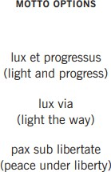
Slide #836
(1)

Slide 92
"Lighting the Way“
Slide #889
(2)

Slide 93
Slide #945
(1)
PEACE

Slide 94
Omnes sic advenite, et tuti sunt
All are welcome, all are safe
Slide #640
(1)

Slide 95

Slide #968
(1)

Slide 96
The new motto I'm proposing is "primus in cogitatione, primus in actio".
Slide #106
(1)

Slide 97
UNDER LIBERTY WE SEEK PEACE, JUSTICE, AND EQUALITY FOR ALL
Slide #178
(1)

Slide 98

Slide #234
(1)

Slide 99
Slide # 696
(1)
The State Motto should be: SAFEGUARD PEACE AND LIBERTY
This is a shorter rephrasing of the inscription on the north side of the beautiful Boston Public Library building: "THE COMMONWEALTH REQUIRES THE EDUCATION OF THE PEOPLE AS THE SAFEGUARD OF ORDER AND LIBERTY"

Slide 100
Slide # 197
(1)
Two proposals for a new motto: 1. "For the People and the Common Wealth" 2. "From This Cradle Grows Liberty”

Slide 101
Slide # 18
(1)
(2)
Melius praeteritum futurum intelligendo facimus.
Translated from Latin:
“By understanding the past, we make a better future.”

Slide 102
(1)
Slide #1105
In the Spirit of the First Light, We Remember and Rise with Justice and Truth

Slide 103
Slide #55
(4)
Eliminate the arm and sword image. Replace the Indian symbol with a turkey (which represents intelligence, endurance and overcoming adversity.) Replace the slogan with: Peace, Liberty and freedom from tyranny. ( I prefer the slogan be in English, but Latin is acceptable.)

Slide 104
(2)
Slide # 155
Together We Are Better

Slide 105
(2)
Slide #278
"By Wisdom and Revolution, We Rise" - Honors the state's role in the American Revolution and its leadership in education (Harvard, MIT) while looking forward.
"Defiant Spirit, Relentless Progress" - Reflects Massachusetts' rebellious roots and its modern push for social and technological advancement.
"The Past's Battleground, The Future's Blueprint" - Acknowledges its revolutionary history while emphasizing its role in innovation (biotech, renewable energy).
"Freedom First, Forward Always" - A modern twist on its revolutionary legacy and progressive politics. "Think Bold, Act Just, Move Forward" - Speaks to Massachusetts' intellectual culture, social activism, and innovative drive.
"Cunning Minds, Stubborn Hearts" - A playful take on the stereotypical Bostonian attitude (sharp, argumentative, but principled).
"From Liberty's Cradle to Tomorrow's Light" - Connects its revolutionary origins (Lexington, Concord) with its leadership in science and education.
"The Spirit of '76 Still Speaks" - A direct homage to its revolutionary fire, suggesting that its boldness endures today.

Slide 106
Slide #551
(2)

Slide 107
Slide #857
(2)
"Born Free and Equal" We propose "Born Free and Equal" as the new motto of the Commonwealth. It is drawn from the first sentence of the first article of the Massachusetts state constitution. This phrase powerfully reflects the Commonwealth's core values of liberty and equality. It affirms that all people are inherently equal and entitled to freedom under the law. This principle not only laid the foundation for the abolition of slavery in Massachusetts but also continues to inspire movements for civil rights and social justice today. "Born free and equal" speaks to a more inclusive vision of Massachusetts and one that honors its historical leadership in the fight for human dignity.

