Slide 1
Seasonal Communities Overview
Cape Cod Seasonal Communities Info Session
February 2, 2025

Slide 2
Contents
Designation Overview | 3 – 7
Designation Benefits | 8 – 13
Designation Requirements | 14 – 15
Regulation Update | 16 – 17
Next Steps | 18 – 19
Resources & Questions | 20

Slide 3
Designation Overview

Slide 4
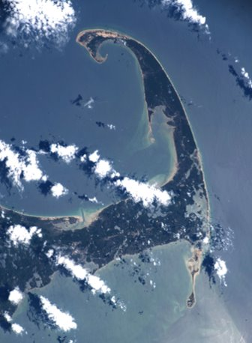
What is the Seasonal Communities Designation?
Why was it created?
The Seasonal Communities designation was created as part of the Affordable Homes Act, passed by the Legislature and signed into law by Governor Maura Healey on Aug. 6, 2024. The historic legislation authorized $5.16 billion in spending over the next five years along with nearly 50 policy initiatives to counter rising housing costs caused by high demand and limited supply.
The Seasonal Communities designation is designed to recognize and support the unique needs of Massachusetts communities that experience substantial variations in seasonal visitation, employment, and housing demand.
The designation supports these municipalities with distinctive tools to benefit the year-round residents, artists, and essential public employees who make these communities attractive destinations for seasonal visitors.
These tools include year-round occupancy restrictions, a housing preference for essential public employees, and more.
Sources:
Section 32 of Chapter 150 of the Acts of 2024 (HTML)
Section 32 of Chapter 150 of the Acts of 2024 (PDF)

Slide 5
How Does a City/Town Become a Seasonal Community?
(I/III)
Statute sets out the following criteria for Seasonal Communities designations:
The AHA establishes that the following communities should be offered designation automatically*, including:
All municipalities in the counties of Dukes and Nantucket;
All municipalities with over 35% seasonal housing units in Barnstable county; and
All municipalities with more than 40% seasonal housing units in Berkshire county.
*A list of communities for which designation as Seasonal Communities is ordered by statute is included on the next slide (slide 6).
The law also lists criteria which EOHLC may consider in offering additional Seasonal Communities designations; including:
High rates of short-term rentals;
Significant population increases in seasonal visitors;
Large disparities between the area median income and the income required to purchase a median home price;
High percentage of seasonal housing stock
High variations in monthly employment
*A list of communities designated as Seasonal Communities in December 2025 according to the above metrics is included on the following slide (slide 7).
Note: The local legislative body of a municipality offered the designation must vote to accept the designation before statutory provisions apply.

Slide 6
How Does a Community Become a Seasonal Community?
(II/III)
List of communities automatically offered designation as Seasonal Communities per statute*:
Municipality | County | % Seasonal Units
Brewster | Barnstable County | 41.4%
Chatham | Barnstable County | 54.5%
Dennis | Barnstable County | 51.9%
Eastham | Barnstable County | 57.1%
Harwich | Barnstable County | 38.8%
Orleans | Barnstable County | 47.0%
Provincetown | Barnstable County | 55.7%
Truro | Barnstable County | 71.3%
Wellfleet | Barnstable County | 57.9%
Alford | Berkshire County | 42.5%
Becket | Berkshire County | 46.4%
Hancock | Berkshire County | 58.0%
Monterey | Berkshire County | 53.2%
Municipality | County | % Seasonal Units
Mount Washington | Berkshire County | 49.1%
Otis | Berkshire County | 56.0%
Stockbridge | Berkshire County | 43.6%
Tyringham | Berkshire County | 40.5%
Chilmark | Dukes County | 65.5%
Edgartown | Dukes County | 69.2%
Aquinnah | Dukes County | 47.2%
Gosnold | Dukes County | 85.9%
Oak Bluffs | Dukes County | 56.3%
Tisbury | Dukes County | 48.5%
West Tisbury | Dukes County | 56.4%
Nantucket | Nantucket County | 59.9%
*Bolded font indicates communities which have voted to accept the Seasonal Communities designation as of January 2026

Slide 7
How Does a Community Become a Seasonal Community?
(II/III)
List of communities offered designation considering criteria for additional designations:
Municipality | County | % seasonal units | % Short-Term Rentals
Barnstable | Barnstable | 23.00% | 5.42%
Bourne | Barnstable | 18.08% | 3.46%
Falmouth | Barnstable | 30.22% | 5.99%
Mashpee | Barnstable | 30.74% | 6.05%
Sandwich | Barnstable | 13.49% | 6.14%
Yarmouth | Barnstable | 32.22% | 7.30%
Egremont | Berkshire | 33.23% | 6.43%
Great Barrington | Berkshire | 12.71% | 7.60%
Lee | Berkshire | 12.64% | 3.34%
Municipality | County | % Seasonal Units | % Short-Term Rentals
Lenox | Berkshire | 20.92% | 3.89%
New Marlborough | Berkshire | 33.63% | 9.14%
Richmond | Berkshire | 20.91% | 4.21%
Sandisfield | Berkshire | 35.49% | 4.96%
Sheffield | Berkshire | 14.41% | 3.39%
West Stockbridge | Berkshire | 36.44% | 5.56%
Williamstown | Berkshire | 12.83% | 3.63%
Hawley | Franklin | 16.39% | 6.56%
Monroe | Franklin | 24.29% | 5.71%
Note: These communities were offered the Seasonal Communities designation in December 2025 and are now eligible to vote to accept the designation

Slide 8
Designation Benefits

Slide 9
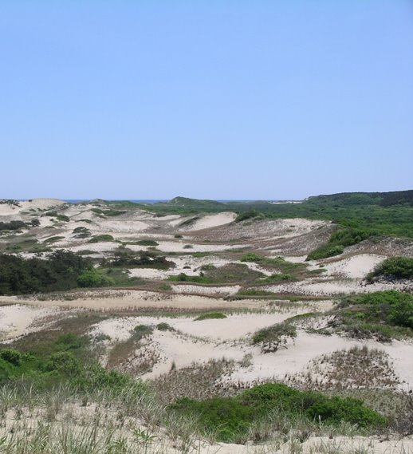
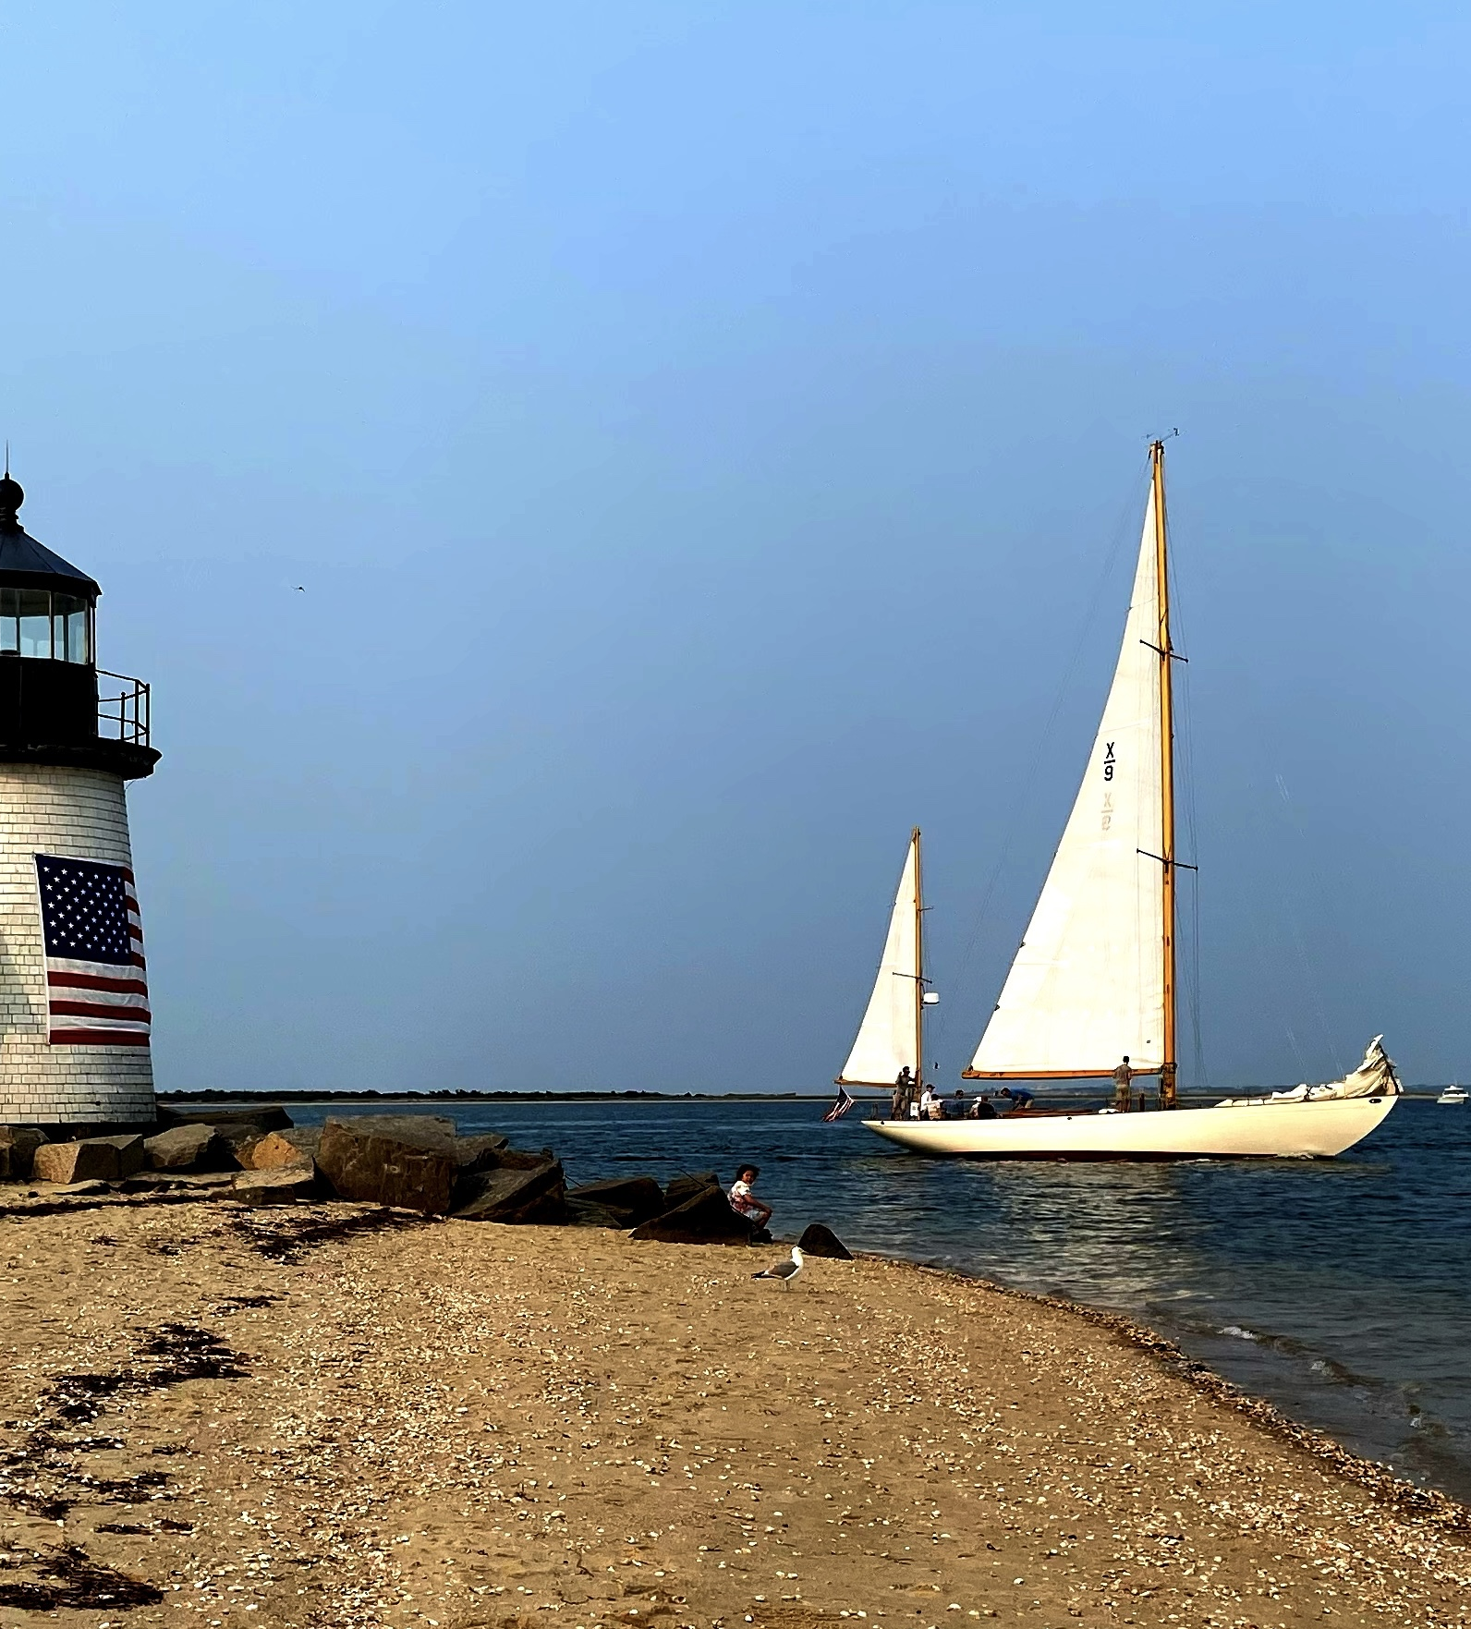
Designation Benefits: Overview
The Seasonal Communities designation empowers communities with unique tools to meet year-round housing needs:
Year-Round Housing Trusts and Occupancy Restrictions
Essential Public Employee Housing Preference
Year-Round Artist Housing
Residential Property Tax Exemption Increase
CIP Funding made available through annual NOFA

Slide 10
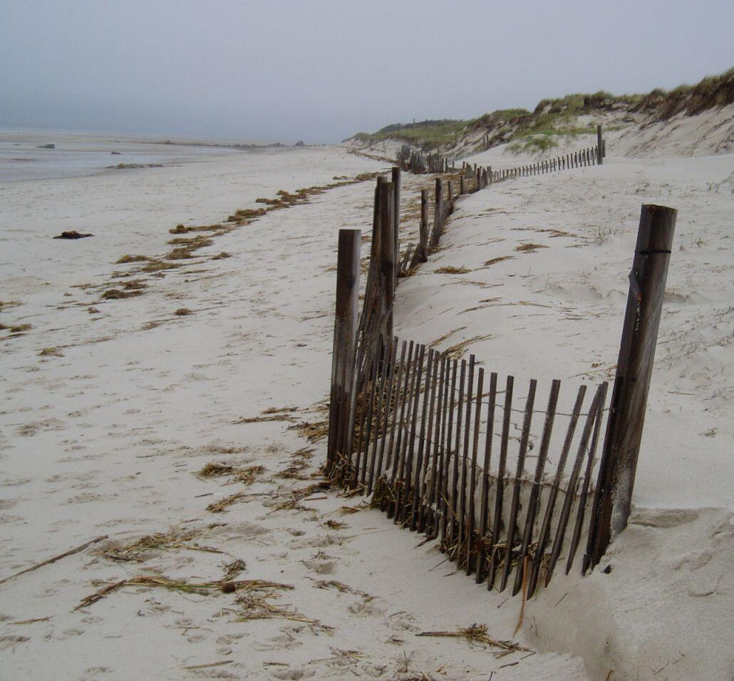
Designation Benefits:
Year-Round Housing Trusts & Occupancy Restrictions
Year-Round Housing Trust Funds
Designated communities may establish year-round housing trusts, similar to affordable housing trusts (except: 3-yr terms; exemptions from taxation, 30B for intra-municipal transfers)
Trusts support the creation and preservation of Affordable (up to 80% AMI) and Attainable* (up to 250% AMI) housing for year-round residents
Trusts may be regional, terms of regional trust established by member municipalities
Year-Round Occupancy Restrictions
Designated communities may acquire year-round housing occupancy restrictions
Must occupy unit as principal residence for 10+ months per year, with reasonable exceptions as allowed locally
30-yr term unless otherwise specified, may not currently be held in perpetuity
*Attainable housing units must satisfy existing requirements for SHI inclusion to be counted

Slide 11
Designation Benefits:
Essential Public Employee Preference & Artist Housing
Essential Public Employee Preference
Preference may be employed when:
A Seasonal Community supports development through financial assistance, property tax relief, or donation of land
Preference may be employed for:
Households with at least one municipal, county, or state employee (defined in line with Conflict of Interest Law (M.G.L. 268A)) essential for public health and safety in a Seasonal Community
  Includes, but is not limited to: teachers at public institutions, public works employees, publicly employed first-responders, town administrators, and other employees essential for municipal operations
  Employees may be full-time, part-time, intermittent, or volunteer
Artist Housing
Municipalities may develop year-round housing for artists
Artist defined as a person who "by vocation produces or supports artistic and literary activities," allowing flexibility for municipalities to further define

Slide 12
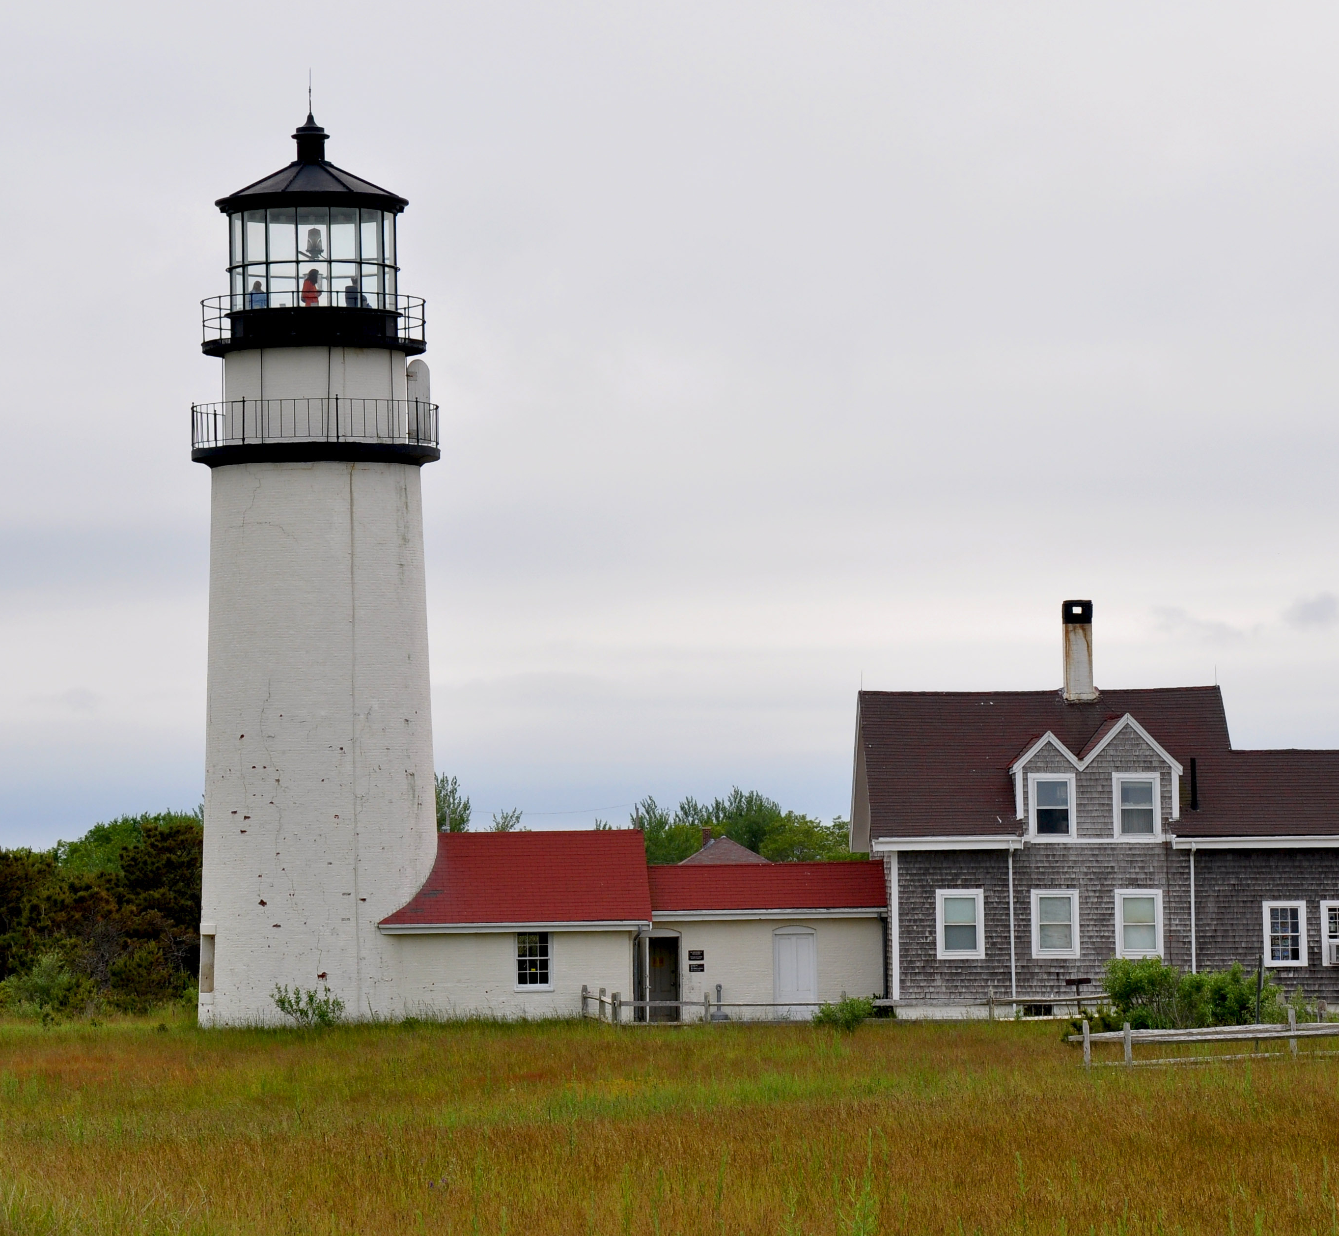
Designation Benefits:
Residential Property Tax Exemption
Residential Property Tax Exemption
Municipalities which have already adopted the Residential Property Tax Exemption may increase the exemption to up to 50% of the avg. assessed value of all class one, residential parcels within that municipality
Municipalities must adopt the increase at the option of their select board, or their mayor with the approval of their city council
Municipalities must then, upon request, provide the Commissioner of Revenue with evidence of a) designation acceptance and b) vote to increase the exemption
Still subject to other requirements of M.G.L. c.59, § 5C, which establishes exemption authority

Slide 13
Designation Benefits:
CIP Funding
Seasonal Communities CIP Funding
The Capital Investment Plan makes up to $4 million available in FY26 and FY27 to support Seasonal Communities ($2M in each fiscal year)
FY26 NOFA issued to eligible communities (14 communities that accepted) to apply for $2M in total funding
All eligible communities that accepted the designation were eligible to receive a grant of $50,000 - $175,000 for permissible activities, based on population
All eligible communities applied, and applications are now being reviewed
Permissible activities listed in the NOFA included:
  Planning and zoning activities, including, but not limited to: 1) Planning activities related to housing needs assessments, 2) Zoning and/or bylaw revisions to implement Seasonal Communities policies, and 3) Planning for housing development.
  Local actions for housing development, including but not limited to: 1) Funding for housing development projects, 2) Technical Assistance to establish a Year-Round Housing Trust Fund, and 3) Seed funding for Year-Round Housing Trust to support housing development.
  Public horizontal infrastructure projects to leverage housing development, including pre-construction (design/engineering documents) and/or construction related to: 1) Sewer lines, septic systems, and other sanitary waste disposal systems, water lines, wells, and water treatment systems; 2) Utility extensions; 3) Streets, roads, curb cuts, and other transit improvements such as crosswalks and pedestrian and bicycle ways; and 4) Other related horizontal infrastructure work adjacent to planned or imminent housing improvements.

Slide 14
Designation Requirements

Slide 15
Designation Requirements
Overall
Requires that municipalities adopt zoning that permits 1) undersized lot and 2) tiny house development as-of-right in all single-family residential zoning districts
Undersized Lots
Limits as-of-right requirement to year-round, attainable housing units
Prohibits residential units on undersized lots from being rented for less than 6 months
Tiny Houses
Limits as-of-right requirement to year-round housing units
Requires tiny houses to comply with state building code and local enhancements (e.g. opt-in energy code), applicable water and sewer requirements, floor-to-area ratio requirements
Allows municipalities to further regulate movable tiny houses

Slide 16
Regulation Update

Slide 17
Regulation Update
HLC received 50+ substantive individual comments on draft regulations, including comments from:
  9 seasonal communities
  10 nonprofit, advocacy organizations, and regional planning agencies
  30 individual residents
Regulations are in the final stage of promulgation process, and final regulations will be promulgated shortly, with updates to draft regulations including:
  Year-Round Occupancy Restrictions: Updated approach adds flexibility to allow occupancy restrictions through instruments other than deed restrictions
  Tiny House & ADU Overlap: Updated approach specifies that tiny house requirement applies only to tiny houses as principal dwellings
  Undersize Lots - New vs Existing: Updated approach requires attainable housing to be allowed as-of-right for existing lots. Communities can allow attainable housing on new lots by-right if they choose.
  Lot size: Updated approach specifies that municipalities must allow attainable housing as-of-right on undersized lots are at least 10,000 sq ft in size or 25% of the district’s minimum lot size, whichever is larger. Municipalities may choose to set lower thresholds if they choose.
  Setbacks: Updated approach specifies that undersized lot developments must have at least 1 foot of setbacks for every 1,000 sq feet of lot size unless the municipality grants a waiver. However, the setback requirements can't exceed 15 feet of setbacks and 20 feet of frontage, no matter the lot size.

Slide 18
Next Steps

Slide 19
Next Steps
Early February: Final Regulations Available
Mid-February: Save the Date for Seasonal Communities Office Hours
  Monday, February 9, 2:30-4 PM
  Tuesday, February 10, 2-3PM
  Wednesday, February 11, 3:30-6PM
  Sign Up Here: https://doodle.com/meeting/participate/id/bm0q9QAa/vote

Slide 20
Thoughts? Questions?
Share today or contact us at:
EOHLCSeasonalCommunities@Mass.Gov
Find more information about the Seasonal Communities Designation, including the Seasonal Communities Advisory Council's first Annual Report at:
https://www.mass.gov/info-details/seasonal-communities

