Slide 1
Seasonal Communities Advisory Council Funding, Data & Designations
March 12th, 2025

Slide 2
Agenda
Call to Order, Swearing In, Approval of Minutes | N/A
Designation Acceptance | 3 – 4
Statutory Metrics Data Review | 5 – 18
Further Designations | 19 – 20
Working Groups | 21 – 24
Timeline & Next Steps | 25 – 27

Slide 3
Designation Acceptance

Slide 4
Designation Acceptance
Determination: All municipalities designated as a Seasonal Community must locally vote to accept or deny their designation
Votes may be held in any manner consistent with the laws of the Commonwealth and the designated municipality's charter
Key Statutory Text:
"A municipality designated by the executive office as a seasonal community pursuant to this section shall accept or deny the designation by vote of its legislative body"
Source: MGL c. 23B, s. 32 (PDF)
MGL c. 23B, s. 32 (HTML)

Slide 5
Statutory Metrics Data Review

Slide 6
Criteria for designating additional Seasonal Communities
“The executive office may designate additional municipalities as seasonal communities based on consideration of the following factors:
(i) a high rate of short-term rentals in relation to the overall housing inventory;
(ii) a significant population increase in seasonal visitors;*
(iii) an excessive disparity between the area median income and the income required to purchase the municipality’s median home price;
(iv) the percentage of housing stock that is used for seasonal, occasional or recreational use or is otherwise not used as a primary residence by the property’s owner; and
(v) high variations in the average monthly variation of employment in the sector over the full year, in relation to the municipality’s minimum employment threshold.”
*Further analysis required; data not included in these materials

Slide 7
I) Short-Term Rentals
There are 43,401 short term rentals (STRs) registered with the Massachusetts Department of Revenue as of July 2024. Six towns have no registered short-term rentals.
UMass Donahue Institute collected data from the MA DOR and excluded the following registered STRs:
Units that are “rooms” or “suites”, rather than an entire dwelling units
Units occupied by guests for 14 days or less each year (these are exempt from the lodging tax)
Owner-occupied units
There are 34,000 “primary” short-term rentals: complete units that are not owner-occupied and that are rented for 15 days or more each years. This is 78 percent of all registered STRs, and 1.1% percent of the state’s housing stock (2018 – 2022 ACS).
Half of all primary STRs are in Barnstable County despite having only 6 percent of the state’s housing units. 10 percent of the county’s housing stock is a full-time STR.
Over 20% of homes on Martha’s Vineyard and Nantucket are registered as a primary STR.
Primary STRs in Berkshire County take up 2.6% of the housing stock county-wide.

Slide 8
I) Short Term Rentals, by region

Slide 9
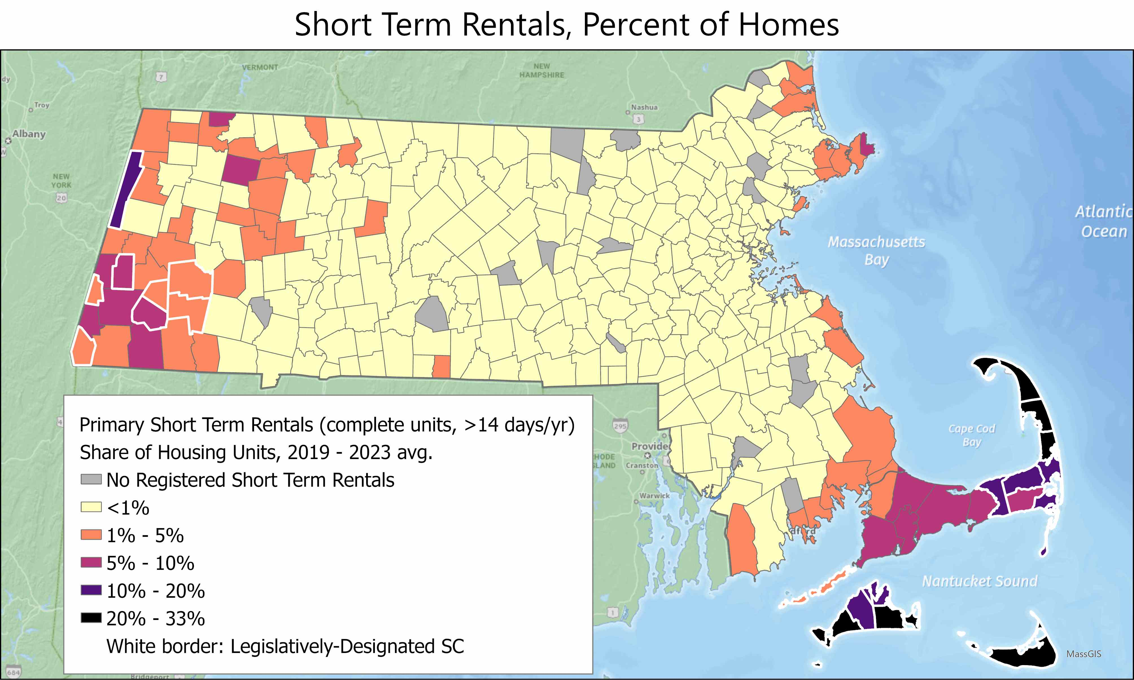
I) Short term rentals

Slide 10
III) Disparity between the area median income and the income required to purchase the municipality’s median-priced home
Area Median Income is determined by HUD
Based on median income for a four person family household -- not median for all households.
Drawn from 2018 – 2022 ACS data inflation adjusted to 2024 dollars.
Values are estimated for 19 different Fair Market Rent areas in Massachusetts.
Home sale prices based on Zillow Home Value Index, “a measure of the typical home value and market changes across a given region and housing type. It reflects the typical value for homes in the 35th to 65th percentile range.”
Includes both single family homes and condos
Monthly stats averaged to yield a 2024 median home value estimate
Ownership costs assumed 20% down payment, 6.6% interest rate
Insurance costs based on 2022 US Treasury data on average homeowners insurance premiums by zip code
Property tax costs calculated based on FY24 local mill rate assessed on median home sale price.

Slide 11
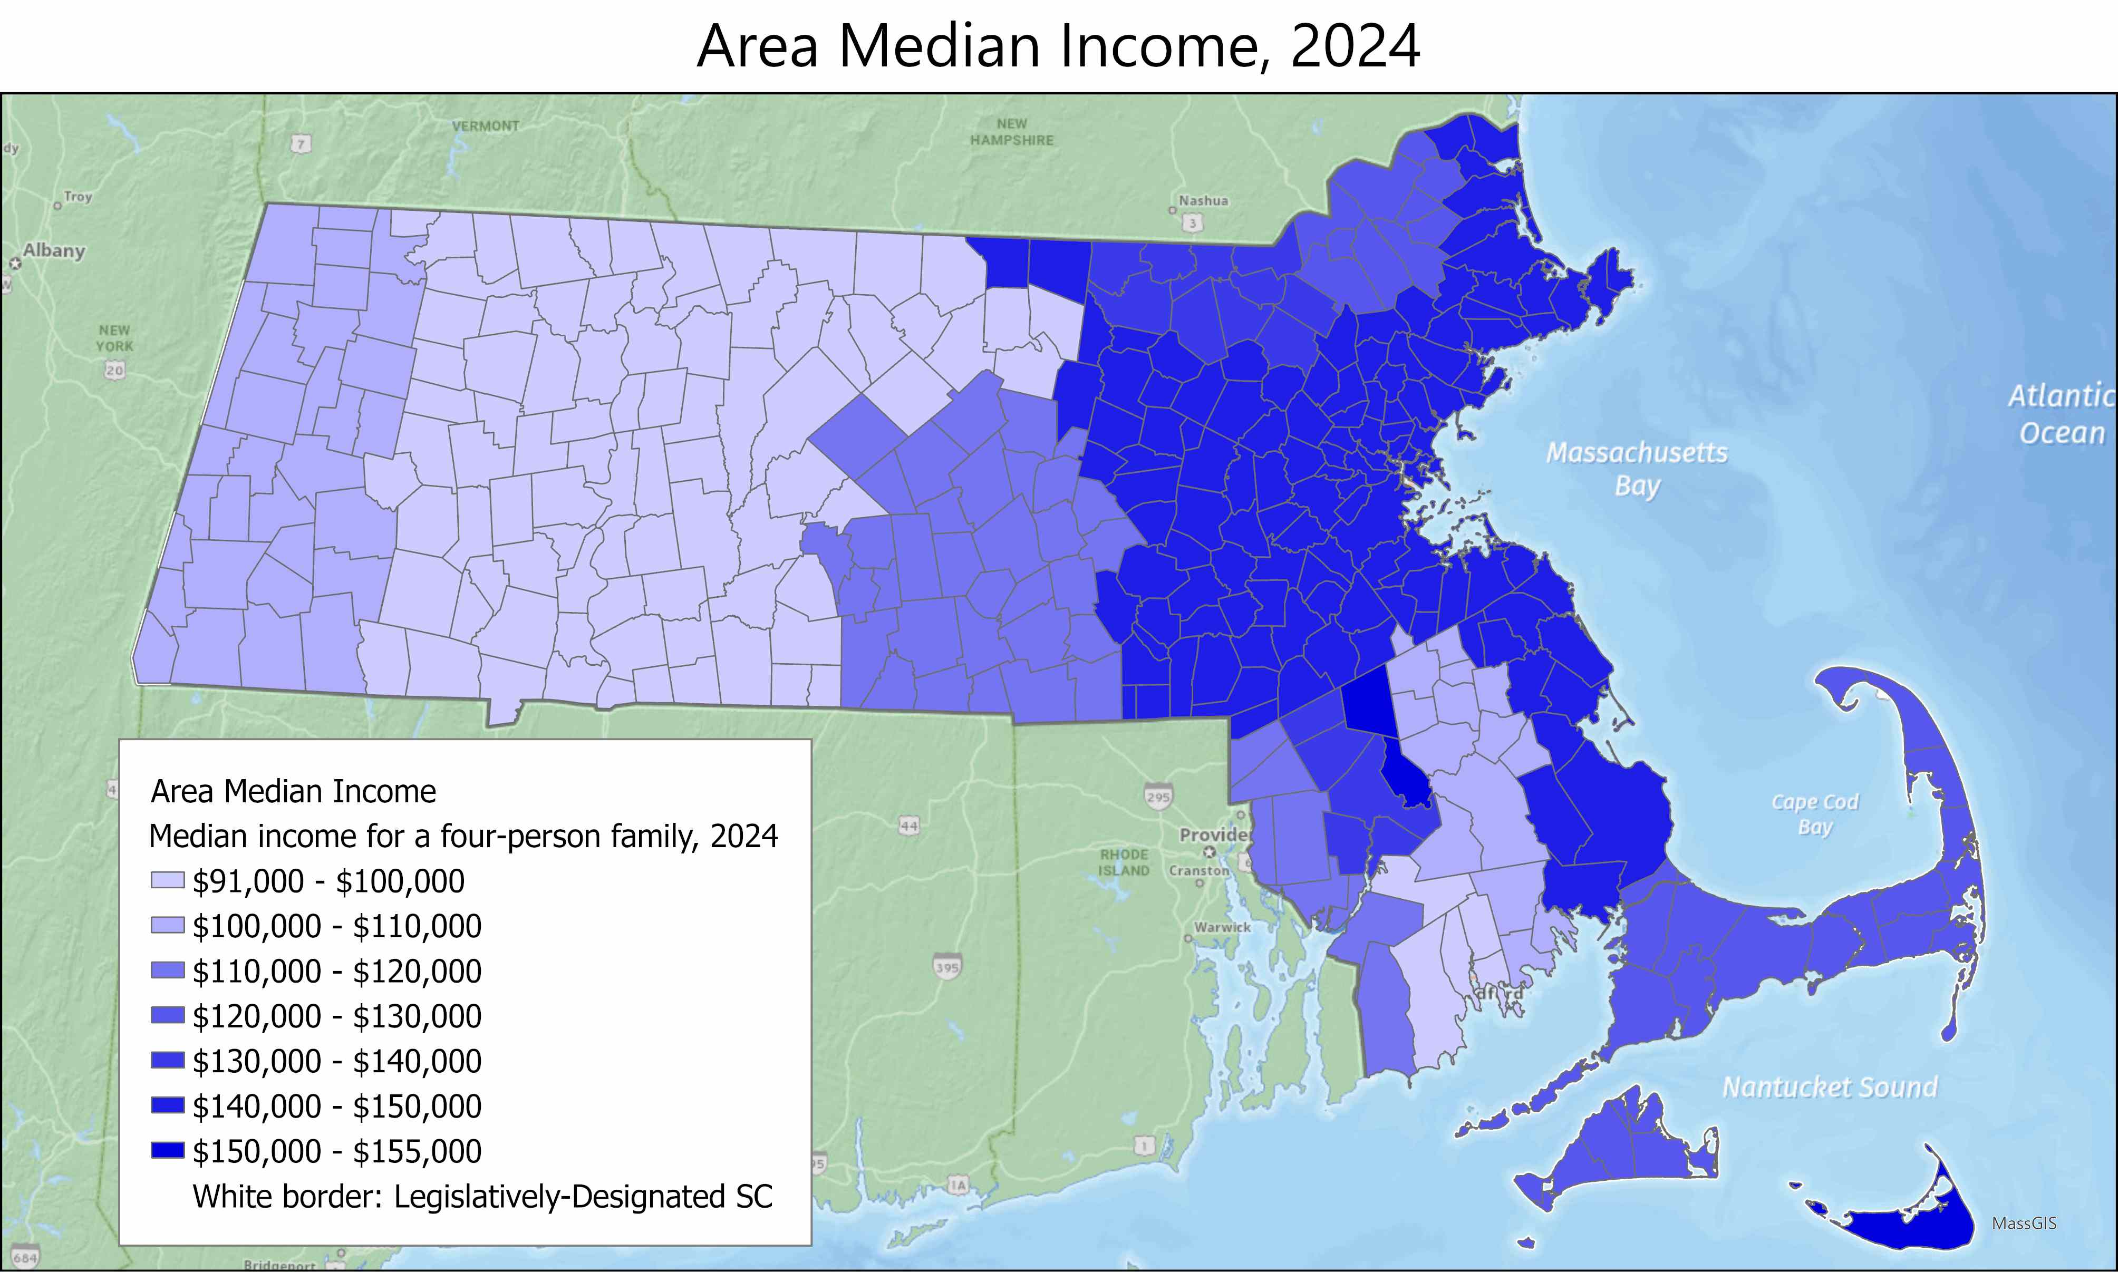
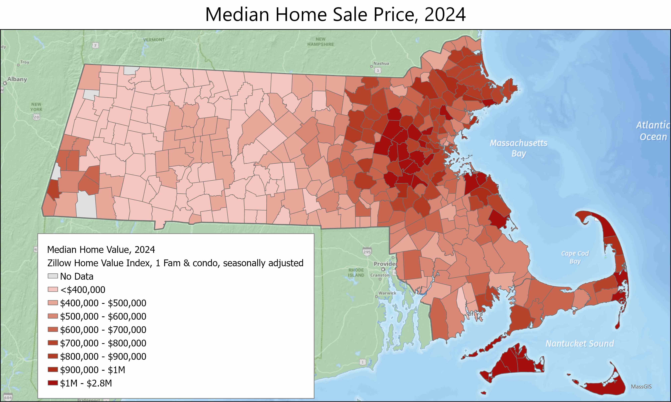
III) Disparity between the area median income and the income required to purchase the municipality’s median-priced home

Slide 12
III) Income required to purchase the municipality’s median-priced home

Slide 13
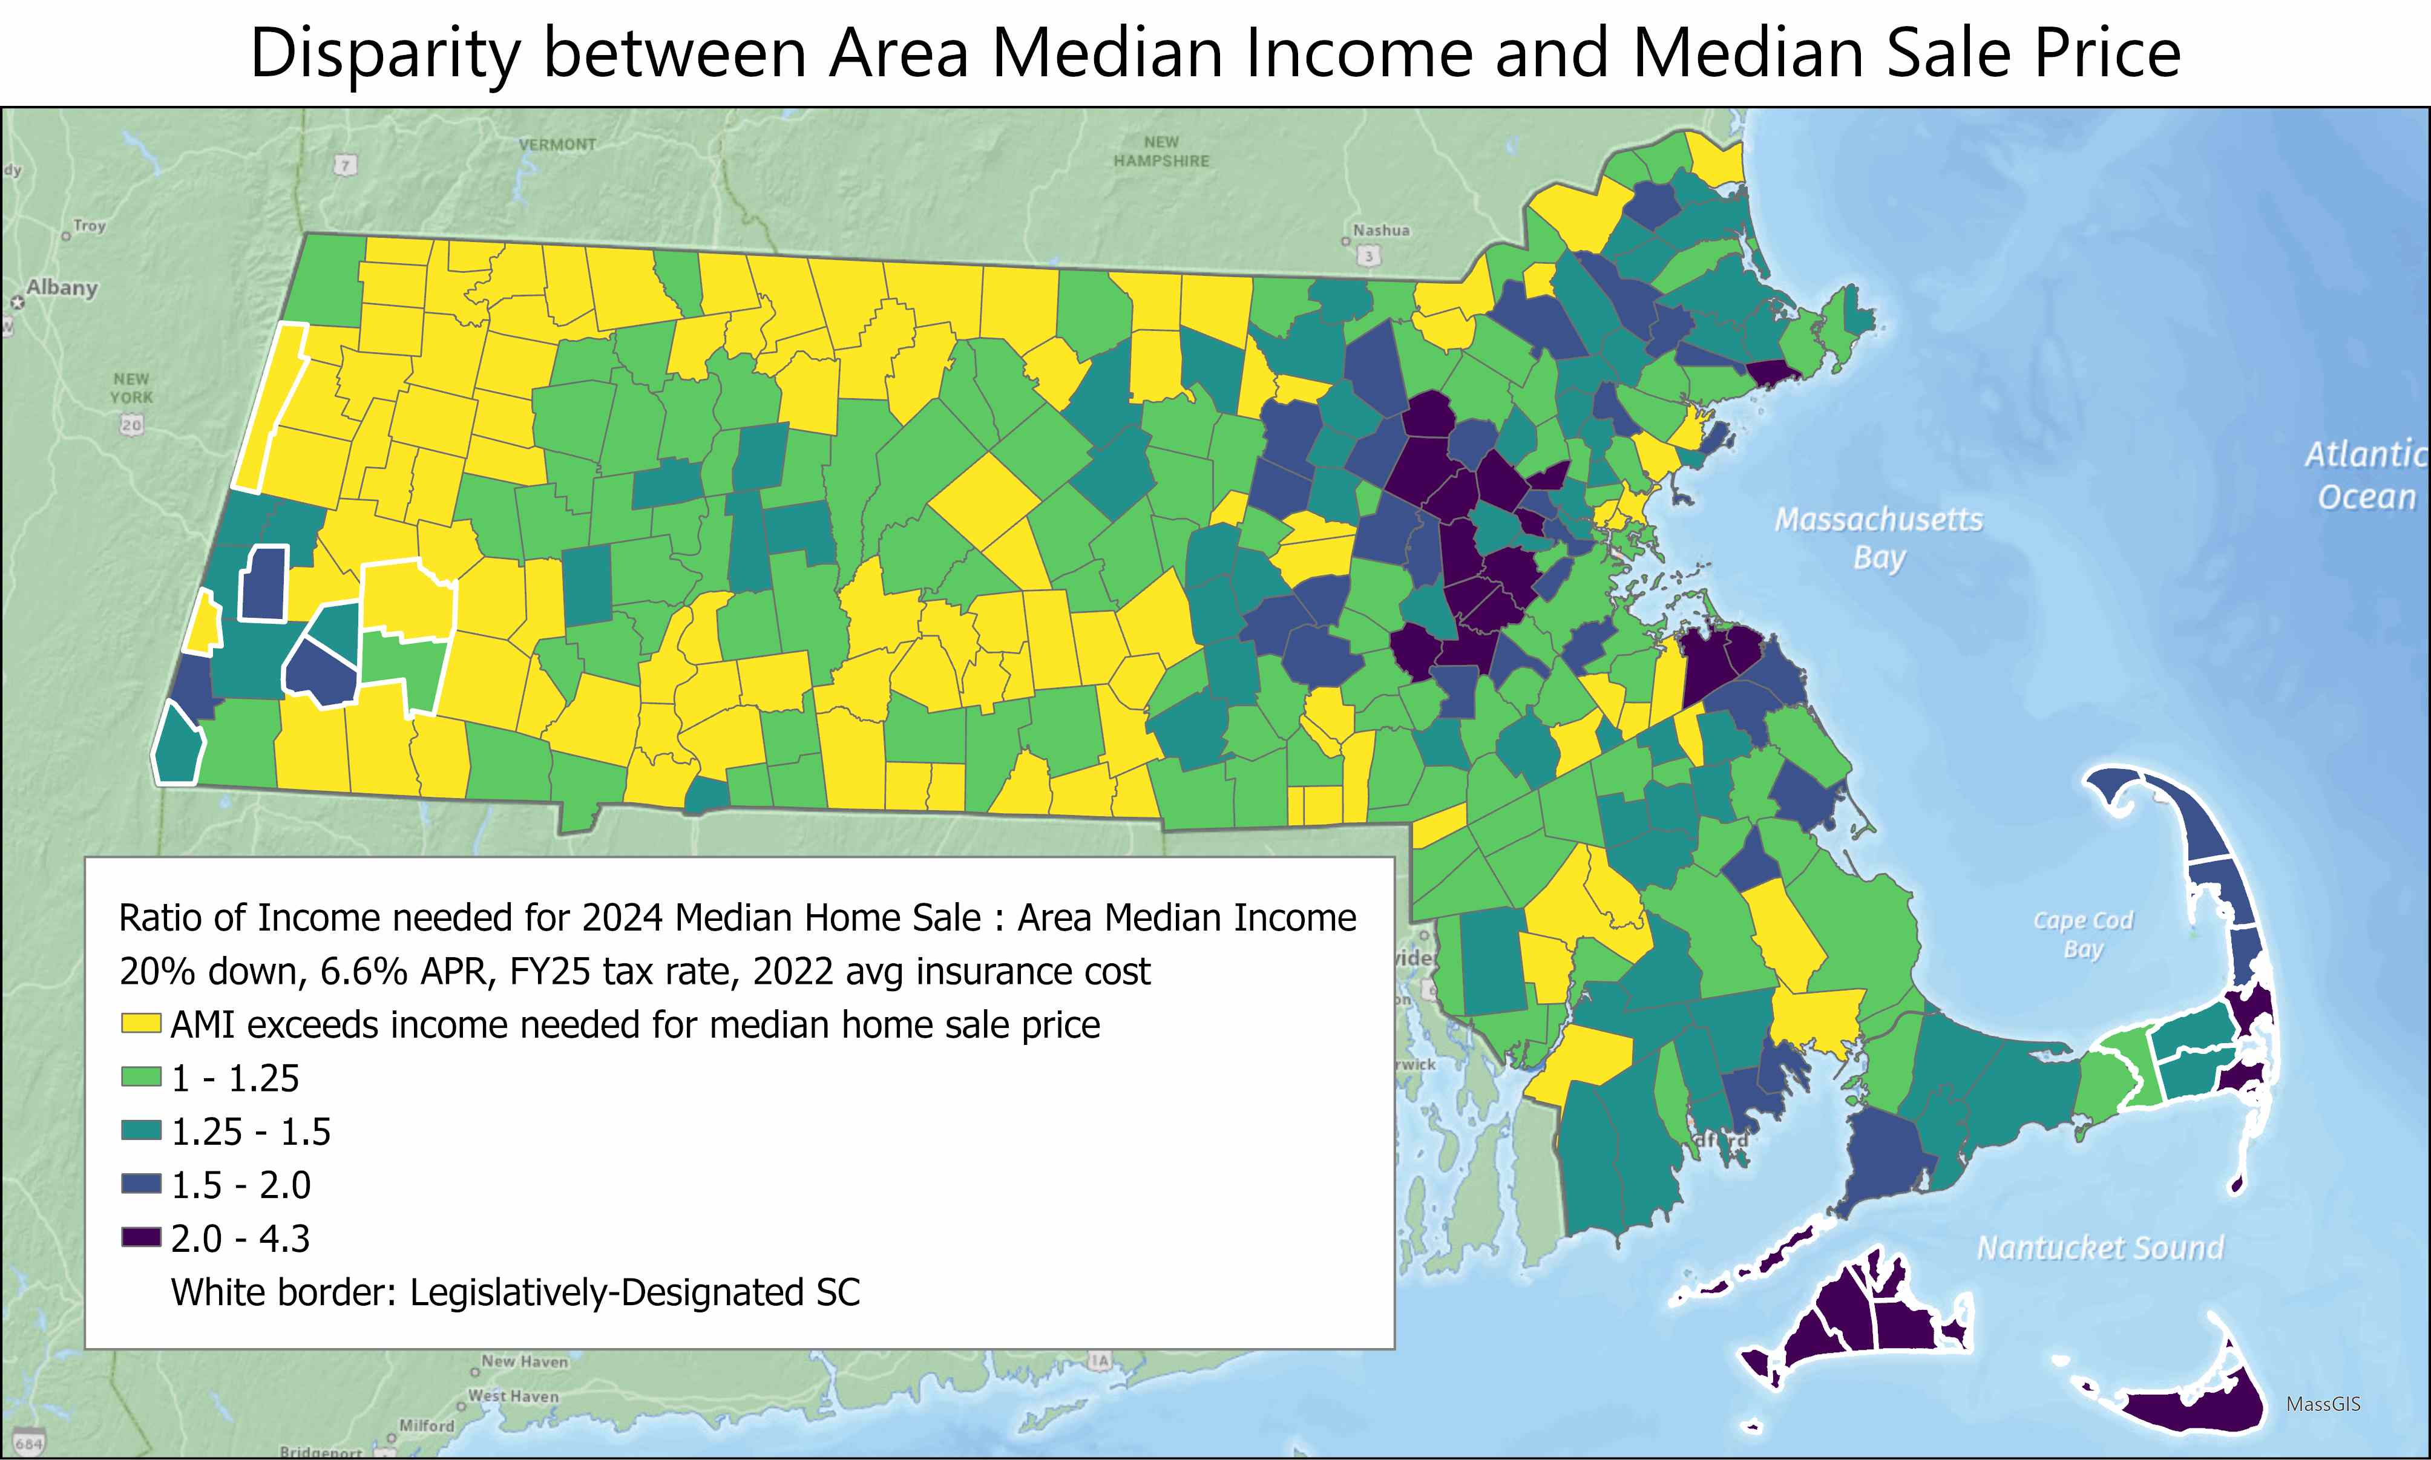
III) Disparity between the area median income and the income required to purchase the municipality’s median-priced home

Slide 14
IV) Percentage of homes used for seasonal, occasional or recreational use
The ACS classifies units into occupied and vacant; and vacant units are assigned a “Vacancy Status.” One status is “For seasonal, recreational, or occasional use.” Those terms are defined by the Census Bureau as follows:
For occasional use: Units held for weekends or occasional use throughout the year. Time-shared units are classified in this category if the vacant unit is not for-rent or for-sale-only, but held for use for an individual during the time of interview.
Seasonal Vacant Units: Units intended for occupancy only during certain seasons of the year and are found primarily in resort areas.
The Cape Cod Commission’s Regional Housing Needs Assessment and the Berkshire Regional Planning Commission’s Berkshire Benchmarks both use this same ACS data as the basis for their seasonal home estimates.
Analysis was conducted using 2018 – 2022 ACS data.

Slide 15
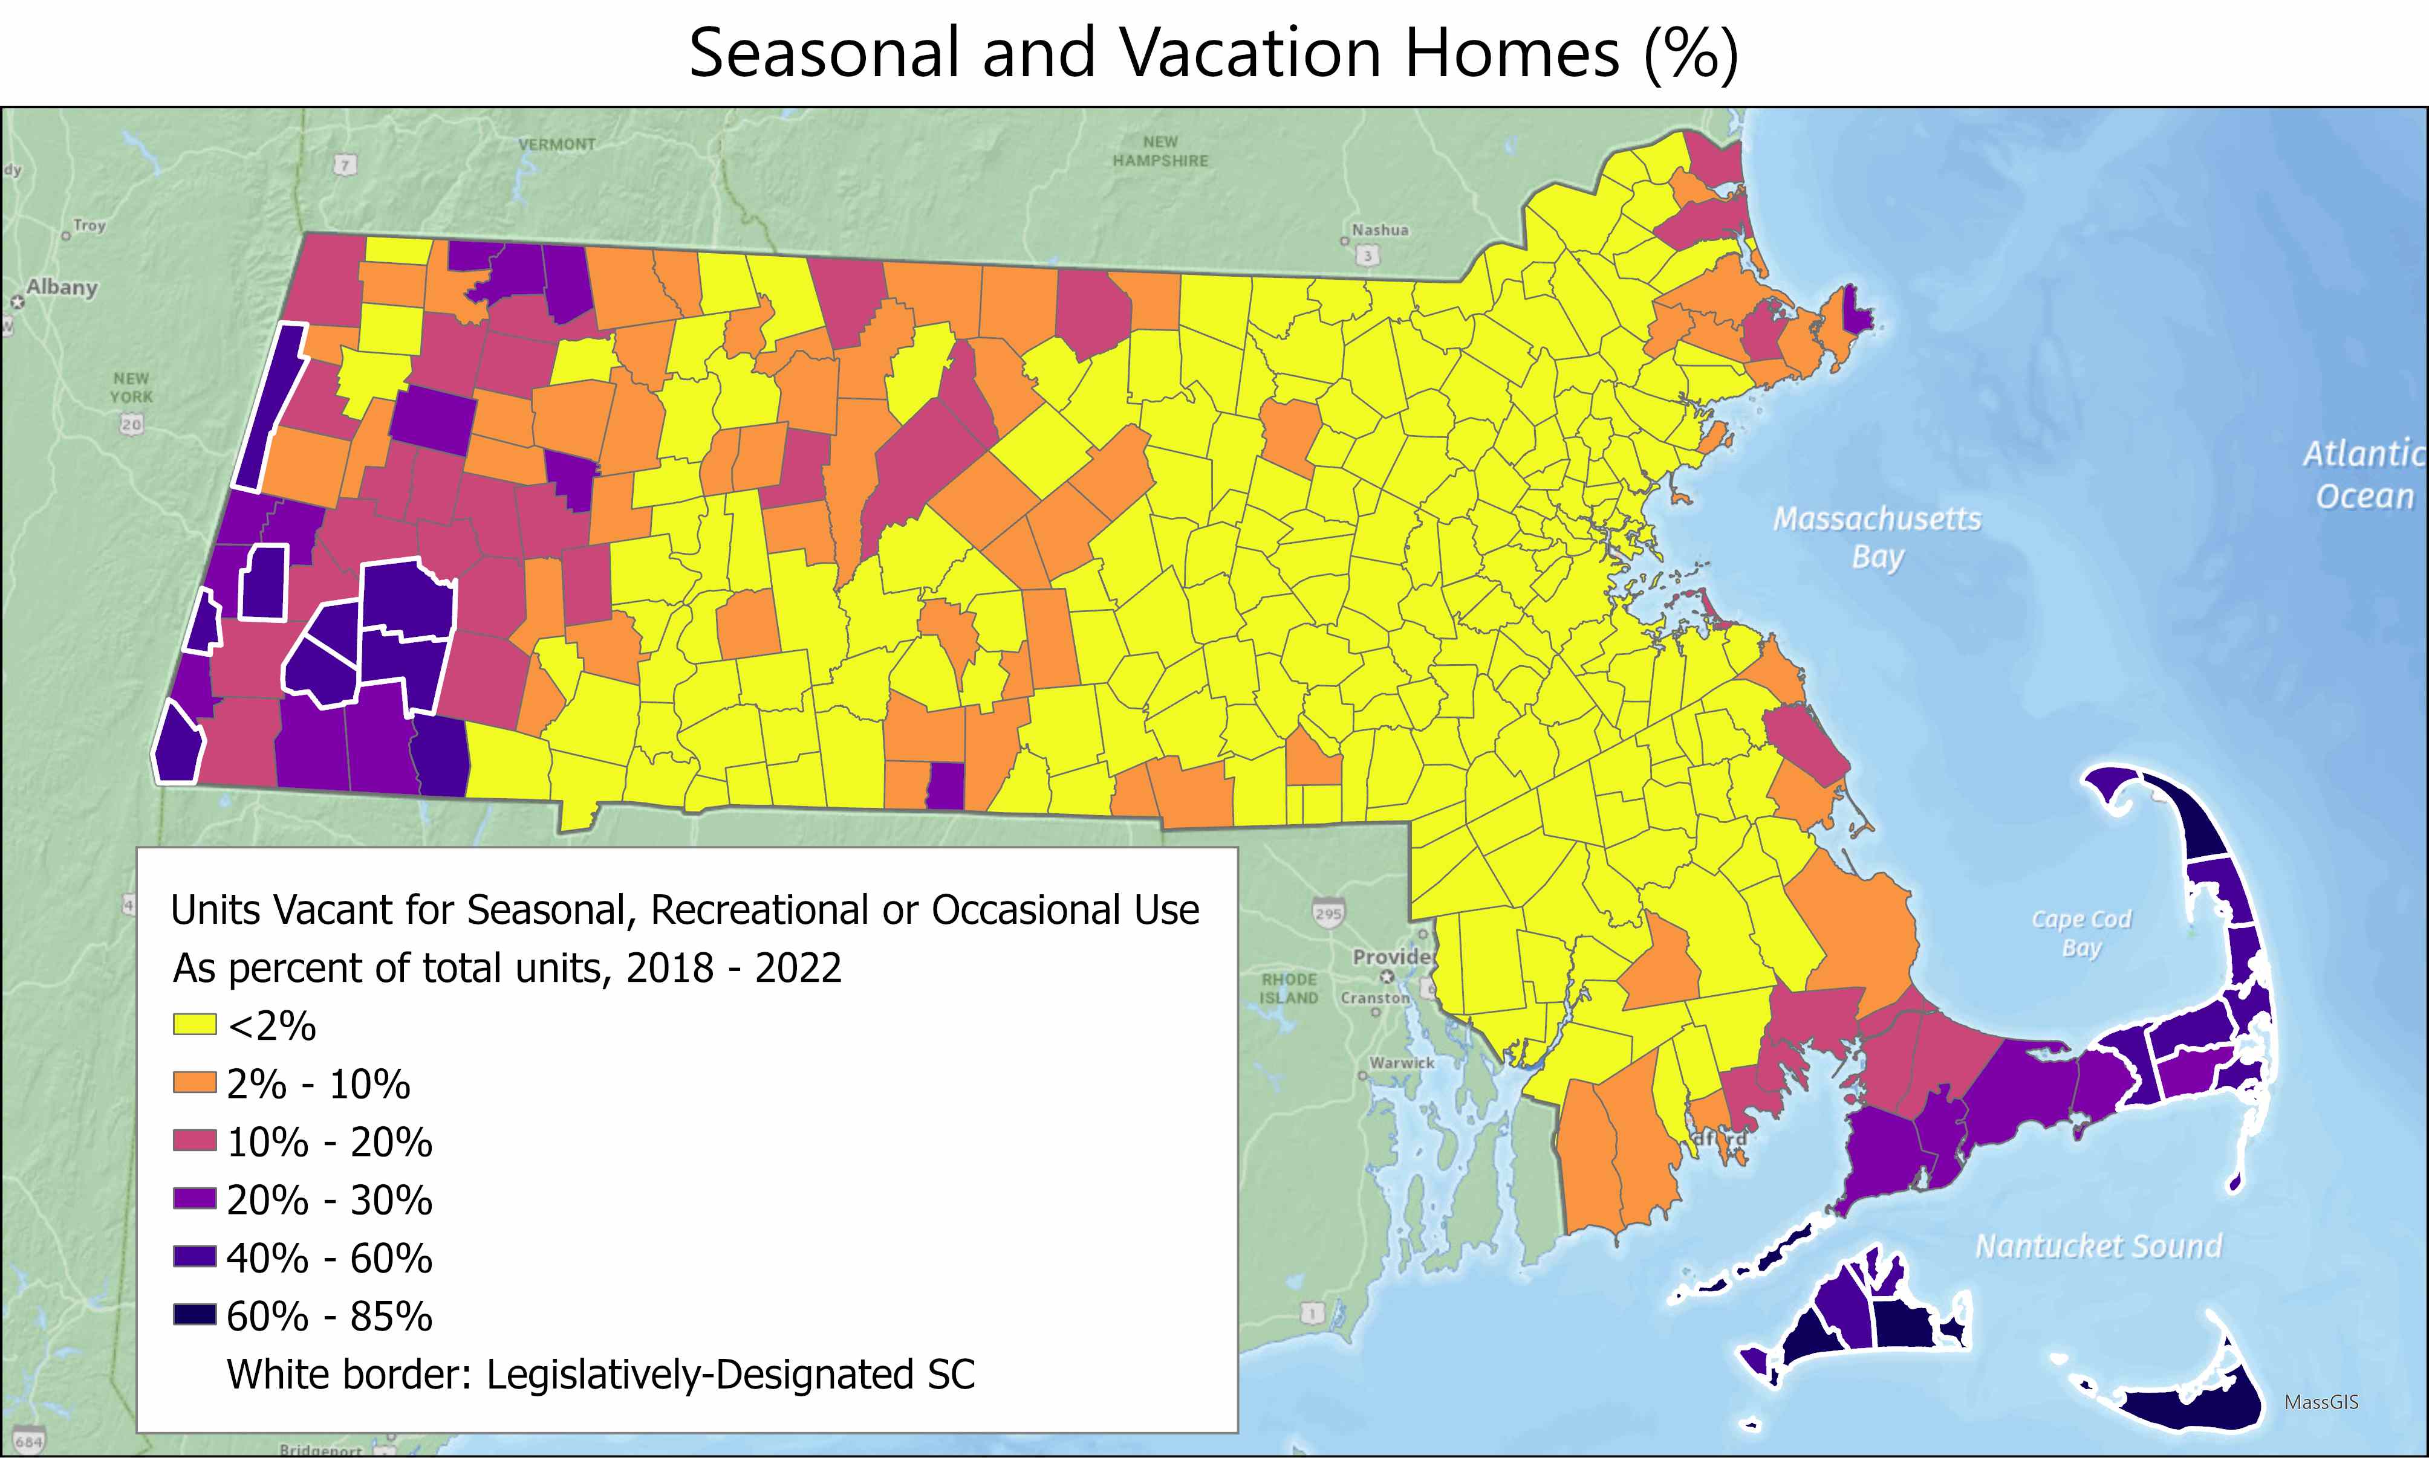
IV) Statutory Metrics Data Review

Slide 16
V) High variations in employment over the full year
EOHLC collected data on monthly employment by municipality from EOLWD for total employment, private sector employment (excludes city, town, state, federal employment), and Leisure & Hospitality sector.
Seasonal Employment Ratio was calculated as follows:
Calculate three-month rolling average of employment over the period 2014 – 2023
For each municipality, determine the three-month periods with the highest and lowest employment average for each calendar year. These are termed the “peak-season” and “off-season” employment totals.
Calculate the ratio of peak-season to off-season employment for each calendar year
Eliminate the highest and lowest calendar year ratios for the ten-year study period, for each municipality
Average the remaining ratios to produce an average Seasonal Employment Ratio for each municipality.
Current estimates are for all private sector employment. Further analysis will estimate Leisure & Hospitality ratios and share of seasonal employment associated with Leisure & Hospitality jobs.

Slide 17
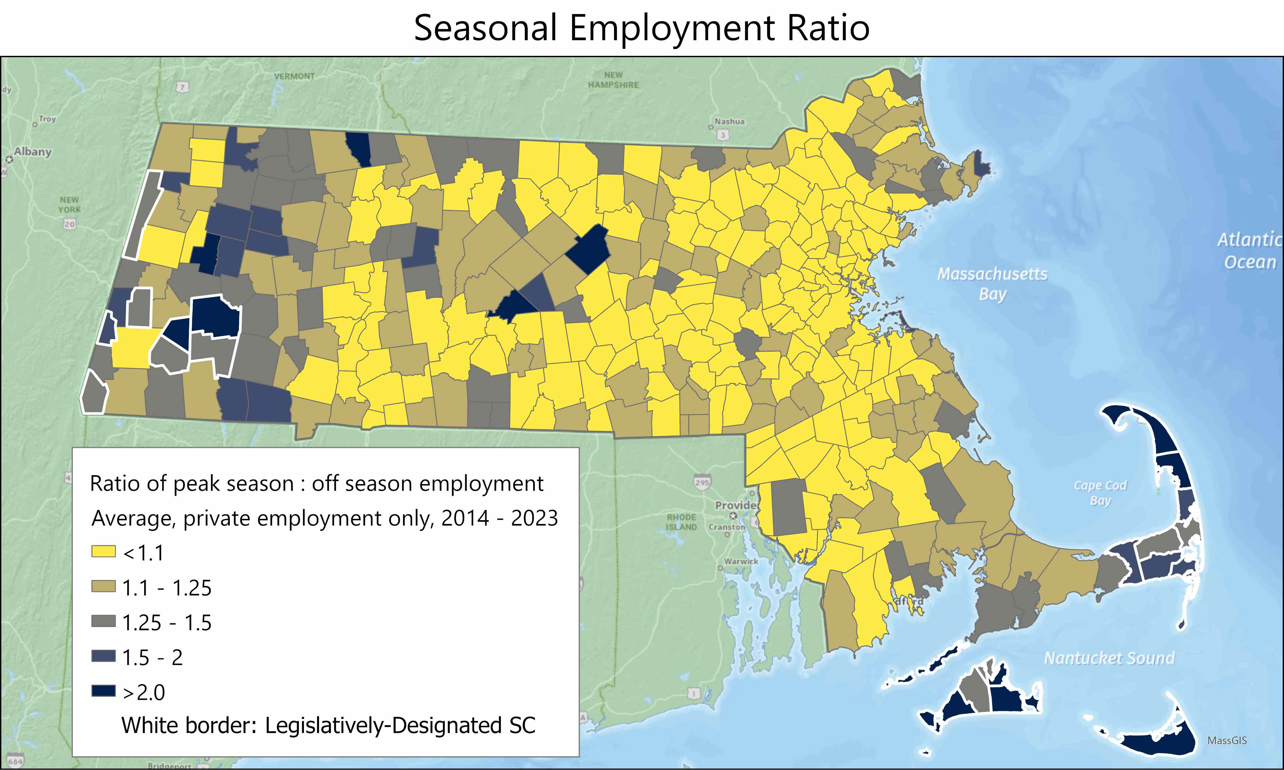
V) Seasonal Variation in Employment

Slide 18
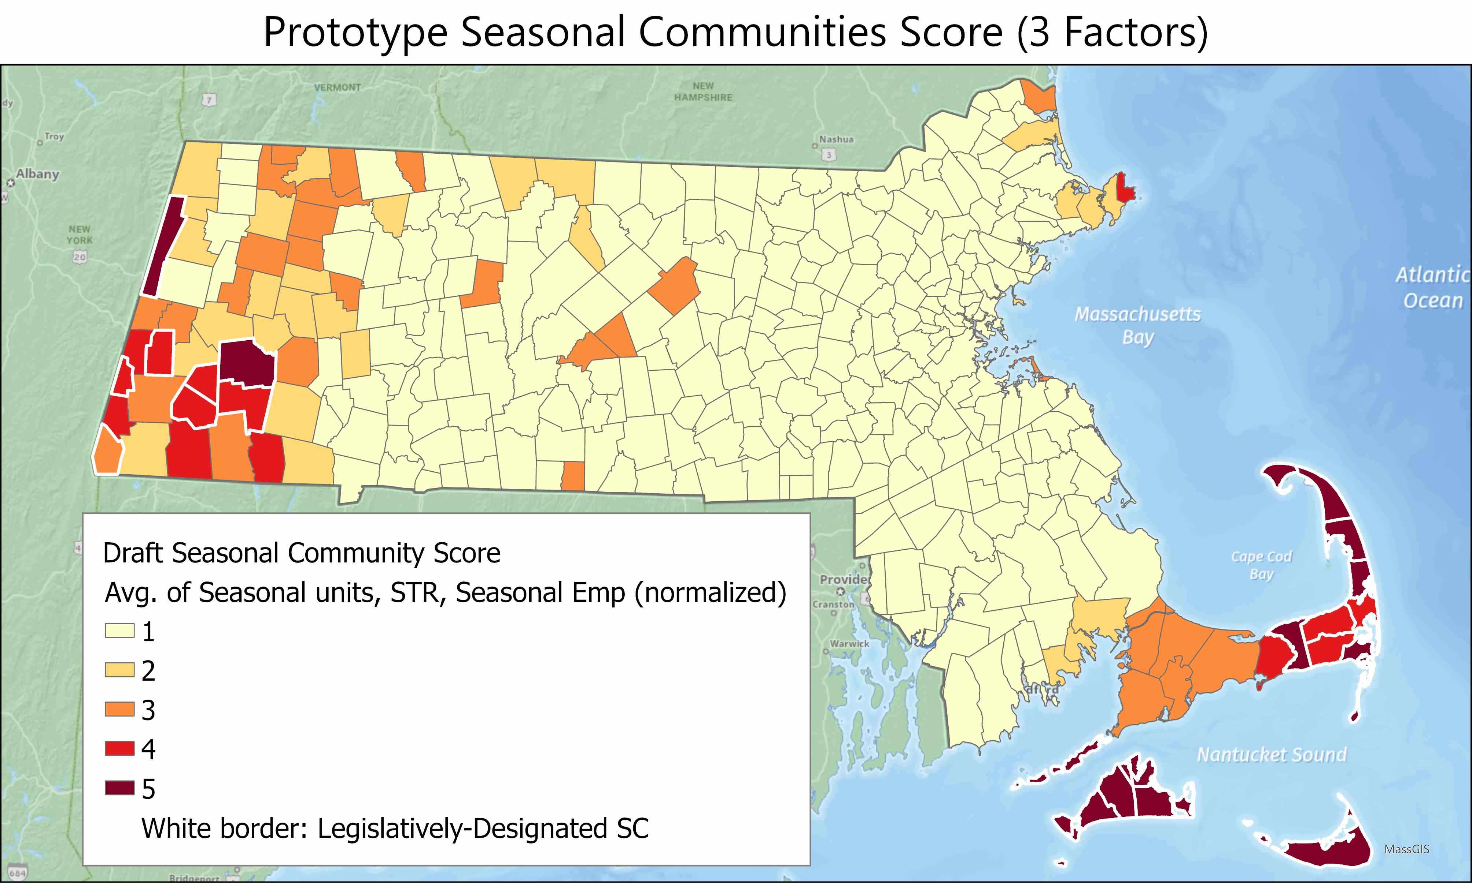
Combined Seasonal Communities Score
EOHLC calculated a ‘normalized’ score for three of the measures described above (Short Term Rentals, Seasonal Homes, Seasonal Employment Ratio). Normalized scores were averaged to produce a preliminary Seasonal Communities Score of 1 through 5 (Breaks between each category are arbitrary, not determinative).

Slide 19
Further Designations

Slide 20
Process for Designation
Communities designated as Seasonal Communities by statute must ...
Take a local vote to accept or deny that designation.
Communities designated as Seasonal Communities by EOHLC based on statutory metrics must …
Take a local vote to accept or deny that designation
Communities NEITHER designated by statute NOR by EOHLC which are interested in receiving the Seasonal Communities designation must...
Formally request a designation through a process to be determined by EOHLC in consultation with the Council
Take a local vote to accept or deny that designation
**HLC may designate further communities at the discretion of the Secretary

Slide 21
Working Groups

Slide 22
Why Working Groups?
To facilitate the swift, but thoughtful development of Seasonal Communities regulations by Fall 2025, EOHLC proposes forming working groups to provide recommendations on each necessary section of regulations.
Meeting Timeline: Mid-March – Late April
Meeting Frequency: Bi-weekly (~3 meetings)
Meeting Duration: 1 hour
Working Group Reports: May Council Meeting
Council members will select working groups preferences in a follow-up survey. Each group will then work to identify and develop recommendations to address key questions and concerns requisite to the development of regulations in their respective subject matter area.

Slide 23
Working Group Formation (I/II)
GROUP 1 – METRICS & FURTHER DESIGNATION
Statute establishes the following metrics to consider in further designations:
Short-Term Rentals
Seasonal Population
Median Income to Median Home Price Disparities
Seasonal Housing Stock
Seasonal Employment
EOHLC proposes to consider these factors together through a combined Seasonal Communities Score. This group will work to refine the prototype score developed and reach consensus on a framework for the designation of further communities.
GROUP 2 – YEAR-ROUND HOUSING TRUSTS + OCCUPANCY RESTRICTIONS
Year-Round Housing Occupancy Restrictions
Year-Round Housing Trusts
Year-Round Artist Housing
Tiny Homes and Undersized Lots for Year-Round Housing
This group will guide the development of regulations structuring the year-round housing powers of Seasonal Communities.

Slide 24
Working Group Formation (II/II)
GROUP 3 – TOOLS & REQUIREMENTS: EXISTING AND FUTURE
Requirement: Tiny Homes By-Right
Requirement: Undersized Lots
Tool: Municipal Employee Housing – Development & Preference
Tool: Primary Residence Property Tax Exemption
What's next?
This group will guide the development of regulations structuring all requirements for designated communities, as well as the municipal workforce housing and primary residence tax exemption powers available to them. The group will also consider potential future requirements and tools appropriate for designated communities.

Slide 25
Timeline & Next Steps

Slide 26
Timeline
MARCH - MAY
Working groups meet, develop recommendations
MAY – JULY
EOHLC drafts regulations shaped by working groups recommendations; target for publicizing draft regulations for comment
JULY – AUGUST
Target comment period on draft regulations ends, EOHLC revises recommendations based on comments
SEPTEMBER
Target for final regulations to be filed and publicized

Slide 27
Next Steps
Council to respond to follow-up survey on data, designations by 3/19/25
EOHLC to consolidate survey responses, share with Council in advance of next meeting
Working groups to form, advise EOHLC on drafting, promulgation of regulations (Target: Late September)
EOHLC to hold series of listening sessions
Tentative Next Meetings: May (Cape Cod), September (Nantucket)

