Slide 1

Commonwealth of Massachusetts
Interagency Task Force on Newborns with Neonatal Abstinence Syndrome
Second Task Force Meeting Presentation
December 19, 2016

Slide 2
Meeting Agenda
2017 Policy Academy Update
Advisory Council Recommendation
Inventory of Existing NAS/SEN Services, Programs, & Initiatives
Three Pillars of Data Review
Picture of NAS/SEN: What does it tell us?
Data Mechanics: What is currently collected?
What could a Statewide Plan on data look like?
Health Policy Commission Investments in NAS (separate PPT)
Action Items & Next Steps

Slide 3


2017 Policy Academy Update
By participating in the Policy Academy, teams will benefit from:
Presentations by national experts.
Dialogue with and coaching from sites that have previously received Technical Assistance.
Hearing about the strategies employed by the Mentor Sites, the barriers they faced, and how they resolved them.
Dedicated team time to develop an action plan, governance structure and goals.
Access to a package of technical assistance tools and resources that teams can use in the planning and implementation process.
Up to six months of follow-up technical assistance from the NCSACW to meet each team’s needs.

Slide 4
2017 Policy Academy Update
State teams will:
Develop a state-specific action plan that describes current practices, gaps and barriers.
Identify potential changes in practices, policies and legislation needed to improve outcomes. Build upon collaborative structure and processes.
Use the Five-Point Framework (Pre-Pregnancy, Prenatal, Birth, Neonatal, Postnatal (throughout Childhood and Adolescence)) for developing action plans.
Receive up to six months of follow-up technical assistance towards implementing the state-specific action plan (through August).
Policy Academy Timeline
January 10: Policy Academy webinar
February 7-8: Policy Academy
March-August: Technical assistance
Massachusetts Policy Academy
Team Roster
Co-leader: Kim Bishop-Stevens, DCF
Co-leader: Karen Pressman, DPH
Ron Benham, DPH
Judge Gail Garinger, AG’s Office
Katherine Record, HPC
Kelley Saia, Boston Medical Center
Kevin Wicker, OBH
Michael Kelleher, EOHHS

Slide 5
Advisory Council
Recommendation

Slide 6
Advisory Council Recommendation Process
Recruitment Process
RFR posted on 11/15/16
Original deadline of 11/28/16 was extended to 12/02/16
Evaluation and Recommendations Process
The Evaluation Committee, composed of Judge Gail Garinger, Abigail Taylor, Michael Kelleher and Vivian Pham, reviewed all applications on 12/05/16.
The Evaluation Committee is recommending all 41 applicants for Advisory Council membership to the Task Force.

Slide 7
Advisory Council: Full Geographic Representation and Broad Expertise
*Applicants listed multiple geographic regions and areas of expertise

Slide 8
Advisory Council Represents Numerous Stakeholders Across the Care Continuum
Perspective* | #
NICU provider | 10
Public health advocate or expert | 9
OBGYN / other maternal health provider | 8
Pediatrician/ other pediatric provider | 8
Child welfare advocate or expert | 7
Social services provider for parents/caregivers | 6
Substance use disorder treatment provider | 5
Consumer advocacy organizations | 5
Social services provider for children | 3
Consumers directly impacted by NAS/SEN | 3
Administrator of acute hospital w/ birthing/NICU | 1
Legal system | 1
Intervention Stage Focus* | #
Neonatal | 11
Throughout Childhood and Adolescence (Postnatal) | 11
Pre-pregnancy (Prevention/ education) | 8
Birth (inpatient) | 6
Prenatal | 5
*Applicants indicated more than one perspective and intervention stage focus

Slide 9
41 Advisory Council Members
First Name | Last Name | Organization | Title
Nichole | Aguiar | March of Dimes | Director of Advocacy & Government Affairs
Marilyn | Augustyn | Boston Medical Center | Division Director, Developmental and Behavioral Practices
Debra | Bercuvitz | DPH, BFHN | Perinatal Substance Use Coordinator
Marjorie | Bloom | Baystate Medical Center | Medical Social Worker, Labor and Delivery
Annery | Brown | Baystate Medical Center | Medical Social Worker
Kathleen | Charette | Hudson Public Schools | Central Regional School Nurse Consultant
Jennifer | Childs-Roshak | Planned Parenthood League of Mass. | President & CEO
Sharyl | Costa | DCF | Social Worker
Mara G. | Coyle | Women & Infants Hospital | Neonatologist; Professor of Pediatrics
Jonathan M. | Davis | The Floating Hospital for Children at Tufts Medical Center | Vice-Chair of Pediatrics and Chief od Newborn Medicine

Slide 10
41 Advisory Council Members
First Name | Last Name | Organization | Title
Susan | Elsen | MA Law Reform Institute | Child Welfare Advocate, lawyer
Norma | Finkelstein | Institute for Health and Recovery | Executive Director
Maryanne | Frangules | Mass. Organization for Addiction Recovery | Executive Director
Mark | Friedman | Community Catalyst | Volunteer; retired pediatrician
Munish | Gupta | Beth Israel Deaconess Medical Center; Neonatal Quality Improvement Collaborative | Neonatologist
Cynthia | Horgan | Cape Cod Children's Place | Executive Director/Family Support Coordinator
Ronald E. | Iverson | Boston Medical Center | Physician
Linda | Jablonski | Baystate Franklin Medical Center | Assistant Nurse Manager of the Birthplace; Co-Chair of the Frankling County Perinatal Support Coalition
Leslie S. | Kerzner | Mass. General Hospital | Associate Medical Director Special Care Nursery; Director of Newborn Developmental Follow-up Program, Director of NAS Program and Task Force
Georganna | Koppermann | AdCare | Vice President, Community Services & Marketing

Slide 11
41 Advisory Council Members
First Name | Last Name | Organization | Title
Claudette | Laffan | Steward Morton Hospital | RNC
Jennifer | Lee | Beverly/ Boston Children's Hospital | Neonatologist
Erin | MacIntosh | Beth Israel Deaconess Medical Center | Pediatric Occupational Therapist, Newborn Intensive Care/Newborn Nurseries
Mary | McGeown | MSPCC | Executive Director
Amy | Miner-Fletcher | South Bay Community Services | Division Director, Early Childhood
Kristy | Pereira | Umass Amherst, College of Nursing | Clinical Assistant Professor
Joanne | Peterson | Learn to Cope, Inc. | Executive Director
Fabiola | Powell | South Middlesex Opportunity Council | Clinical Coordinator for Pregnant and Postpartum Women/Behavioral Health Provider
Karen | Pressman | DPH, BSAS | Director, Planning and Development
Julian N. | Robinson | Brigham & Women's Hospital | Chief of Obstetrics

Slide 12
41 Advisory Council Members
First Name | Last Name | Organization | Title
Christina | Russell | Cape Cod Children's Place | Family Support Specialist
Davida | Schiff | Boston Medical Center | Pediatrician
Nicole | Sczekan | Lahey Beverly Hospital, Essex County OB/GYN Association | Certified Nurse Midwife; co-director of Maternal Bheavioral Health Integrative Program
Robert | Sege | Health Resources in Action | Chief Medical Officer
Jeffrey S. | Shenberger | Baystate Children's Hospital | Chief of Newborn Medicine; Professor of Pediatrics
Rachana | Singh | Baystate Children's Hospital | Medical Director, NICU
Shannon | Snyder | DCF | Supervisor
Julie | Stanitis Thompson | Baystate Franklin Medical Center, Pioneer Women's Health | OB/GYN, Chair of Obstetrics
Deborah | Sweet | DCF | Foster Parent; Foster Parent Ambassador
Marianne | Valle | St. Luke's Hospital | RN (Maternal child health nurse)
Elisha | Wachman | Boston Medical Center | Assistant Professor of Pediatrics; Neonatologist

Slide 13
Advisory Council Members will be distributed into Topic Subgroups
Distribute the 41 selected Advisory Council members into subgroups based on self-selected area of expertise (as indicated on their application) as well as geographic representation and/or perspective.
Staff will ensure subgroups are topic-aligned and representative of the entire state and multiple perspectives. Assign a “lead” to coordinate each sub-group and their interactions outside of TF meetings
These subgroups listed below will support Assignment #2
“Best Practices”
Screening and intervention protocols
Referral and support services
Provider training and staff development
Data collection and reporting
Quality and outcome measurement

Slide 14
Advisory Council: Next Steps
Email notification of selection to the Advisory Council
Reminder of responsibilities
Required meeting dates
Opportunity to opt-out should they no longer be able to commit
Send survey of inventory of existing NAS/SEN Services, Programs & Initiatives to all Advisory Council members (Assignment #1)
Once finalized, will provide full roster, contact information and subgroup assignment to all Advisory Council members

Slide 15
Inventory of Existing NAS/SEN Services, Programs & Initiatives

Slide 16
Development of Inventory
Feedback from the first Task Force meeting
Added geographic region, capacity, and gaps in service/programs
Inventory Refinement
Distributed the draft inventory form for review by (AG’s office, Task Force members, other subject matter experts, as needed)
Added more detail to capacity, types of interventions, target population, and funding source
Ensured the survey terms and examples were aligned with federal recommendations (SAMHSA/CSAT)

Slide 17
Assignment #1: Distribution of Inventory to Advisory Council
Online Survey & Example
For ease of distribution and data collection, an online survey was created on SurveyMonkey
A PDF example was created to demonstrate the level of detail we are looking to capture from those who complete the survey
Parts of the survey are closed ended questions while other areas are open-ended to allow for more detailed content to be submitted
Distribution
Survey link and example PDF were distributed on 12/09 in an email to the Advisory Council
Survey closes on 12/30
Results will be reviewed at next Task Force meeting

Slide 18
Components of Inventory
Contact Information
Organization; Name of Service/Program/Initiative
Organization/Program Description as It Relates to NAS/SEN
Geographic Region(s) Served
Northeastern; Boston area; Southeastern; Cape and Islands; Central; Pioneer Valley; Western
Intervention Stage
Pre-pregnancy; Prenatal; Birth; Neonatal; Postnatal (Throughout Childhood and Adolescence)

Slide 19
Components of Inventory
6. Type of Intervention
Prevention/Education/Outreach; Screening/Testing/Assessment; Treatment; Social Services, Training, Data Collection; Quality Improvement
7. Target population
Women of childbearing age; pregnant women (with SUD/OUD); mothers; at-risk parents; other caretakers; newborns/infants; older children; providers
Capacity
9. Funding Source and Duration
State appropriation; grant (federal or state); private; payer reimbursement
10. Gaps in Services and Programs

Slide 20
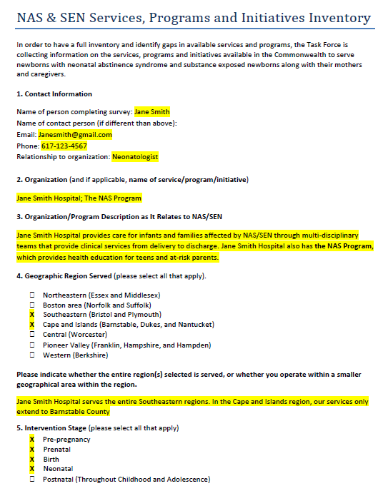
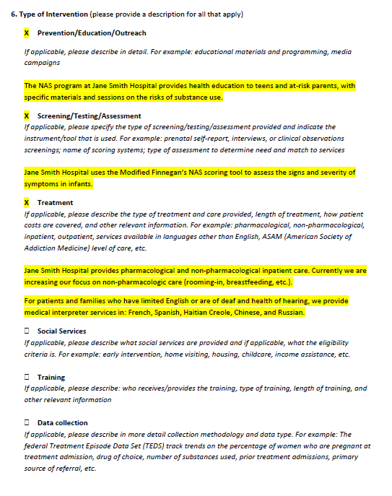
Example

Slide 21
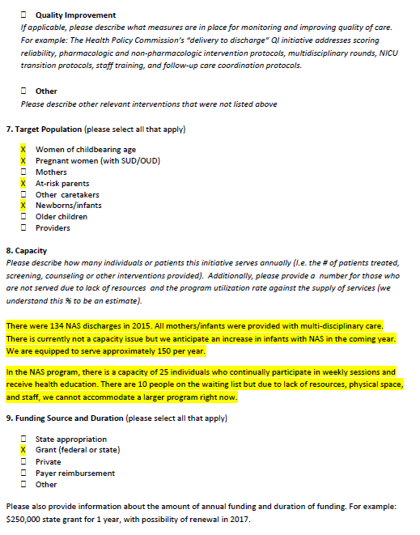

Example

Slide 22
Next Steps for Inventory: AC Assignment #2
Survey closes on 12/30
Staff will aggregate the survey results in multiple ways for analysis and presentation
Role of Advisory Council in reviewing survey results
We will collect all the open-ended narrative responses for Question 6 (Type of Intervention and description), organize by topic area and distribute to the subgroup for that particular area.
We will ask the subgroup to organize itself (provided appropriate support) to review the content and reflect on the following questions (draft):
What can be learned from the various programs/initiatives within this subject area? Is it a “best practice” that could be replicated or an intervention type that is best suited for a particular population/geography/setting?
Does the response provide direction as to a consensus approach (i.e.. Staff training, screening/assessment, etc.) that should be promoted as a standard policy or procedure?
Based on the group’s expertise, are these approaches what Task Force should include in the Statewide Plan?

Slide 23
Overview of NAS/SEN Data

Slide 24
Three Pillars of Data Review
Picture of NAS/SEN:
What does it tell us?
Based on the data currently collected across the Commonwealth, what can we learn about gaps in needed services, access to existing services and quality of care?
Data Mechanics:
What is currently collected?
What are the data fields, frequency and reporting?
How complete of a picture do we have on NAS/SEN services, utilization and quality?
Statewide Plan on Data:
What could a unified statewide plan on data look like?
How far from the end goal are we?

Slide 25
Review of Data Collection Methodology
Three Parts: Picture of NAS/SEN, Data Mechanics, State Plan
Picture of NAS/SEN in Commonwealth
Geographic region(s) represented
Target population
Type and Stage of Intervention
Gaps in service/programming
Data Mechanics
Data set name
Data set owner
Data source
Data collector
Frequency of collection/reporting
Reporting produced (what is it used for?)
Data gaps
Shared/Collaboration?
Statewide Plan on Data Collection and Reporting

Slide 26
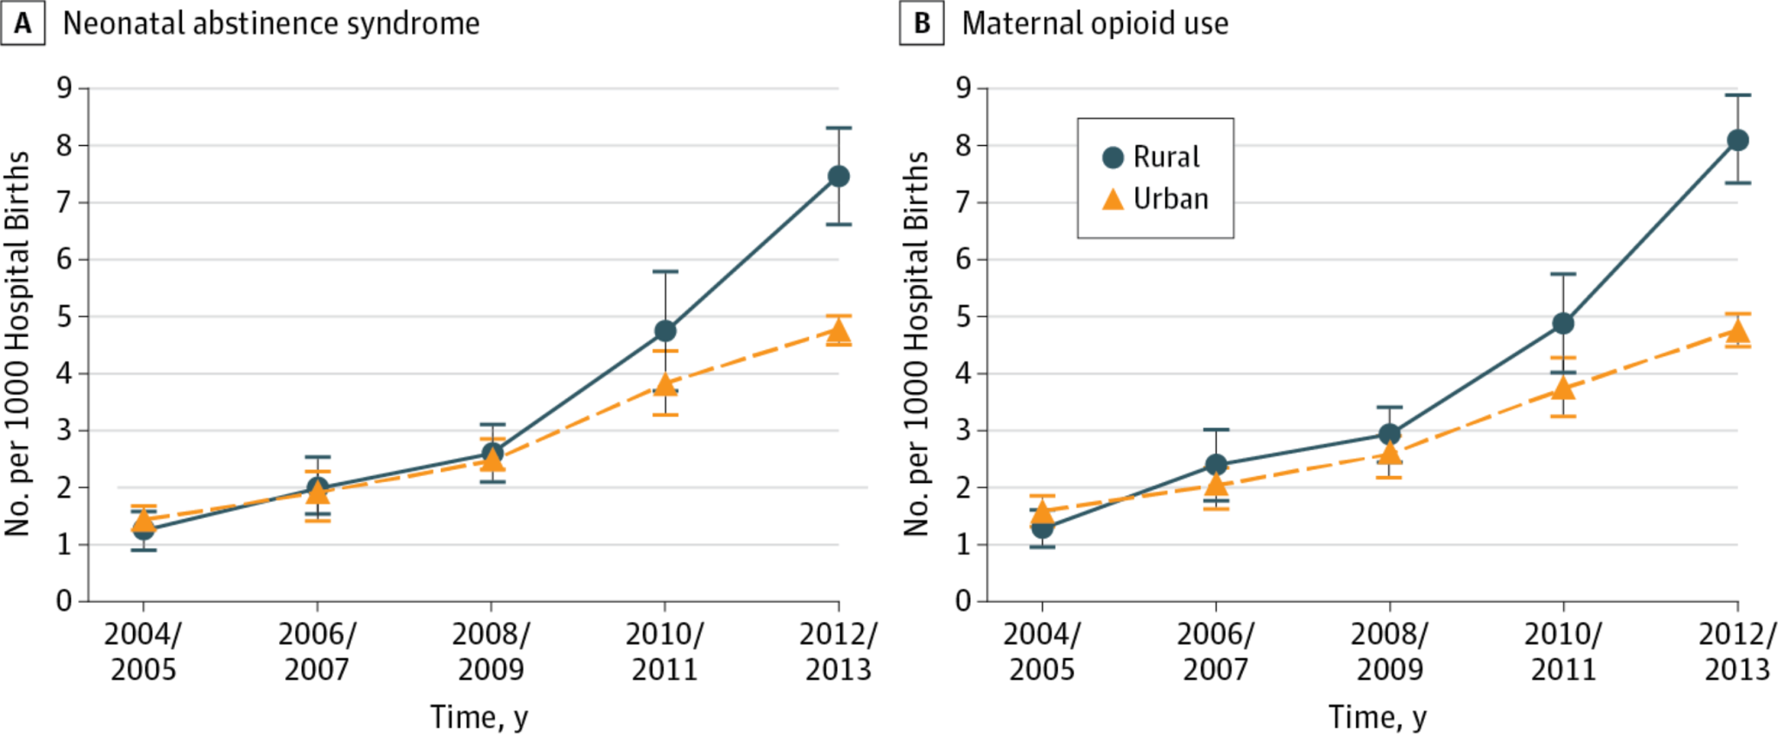

Nationally, the rate of NAS is increasing most
quickly in rural areas
Rural and Urban Differences in Neonatal Abstinence Syndrome and Maternal Opioid Use, 2004 to 2013
JAMA Pediatr. Published online December 12, 2016. doi:10.1001/jamapediatrics.2016.3750

Slide 27
NAS is increasing more rapidly in
Massachusetts than nationally
29% increase
23% increase

Slide 28
NAS increased significantly in Massachusetts
between 2011 and 2015
Volume of NAS discharges
27% increase in volume
31% increase in rate
Source: HPC analysis of Center for Health Information and Analysis, Inpatient Discharge Database 2011-2015
Notes: NAS discharges were identified using ICD-9-CM diagnosis code 779.5 (drug withdrawal syndrome in a newborn).

Slide 29
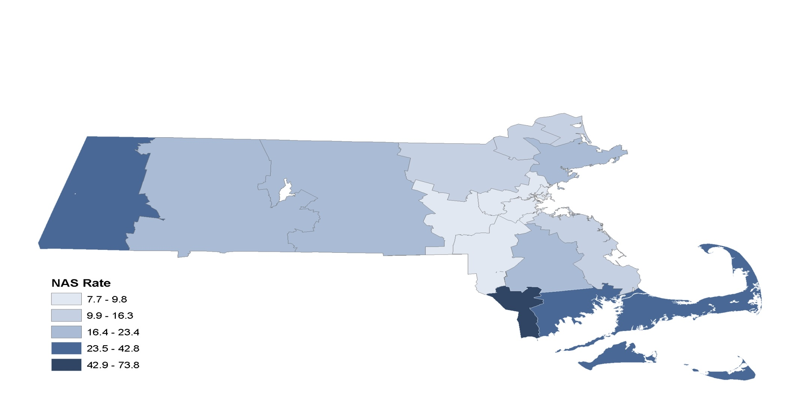
Rate of NAS discharges per 1,000 live births,
by HPC region, in 2015
Source: HPC analysis of Center for Health Information and Analysis, Inpatient Discharge Database 2015
Notes: NAS discharges were identified using ICD-9-CM diagnosis code 779.5 (drug withdrawal syndrome in a newborn).

Slide 30
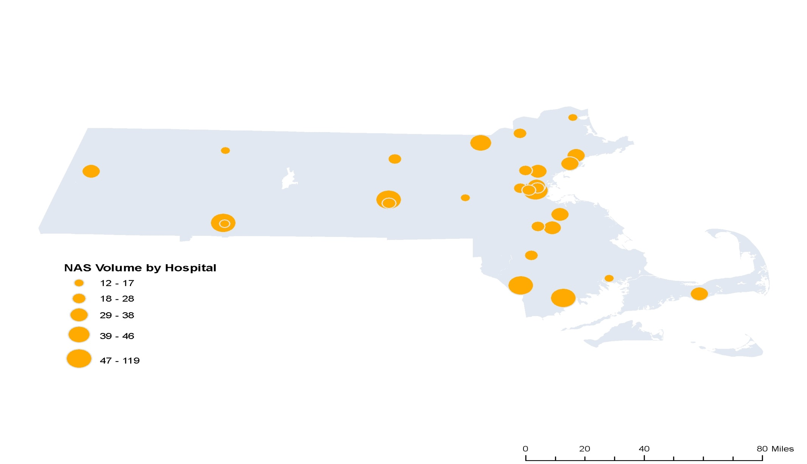
2015 NAS discharges by hospital volume
Source: HPC analysis of Center for Health Information and Analysis, Inpatient Discharge Database 2015
Notes: NAS discharges were identified using ICD-9-CM diagnosis code 779.5 (drug withdrawal syndrome in a newborn). Only includes hospitals with 12 or more NAS discharges.

Slide 31
MA hospitals with highest rate of NAS in 2015
8 CHART hospitals
11 non-CHART hospitals
Source: HPC analysis of Center for Health Information and Analysis, Inpatient Discharge Database 2015
Notes: NAS discharges were identified using ICD-9-CM diagnosis code 779.5 (drug withdrawal syndrome in a newborn). Only includes hospitals with 12 or more NAS discharges.

Slide 32
Substance Exposed Newborn Data
DCF began collecting data at Intake on Substance Exposed Newborns (SENs) in March of 2014. 51A reports that alleged exposure of a newborn to alcohol or drugs during pregnancy were assigned the allegation of SEN.

Slide 33
Neonatal Abstinence Syndrome Data
When DCF rolled out the current Intake policy at the end of February 2016, another neglect allegation type was added to capture the number of newborns reported to DCF diagnosed with Neonatal Abstinence Syndrome (NAS).
Neglect – Substance Exposed Newborn
Neglect – Substance Exposed Newborn\Neonatal Abstinence Syndrome

Slide 34
SEN and NAS Data 2016
SEN at 51A Report NAS at 51A Report
January 2016 232 Not Available
February 2016 197 Not Available
March 2016 210 20
April 2016 207 23
May 2016 199 13
June 2016 228 19
July 2016 201 14
August 2016 235 18
September 2016 207 17
October 2016 217 15

Slide 35
Understanding DCF SEN\NAS Intake Data
NAS is often not diagnosed at birth and the newborn may not show signs of NAS when the initial report is filed with DCF in which case a Neglect –SEN allegation would be used. *
Hospitals may have different definitions of NAS. DCF would not assign the SEN\NAS allegation if the hospital did not specify a NAS diagnosis, even if the hospital talks about some withdrawal signs.
DCF staff may need further training to understand the difference between the two allegation categories.
* If there is a subsequent diagnosis of NAS, DCF may unsupport the original allegation and add an allegation of SEN\NAS to better capture newborns that are diagnosed with NAS after the initial filing.

Slide 36
Data Analysis: The whole is greater than the sum of its parts
Data Mechanics: What is currently collected? What are the data fields, frequency and reporting? How complete a picture do we have on NAS/SEN services, utilization and quality?
Department of Public Health
Department of Children & Families
Center for Health Information and Analysis
Health Policy Commission (CHART and other investment data)
Individual Health Systems
Neonatal Quality Improvement Collaborative
Other
Data Set Name
Data Set Owner
Data Source
Data Collected By
Frequency of Collection/Reporting
Description of Data
Geographic Region Included
Target Population
Intervention Stage
Type of Intervention
Known Data Gaps
Reporting Produced (what is it used for?)
Shared/ Collaboration

Slide 37
3: Potential Statewide Plan for Data-Sharing and Quality Improvement
1) Recommend Population-Based Metrics for NAS/SEN Improvement Dashboard
Pre-pregnancy/Prenatal
Birth/Inpatient/Neonatal
Postnatal/Post-Discharge
Perinatal substance use incidence
Maternal use of medication-assisted therapy
Timeliness of Prenatal Visits
Frequency of ongoing prenatal care
NAS incidence
Average LOS for infants with NAS
Inpatient pharmacologic therapy for infants with NAS
Breastfeeding in infants with NAS
Readmissions for infants with NAS
Enrollment in EI for infants with NAS
Relapse for mothers on MAT
Timeliness of Postpartum Visits
Childcare visits in first 15 months
2) Develop and Incent Data-Collection, Data-Sharing and Data-Reporting across the NAS/SEN care continuum
Outpatient clinics
PCP Offices
Community Health Centers
Birthing hospitals
Acute hospitals
Other birthing centers
Outpatient clinics
PCP Offices
Community Health Centers
3) Address patient-confidentiality and data-sharing in supporting care coordination
Review all existing state and federal patient confidentiality and data-sharing protections (HIPPA, 42 CFR Part 2, Chapter 224, 105 CMR.140 and others) to understand what information can be shared among treating clinicians across the care continuum)
Identify barriers and challenges (existing in regulations/statutes or in practice) that limit appropriate, necessary and timely care coordination
Develop a list of recommendations for needed regulatory or statutory changes as well as state-directed guidance clarifying what information (under what circumstances) is currently permissible to be shared

Slide 38
Health Policy Commission Investments in NAS (separate PPT)

Slide 39
Next Steps

Slide 40
Next Steps
Survey/Inventory
Distribute to Advisory Council, Task Force, and other stakeholders
Complete by 12/30
Staff to collect and analyze responses
January 18th meeting with Task Force AND Advisory Council
Review of inventory survey results
Early February, sub-group will recommend priority areas for the coordination of care and services, identified service gaps and recommendations to fill those gaps to the Task Force
Sub-group recommendations are to be submitted to staff
A designee (“lead”) from each sub-group will present their recommendations at the final Task Force meeting in February
Next Task Force Meeting – January 18th 1-4pm (note the time extension)

