Slide 1
SECTION 35
COMMISSION
Established by Section 104 of Chapter 208 of the Acts of 2018
July 1, 2019

Slide 2
On March 29, 2019, the Commonwealth was formally served with John Doe v. Mici et al. As a result, all executive branch employees appointed to this Commission abstained from opining or voting on specific recommendations. No executive branch employee endorsed this report either in part or in its entirety.¹
1. The legal memorandum in Appendix G was prepared by executive branch employees for the Commission’s consideration.
2

Slide 3
Table of Contents
Commission Overview - Slides 4-5
Recommendations Proposed by Individual Members and Voted on June 27, 2019 - Slides 6-9
Section 35 Commitment Criteria - Slide 10
Overview of Section 35 Process - Slides 11-13
Section 35 Facilities and Current Capacity - Slides 14-15
Section 35 Facilities’ Treatment Options and Length of Stay - Slide 16
Section 35 Discharge Data - Slide 17
Section 35 Commitment Data - Slides 18-20
Section 35 Demographic Data - Slide 21
Charges
Review medical literature and expert opinions on the long-term relapse rates of individuals diagnosed with a substance use disorder following involuntary inpatient treatment
Evaluate and develop a proposal for a consistent statewide standard for the medical review of individuals who are involuntarily committed due to an alcohol or substance use disorder pursuant to Section 35 of Chapter 123 of the General Laws
Appendices
Appendix A – Legislative Mandate
Appendix B – Section 35 Commission Members
Appendix C – Summary of Meetings and Input Provided to the Commission
Appendix D – Resources Reviewed by the Commission
Appendix E – Trial Court Forms
Appendix F – Bureau of Substance Addiction Services Treatment and Recovery Programs
Appendix G – Section 35 Legal Memorandum
Appendix H – Committee for Public Counsel Services Legal Memorandum
Appendix I – Request for Information and Responses Received by June 20, 2019
Appendix J – Recommendations Considered Out-of-scope and Not Voted on by the Commission on June 27, 2019
Appendix K – Comments Received from Members on the Draft Report to the Legislature
3

Slide 4
Commission Overview
The Section 35 Commission was established in Section 104 of Chapter 208 of the Acts of 2018 to study the efficacy of involuntary inpatient treatment for non-court involved individuals diagnosed with a substance use disorder.
The Commission was charged with:
Reviewing medical literature and expert opinions on the long-term relapse rates of individuals diagnosed with a substance use disorder following involuntary inpatient treatment, including:
the differences in outcomes for coerced and non-coerced patients,
any potential increased risk of an individual suffering a fatal overdose following a period of involuntary treatment,
medical literature on length of time necessary for detoxification of opioids and recommended time following detoxification to begin medication-assisted treatment,
the legal implications of holding a non-court involved individual who is diagnosed with a substance use disorder but is no longer under the influence of substances,
whether the current capacity, including acute treatment services, clinical stabilization services, transitional support services and recovery homes, is sufficient to treat individuals seeking voluntary treatment for substance use disorder,
the availability of other treatments for substance use disorder, including those treatments used in less restrictive settings, and
the effectiveness of the existing involuntary commitment procedures pursuant to Section 35 of Chapter 123 of the General Laws at reducing long-term relapse rates; and
Evaluating and developing a proposal for a consistent statewide standard for the medical review of individuals who are involuntarily committed due to an alcohol or substance use disorder pursuant to Section 35 of Chapter 123 of the General Laws, including, but not limited to, developing:
a proposed standardized form and criteria for releasing medical information for use in a commitment hearing under Section 35 that is in compliance with federal and state privacy requirements, and
criteria and guidance to medical staff about filing a petition under Section 35.
4

Slide 5
Commission Overview (continued)
The Commission was required to file recommendations, including any proposed legislation, with the Clerks of the House of Representatives and the Senate, not later than July 1, 2019.
The Commission met seven times from October 2018 through June 2019. All meetings were subject to the open meeting law and minutes were taken and approved for each meeting. Minutes of the Commission’s meetings may be found online: https://www.mass.gov/lists/section-35-commission-meeting-minutes.
Appendix C outlines the meetings and input provided, including the individuals who presented. Reading materials considered by the Commission are posted on a publicly-available webpage: https://www.mass.gov/orgs/section-35-commission and listed in Appendix D.
The Department of Correction was not asked to make a presentation to the Commission. Data provided by the Department of Correction can be found on Slides 15 and 16.
An email address was created for members of the public to submit comments and questions for the Commission: EHS.Section35Commission@MassMail.State.MA.US
5

Slide 6
Recommendations Proposed by Individual Members and Voted on June 27, 2019
Recommendation | In favor | Opposed | Abstained | Absent
The Commonwealth should expand development of low-threshold, treatment on demand models, including harm reduction interventions in community-based settings, immediate access to medication-assisted treatment (MAT) and expansion of bridge clinics, addiction consult services, outreach and engagement programs, post-overdose intervention programs, syringe services programs, and family intervention programs. | 18 | 0 | 4 | 7
The Commonwealth should establish standards of medical care for patients who are committed under Section 35. | 18 | 0 | 4 | 7
The Commonwealth should ensure continuity of care post-discharge between Section 35 facilities and community-based facilities. | 18 | 0 | 4 | 7
The Commonwealth, in conjunction with the research community and other relevant stakeholders, should define and collect the necessary data to determine the effectiveness of the current Section 35 process as it relates to relapse, ongoing treatment and recovery within the next two years. EOHHS should seek appropriations, grants and other financing tools to conduct an in-depth multi-year study using best research practices. As part of the study, EOHHS should identify any successful initiatives or practices that support the recovery of people with a substance use disorder. | 18 | 0 | 4 | 7
6

Slide 7
Recommendations Proposed by Individual Members and Voted on June 27, 2019 (cont.)
Recommendation | In favor | Opposed | Abstained | Absent
The Commonwealth, in consultation with provider organizations, peer and family groups, legal advocates, other stakeholders, and academic experts in the field of evaluation of care of people with substance use disorder, should create a consistent set of required quality metrics that will be regularly, publicly reported on by every provider of care to a person civilly committed through the Section 35 process. | 16 | 0 | 6 | 7
The Commonwealth, in consultation with provider organizations, peer and family groups, legal advocates and other stakeholders, should identify alternative pathways in addition to the current court-based process, to civilly-commit individuals for addiction treatment. | 14 | 4 | 4 | 7
The Commonwealth should prohibit civilly-committed men from receiving treatment for addictions at any criminal justice facility, provided that the Commonwealth fund and/or procure vendor or state-operated beds in Western Massachusetts and other parts of the Commonwealth to offset on a one-to-one basis diminished bed capacity resulting from the prohibition on placing individuals in criminal justice settings. | 13 | 1 | 8 | 7
If restraints are needed, they should be humane, and training should be provided to staff on proper usage. | 12 | 0 | 10 | 7
The Legislature, in conjunction with EOHHS and in consultation with stakeholders, should (1) conduct an analysis of the benefits of, and any barriers to, creating a Section 35 process that models the Section 12 process found in MGL Chapter 123, and (2) develop and file legislation to implement this change. | 12 | 5 | 5 | 7
7

Slide 8
Recommendations Proposed by Individual Members and Voted on June 27, 2019 (cont.)
Recommendation | In favor | Opposed | Abstained | Absent
The Commission should oppose a 72-hour involuntary civil commitment for substance use disorder without judicial involvement. | 11 | 2 | 9 | 7
The use of Section 35 should be statutorily narrowed in two ways: (1) Section 35 should not be used for voluntary commitments; (2) Even for involuntary commitments Section 35 should be rewritten so that it is available only in cases in which it is clear that the subject individual is in danger of causing severe immediate harm to self or others or loss of life above and beyond the harms that are routinely attendant upon the abuse of substances, such as death by overdose. | 9 | 1 | 12 | 7
The Section 35 process should be amended to provide adequate time for the presentation of independent medical testimony by the respondent. | 8 | 1 | 13 | 7
The Commonwealth should “commence a process with the goal to reduce and/or eliminate the use of Section 35,” as there is insufficient evidence of its efficacy to justify deprivation of individuals’ civil liberties. Demographic data suggests significant racial and ethnic disparities in the use of Section 35. | 6 | 3 | 13 | 7
8

Slide 9
Recommendations Proposed by Individual Members and Voted on June 27, 2019 (cont.)
Recommendation | In favor | Opposed | Abstained | Absent
The Commission should oppose a 72-hour involuntary civil commitment for substance use disorder without judicial involvement. | 11 | 2 | 9 | 7
The use of Section 35 should be statutorily narrowed in two ways: (1) Section 35 should not be used for voluntary commitments; (2) Even for involuntary commitments Section 35 should be rewritten so that it is available only in cases in which it is clear that the subject individual is in danger of causing severe immediate harm to self or others or loss of life above and beyond the harms that are routinely attendant upon the abuse of substances, such as death by overdose. | 9 | 1 | 12 | 7
The Section 35 process should be amended to provide adequate time for the presentation of independent medical testimony by the respondent. | 8 | 1 | 13 | 7
The Commonwealth should “commence a process with the goal to reduce and/or eliminate the use of Section 35,” as there is insufficient evidence of its efficacy to justify deprivation of individuals’ civil liberties. Demographic data suggests significant racial and ethnic disparities in the use of Section 35. | 6 | 3 | 13 | 7
Recommendation | In favor | Opposed | Abstained | Absent
Nurse practitioners should be allowed to file Section 35 petitions. | 4 | 7 | 11 | 7
The Legislature should amend the law to allow for correctional facilities to become licensed by DPH and/or DMH to provide addiction treatment services. In the case of dual status individuals, it would make sense to be able to provide services for addiction simultaneously to the path and time of ongoing criminal cases. While the current system may need improvement a complete ban on Section 35 commitment in correctional settings is not ideal either. | 2 | 10 | 10 | 7
The Commonwealth should create a process where the Trial Court "On Call Judge" be incorporated into the current process of civil commitment to address the expiring nature of apprehension warrants and the limited ability of law enforcement in locating individuals during the courts regular business hours. Additionally, a preliminary request for commitment could be approved that could bridge the gap until a full hearing could be conducted. | 1 | 11 | 10 | 7
The Legislature should authorize the short-term hospitalization of patients with a substance use disorder under Chapter 123 S. 12. The legislative change would amend Chapter 123 S. 12 to include “a person who represents a likelihood of serious harm by reason of a substance use disorder.” | 1 | 15 | 6 | 7
9

Slide 10
Section 35 Commitment Criteria
Under Section 35, in order for an individual, referred to as the “respondent,” to be involuntarily committed, the courts must find that the individual meets the following two criteria:
The respondent has an alcohol or substance use disorder, as defined in G.L. c. 123, Section 35, and
There is a likelihood of serious harm, as defined in G.L. c. 123, Section 1 and through case law, as a result of the respondent’s alcoholism or substance use disorder, to the respondent, the petitioner, or any other person.
G.L. c. 123, Section 35
“Alcohol use disorder,” the chronic or habitual consumption of alcoholic beverages by a person to the extent that (1) such use substantially injures the person's health or substantially interferes with the person's social or economic functioning, or (2) the person has lost the power of self-control over the use of such beverages.
“Substance use disorder,” the chronic or habitual consumption or ingestion of controlled substances or intentional inhalation of toxic vapors by a person to the extent that: (i) such use substantially injures the person's health or substantially interferes with the person's social or economic functioning; or (ii) the person has lost the power of self-control over the use of such controlled substances or toxic vapors.
G.L. c. 123, Section 1
“Likelihood of serious harm,” (1) a substantial risk of physical harm to the person himself as manifested by evidence of, threats of, or attempts at, suicide or serious bodily harm; (2) a substantial risk of physical harm to other persons as manifested by evidence of homicidal or other violent behavior or evidence that others are placed in reasonable fear of violent behavior and serious physical harm to them; or (3) a very substantial risk of physical impairment or injury to the person himself as manifested by evidence that such person's judgment is so affected that he is unable to protect himself in the community and that reasonable provision for his protection is not available in the community.¹
10

Slide 11
Overview of Section 35 Process
Under Section 35, a spouse, immediate family member, police officer, physician, or court official who believes that an individual has an alcohol or substance use disorder and is at risk of serious harm to themselves or others as a result of their alcohol or substance use disorder may file a petition for civil commitment.
Process to file a petition for commitment¹
Petitions for commitment under Section 35 may be filed in District, Boston Municipal, or Juvenile Courts and are heard by judges during regular business hours, Monday through Friday (See Appendix E for copies of Trial Court forms).
In the written petition, signed under the penalties of perjury, the petitioner must provide detailed information documenting that the respondent has an alcohol or substance use disorder and is at risk of serious harm as a result of their addiction.
A judge will review the submitted facts and decide whether to issue either a summons for the respondent to appear before the court or a warrant of apprehension if there are reasonable grounds to believe that they will not appear voluntarily or that a delay in the proceedings would present an immediate danger to the physical well-being of the respondent.
If summonsed, the respondent will receive an order to appear in court before a judge. If a warrant is issued, police officers will attempt to locate the person, take the person into custody, and deliver the person to the court for a commitment hearing.
Warrants of apprehension are valid for up to five consecutive days, excluding Saturdays, Sundays, and legal holidays, or until the person appears in court, whichever occurs first. After five days, the warrant “sunsets” and must be renewed.
If the judge determines that the case should be heard in another Division or Department, e.g., due to the respondent's age, location, or for other good reasons, the judge may make the warrant or summons returnable to an appropriate court in another Division or Department.
11

Slide 12
Overview of Section 35 Process (cont.)
Commitment hearing process¹
The respondent has the right to counsel and the right to present evidence, including independent medical testimony. If the respondent is not represented by counsel, the court may provide counsel.
Under Rule 9 of the Uniform Trial Court Rules for Civil Commitment Proceedings for Alcohol and Substance Use Disorders G. L. c.123 s.35 the respondent may be handcuffed or shackled throughout the commitment hearing process.
The court orders an examination by a qualified physician, psychologist, or social worker. This examination is done by a Department of Mental Health (DMH) court clinician. The clinician conducts an assessment to determine whether the individual has an alcohol or substance use disorder and whether there is a likelihood of serious harm as a result of the person’s substance use disorder.
During the hearing, the court may also hear from other interested parties such as the respondent’s family.
After hearing testimony and reviewing the clinical assessment and any evidence presented, the judge will decide whether: (1) there is clear and convincing evidence that the respondent has an alcohol or substance use disorder and (2) there is a likelihood of serious harm to themselves or others as a result of their addiction. If only one of the two criteria are met, the respondent will be released. If the judge determines that both requirements are met, the judge grants the petition and orders the commitment.
A commitment order is then signed by the judge, committing the respondent to an approved treatment facility. (See Slide 13 for a detailed list of Section 35 treatment facilities).
After the hearing, the respondent will be returned to a holding cell to await transportation by the local sheriff’s department to the commitment facility. Transportation often does not occur until after the courts close, so the respondent may wait several hours depending on what time the hearing was held.
The respondent is handcuffed and shackled and transported to the treatment facility by the sheriff’s department. On occasion, civilly committed individuals are transported in the same vehicle as others facing criminal charges, although they may be placed in separate compartments.
12

Slide 13
Overview of Section 35 Process (cont.)
Intake, treatment and discharge
Intake protocols vary across facilities. Upon arrival at a treatment facility, an individual’s medical and mental health needs are assessed by a medical professional, including their need for detoxification.
The length of time necessary for detoxification varies depending on the substance(s) used, the amount of use, the time since last use, and the individual’s overall health. During this time, medical staff monitor the individual’s health, overseeing the physical aspects of the withdrawal process.
Once detoxification is complete, the individual receives clinical support services in the facility and works with counselors and case managers to learn more about addiction, sobriety, and strategies for preventing relapse. Generally, alcoholics anonymous and narcotics anonymous group sessions are also available.
Practice varies by facility, medication-assisted treatment (MAT) may be offered as a complement to addiction counseling and other supports. (See Slide 15 for additional information about treatment options available at each facility.)
Under the statute, a review of the necessity of the commitment shall take place by the superintendent of the facility on days 30, 45, 60, and 75, as long as the commitment continues. Individuals may be released prior to the expiration of the 90-day commitment period upon a written determination by the superintendent that release of the person will not result in a likelihood of serious harm.
13

Slide 14
Section 35 Facilities and Current Capacity
Oversight | Facility Name | Location | Population | Capacity
DPH | High Point Women’s Addiction Treatment Center (WATC) | New Bedford, MA | Female | 102 beds (30 ATS and 72 CSS)⁴
 | High Point Treatment Center at Shattuck Hospital (HPTC) | Jamaica Plain, MA | Female | 32 beds (16 ATS and 16 CSS)
 | High Point Men’s Addiction Treatment Center (MATC) | Brockton, MA | Male | 108 beds (32 ATS and 76 CSS)
DMH | DMH Women’s Recovery from Addiction Program (WRAP) | Taunton, MA | Female | 45 beds (15 ATS and 30 CSS)⁵
DOC¹ | Massachusetts Alcohol and Substance Abuse Center (MASAC) | Plymouth, MA | Male | 251 beds (42 ATS and 209 CSS)
 | MCI – Framingham First Step Program³ | Framingham, MA | Female | N/A; dual status must have bail (ATS and CSS)
HCSD² | Stonybrook Stabilization and Treatment Center – Ludlow | Ludlow, MA | Male | 85 beds (ATS and CSS)
 | Stonybrook Stabilization and Treatment Center – Springfield | Springfield, MA | Male | 32 beds (CSS)
¹ Department of Correction (DOC)
² Hampden County Sheriff’s Department (HCSD)
³ Female dual status commitments (civil commitment and bail set pursuant to a criminal case) are committed to the Massachusetts Correctional Institution (MCI) in Framingham, where they are housed in a separate unit from the general population and participate in a treatment program offered at the facility called “First Steps.” If bail is paid, the individual is transferred to a different Section 35 facility for women.
⁴ Acute Treatment Services (ATS) and Clinical Stabilization Services (CSS) (See Appendix F for additional details)
⁵ In January 2016, Governor Baker signed Chapter 8 of the Acts of 2016 (https://malegislature.gov/Laws/SessionLaws/Acts/2016/Chapter8). Under this law, women who are civilly committed under Section 35 may no longer be sent to MCI-Framingham. To ensure the closure did not reduce the availability of treatment capacity for civilly committed women, EOHHS created the DMH WRAP 45 bed treatment program and a 32 bed treatment program at Shattuck Hospital. The WRAP is funded by a state appropriation to the Department of Mental Health.
14

Slide 15
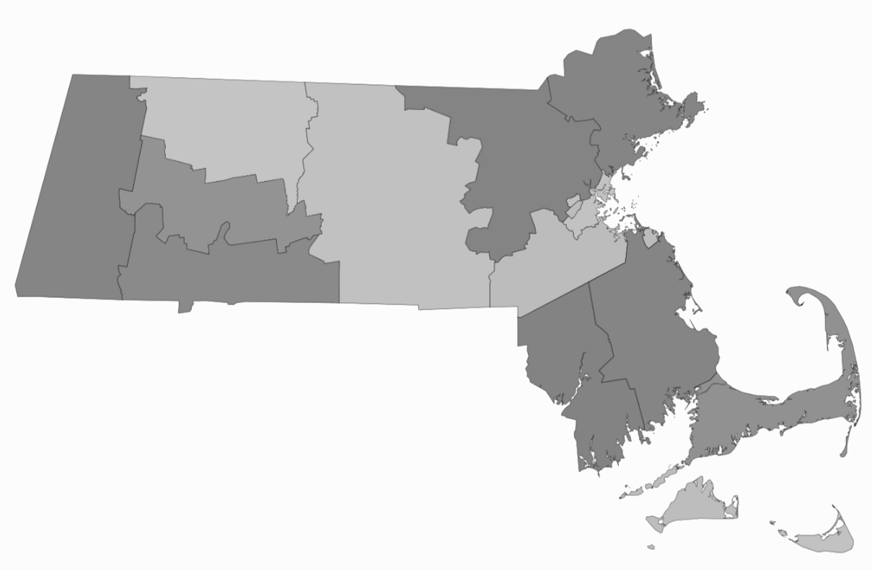
Section 35 Facilities and Current Capacity (cont.)
Massachusetts Section 35 Facilities
MCI-Framingham First Step Program
High Point Treatment Center at Shattuck Hospital (HPTC)
Stonybrook Stabilization and Treatment Center (Ludlow)
Stonybrook Stabilization and Treatment Center (Springfield)
Men’s Addiction Treatment Center (MATC)
Women’s Recovery from Addiction Program (WRAP)
Massachusetts Alcohol and Substance Abuse Center (MASAC)
Women’s Addiction Treatment Center (WATC)
0 25 50 miles
15

Slide 16
Section 35 Facilities’ Treatment Options and Length of Stay
* Information accurate as of June 19, 2019
Facility Name | Medication Options for Detoxification* | Options for Induction on MAT | Access to Counseling/ Group Therapy | Discharge Planning/ Aftercare | Avg. Length of Stay
High Point Women’s Addiction Treatment Center (WATC) | Methadone Buprenorphine Additional medications (Clonidine, Chlordiazepoxide, Oxazepam, Phenobarbital) | Methadone Buprenorphine Naltrexone (oral & inject.) Baclofen | ATS 4 hours/day of psycho-educational group sessions 4 hours/week of group self help sessions CSS 3 hours/week of individualized clinical counseling 1.5 hours/week with care coordinators 10 hours/week of group therapy 15/week psycho-educational group sessions Access to AA/NA | Individualized aftercare plans developed with Aftercare Coordinator May include medical and psychiatric appointments Referrals to community-based case management, SUD services, and MAT providers May include Recovery Coaches, Recovery Support Navigators, Behavioral Health Community Partners | 20 days (FY 2018)
High Point Treatment Center (HPTC) at Shattuck Hospital |  |  |  |  | 19 days (FY 2018)
High Point Men’s Addiction Treatment Center (MATC) |  |  |  |  | 23 days (FY 2018)
DMH Women’s Recovery from Addiction Program (WRAP) | Methadone Buprenorphine Additional medications (Chlordiazepoxide, Clonidine, Oxazepam, Phenobarbital) | Methadone Buprenorphine Naltrexone (oral & inject.) Acamprosate Disulfiram | 11-12 hours/day of individual counseling, psycho-educational group sessions, skill development, relapse prevention, and self-help Access to AA/NA | Individualized aftercare plans developed with Aftercare staff Includes medical and psychiatric appointments Referrals to community-based case management services, MAT providers, and Recovery Coaches | 44 days (FY 2019 partial)
Massachusetts Alcohol and Substance Abuse Center (MASAC)* | Buprenorphine Additional medications (Chlordiazepoxide, Clonidine, Depakote, Levetiracetam, Lorazepam, Ondansetron, Promethazine, Ropinirole) | Buprenorphine Naltrexone (inject.) | 1.5 hours/week individual case management planning 1 hour/week of group therapy 16 hours/week of group education Access to peer-led support groups (AA/NA) | Individualized aftercare plans developed with Substance Abuse Programming staff. Includes medical and psychiatric appointments Referrals to community-based case management services, MAT providers, and Recovery Pathfinders, based on client interest | 39 days (FY 2019 partial)
MCI – Framingham First Step Program* | Methadone (for pregnant maintenance and postpartum taper) Buprenorphine Additional medications (Chlordiazepoxide, Clonidine, Depakote, Levetiracetam, Lorazepam, Ondansetron, Promethazine, Ropinirole) | Methadone (for pregnant maintenance and postpartum taper) Buprenorphine Naltrexone (oral & inject.) | 30 minutes/week individual counseling 2.5 hours/day (Mon-Thurs) of group therapy 2 hours/day (Fri) of group counseling and self help sessions | Aftercare plans developed with counselors during weekly meetings Counselors may facilitate arrangements for community-based care Due to dual status, majority of civil commitments are transferred to awaiting trial status or WATC if bail is posted. | 34 days (FY 2019 partial)
Stonybrook Stabilization and Treatment Center – Ludlow | Buprenorphine Chlordiazepoxide | Buprenorphine Naltrexone (oral & inject.) | 32 hours/week of group and individual counseling Access to AA/NA | Individualized aftercare plans developed with Aftercare staff Includes medical and psychiatric appointments Referrals to community-based case management services, MAT providers, and Recovery Coaches and/or Recovery Pathfinders | 49 days (FY 2019 partial)
Stonybrook Stabilization and Treatment Center – Springfield | N/A |  | 32 hours/week of group and individual counseling Access to AA/NA 15 hours/week of intensive outpatient services through Providence Hospital
16

Slide 17
Section 35 Discharge Data
Facility Name | Discharge Data
High Point Women’s Addiction Treatment Center | FY 2018 Home (alone, family, community organization): 74.6% Residential program (CSS, TSS, sober home): 24.3% Opioid treatment (MAT): 12.0% Acute medical facility: 6.1% Other: 6% AMA: 4.9% Shelter: 2.0% | Notes: Up to three referrals may be listed for each discharged individual, but majority (70%) of discharged individuals only listed a single referral.
High Point Treatment Center at Shattuck Hospital
High Point Men’s Addiction Treatment Center
DMH Women’s Recovery from Addiction Program | FY 2018 Home (alone, family, non-family): 69.1% Residential program: 18.0% Shelter: 6.3% Acute medical facility: 4.1% State operated mental health center: 1.2% Court: 0.7% Respite: 0.2% AMA: 0.2%
Massachusetts Alcohol and Substance Abuse Center | FY 2019 (partial) Referrals for self help (AA/NA): 44.5% Referrals for intensive outpatient services: 24.6% Home (alone, family, non-family): 24.0% Referrals for mental health services: 15.6% Shelter: 14.5% Residential program: 12.9% Court: 10.4% Acute medical facility: 2.7% | Notes: Acute medical facility data includes commitments under Section 12 and medical releases to hospitals.
MCI – Framingham First Step Program | FY 2018 Awaiting trial: 20 Court: 17 Released to criminal sentence: 2 State operated mental health facility: 1 Home, Residential program, Shelter, Acute Medical Facility: 0 | Notes: Total number of commitments, not percentages. Due to dual commitment status, civil commitments are not released directly to the street from facility; all are released either through court or to their awaiting trial status.
Stonybrook Stabilization and Treatment Center – Ludlow | FY 2019 (partial) Home (alone, family, non-family): 43.7% Residential program, Foundation House, TSS, CSS: 20.9% Court: 11.0% Transferred back to MASAC: 9.3% Shelter: 7.3% Transferred to other HOC (various counties): 2.4% Medical rescission: 1.2% Other agency: 0.8% Nursing home: 0.6% Section 12: 0.4% | Notes: Out of 551 total discharges, 89% (492) were tracked with confidence. Additional discharge data for remaining 59 releases is being validated and will be incorporated. Patients transferred back to MASAC included non-Western MA clients with open cases.
Stonybrook Stabilization and Treatment Center – Springfield

Slide 18
Section 35 Commitment Data
In FY 2018:
10,770 petitions for civil commitment under Section 35 were filed in Massachusetts courts.¹
32.5% (3,503) were not heard and did not proceed as a Section 35 commitment.^{2,3}
67.5% (7,267) moved forward, resulting in an order for an in-court evaluation by court clinicians.
Overall, 83.2% (6,048 of 7,267) of all petitions heard resulted in commitment to a Section 35 treatment facility.
Section 35 Commitment Data, FY 2011-2018²
Section 35 Data | FY 2011 | FY 2012 | FY 2013 | FY 2014 | FY 2015 | FY 2016 | FY 2017 | FY 2018
Number of petitions for civil commitment filed in MA courts | 6,105 | 7,129 | 7,358 | 7,773 | 8,371 | 10,040 | 10,917 | 10,770
Number of petitions filed in MA courts that were not heard | 859 | 1,017 | 1,776 | 2,004 | 2,034 | 2,647 | 3,403 | 3,503
Number of Section 35 evaluations by court clinicians | 5,246 | 6,112 | 5,582 | 5,769 | 6,337 | 7,393 | 7,514 | 7,267
Number of commitments to a Section 35 treatment facility | 4,103 | 4,984 | 4,790 | 4,890 | 5,363 | 6,337 | 6,338 | 6,048
18

Slide 19
Section 35 Commitment Data (cont.)
Source: Massachusetts Trial Court data
19

Slide 20
Section 35 Commitment Data (cont.)
In May 2019, the Committee for Public Council Services (CPCS) conducted an informal, online survey of 269 CPCS attorneys that handle Section 35 petitions. The informal survey suggests that a portion of Section 35 commitments are unopposed by the respondent. *
94% of attorneys surveyed acknowledged representing a client who was not objecting to the Section 35 petition.
Of those, 24% indicated that over a third of their clients did not object to the Section 35 petition.
When representing a client who was NOT objecting to the Section 35 petition:
47% of attorneys indicated that while in court, the respondent was restrained and held in the same lock up as criminal defendants.
27% of attorneys indicated that the respondent was allowed to remain in court without restraint.
81% of attorneys indicated that the wait for a hearing is between 1-3 hours.
* The complete survey results can be found at: https://www.mass.gov/files/documents/2019/06/28/CPCS%20Survey%20May%202019.pdf
20

Slide 21
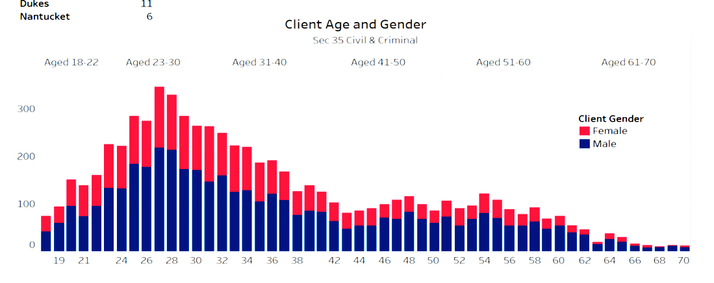
Section 35 Demographic Data
DMH Adult Court Clinic Data (FY 2018)¹
Race (N = 6,982) |  |  |  | Area |  |  | County
White (non-Hispanic) | 84.2% |  |  | Central | 2,600 |  | Homeless² | 1,654
White (Hispanic) | 1.7% |  |  | Southeast | 1,731 |  | Middlesex | 835
Black or African-American (non-Hispanic) | 6.3% |  |  | Northeast | 1,060 |  | Bristol | 705
Black or African-American (Hispanic) | 0.1% |  |  | Western | 946 |  | Worcester | 631
Asian | 0.44% |  |  | Boston | 472 |  | Hampden | 607
American Indian or Alaska Native | 0.1% |  |  |  |  |  | Plymouth | 519
Native Hawaiian or Other Pacific Islander | 0.01% |  |  | Housing Status |  |  | Suffolk | 416
Two or More Races | 1.3% |  |  | Homeless | 22.8% |  | Essex | 391
Declined | 6% |  |  |  |  |  | Norfolk | 383
 |  |  |  |  |  |  | Barnstable | 268
 |  |  |  |  |  |  | Berkshire | 138
 |  |  |  |  |  |  | Hampshire | 99
 |  |  |  |  |  |  | Franklin | 72
 |  |  |  |  |  |  | Dukes | 11
 |  |  |  |  |  |  | Nantucket | 6
Client Age and Gender
Data for Section 35 Civil and Criminal Cases Combined
¹ Totals may not reflect all client demographic data due to incomplete data reporting at time of court clinic evaluation.
² County of residence for homeless respondents not recorded.
21

Slide 22
Research on Outcomes Following Involuntary Commitment
The Commission is charged with reviewing medical literature and expert opinions on the long-term relapse rates of individuals diagnosed with a substance use disorder following involuntary inpatient treatment, including:
the differences in outcomes for coerced and non-coerced patients,
any potential increased risk of an individual suffering a fatal overdose following a period of involuntary treatment,
the effectiveness of the existing involuntary commitment procedures pursuant to Section 35 of Chapter 123 of the General Laws at reducing long-term relapse rates.
There is limited quality, peer-reviewed research on the efficacy of involuntary treatment for alcohol and substance use disorders. The limited research that exists generally relies upon observational data of previously incarcerated populations. Variations across study conditions make comparisons difficult. Moreover, findings related to observations about compulsory treatment in the criminal justice context cannot be generally extrapolated to civilly committed individuals because the coercive factors at play are different.
A 2016 review by Werb et al.¹ of nine quantitative studies looked at whether compulsory drug treatment results in decreased drug use or a decrease in criminal recidivism. Of the nine quantitative studies, four were from Southeast Asia, four were from North America and one was from Western Europe. Across the nine studies, a range of compulsory treatment settings including drug detention facilities, short (i.e., 21-day) and long-term (i.e., 6 months) inpatient treatment, community-based treatment, group-based outpatient treatment, and prison-based treatment were evaluated.
¹ Werb et al. (2016). The effectiveness of compulsory drug treatment: A systematic review. International Journal of Drug Policy, 28:1-9. https://www.ncbi.nlm.nih.gov/pubmed/26790691
22

Slide 23
Research on Outcomes Following Involuntary Commitment (cont.)
The analysis by Werb et al. concluded that while limited literature exists, the majority of studies evaluating compulsory treatment failed to detect any significant positive impacts on drug use or criminal recidivism over other approaches, with two studies detecting negative impacts of compulsory treatment on criminal recidivism compared with control arms.
Werb et al. further found, only two studies observed positive impact of long-term compulsory inpatient treatment on criminal recidivism: one reported a small effect size on recidivism after two years, and one found a lower risk of drug use within one week of release from compulsory treatment.
Werb et al. further concluded that in light of the potential for human rights violations that were reported in some of the studies (i.e. forced labor, physical and sexual abuse) within compulsory treatment settings, the results of this systematic review did not, on the whole, suggest improved outcomes in reducing drug use and criminal recidivism among drug-dependent individuals.
Rafful et al.¹ also noted that few studies have examined the relationship between drug treatment (either voluntary or involuntary) and non-fatal overdose.
¹ Rafful et al. (2018). Increased non-fatal overdose risk associated with involuntary drug treatment in a longitudinal study with people who inject drugs. Addiction, 113(6): 1056-1063.) https://www.ncbi.nlm.nih.gov/pubmed/29333664.
23

Slide 24
Research on Outcomes Following Involuntary Commitment (cont.)
In Massachusetts, the availability of outcome data for patients following periods of involuntary commitment has been limited. The most recent analysis of outcome data related to involuntary and voluntary commitments was published by DPH in 2016, An Assessment of Opioid-related Deaths in Massachusetts (2013–2014).¹
The DPH report acknowledges that data from only two Section 35 treatment facilities (WATC, MATC) over a limited time period were utilized for the analyses. This was a crude analysis, meaning it did not account for all factors that may have contributed to opioid-related overdose deaths. In the report, DPH recommends additional analysis be conducted to better understand the underlying risk factors that impact patient outcomes following a period of involuntary treatment.
Direct comparisons of treatment outcomes for individuals who have undergone involuntary and voluntary treatment is challenging, as characteristics of those not seeking treatment for addiction are inherently different than those who have chosen to seek help through either inpatient or outpatient treatment settings. Patients who are committed for treatment under Section 35 are among the most ill, most complex and at the greatest risk for an overdose.
If the Commonwealth wants to examine the effectiveness of Section 35, additional datasets would need to be compiled and linked over an extended period of time. This work would be extensive. Due to the significant changes to the treatment environment over the past five years, careful thought would need to be given to study design. This first of its kind analysis would need to be conducted in a way that addresses potential biases and other limitations inherent to this kind of study.
¹ DPH Chapter 55 report (https://www.mass.gov/files/documents/2016/09/pg/chapter-55-report.pdf)
24
Notes:
Abbie was insistent on removing reference to survival rate from second bullet

Slide 25
Detoxification Prior to Induction on Medication-assisted Treatment
The Commission is charged with reviewing medical literature and expert opinions on the length of time necessary for detoxification of opioids and recommended time following detoxification to begin medication-assisted treatment
For the Commission’s November 5, 2018 meeting, Alexander Y. Walley, MD, MSc, Colleen LaBelle, MSN, RN-BC, CARN, and Maria Sullivan, MD, PhD were invited to present on this topic; a summary of their presentations appears in the table below.
MAT Option | Abstinence Required? | Dosing Schedule | Required Training/ Regulation
Methadone | No, but recommended to initiate with low dose and titrate based on patient’s response¹ | Daily clinic administered¹ | Licensed OTP clinic only¹
Buprenorphine | 12 hours¹ | Daily pharmacy prescription¹ | 8 hour training for MD/DO 24 hour training for NP/PA¹
Naltrexone (extended-release injectable) (Vivitrol) | 7-10 days² | Every 4 weeks; administered by a health care provider as an intramuscular gluteal injection² | None¹
Naltrexone (oral) | 7-10 days¹ | Daily pharmacy prescription¹ | None¹
¹ Dr. Walley’s presentation https://www.mass.gov/files/documents/2018/11/16/Section%2035%20PPT%20Walley%2011.5.pdf
² Dr. Sullivan’s presentation https://www.mass.gov/files/documents/2018/11/16/Section%2035%20PPT%20Sullivan%2011.5.pdf
25

Slide 26
Legal Implications of an Alternative Path for Involuntary Treatment
The Commission is charged with reviewing the legal implications of holding a non-court involved individual who is diagnosed with a substance use disorder but is no longer under the influence of substances
A draft memorandum was prepared by the Office of DMH General Counsel and shared with a sub-group of the Commission on May 7, 2019. Limited edits were offered, all of which were incorporated. An updated version of the memorandum was shared with the entire Commission on May 17, 2019. An email from the ACLU, in response to the memorandum, is also attached to the final document. See Appendix G.
The memorandum concludes that there is no legal impediment; the Massachusetts Legislature may permit a qualified clinician to authorize short-term emergency hospitalizations without judicial involvement for individuals with a substance use disorder, similar to the process for commitment of mentally ill persons under M.G.L. c. 123, § 12. The memorandum notes that such an amendment should include similar due process protections that apply to commitments made under Section 12. A full copy of the memorandum is available in Appendix G, as well as the Section 35 Commission’s webpage.
A memorandum drafted by the Committee for Public Counsel Services (CPCS) was submitted to the Commission on May 23, 2019.
The memorandum acknowledges that the Legislature could authorize short-term emergency hospitalizations without judicial involvement. However, the memorandum outlines constitutional, procedural and practical concerns with the current commitment process under M.G.L. c. 123, § 12. Specifically, the lack of a statutory limit on the length of time a person can be detained while waiting for admission to a mental health facility and the lack of judicial review for the short-term emergency hospitalization in the emergency department. Given these concerns, the memorandum cautions against grafting section 12 (a) and 12 (b) onto Section 35. A full copy of the memorandum is available in Appendix H, as well as the Section 35 Commission’s webpage.
During the May 23 meeting, during the discussion of the two memoranda, several Commission members raised practical concerns regarding implementation of a non-court involved alternative pathway to involuntary treatment, similar to the process outlined in Section 12 of Chapter 123 of the General Laws. (See https://www.mass.gov/lists/section-35-commission-meeting-minutes) Two members also raised that procedural and substantive due process questions had never been litigated with respect to Section 12, and noted they had substantive due process concerns with the existing Section 12 process and the proposed addition of short-term emergency hospitalizations without judicial involvement for individuals with a substance use disorder.
26

Slide 27
Current Treatment Capacity
The Commission is charged with reviewing:
5) whether the current capacity, including acute treatment services, clinical stabilization services, transitional support services and recovery homes, is sufficient to treat individuals seeking voluntary treatment for substance use disorder,
6) the availability of other treatments for substance use disorder, including those treatments used in less restrictive settings
Since 2015, treatment capacity has significantly increased. (See chart on following slide for additional details.)
Chapter 208 of the Acts of 2018 required acute care hospitals that provide emergency services within an emergency department and satellite emergency facilities to have the capacity to initiate opioid agonist therapy to patients that present after an opioid-related overdose. The patient must also be directly connected to continuing treatment prior to discharge.
The Massachusetts Helpline is a statewide public resource for finding licensed and approved substance use treatment and recovery services. In 2018, it launched several new enhancements, including an online chat feature, real-time wait list management system for use by all DPH-funded residential treatment programs, and a Spanish version of the Helpline website. (https://helplinema.org)
Massachusetts Behavioral Health Access (MABHA), administered by the Massachusetts Behavioral Health Partnership, helps providers and members locate openings in mental health and substance use treatment services. (https://www.mabhaccess.com)
Learn to Cope is a statewide family support organization. (https://www.learn2cope.org)
27

Slide 28
Behavioral Health Treatment Capacity
Adult Behavioral Health Inpatient Beds | Licensed Capacity as of January 1, 2015 | Licensed Capacity as of May 1, 2019 | Change
DPH Acute Treatment Services (ATS) (level 4.0 & 3.7) | 846 beds | 173 beds (4.0) 1,033 beds (3.7) | 360 beds
DPH Clinical Stabilization Services (CSS) | 297 beds | 819 beds | 522 beds
DPH Transitional Support Services (TSS) | 339 beds | 382 beds | 43 beds
DPH Adult Residential Recovery Services (RRS) | 2,300 beds | 2,324 beds¹ | 24 beds
DPH Co-occurring Enhanced Adult Residential Programs² | N/A | 50 beds | 50 beds
DPH Second Offender Residential Program | 58 beds | 58 beds | 0
DPH Adolescent / Transitional Youth Residential Beds | 144 beds | 101 beds | (43 beds)
Section 35 Men's Beds | 258 beds | 476 beds | 218 beds
Section 35 Women's Beds | 90 beds | 179 beds | 89 beds
Youth Behavioral Health Inpatient Beds
DPH Youth Stabilization Beds | 48 beds | 48 beds | 0
DPH Family Residential | 110 families | 112 families | 2 families
Outpatient Substance Use Disorder Programs
DPH Outpatient Treatment Program (OTP) – MAT Programs (methadone) | 39 programs | 43 programs | 4 programs
DPH Outpatient Counseling and Outpatient Detoxification Programs | 190 programs | 245 outpatient counseling 1 outpatient detox | 56 programs
DPH Office-Based Outpatient Treatment (OBOT) (buprenorphine) – MAT sites funded by DPH | 14 programs | 33 licensed 32 funded | 51 programs
Sober Homes
Sober Homes Certified by the Massachusetts Alliance for Sober Housing | 0 | 186 homes (2,579 beds) | 186 homes (2,579 beds)
Recovery Support
Recovery Centers | 10 centers | 18 centers | 8 centers
¹ These numbers reflect total licensed capacity. In 2017, RRS became a covered benefit under MassHealth. This significantly increased access to this level of care for MassHealth members.
² This new level of care is a covered benefit under MassHealth and DPH has contracted with 26 providers as the payer of last resort. Approximately 350 additional beds are projected to open by the end of FY 2022. More info at: https://www.mass.gov/news/baker-polito-administration-to-fund-26-new-programs-to-help-people-with-substance-use-and
28

Slide 29
Treatment for Individuals Committed Under Section 35 in Western Massachusetts
The Hampden County Sheriff’s Department developed a Section 35 treatment program in Western Massachusetts. The commission heard more positive comments about the program run by the Hampden County Sheriff than about MASAC.
A procurement for Section 35 treatment beds for men has not been released since FY 2007. A procurement for Section 35 treatment beds for women has not been released since 2006. ^{1,2}
This Commission issued a request for information to identify vendors with potential interest in operating a secure treatment center for individuals committed under Section 35 in Western and Central Massachusetts.
Seven responses were received. Six of those responses indicated an interest in providing treatment for individuals committed under Section 35 in Western and Central Massachusetts. For more details, see Appendix I.
¹ See COMMBUYS: (S104135-vCurrent) Statewide Treatment Center for Civilly-Committed Women and (S107833-vCurrent) Substance Abuse Treatment for Civilly Committed Men.
² A procurement for Acute Treatment Service beds to provide treatment for individuals who are voluntarily seeking treatment was issued in December, 2016. As part of this procurement, the Department of Public Health attempted to identify providers who provide voluntary treatment in a setting that also could meet the security requirements necessary to provide involuntary treatment. The Department was attempting to identify providers that could accept Section 35 transfers from another Section 35 facility if existing Section 35 treatment beds were full. No provider indicated that they had this type of dual capacity.
29

Slide 30
Access to Buprenorphine
Chapter 208 of the Acts of 2018, requires acute care hospitals to have the capacity to initiate opioid agonist therapy to patients that present after an opioid-related overdose. The patient must also be directly connected to continuing treatment prior to discharge.
The Massachusetts Health and Hospital Association (MHA) worked in collaboration with the Massachusetts College of Emergency Physicians (MACEP) to develop guidelines for administering MAT for opioid use disorder within the emergency department. The guidance primarily focuses on the prescription and administration of buprenorphine. ¹
Percentage of MA City/Town Residents Receiving Buprenorphine Medications²
Practitioner DATA Waivers (by City/Town FY18)²
¹ Latest version available on PatientCareLink (https://patientcarelink.org/improving-patient-care/substance-use-disorder-prevention-treatment-2/)
² Source: DPH 2019 (https://www.mass.gov/files/documents/2019/06/28/BSAS%20Buprenorphine%20provider%20capacity%205-21.pdf)
30

Slide 31
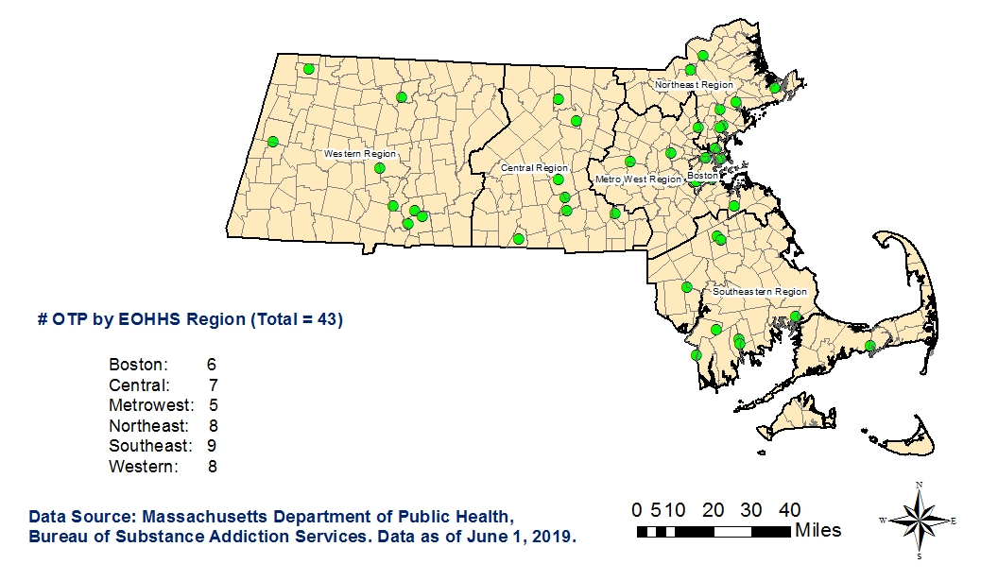
Access to Methadone – Locations of Opioid Treatment Programs
Locations as of June 1, 2019
31

Slide 32
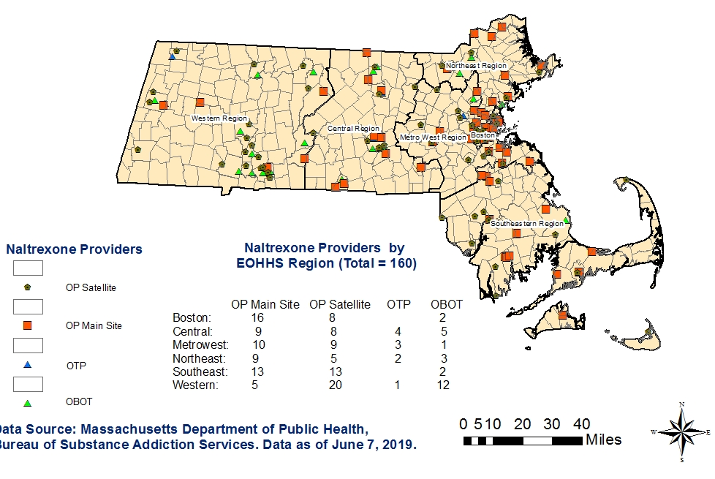
Access to Naltrexone – Known Naltrexone Providers
Locations as of June 12, 2019
32

Slide 33
Standardization of Forms and Procedures
The Commission is charged with evaluating and developing a proposal for a consistent statewide standard for the medical review of individuals who are involuntarily committed due to an alcohol or substance use disorder pursuant to Section 35 of Chapter 123 of the General Laws, including, but not limited to, developing:
a proposed standardized form and criteria for releasing medical information for use in a commitment hearing under said Section 35 of said Chapter 123 that is in compliance with federal and state privacy requirements, and
criteria and guidance to medical staff about filing a petition under said Section 35 of said Chapter 123
Massachusetts Health and Hospitals Association (MHA), working with a representative group of providers, developed a proposed set of materials to help standardize the process for submitting patients’ medical information to the Courts for use during a Section 35 commitment hearing. Copies of the materials are available on the Section 35 Commission’s webpage and include the following:
Affidavit letter issued by a physician that outlines the clinical support for the Section 35 petition. The affidavit letter would be attached to the existing Trial Court form: “Affidavit in Support of Petition for Commitment under G.L. c. 123, Section 35” (See Appendix E for copies of the Trial Court forms).
Checklist of supporting clinical information for use by hospitals and physicians that outlines the minimum information and supporting documentation that should be included along with the affidavit letter.
Privacy memorandum drafted by an outside counsel retained by MHA that outlines the federal and state legal protections that permit the disclosure of patients’ medical information to the Courts for use during a Section 35 commitment hearing.
Beginning in June 2019, MHA and DMH will coordinate to pilot the introduction of the affidavit and checklist with specific courts in the Commonwealth to ensure that the clinical information outlined in the documents is sufficient, whether additional information is needed to assist with care coordination during placement post-hearing, and to identify any potential gaps in the process.
Following the pilot program, MHA will coordinate with the Trial Courts and DMH to host a statewide educational webinar for providers to review the materials and process and discuss best practices based on the pilot program. The session may be recorded for the benefit of new hospital staff to ensure continuous understanding of the new standardized process and materials.
33

Slide 34
Appendices
34

Slide 35
Appendix A – Legislative Mandate
CHAPTER 208, SECTION 104 OF THE ACTS OF 2018
There shall be a section 35 involuntary commitment commission to study the efficacy of involuntary inpatient treatment for non-court involved individuals diagnosed with substance use disorder. The commission shall:
review medical literature and expert opinions on the long-term relapse rates of individuals diagnosed with substance use disorder following involuntary inpatient treatment including:
the differences in outcomes for coerced and non-coerced patients
any potential increased risk of an individual suffering a fatal overdose following a period of involuntary treatment,
medical literature on length of time necessary for detoxification of opioids and recommended time following detoxification to begin medication-assisted treatment,
the legal implications of holding a non-court involved individual who is diagnosed with substance use disorder but is no longer under the influence of substances,
whether the current capacity, including acute treatment services, clinical stabilization services, transitional support services and recovery homes, is sufficient to treat individuals seeking voluntary treatment for substance use disorder
the availability of other treatments for substance use disorder, including those treatments used in less restrictive settings, and
the effectiveness of the existing involuntary commitment procedures pursuant to section 35 of chapter 123 of the General Laws at reducing long-term relapse rates; and
evaluate and develop a proposal for a consistent statewide standard for the medical review of individuals who are involuntarily committed due to an alcohol or substance use disorder pursuant to section 35 of chapter 123 of the General Laws, including, but not limited to, developing:
a proposed standardized form and criteria for releasing medical information for use in a commitment hearing under said section 35 of said chapter 123 that is in compliance with federal and state privacy requirements, and
criteria and guidance to medical staff about filing a petition under said section 35 of said chapter 123.
The commission shall consist of: the secretary of health and human services or a designee, who shall serve as chair; the house and senate chairs of the joint committee on mental health, substance use and recovery or their designees; the house and senate chairs of the joint committee on judiciary or their designees; the minority leader of the house or a designee; the minority leader of the senate or a designee; 1 representative of an academic institution appointed by the speaker of the house; 1 representative of an academic institution appointed by the senate president; the chief justice of the trial court or a designee; the commissioner of the department of mental health or a designee; the commissioner of the department of public health or a designee; the director of the office of health equity in the department of public health; an addiction expert with experience in federal and state policy on substance use disorder; and 1 representative from each of the following organizations: Massachusetts Organization for Addiction Recovery, Inc.; The Boston Health Care for the Homeless Program, Inc.; Massachusetts Nurses Association; the Massachusetts Association of Advanced Practice Psychiatric Nurses; the Massachusetts chapter of the National Association of Social Workers, Inc.; American Civil Liberties Union of Massachusetts, Inc.; the committee for public counsel services; Massachusetts Health & Hospital Association, Inc.; the Massachusetts Psychological Association, Inc.; Massachusetts Medical Society; Massachusetts Psychiatric Society, Inc.; Massachusetts College of Emergency Physicians, Inc.; Massachusetts Society of Addiction Medicine, Inc.; Association for Behavioral Healthcare, Inc.; and Massachusetts Association of Behavioral Health Systems, Inc.
The commission shall file recommendations, including any proposed legislation, with the clerks of the house of representatives and the senate not later July 1, 2019.
35

Slide 36
Appendix B – Section 35 Commission Members
Name | Title / Affiliation
Marylou Sudders (Chair) | Secretary, Executive Office of Health and Human Services, Massachusetts
Ruth B. Balser, PhD | Massachusetts State Representative
Leo Beletsky, JD, MPH | Associate Professor of Law and Health Sciences, Northeastern University
Kristin Beville, MSW, LICSW, MPH | Director, Department of Social Work, McLean Hospital
Monica Bharel, MD, MPH | Commissioner, Massachusetts Department of Public Health
William N. Brownsberger | Massachusetts State Senator
Hon. Paula M. Carey | Chief Justice, Trial Court
Alain A. Chaoui, MD | President, Massachusetts Medical Society
Nancy Connolly, PsyD | Assistant Commissioner, Massachusetts Department of Mental Health
Vicker V. DiGravio III | President/CEO, Association for Behavioral Health
Michael J. Finn | Massachusetts State Representative
Marcia Fowler | CEO, Bournewood Health Systems
Maryanne Frangules | Executive Director, Massachusetts Organization for Addiction Recovery
Richard G. Frank, PhD | Professor of Health Economics, Harvard Medical School
Cindy F. Friedman | Massachusetts State Senator
36

Slide 37
Appendix B – Section 35 Commission Members (cont.)
Name | Title / Affiliation
Mark Green, MD | Addiction Psychiatrist, Psych Garden
Neal S. Hovey | Sergeant, Topsfield Police Department
Carrie Jochelson PMHCNS-BC | Clinical Nurse Specialist, Massachusetts Association of Advanced Practice Psychiatric Nurses
Todd A. Kerensky, MD | Medical Director, Spectrum Health
Mark Larsen | Committee for Public Counsel Services
Carol Mallia, RN, MSN | Massachusetts Nurses Association
David Munson, MD | Medical Director, Respite Programs, Boston Health Care for the Homeless Program
David Podell, PhD | President, MassBay Community College
John E. Rosenthal | Police Assisted Addiction and Recovery Initiative
Jessie Rossman | American Civil Liberties Union of Massachusetts
Sabrina Selk, ScM, ScD | Director, Office of Health Equity, Department of Public Health
David G. Stewart, PhD, ABPP | Chief of Psychology, Department of Psychiatry, Cambridge Health Alliance
Scott G. Weiner, MD, MPH, FACEP, FAAEM | President, Massachusetts College of Emergency Physicians
Leigh Simons Youmans, MPH | Director, Behavioral Health and Healthcare Policy, Massachusetts Health and Hospital Association
37

Slide 38
Appendix C – Summary of Meetings and Input Provided to the Commission
Presenters | Topics Discussed | Resources and Supporting Documents
October 30, 2018
Secretary Sudders Commission Chair | Discussion of the Commission’s charges, members’ expectations, and proposed schedule for each meeting | Commission presentation
November 5, 2018
Hon. Rosemary Minehan Massachusetts Trial Court | Overview of the Section 35 process | Judge Minehan’s presentation
Alexander Y. Walley, MD, MSc Boston Medical Center | Medication-based treatment approaches for addressing opioid overdose and opioid use disorder | Dr. Walley’s presentation
Colleen LaBelle, MSN, RN-BC, CARN Boston Medical Center | Treating opioid use disorder with evidence-based treatments | Ms. LaBelle’s presentation
Maria Sullivan, MD, PhD Alkermes | Detoxification and induction on medication-assisted treatment | Dr. Sullivan’s presentation
38

Slide 39
Appendix C – Summary of Meetings and Input Provided to the Commission (cont.)
Presenters | Topics Discussed | Resources and Supporting Documents
December 6, 2018
Lina Abdalla Denise Bohan Merredith Cunniff Joel Kergaravat Joanne Peterson Robin Wallace Zachary Wallace | Patients’ and families’ perspectives and firsthand experiences with the Section 35 process
February 28, 2019
Hermik Babakhanlou-Chase Michael Richardson Dana Bernson, MPH Bureau of Substance Addiction Services | DPH data from Section 35 facilities | Bureau of Substance Addiction Services’ presentation
Steven Garceau Boston EMS Chief John McCarthy Gloucester Police Department Leslie W. Milne, MD Massachusetts General Hospital John Rosa Boston EMS Deputy Superintendent Leonard Shubitowski Boston EMS | First responders and their experiences with the Section 35 process | Dr. Milne’s presentation
39

Slide 40
Appendix C – Summary of Meetings and Input Provided to the Commission (cont.)
Presenters | Topics Discussed | Resources and Supporting Documents
April 25, 2019
Sheriff Nicholas Cocchi Thomas Foye Elizabeth Hanna Sally Johnson Van Wright Anthony Scibelli Hampden County Sheriff’s Department | Overview of the Stonybrook Stabilization and Treatment Centers | Hampden County Sheriff's Department presentation Hampden County Sheriff's Department materials
Teri St. Pierre, LMHC Rasim Arikan, MD Women’s Recovery from Addiction Program | Overview of Women’s Recovery from Addiction Program | Women’s Recovery from Addictions Program presentation
Mark Larsen Jessica Gallagher Ann Grant Committee for Public Counsel Services | Legal representation and the Section 35 process | Committee for Public Counsel Services presentation
40

Slide 41
Appendix C – Summary of Meetings and Input Provided to the Commission (cont.)
Presenters | Topics Discussed | Resources and Supporting Documents
May 23, 2019
Anuj K. Goel, JD, MPH Massachusetts Health and Hospital Association (MHA) Nancy Connolly, PsyD Department of Mental Health | Proposed guidelines and standardized clinical forms for submission of medical information to the Courts for use during Section 35 commitment hearings | MHA presentation Proposed affidavit, checklist, and privacy memorandum
41

Slide 42
Appendix D – Resources Reviewed by the Commission
October 30, 2018
Section 35 Commission Meeting Presentation
Massachusetts Department of Public Health Chapter 55 Data Brief. (2017) “An Assessment of Opioid-Related Overdoses in Massachusetts 2011-2015 (2017)
Massachusetts Department of Public Health Chapter 55 Data Brief (excerpt) (2017)
Harvard Institute of Politics (2014) “Involuntary Commitment for Substance Abuse Treatment in Massachusetts: Problems and Proposed Solutions.”
National Alliance for Model State Drug Laws. (2016) “Involuntary Commitment for Individuals with a Substance Use Disorder or Alcoholism.”
Overview of New Requirements Related to Involuntary Treatment Act (1/18/2018)
Summary of Massachusetts Behavioral Health Treatment Capacity (October 2018)
Chelsea Appeals Court. (2016) In the Matter of A.M.
November 5, 2018
Section 35 Commission Meeting Presentation
Section 35 Commission Updated Meeting Agenda
Presentation from Hon. Rosemary Minehan on Section 35 Process
Presentation from Alexander Y. Walley, MD, MSc on Medication-based Treatment Approaches
Presentation from Colleen LaBelle, MSN, RN-BC, CARN on Medication-assisted Treatment for Opioid Use Disorder
Presentation from Maria Sullivan, MD, PhD on Detoxification and Induction on Medication-assisted Treatment
Bisaga, A. et al. (2018) Antagonists in the Medical Management of Opioid Use Disorders: Historical and Existing Treatment Strategies. American Journal on Addictions, 27: 177–187
42

Slide 43
Appendix D – Resources Reviewed by the Commission (cont.)
December 6, 2018
Section 35 Commission Meeting Presentation
Section 35 Commission Updated Meeting Agenda
Uniform Trial Court Rules for Civil Commitment Proceedings for Alcohol And Substance Abuse
Opioid Related Overdose Deaths Among MA Residents
Jain, A. et al. (2018) Civil Commitment for Opioid and Other Substance Use Disorder: Does It Work? Psychiatric Services, 69:4
In the Matter of G.P. Summary
In the Matter of G.P. Opinion
In the Matter of A.M.
February 28, 2019
Section 35 Commission Meeting Presentation
Section 35 Commission Updated Meeting Schedule
Presentation on DPH Opioid and Civil Commitment Data
DPH Opioid-related Overdose Deaths Among Massachusetts Residents (Feb. 2019)
Dr. Leslie W. Milne MGH Emergency Department Section 35 Data
Christopher, P. et al. (2018) Civil Commitment Experiences Among Opioid Users
Cover Letter and Additional Materials Provided by Dr. Maria Sullivan (12/3/2018)
43

Slide 44
Appendix D – Resources Reviewed by the Commission (cont.)
April 25, 2019
Section 35 Commission Meeting Presentation
Section 35 Commission Updated Meeting Agenda
Presentation on Stonybrook Stabilization and Treatment Centers
Hampden County Sheriff’s Department Section 35 Materials
Presentation on Women’s Recovery from Addictions Program
Presentation on Committee for Public Counsel Services
May 23, 2019
Section 35 Commission Meeting Presentation
Massachusetts Health and Hospital Association Presentation
Proposed Guidelines and Standardized Clinical Forms
Section 35 Legal Memorandum
Committee for Public Counsel Services Legal Memorandum
DPH Opioid-related Overdose Deaths Among MA Residents (May 2019)
Prisoners’ Legal Services Written Testimony
Bhalla, I. et al. (2018) The Role of Civil Commitment in the Opioid Crisis. Journal of Law, Medicine and Ethics (forthcoming)
Beletsky, L. (2018) Involuntary Treatment for Substance Use Disorder: A Misguided Response to the Opioid Crisis. Harvard Health Blog
44

Slide 45
Appendix D – Resources Reviewed by the Commission (cont.)
June 27, 2019
Request for Information Regarding Western and Central Massachusetts Secure Section 35 Treatment Centers
Charts of Licensed Addiction Treatment Capacity Submitted by Association for Behavioral Healthcare
Committee for Public Counsel Services Survey Results (May 2019)
Werb, D. et al. (2016) The effectiveness of compulsory drug treatment: A systematic review. International Journal of Drug Policy, Feb;28:1-9
Rafful, C. et al. (2018) Increased non-fatal overdose risk associated with involuntary drug treatment in a longitudinal study with people who inject drugs. Addiction, Jun;113(6):1056-1063
DPH Presentation on Opioid-related Overdose Death Data
BSAS Presentation on OTP and OBOT Statistics
BSAS Presentation on Buprenorphine Provider Capacity
Health Policy Commission Presentation on Availability of Behavioral Health and Substance Use Disorder Treatment
MassHealth Presentation on MAT Initiation Among Members with Opioid Use Disorder
45

Slide 46
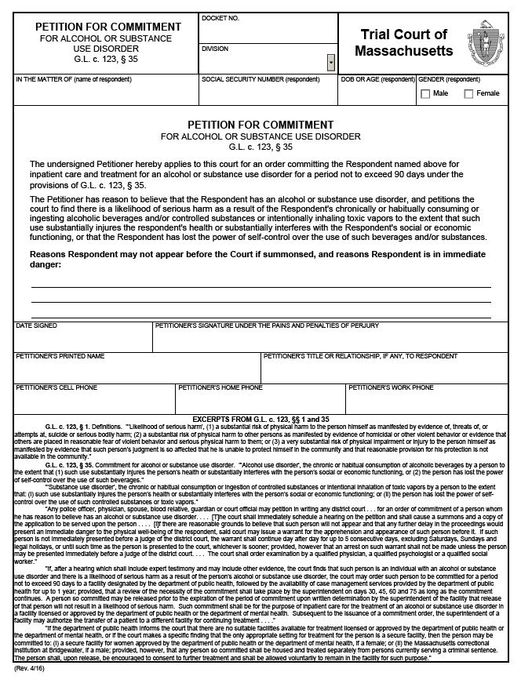
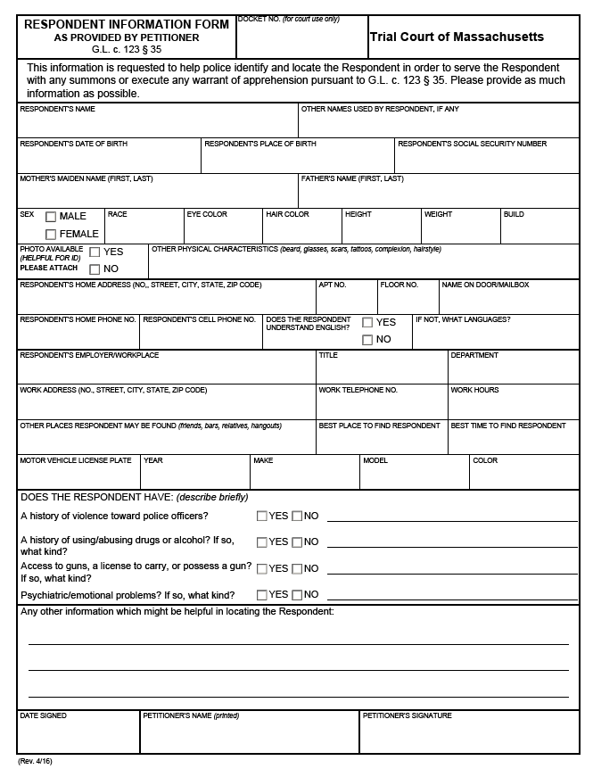
Appendix E – Trial Court Forms
46

Slide 47
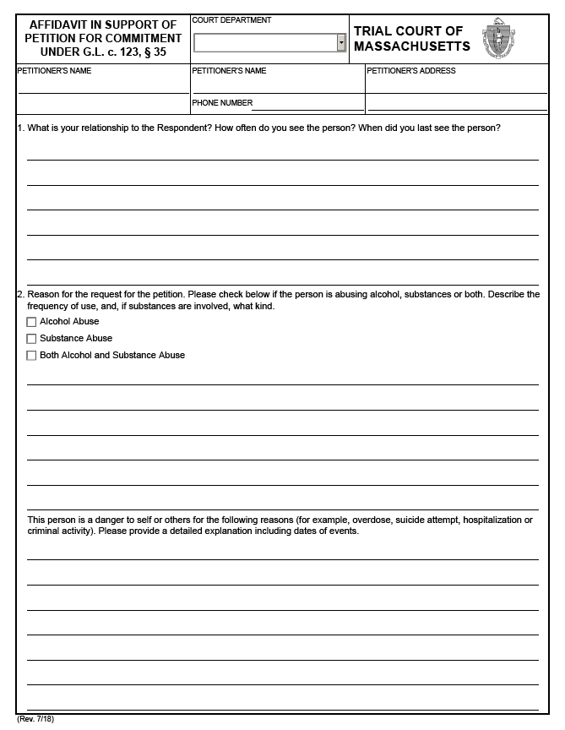
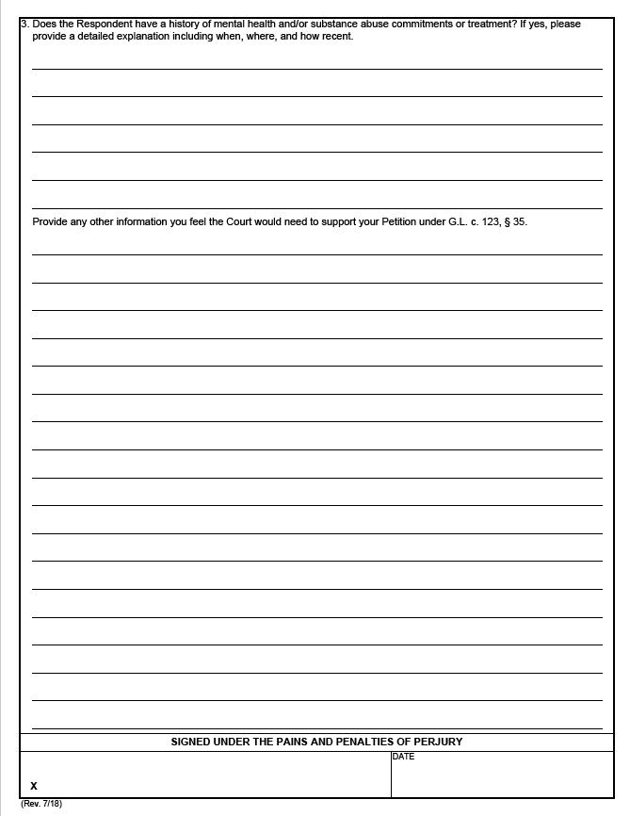
Appendix E – Trial Court Forms (cont.)
Page 1 Page 2
47

Slide 48
Appendix F – Bureau of Substance Addiction Services Treatment and Recovery Programs
Partial List of Bureau of Substance Addiction Services Treatment and Recovery Programs
Acute Treatment Services (ATS): 24-hour medically supervised addiction treatment for adults or adolescents provided in a medically managed or medically monitored inpatient facility equivalent to American Society for Addiction Medicine (ASAM) Level 3.7 that provides evaluation and withdrawal management and which may include biopsychosocial assessment, individual and group counseling, psychoeducational groups and discharge planning.^{1,2}
Clinical Stabilization Services (CSS): 24-hour clinically managed post detoxification treatment for adults or adolescents equivalent to ASAM Level 3.5, usually following acute treatment services for substance abuse, which may include intensive education and counseling regarding the nature of addiction and its consequences, relapse prevention, outreach to families and significant others and aftercare planning, for individuals beginning to engage in recovery from addiction.^{1,2}
Transitional Support Services (TSS): Short-term residential support services equivalent to ASAM Level 3.1 for clients who need a safe and structured environment to support their recovery process after detoxification. Designed to help those who need services between acute treatment and residential rehabilitation, outpatient, or other aftercare. Eligibility restricted to individuals ages 18 years or older who are referred by a publicly-funded ATS program, homeless shelter, or by homeless outreach worker.³
Residential Treatment Over 30 Days: Services for individuals who have recently stopped using alcohol and/or other substances, have been stabilized medically, and are able to participate in a structured, residential treatment program. Includes Recovery Homes, Social Model Homes, Therapeutic Communities, Specialized Residential Services for Women, Specialized Residential Services for Families, and Youth Residential Programs.
Recovery Homes: Structured, sober environments for individuals recovering from addiction to alcohol and/or other substances. Programming emphasizes recovery and treatment within a structured, therapeutic setting. Residents are encouraged to integrate with the community and to access community resources, including self-help groups and employment. Some Recovery Homes offer residents enhanced services for pregnant and post-partum women and their infants, which include coordination of prenatal/pediatric care.
¹ M.G.L. c. 175 § 47GG: https://malegislature.gov/Laws/GeneralLaws/PartI/TitleXXII/Chapter175/Section47GG
² ASAM Levels of Care: https://www.asamcontinuum.org/knowledgebase/what-are-the-asam-levels-of-care/
³ BSAS Substance Abuse Services Descriptions: https://www.mass.gov/service-details/substance-abuse-services-descriptions
48

Slide 49
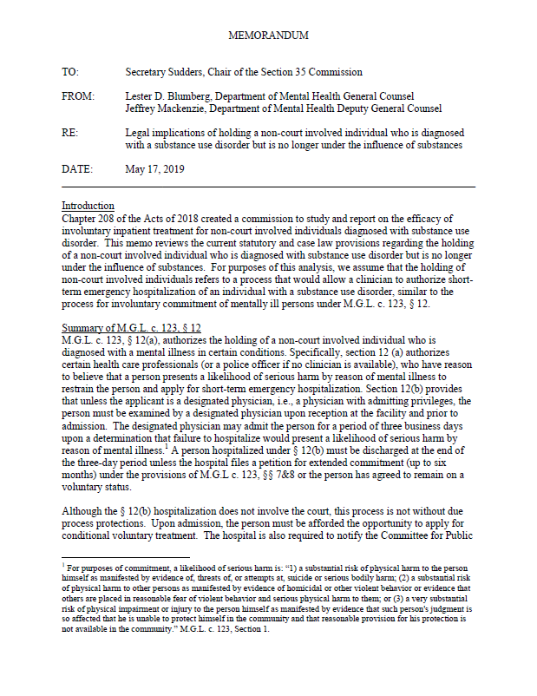
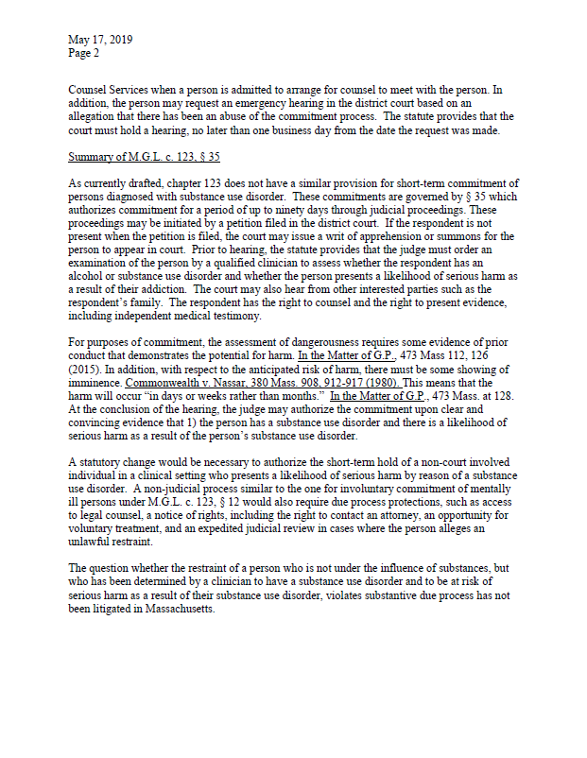
Appendix G – Section 35 Legal Memorandum
Page 1 Page 2
49

Slide 50
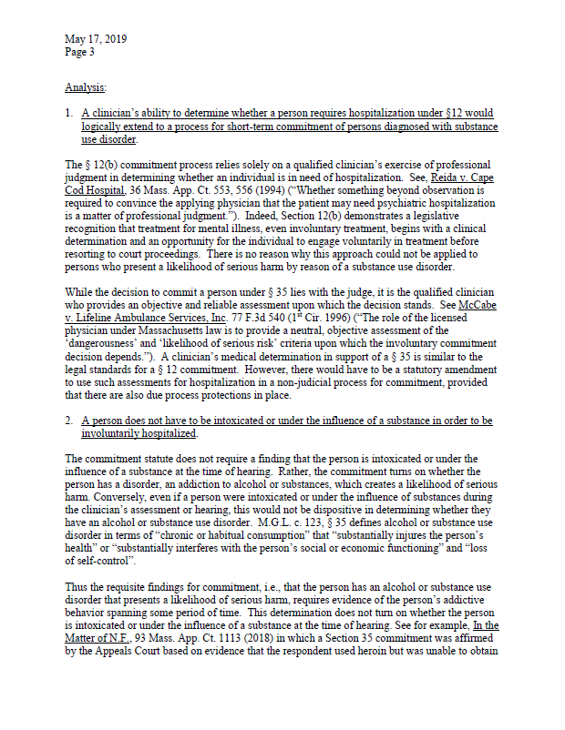
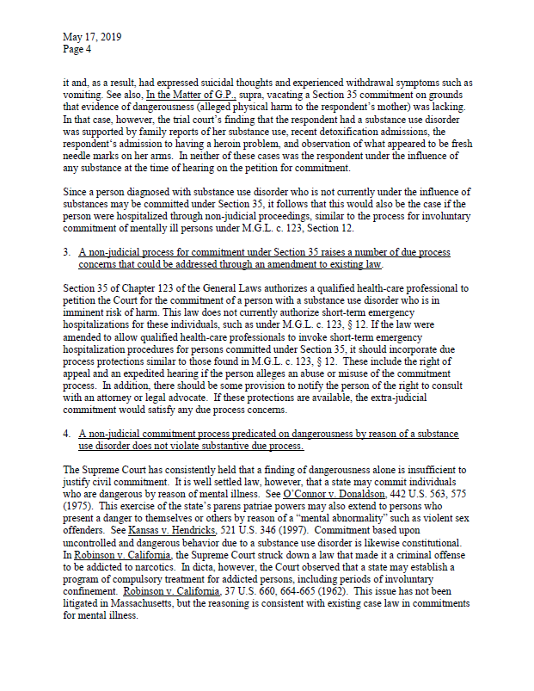
Appendix G – Section 35 Legal Memorandum (cont.)
Page 3 Page 4
50

Slide 51
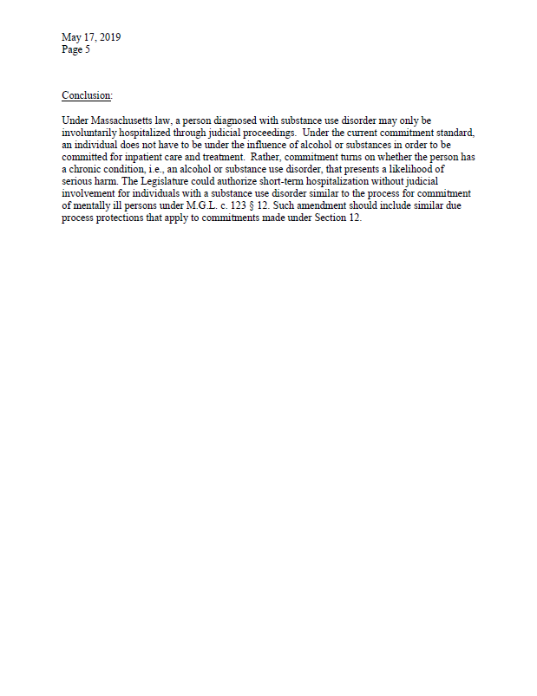
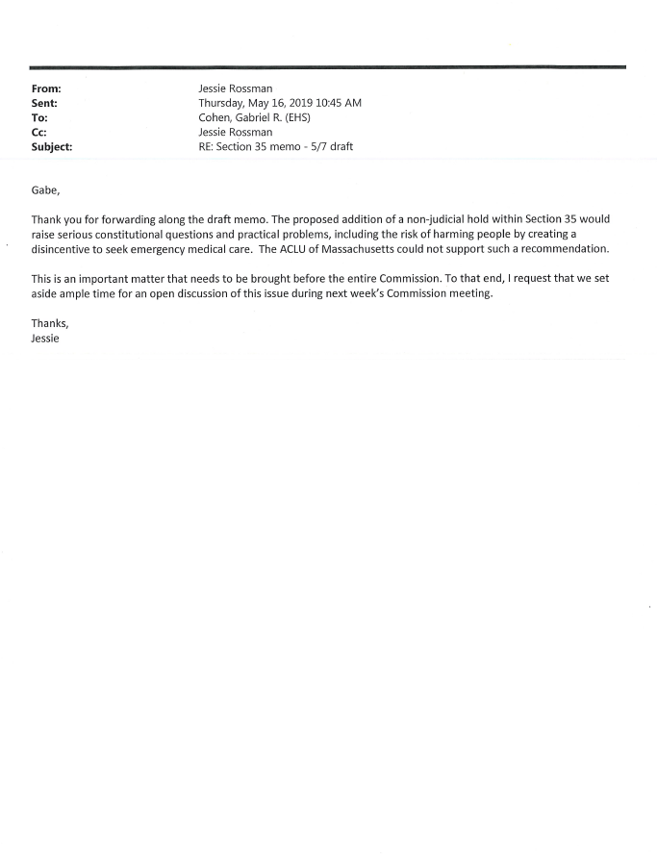
Appendix G – Section 35 Legal Memorandum (cont.)
Page 5
51

Slide 52
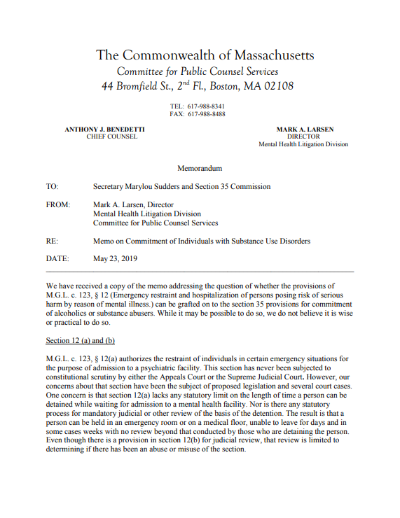
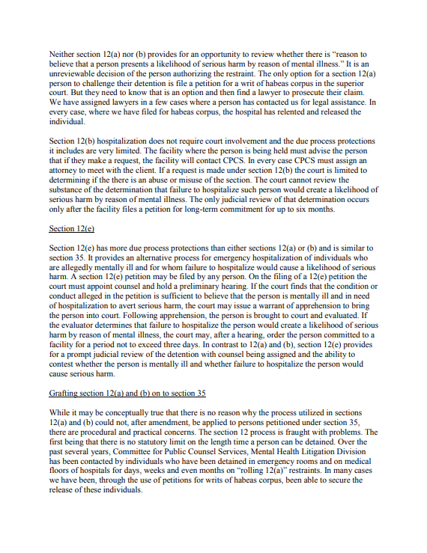
Appendix H – Committee for Public Counsel Services Legal Memorandum
Page 1 Page 2
52

Slide 53
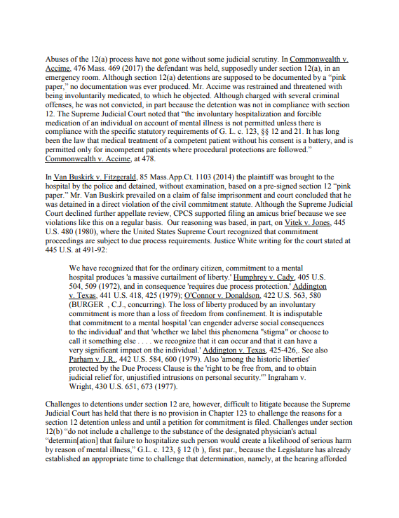
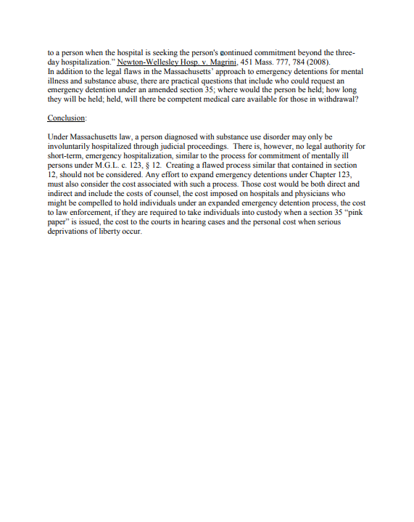
Appendix H – Committee for Public Counsel Services Legal Memorandum (cont.)
Page 3 Page 4
53

Slide 54
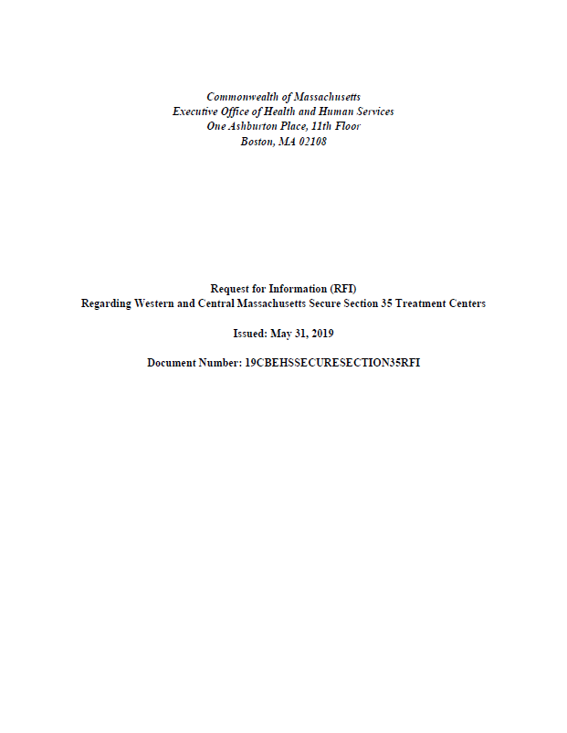
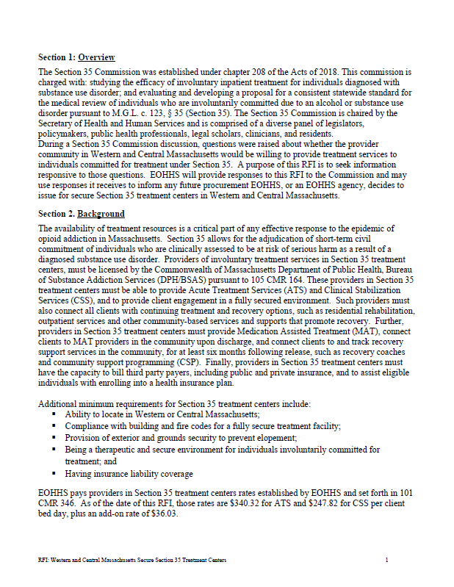
Appendix I – Request for Information and Responses Received by June 20, 2019
Request for Information Request for Information Cover Page 1
54

Slide 55
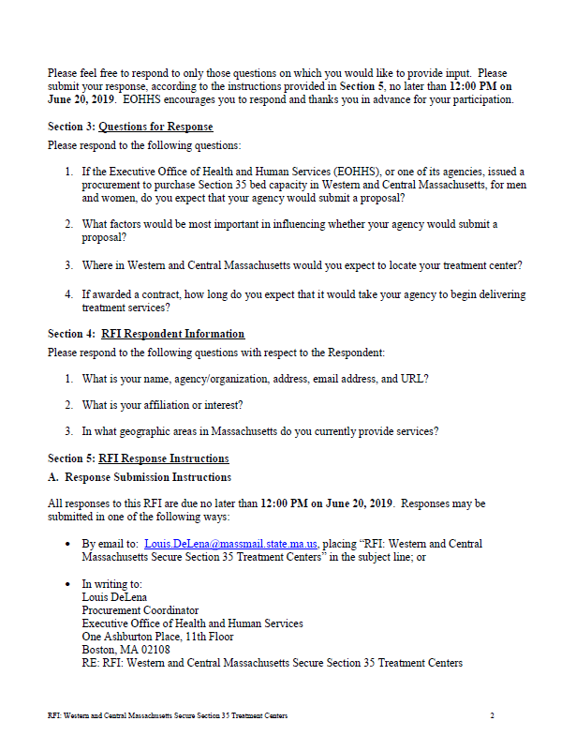
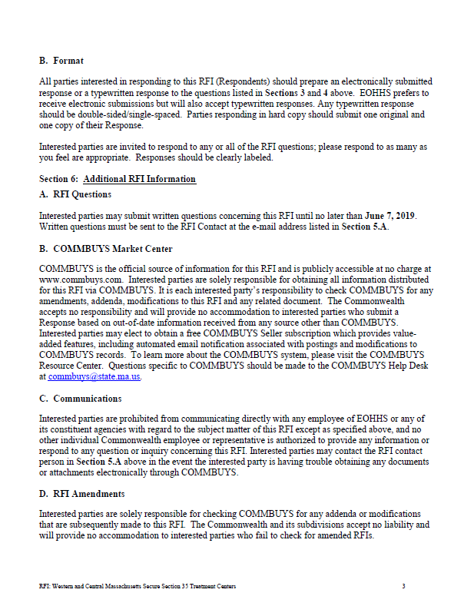
Appendix I – Request for Information and Responses Received by June 20, 2019 (cont.)
Request for Information Request for Information Page 2 Page 3
55

Slide 56
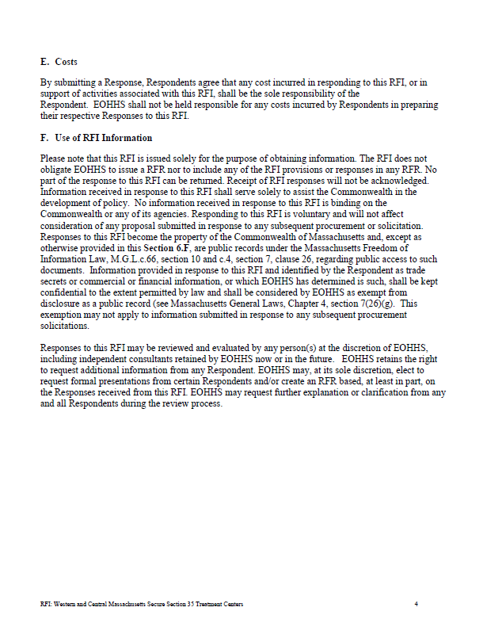
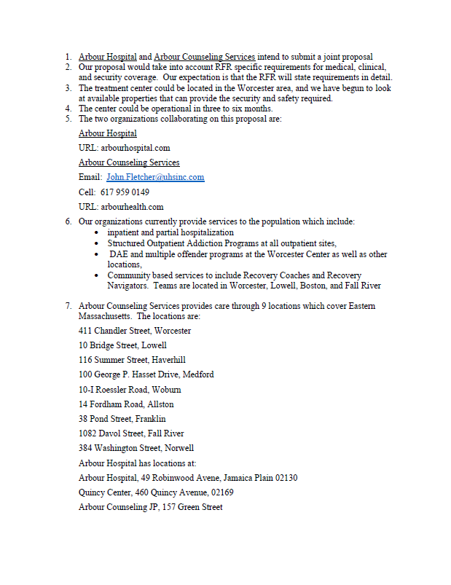
Appendix I – Request for Information and Responses Received by June 20, 2019 (cont.)
Request for Information Arbour Hospital Page 4 Page 1
56

Slide 57
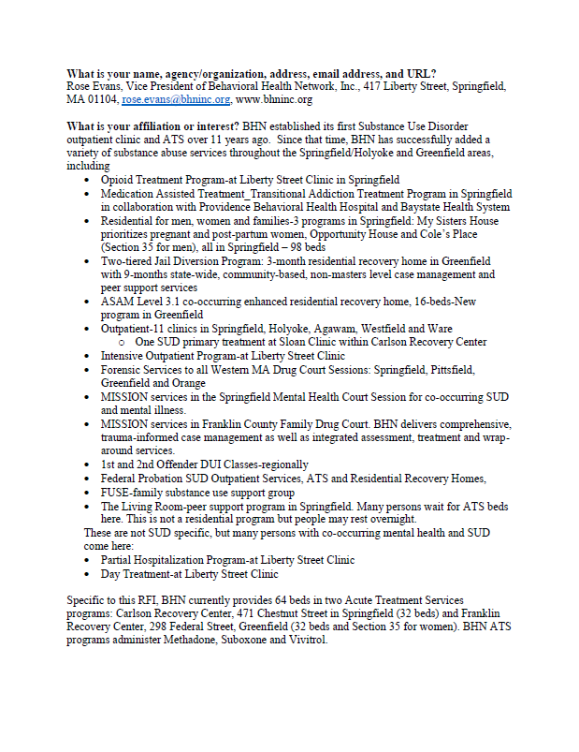
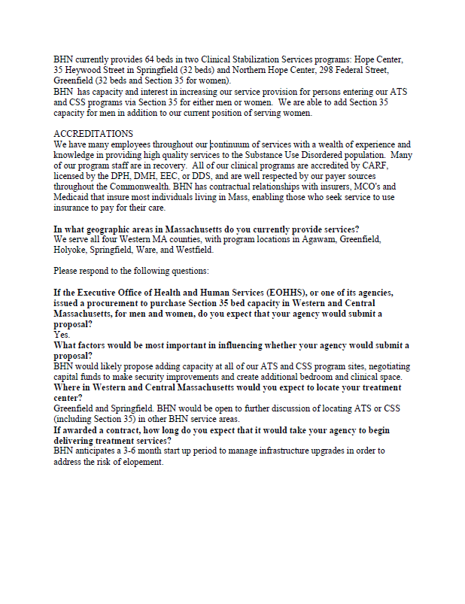
Appendix I – Request for Information and Responses Received by June 20, 2019 (cont.)
Behavioral Health Network Behavioral Health Network Page 1 Page 2
57

Slide 58
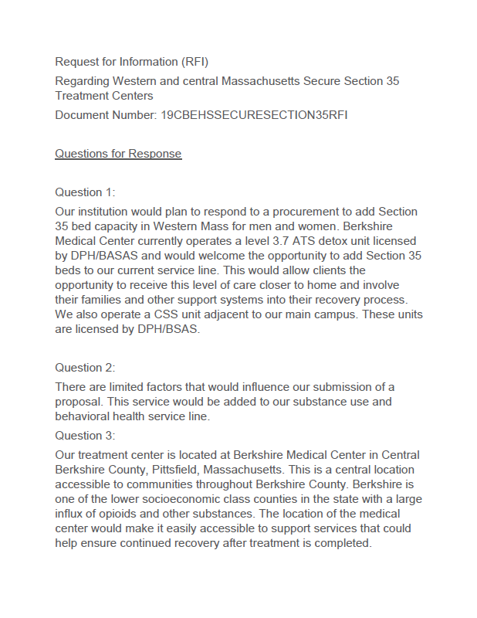
Appendix I – Request for Information and Responses Received by June 20, 2019 (cont.)
Berkshire Medical Center Berkshire Medical Center Page 1 Page 2
58

Slide 59
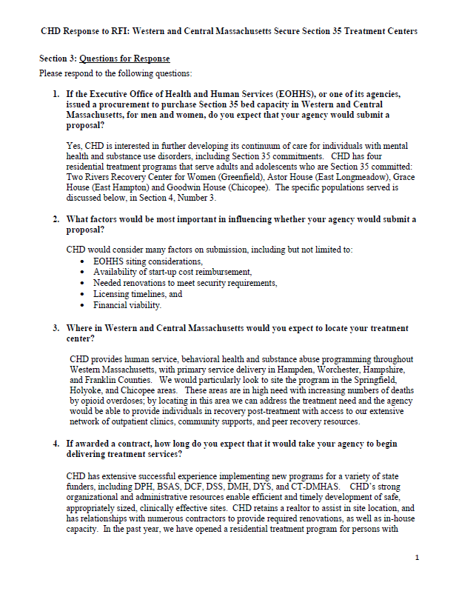
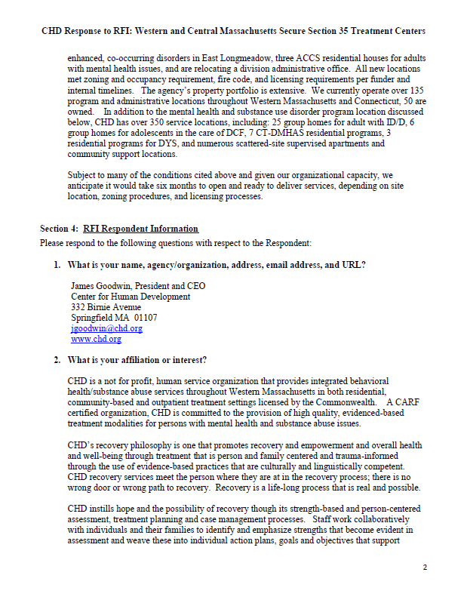
Appendix I – Request for Information and Responses Received by June 20, 2019 (cont.)
Center for Human Development Center for Human Development Page 1 Page 2
59

Slide 60
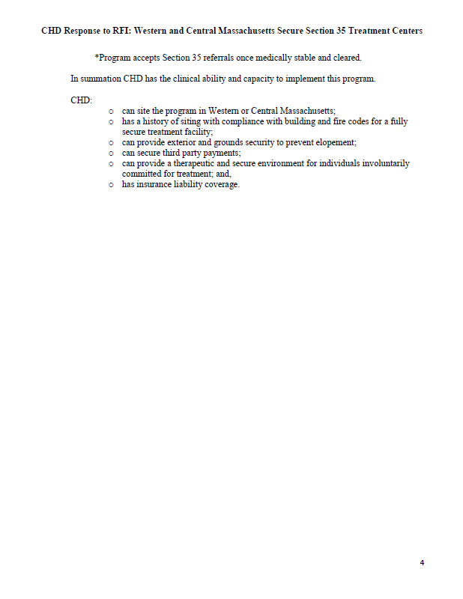
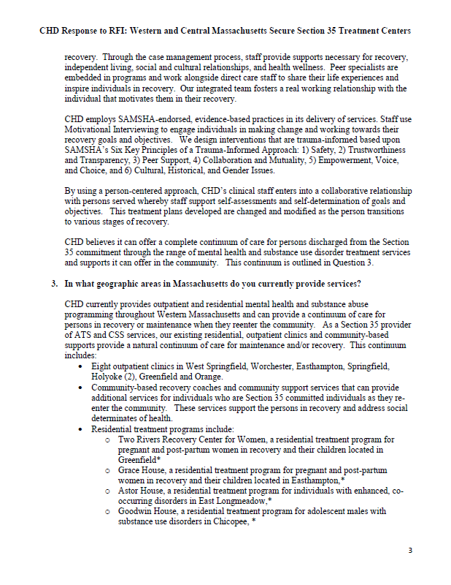
Appendix I – Request for Information and Responses Received by June 20, 2019 (cont.)
Center for Human Development Center for Human Development Page 3 Page 4
60

Slide 61
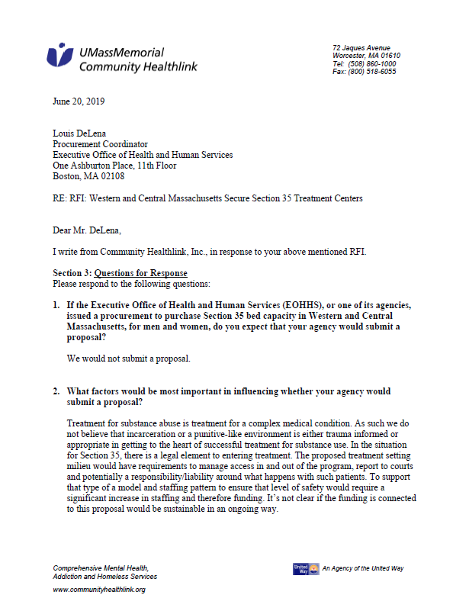
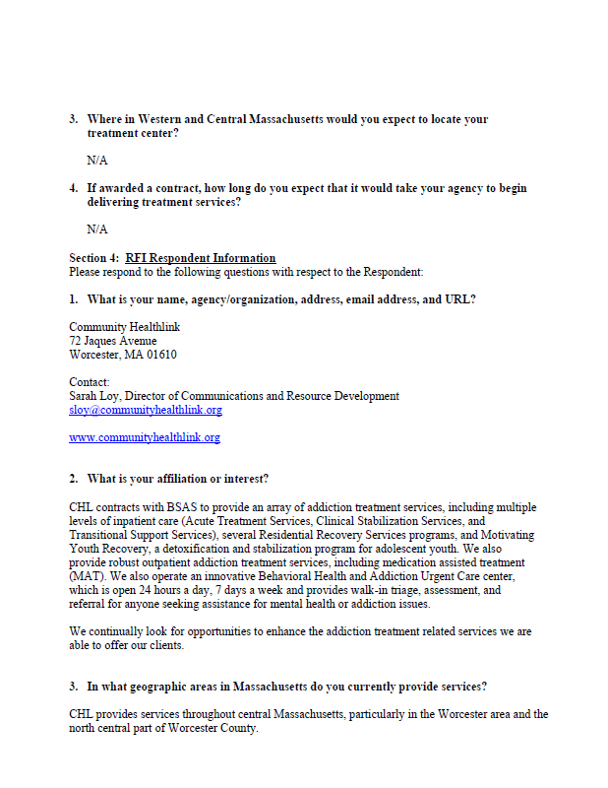
Appendix I – Request for Information and Responses Received by June 20, 2019 (cont.)
Community Healthlink Community Healthlink Page 1 Page 2
61

Slide 62
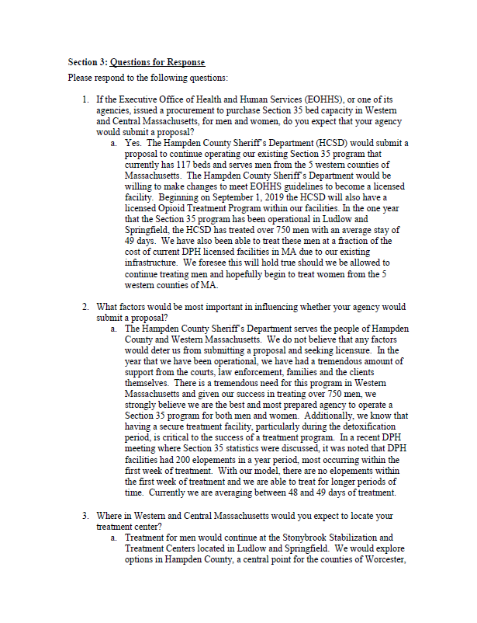
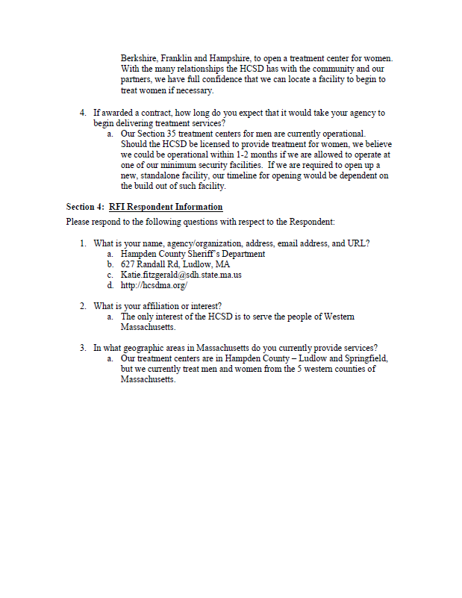
Appendix I – Request for Information and Responses Received by June 20, 2019 (cont.)
Hampden County Sheriff’s Department Hampden County Sheriff’s Department Page 1 Page 2
62

Slide 63
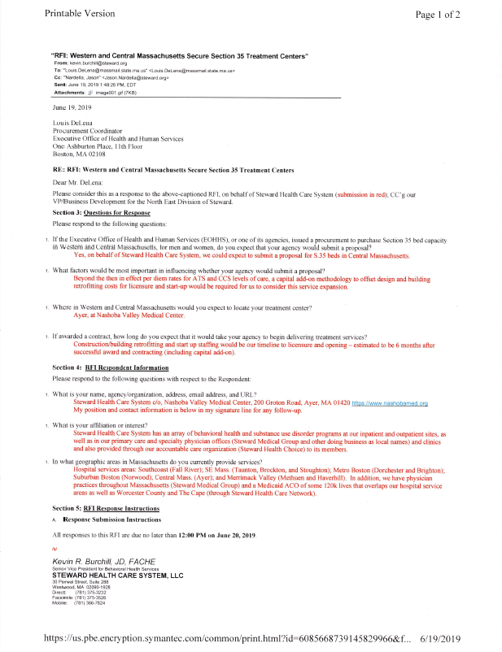
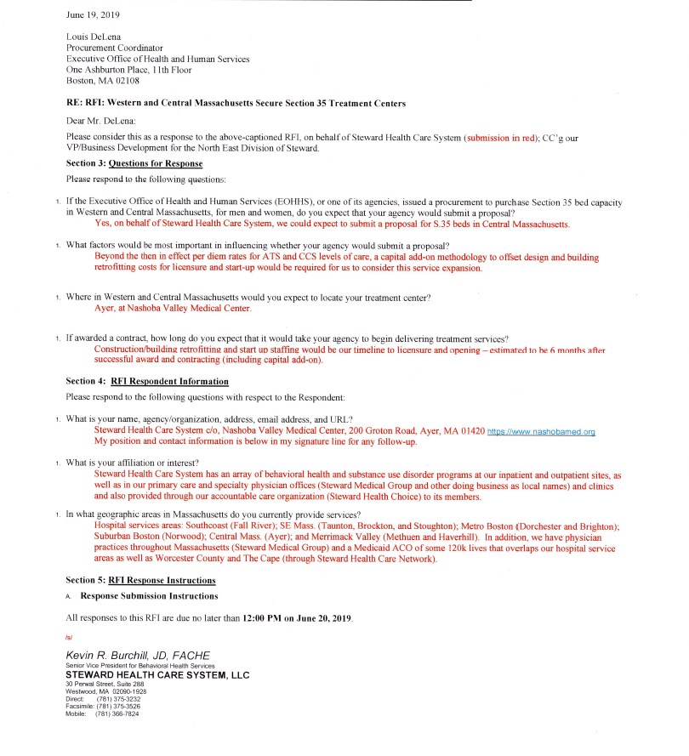
Appendix I – Request for Information and Responses Received by June 20, 2019 (cont.)
Steward Health Care System Page 1
63

Slide 64
Appendix J – Recommendations Considered Out-of-scope and Not Voted on by the Commission on June 27, 2019
Recommendation
A review should be conducted on use of gabapentin, Klonopin, and Adderall combined with Suboxone post treatment.
The Commonwealth should implement “Know Your Rights Campaigns” that would ideally be supported by EOHHS, AGO, and DOI with family and recovery community organizations on how to use the continuum of care and get immediate access to care.
Actions should be taken by the Commonwealth to strengthen parity laws for equal access to care.
The Commonwealth should explore whether the Hampden County model could be scaled up for general population.
The Commonwealth should address the lack of adequate insurance coverage, including inadequate networks, low and wildly disparate rates among plans, insufficient treatment duration as well as workforce that pose barriers to treatment.
64

Slide 65
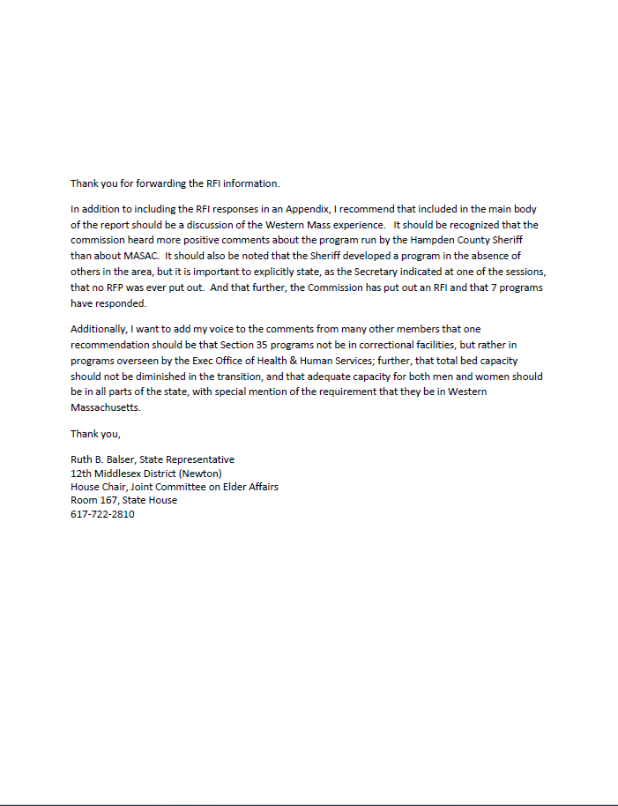
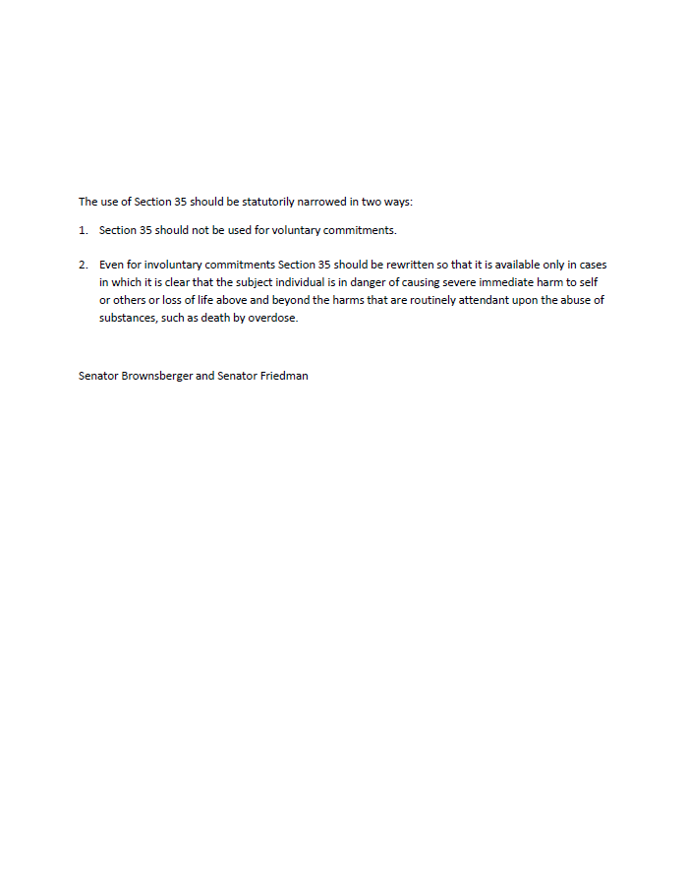
Appendix K – Comments Received from Members on the Draft Report to the Legislature
65

Slide 66
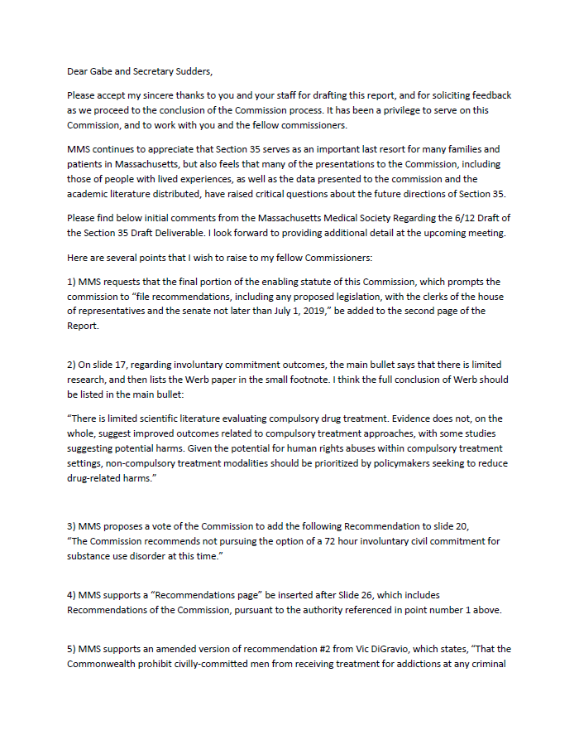
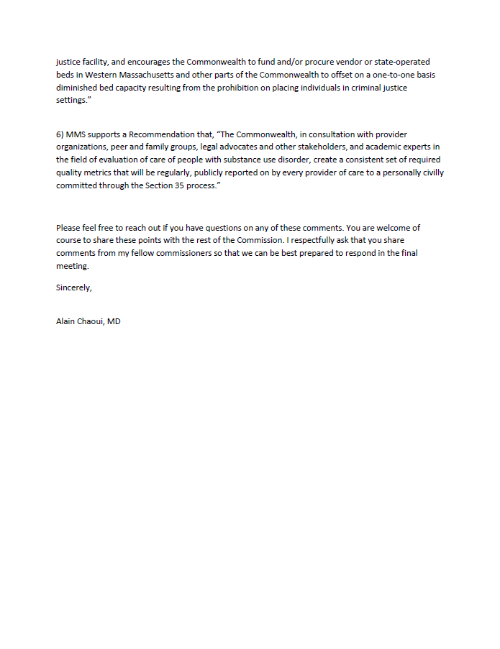
Appendix K – Comments Received from Members on the Draft Report to the Legislature (cont.)
Page 1 Page 2
66

Slide 67
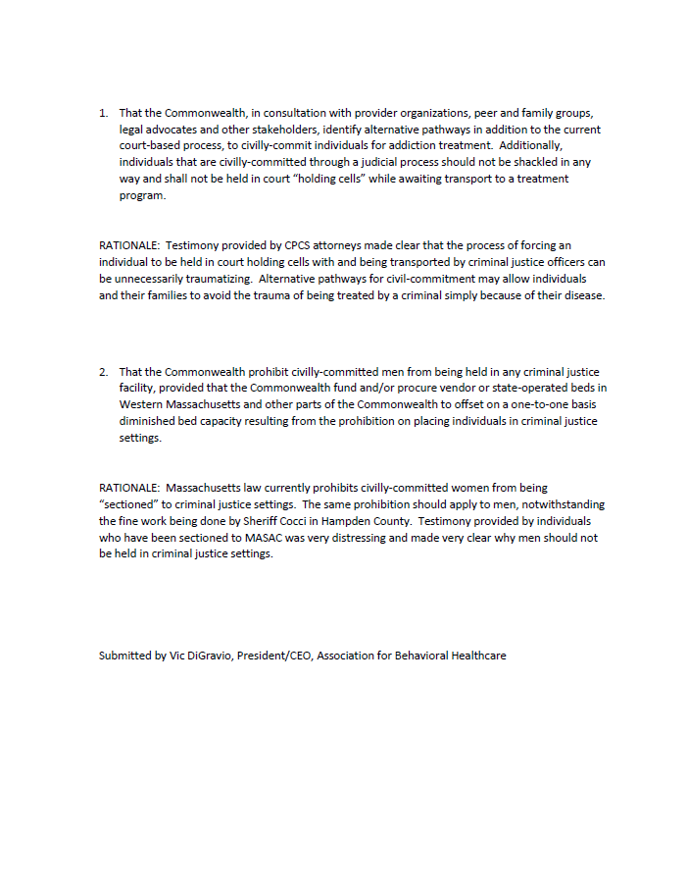
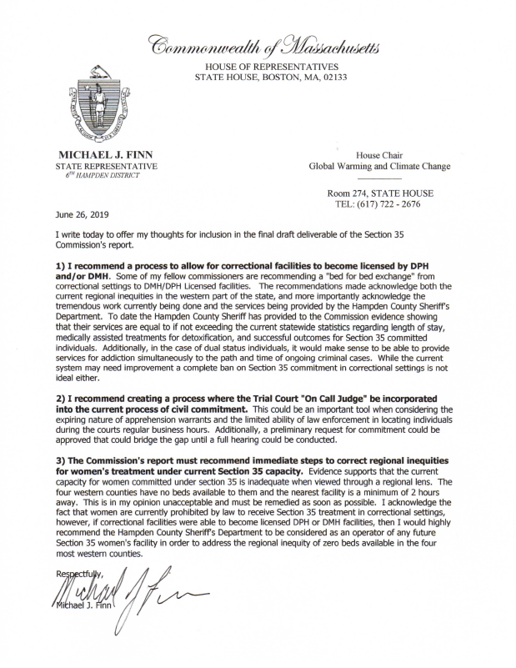
Appendix K – Comments Received from Members on the Draft Report to the Legislature (cont.)
67

Slide 68
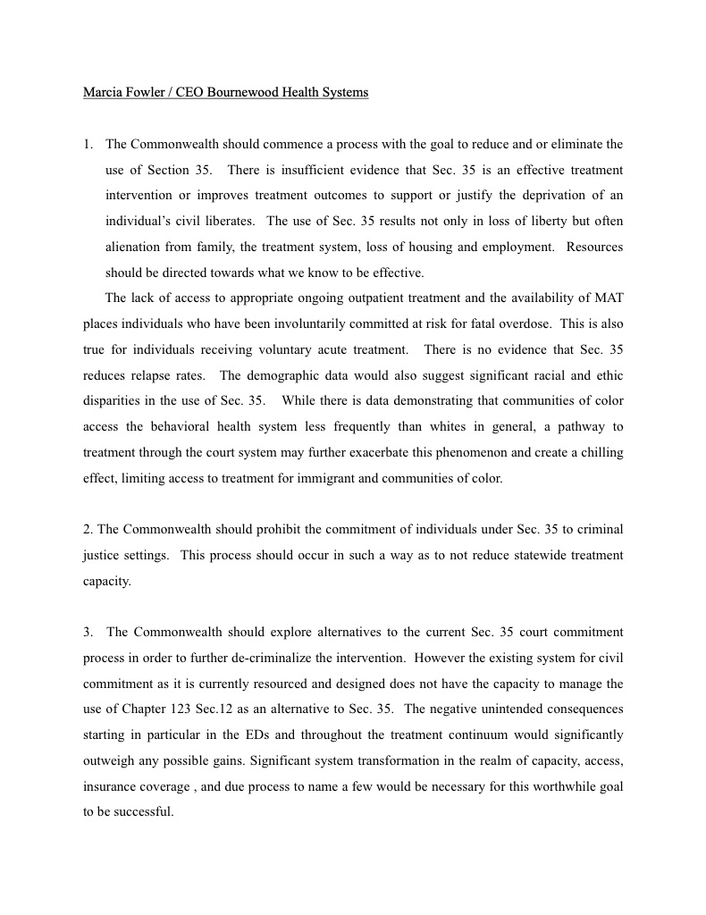
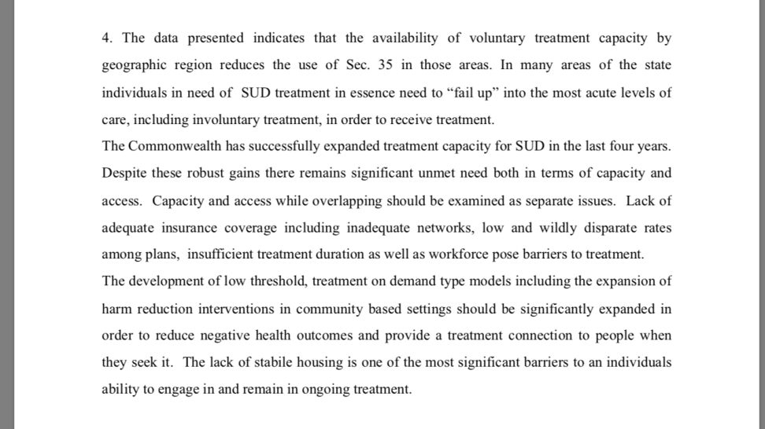
Appendix K – Comments Received from Members on the Draft Report to the Legislature (cont.)
Page 1 Page 2
68

Slide 69
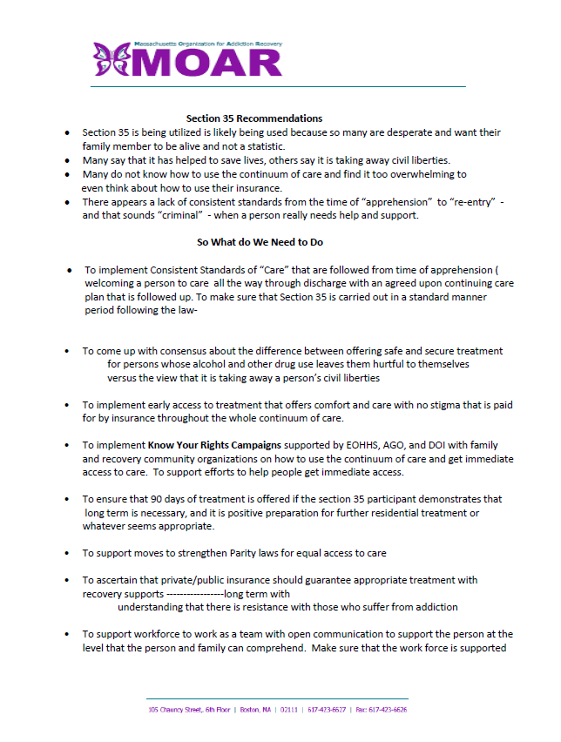
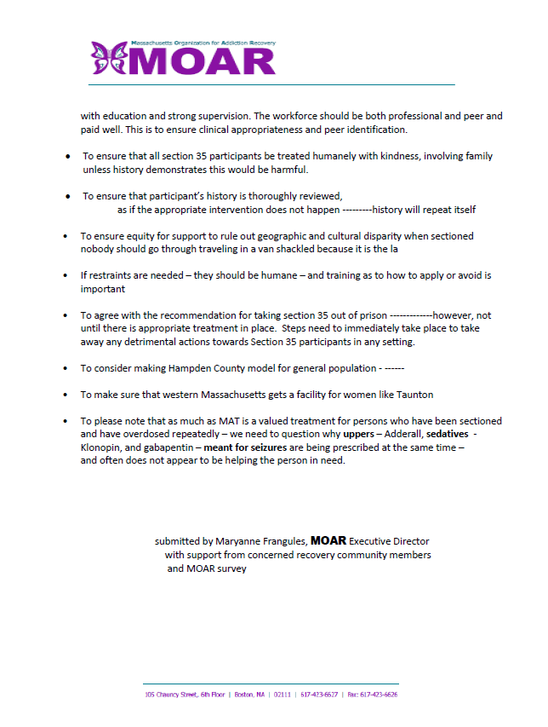
Appendix K – Comments Received from Members on the Draft Report to the Legislature (cont.)
Page 1 Page 2
69

Slide 70
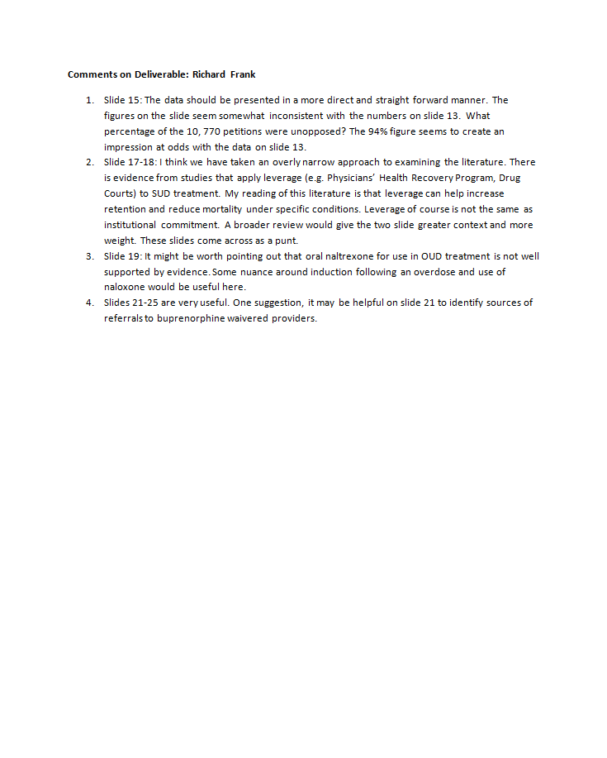
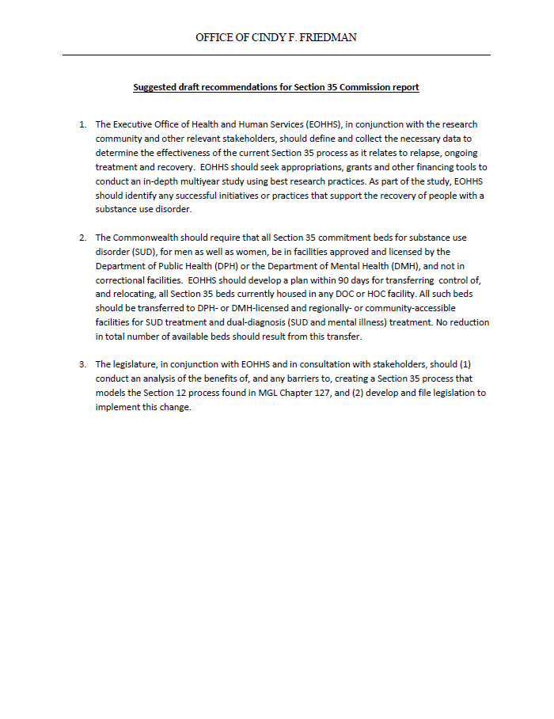
Appendix K – Comments Received from Members on the Draft Report to the Legislature (cont.)
70

Slide 71
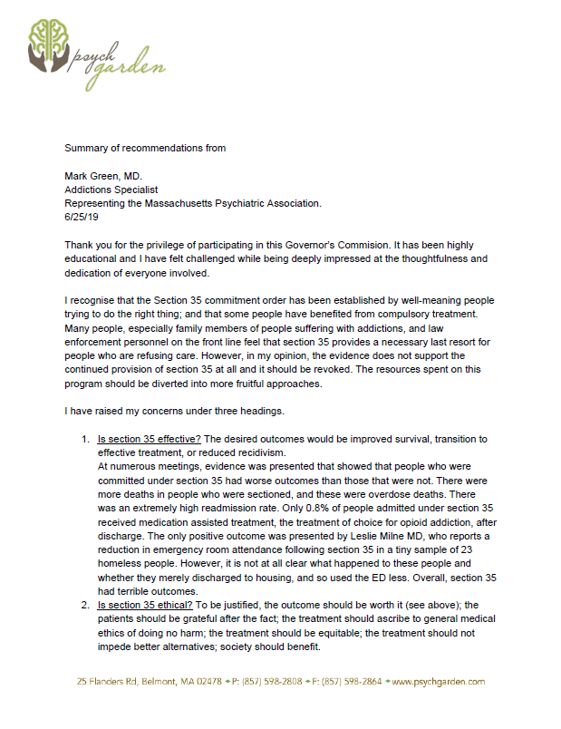
Appendix K – Comments Received from Members on the Draft Report to the Legislature (cont.)
Page 1 Page 2
71

Slide 72
Appendix K – Comments Received from Members on the Draft Report to the Legislature (cont.)
Page 3 Page 1
72

Slide 73
Appendix K – Comments Received from Members on the Draft Report to the Legislature (cont.)
Page 2 Page 3
73

Slide 74
Appendix K – Comments Received from Members on the Draft Report to the Legislature (cont.)
Page 4 Page 5
74

Slide 75
Appendix K – Comments Received from Members on the Draft Report to the Legislature (cont.)
Page 6
75

Slide 76
Appendix K – Comments Received from Members on the Draft Report to the Legislature (cont.)
Page 1 Page 2
76

Slide 77
Appendix K – Comments Received from Members on the Draft Report to the Legislature (cont.)
Page 3 Page 4
77

Slide 78
Appendix K – Comments Received from Members on the Draft Report to the Legislature (cont.)
Page 5 Page 1
78

Slide 79
Appendix K – Comments Received from Members on the Draft Report to the Legislature (cont.)
Page 2 Page 3
79

Slide 80
Appendix K – Comments Received from Members on the Draft Report to the Legislature (cont.)
80

Slide 81
Appendix K – Comments Received from Members on the Draft Report to the Legislature (cont.)
Page 1
81

Slide 82
Appendix K – Comments Received from Members on the Draft Report to the Legislature (cont.)
Page 2 Page 3
82

Slide 83
Appendix K – Comments Received from Members on the Draft Report to the Legislature (cont.)
Page 4 Page 1
83

Slide 84
Appendix K – Comments Received from Members on the Draft Report to the Legislature (cont.)
Page 2 Page 3
84

Slide 85
Appendix K – Comments Received from Members on the Draft Report to the Legislature (cont.)
Page 4 Page 1
85

Slide 86
Appendix K – Comments Received from Members on the Draft Report to the Legislature (cont.)
Page 2
86

Slide 87
Appendix K – Comments Received from Members on the Draft Report to the Legislature (cont.)
87

