Slide 1
EPIA External Report
September 2024
Does not include referrals received as part of BHTRP Pilot

Slide 2
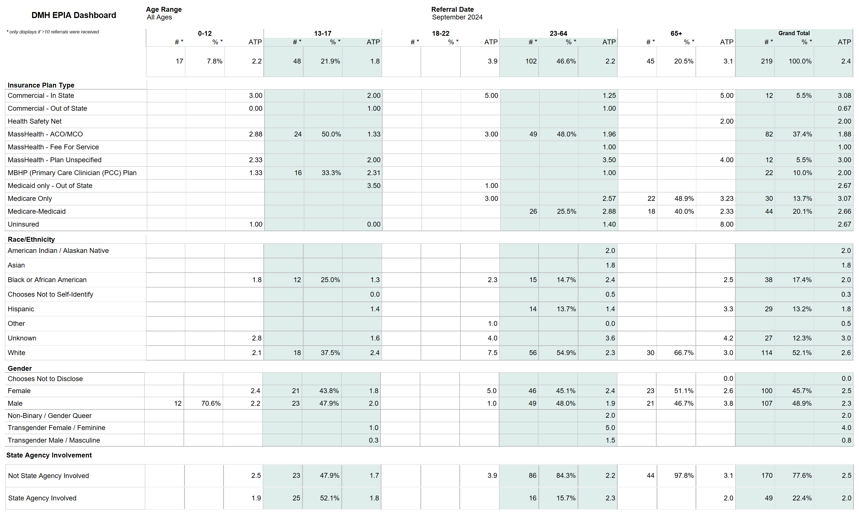

Slide 3
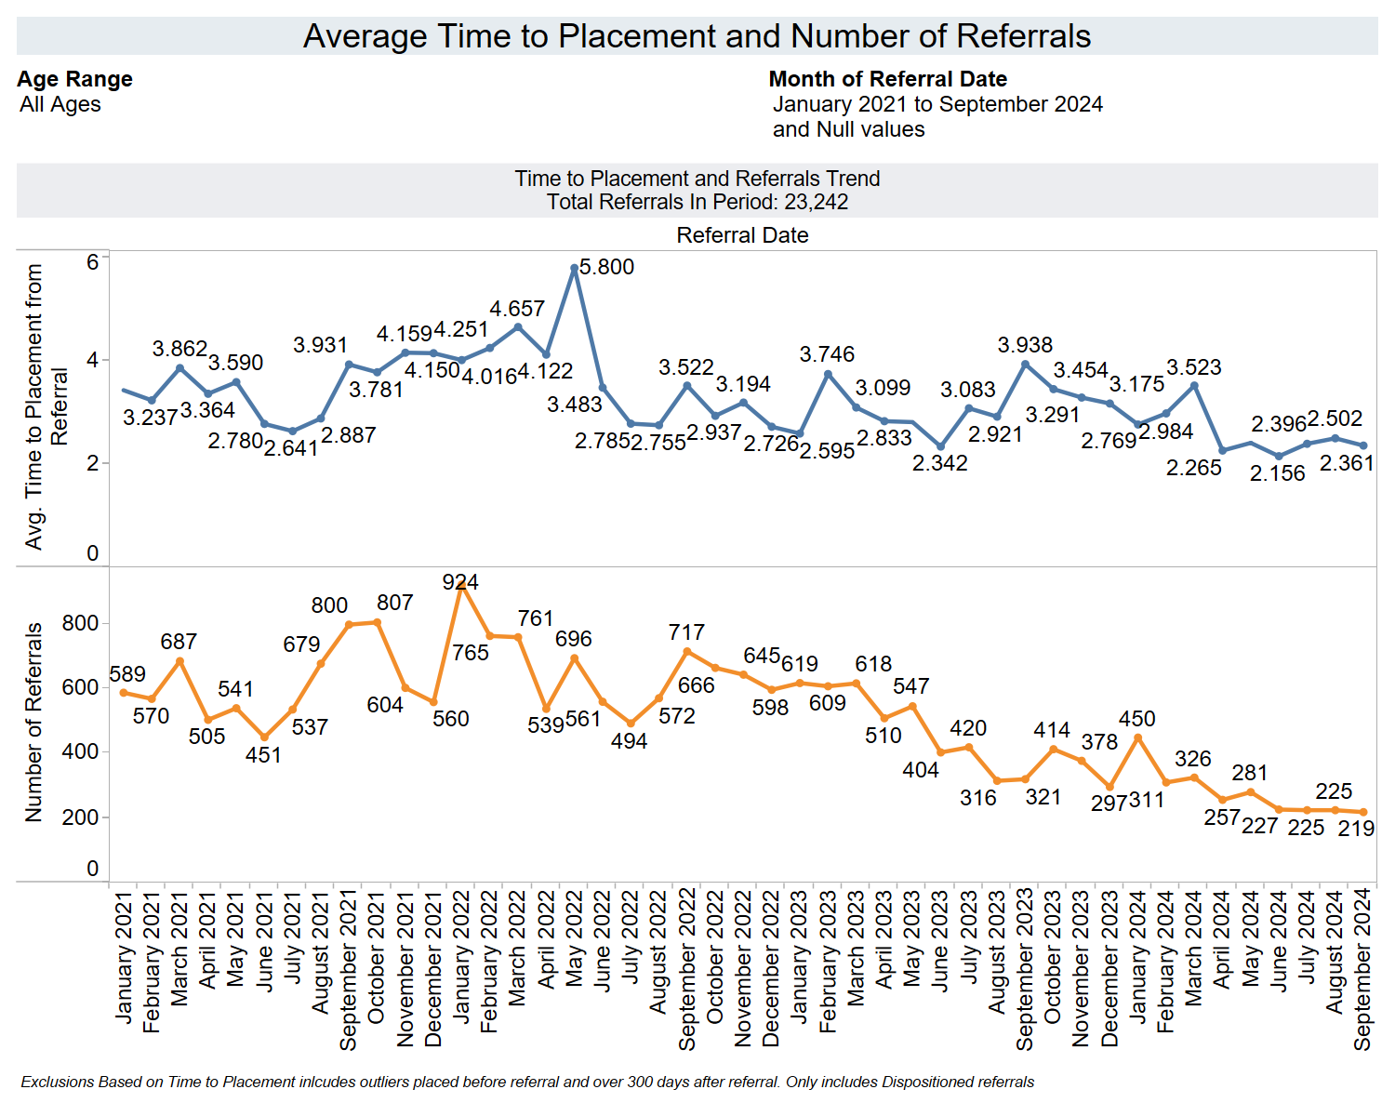

Slide 4
