Slide 1

Innovation and Opportunity
Leading By Example Council Meeting
September 15th, 2026
Presented by
09/15/2026
MA Department of Energy Resources, Leading By Example Division

Slide 2
Agenda
TIME | TOPIC
10:00AM – 10:10AM | Introduction & Agenda
10:10AM – 10:20AM | LBE Grants: Upcoming changes to PONs
10:20AM – 10:30AM | Electric Utility Vehicles Speaker: Steve Brown, C2 Vehicles
10:30AM – 10:40AM | Fast-charging Battery Platforms Speaker: Joshua Neurath, STIHL
10:40AM – 10:50AM | Autonomous Mowers Speaker: Steve Germaine, MTE Equipment Solutions
10:50AM – 11:00AM | Ride-On/Stand-On Mowers Speaker: Lou Secki, Turf Products
11:00AM – 11:20AM | Mass DEP’s Wastewater Energy Recovery (WWER) Grant Pilot Speaker: Danah Tench, MassDEP
11:20AM – 11:30AM | LBE Updates & Reminders
11:30AM – 11:45AM | Renewable Diesel Guidance for State Entities: Policy Overview
11:50AM – 12:00PM | Q&A
12:00PM | Closing

Slide 3

Before we get started…
Place your guesses in the chat!
Which of the following is NOT a holiday celebrated in September?
International Talk Like A Pirate Day
National Punctuation Day
National Middle Name Pride Day
Kids Take Over The Kitchen Day

Slide 4
LBE Grants: Updated PONs

Slide 5

Current LBE Grant Programs
Solar-Decarb.
Incentives for solar PV, decarb. projects, and associated EVSE & storage
Equipment Decarb.
Partial cost coverage for electrifying state-owned equipment
Fleet EV Charging
Up to 100% cost coverage for EVSE at state facilities & approved domicile locations
Feasibility Studies
Solar & Decarb. Repair
Funds examination of sustainability technologies and strategies
Cost coverage for repair or replacement of critical components for existing systems
Updated PONs!

Slide 6
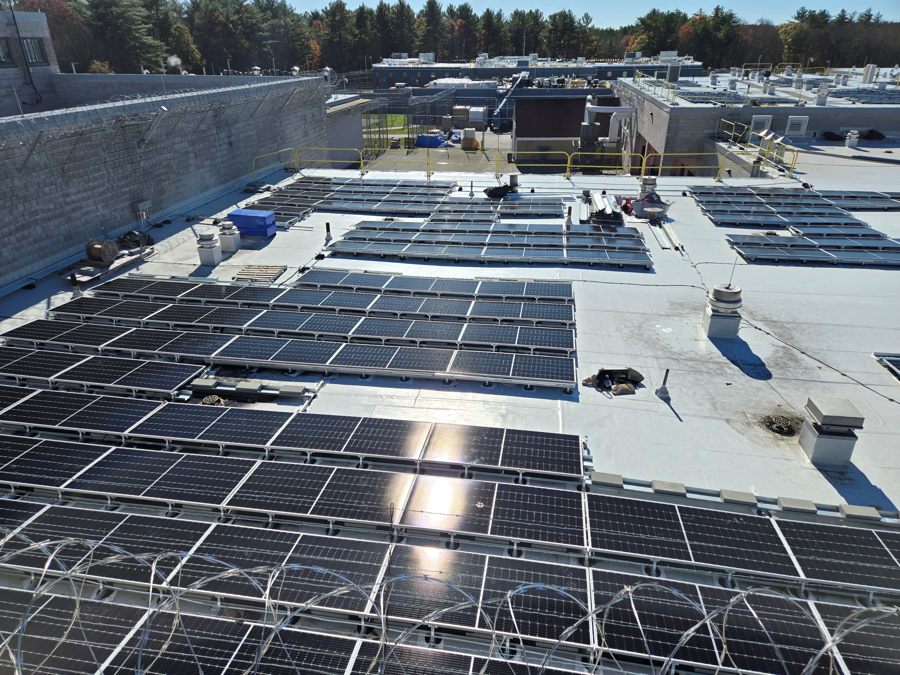
Solar Decarbonization Grant
Updated PON coming soon
Key Changes
  Removal of embodied carbon offset requirement
  Inclusion of Embodied Carbon Adders for:
    Environmental Product Declarations
    Use of domestic steel and/or
    Use of EPEAT Certified solar panels
  PPA rate limited to 60% reduction from basic service rate if also receiving adder(s)
  Battery storage incentive changes:
    If part of solar PPA: incentive amount sufficient to maintain solar PPA rate (max $1,000/kWh)
    If not part of PPA or state-owned: $750/kWh

Slide 7

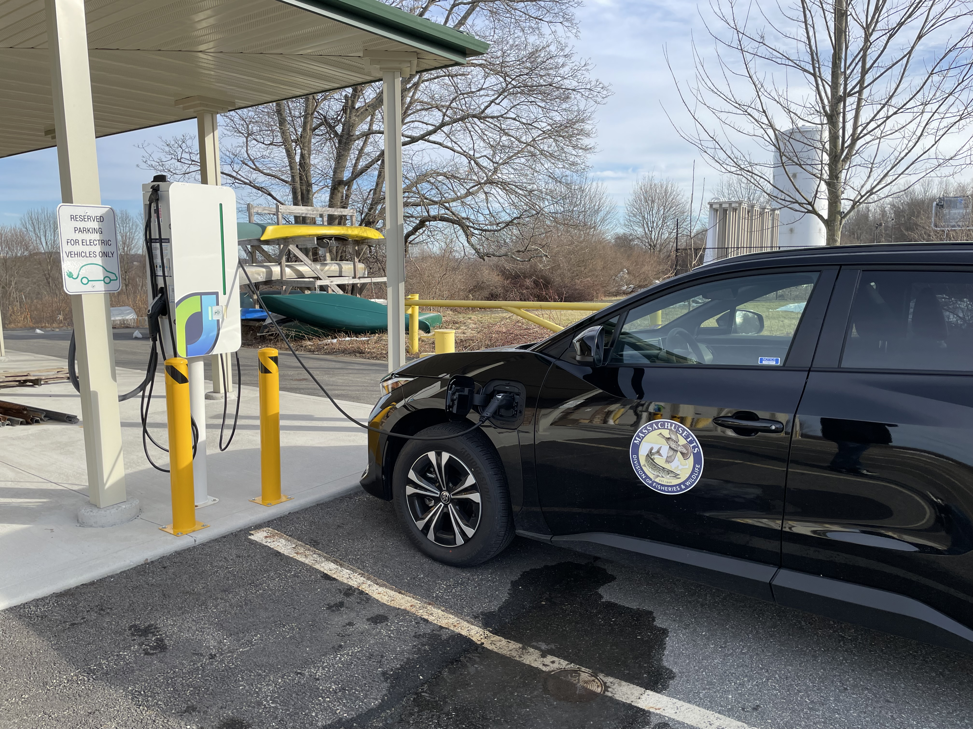
Fleet EV Charging Grant 4.0
New PON released; no major changes
Eligible Sites | Available Funding
State-owned sites | $500,000
Domicile locations | $127,390
Maximum grant per entity: $300,000
Mobile charging no longer eligible
For projects at state-owned sites, work must be complete by June 30, 2027

Slide 8




Equipment Decarbonization Grant
Grant Overview
The LBE Equipment Decarbonization Grant offers funding for four project categories:
Product Categories
Space Heating*
Water Heating*
Commercial Kitchen Equipment
Facilities Maintenance, Operations, and/or Landscaping Equipment
Eligible Applicants: Executive branch agencies, quasi-public authorities, and public institutions of higher education
Total Funding: $2,450,000
Deadline: June 30, 2027 or until funds run out
Contact: Morgan Bowler (Morgan.Bowler@mass.gov)
* Need to adhere to BABA Requirements

Slide 9

Proposed Changes
Updated PON coming soon
Proposed Changes
  Removal of funding cap per site address
  Increase funding percentages to 75% base grant funding for every category
  Replacement of Climate and Economic Justice Adder with Gateway Municipality adder
    Additional 25% of total project cost in DOER funding for a maximum of 100%
  We have clarified window unit heat pumps are eligible equipment costs and don’t have to meet BABA
  Construction related projects less than $250k can receive an expedited BABA waiver

Slide 10

Disclaimer
DOER does not endorse any such products or services that participants are made aware of through DOER’s Leading by Example Division (LBE), LBE Staff, LBE Council Meetings, or any mailing list.
Products and services presented and discussed by LBE are provided for information purposes only. DOER exclaims any express or implied warranty, warranty of fitness for a particular purpose or merchantability and makes no representations as to the quality or value of any such product or service.
DOER further exclaims any and all liability relative to any such product or service and advises that any party interested in any such product or service independently review and due their own due diligence in order to make an informed decision about any such product or service.
Notes:
This is a selection of vendors, not inclusive of vendors or their products

Slide 11
Lithium Utility Vehicles
Stephen Brown – C2 Vehicles
508-317-5548
sbrown@c2vehicles.com

Slide 12
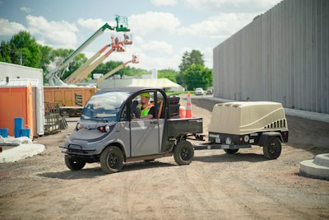
Lithium Electric Vehicles Can Replace Gas Vehicles and Improve Operational Efficiency (1)
Lower Total Cost – Lithium models should achieve an est. 60%-70% lifetime cost savings over gas
Lithium = Zero Maintenance – no oil changes, no watering batteries
Fast Charging – Lithium charges much faster, can opportunity charge whenever for short periods
Improved Battery Performance

Slide 13
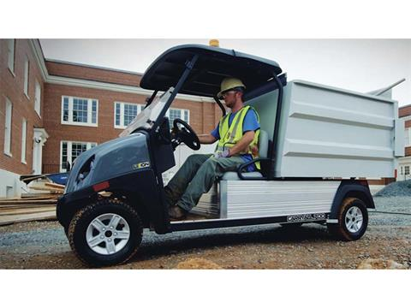
Lithium Electric Vehicles Can Replace Gas Vehicles and Improve Operational Efficiency (2)
Zero Emissions
Towing & Payload – Haul 1,000+ pounds tow up to 2,000 pounds
Much Quiter operation
Improved Mile Range – 30-80 miles per charge
Lithium batteries are lasting much longer than previously thought – 12+ Years

Slide 14
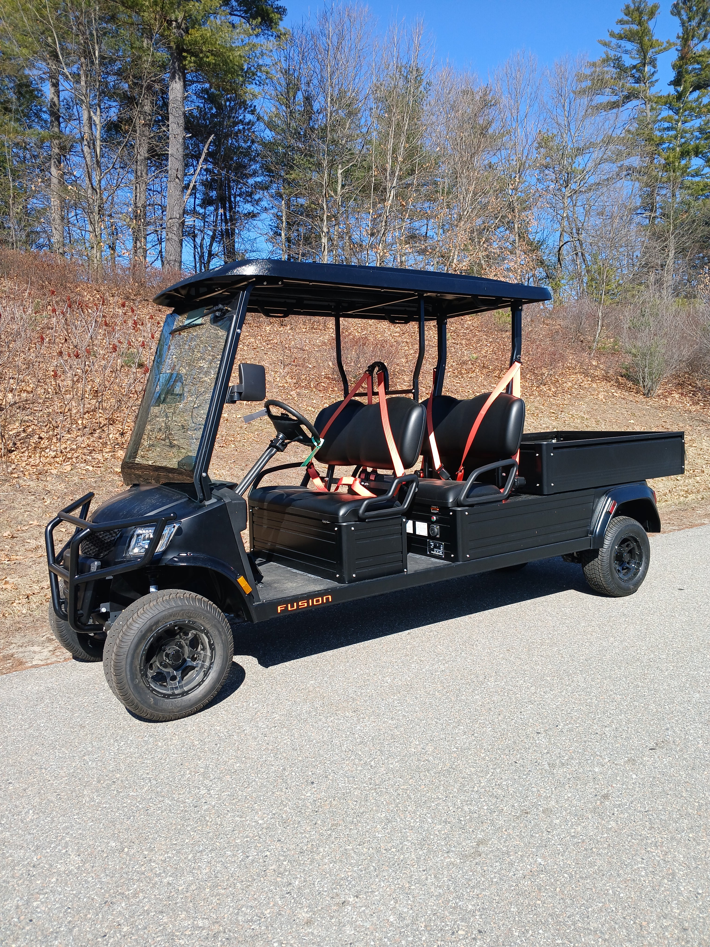
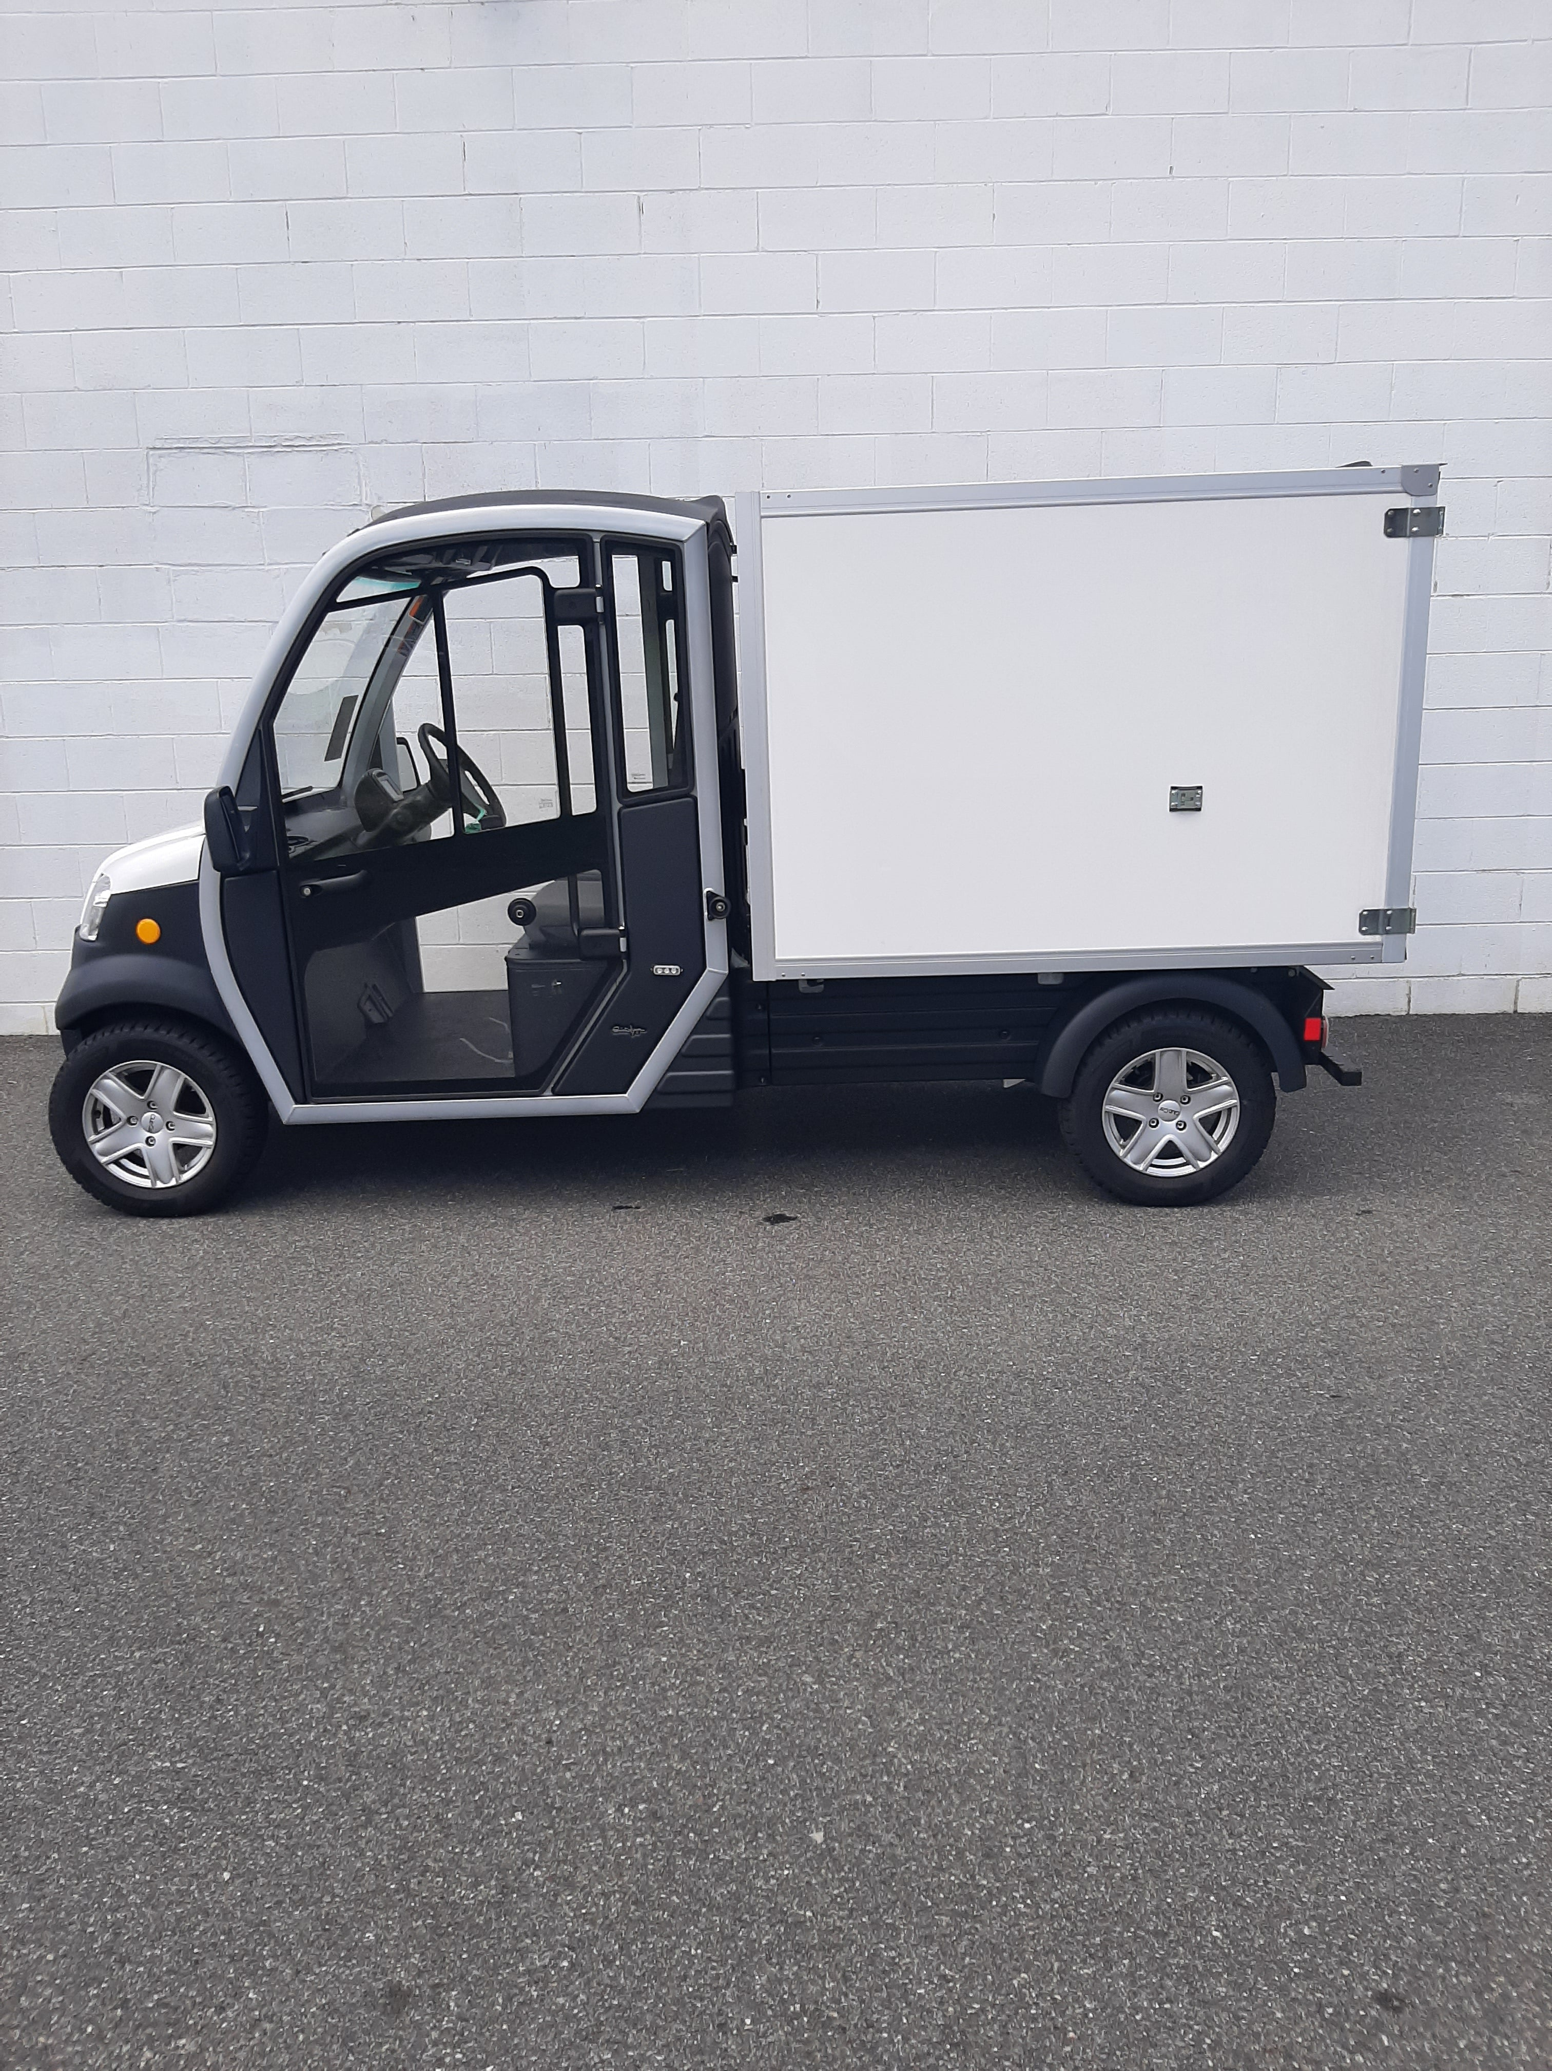
Low Speed Street Legal Vehicles
Utility Vehicles are now available as LSVs
Eliminate the need for a truck for small trips around town
Enhanced safety features
Work on roads
Ability to register the vehicle
A vehicle for every use case

Slide 15

Environmental Impact of Replacing 1 Gas Utility Vehicle With 1 Lithium Utility Vehicle
Will reduce your operational greenhouse gas emissions by roughly 65% to 85%
Switching will avoid emitting roughly 1 to 2.5 metric tons of CO₂ per year

Slide 16

Leading by Example Equipment Decarbonization Grant Program
For utility vehicles, this grant will provide up to 55% of the total cost of equipment after accounting for other available incentives.
Opportunity to replace aging gas & diesel fleets
The time is now

Slide 17


Autonomous Mowing Solutions

Slide 18

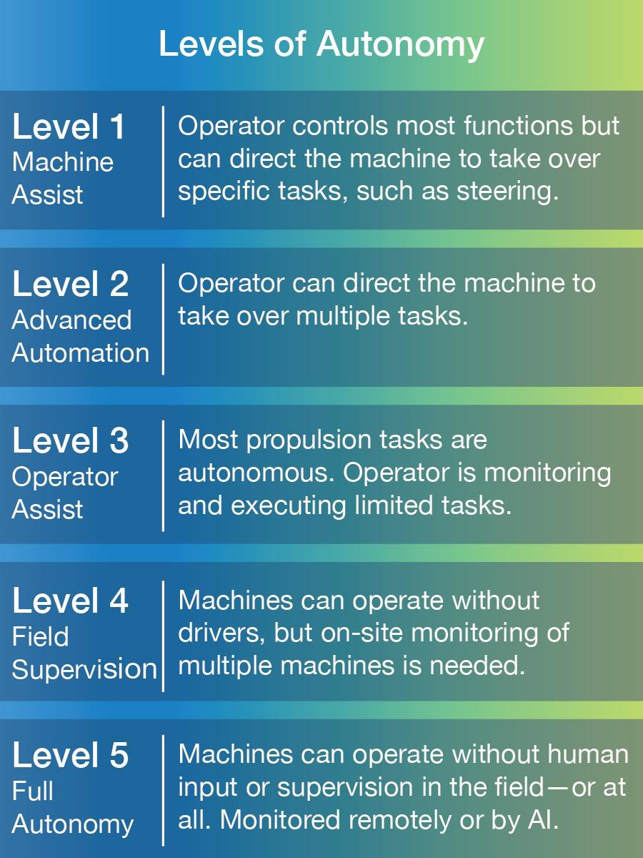

Levels of Autonomy

Slide 19

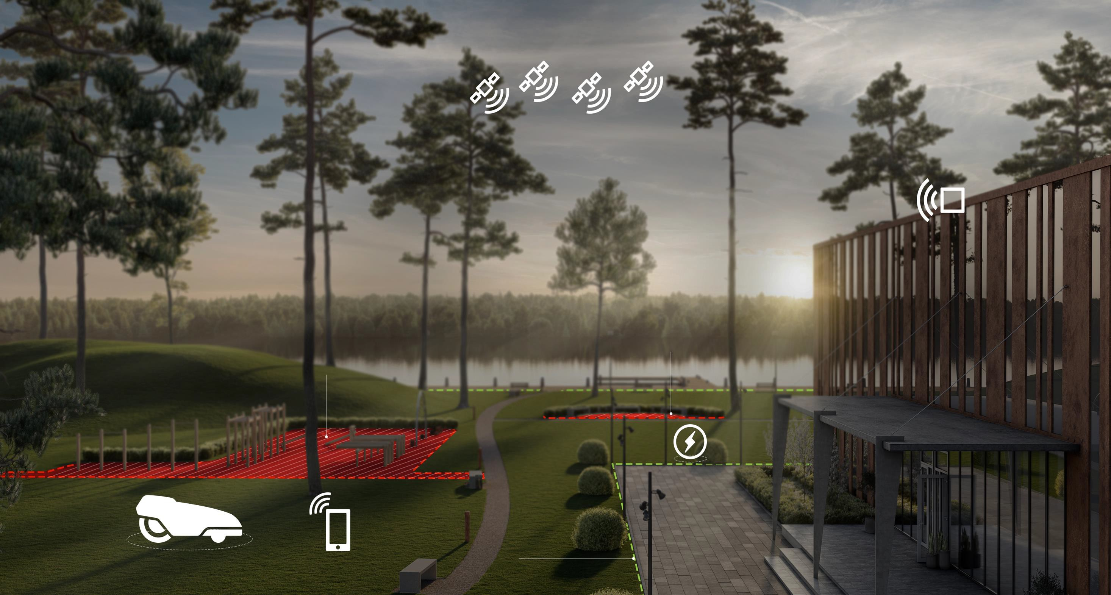
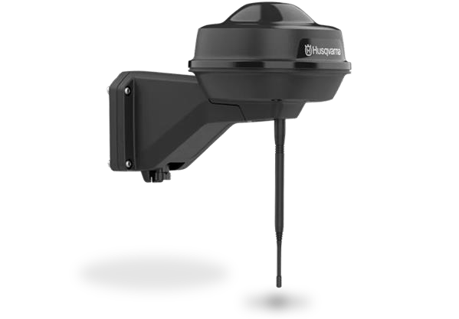





How does the Technology Work
HUSQVARNA PROFESSIONAL AUTONOMOUS TURF CARE SOLUTIONS – HOW IT WORKS
Navigation satellites
Reference Stations
RTK Technology has been around for 40 Years in Ag
Control Your Network, No Subscriptions
Cellular Network
Less Stations, Further Coverage
Need to have good Cell Service on Course
Stay-out zone
Stay-out zone
Charging station
Virtual boundary
Mobile app

Slide 20
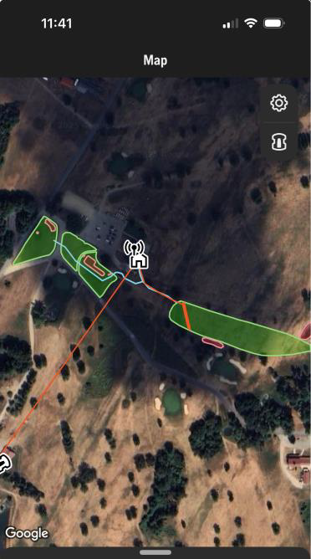
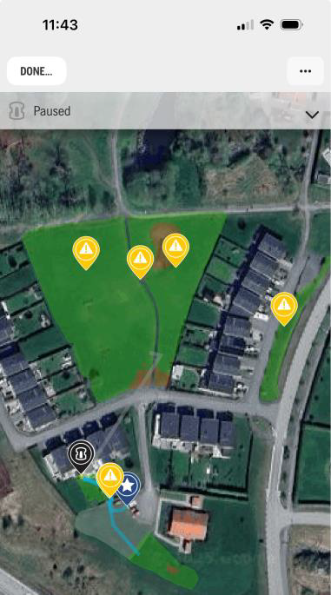
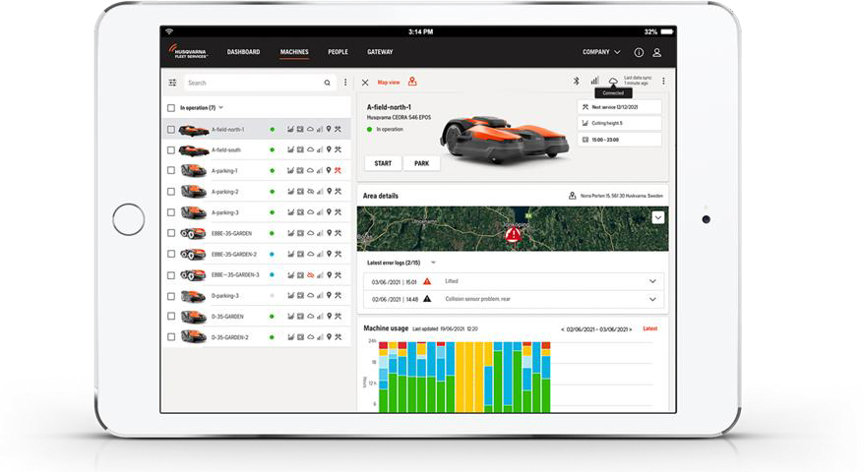
How it works
To deploy the Mowers
Phone Apps
Web Based Fleet Management Software
To Map
App on Phone
On Board Mapping
Overview
User directs mowers to do various tasks
Pins are dropped or lines created and saved to the Cloud and/or to the mower
User has flexibility to make their own changes

Slide 21

Battery and Autonomuos Products
Presented by Lou Secki
Territory Manager
Turf Products Corporation

Slide 22


Z Master Revolution Series Mowers

Slide 23

Toro Z Master Revolution Series Mowers
Revolution Series Z Master is built on the same proven Z Master chassis and TURBO FORCE® deck
Also available in the Toro Granstand Line
Available in 48”, 52” and 60” cutting Widths, as well as a Rear Discharge and MyRide versions of the Z Master

Slide 24
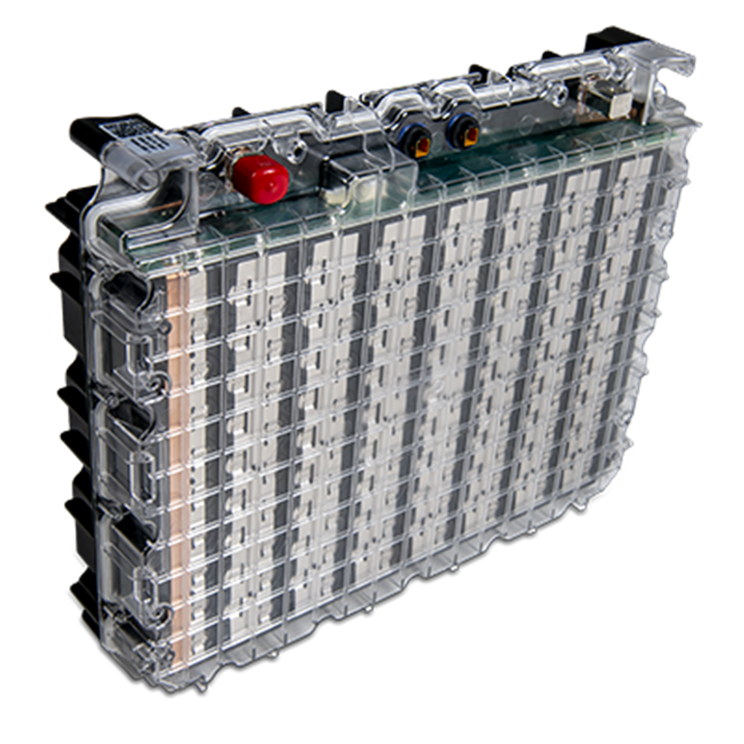
Toro Hyper Cell Battery Technology
23.4kWh Hypercell battery
Contains 10 individual replaceable cells
4.5 – 7+ hours of run time
Charge Time - 8 hours

Slide 25
Proline Autonomous
Product Overview

Slide 26
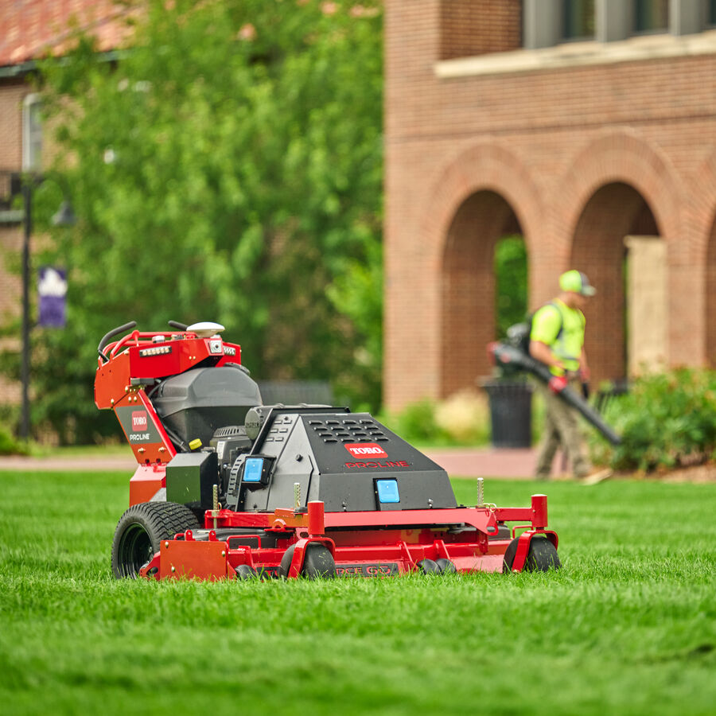
Toro Proline AMI Mower
Existing Proline Platform
  Familiar HDX deck and Grandstand like controls
Autonomous Features
  Wide area cutting while crew is on site
  Not a “mow-bot” that you leave overnight
Can be driven manually
  Used to map out perimeter for autonomous
  Easy to load and trim with

Slide 27
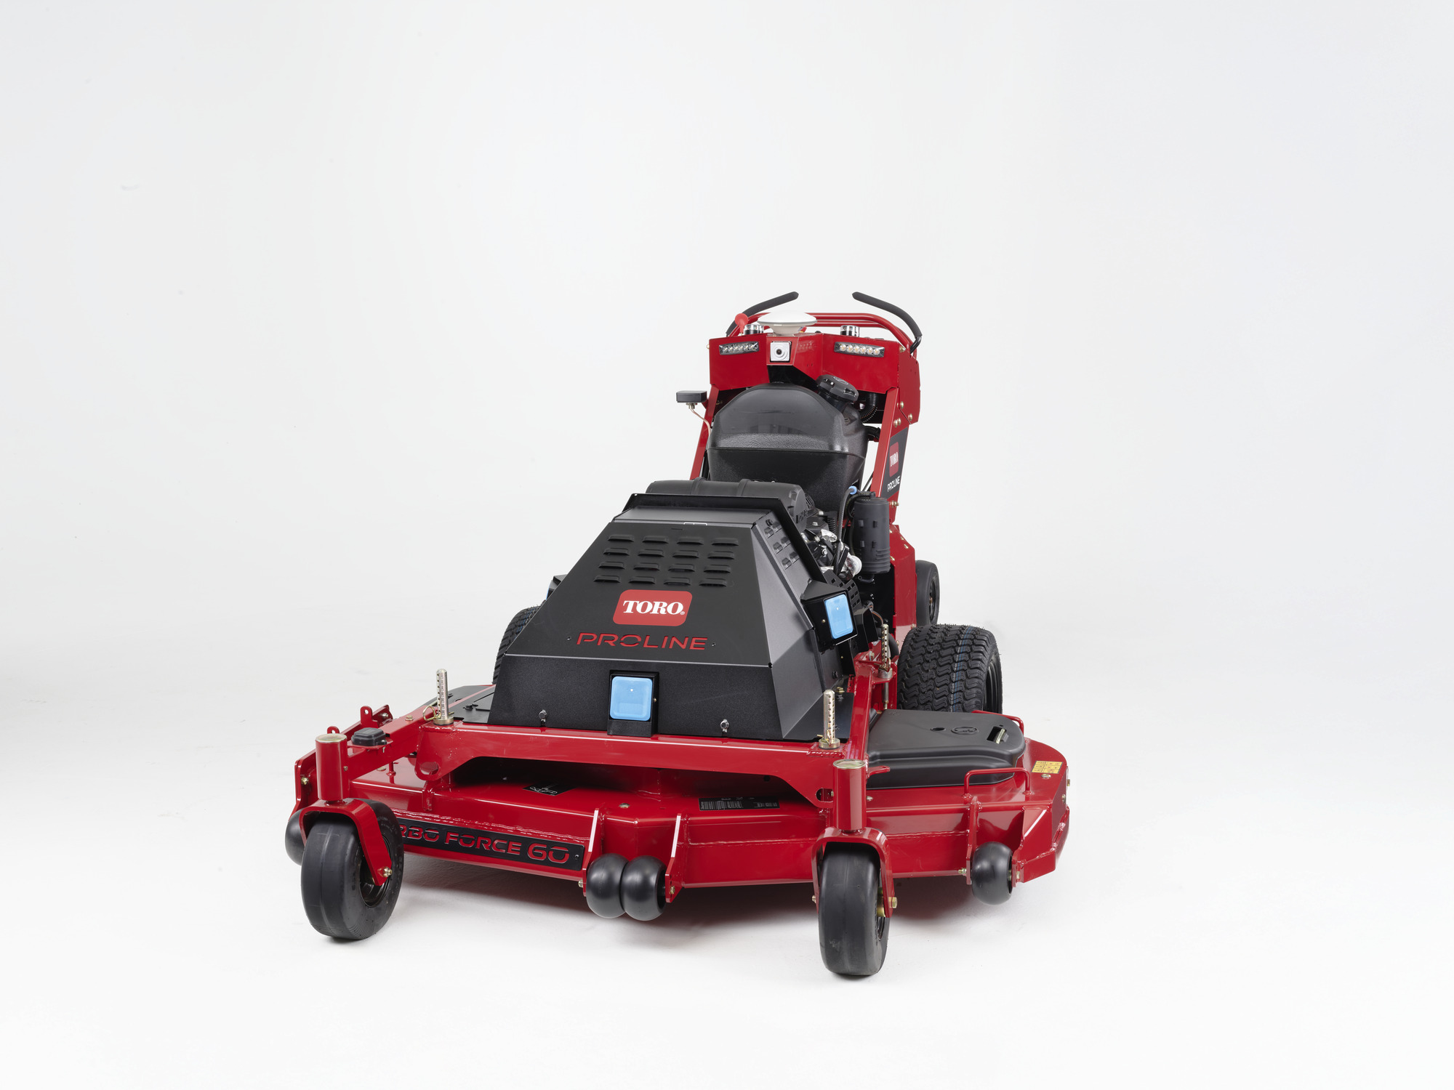
Technology Basics
RTK
GNSS Satellite
SERVICES
OSS
(Internal at Toro)
Mobile
App
Robot Operations
Center (ROC)
Software Updates
Path Plan
Corrections Data (RTK)
User Accounts
LTE cellular data connect
Boundary record data
Machines
Assigned
Boundaries and Paths
Users and Admins
Telemetry and Logs

Slide 28

Safety Functions
7ft
4ft
Zone definitions
Slow Down
Stop & auto restart if clear
Hard Stop with engine shut down
4ft
9ft
15ft
Designed and tested to comply with ISO 13849 – Safety of control systems
4ft
7ft

Slide 29
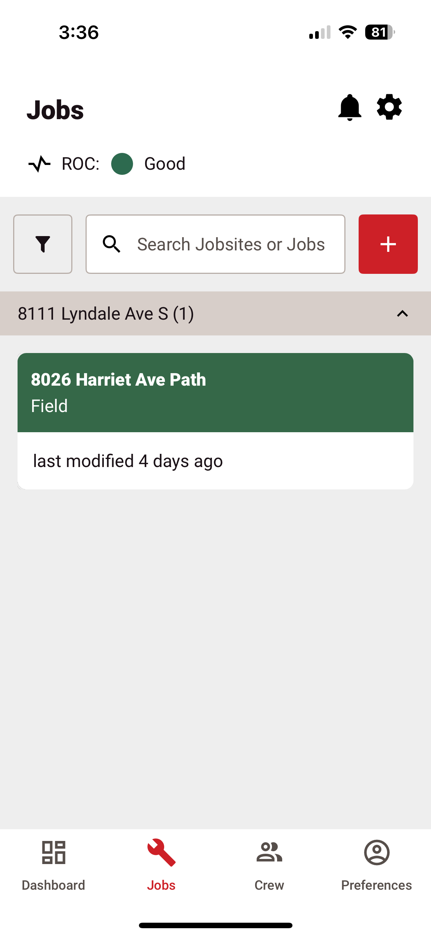
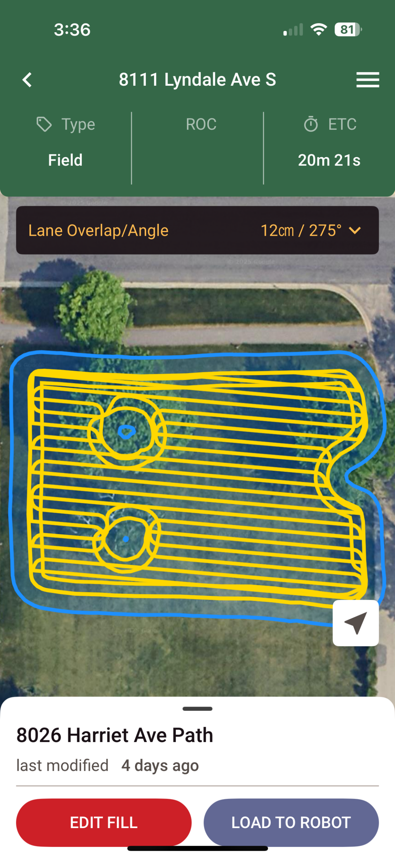
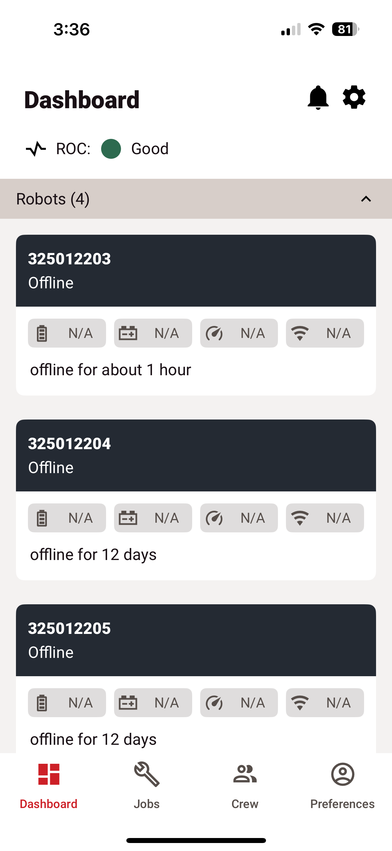
Robotics App Overview
See Past Jobs
See Mower Path
See Fleet of Mowers

Slide 30
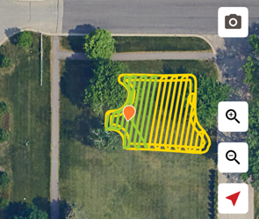
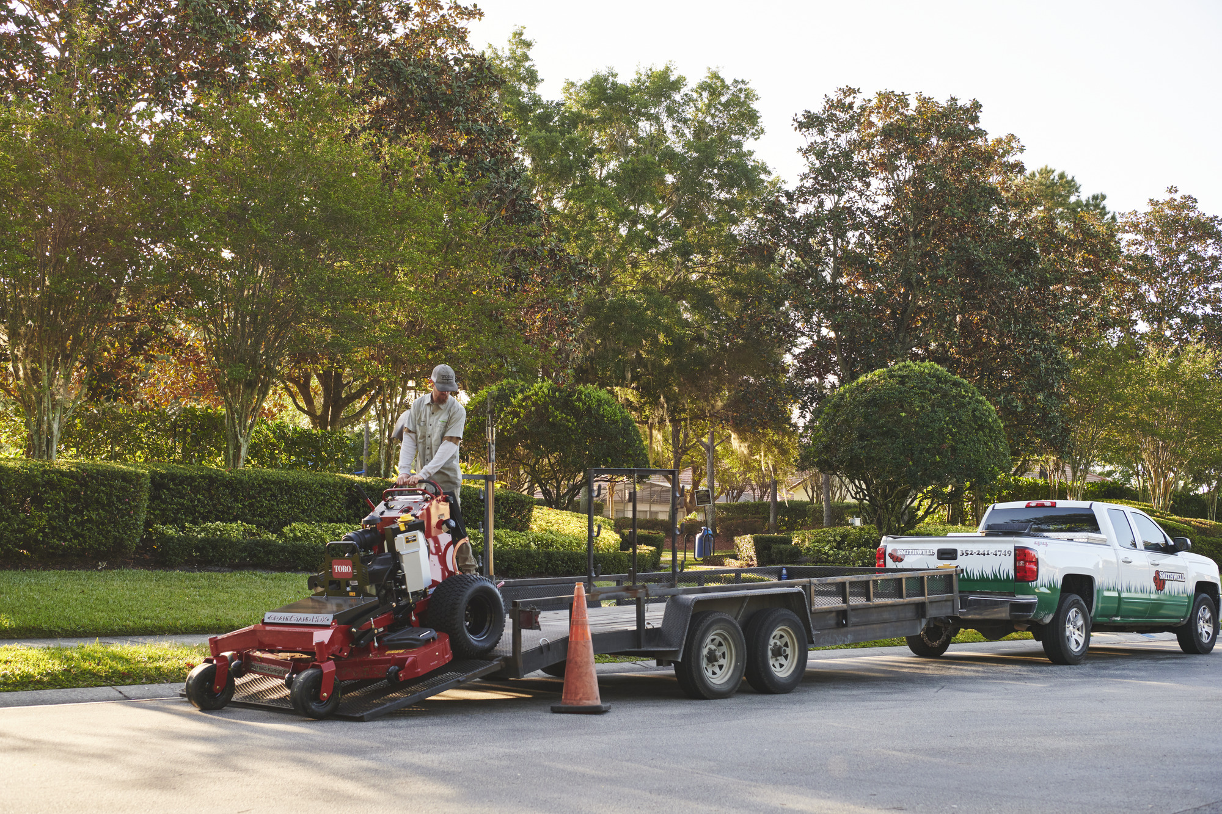
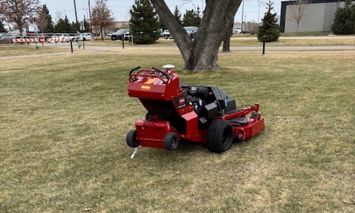
Record, Mow, Trailer
Record boundary and exclusions zones
15% of time on property (one time only)
Mow
80% of time on property
Trailer unit and strap down
5% of time on property

Slide 31
Simple Job Setup and Memory
Record boundary of the property being cut (PTO can be on to cut perimeter)
Outline around exclusion zones (Trees, drains, ponds, etc)
Set mower in direction you want it to stripe in and hit “go”
ROC will remember the boundary set with GPS coordinates
Return mower to property and position it in the direction you want it to cut.
Mower will snap to a degree within 45° of the initial striping angle
45°

Slide 32
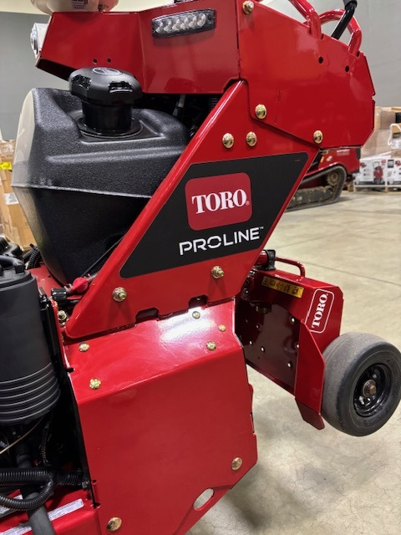
Support
Direct support into Toro
OSS technology allows Toro support to diagnose machine virtually
Jobs are saved on the cloud to user profile and be run by other mowers in fleet

Slide 33





Wastewater Energy Recovery Pilot Grant Program 2026-2027 Opportunity
September 15, 2026
Leading By Example (LBE) Council Meeting
Danah Tench, Director Clean Energy Results Program
An Innovative Partnership:
The Massachusetts Department of Environmental Protection The Massachusetts Department of Energy Resources
The Massachusetts Clean Energy Center
1

Slide 34

WWE Agenda
Agenda
Background and Goals
WWER Energy Pilot Grant
  Eligible Projects
  Eligible Entities
  Funding Offered
  Application Information Required
  On-Line Application Process
  Scoring Criteria
  Key Dates
Questions
2

Slide 35
Wastewater Energy Recovery Pilot Grant
What is wastewater energy recovery?
Wastewater Energy Recovery- is a sustainable energy practice that involves capturing and reusing heat from wastewater. This wastewater can come from a variety of sources, including residential, commercial, and industrial processes. Typically, the water used in these settings is warm—carrying heat from a variety of activities—and instead of simply being treated and discharged into the environment, the thermal energy it contains can be reclaimed and repurposed. Also known as Sewer Heat Recovery, it is a stable, efficient, renewable and scalable thermal resource. Source: Sewer Thermal Energy Network

Slide 36
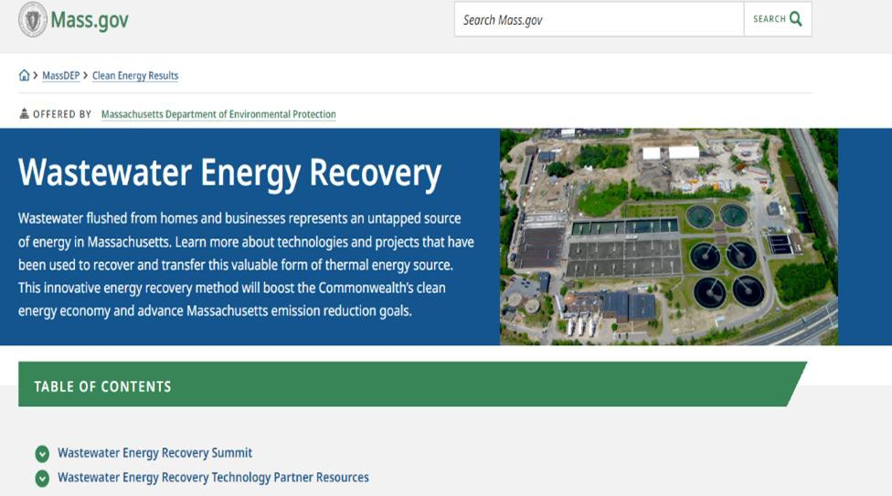
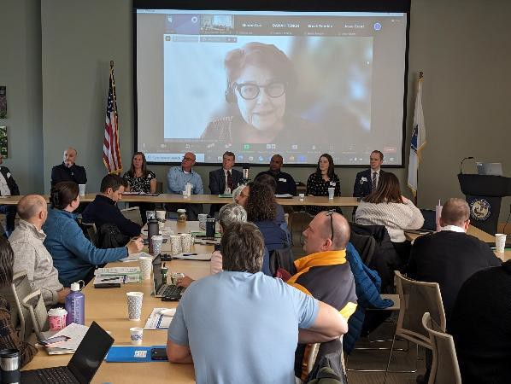




Wastewater Energy Pilot Grant Program
Tapping into an existing source for thermal energy

Slide 37
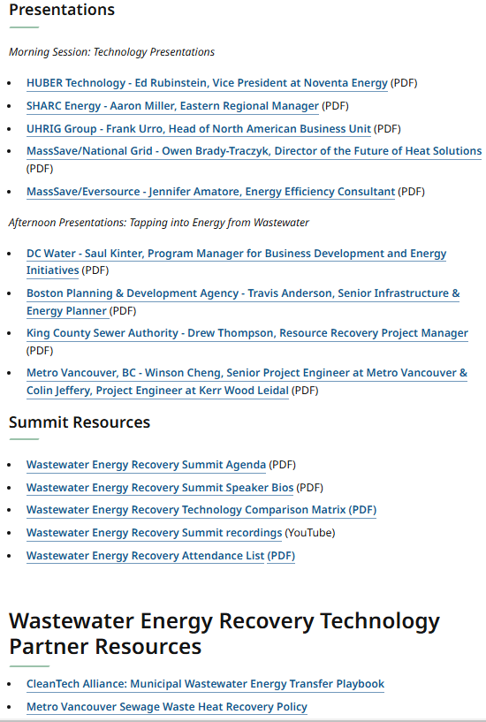
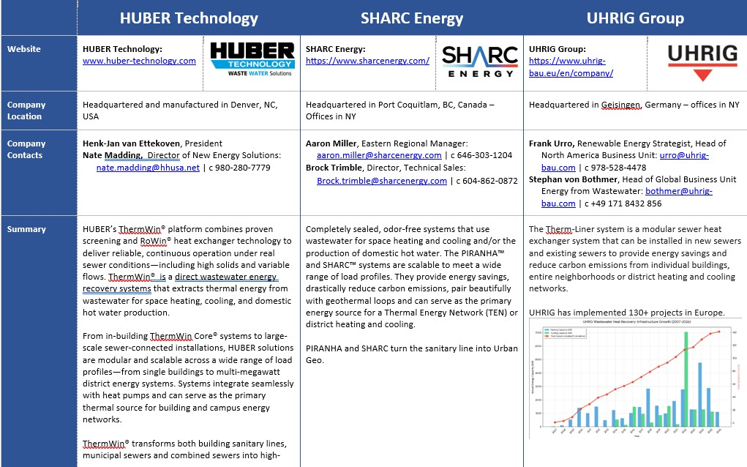
Wastewater Energy Recovery Summit
December 8, 2023
https://www.mass.gov/info-details/wastewater-energy-recovery

Slide 38

Pilot Project Goals
The WWER pilot program has three main goals:
Support construction and activation of pilot projects using WWER technologies. Encourage project locations across regions, of varying size and scale
Evaluate the cost, energy, and environmental effectiveness of the completed pilot installations.
Develop a replicable WWER partnership model for cost-effective and scaled project development in Massachusetts and elsewhere, through data collection and assessment, development of guidance, and integration into existing design standards for wastewater treatment facilities.

Slide 39
Wastewater Energy Recovery Pilot Grant
2026 Funding Opportunity 5 Million: What are the funding levels?
Conduct a focused Technical Assistance Study performed (by an energy utility, consultant, a wastewater energy recovery technology provider, or applicant’s engineering team) that provides building owners with a draft plan for wastewater energy recovery, including initial project costs, estimates for energy-savings, greenhouse gas emission (GHG) reductions, and a basic site diagram showing how wastewater energy sources will be assessed for space heating, cooling, hot water etc. in the building or buildings.
Energy Assessment
(up to $15,000)
Develop a final design and signed schematic drawings for technically and economically viable WWER projects. The design grant will fund: (1) the production of a 100% design and bid ready drawings of the proposed project that consist of fully developed
Design
(up to $100,000)
Develop an integrated capital funding plan that leverages state, federal, energy utility and technology provider funding options and incentives to construct technically and economically viable wastewater energy recovery projects.
Construction
(up to $750,000)

Slide 40

What Is An Eligible Project? (1)
Closed loop piping system (that includes supply and return lines)
Heat exchanger/ thermal liners
Wet Wells
Wastewater holding tanks
Solids handling equipment (screening, pumps, etc.)
Water source heat pump

Slide 41
What Is An Eligible Project? (2)
Water chilled beam HVAC units
Water to air HVAC units
Ground source heat pumps
Building management / mechanical room controls
Monitoring system

Slide 42

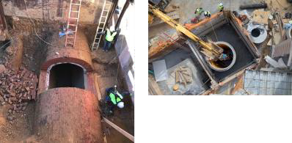
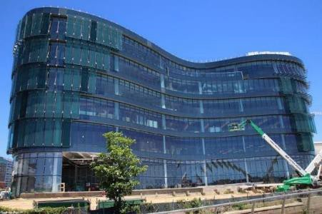
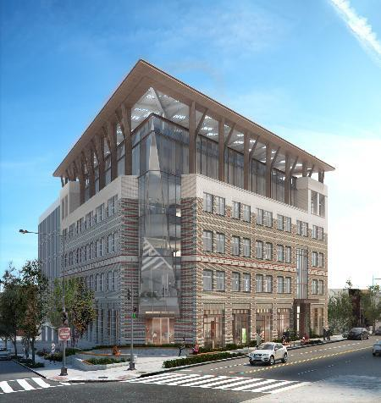
Wastewater Thermal Energy Buildings in Operation
Credit: Slide courtesy of Saul Kinter (DC Water) - MassDEP Summit 12/8/2023
American
Geophysical Union
Completed 2018
Houses admin/public functions of DC Water
Built on top of sewage pump station
150,000 square feet
DC Water Headquarters

Slide 43
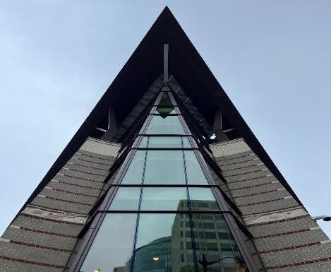
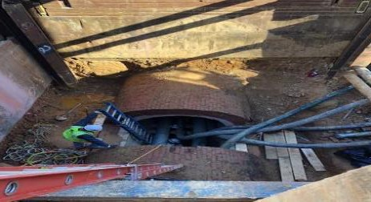

Wastewater Thermal Energy – Buildings in Operation
Credit: Slide courtesy of Ed Rubenstein, Novanta Energy - MassDEP Summit 12/8/2023
American Geophysical Union
Washington, D.C. [United States]
Office: 5,800 sq. m. [62,000 sq. ft.]
7-storey refurbished structure
Certified Net-Zero Energy building by the U.S. Green Building Council
Impact
  Sewer Flow Rate: 404 L/s [6,400 GPM]
  RoK4-700 fine screen pumping station
    Inserted in a shaft beside the sewer next to building
  Heat Exchanger: 1 RoWin® BG8 installed
  System Provided: 480kW of heating & 840kW of cooling
  Coefficient of Performance (COP): 6+

Slide 44
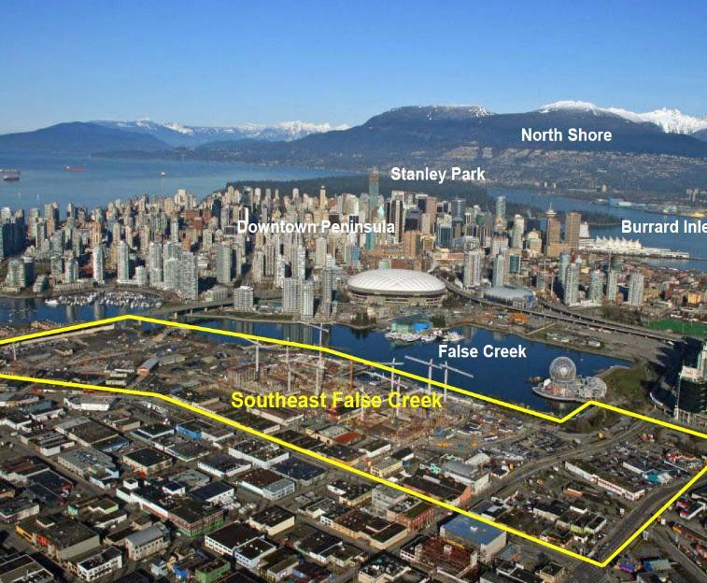
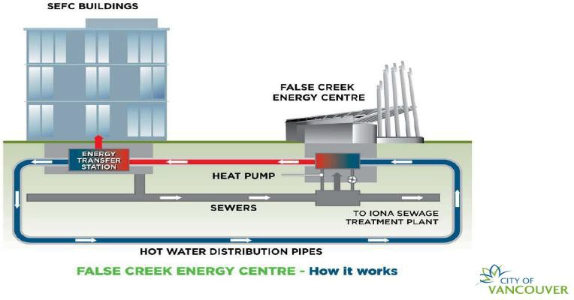
Wastewater Thermal Energy – District Energy
Credit: Slide courtesy of Saul Kinter (DC Water) - MassDEP Summit 12/8/2023
False Creek Neighborhood Energy Utility (Vancouver, Canada)
Uses waste thermal energy captured from a sewage pump station to provide space heating and hot water to 6.4 million square feet of residential, commercial, and institutional space, as of 2021.

Slide 45
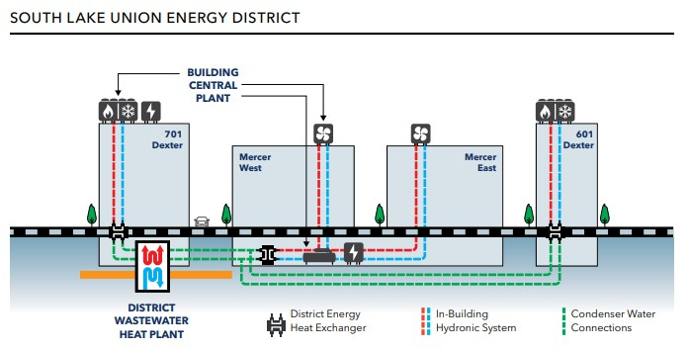
Alexandria Center®
for Life Science – South Lake Union
70% of campus heating from sewer
heat recovery
99% lower carbon emissions anticipated compared to typical laboratory building
Four buildings on system = 1.3 million square feet
One of two largest systems in the U.S.
Closed loop system for heating
King County's sewer line was successfully tapped July 2023
ARE's construction of campus is ongoing

Slide 46

Eligible Entities
Publicly-owned & privately-owned wastewater facilities
Collection System, pumping stations, treatment plants
Municipal & state-owned buildings
Public & private K-12 schools, colleges and universities
Nonprofit and privately-owned organizations

Slide 47
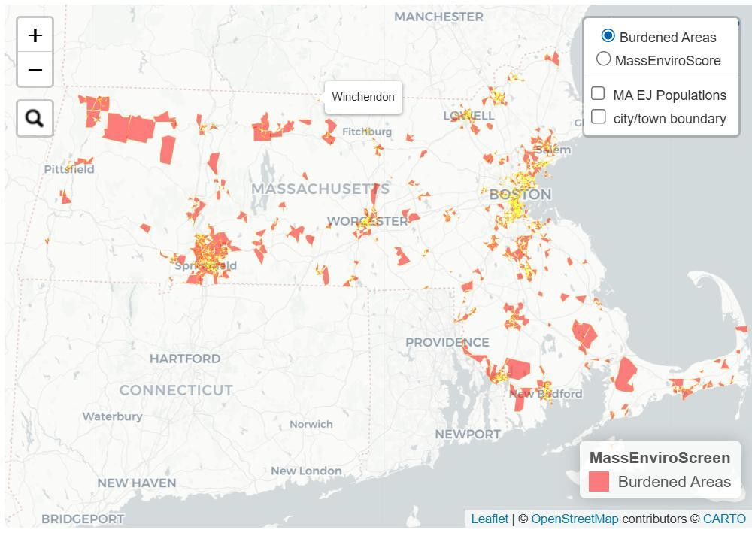
Burdened Areas
Burdened Areas – MassDEP grants prioritize funding to certain areas to address inequitable environmental burdens or related health consequences.
  Location of Project – Project narrative should include a description of project’s burdens or benefits to communities within the Burdened Area(s)
Mass EnviroScreen – Is an EEA data-
driven mapping tool used to help identify Burdened Areas in Massachusetts based on a cumulative burden score that incorporates exposure to pollution and climate risks and the presence of sensitive or vulnerable populations, as well as whether the community meets a criterion related to lower household income.

Slide 48

Funding Sources and More
Possible Funding Sources
MassSave Incentives (Not available for Design Phase)
Municipal Light Plant Funding Assistance
Tech Provider In-kind Funding
State Revolving Loan Fund (Available only to municipal water facilities)
Green Communities Grant Programs
Applicant Funds (Municipal Capital funds, etc.)

Slide 49
Online Application Components (1)
 | Phase 1 | Phase 2 | Phase 3
APP A: PROJECT NARRATIVE and BUDGET | Must be submitted | Submission includes Phase 1 findings | Submission includes Phase 1 and 2 findings
APP B: AUTHORIZATION and OWNERSHIP FORMS | Required | Required | Required
APP C: DESIGN STANDARDS AND SCHEMATIC DRAWINGS | Not required | Not required for submission, use as reference | Submission must be consistent with Appendix C Guidance specifications
APP E: ONLINE QUESTIONS | Required | Required | Required 17

Slide 50
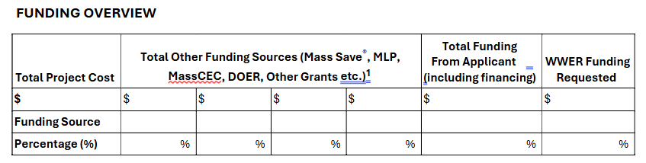
Wastewater Energy Recovery Pilot Grant
2026 Funding Opportunity: Online Application Components
APPENDIX A: PROJECT NARRATIVE and FUNDING OVERVIEW
PROJECT NARRATIVE
Project Summary: description of the project, work completed to date, overview of project budget, organizations engaged, etc. (max 2 pages)
Organization chart: including confirmed team members and any subcontractors (Includes identifying the specific leads and supporting personnel for each task in Attachment 1, and why these leads/supporting personnel are qualified for the task)
Communication plan: describe plan between the project team and MassDEP (e.g., frequency of updates to MassDEP – bi-monthly, monthly, quarterly, etc.) (max 2 pages)
Location Description and benefits of proposal: describe the project and project impacts, including burdens or benefits to communities within Burdened Area(s). (max 2 pages)
Stakeholder engagement plan: describe frequency of outreach, outreach medium (virtual/in-person meeting, website, social media post, etc.), and audience (e.g. municipal boards, neighborhood associations, etc.) (max 3 pages)
Example:
Project Total for Assessment: $25,000
Incentive from National Grid, Eversource, or a Municipal Light Plant:
$5,000
Incentive(s) from other source(s):
$5,000 or
Grant request = $15,000*
Applicant financing: If needed
* Up to $15,000 for Phase 1, up to $100,000 for Phase 2, up to $750,000 for Phase 3
18

Slide 51
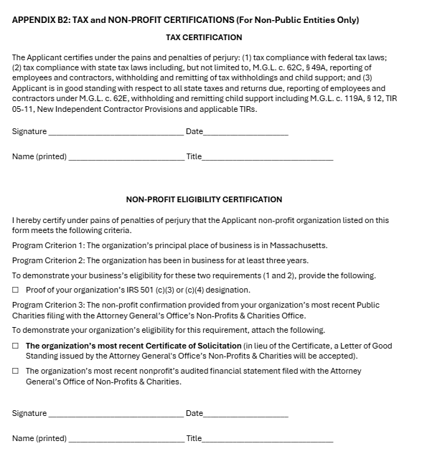
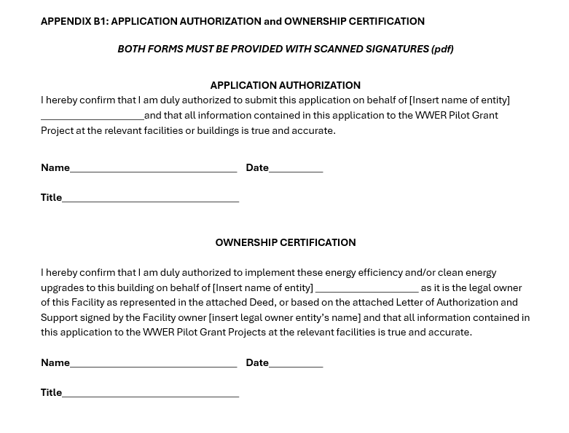
Online Application Components (2)
19

Slide 52
Evaluation Criteria
Proposed Completeness and Clarity (up to 35 points) a feasible and organized work
plan and schedule that meets the project timeline and communication plan.
Impact of Wastewater Energy Recovery System (up to 30 points) size and scope of energy recovery system, estimated lifecycle energy and cost savings and greenhouse gas emission reductions; displacement of fossil fuels.
Cost Effectiveness (up to 15 points) amount of leveraged funding; applicant cost share contribution (including in kind), public return on investment.
Location (up to 20 points) regional distribution across the state; location within or serving a Burdened Area; and proposal for incorporating benefits for these populations. A “Burdened Area” is a census block group that is subject to an existing unfair or inequitable environmental burden or related health consequence as identified through MassEnviroScreen.

Slide 53
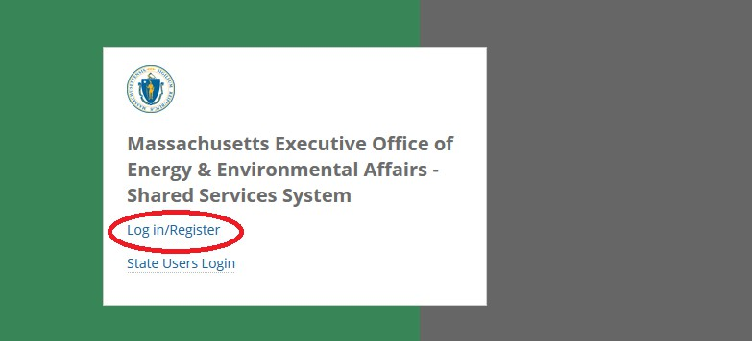
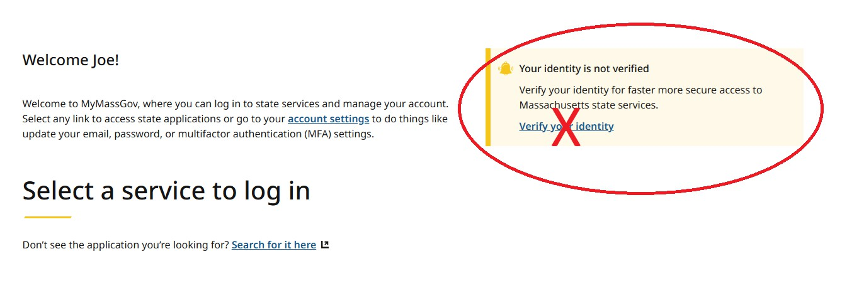
Online Application and Submission
All applications must be submitted via the Energy and Environmental Affairs Grant Management System
Sign up with MyMassGov
Create a “Business Account” NOT a personal account

Slide 54
Updated Key Dates
May 8, 2026 – Notice of Grant Opportunity published on COMMBUYS and MassDEP website
– October 13, 2026 2-3:30 pm– 2nd Bidders’ Informational Conference (via Zoom)
To obtain dial-in information or the Zoom link for either session, please register. Interested applicants may attend
either session, both informational sessions will be recorded.
Deadline to submit written question:
– October 16, 2026 at 5:00 PM EST – following the second Bidders’ Information Conference
Official Answers for Q&A/Amendments published on MassDEP website:
– October 23, 2026 – Answers to the second Bidders’ Information Conference
– May 31, 2028 Rolling Grant Application or when funding has been spent for each phase –

Slide 55
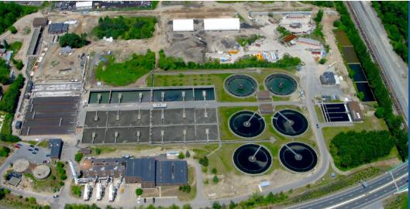
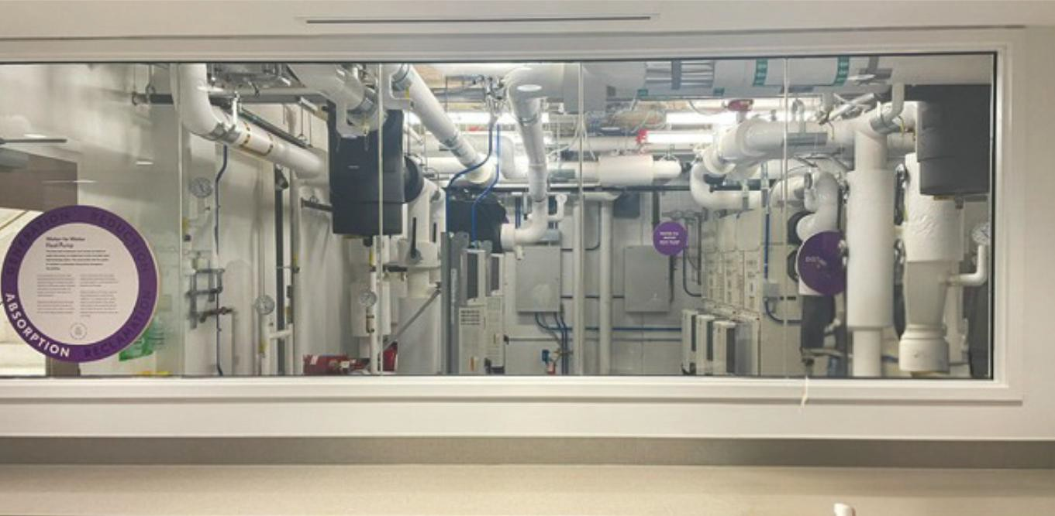
Wastewater Energy Recovery Pilot Grant
2026 Funding Opportunity
Questions?

Slide 56
LBE Updates and Reminders

Slide 57
EV incentives update – light duty
The following are proposed changes to the light-duty portion of the MOR-EV program
Category | Current | Proposed Changes
General* | No cap on number of rebates that applicant can apply for | Individuals may not receive rebates for more than two eligible vehicles in any three-year period
New Light Duty | $55,000 Price Cap | $50,000 Price Cap
Used Light Duty | $40,000 Price Cap | $35,000 Price Cap
Used Light Duty |  | Disallow rebates to exceed car purchase price
MOR-EV+ Adder** | Must prove eligibility through participation in income-qualifying programs | Expand eligibility criteria to also include income thresholds of $150,000 for joint return or surviving spouse, $112,500 for head of household, or $75,000 for individual filer or taxpayer
*Applicable to the MHDV rebate offerings
*Applicable to the Pick Up & Class 2b rebate offerings

Slide 58
EV incentives update – Pick Up and Class 2b Trucks
The following are proposed changes to the medium-/heavy-duty portion of the MOR-EV program:
Current | Proposed Changes
Individuals and fleets eligible for $7,500 rebate | Individuals eligible for $4,500 Fleets still eligible for $7,500
No used pick-up truck rebate available | Create used pick-up truck rebate with $55,000 price cap

Slide 59
EV incentives update – Class 3-8 Vehicles
The following are proposed changes to the medium-/heavy-duty portion of the MOR-EV program:
Current | Proposed
$2 million price cap for classes 3-8 | $100,000 Price Cap for Class 3 $500,000 Price Cap for Class 4-6 $2,000,000 Price Cap for Class 7 and 8
All Class 3-8 applicants must receive a rebate reservation voucher before vehicle delivery | Class 3 applications will utilize post purchase rebate process and no longer need voucher
Individual applicants receive the same rebate amount as fleet applicants ($15,000 to $90,000 depending on class) | Individual applicants will be capped at a $7,500 rebate for classes 3-8
Environmental Justice Adder based on Environmental Justice Populations term | Burdened Areas Adder based on Burdened Areas term

Slide 60
EV incentives for state fleets
DOER Incentives
Incentive Program | Incentive Value
MOR-EV Pick Up & Class 2b | $7,500 per vehicle
MOR-EV Class 3-8 | $15,000-$90,000 rebate dependent on GVWR and 10% optional adder if eligible
MassDEP Incentives
Incentive Program | Incentive Value
MassEVIP Fleet Vehicles | $750-$7,500 dependent on the type of vehicle (ZEM, PHEV, BEV) and if it was a purchase or lease
MassEVIP Workplace & Fleet Charging | 60% of hardware and installation costs with maximum of $50,000 per street address
MassEVIP Public Access Charging | For government-owned sites: up to 100% of hardware and installation costs with maximum of $50,000 per street address

Slide 61
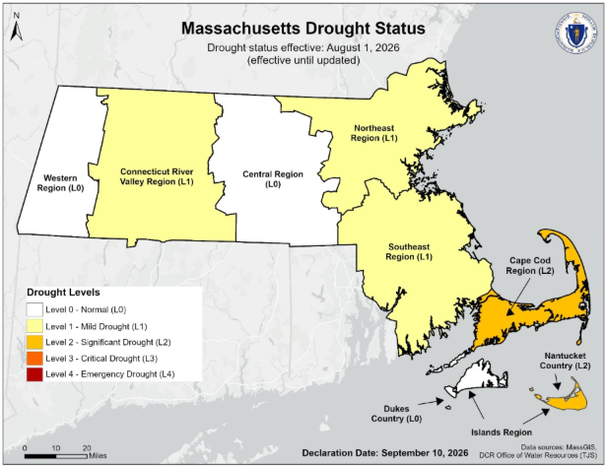
Good news! Drought conditions have improved
Summer rainfall brought relief
  Rainfall in June through August was near or above normal across much of the state
Central Region has returned to “Normal” conditions
Cape Cod and Nantucket are still comparatively dry

Slide 62

FY26 Tracking Form: Out Now!
FY26 data is due December 4th
LBE is required to track annual energy consumption and other important sustainability metrics
The tracking form this year is due Friday, December 4
Submit your forms via email to Sophia (Sophia.Vitello@mass.gov)
Visit the LBE website to download the FY26 LBE Tracking Form

Slide 63

Connect with vendors at MASSBUYS!
Register today!
When: October 1st, 8:00AM – 3:00PM
Where: Gillette Stadium
MASSBUYS connects procurement staff from government agencies, municipalities, non-profit organizations, and public education institutions with Statewide Contractor Vendors
Register online through OSD: MASSBUYS EXPO | Mass.gov

Slide 64
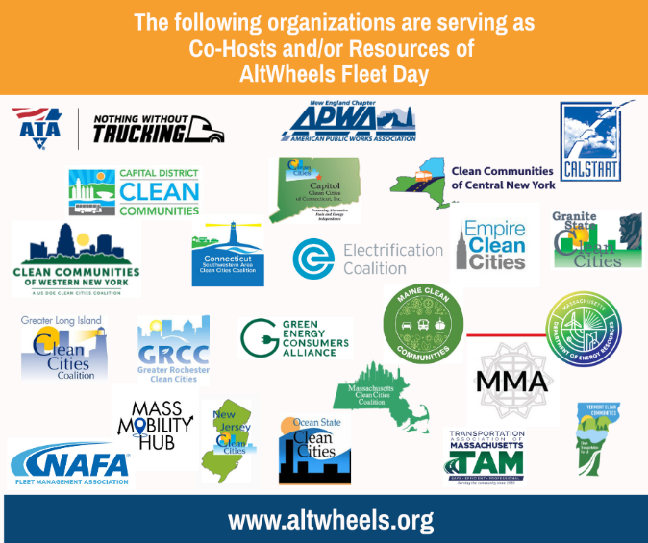
23rd Annual AltWheels Fleet Day
Come see LBE staff at AltWheels!
Co-hosted by DOER!
When: October 5th, 2026, 8:00AM – 5:00PM
Where: Four Points by Sheraton, Norwood
Description: AltWheels is an annual sustainable transportation event that brings together corporate and municipal fleet managers and clean-fleet stakeholders working to reduce emissions and lower costs for tomorrow’s transportation needs
Register online at Eventbrite.

Slide 65
NEW! Renewable Diesel Policy for State Entities

Slide 66
New Renewable Diesel (RD) Policy and Guidance!
Based on Executive Order 594…
“On an annual basis, LBE shall be responsible for tracking and collecting building and vehicle energy consumption, clean energy development, GHG emissions, and other relevant information associated with state government operations.”
LBE Renewable Diesel Policy

Slide 67

Renewable Diesel (RD) Policy Goals
The purpose of the RD policy is to…
Provide guidance to state entities on how RD can be used as an emissions reduction strategy:
  Eligible use cases
  Eligible feedstocks
  Process to receive approval for RD use
  Emissions calculations
Ensure consistency across state portfolio and with other statewide goals and reporting mechanisms
Ensure prioritization of long-term electrification
Notes:
Ensuring alignment with CECP and DEP’s emissions tracking protocols

Slide 68
RD Policy Overview: Use Cases
Eligible Use Cases
Medium- and heavy-duty vehicles
(with no currently available or cost-feasible electric alternatives)
Renewable diesel can only be used to replace use of petroleum diesel.
State entities cannot use renewable diesel to replace use of natural gas.
Central campus or building heating systems
Emergency generators

Slide 69
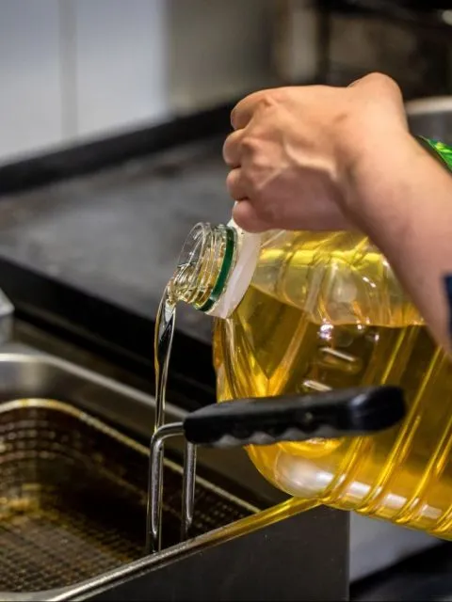
RD Policy Overview: Sourcing Requirements
To claim emissions benefits from RD, state entities must use “eligible RD”
“Eligible RD” is
derived from waste oil feedstocks (i.e., used cooking oil (UCO), tallow, and/or animal fats)
sourced domestically
RD is meant to be a transition fuel. Sites must identify current challenges with electrification and acknowledge commitment to long-term electrification.
Entities interested in using RD for emissions reduction credit must complete the LBE Renewable Diesel Application Form.
Notes:
Acknowledging electrification challenges; policy is intended as a transition for now until electrification is readily available

Slide 70

Calculating Renewable Diesel (RD) Emissions
Aligning with state emissions accounting and reporting
Main points:
LBE will collect and track RD data separately via Annual LBE Tracking Form
For current reporting purposes, eligible RD will not count towards onsite fossil fuel emissions (Scope 1)
At the time of Net Zero emissions targets, RD will be included in total GHG emissions as biogenic emissions

Slide 71
Renewable Diesel (RD) – Next Steps
LBE published RD guidance and forms on our website
LBE will host office hours on RD policy for interested entities
LBE will evaluate if any adjustments are needed to the process

Slide 72
Questions?

Slide 73
Thank You!

