Slide 1
Mass. Commission on Falls Prevention
James Fuccione – MHAC Senior Director
September 2021
The work of the Massachusetts Healthy Aging Collaborative is supported in part by:

Slide 2
MHAC Storyline
MHAC formed out of a strategic initiative from Tufts Health Plan Foundation to focus on Healthy Aging
2009-2013:
2014:
2017:
2018-2019:
MHAC hosts meetings and conferences to share updates, ID opportunities, leverage each other’s work
Conference w/ 400 attendees debuted MHAC website and Healthy Aging Data Report
MHAC hired Senior Director to advance movement focused on Age-Friendly Communities.
Governor’s Council to Address Aging is convened
Updated Healthy Aging Data Report.
Massachusetts becomes “age-friendly” state and submits first statewide action plan.
Nation-leading 76 age-friendly communities

Slide 3
MHAC Strategy
The Massachusetts Healthy Aging Collaborative is a cross-sector network of leaders in community, health and wellness, government, advocacy, research, business, education, and philanthropy who have come together to advance healthy aging.
Building the Age- and Dementia Friendly Movement
Embed Access, Equity and Inclusion within the movement
Develop/Promote Policy and Advocacy Platform for Healthy Aging
Deepen Capacity-Building for Communities

Slide 4
Defining Age-Friendly
Age-friendly environments foster health and well-being and the participation of people as they age. They are accessible, equitable, inclusive, safe and secure, and supportive.
Without age-friendly environments, health for all cannot be achieved.
Creating barrier-free and affordable housing, accessible public spaces, and transportation enable people to stay independent and participate in community life.
Older people play a crucial role in their communities – they engage in paid or volunteering work, transmit experience and knowledge, and help their families with caring responsibilities.
…These contributions can only be ensured if societies foster their health and participation.

Slide 5
Age and Dementia Friendly Communities
Transportation
Age & Dementia Friendly
Housing
Communication, Information, & Technology
Outdoor Spaces & Buildings
Access, Equity, Inclusion
Services (Community, Health, Business)
Social Inclusion & Participation
Public Safety
Civic Participation & Employment

Slide 6
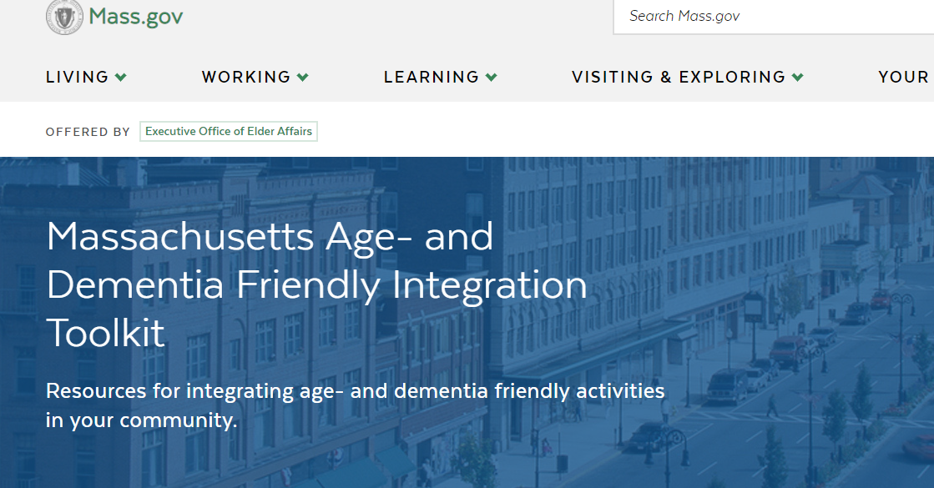
Age- and Dementia Friendly Communities

Slide 7
Age-Friendly Communities in MA
85 Age-Friendly Communities covering 150 cities and towns
Statewide designation: ReiMAgine Aging
Dementia Friendly alignment

Slide 8
Stakeholders and Partners

Slide 9
Healthy Aging for All
Healthy Aging Fund
Pilot use of HAFA Guide in 3 Communities (Framingham, Lowell, Pioneer Valley).
Periodic reports on how HAFA is used in meetings and discussions.
Case studies that can inform future use.
Establish “Equity in Aging” Committee that adds expertise and strength to HAFA and community/statewide efforts.

Slide 10
Healthy Aging for All

Slide 11
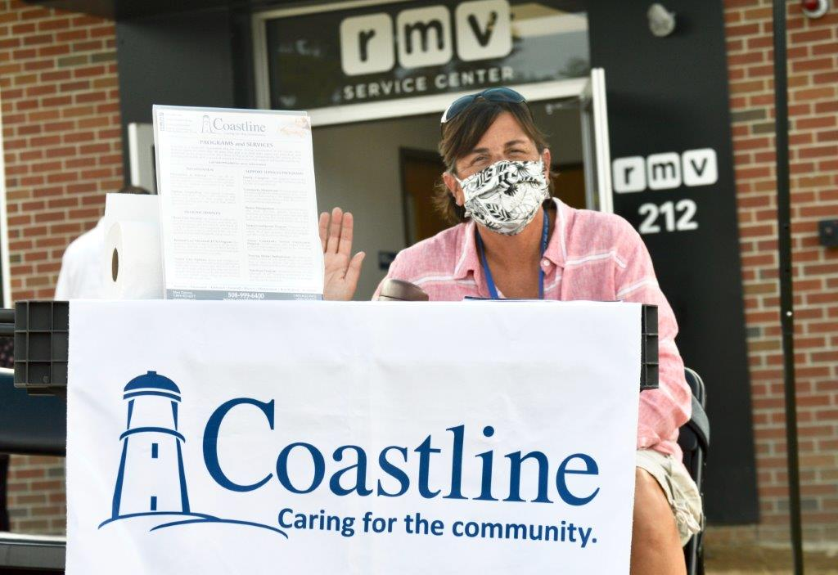
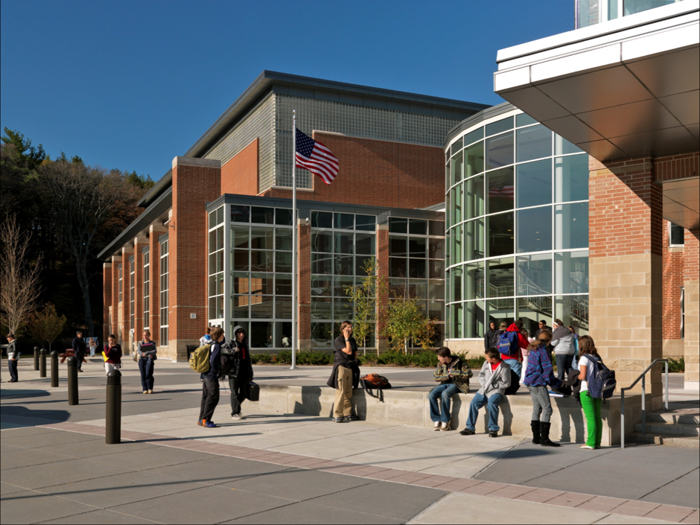
Healthy Aging in Action

Slide 12
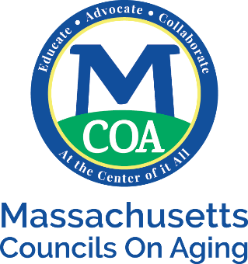
Thank You!
James Fuccione: James.Fuccione@mahealthyaging.org
617-717-9493

