Slide 1
Commonwealth of Massachusetts Department of Early Education and Care
Board Retreat
September 7, 2022

Slide 2
Agenda
Topic | Time | Lead
Welcome, Introductions & Meeting Overview | 10:30am | Chair Lesaux
Agency Overview & Update | 10:45am | Commissioner Kershaw Members of the EEC Exec Team
Building a Workforce System: Workforce Pipeline & Educator Recruitment | 11:30am | Jocelyn Bowne Sarah Volkenant Amy Checkoway Adrienne Murphy Members of the Board
Lunch | 12:15pm
Building a Workforce System: Workforce Pipeline & Educator Recruitment (Continued) | 12:45pm | Jocelyn Bowne Sarah Volkenant Amy Checkoway Adrienne Murphy Members of the Board
Break | 1:30pm
Reimagining the Child Care Financial Assistance System | 1:45pm | Commissioner Kershaw Joy Cohen Members of the Board
Wrap-Up, Next Steps & Closing | 2:30pm | Chair Lesaux Commissioner Kershaw

Slide 3
Retreat Objectives
Meet the new EEC Leadership Team!
Review and affirm framework for operationalizing EEC’s Strategic Action Plan including new organizational structure and priority initiatives (September – December 2022)
Establish shared understanding of current workforce recruitment and retention challenges facing the early education and care field and identify actions for EEC and the Board to pursue
Establish shared understanding of Child Care Financial Assistance (Subsidy) system current state and areas for reform/focus, including anticipated Board engagement and actions

Slide 4
EEC Strategic Action Plan Goals
Children, Youth, Families | Educators | Programs | State System
Children are on track for success in school and to reach their full potential. Their families are empowered to work, build their skills, and attain economic mobility while supporting their children’s education and development.
The early childhood and out-of-school time workforce is professionally prepared, well supported, adequately compensated, and culturally and linguistically representative of the population it serves.
To efficiently and effectively steward public investments in early education and care with utmost integrity, transparency and accountability to the people of Massachusetts.
Programs will increase their sustainability, engage in continuous quality improvement, and promote high-quality education and healthy development among children and youth.

Slide 5
Priority Outcomes and Indicators from Strategic Action Plan
Outcomes | Leading indicators
Programs stabilize and increase their sustainability | Growth in licensed capacity (slots) by region, program type Growth in licensed agencies by region, program type Decrease in program closings
Greater supply of professionally qualified EEC workforce | Increase in professionally qualified EEC workforce across MA Increase in qualified EEC workforce diversity by race, ethnicity, primary language Increase in average compensation by professional category
Outcomes | Leading indicators
Families gain equitable access to needed supports | Increase in licensed capacity in areas of greatest need Increase in #/% of children in low-income families receiving child care subsidies Increase in #/% of infants and toddlers in low-income households receiving child care subsidies Increase in # of children ages 9-35 months receiving developmental screening with parent-completed tool like ASQ
Children are on track to 3rd grade success | Increase in 4th grade reading proficiency levels Increase in 4th grade math proficiency levels
5

Slide 6
Operationalizing the EEC Strategic Action Plan Implementation Framework & Operational Focus
Human/user-centered restructuring of agency operations and business processes to modernize and improve the staff and user experience
Key User Groups
Children, Youth and Families
Programs
Educators
Maximize access, streamline procedures and expand early education and care options
Provide consistent, ongoing supports that promote stable financing, quality services and health and safety
Facilitate meaningful career pathways, professional advancement and retention of educators in the field
Enabling Mechanisms
Data-driven decision making
New and expanded technology
Staff expertise and engagement
On-going stakeholder engagement
Targeted Program Integrity
May 10, 2022

Slide 7
EEC Organizational Structure: Overview & Summary
New organizational structure designed to:
Support and deliver on core agency functions
Operationalize Strategic Action Plan/execute on priority projects/initiatives
Align to and facilitate key “user” experiences/ journeys
Promote collaboration within EEC/strengthen cross agency collaboration
Build capacity in existing and key areas of growth
New organizational structure includes:
7 Agency Divisions
Operations & Fiscal
Legal
Field Operations
Family Access & Engagement (New)
Workforce, Program Supports & Innovation
Research and Policy (New)
Commissioner’s Office
Communications
Legislative Affairs
External Engagement
Diversity, Equity and Inclusion
7

Slide 8
Department of Early Education and Care
Organizational Chart – as of 9.7.2022
BOARD OF EARLY EDUCATION AND CARE
EXECUTIVE OFFICE
OF EDUCATION
COMMISSIONER
Amy Kershaw
Platform & Portfolio Manager (EOEIT)
Ken Klau
Diversity, Equity & Inclusion Officer*
VACANT
CHIEF OF STAFF
Chris Power
CHIEF OPERATING OFFICER
Greg Norfleet
DEPUTY COMMISSIONER
FIELD OPERATIONS
Andrew Rome
GENERAL COUNSEL
Janis DiLoreto Smith
Legislative Affairs
Addison Koelle
Special Projects
Christian Kelly
Administration & Finance
Sandy Fortier-Hollow
(Acting)
Internal Operations
Meaghan Blanton
Investigations
Margie Gilberti
Regional Licensing
VACANT
Legal
Neil Flynn & Rob Orthman
External Engagement
Eugenia Soiles
Communications
Martha Waldron
Financial Management
Sandy Fortier-Hollow
Business Systems
VACANT
Residential & Placement Licensing
Kelly Buckley & Tim Keane
Region 1
Erin Craft
Hearings & Appeals
Executive Support
Jackie Foley
Budget & Finance
Amanda Sakaguchi
Strategy & Project Management
VACANT
Region 2
Marisol Rosado-LeDoux
Financial Assistance Review Unit
Applied Behavior Analysis (ABA) Licensing*
VACANT
Region 3
Maria Torres de Martinez
Background Record Checks
Mechell Grays
Audit & Internal Controls
Alicia Siryon-Wells
Region 5
Renee Collyer
Federal Compliance & Subsidy Administration
Carole Meehan Oyama
Field Operations Initiatives
Susan Cohen
Region 6
Kelly Meehan
DEPUTY COMMISSIONER
FAMILY ACCESS & ENGAGEMENT*
VACANT
SENIOR ASSOCIATE COMMISSIONER RESEARCH & POLICY
Amy Checkoway
DEPUTY COMMISSIONER WORKFORCE, PROGRAM SUPPORT
& INNOVATION
Jocelyn Bowne
Family & Community Supports
VACANT
CCRR Program Management*
VACANT
Policy Development
Joy Cohen
Associate Commissioner
Workforce Development
VACANT
Program Quality
Amy Whitehead-Pleaux
Priority Population Program Management*
VACANT
Research & Data Analytics
Adrienne Murphy
State Head Start Collaboration
VACANT
Program Innovation & Supports
Sarah Volkenant
Comprehensive System Supports
Kyla McSweeney
Income Eligible Program Management*
VACANT
Grant Development & Management
Jay Swanson
Workforce Development & Educational Technology Specialist
Pam Roux
Child Care Business Operations and Facilities*
VACANT
New Position – Posting/Hire In Progress
Position – In Development/To Be Posted
8

Slide 9
Building a Workforce System:
Workforce Pipeline & Educator Recruitment
9

Slide 10
Building the Workforce System: Transitioning from Current to Future State
EEC will support two parallel, but equally important efforts to address system needs.
Work to build robust professional opportunities and career pathways
Immediate steps to address workforce hiring challenges
Reduce barriers to quick hiring and support recruitment
Create strong pathways to qualified teacher and director roles
Support programs in providing competitive compensation and strong job quality
Encourage opening and support the success of new family child care
Access to Higher Education and Preparation Programs
Stable Employers, Competitive Compensation
Clear, Compelling Career Pathways
Workforce Pipeline, Educator Recruitment

Slide 11
Discussion Roadmap
What we know about current capacity and the workforce challenges facing the field
Review current EEC efforts and preliminary review of promising efforts in MA and beyond
Identify areas of interest for further exploration and information gathering
Discuss next steps and potential actions to further define and address key challenges

Slide 12
What we know about current state of the MA early education and care workforce
Problem Statement:
A successful early education and care system requires sufficient numbers of qualified educators to meet licensing requirements and support children’s development.
Data suggest the field is struggling to replace 13% of staff necessary to serve programs’ full licensed capacity.
Center-based programs rely heavily on qualified educators to meet licensing requirements and support children's learning, and are struggling to hire these roles.
Workforce challenges are greatest in areas of highest need.
Programs have raised salaries but are not successfully addressing the crisis.
New FCCs are entering the field, with more programs opening than prior to the pandemic.

Slide 13
Licensed child care capacity in Massachusetts is moving closer to pre-pandemic levels.
Pandemic Emergency Closure
Nearly 80% of programs that were open in March 2020 re-opened by September 2020. Those not reopened have largely closed permanently (19%).
Since September 2020, program capacity increased primarily through newly licensed programs.
There are 1,167 programs currently operating that have been newly licensed since March 2020. | 63% | 71% | 42%
 | are serving the highest SVI communities | are FCC providers | serve children with subsidies
13

Slide 14
However, the Massachusetts child care workforce was harder hit and is slower to recover.
The level of recovery of child care jobs post-pandemic continues to vary across states. Per a recent report from UC Berkley’s Center for the Study of Child Care Employment, “While child care employment in New Jersey has nearly reached pre-pandemic levels, Massachusetts child care jobs are 12.93% …below pre-pandemic numbers.”

Slide 15
Center-based programs face recruitment challenges that can limit capacity.
Since summer 2021, hiring seems to have kept pace with but not exceeded attrition. C3 application data
suggest the number of educators in the system has remained roughly the same with significant open positions continuing to limit programs’ from operating up to their licensed capacity
C3 application and survey data for center-based and OST programs indicates:
65% of programs have open educator positions, with the average program hiring for ~ 2.8 positions
23% of center-based programs reported limiting licensed capacity due to educator openings
Regulations make a loss of a lead teacher harder to accommodate than the loss of an assistant
Current Staffing by Role
(Based on number of FTEs reported in C3 application data)

Slide 16
Workforce openings are widespread and faced more by low-income and BIPOC communities.

Slide 17
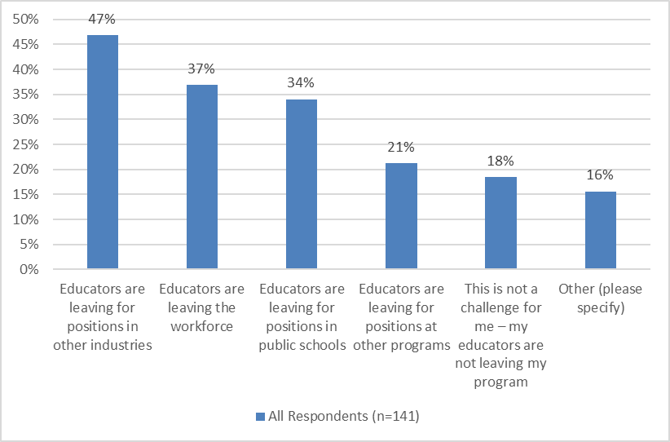
Programs are losing educators to other fields…
EEC conducted a small field survey of center-based providers in December 2021, in which programs reported that educators leaving their program were
leaving the field altogether.
17

Slide 18
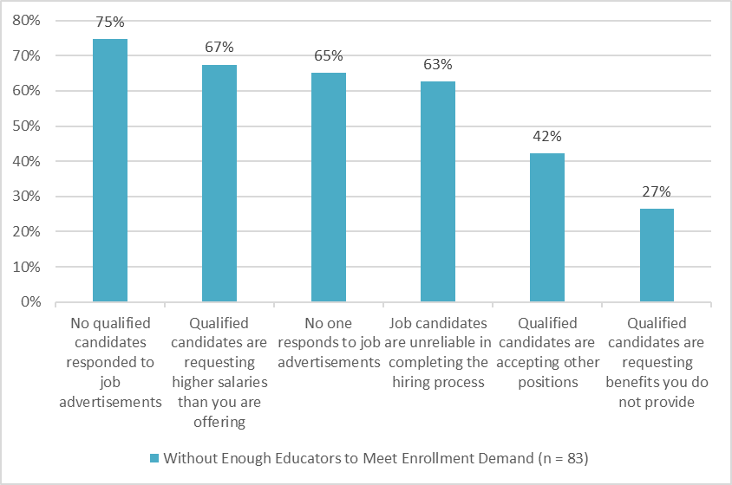
...and struggling to secure qualified candidates.
Providers without enough educators to meet enrollment demands reported experiencing significant trouble attracting qualified applicants who complete the hiring process and then meeting qualified candidates’ preferred salaries and benefits.
18

Slide 19
FCCs were initially slower to recover, but growth in new FCC providers now exceeds pre-pandemic levels.
Of the FCC providers that have opened since Sept 1, 2021:
98% are still licensed
53% have a preferred language other than English
75% are serving highest SVI areas (SVI >.75)

Slide 20
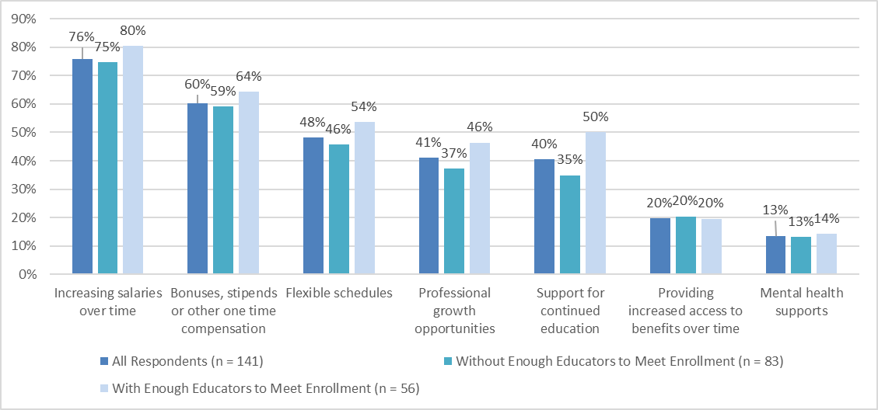
Recruitment strategies focus on compensation as well as work environment and other benefits.
After 10 months of C3:
85% of center-based programs report salary increases to their educators
10% of center-based programs’ C3 funds were used for one-time bonuses
8% of center-based programs’ C3 funds were used for salary increases
A higher percentage of center-based programs’ C3 funds were used for forward-looking investments the longer they received C3 funds.
20

Slide 21
Agenda
Topic | Time | Lead
Welcome, Introductions & Meeting Overview | 10:30am | Chair Lesaux
Agency Overview & Update | 10:45am | Commissioner Kershaw Members of the EEC Exec Team
Building a Workforce System: Workforce Pipeline & Educator Recruitment | 11:30am | Jocelyn Bowne Sarah Volkenant Amy Checkoway Adrienne Murphy Members of the Board
Lunch | 12:15pm
Building a Workforce System: Workforce Pipeline & Educator Recruitment (Continued) | 12:45pm | Jocelyn Bowne Sarah Volkenant Amy Checkoway Adrienne Murphy Members of the Board
Break | 1:30pm
Reimagining the Child Care Financial Assistance System | 1:45pm | Commissioner Kershaw Joy Cohen Members of the Board
Wrap-Up, Next Steps & Closing | 2:30pm | Chair Lesaux Commissioner Kershaw

Slide 22
Building a Workforce System:
Workforce Pipeline & Educator Recruitment
(Continued)
22

Slide 23
What we know about current state of the MA early education and care workforce
Problem Statement:
A successful early education and care system requires sufficient numbers of qualified educators to meet licensing requirements and support children’s development.
Data suggest the field is struggling to replace 13% of staff necessary to serve programs’ full licensed capacity.
Center-based programs rely heavily on qualified educators to meet licensing requirements and support children's learning, and are struggling to hire these roles.
Workforce challenges are greatest in areas of highest need.
Programs have raised salaries but are not successfully addressing the crisis.
New FCCs are entering the field, with more programs opening than prior to the pandemic.

Slide 24
Recruitment & retention efforts in motion: EEC
Recruitment
Minimum hiring requirements (increased flexibility in hiring)
Hiring bonuses (through C3)
Partnerships with vocational education high schools
Compensation and job quality
Retention bonuses/salary increases (through C3)
Job quality through JVS and Neighborhood Villages
Professional advancement
Career Pathways (early childhood coursework at community colleges)
Professional Pathways through Neighborhood Villages (facilitating access to higher education)
Leadership support and business coaching
Professional Development Centers (PDCs)
Early Childhood Support Organizations (ECSOs)
Business training opportunities for GSA and FCCs through Neighborhood Villages
24

Slide 25
Recruitment & retention efforts in motion: Massachusetts
Recruitment
Economic Development Administration (EDA) Good Jobs Challenge Grant - City of Boston
Resources to source, develop, train and employ talent for early care and education employers in addition to employers in health care and green energy.
Apprenticeships and Mentoring
Registered Apprenticeships through the MA Executive Office of Labor and Workforce Development (EOLWD)
Ex: Project Flourish Child Development Apprenticeship (Family Services of Central MA, an Affiliate of the Seven Hills Foundation, with support from Edward Street).
TCG Child Care Practicum and Mentoring Program
Targeted Investment in FCC
Boston Mayor’s Office of Women’s Advancement
ParentChild+ FCC Pipeline Pilot
State Treasurer’s Child Care Start Up Grants for FCC
25

Slide 26
Promising pipeline and recruitment efforts from other states
Public Information Campaign
NM – Promoting benefits of working in early education and new centralized jobs website for the sector (Developing Futures (futuresnm.org)
Apprenticeship Programs
VT – Pre-apprenticeship opportunities for high school students, providing in-service training to qualifications
PA – Registered apprenticeship for early educators
RI and CT - SEIU Education and Support Fund supports registered apprenticeship programs
Subsidized Child Care for Early Educators
KY – Providing categorical eligibility for child care financial assistance for staff in early education and care settings
Targeted Investment in FCC
NV – Partnership with Wonderschool for FCC recruitment & support
26

Slide 27
Dimensions of Investment to Consider
Pipeline targets
Recruitment and entry points (public information campaign, MassHire)
FCC-focused recruitment and supports (Wonderschool, local investments)
Retention and pathways to teacher and director roles (apprenticeships)
System-Level building
Supports for leaders to manage recruitment (hiring requirements, job referrals, subsidy access to support child care as benefit)
Apprenticeship structure (expectations for training and coaching supports, credentialing)
Funding targets
Short term seed funding for pilots (scale through testing and expansion)
Longer term systemic investments in state support structures (Career and Professional Pathways)
Other scaling considerations
Supports to organizations for capacity needed to reach scale
Build partnerships to expand reach of promising programs

Slide 28
Discussion
What existing or promising efforts should we consider enhancing, scaling or initiating?
What role is most important/effective for EEC?
What are some immediate steps we can take to meet the urgency of the challenges for our programs and educators?
What would success look like and how would we know we achieved it?
Next steps
Board mechanisms for ongoing support and guidance
Workforce Advisory Council (9/8/2022)
Collaboration/engagement with workforce partners (EOLWD, Community Colleges, Commonwealth Corporation, JVS, neighborhood villages, Good Jobs Initiative, etc.)
Timeline for action

Slide 29
Agenda
Topic | Time | Lead
Welcome, Introductions & Meeting Overview | 10:30am | Chair Lesaux
Agency Overview & Update | 10:45am | Commissioner Kershaw Members of the EEC Exec Team
Building a Workforce System: Workforce Pipeline & Educator Recruitment | 11:30am | Jocelyn Bowne Sarah Volkenant Amy Checkoway Adrienne Murphy Members of the Board
Lunch | 12:15pm
Building a Workforce System: Workforce Pipeline & Educator Recruitment (Continued) | 12:45pm | Jocelyn Bowne Sarah Volkenant Amy Checkoway Adrienne Murphy Members of the Board
Break | 1:30pm
Reimagining the Child Care Financial Assistance System | 1:45pm | Commissioner Kershaw Joy Cohen Members of the Board
Wrap-Up, Next Steps & Closing | 2:30pm | Chair Lesaux Commissioner Kershaw

Slide 30
Reimagining the Child Care Financial Assistance System
30

Slide 31
Financial Assistance for Child Care (Subsidy):
Updates from June Board Meeting
EEC has begun holistic listening and feedback-driven analysis of the child care financial assistance system (subsidy).
Initial areas of focus have been identified to simplify the process for families, reduce the burden on CCRRs/providers, and collect better data on system needs.
EEC project team is focused on increasing placements, reconciling waitlist data, innovative efforts to connect families to referral services, and revising policies to facilitate family access.
Interviewing Mass211 and CCRRs about pain points and processes
Conduct interviews with contracted providers and providers with voucher agreements
Collect feedback on existing subsidy IT systems for needed enhancements
Reviewing previous engagements, family surveys and EEC strategic plan, and legislative reports
Reviewing existing policies, procedures, regulations and forms
Engagement with families and key stakeholders
Complete
Underway or planned
June 21, 2022

Slide 32
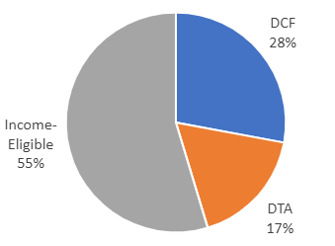
Landscape: The State of Child Care Financial Assistance in MA
Subsidized Provider Capacity
As of August 2022, 49,296 children were supported by EEC subsidies for low-income and vulnerable families​​
Currently, 55.4% of child care providers in Massachusetts accept EEC subsidies.
Of these 4,328 providers:
61.7% are Family Child Care Homes (2,670), and
38.3% are Center-Based, including Out-of-School Time Programs (1,658)
44.7% of child care providers in Massachusetts do not accept child care financial assistance through EEC and are funded entirely by private pay fees from families​ or other sources
Budget Implications
On average, EEC spends ~$12,770 annually per child
In FY21, 75.1% or $579.3M of EEC’s budget was dedicated to child care subsidies:
54.7% or $316.7M for Income-Eligible families
27.9% or $161.8M for families served by DCF
17.4% or $100.8M for families served by DTA

Slide 33
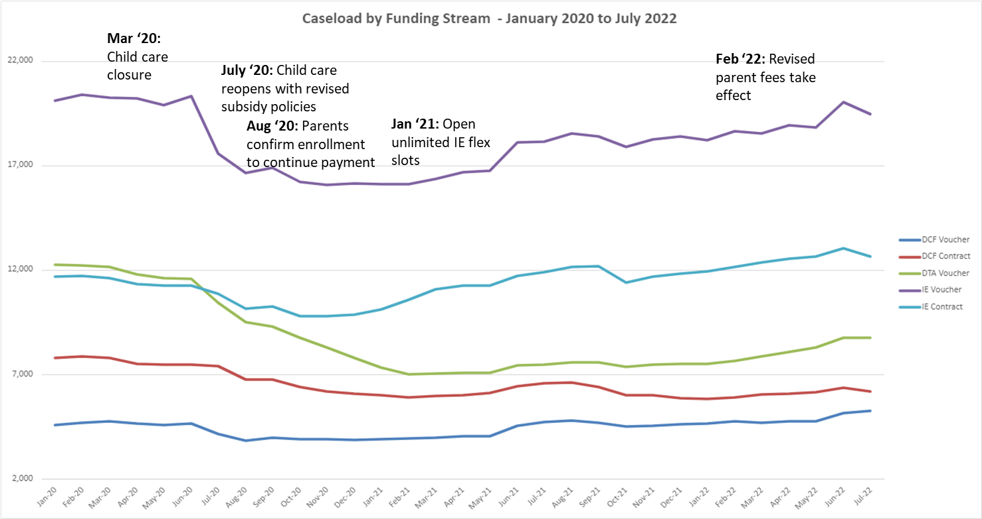
Caseload Trends, January 2020-July 2022

Slide 34
Child Care Financial Assistance System – Constructs
The child care financial assistance system is governed by federal and state statute and regulations that must be considered in all reform efforts
Purpose
Role of EEC
The Child Care Development and Block Grant (CCDBG) establishes the baseline eligibility requirements for subsidized child care | Determine policies & processes, define terms, decide on methods for eligibility and care
State Appropriations dictate how we can use funds earmarked for the subsidy | Ensure spending is in accordance with the law
Massachusetts General Law, Chapter 15D, § 2, articulates responsibilities for administering subsidies | Administer federal funds, subsidy waiting list, and rate structures
Federal Statute (CCDBG)
Appropriations
State Statute (M.G.L.)

Slide 35
Reimagining the Subsidy System & Tools to Effect Changes
Guiding Principles
Reorient EEC’s Subsidy System to prioritize families’ needs and experiences
Shift agency culture through policy, procedure and business process changes
Human/user-centered restructuring of agency operations and improve use of subsidy administrators to modernize and improve the staff and user experience​
Policy & Procedures
Recommend regulatory and policy changes for Subsidy System
Family Experience
Examine how families navigate the subsidy system (eligibility assessment, Waitlist)
Pilot streamlined intake process with Mass211 and CCRR’s
Subsidy Administrators
Analyze current role of CCRR’s and subsidized providers in the state subsidy system; assess strengths and weaknesses
Opportunity to procure new contracts with CCRR’s
Assess Federal vs. State Requirements
Deploy Phase 1 Policy and Procedures to field
Deploy Phase 2 new Regulations and Procedures to field
New family-facing subsidy intake and navigation materials
EEC Internal and External Stakeholder Facilitated Visioning Sessions; including families
intake application support, targeted outreach, and waitlist reconciliation
Market Rate Survey
35

Slide 36
Child Care Financial Assistance Reforms
Major Initiatives and Key Milestones through Winter 2023
Launch Pilot with intake application support, targeted outreach, and waitlist
reconciliation
EEC Internal and External Stakeholder Facilitated Visioning Sessions; including families
Drafting and preparation to post CCRR RFR
Engage with KPMG to provide consulting support for Visioning Sessions and CCRR procurement
Deploy Phase 1 Policy and Procedures to field
Present Phase 2 Regulations Revisions to Board
July
2022
August
2022
October 2022
Fall 2022
December 2022
Winter 2022/2023
Complete
Underway or planned

Slide 37
Key Metrics for Child Care Financial Assistance Reforms
Increase…
Decrease…
The number of children in families receiving child care financial assistance, including:
Low-income families (income-eligible)
Infants and toddlers
Families receiving SNAP and/or TAFDC through DTA
Supportive Child Care through DCF
Families facing housing insecurity/homelessness
The number of providers participating in the child care financial assistance system
The number of families on the Income Eligible Waitlist
The timeline between a family’s application for assistance to placement in a program.
The timeline for appeals decisions

Slide 38
Discussion
Do the planned reforms/focus areas address the challenges families are facing? What’s missing?
Do the planned reforms/focus areas address the challenges programs are facing? What’s missing?
What other key metrics should we be identifying and tracking?
Next Steps
Identify Board opportunities for ongoing support and guidance
Advisory Council Meetings/stakeholder engagement
“Visioning” sessions for re-procurement of CCRR and subsidized child care contracts with internal and external stakeholders
Technical Assistance from USDHHS, Administration for Children and Families (ACF), Office of Child Care (OCC) on alignment with federal expectations on promoting efficiency, access and stability for families

Slide 39
Appendix for Child Care Financial Assistance Discussion

Slide 40
Background and Context
The Child Care and Development Fund (CCDF) is a federal and state partnership program authorized under the Child Care and Development Block Grant Act (CCDBG).
States use CCDF to provide financial assistance to low-income families to access child care so they can work or attend a job training or educational program.
In addition, states use the CCDF to invest in quality initiatives to benefit millions more children by building the skills and qualifications of the teacher workforce, supporting child care programs to achieve higher standards, and providing consumer education to help parents select child care that meets their families’ needs.
The Massachusetts EEC child care financial assistance program is primarily funded by CCDF.
Family’s income cannot exceed 85 percent of the applicable state median income, and the family cannot have countable assets in excess of $1,000,000
Parents or guardians must be working or attending a job training or educational program, with some options for states to grant exceptions.
Children served by CCDF funded subsidies must be under 13 years of age (unless the child has special needs)
Federal policies establish the basic requirements for eligibility for CCDF-funded child care subsidies
EEC must follow these policies in order to use CCDF monies for its child care financial assistance program, and EEC develops its regulations and policies accordingly.
40

Slide 41
How Child Care Financial Assistance Works
Eligible Family - States set their rules for eligibility within the CCDF regulations. To establish and maintain enrollment in a subsidy program, families must meet both federal and state-specific eligibility requirements, including that families meet the income limits and employment or training requirements, and have a need for child care services (a service need) for a child within the State’s age definition (0-13).
Established Service Need - The service need is the amount of time that neither parent/guardian is available to care for the child(ren) because they are working, going to school, looking for employment, or are incapacitated. To qualify for full-time child care services, a family must have at least 30 hours of service need. To qualify for part-time child care services, a family must have at least 20 but less than 30 hours of service need.
Parent Fees - States subsidize the cost of care using a rate schedule determined by the State. States subtract from the rate a family co-payment. The co‐payment is based on a sliding fee schedule set by the State. 98% of families receiving subsidized child care services pay a co-payment fee that is 7% of income or less (in keeping with federal guidelines) As of 2/1/22, families do not pay any fees on income below 100% of federal poverty level.
Provider Capacity - Subsidy is available for eligible families as long as funding and a provider with an opening for the age/needs of the child is available. If there is no funding or available placement, the child will be placed on the waitlist (Kinderwait).
Funding Availability – The number of income eligible subsidies offered by EEC may be limited by the amount of available funds appropriated by the Legislature and approved by the Governor. For DCF and DTA related child care, EEC is required under budget language to serve all children referred for those programs, so EEC works closely with A&F and the Legislature to ensure sufficient funding

Slide 42
How a Family Referred for Child Care Financial Assistance
(By Program)
Income Eligible Child Care Program
Provides child care to eligible low-income and at-risk families, as allowed by funding.
All children enrolled in the IE program must come from the centralized waitlist.
Teen Parent Child Care Program: Administered by 25 contracted entities to provide child care for Young Parents who are participating in full-time high-school or high-school equivalency (GED) program who are not eligible for care under DCF- or DTA-Related child care programs. Teen parents eligible for this program must be placed on the centralized waitlist but may be prioritized for immediate enrollment by an EEC Teen Parent Contract Provider.
Homeless Child Care Services: Children are entered into the waitlist system, but do not remain on the waitlist for homeless child care if care is available immediately at a contracted entity. Homeless children who cannot access care through a contracted entity may also be prioritized for a regular income eligible subsidy.
The referral from DHCD or DCF is the main eligibility documentation. Parents also must submit income documentation.
DCF-Involved Child Care Program
Provides child care to children with active cases at DCF
90 contract providers have contracts to work with DCF directly in placing children; additional children are enrolled in vouchers by DCF staff based on DCF eligibility
DCF documents eligibility and sends a referral to EEC. The referral and a photo ID are the only eligibility documentation required from EEC
DTA-Involved Child Care Program
Provides child care to eligible children from certain families receiving Transitional Aid to Families with Dependent Children (TAFDC) through DTA and families receiving SNAP benefits who are engaged in an approved Path to Work Activity.
DTA documents eligibility and sends a referral to EEC. The referral and a photo ID are the only eligibility documentation required from EEC.

Slide 43
Overview of Phase 1 Policy and Procedure Improvements
Bolded = further explained on slides 5-10
Areas for Reform
Adjusting paystub requirement and allowing tax forms as option for employed families to establish income eligibility
Giving families 30 days to gather required documentation
Translation of documentation and foreign documentation no longer reviewed by EEC but through a new translation vendor recently procured
911 emergency residence verifications to be accepted for proof of residency
Streamlining requirements for applications for single parent households
Make unexplained absence policy less restrictive
Remove requirement for Parents to submit a second or third Verification of Disability/Special Need of Parent form at reauthorization
Clarifying definition of applicant (moved to Phase II)
Adding definition of special need
Simplify policies, processes and procedures
Align with other public benefit programs
DTA vouchers processed entirely by DTA without needing to go to CCRR
Sibling access for families with other children who are in foster care (DCF)
Revisit/Update Kinderwait
Single Intake Application: electronic form with required fields, logic and e-signature capability; mobile- and desktop-friendly
Tracker for stronger waitlist data collection and analysis
Increasing number of notices (and methods) subsidy admin are required to give to families about reauthorizations/terminations
Requiring more outreach to families on the waitlist
Consistent use of eDocuments
Clarify in policy that substance abuse/treatment program can serve as a service need
Provisional eligibility for self-employed families
Allowing ICC to be combined as part of care option for special need service need
Full, manual reconciliation of waitlist: strengthening available data on family need
Family-facing communications
Expand access
43

Slide 44
Agenda
Topic | Time | Lead
Welcome, Introductions & Meeting Overview | 10:30am | Chair Lesaux
Agency Overview & Update | 10:45am | Commissioner Kershaw Members of the EEC Exec Team
Building a Workforce System: Workforce Pipeline & Educator Recruitment | 11:30am | Jocelyn Bowne Sarah Volkenant Amy Checkoway Adrienne Murphy Members of the Board
Lunch | 12:15pm
Building a Workforce System: Workforce Pipeline & Educator Recruitment (Continued) | 12:45pm | Jocelyn Bowne Sarah Volkenant Amy Checkoway Adrienne Murphy Members of the Board
Break | 1:30pm
Reimagining the Child Care Financial Assistance System | 1:45pm | Commissioner Kershaw Joy Cohen Members of the Board
Wrap-Up, Next Steps & Closing | 2:30pm | Chair Lesaux Commissioner Kershaw

