Slide 1
Services Beyond High School
Brittany Taylor, CRC
Supervisor, Vocational Rehabilitation & Children’s Services
March 28, 2025

Slide 2
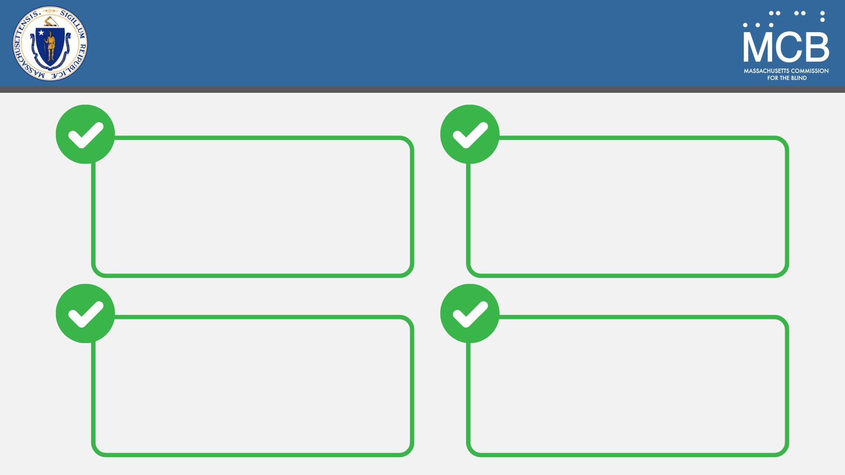
Objectives
Understand
MCB Services & Eligibility
Explore
Transition Planning
& Support
Identify Vocational Rehabilitation Pathways
Learn About Available Resources & Next Steps

Slide 3
Mission & Vision
Mission
To provide individualized training, education, and empowerment to people who are legally blind, and advocate for inclusive policies across the Commonwealth, with the goal of life-long independence and full community participation​
Vision
All residents of the Commonwealth who are legally blind are empowered to live a fulfilling and independent life, with opportunities to work and thrive

Slide 4
Eligibility
Requirements
Legal blindness diagnosis
Massachusetts resident
Definition of Legal Blindness
Vision with correction of 20/200 or less in the better eye; or
Peripheral field of ten degrees (10°) or less, regardless of visual acuity
Individuals may also be eligible for services if they have low vision due to a progressive eye condition expected to lead to legal blindness, along with a vocational objective.

Slide 5
Registration Process
1
The individual is seen by an eye care provider, such as an optometrist or ophthalmologist.
2
The eye care provider determines the patient meets the criteria for legal blindness.
3
The eye care provider is legally required to submit a Mandatory Report of Legal Blindness
to MCB within 30 days.
4
The newly registered individual is referred to a counselor, who will schedule an appointment to discuss available programs, services, and benefits.
5
The counselor will make referrals to the appropriate internal departments or external partners
as needed.
6
Services begin, the consumer makes progress, and services are closed once goals are met.

Slide 6
Children’s Services
Services begin at birth and continue until the child turns 14.
Advocacy
Information & Referral Services
Case Management
Transitional Support
Assistance with Applications for Programming
Support Counseling
Flexible Family Support & Camperships *
* Dependent on income eligibility

Slide 7
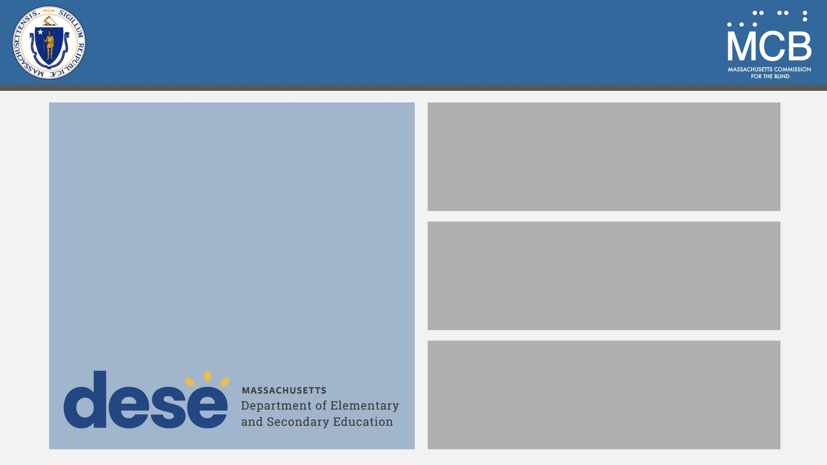
Chapter 688 Referrals
“The primary goal of filing a Chapter 688 referral is to plan for needed adult services for students with severe disabilities. Filing a Chapter 688 referral creates documentation that students with severe disabilities will need adult services and supports. This documentation alerts Transition Agencies (e.g., the Department of Developmental Disabilities, the MassAbility, the Department of Mental Health)…”
Students who are legally blind or have a diagnosis of progressive vision loss should have their Chapter 688 referrals sent to MCB.
Referrals sent to MassAbility will likely be redirected to MCB.
MCB and MassAbility can collaborate on a plan but cannot duplicate services.

Slide 8
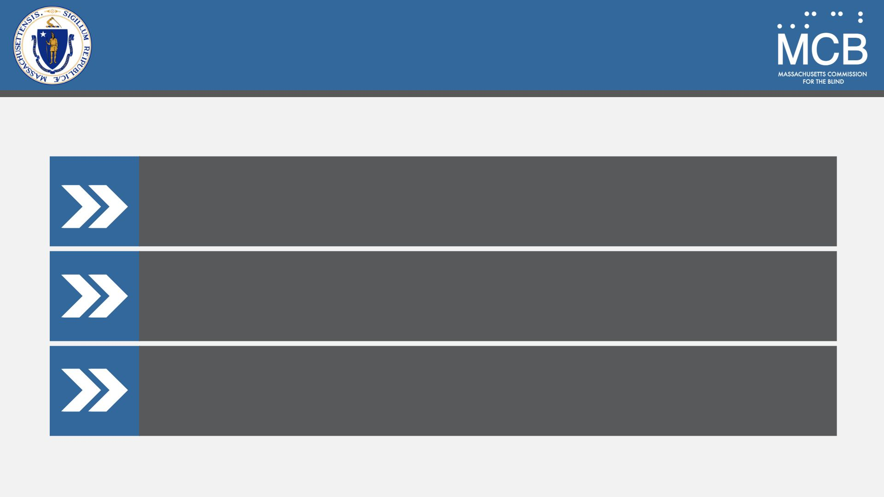
Service Delivery Tracks
Aged 14-22
DeafBlind Extended Supports (DBES)
Potentially Eligible (PEL)
Pre-Employment Transition Services (Pre-ETS)

Slide 9
Potentially Eligible (PEL)
Individuals who may or may not be Massachusetts Department of Developmental Services (DDS)-eligible but are not necessarily college or vocational bound.
May benefit from group programs or camperships.
Serves as an extended evaluation period to better understand individual needs.

Slide 10
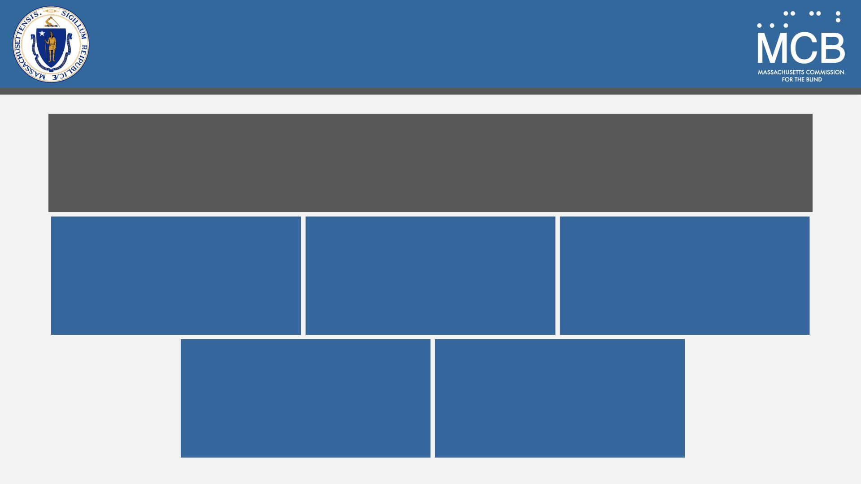
Pre-Employment Transition
Services (Pre-ETS)
Five service categories eligible students should receive to encourage better preparation for postsecondary education, independent living, and employment.
Counseling on
Post-Secondary Education & Training Opportunities
Job Exploration Counseling
Work-Based
Learning
Workplace Readiness Training
Instruction in Self-Advocacy

Slide 11
Service Delivery Tracks
Post Secondary
Vocational Rehabilitation (VR)
Social Rehabilitation (SR)
DeafBlind Extended Supports (DBES)

Slide 12
DeafBlind Extended Supports (DBES)
Individuals receiving DBES services at age 14 will continue with these services.
New Massachusetts Department of Developmental Services (DDS)-eligible individuals will transition to DBES services.
DDS is the primary agency, with MCB as the secondary agency.

Slide 13
DeafBlind Extended Supports (DBES) Services
Case Management & Advocacy
Information & Referral Services
Orientation & Mobility
Rehabilitation Teaching
Adaptive Technology
Low Vision Aids
Communication Access Support
Respite Services
Homemaker Services
Family Flex Funding
Recreation and Campership Funding
Community & Center-Based Day Supports
Supported Employment

Slide 14
Social Rehabilitation (SR)
For individuals not seeking employment and who do not meet Massachusetts Department of Developmental Services (DDS) eligibility.
The goal is to help individuals gain independence at home while adjusting to vision loss.
Services Include:
Rehabilitation Teaching
Orientation & Mobility
Assistive Technology
Low Vision Evaluations
Peer Support Groups

Slide 15
Vocational Rehabilitation (VR)
For individuals 22 and older who seek to obtain or maintain employment.
If eligible, individuals are assigned a Vocational Rehabilitation Counselor to develop an Individualized Plan of Employment (IPE).
Employment goals may include:
Competitive Integrated Employment
Randolph-Sheppard Vending Facility Program
Supportive Employment
Self-Employment

Slide 16
Vocational Rehabilitation (VR) Services
Vocational Counseling & Guidance
Information & Referral Services
Low Vision Assessment
Orientation & Mobility
Rehabilitation Teaching
Assistive Technology
College/University Support
Job Readiness Training
Job Development & Placement
Benefits Counseling
Job Retention Services

Slide 17
Determining a Vocational Path
Identify the individual’s vocational goal.
Determine the best path to achieve the goal:
College – Is the individual prepared for and likely to succeed in a college setting?
Trade School – Would a certificate or hands-on training be a better fit?
Direct to Work – Is the individual ready to enter the workforce immediately?
Assess strengths, challenges, and necessary supports.

Slide 18
Trade School
Certificate Program
MCB may be able to cover the full cost of the program, depending on duration and cost.
Vocational Rehabilitation Counselor can assist with accommodations, such as adaptive tools.

Slide 19
College/University
After acceptance, the Vocational Rehabilitation Counselor (VRC) will work with the student to create a vocational objective.
The VRC will encourage the student to meet with the college or university’s disability services office to discuss accommodations. The VRC can attend this meeting for support.
The VRC will refer the student for Orientation & Mobility, Rehabilitation Teaching, and Assistive Technology evaluations to support their success.
VRC will ensure FAFSA is completed by April 1st.
Once FAFSA is processed, the college or university will complete an Information Exchange Form to assess financial need.

Slide 20
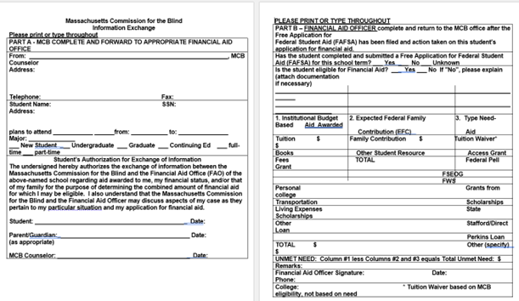
Information Exchange Form
Sample

Slide 21
Information Exchange Form
The Vocational Rehabilitation Counselor (VRC) will review the submitted form and subtract any grants, scholarships, and the Expected Family Contribution (EFC), unless the student is SSI-eligible.
The remaining financial need is what MCB can assist with, up to a certain amount.
This year's maximum funding is $17,772 per year or $8,886 per semester.
The maximum MCB can pay per calendar year is determined annually by UMASS Amherst. Regardless of MCB’s contribution, students attending a Massachusetts state school receive a tuition waiver.
Graduate programs and law schools have different funding maximums.

Slide 22
Books & Supplies
MCB can contribute $650 towards books and supplies each semester, regardless of the student’s financial need.
This contribution can be paid directly to the student or the bookstore.

Slide 23
Reader Fees
MCB can contribute financially toward a reader to assist the student with extensive reading.
The student can select the reader.
MCB pays for up to 15 hours per month at the minimum wage rate ($15.00/hour).
The payment is made directly to the student, who then pays the reader.

Slide 24
Student Responsibilities
College/University
Students sign a form acknowledging understanding of our policies.
Key responsibilities include:
Maintaining a 2.0 Grade Point Average (GPA)
Staying in contact with their Vocational Rehabilitation Counselor monthly
Providing grades every semester
If the student’s GPA falls below a 2.0, tuition assistance for the following semester will be suspended, but MCB can still provide support for books, supplies, and reader fees. Students can regain tuition assistance by improving their grades.

Slide 25
Employment Services
For individuals who go directly to work after school, Employment Services specialists assist with job development and job search preparation.
MCB also offers employment services for individuals who have completed their degrees or certificate programs.
Services Include:
Resume Writing
Cover Letter Writing
Mock Interviews
Employment Networking Strategies
Project LENS (mentorship program)
Job Fairs

Slide 26
Project LENS
Mentorship program for individuals aged 18-25.
Participants are matched with a mentor who has a visual impairment and works in the same or similar field of interest.
The mentor helps with:
Adjusting to Blindness
Building Self-Confidence
Answering Career-Related Questions

Slide 27
Summer Internship Program
Each summer, MCB offers a 120-hour internship for college students or individuals seeking more on-the-job experience.
Employment Services specialists help match participants with placements aligned with their job goals.
$1,000 stipend provided to each intern.
Interns must attend:
Soft Skills Training
Opening Ceremony
Closing Ceremony

Slide 28
Questions?

Slide 29
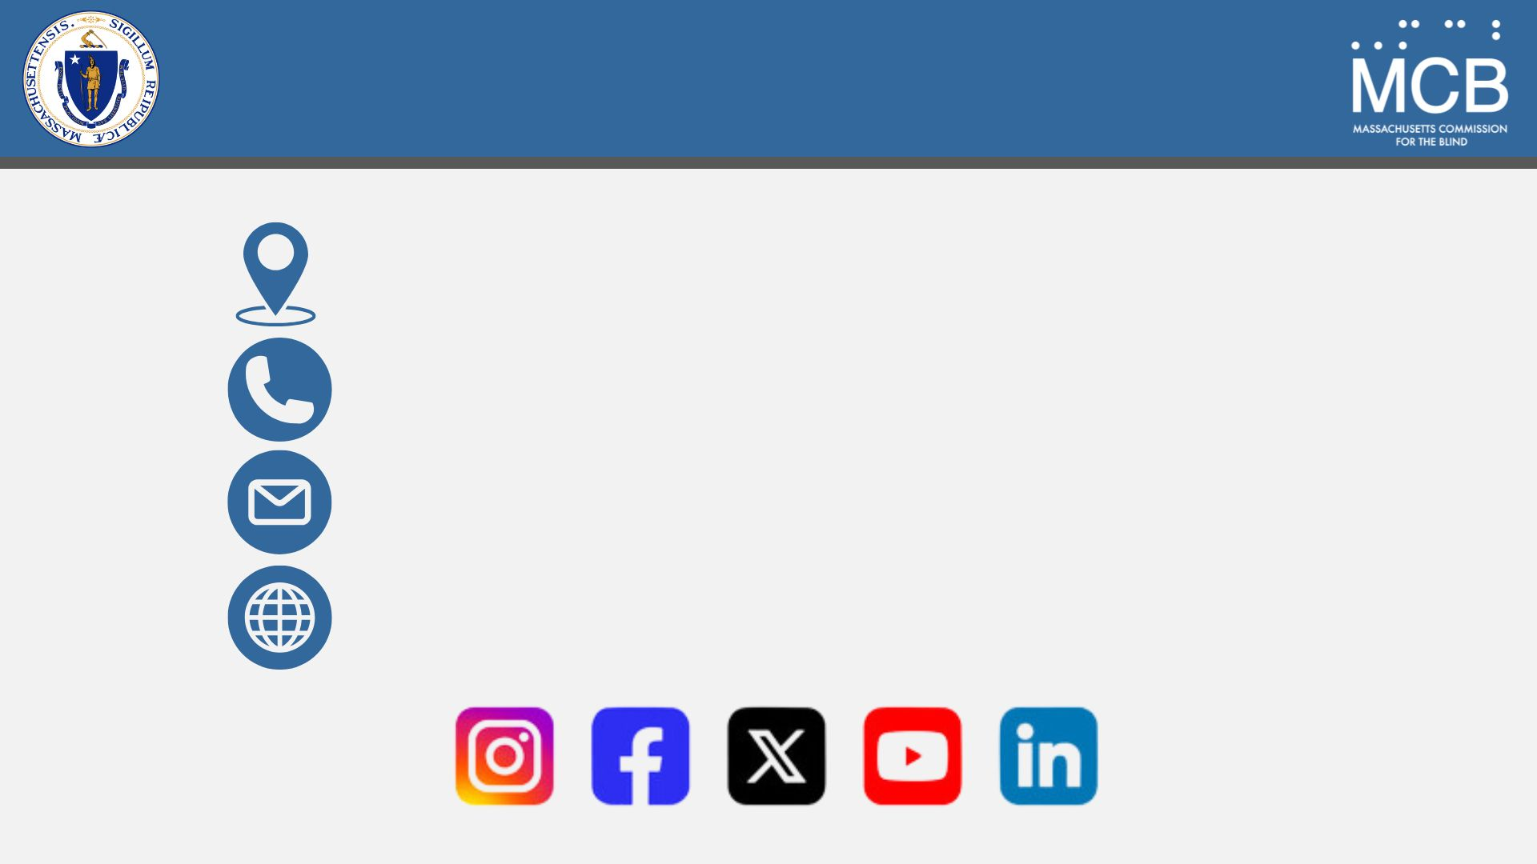
Connect With Us
600 Washington Street, Boston, MA 02111
1-800-392-6450
mcbinfo@mass.gov
mass.gov/mcb

